Slide 1
Interactive Proofs and Zero Knowledge: Definitions and a First Example
CS355 Spring 2025
https://cs355.stanford.edu

Slide 2
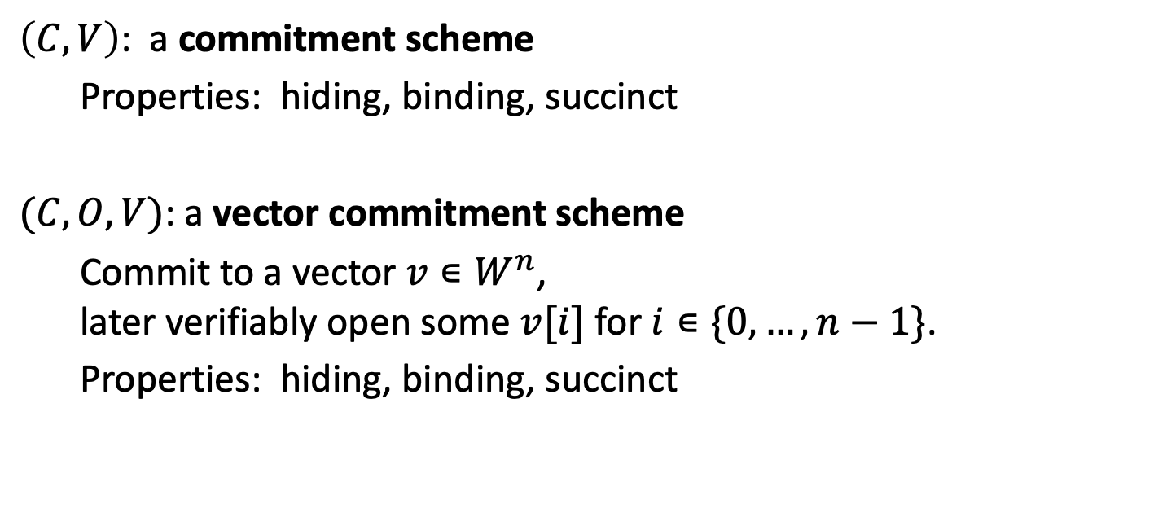
Recap
$\left(C,V\right)$: a commitment scheme
Properties: hiding, binding, succinct
$(C,O,V)$: a vector commitment scheme
Commit to a vector $v∊W^{n}$, later verifiably open some $v[i]$ for $i∊\{0,…,n−1\}$.
Properties: hiding, binding, succinct

Slide 3
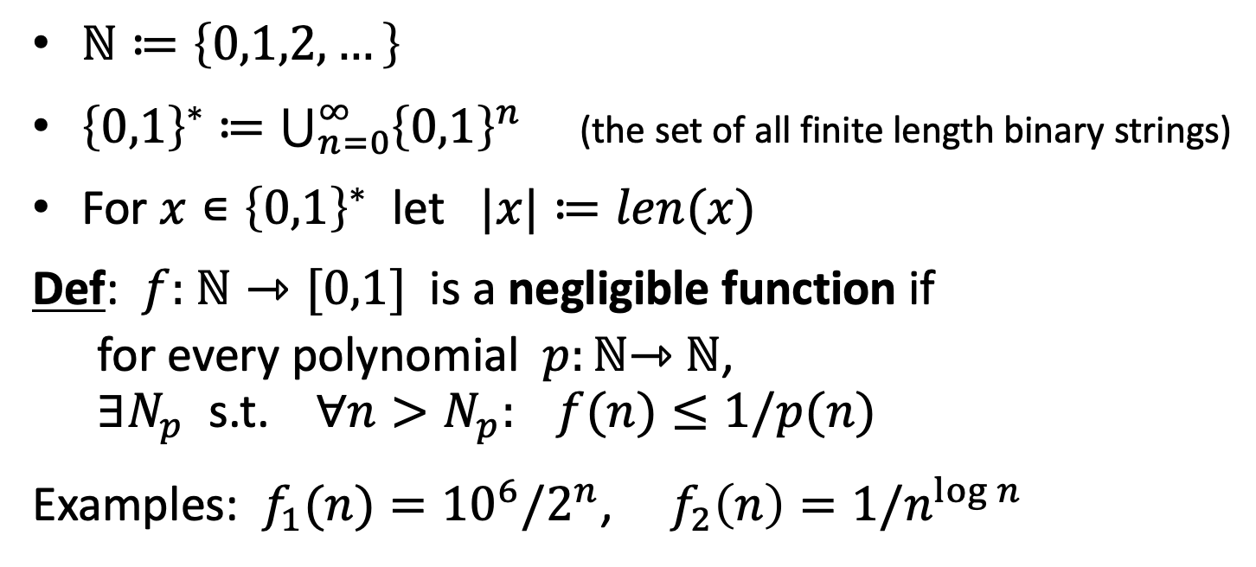
Notation for the rest of the course
$ℕ≔\left\{0,1,2,…\right\}$
${\left\{0,1\right\}}^{∗}$ $≔\bigcup_{n=0}^{∞}{{\left\{0,1\right\}}^{n}}$ (the set of all finite length binary strings)
For $x∊{\left\{0,1\right\}}^{∗}$ let $|x|≔len(x)$
Def: $f:$ $ℕ⇾[0,1]$ is a negligible function if
for every polynomial $p:ℕ$⇾ $ℕ$, $∃N_{p}$ s.t. $∀n>N_{p}: f(n)≤1/p(n)$
Examples: $f_{1}(n)={10}^{6}/2^{n}$, $f_{2}\left(n\right)=1/n^{\log{n}}$

Slide 4
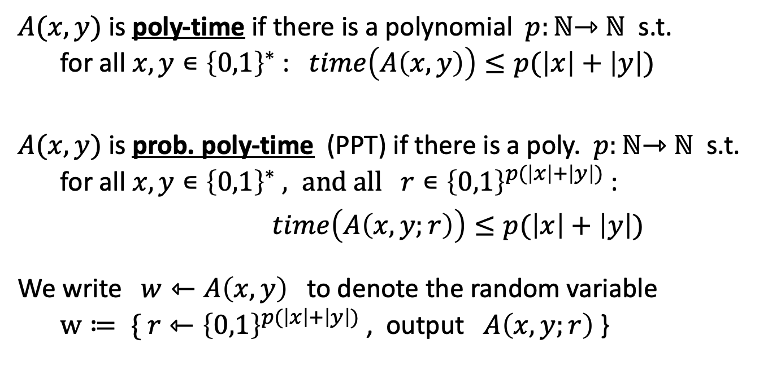
Algorithms
(modeled at TM)
$A(x,y)$ is poly-time if there is a polynomial $p:ℕ\text{⇾} ℕ$ s.t. for all $x,y∊{\left\{0,1\right\}}^{∗}$ : $time\left(A\left(x,y\right)\right)≤p(\left|x\right|+\left|y\right|)$
$A(x,y)$ is prob. poly-time (PPT) if there is a poly. $p:ℕ\text{⇾} ℕ$ s.t. for all $x,y∊{\left\{0,1\right\}}^{∗} , and all r∊{\left\{0,1\right\}}^{p(\left|x\right|+\left|y\right|)}$ :
$time\left(A\left(x,y;r\right)\right)≤p(\left|x\right|+\left|y\right|)$
We write $w⇽A\left(x,y\right)$ to denote the random variable $w≔ \{ r⇽{\left\{0,1\right\}}^{p(\left|x\right|+\left|y\right|)}$ , output $A\left(x,y;r\right)$ }

Slide 5
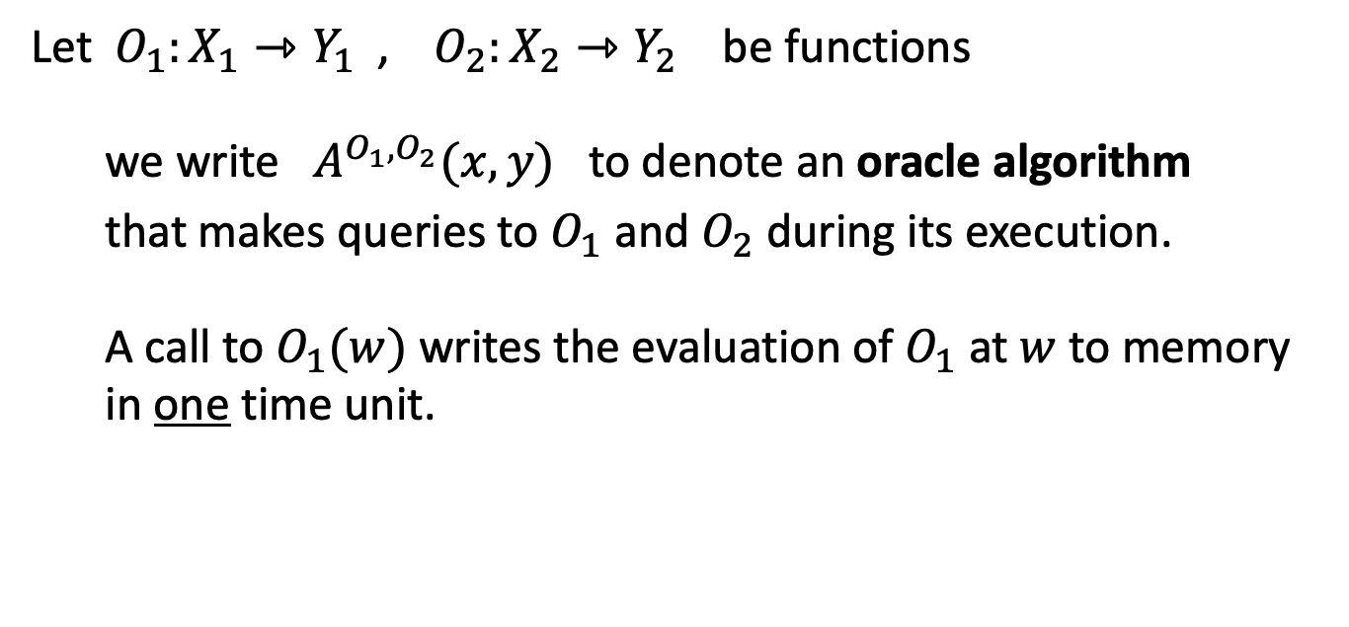
Algorithms
Let $O_{1}:X_{1}⇾Y_{1}$ , $O_{2}:X_{2}⇾Y_{2}$ be functions
we write $A^{O_{1},O_{2}}(x,y)$ to denote an oracle algorithm that makes queries to $O_{1}$ and $O_{2}$ during its execution.
A call to $O_{1}(w)$ writes the evaluation of $O_{1}$ at $w$ to memory in one time unit.

Slide 6
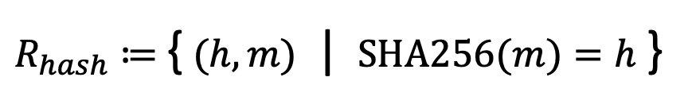
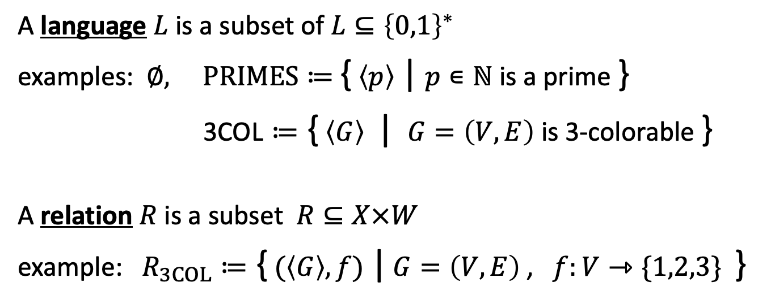
Relations
A language $L$ is a subset of $L⊆{\left\{0,1\right\}}^{∗}$
examples: $∅, PRIMES≔$ { $\left\langle p\right\rangle$ | $p∊ℕ$is a prime }
3COL $≔$ { $\left\langle G\right\rangle$| $G=\left(V,E\right)$ is 3-colorable }
A relation $R$ is a subset $R⊆X×W$
example: $R_{3COL}≔$ { $(\left\langle G\right\rangle ,f)$ | $G=\left(V,E\right)$ , $f:V⇾\{1,2,3\}$ }
is a valid 3-coloring
$R_{hash}$ $≔$ { $(h,m)$ | $SHA256(m)=h$ }

Slide 7
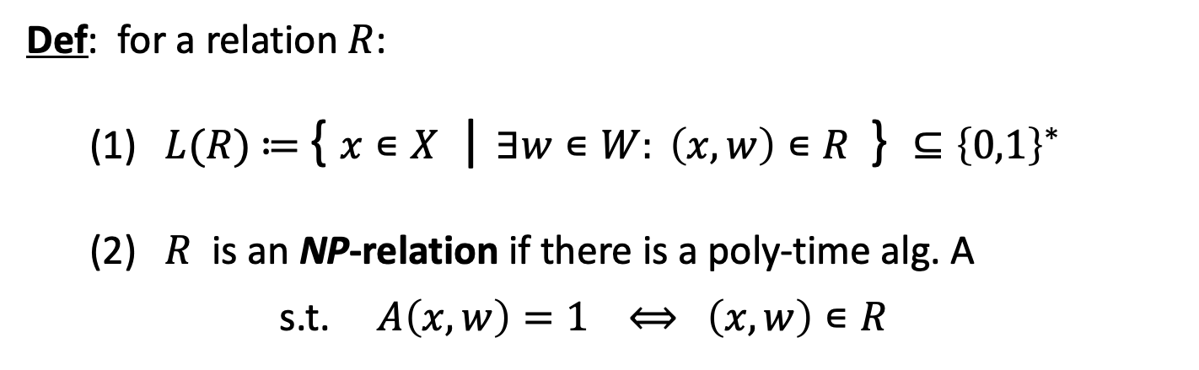
Relations
Def: for a relation $R$:
(1) $L(R)$ $≔$ { $x∊X$ | $∃w∊W: \left(x,w\right)∊R$ } $⊆{\left\{0,1\right\}}^{∗}$
(2) $R$ is an NP-relation if there is a poly-time alg. A s.t. $A\left(x,w\right)=1 ⟺$ $\left(x,w\right)∊R$
example: ${L(R}_{3COL})=3COL$ and $R_{3COL}$ is an NP-relation

Slide 8
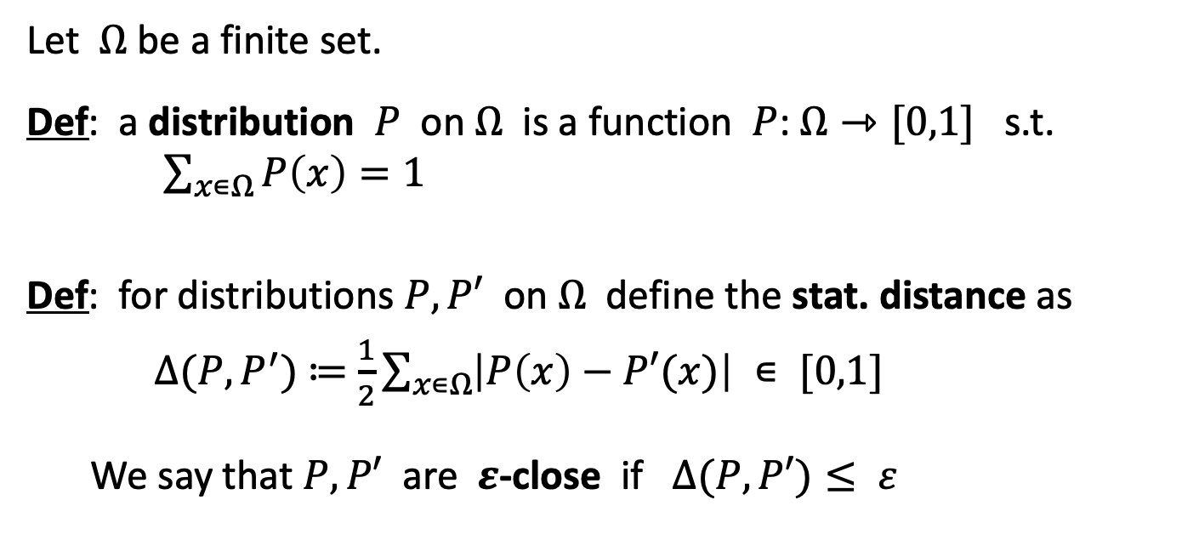
Distributions
Let $Ω$ be a finite set.
Def: a distribution $P$ on $Ω$ is a function $P$: $Ω⇾[0,1]$ s.t. $\sum_{x∊Ω}{P\left(x\right)=1}$
Def: for distributions $P,P′$ on $Ω$ define the stat. distance as
$∆(P,P^{′})$ $≔$ $\frac{1}{2}\sum_{x∊Ω}{\left|P\left(x\right)−P′(x)\right| ∊ [0,1]}$
We say that $P,P′$ are $ε$-close if $∆(P,P′)≤ ε$

Slide 9
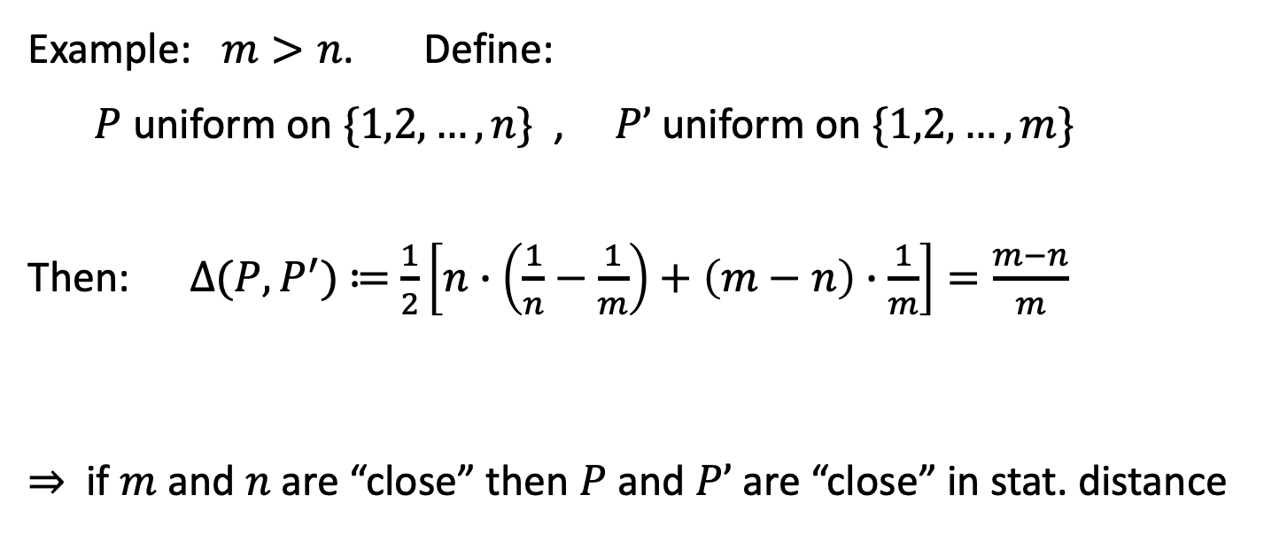
Distributions
Example: $m>n$. Define: $P$ uniform on $\{1,2,…,n\}$ , $P’$ uniform on $\{1,2,…,m\}$
Then: $∆(P,P^{′})$ $≔$ $\frac{1}{2}\left[n∙\left(\frac{1}{n}−\frac{1}{m}\right)+\left(m−n\right)∙\frac{1}{m}\right]=\frac{m−n}{m}$
⇒ if $m$ and $n$ are “close” then $P$ and $P’$ are “close” in stat. distance

Slide 10
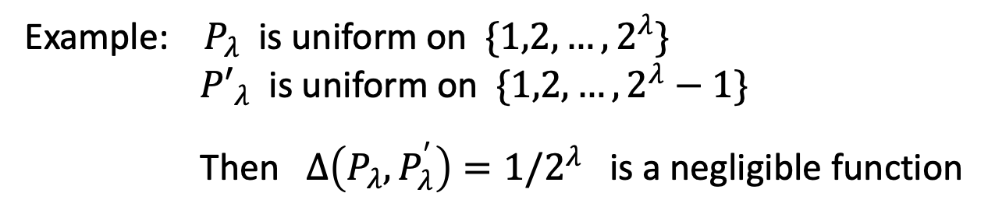
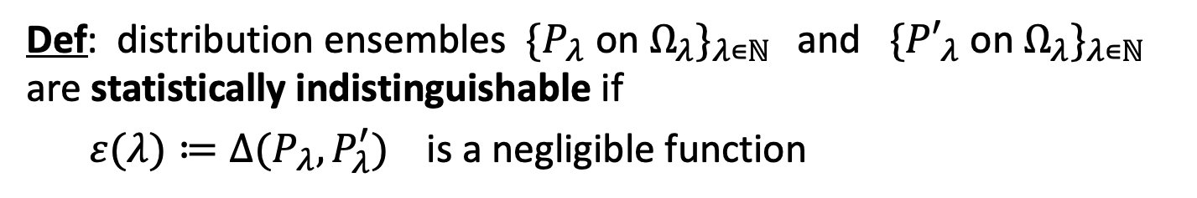


Statistically indistinguishable distributions
Def: distribution ensembles $\{P_{λ}$ on $Ω_{λ}\}_{λ∊ℕ }$ and $\{{P′}_{λ}$ on $Ω_{λ}\}_{λ∊ℕ }$ are statistically indistinguishable if
$ε(λ)≔∆(P_{λ},P_{λ}^{′})$ is a negligible function
Example: $P_{λ}$ is uniform on $\{1,2,…,2^{λ}\}$
${P′}_{λ}$ is uniform on $\{1,2,…,2^{λ}−1\}$
Then $∆\left(P_{λ},P_{λ}^{′}\right)=1/2^{λ}$ is a negligible function
$$Ω_{λ}=\{1,…,2^{λ}\}$$
s
We write: $\{P_{λ}\}_{λ∊ℕ }$ $≈$ $\{{P′}_{λ}\}_{λ∊ℕ }$

Slide 11
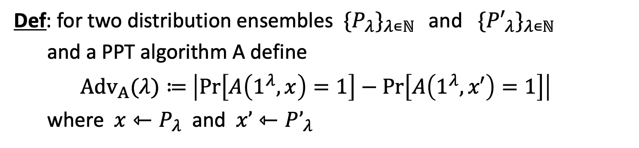
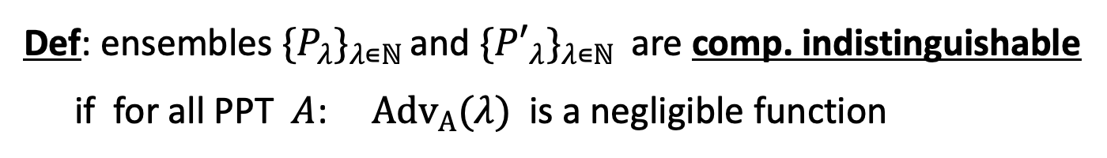
Computationally indistinguishable distributions
Def: for two distribution ensembles $\{P_{λ}\}_{λ∊ℕ }$ and $\{{P′}_{λ}\}_{λ∊ℕ }$
and a PPT algorithm A define
$Adv_{A}(λ)≔$ $\left|\operatorname{Pr}\left[A\left(1^{λ},x\right)=1\right]−\operatorname{Pr}\left[A\left(1^{λ},x′\right)=1\right]\right|$
where $x⇽P_{λ}$ and $x’⇽P’_{λ}$
Def: ensembles $\{P_{λ}\}_{λ∊ℕ }$and $\{{P′}_{λ}\}_{λ∊ℕ }$ are comp. indistinguishable if for all PPT $A$: $Adv_{A}(λ)$is a negligible function
c
⇒ No PPT algorithm can distinguish $P$ from $P’$ . We write $\{P_{λ}\}_{λ∊ℕ }$ $≈$ $\{{P′}_{λ}\}_{λ∊ℕ }$ .

Slide 12
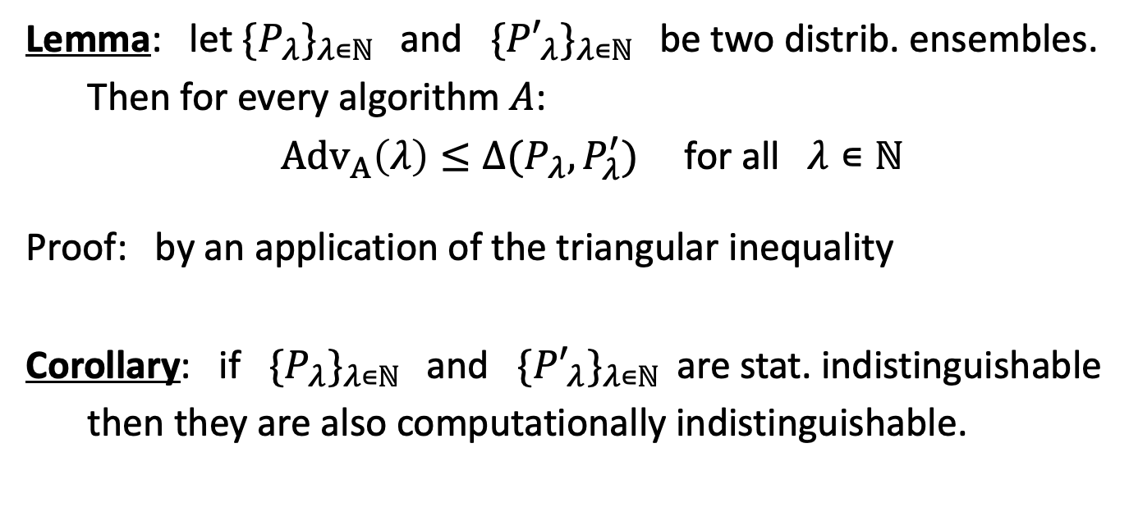
Stat. indist. ⇒ Comp. indist.
Lemma: let $\{P_{λ}\}_{λ∊ℕ }$ and $\{{P′}_{λ}\}_{λ∊ℕ }$ be two distrib. ensembles.
Then for every algorithm $A$:
$Adv_{A}\left(λ\right)≤∆(P_{λ},P_{λ}^{′})$ for all $λ∊ℕ$
Proof: by an application of the triangular inequality
Corollary: if $\{P_{λ}\}_{λ∊ℕ }$ and $\{{P′}_{λ}\}_{λ∊ℕ }$ are stat. indistinguishable
then they are also computationally indistinguishable.

Slide 13

Interactive Proofs (IP) [Babai, GMR 1985]
A traditional proof: a long text that can be verified in linear time
New idea: an interactive proof between prover and verifier
Goal: for a relation $R⊆X×W$ and $x∊X$
Prover wants to convince Verifier that $x∊L(R)$

Slide 14

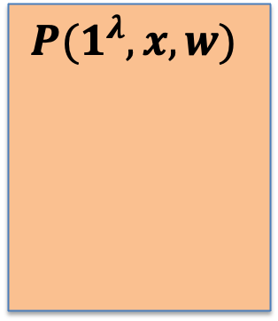

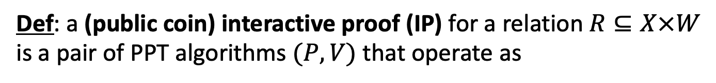




Interactive Proofs (IP) [Babai, GMR 1985]
Def: a (public coin) interactive proof (IP) for a relation $R⊆X×W$
is a pair of PPT algorithms $(P,V)$ that operate as
$$m_{0}$$
$$P(1^{λ},x,w)$$
V$(1^{λ},x)$
$$r_{1}⇽R_{1}$$
$$m_{1}$$
…
$$r_{n}⇽R_{n}$$
V keeps
no secrets
$$m_{n}$$
0/1
(also called an Arthur-Merlin game)

Slide 15
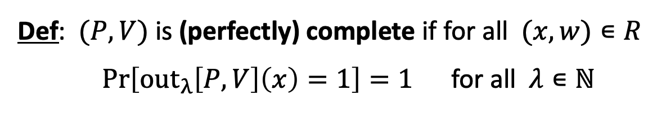
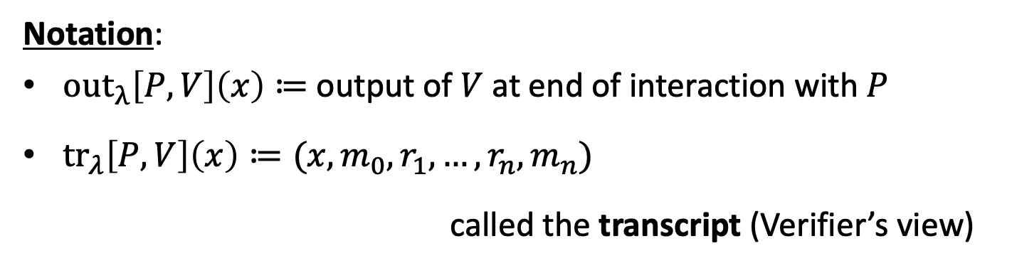
Interactive Proofs (IP)
Notation:
$out_{λ}\left[P,V\right]\left(x\right)≔$ output of $V$ at end of interaction with $P$
${tr}_{λ}\left[P,V\right]\left(x\right)≔(x,m_{0},r_{1},…,r_{n},m_{n})$
called the transcript (Verifier’s view)
Def: $(P,V)$ is (perfectly) complete if for all $(x,w)∊R$
$\operatorname{Pr}\left[out_{λ}\left[P,V\right]\left(x\right)=1\right]=1$ for all $λ∊ℕ$

Slide 16

Interactive Proofs (IP)
Notation:
$out_{λ}\left[P,V\right]\left(x\right)≔$ output of $V$ at end of interaction with $P$
Def: $(P,V)$ is sound if for all $x∉L(R)$ and all $P^{∗}$ :
$ε\left(λ\right)≔Pr\left[out_{λ}\left[P^{∗},V\right]\left(x\right)=1\right]$ is a negligible function
$ε\left(λ\right)$ is called the soundness error of $(P,V)$.
Def: $(P,V)$ is computationally sound if soundness only holds against PPT provers $P^{∗}$ . (an unbounded prover may fool $V$)
Notes:
This is sometimes called an argument instead of a proof.

Slide 17
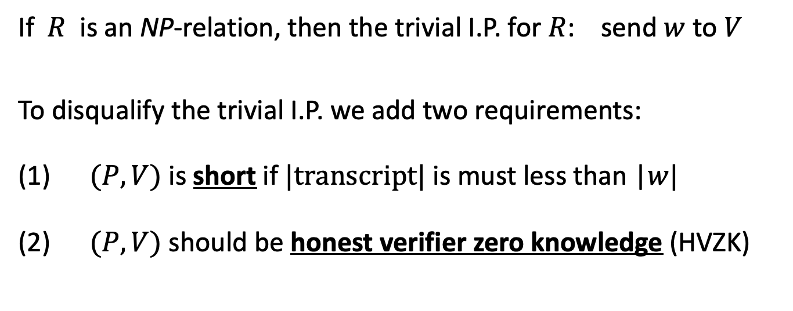
Interactive Proofs (IP)
If $R$ is an NP-relation, then the trivial I.P. for $R$: send $w$ to $V$
To disqualify the trivial I.P. we add two requirements:
(1) $(P,V)$ is short if $|transcript|$ is must less than |$w|$
(2) $(P,V)$ should be honest verifier zero knowledge (HVZK)
Each of these requirements, on its own, disqualifies the trivial I.P.

Slide 18
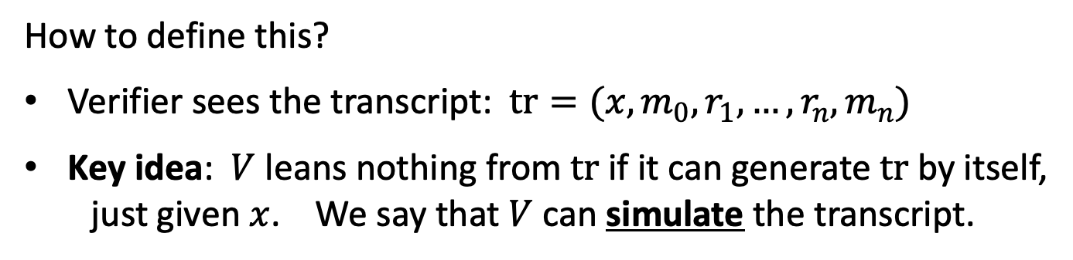
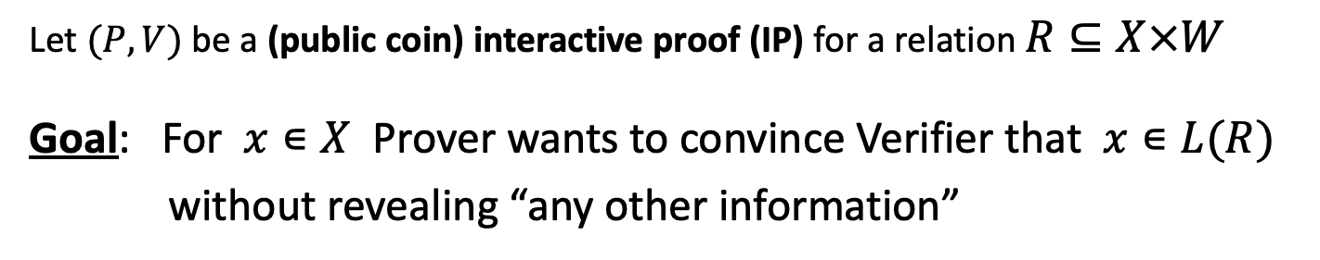
Honest Verifier Zero-Knowledge (HVZK)
Let $(P,V)$ be a (public coin) interactive proof (IP) for a relation $R⊆X×W$
Goal: For $x∊X$ Prover wants to convince Verifier that $x∊L(R)$
without revealing “any other information”
How to define this?
Verifier sees the transcript: $tr=(x,m_{0},r_{1},…,r_{n},m_{n})$
Key idea: $V$ leans nothing from $tr$ if it can generate $tr$ by itself, just given $x$. We say that $V$ can simulate the transcript.

Slide 19
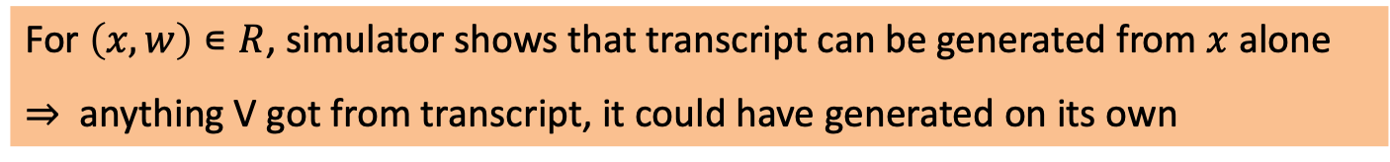
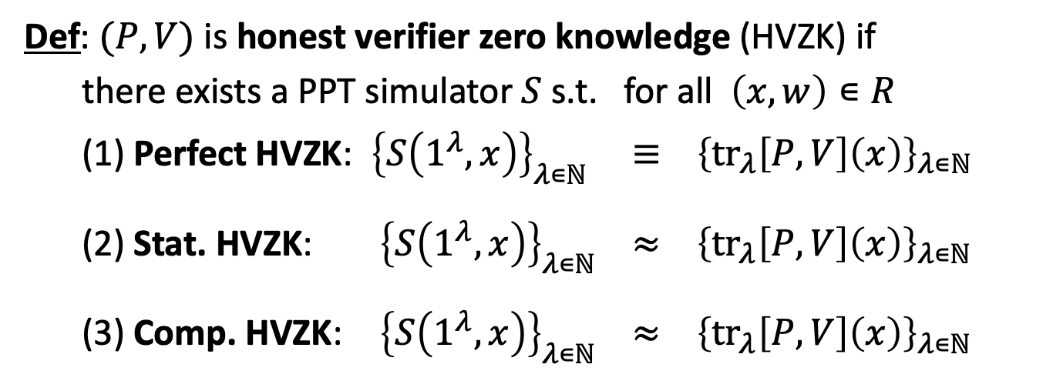
Honest Verifier Zero-Knowledge (HVZK)
Def: $(P,V)$ is honest verifier zero knowledge (HVZK) if
there exists a PPT simulator $S$ s.t. for all $\left(x,w\right)∊R$
(1) Perfect HVZK: ${\left\{S\left(1^{λ},x\right)\right\}}_{λ∊ℕ} ≡ {\left\{{tr}_{λ}\left[P,V\right]\left(x\right)\right\}}_{λ∊ℕ}$
(2) Stat. HVZK: ${\left\{S\left(1^{λ},x\right)\right\}}_{λ∊ℕ} ≈ {\left\{{tr}_{λ}\left[P,V\right]\left(x\right)\right\}}_{λ∊ℕ}$
(3) Comp. HVZK: ${\left\{S\left(1^{λ},x\right)\right\}}_{λ∊ℕ} ≈ {\left\{{tr}_{λ}\left[P,V\right]\left(x\right)\right\}}_{λ∊ℕ}$
s
c
For $\left(x,w\right)∊R$, simulator shows that transcript can be generated from $x$ alone
⇒ anything V got from transcript, it could have generated on its own

Slide 20
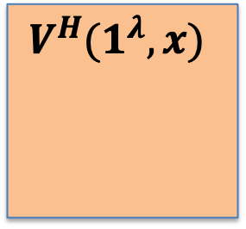
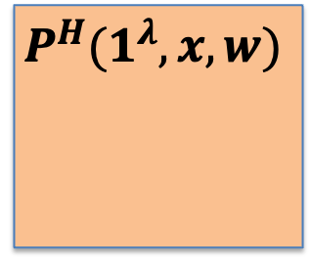

Is interaction necessary?
We will later see a transformation:
(public-coin) interactive protocol ⇒ a non-interactive protocol
$$P^{H}(1^{λ},x,w)$$
$$V^{H}(1^{λ},x)$$
$$π$$
0/1

Slide 21



An HVZK for $R_{3COL}$
2
$$G=(V,E)$$
1
3
$$f:V⇾\{1,2,3\}$$
3

Slide 22
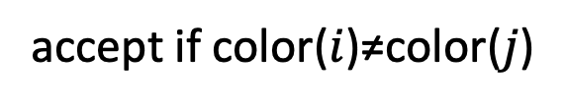
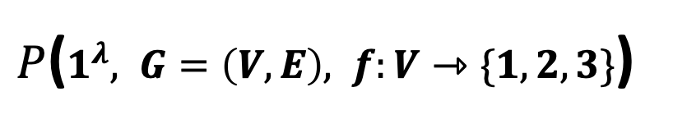


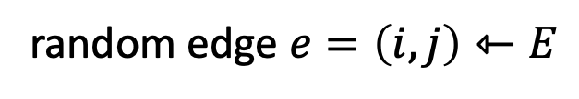
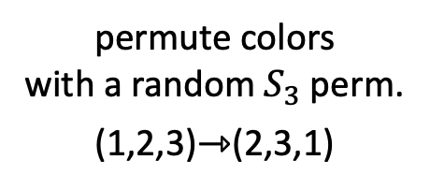
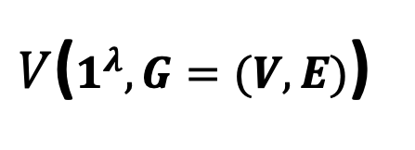
An HVZK I.P. for $R_{3COL}$
[GMW’86]
$P$($1^{λ}, G=\left(V,E\right), f:V⇾\{1,2,3\}$)
$V$($1^{λ},G=(V,E)$)
2
3
1
3
2
1
2
permute colors
with a random $S_{3}$ perm.
(1,2,3)⇾(2,3,1)
vector commit to permuted colors
3
1
1
random edge $e=\left(i,j\right)⇽E$
open colors of nodes $i$ and $j$
accept if color($i$)≠color($j$)

Slide 23
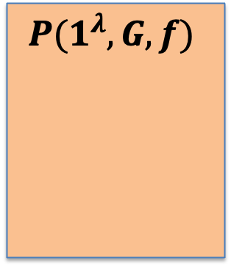
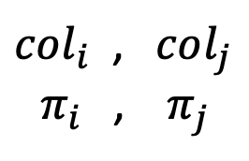



An HVZK I.P. for $R_{3COL}$
[GMW’86]
Protocol sketch:
$$com$$
$$P(1^{λ},G,f)$$
V$(1^{λ},G)$
$$e=(i,j)⇽E$$
$col_{i}$ , $col_{j}$
$π_{i}$, $π_{j}$
0/1
opening proofs
for vector commitment

Slide 24

An HVZK I.P. for $R_{3COL}$
This is perfectly complete
Is it computationally sound?
Is it HVZK?

Slide 25

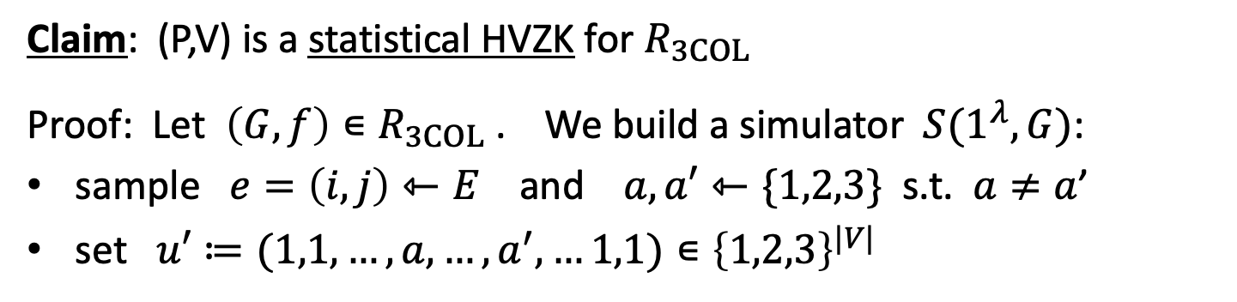
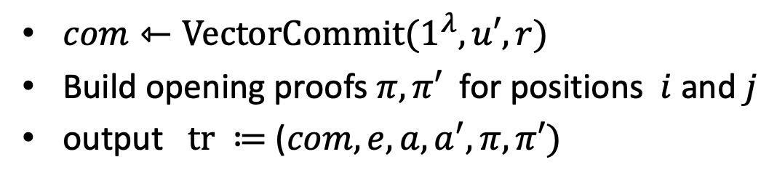

Proof of HVZK
Claim: (P,V) is a statistical HVZK for $R_{3COL}$
Proof: Let $\left(G,f\right)∊R_{3COL}$ . We build a simulator $S(1^{λ},G)$:
sample $e=\left(i,j\right)⇽E$ and $a,a′⇽\{1,2,3\}$ s.t. $a≠a$’
set $u′≔(1,1,…,a,…,a^{′},…1,1)∊{\left\{1,2,3\right\}}^{|V|}$
pos. $i$
pos. $j$
$com⇽VectorCommit(1^{λ},u′,r)$
Build opening proofs $π,π′$ for positions $i$ and $j$
output $tr ≔$ ($com, e, a, a^{′},π,π′)$

Slide 26
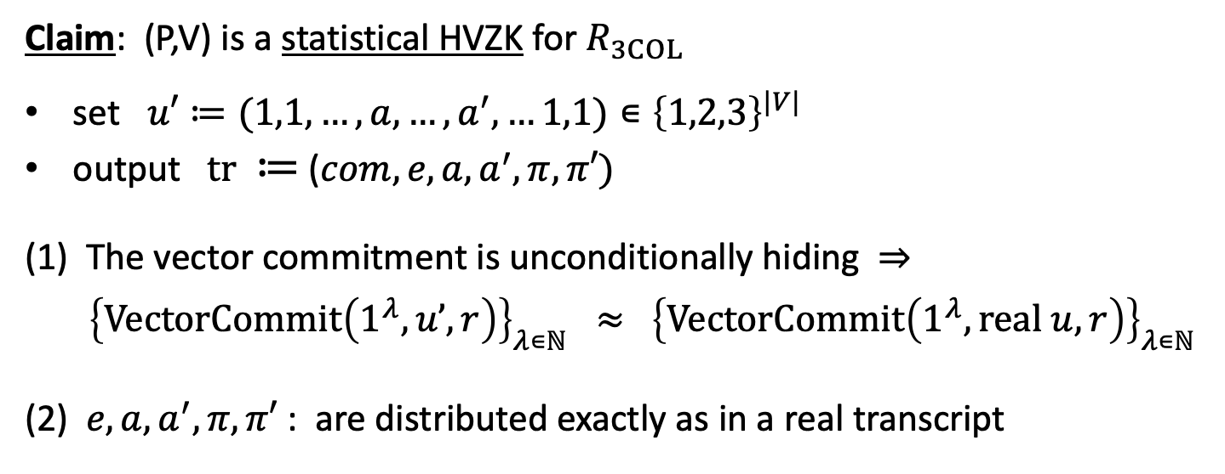
Proof of HVZK
Claim: (P,V) is a statistical HVZK for $R_{3COL}$
set $u′≔(1,1,…,a,…,a^{′},…1,1)∊{\left\{1,2,3\right\}}^{|V|}$
output $tr ≔$ ($com, e, a, a^{′},π,π′)$
(1) The vector commitment is unconditionally hiding ⇒
${\left\{VectorCommit\left(1^{λ},u’,r\right)\right\}}_{λ∊ℕ} ≈$ ${\left\{VectorCommit\left(1^{λ},real u,r\right)\right\}}_{λ∊ℕ}$
(2) $e, a, a^{′},π,π′$ : are distributed exactly as in a real transcript
s
Puzzle: would the protocol be HVZK if $V$ chose ($i,j)⇽{\left|V\right|}^{2}$ ??

Slide 27
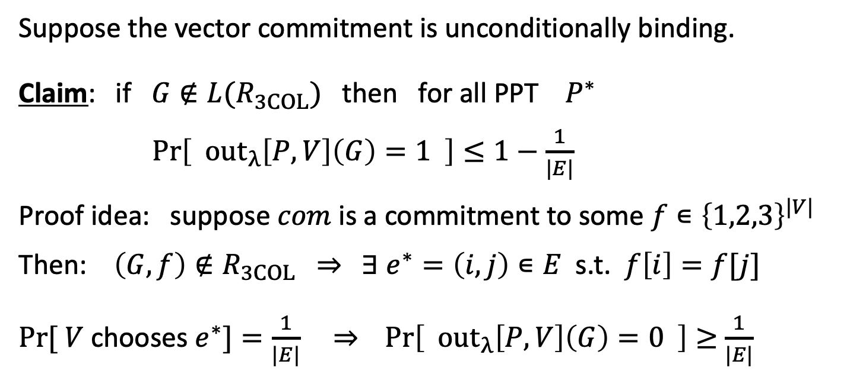
Computational Soundness
Suppose the vector commitment is unconditionally binding.
Claim: if $G∉{L(R}_{3COL})$ then for all PPT $P^{∗}$
$\operatorname{Pr}\left[ out_{λ}\left[P,V\right]\left(G\right)=1 \right]≤1−\frac{1}{|E|}$
Proof idea: suppose $com$ is a commitment to some $f∊{\left\{1,2,3\right\}}^{|V|}$
Then: $\left(G,f\right)∉R_{3COL}$ ⇒ $∃ e^{∗}=\left(i,j\right)∊E$ s.t. $f\left[i\right]=f[j]$
$Pr⁡[ V$ chooses $e^{∗}]=\frac{1}{|E|}$ ⇒ $\operatorname{Pr}\left[ out_{λ}\left[P,V\right]\left(G\right)=0 \right]≥$ $\frac{1}{|E|}$
not negligible!

Slide 28

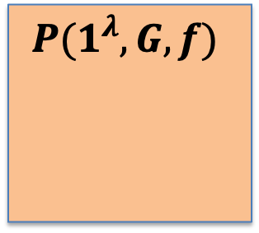
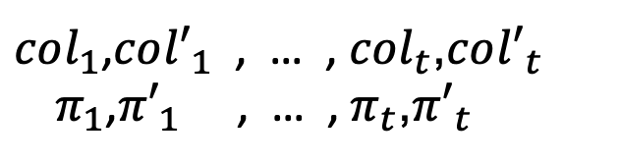
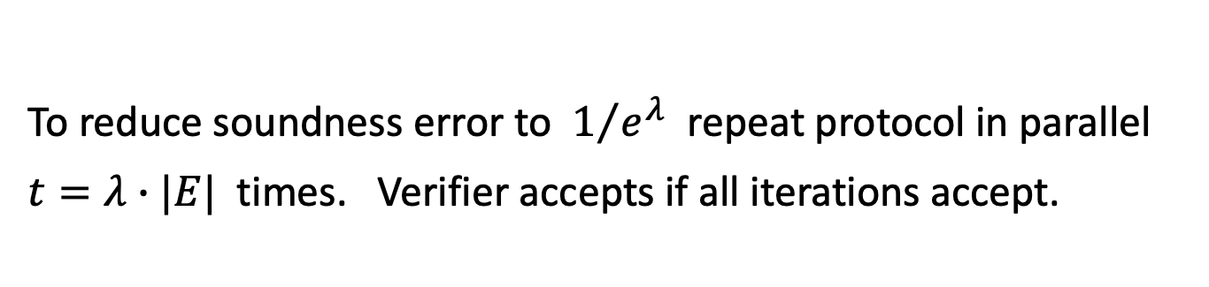



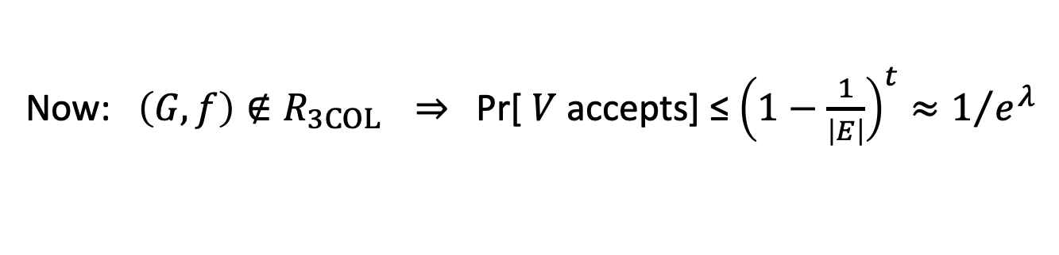
Amplification by parallel composition
To reduce soundness error to $1/{e^{λ}}$ repeat protocol in parallel $t=λ∙|E|$ times. Verifier accepts if all iterations accept.
$$com_{1},…, com_{t}$$
$$P(1^{λ},G,f)$$
V$(1^{λ},G)$
$$e_{1},…,e_{t}⇽E$$
accept if all $t$
transacripts accept
$col_{1}$,$co{l′}_{1}$ , … , $col_{t}$,$co{l′}_{t}$
$π_{1}$,${π′}_{1}$ , … , $π_{t}$,${π′}_{t}$
0/1
Now: $\left(G,f\right)∉R_{3COL}$ ⇒ Pr[ $V$ accepts] ≤ ${\left(1−\frac{1}{\left|E\right|}\right)}^{t}≈1/{e^{λ}}$

Slide 29


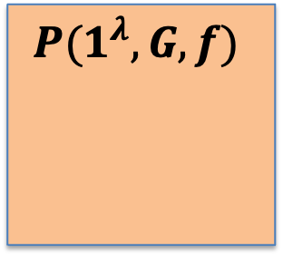
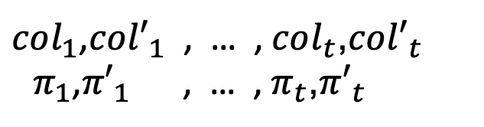


Amplification by parallel composition
$$com_{1},…, com_{t}$$
$$P(1^{λ},G,f)$$
V$(1^{λ},G)$
$$e_{1},…,e_{t}⇽E$$
accept if all $t$
transacripts accept
$col_{1}$,$co{l′}_{1}$ , … , $col_{t}$,$co{l′}_{t}$
$π_{1}$,${π′}_{1}$ , … , $π_{t}$,${π′}_{t}$
0/1
Note: length of transcript is $O(|E|)$ ⇒ not short
Lemma: $\left(P,V\right) is HVZK ⇒ \left(P^{t},V^{t}\right)$ is also HVZK
(not true for regular ZK)

Slide 30
END OF LECTURE
Important point: $3COL$ is NP-complete ⇒ all of NP has HVZK I.P.
Next lecture: a succinct I.P. for every NP-relation

