Slide 1
Applied Zero Knowledge Proofs
CS355 Spring 2025
https://cs355.stanford.edu
Dan Boneh and Binyi Chen
Stanford University
[discussions on edstem, homework on gradescope]

Slide 2
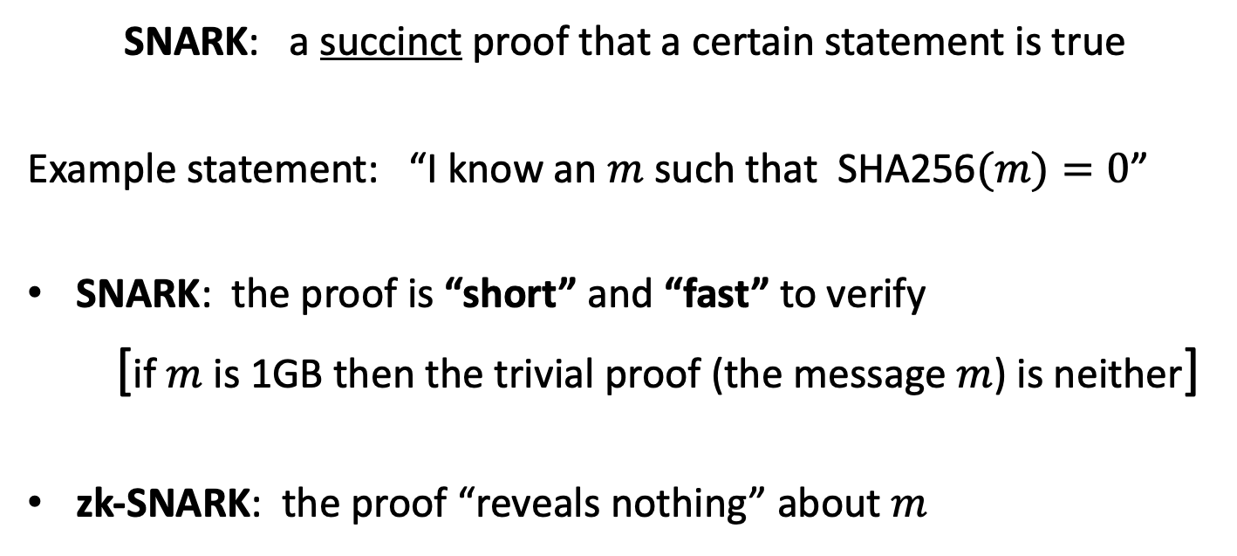
Succinct non-interactive proofs
SNARK: a succinct proof that a certain statement is true
Example statement: “I know an $m$ such that SHA256$(m)=0$”
SNARK: the proof is “short” and “fast” to verify
[if $m$ is 1GB then the trivial proof (the message $m$) is neither]
zk-SNARK: the proof “reveals nothing” about $m$

Slide 3
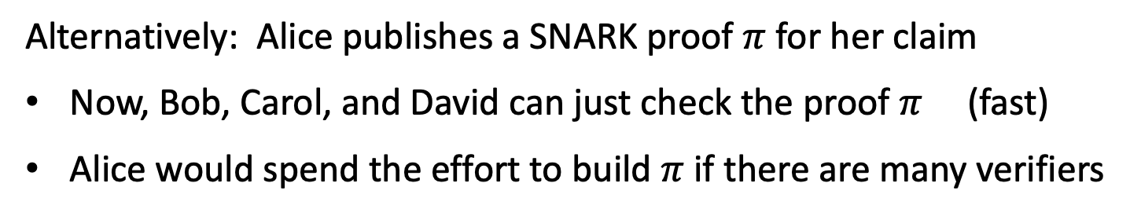
A simple example: digits of Pi
Alice claims that the billion-th digit of Pi is 5
if Bob, Carol, and David want to check ⇒ redo the entire computation
Alternatively: Alice publishes a SNARK proof $π$ for her claim
Now, Bob, Carol, and David can just check the proof $π$ (fast)
Alice would spend the effort to build $π$ if there are many verifiers
How hard is proof generation? ≈30 MHz RISC-V computer
(using one H200 GPU, MatterLabs Boojum 2.0 prover)

Slide 4
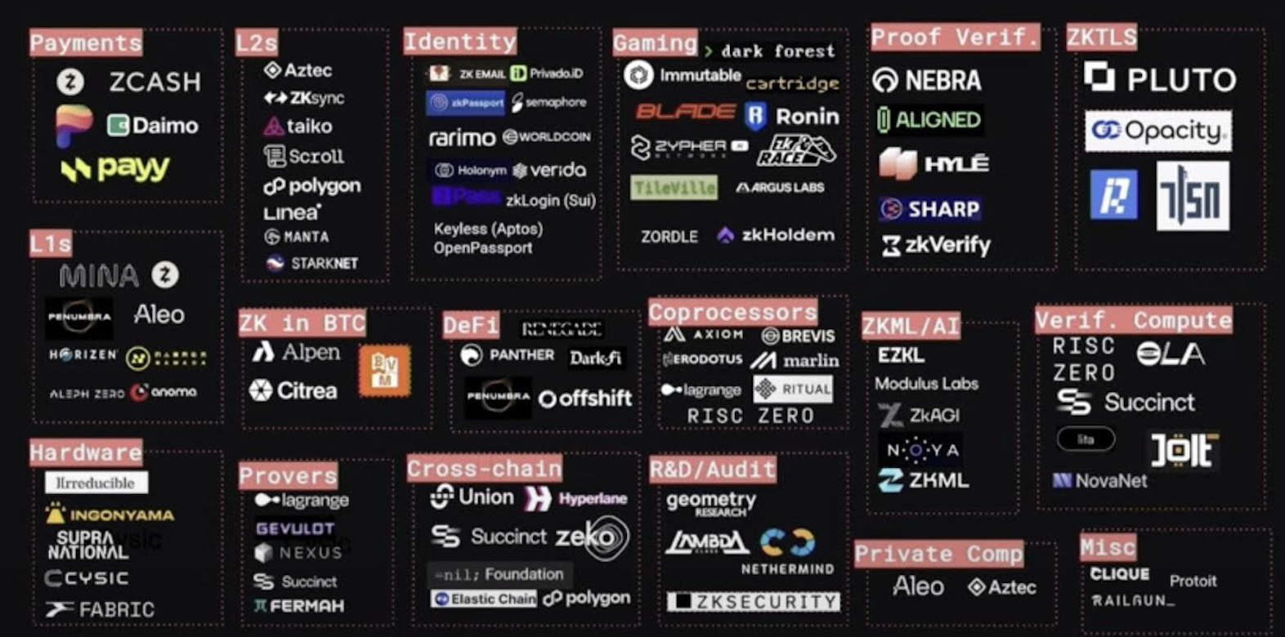
Much commercial and research effort
A (partial) map of companies using and building SNARKs
source: ZKV
Strong demand from industry for ever faster provers

Slide 5
Why so much interest in SNARKs now?
The breakthrough: new SNARK systems with a fast prover
Many commercial applications
Many beautiful ideas
a large bibliography: a16zcrypto.com/zero-knowledge-canon
Notes:
GGPR 2013: Gennaro, Gentry, Parno, Reykova . Quadratic span programs.

Slide 6
Applications: (1) Scaling Blockchains
Babai-Fortnow-Levin-Szegedy 1991:
In this setup, a single reliable PC can monitor the operation of a herd of supercomputers working with unreliable software.
a slow and expensive computer
CPUs
“Checking Computations in Polylogarithmic Time”
Notes:
NP has PCPs

Slide 7
Applications: (1) Scaling Blockchains
(simplified)
On an L1 chain: every validator verifies all transactions
verify all Tx
verify all Tx
block
verify all Tx
⇒ limited # Tx in a block

Slide 8



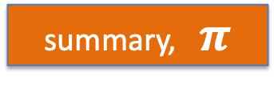
Applications: (1) Scaling Blockchains
(simplified)
A zk-Rollup: validators only check proof that Tx are valid
(note: ZK is not needed for this application)
verify $$π$$
verify $$π$$
summary, $π$
(single Tx)
rollup server
verify $$π$$
⇒ 100x more transactions per second

Slide 9
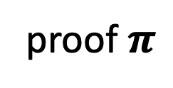
Application (1’): private transactions
I can withdraw one coin
1
Tornado
proof $π$
1
1
zero-knowledge: hides who is
withdrawing
1
PrivatePools
Railgun
Who owns coin??? Anonymity set =
{Alice, Bob, Carol}
Alice, Bob, and Carol deposit 1 ETH each

Slide 10
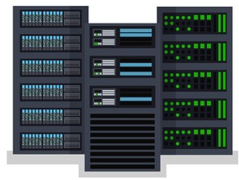

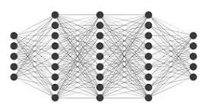
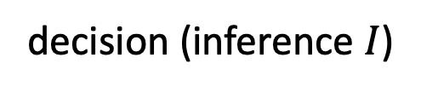
Applications: (2) SNARKs in ML (ZKML)
I trained a secret financial model $θ$
Server
Alice financial data $Q$
decision (inference $I$)
Alice
Is the same model used for everyone ??
Did the server run the model correctly ??
$$θ$$

Slide 11
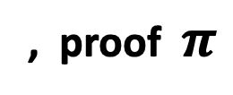
Applications: (2) SNARKs in ML (ZKML)
I trained a secret financial model $θ$ com ⇽ Commit($θ$)
Server
com
Alice financial data $Q$
decision (inference $I$)
, proof $π$
Alice
π proves: server knows $θ$ s.t.
(i) $f_{θ}(Q)=I$ and (ii) com = Commit($θ$)
$$θ$$

Slide 12
Applications: (2) SNARKs in ML (ZKML)
I trained a secret financial model $θ$ com ⇽ Commit($θ$)
Server
com
Alice financial data $Q$
decision (inference $I$)
, proof $π$
Alice
$$θ$$
Is this practical? Commercial library: EZKL

Slide 13
Applications: (2) SNARKs in ML (ZKML)
com
inference $I$, proof $π$
Proof is short and fast to verify
Is this practical?
EZKL: a commercial system designed to generate proofs for pytorch models, random forest, SVM, …
Several research systems

Slide 14
Model | #Parameters | FLOPS to evaluate | Proving time
GPT-2 | 81.3M | 188.9M | ≈1 hour
Diffusion | 19.5M | 22.9B | ≈1 hour
Twitter recommendations | 48.1M | 96.2M | ≈10 mins
MobileNet (ImageNet) | 3.5M | 601.8M | ≈20 mins
ResNet-18 (CIFAR-10) | 281K | 81.9M | ≈1 min
VGG16 (CIFAR-10) | 15M | 627.9M | ≈10 mins
AWS instance: 32 vCPU cores and 256 GB of RAM
Can we generate these proofs in a few seconds before 2100?
[Chen-Waiwitlikhit-Stoica-Kang: EuroSys Apr. 2024]
Notes:
GPT-2: a distilled GPT-2 optimized for inference (not chat).

Slide 15
FairProof: proving model fairness in ZK
[Yadav-Chowdhury-B-Chaudhuri, ICLR’24]
com
Alice’s financial data
Mortgage decision, proof $π$
Alice
Proof $π$ proves:
Local Individual Fairness: treating similar people similarly [DHPRZ’12]
Same model used for everyone
Notes:
Dwork et al.

Slide 16
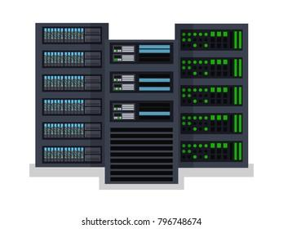
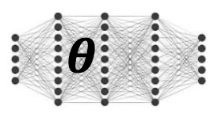
ExpProof: proving AI model explanation in ZK
[Yadav-Laufer-B-Chaudhuri, 2025]
requirement for an explanation
Why?
com
financial data Q
decision (Y/N)
Alice
Notes:
Dwork et al.

Slide 17
ExpProof: proving AI model explanation in ZK
[Yadav-Laufer-B-Chaudhuri, 2025]
Why?
com
financial data Q
, proof π
decision D, explanation E
Alice
(LIME)
Proof π:

Slide 18
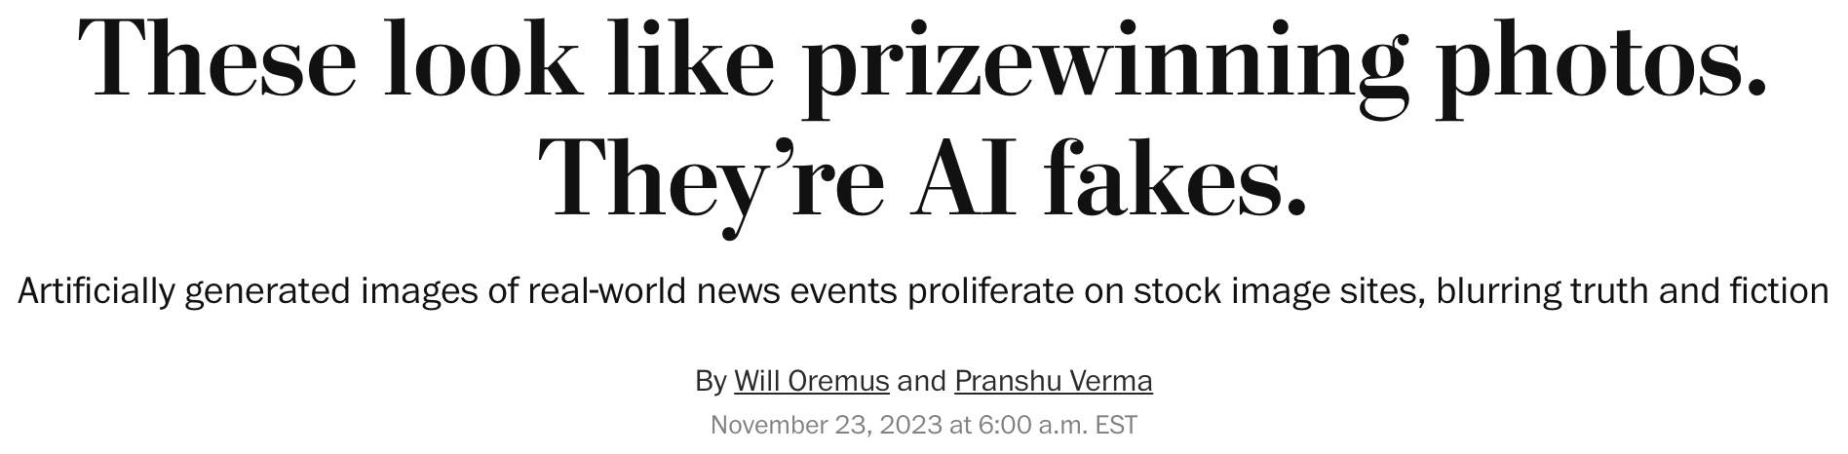
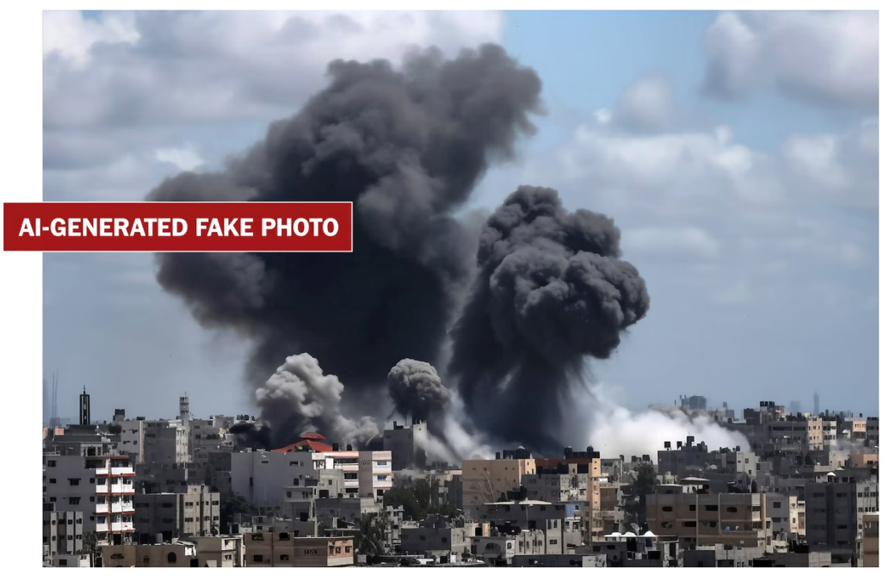
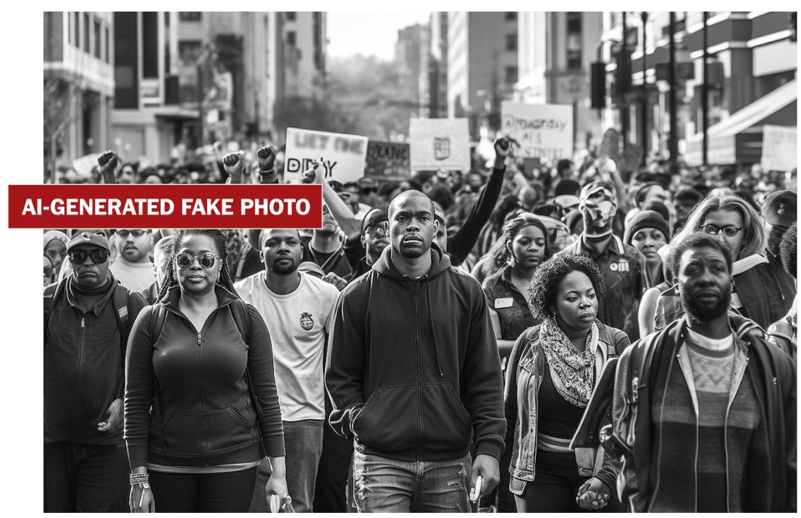
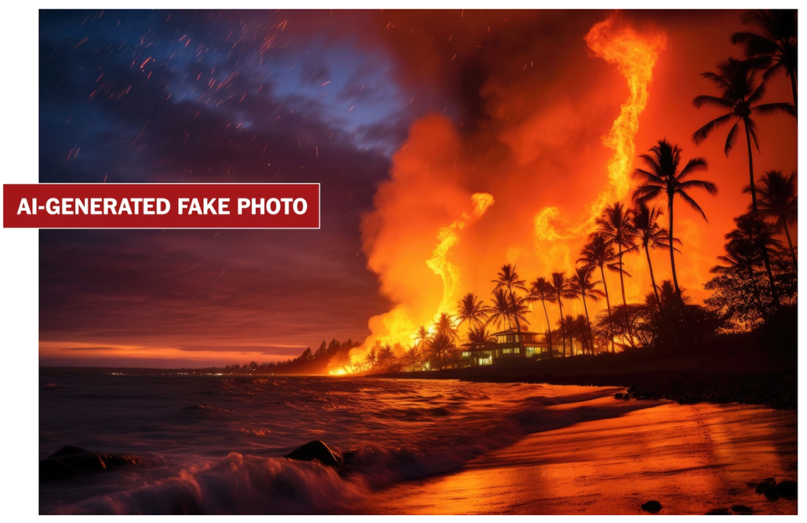
Applications: (3) image provenance

Slide 19
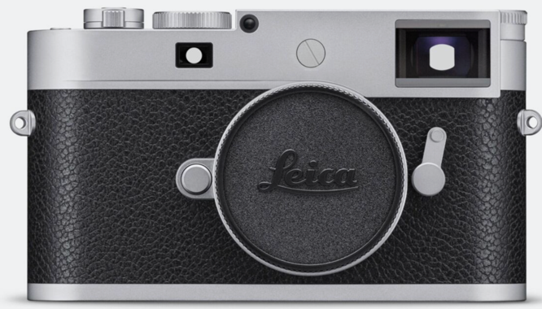
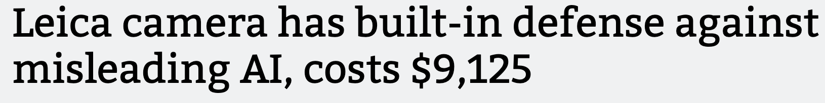



C2PA: a standard for content provenance
60MP
(also Sony and Nikon)
location
timestamp
embedded certified signing key sk
signature
verify metadata
by checking sig
2025: Cloudflare support
C2PA
Notes:
https://blog.cloudflare.com/preserve-content-credentials-with-cloudflare-images/

Slide 20
A problem: post-processing (editing)
Newspapers often process the photos before publishing:
Resize (1500×1000), Crop, Grayscale, Blur face (AP lists allowed ops)
The problem: laptop cannot verify signature on processed photo
processed photo
???
The Solution proposed by C2PA is not ideal … is there a better solution?

Slide 21
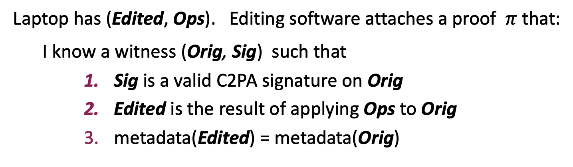
A Cryptographic Solution: zkSNARKs
public statement
Laptop has (Edited, Ops). Editing software attaches a proof $π$ that:
I know a witness (Orig, Sig) such that
Sig is a valid C2PA signature on Orig
Edited is the result of applying Ops to Orig
metadata(Edited) = metadata(Orig)
edited photo
⇒ Laptop verifies $π$ and shows metadata to user
location
timestamp
proof π
Notes:
Kang, Hashimoto, Stoica, and Sun (2022): 768 x 768
Monica, Visconti, Vitaletti, and Zecchini (RWC’24): tile by tile. For 24MP: proof size: 100KB, verify time: 65 sec.

Slide 22
Application (4): liberating Web data
Goal: ZK proof that Bob’s bank account balance > X
ZK proof that Bob bought a ticket to the Lakers game
ZK proof that Bob ordered DoorDash 10 times this month
⋯
The challenge: no changes to web site!
Notes:
This requires a client-side TEE, which does not currently exist.

Slide 23
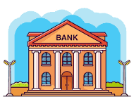
zk TLS (DECO: CCS’2020)
The problem: TLS payload is not authenticated
browser
HTTPS web server
TLS session setup
(signed by web server)
TLS HTML payload
(encrypted with session key)
session-key
session-key
⇒ enc. payload can be forged by client
Future: RFC 9421 (HTTP msg sigs)
Notes:
RC 9421 by amazon.

Slide 24

A TLS Proxy Design
(simplified)
browser
web proxy
HTTPS web server
HTTPS request
signed HTTPS response by proxy
signing key
Browser generates ZK proof that:
HTTPS handshake is signed by bank
encrypted payload is signed by proxy
decrypted payload says balance > X
A network attack:
cause proxy to sign incorrect encrypted TLS frame

Slide 25
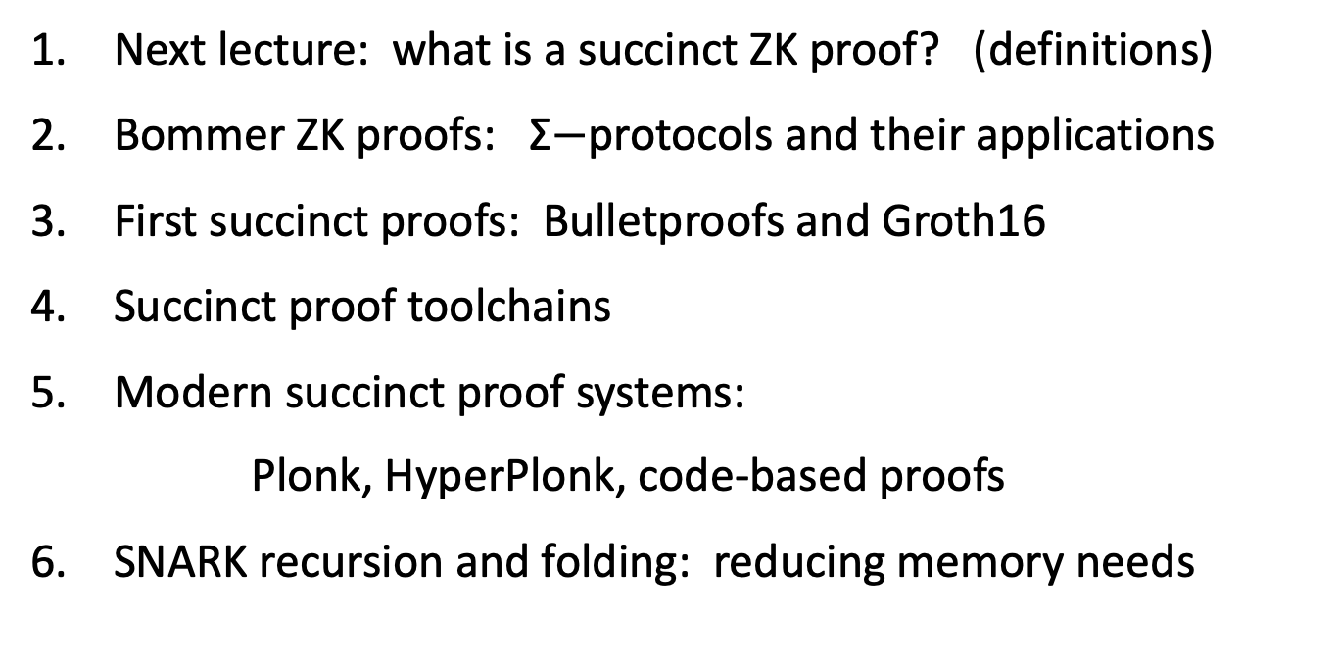
Course organization
Next lecture: what is a succinct ZK proof? (definitions)
Bommer ZK proofs: Σ$−$protocols and their applications
First succinct proofs: Bulletproofs and Groth16
Succinct proof toolchains
Modern succinct proof systems:
Plonk, HyperPlonk, code-based proofs
SNARK recursion and folding: reducing memory needs

Slide 26
Course organization
cs355.stanford.edu
Homework problems and project. No final exam.
Optional weekly sections on Friday
Please tell us how we can improve … Don’t wait until the end of the quarter

Slide 27
Let’s get started …

Slide 28

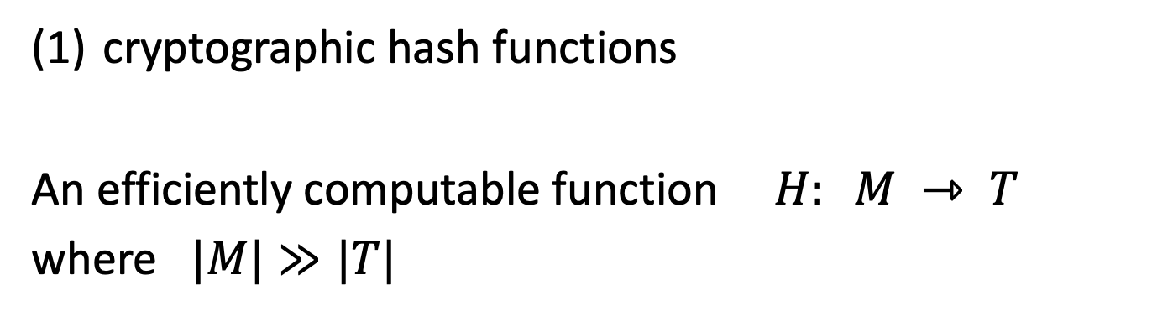
Cryptography Background
cryptographic hash functions
An efficiently computable function $H: M ⇾ T$
where $|M|≫|T|$
32 bytes
megabytes
hash value
$$T = {\left\{0,1\right\}}^{256}$$

Slide 29
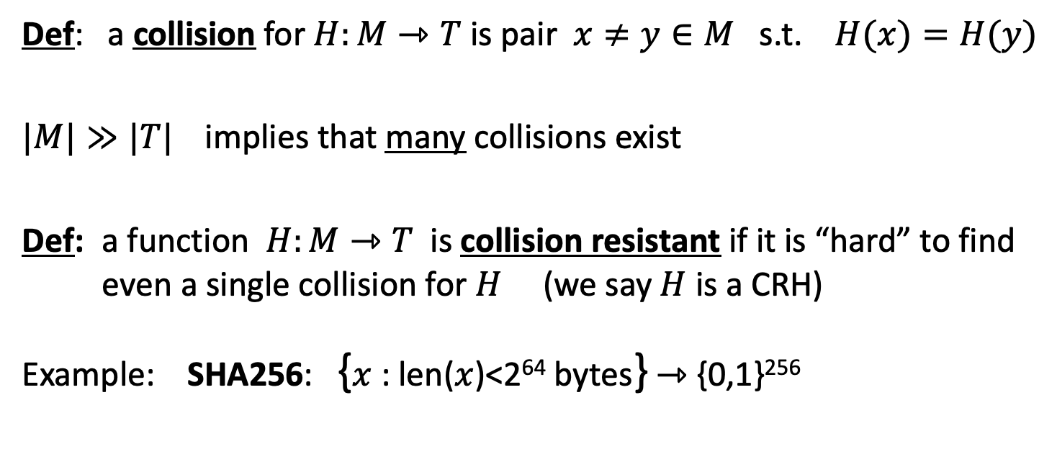
Collision resistance
Def: a collision for $H:M⇾T$ is pair $x≠y∈M$ s.t. $H(x)=H(y)$
$|M|≫|T|$implies that many collisions exist
Def: a function $H:M⇾T$ is collision resistant if it is “hard” to find even a single collision for $H$ (we say $H$ is a CRH)
Example: SHA256: {$x$ : len($x$)<2⁶⁴ bytes} ⇾ {0,1}²⁵⁶
(output is 32 bytes)
details in CS255

Slide 30
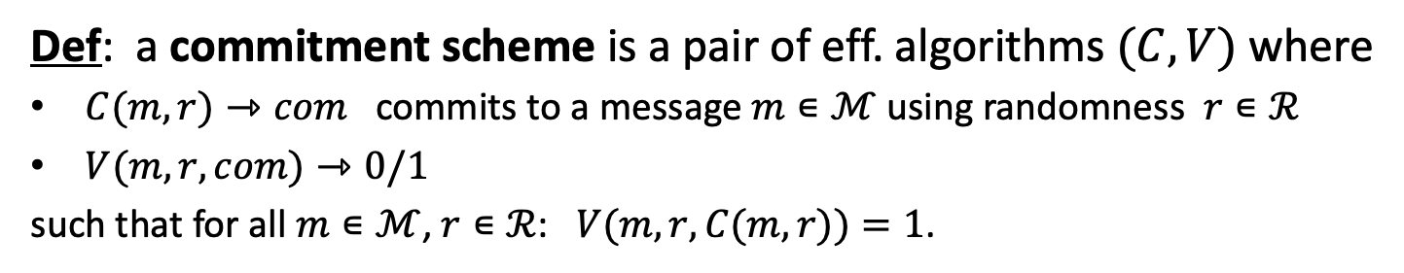
(2) Cryptographic Commitments
Def: a commitment scheme is a pair of eff. algorithms $(C,V)$ where
$C(m,r)⇾com$ commits to a message $m∊ℳ$ using randomness $r∊ℛ$
$V(m,r,com)⇾0/1$
such that for all $m∊ℳ$, $r∊ℛ$: $V(m,r,C(m,r))=1$.
The scheme is computationally binding if for every efficient adv. $A$:
The scheme is unconditionally hiding if for every adv. $A$ and all $m_{0},m_{1}∊ℳ$

Slide 31

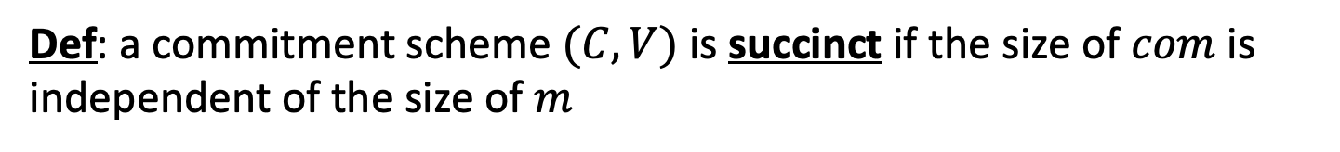



(2) Cryptographic Commitments
Def: a commitment scheme $(C,V)$ is succinct if the size of $com$ is independent of the size of $m$
$$C(m,r)$$
$$m$$
$$com$$
megabytes
32 bytes
(actually ${\left\{0,1\right\}}^{λ}$)
Note: an unconditionally binding commitment scheme cannot be succinct. Why?
Def: a binding commitment scheme is a commitment scheme that is binding but not necessarily hiding.

Slide 32
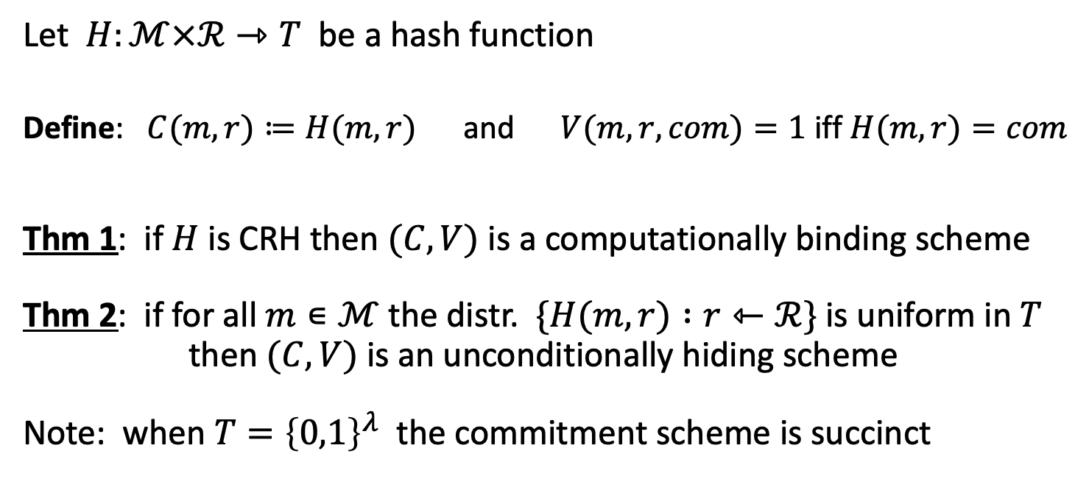
A commitment scheme from a CRH
Let $H:ℳ×ℛ⇾T$ be a hash function
Define: $C(m,r)≔H(m,r)$ and $V(m,r,com)=1$ iff $H(m,r)=com$
Thm 1: if $H$ is CRH then $(C,V)$ is a computationally binding scheme
Thm 2: if for all $m∊ℳ$ the distr. $\{H(m,r) :r⇽ℛ\}$ is uniform in $T$ then $(C,V)$ is an unconditionally hiding scheme
Note: when $T={\left\{0,1\right\}}^{λ}$ the commitment scheme is succinct
Notes:
Alice posts hash h on the blockchain.

Slide 33
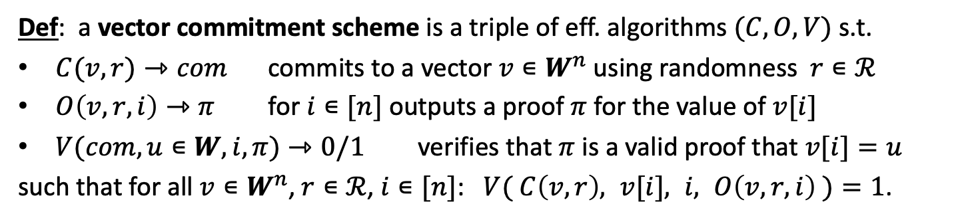
(3) Vector commitments
Def: a vector commitment scheme is a triple of eff. algorithms $(C,O,V)$ s.t.
$C(v,r)⇾com$ commits to a vector $v∊W^{n}$ using randomness $r∊ℛ$
$O\left(v,r,i\right)⇾π$ for $i∊[n]$ outputs a proof $π$ for the value of $v[i]$
$V(com,u∊W,i,π)⇾0/1$ verifies that $π$ is a valid proof that $v[i]=u$
such that for all $v∊W^{n}$, $r∊ℛ$, $i∊[n]$: $V( C\left(v,r\right), v[i], i, O\left(v,r,i\right) )=1$.
Def: the scheme is binding for $n∊ℕ$ if for every efficient adv. $A$:
Hiding (informally): defined as for commitments, but holds for all unopened cells,
after adversary sees a bunch of opening proofs chosen by the adversary.

Slide 34

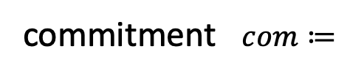


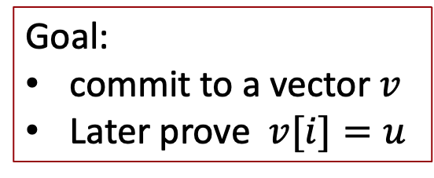


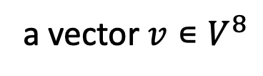




Merkle tree (Merkle 1989)
commitment $com≔$
$$h$$
Goal:
commit to a vector $v$
Later prove $v[i]=u$
Merkle tree commitment
$$v0$$
$$v_{1}$$
$$v_{2}$$
$$v_{3}$$
$$v_{4}$$
$$v_{5}$$
$$v_{6}$$
$$v_{7}$$
a vector $v∊V^{8}$

Slide 35



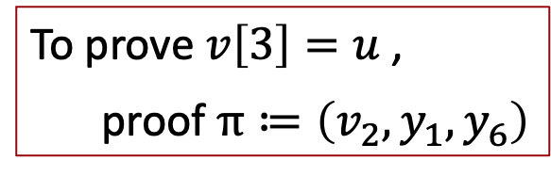





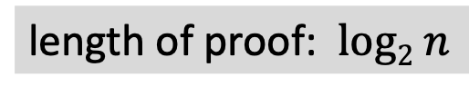


Merkle tree (Merkle 1989) [simplified]
$$H:X^{2}⇾X$$
$$com≔$$
$$h$$
Goal:
commit to a vector $v$
Later prove $v[i]=u$
$$y_{5}$$
H
$$y_{6}$$
H
H
$$y1$$
$$y_{2}$$
$$y_{3}$$
$$y_{4}$$
To prove $v\left[3\right]=u$ ,
proof $π≔\left(v_{2}, y_{1}, y_{6}\right)$
H
H
H
H
$$v_{0}$$
$$v_{1}$$
$$v_{2}$$
$$v_{3}$$
$$v_{4}$$
$$v_{5}$$
$$v_{6}$$
$$v_{7}$$
length of proof: $log2 n$
a vector $v∊V^{8}$

Slide 36
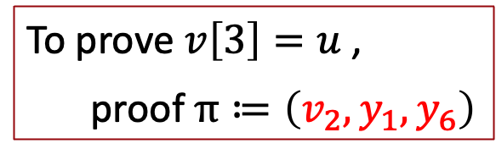
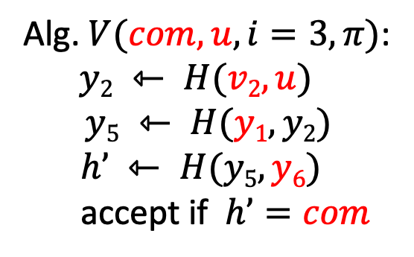
Merkle tree (Merkle 1989) [simplified]
$$com≔$$
$$h$$
To prove $v\left[3\right]=u$ ,
proof $π≔\left(v_{2}, y_{1}, y_{6}\right)$
$$y_{5}$$
H
$$y_{6}$$
H
H
Alg. $V(com,u,i=3,π)$:
$y2 ⇽ H(v2,u)$
$$y5 ⇽ H(y1, y2)$$
$$h’ ⇽ H(y5, y6)$$
accept if $h’=com$
$$y1$$
$$y_{2}$$
$$y_{3}$$
$$y_{4}$$
H
H
H
H
$$v_{0}$$
$$v_{1}$$
$$v_{2}$$
$$v_{3}$$
$$v_{4}$$
$$v_{5}$$
$$v_{6}$$
$$v_{7}$$
a vector $v∊V^{8}$

Slide 37
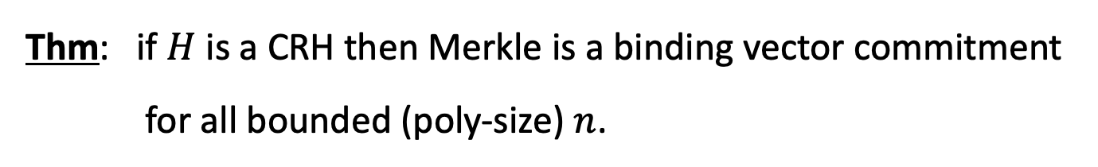
Merkle tree (Merkle 1989)
Thm: if $H$ is a CRH then Merkle is a binding vector commitment for all bounded (poly-size) $n$.
We will use this a lot !!
Question: how to make this hiding?

Slide 38
END OF LECTURE
Next lecture: definitions and a first example

