Slide 1
SNARKs from Polynomial Interactive Oracle Proofs (PIOPs)
CS355, Spring 25
Dan Boneh
Stanford University

Slide 2
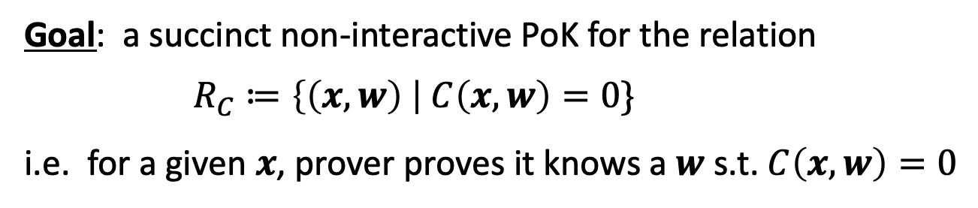



Recall: The Circuit Relation $R_{C}$
Public arithmetic circuit: $C( x, w ) ⇾ 𝔽_{p}$
public statement in $𝔽_{p}^{n}$
secret witness in $𝔽_{p}^{m}$
Goal: a succinct non-interactive PoK for the relation
$R_{C}≔\left\{\left(x,w\right) \right| C\left(x,w\right)=0\}$
i.e. for a given $x$, prover proves it knows a $w$ s.t. $C\left(x,w\right)=0$

Slide 3
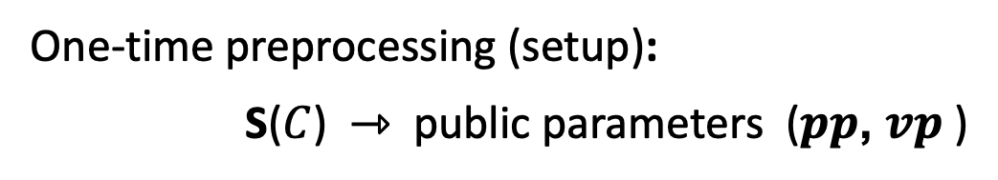
(preprocessing) NARK: Non-interactive ARgument of Knowledge
One-time preprocessing (setup):
S($C$) ⇾ public parameters ($pp$, $vp$ )
$pp$, $x,$ $w$
$vp$, $x$
proof $π$ that $C(x,w)=0$
Prover
Verifier
0 or 1
Notes:
Knowledge is stronger the soundness.

Slide 4
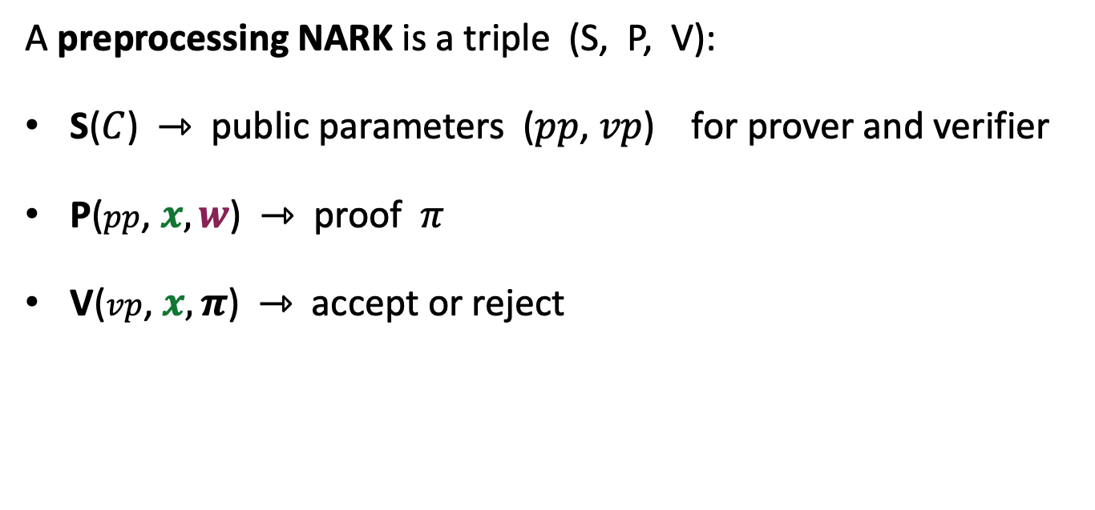
(preprocessing) NARK: Non-interactive ARgument of Knowledge
A preprocessing NARK is a triple (S, P, V):
S($C$) ⇾ public parameters ($pp$, $vp$) for prover and verifier
P($pp$, $x, w$) ⇾ proof $π$
V($vp$, $x, π$) ⇾ accept or reject
all algs. and adversary have
access to a random oracle

Slide 5


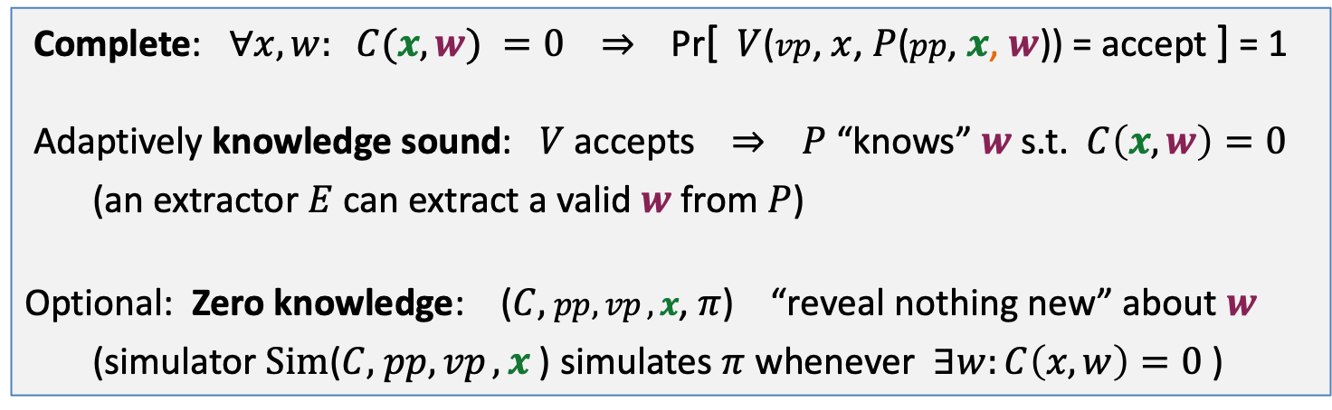

NARK: requirements (informal)
Prover $P$($pp$, $x, w$)
Verifier $V$ ($vp$, $x$, $π$)
proof $π$
accept or reject
Complete: $∀x, w: C(x, w) =0$ ⇒ Pr[ $V$($vp$, $x$, $P$($pp$, $x$, $w$)) = accept ] = 1
Adaptively knowledge sound: $V$ accepts ⇒ $P$ “knows” $w$ s.t. $C\left(x, w\right)=0$
(an extractor $E$ can extract a valid $w$ from $P$)
Optional: Zero knowledge: ($C,$ $pp,vp ,x$, $π$) “reveal nothing new” about $w$
(simulator $Sim$($C,$ $pp,vp ,x$) simulates $π$ whenever $∃w:C\left(x,w\right)=0$ )

Slide 6
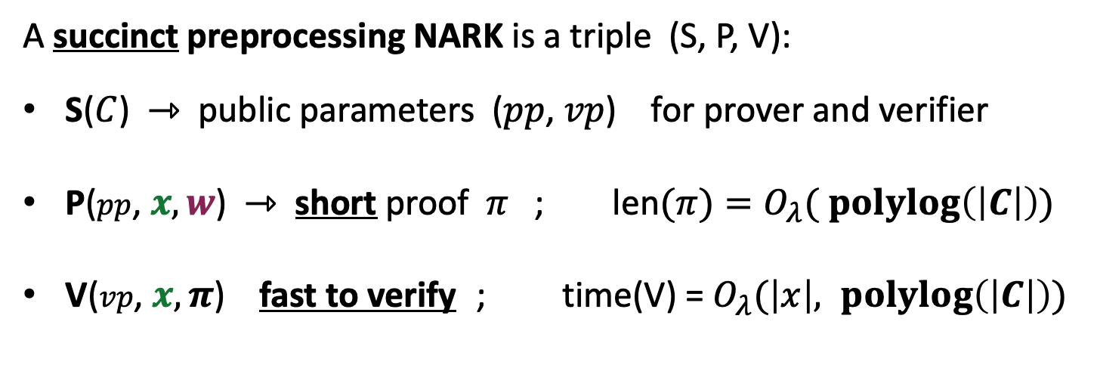
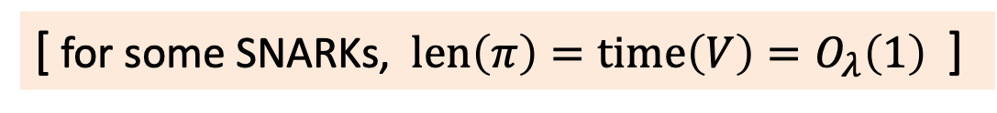

SNARK: a Succinct ARgument of Knowledge
A succinct preprocessing NARK is a triple (S, P, V):
S($C$) ⇾ public parameters ($pp$, $vp$) for prover and verifier
P($pp$, $x, w$) ⇾ short proof $π$ ; len$(π)=O_{λ}( \operatorname{polylog}\left(\left|C\right|\right))$
V($vp$, $x, π$) fast to verify ; time(V) = $O_{λ}(\left|x\right|, \operatorname{polylog}\left(\left|C\right|\right))$
short “summary” of circuit
V has no time to read $C$ !!
[ for some SNARKs, $len\left(π\right)=time\left(V\right)=O_{λ}\left(1\right)$ ]
Notes:
log |C| is bigger than log |w|, so this is not as strict as requiring proof size to be log |w|. In many SNARKs, proof size and verify time is independent of |C| or |w|.

Slide 7
SNARK: a Succinct ARgument of Knowledge
SNARK: a NARC (complete and knowledge sound) that is succinct
zk-SNARK: a SNARK that is also zero knowledge

Slide 8
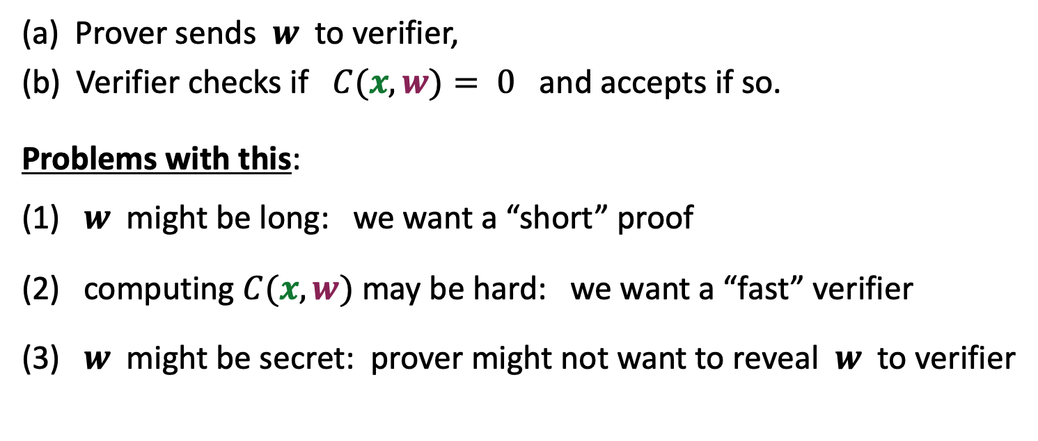
The trivial SNARK is not a SNARK
(a) Prover sends $w$ to verifier,
(b) Verifier checks if $C(x, w)= 0$ and accepts if so.
Problems with this:
(1) $w$ might be long: we want a “short” proof
(2) computing $C(x, w)$may be hard: we want a “fast” verifier
(3) $w$ might be secret: prover might not want to reveal $w$ to verifier

Slide 9
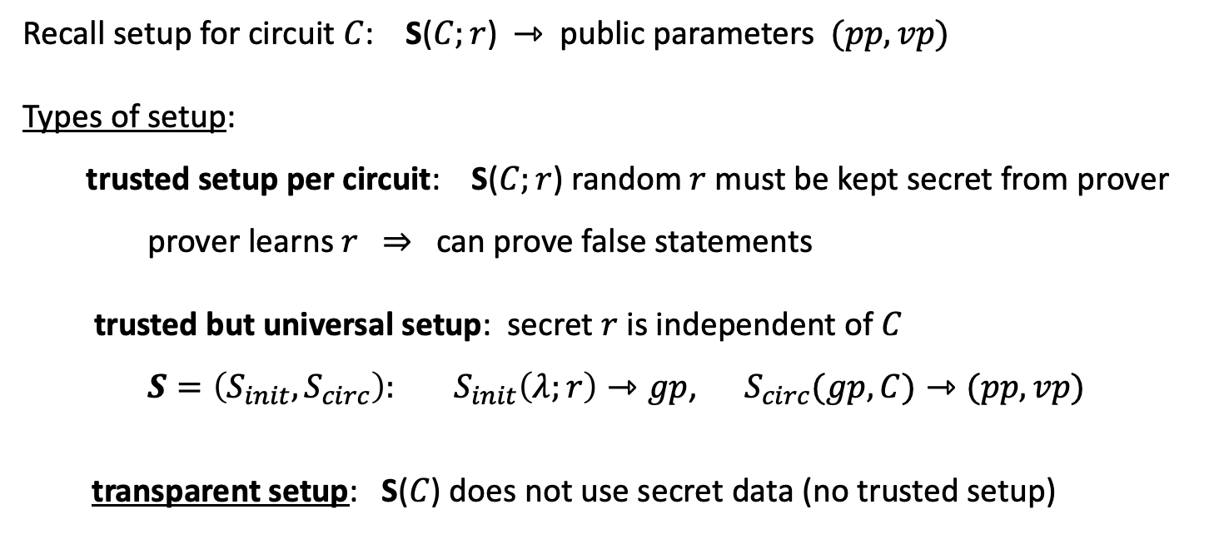
Types of preprocessing Setup
Recall setup for circuit $C$: S($C;r$) ⇾ public parameters $(pp, vp)$
Types of setup:
trusted setup per circuit: S($C;r$) random $r$ must be kept secret from prover
prover learns $r$ ⇒ can prove false statements
trusted but universal setup: secret $r$ is independent of $C$
$S=\left(S_{init}, S_{circ}\right): S_{init}\left(λ;r\right)⇾gp$, $S_{circ}(gp,C)⇾(pp, vp)$
transparent setup: S($C$) does not use secret data (no trusted setup)
random bits
better
one-time
no secret data from prover

Slide 10
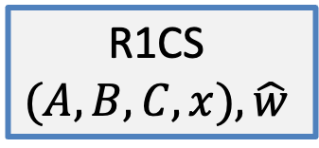
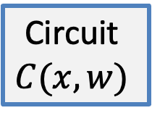
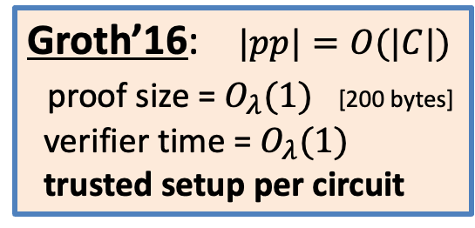
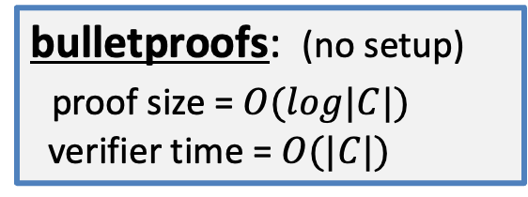
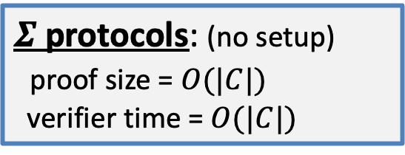
Proof systems so far
$Σ$ protocols: (no setup)
proof size = $O(|C|)$
verifier time = $O(|C|)$
bulletproofs: (no setup)
proof size = $O(log|C|)$
verifier time = $O(|C|)$
Circuit
$$C(x,w)$$
R1CS
$$(A,B,C,x),\hat{w}$$
Groth’16: $|pp|=O(|C|)$
proof size = $O_{λ}(1)$ [200 bytes]
verifier time = $O_{λ}(1)$
trusted setup per circuit
extended witness

Slide 11

The SNARK zoo …
STARK
Bulletproofs
Groth16
Gemini
Plonky2
Plonk
DARK
Halo2
Breakdown
Marlin
Hyperplonk
Nova
Orion
Sonic
⋮
Hyrax
Spartan
Open: one SNARK to rule them all

Slide 12
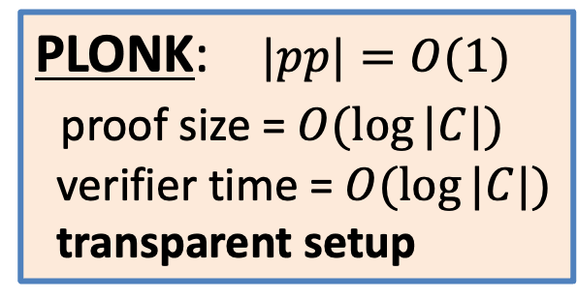
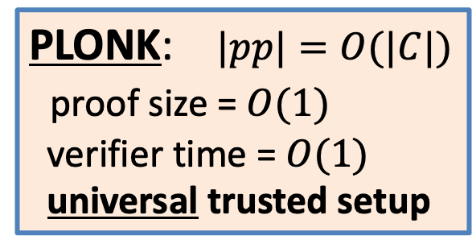
Next: PLONK
We describe Plonk as a Polynomial Interactive Oracle Proof (PIOP)
⇒ leads to many real-world proofs systems (including Plonky2)
PLONK: $|pp|=O(|C|)$
proof size = $O(1)$
verifier time = $O(1)$
universal trusted setup
PLONK: $|pp|=O(1)$
proof size = $O(log⁡|C|)$
verifier time = $O(log⁡|C|)$
transparent setup
eprint/2019/953

Slide 13

A General Paradigm for a Modern SNARK
A functional commitment scheme
SNARK for general circuits
(cryptographic object)
A functional interactive oracle proof (IOP)
Let’s explain each concept …
(info. theoretic object)

Slide 14
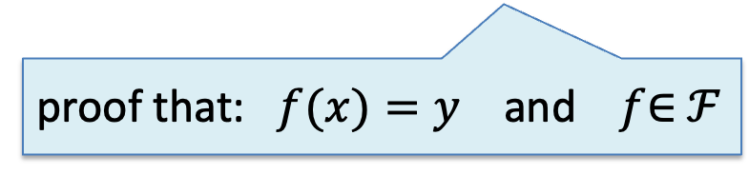
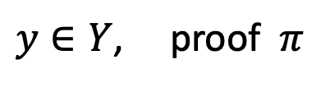

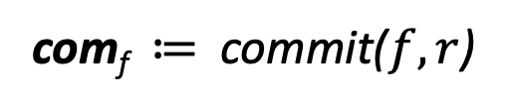

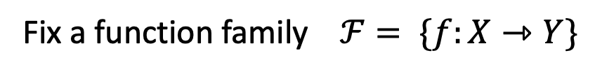
Committing to a function [LRY’16, … BNO’21, …]
Fix a function family $ℱ= \{f:X⇾Y\}$
Prover
Verifier
$$f∈𝓕$$
com_{f} ≔ commit($f,r$)
com_{f}
$$x∈X$$
$y∈Y$, proof $π$
accept or reject
proof that: $f(x)=y$ and $f$∈ $ℱ$
Notes:
LRY: Libert, Ramanna, and Yung
BNO: Boneh, Nguyen, Ozdemir

Slide 15

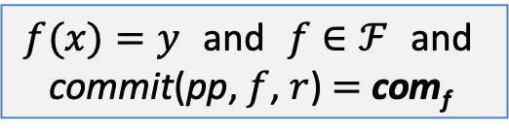
Committing to a function: syntax
A functional commitment scheme for $ℱ$:
setup($1^{λ}$) ⇾ pp, outputs public parameters pp
commit(pp, $f$, $r$) ⇾ com_{f} commitment to $f∈ℱ$ with $r∈ℛ$
a binding (and optionally hiding) commitment scheme for $ℱ$
eval(Prover P, verifier V): for a given com_{f} and $x∈X$, $y∈Y$:
P(pp, $f$, $x$, $y$, $r$) ⇾ short proof $π$
V(pp, com_{f} , $x$, $y$, $π$) ⇾ accept/reject
a (zk)SNARK for the relation:
$f(x)=y$ and $f$ ∈ $ℱ$ and
commit(pp, $f$, $r$) $=$ com_{f}
Notes:
Extractor can extract f from a successful prover.

Slide 16
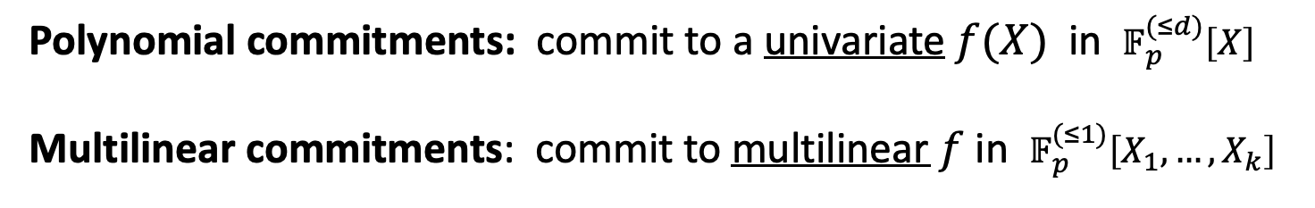
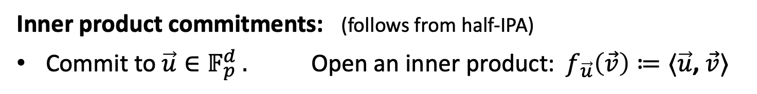
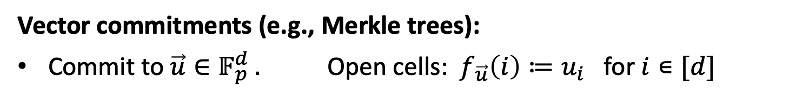

Important functional commitment families
Polynomial commitments: commit to a univariate $f(X)$ in $𝔽_{p}^{(≤d)}\left[X\right]$
Multilinear commitments: commit to multilinear $f$ in $𝔽_{p}^{(≤1)}\left[X_{1}, …, X_{k}\right]$
e.g., $f\left(x_{1},…,x_{k}\right)=x_{1}x_{3}+x_{1}x_{4}x_{5}+x_{7}$
Vector commitments (e.g., Merkle trees):
Commit to $\vec{u}∈𝔽_{p}^{d} .$ Open cells:${ f}_{\vec{u}}\left(i\right)≔u_{i}$ for $i∊[d]$
Inner product commitments: (follows from half-IPA)
Commit to $\vec{u}∈𝔽_{p}^{d} .$ Open an inner product:${ f}_{\vec{u}}\left(\vec{v}\right)≔⟨\vec{u}$, $\vec{v}⟩$
Notes:
IPA implies a slow verifier because queries (v) are linear size.

Slide 17
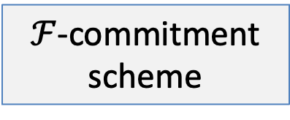
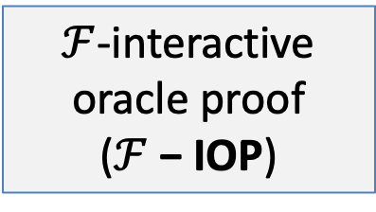
Back to the paradigm
$ℱ$-commitment scheme
(1)
SNARK for general circuits
$ℱ$-interactive oracle proof ($ℱ$− IOP)
(2)

Slide 18

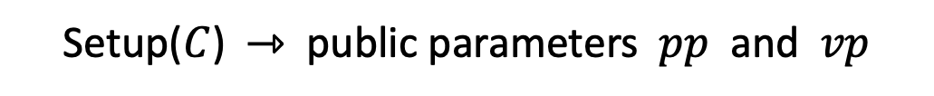





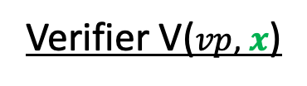
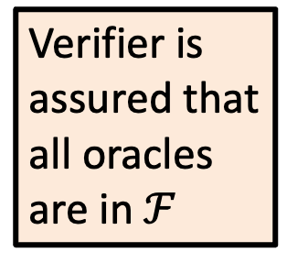
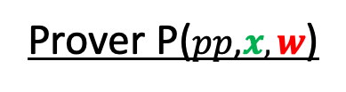

$ℱ$− IOP for a circuit $C(x,w)$ over $𝔽_{p}$
Setup($C$) ⇾ public parameters $pp$ and $vp$
Prover P($pp\text{,}x, w$)
Verifier V($vp\text{,} x$)
$$f1 ∈ℱ$$
oracle
$$r1⇽𝔽_{p}$$
Verifier is
assured that
all oracles
are in $ℱ$
$r$₁
⋮
$$r_{t−1}$$
$$r_{t−1}⇽𝔽_{p}$$
$ft$ $∈ℱ$
oracle
Notes:
Mention bilinear-IOP (in flookup) which gives the verifier more power than just point evaluation.

Slide 19
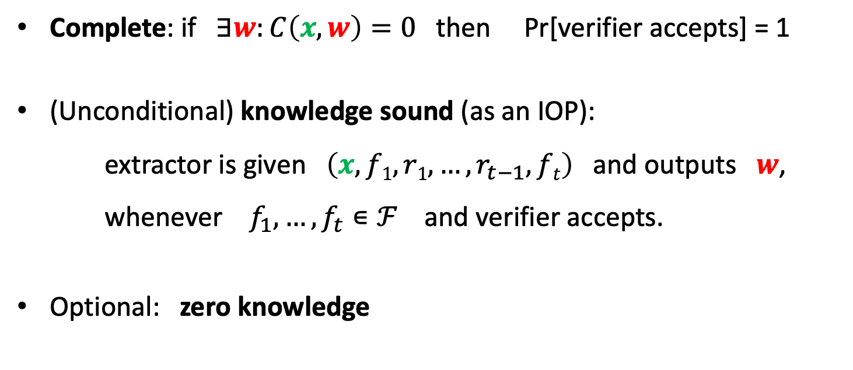
Properties
Complete: if $∃w:C\left(x,w\right)=0$ then Pr[verifier accepts] = 1
(Unconditional) knowledge sound (as an IOP):
extractor is given $\left(x, f1, r1, …,r_{t−1}, ft\right)$ and outputs $w$, whenever $f_{1},…, f_{t}∊ℱ$ and verifier accepts.
Optional: zero knowledge

Slide 20

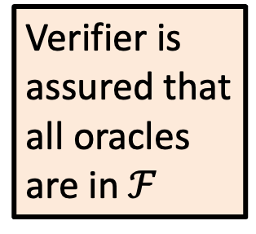



$ℱ$− IOP: a slight generalization
Setup($C$) ⇾ public parameters $pp$ and $(vp, )$
$$f_{−1},…,f_{−s}∊ℱ$$
Prover $P$($pp\text{,}x, w$)
Verifier $V$($vp\text{,} x$)
$$f1 ∈ℱ$$
oracle
$$r1⇽𝔽_{p}$$
Verifier is
assured that
all oracles
are in $ℱ$
$r$₁
⋮
$$r_{t−1}$$
$$r_{t−1}⇽𝔽_{p}$$
$ft$ $∈ℱ$
oracle

Slide 21




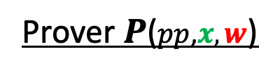
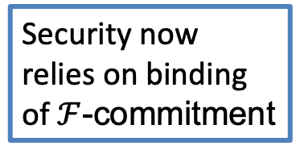



Compiling an $ℱ$− IOP to a SNARK: two steps
Step 1: replace oracles by $ℱ$-commitments
⇒ $vp$ now contains $(com_{f_{−1}},…,com_{f_{−s})}$
We obtain an interactive proof (IP)
Prover $P$($pp\text{,}x, w$)
Verifier $V$($vp\text{,} x$)
$$com_{f_{1}}$$
$$r1⇽𝔽_{p}$$
$r$₁
Security now relies on binding of $ℱ$-commitment
⋮
$$r_{t−1}$$
$$r_{t−1}⇽𝔽_{p}$$
$$com_{f_{t}}$$
$V$ queries for $f_{i}(z)$ ⇒ $P$ responds with $y$ and an eval proof

Slide 22






Compiling an $ℱ$− IOP to a SNARK: two steps
Step 2: Make non-interactive using the Fiat-Shamir transform
Prover $P$($pp\text{,}x, w$)
$$com_{f_{1}}$$
SNARK
Proof
$$r_{1}⇽Hash(x,com_{f_{1}})$$
⋮
$$r_{t}⇽Hash(x,com_{f_{1}},…,com_{f_{t−1}})$$
$$com_{f_{t}}$$
eval proofs (one per $V$query)

Slide 23
Polynomial IOPs (PIOPs): a specific instance of the paradigm

Slide 24
Polynomial IOP (PIOP)
univariate polynomial commitment scheme (PCS)
SNARK for general circuits
Poly Interactive Oracle Proof (PIOP)

Slide 25
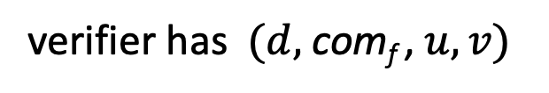
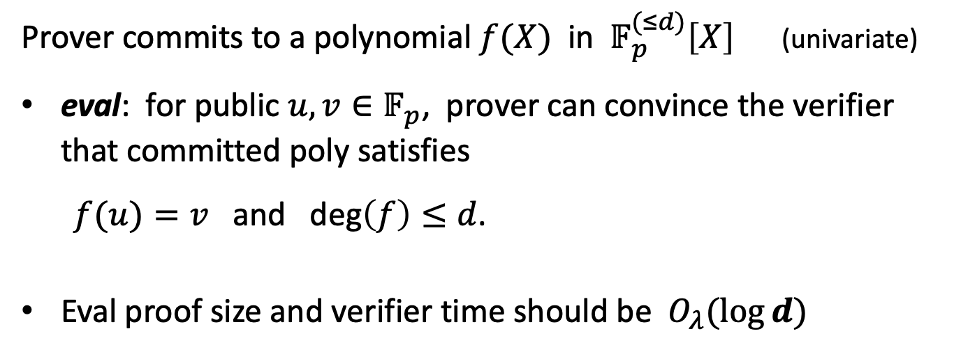

Polynomial commitments (informally)
Prover commits to a polynomial $f(X)$ in $𝔽_{p}^{(≤d)}\left[X\right]$ (univariate)
eval: for public $u,v∈𝔽_{p}$, prover can convince the verifier that committed poly satisfies
$f(u)=v$ and deg$\left(f\right)≤d$.
Eval proof size and verifier time should be $O_{λ}(log⁡⁡d)$
verifier has $(d,$ com_{f} , $u, v)$
$$f$$
Note: poly. commitments have many applications beyond SNARKs

Slide 26
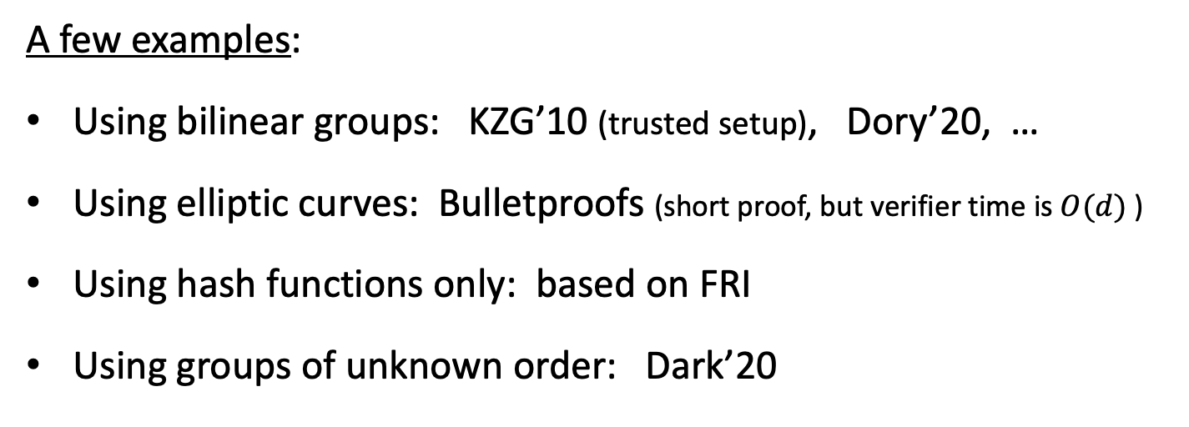
Example polynomial commitments
A few examples:
Using bilinear groups: KZG’10 (trusted setup), Dory’20, …
Using elliptic curves: Bulletproofs (short proof, but verifier time is $O(d)$ )
Using hash functions only: based on FRI
Using groups of unknown order: Dark’20
We will see KZG and FRI in detail in later lectures

Slide 27


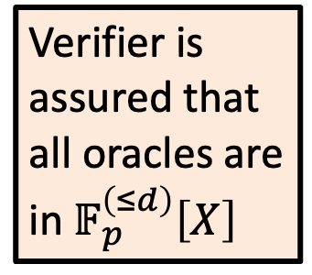

Polynomial IOPs (PIOPs)
$f_{−1},…,f_{−s}∊$ $𝔽_{p}^{\left(≤d\right)}\left[X\right]$
Setup($C$) ⇾ public parameters $pp$ and $(vp, )$
Prover $P$($pp\text{,}x, w$)
Verifier $V$($vp\text{,} x$)
$$f1 ∈𝔽_{p}^{\left(≤d\right)}\left[X\right]$$
oracle
$$r1⇽𝔽_{p}$$
Verifier is
assured that
all oracles are
in $𝔽_{p}^{\left(≤d\right)}\left[X\right]$
$r$₁
⋮
$$r_{t−1}$$
$$r_{t−1}⇽𝔽_{p}$$
$ft$ $∈𝔽_{p}^{\left(≤d\right)}\left[X\right]$
oracle
Notes:
fast means log(|C|) time. Mention bilinear-IOP (in flookup) which gives the verifier more power than just point evaluation.

Slide 28
The Plonk poly-IOP (eprint/2019/953)
Gabizon – Williamson – Ciobotaru
Plonk PIOP + Polynomial Commitment ⇒ SNARK
(and also a zk-SNARK)

Slide 29
Plonk Systems
PCS
pairings
KZG’10
Aztec, JellyFish
The Plonk
PIOP
DLOG group
DLOG-PCS
(bulletproofs)
Halo2
(slow verifier)
FRI
Plonky2, Plonky3
CRH
No trusted setup

Slide 30


PLONK: a poly-IOP for a general circuit $C(x,w)$
Step 1: compile circuit to a computation trace (gate fan-in = 2)
The computation trace (arithmetization):
$$(x1+x2)(x2+w1)$$
77
inputs: 5, 6, 1
Gate 0: 5 , 6 , 11
Gate 1: 6 , 1 , 7
Gate 2: 11, 7, 77
$$\text{×}$$
(Gate 2)
11
7
(Gate 0)
$$+$$
$$+$$
(Gate 1)
5
6
1
6
$$x1$$
$$x2$$
$$w1$$
5
6
1
example input
left inputs
right inputs
outputs
Notes:
Mention R1CS

Slide 31
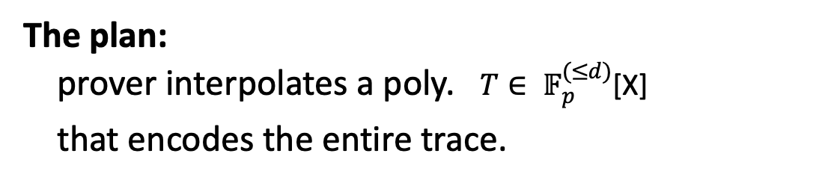

Encoding the trace as a polynomial
$|C|$ ≔ total # of gates in $C$ , |$I$| ≔ |$Ix$| + |$Iw$| $=$ # inputs to $C$
let $d \text{≔} 3 \left|C\right|+|I|$ (in example, $d=12$) and $Ω$ ≔ { 1, $ω$, $ω$²,…, $ω^{d−1}$ }
The plan: prover interpolates a poly. $T{∈ 𝔽}_{p}^{(≤d)}$[X]
that encodes the entire trace.
inputs: 5, 6, 1
Gate 0: 5 , 6 , 11
Gate 1: 6 , 1 , 7
Gate 2: 11, 7, 77
Let’s see how …

Slide 32

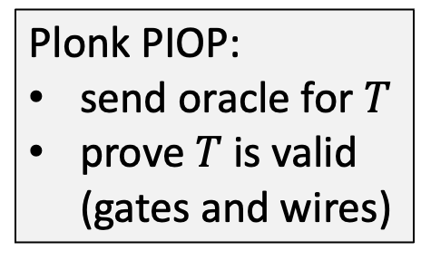
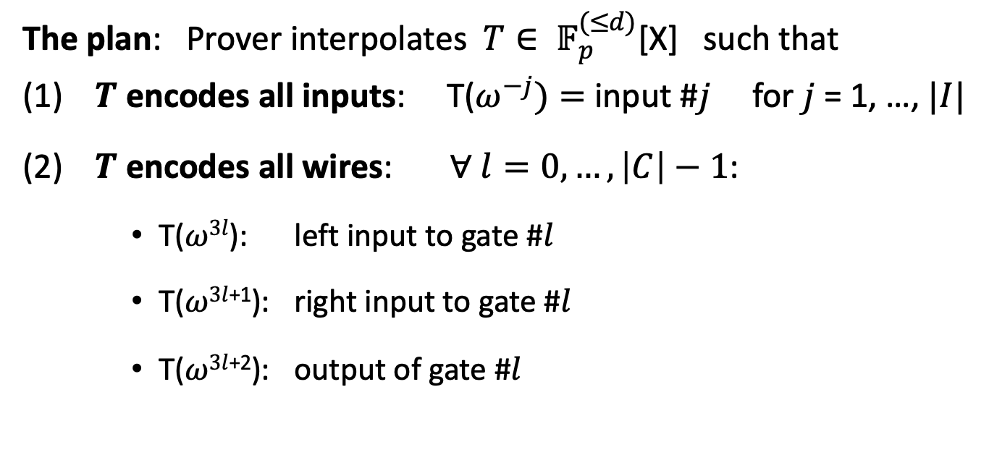
Encoding the trace as a polynomial
The plan: Prover interpolates $T{∈ 𝔽}_{p}^{(≤d)}$[X] such that
(1) $T$ encodes all inputs: T($ω^{−j})=$ input #$j$ for $j$ = 1, …, $|I|$
(2) $T$ encodes all wires: ∀ $l=0,…,\left|C\right|−1$:
T($ω3l$): left input to gate #$l$
T($ω3l$⁺¹): right input to gate #$l$
T($ω3l$⁺²): output of gate #$l$
Plonk PIOP:
send oracle for $T$
prove $T$ is valid (gates and wires)

Slide 33

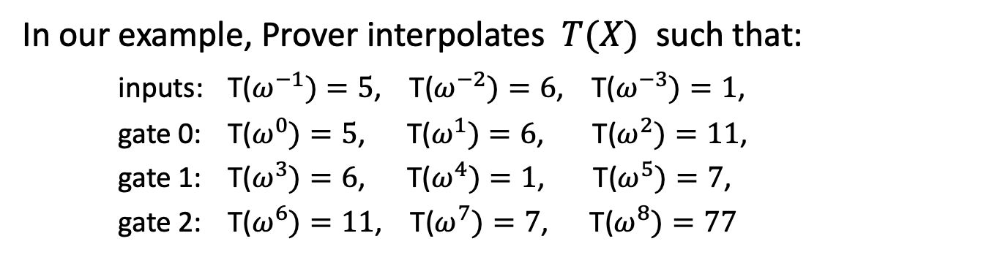
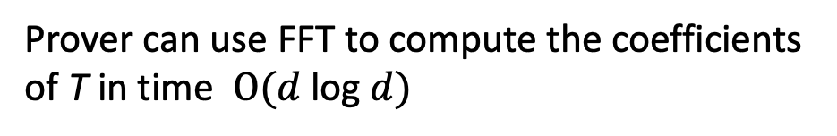
Encoding the trace as a polynomial
In our example, Prover interpolates $T(X)$ such that:
inputs: T($ω^{−1})=5$, T($ω^{−2})=6$, T($ω^{−3})=1$,
gate 0: T($ω^{0})=5$, T($ω^{1})=6$, T($ω^{2})=11$,
gate 1: T($ω^{3})=6$, T($ω^{4})=1$, T($ω^{5})=7$,
gate 2: T($ω^{6})=11$, T($ω^{7})=7$, T($ω^{8})=77$
degree($T$) = 11
inputs: 5, 6, 1
Gate 0: 5 , 6 , 11
Gate 1: 6 , 1 , 7
Gate 2: 11, 7, 77
Prover can use FFT to compute the coefficients of T in time $O(d \text{log} d)$

Slide 34
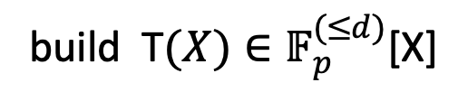
Step 2: proving validity of T
Prover P($Sp,x,w$)
Verifier V($Sv, x$)
build T$(X){∈𝔽}_{p}^{(≤d)}$[X]
$$T$$
Prover needs to prove that T is a correct computation trace:
T encodes the correct inputs,
every gate is evaluated correctly,
the wiring is implemented correctly,
the output of last gate is 0
(wiring constraints)
inputs: 5 , 6, 1
Gate 0: 5 , 6 , 11
Gate 1: 6 , 1 , 7
Gate 2: 11, 7, 77
How? Next lecture.

Slide 35
THE END

