Slide 1
FRI and Proximity Proofs: continued
Dan Boneh
Stanford University

Slide 2
Review: Poly-IOP ⇒ IOP ⇒ SNARK
A direct SNARK construction:
RS-IOPP
(such as FRI)
Merkle
commitments
Fiat-Shamir
Polynomial
interactive
oracle proof
(Poly-IOP)
IOP
Interactive
Proof (IP)
(zk)SNARK for
general circuits
An RS-IOPP is the key ingredient in compilation
Notes:
RS-IOPP is the main ingredient in the compilation.

Slide 3
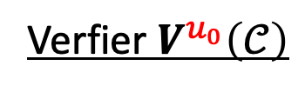
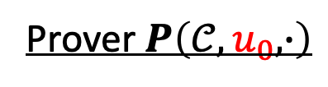
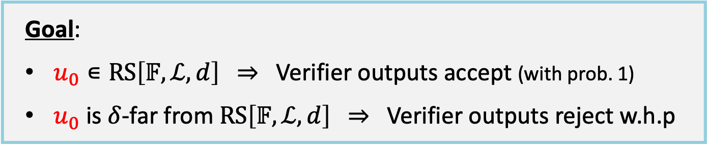
FRI: a Reed-Solomon IOP of Proximity
Let $𝒞=RS[𝔽,ℒ,d]$, $u_{0}:ℒ⇾$ $𝔽$, and $δ∊[0,1]$
Prover $P\left(𝒞,u_{0}, ∙\right)$
Verfier $V^{u_{0}}\left(𝒞\right)$
Goal:
$u_{0}∊RS\left[𝔽,ℒ,d\right]$ ⇒ Verifier outputs accept (with prob. 1)
$u_{0}$ is $δ$-far from $RS\left[𝔽,ℒ,d\right]$ ⇒ Verifier outputs reject w.h.p
We don’t care what happens when $u_{0}$ is between the two cases
Why needed? A key tool for compiling a Poly-IOP into an IOP.

Slide 4

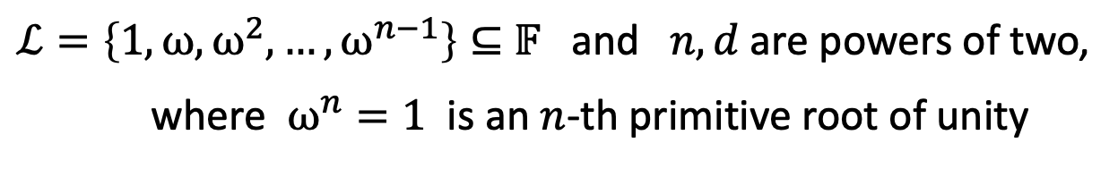
FRI: a Reed-Solomon IOP of Proximity
Let $𝒞=RS[𝔽,ℒ,d]$, $u_{0}:ℒ⇾$ $𝔽$, and $δ∊[0,1]$
Prover $P\left(𝒞,u_{0}, ∙\right)$
Verfier $V^{u_{0}}\left(𝒞\right)$
We will set:
$ℒ=\left\{1,ω,ω^{2},…,ω^{n−1}\right\}⊆$ $𝔽$ and $n,d$ are powers of two,
where $ω^{n}=1$ is an $n$-th primitive root of unity
Then: $\left|ℒ^{2}\right|≔\left|\left\{a^{2}:a∊ℒ\right\}\right|=\left|ℒ\right|/2=n/2$ ( $−a, a→a^{2}$ )
$$\left|ℒ^{4}\right|≔\left|\left\{a^{4}:a∊ℒ\right\}\right|=\left|ℒ\right|/4=n/4$$

Slide 5
Distance Preserving Transformations
Towards an efficient RS-IOPP

Slide 6

Distance Preserving Transformations
Let $ℒ,ℒ′⊆$ $𝔽$, $d,d^{′}$ some degree bounds, and $δ∊[0,1]$.
Def: A distance preserving transformation is a randomized map
$$T\left(u_{1},…,u_{k};r\right)⇾u$$
that maps $u_{1},…,u_{k}:ℒ⇾𝔽$ to $u:ℒ′⇾𝔽$ such that:
case 1: (the honest case)
if $u_{1},…,u_{k}$∊ $RS[𝔽,ℒ,d]$ then $u$∊ $RS[𝔽,ℒ′,d′]$ for all $r$.
case 2: (the dishonest case)
if some $u_{j}$ is $δ$-far from $RS[𝔽,ℒ,d]$ then
$u$ is $δ$-far from $RS[𝔽,ℒ′,d′]$, w.h.p over $r$.

Slide 7

Example 1: batch RS-IOPP
Setting: Prover has $u_{0},…,u_{k}\text{:} ℒ⇾𝔽$, Verifier has oracles for $u_{0},…,u_{k}$.
Goal: convince Verifier that all $u_{0},…,u_{k}$ are $δ$-close to $RS[𝔽,ℒ,d]$.
Naively: run $k$ RS-IOPP protocols ⇒ expensive
Better: batch all $k$ into a single function $u\text{:} ℒ⇾𝔽$
step 1: Verifier samples random $r$ in $𝔽$; sends to prover
step 2: Prover sets $u≔u_{0}+r∙u_{1}+r^{2}u_{2}+…+r^{k}u_{k}\text{:} ℒ⇾𝔽$
step 3: Both run RS-IOPP on $u:ℒ⇾𝔽$
when Verifier wants $u(a)$ for some $a∊ℒ$, prover opens all $u_{0}(a),…, u_{k}(a)$

Slide 8
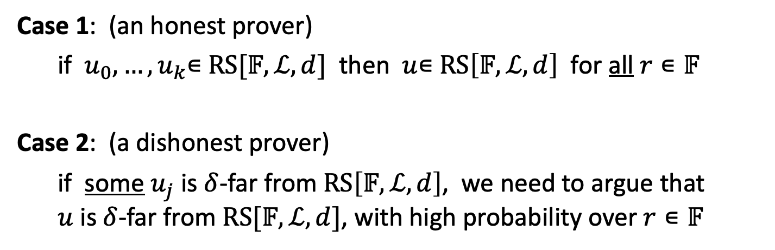
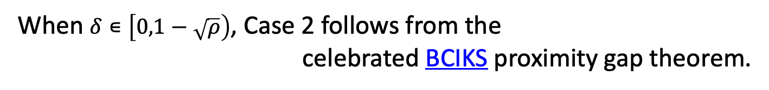
Why is this distance preserving?
Case 1: (an honest prover)
if $u_{0},…,u_{k}$∊ $RS[𝔽,ℒ,d]$ then $u$∊ $RS\left[𝔽,ℒ,d\right]$ for all $r∊𝔽$
Case 2: (a dishonest prover)
if some $u_{j}$ is $δ$-far from $RS\left[𝔽,ℒ,d\right]$, we need to argue that
$u$ is $δ$-far from $RS[𝔽,ℒ,d]$, with high probability over $r∊𝔽$
When $δ∊\left[0,1−\sqrt{ρ}\right)$, Case 2 follows from the
celebrated BCIKS proximity gap theorem.

Slide 9

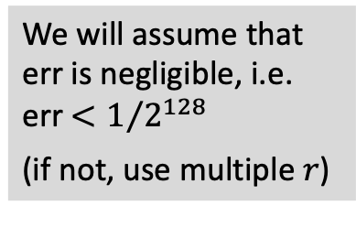
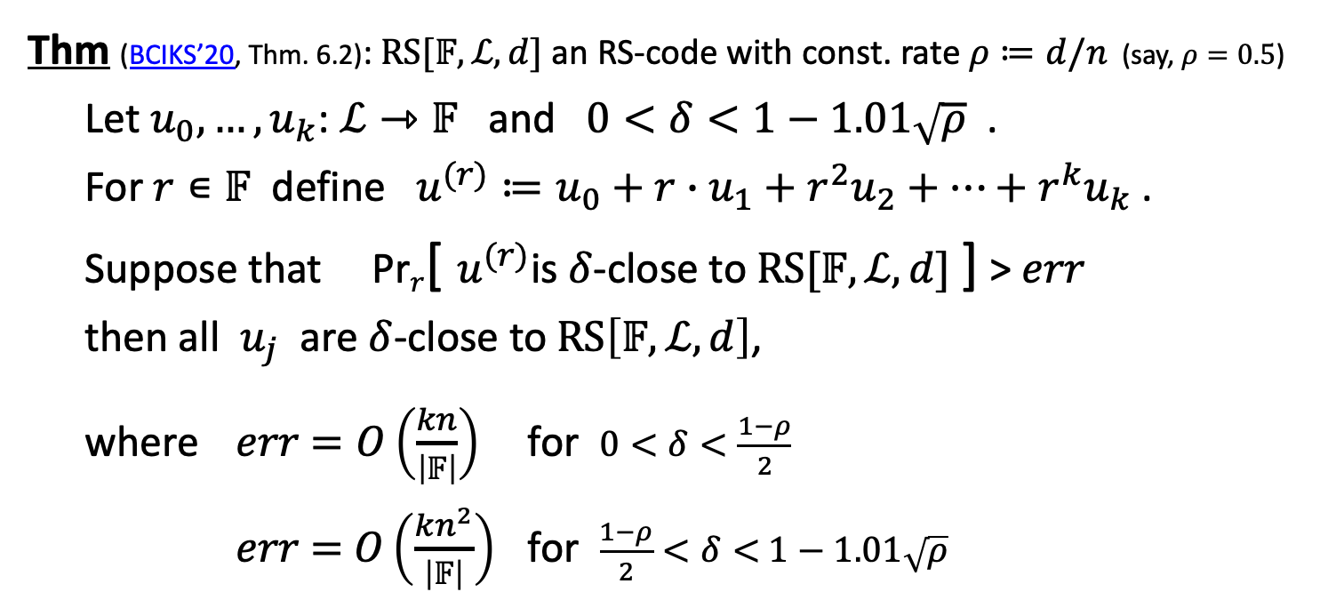
The proximity gap theorem
Thm (BCIKS’20, Thm. 6.2): $RS[𝔽,ℒ,d]$ an RS-code with const. rate $ρ≔d/n$ (say, $ρ=0.5$)
Let $u_{0},…,u_{k}\text{:} ℒ⇾𝔽$ and $0<δ<1−1.01\sqrt{ρ}$ .
For $r∊𝔽$ define $u^{(r)}≔u_{0}+r∙u_{1}+r^{2}u_{2}+…+r^{k}u_{k}$ .
Suppose that Pr$r$[ $u^{(r)}$is $δ$-close to $RS[𝔽,ℒ,d]$ ] > $err$
then all $u_{j}$ are $δ$-close to $RS\left[𝔽,ℒ,d\right]$,
where $err$ $=O\left(\frac{kn}{\left|𝔽\right|}\right)$ for $0<δ<\frac{1−ρ}{2}$
$err$ $=$ $O\left(\frac{kn^{2}}{\left|𝔽\right|}\right)$ for $\frac{1−ρ}{2}<δ<$ $1−1.01\sqrt{ρ}$
$n≔|ℒ$|
We will assume that
err is negligible, i.e.
err $<1/{2^{128}}$
(if not, use multiple $r$)
Notes:
1.01 can be replace by $\left(1+ε\right)$ and this only affects the value of $err$.
When err is negligible: if $u\left(r\right)$ is $δ$-close to $RS[𝔽,ℒ,d]$ for a random r, we can conclude that all $u_{j}$ are $δ$-close, as required for batching.
If F is small, then use multiple r, or use an extension field.
This paper by Gao et al. (https://eprint.iacr.org/2024/1810.pdf) claims to give a linear error bound up to 1.5*(Johnson bound).

Slide 10




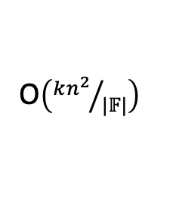

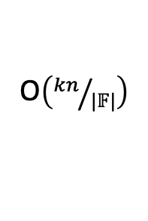

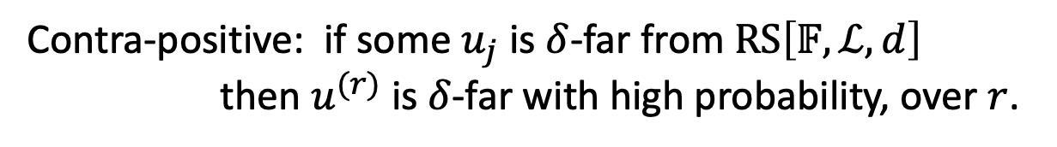

The proximity gap theorem
Suppose that Pr$r$[ $u^{(r)}$ is $δ$-close to $RS[𝔽,ℒ,d]$ ] > $err$
then all $u_{j}$ are $δ$-close to $RS\left[𝔽,ℒ,d\right]$
Contra-positive: if some $u_{j}$ is $δ$-far from $RS\left[𝔽,ℒ,d\right]$
then $u^{(r)}$ is $δ$-far with high probability, over $r$.
conjectured to
be small
Proximity gap error ($err$) as a function of $δ∊[0,1]$ :
O$\left({kn}/{|𝔽|}\right)$
O$\left({kn^{2}}/{|𝔽|}\right)$
unknown
vacuous
$$δ=0$$
$(1−ρ)$/2
$$1−\sqrt{ρ}$$
$1−$ $ρ$
$$1$$
(uniqueness bound)
(Johnson bound)
(capacity bound)
$n≔|ℒ$|
Notes:
When $δ$>capacity bound, then every function is $δ$-close to the code. So the thm becomes vacuous.
Conjecture lets us build more efficient SNARKs, but we don’t know if it is true.
This paper by Gao et al. (https://eprint.iacr.org/2024/1810.pdf) claims to give a linear error bound up to 1.5*(Johnson bound).

Slide 11

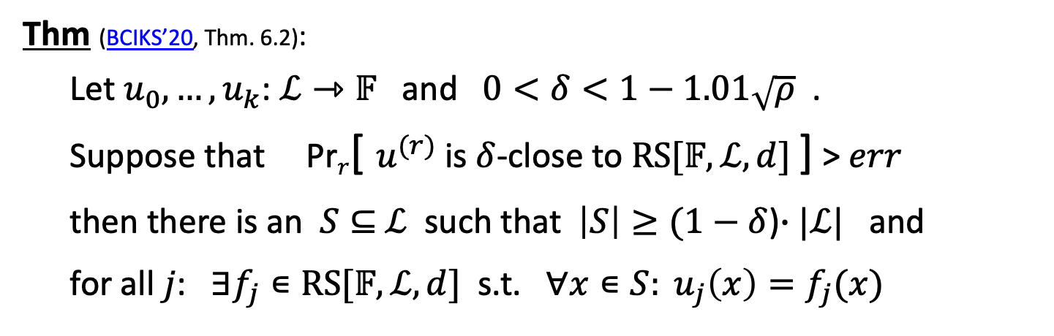
A stronger form: correlated proximity
Thm (BCIKS’20, Thm. 6.2):
Let $u_{0},…,u_{k}\text{:} ℒ⇾𝔽$ and $0<δ<1−1.01\sqrt{ρ}$ .
Suppose that Pr$r$[ $u^{(r)}$ is $δ$-close to $RS[𝔽,ℒ,d]$ ] > $err$
then there is an $S⊆$ $ℒ$ such that $\left|S\right|≥(1−$ $δ$)$∙|ℒ|$ and
for all $j$: $∃f_{j}∊RS[𝔽,ℒ,d]$ s.t. $∀x∊S: {u_{j}\left(x\right)=f}_{j}(x)$
⇒ $u_{0},…,u_{k}$ are $δ$-close to $RS[𝔽,ℒ,d]$ on the same positions $S$ .
(recall $u^{(r)}≔u_{0}+r∙u_{1}+r^{2}u_{2}+…+r^{k}u_{k}$ )
Notes:
In Thm 1.6 they prove exactly the Johnson bound (no 1.01) when $u\left(r\right)$ is a random linear combination of $u_{0},…u_{k}$.

Slide 12

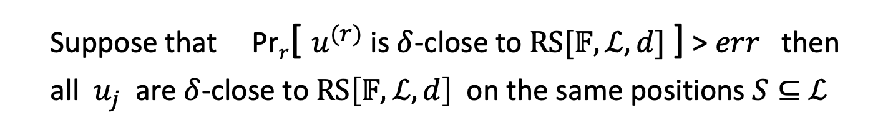


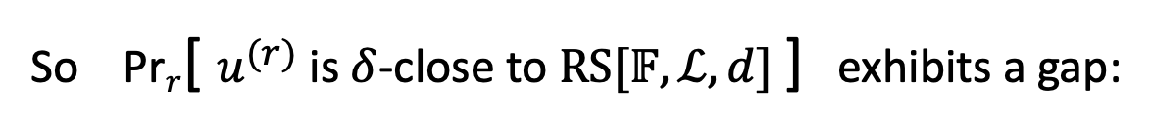

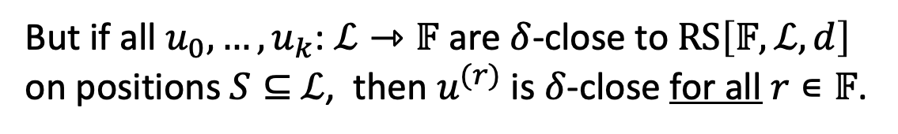

Why is this called a proximity gap??
Suppose that Pr$r$[ $u^{(r)}$ is $δ$-close to $RS[𝔽,ℒ,d]$ ] > $err$ then
all $u_{j}$ are $δ$-close to $RS\left[𝔽,ℒ,d\right]$ on the same positions $S⊆$ $ℒ$
But if all $u_{0},…,u_{k}\text{:} ℒ⇾𝔽$ are $δ$-close to $RS\left[𝔽,ℒ,d\right]$
on positions $S⊆$ $ℒ$, then $u^{(r)}$ is $δ$-close for all $r∊𝔽$.
So Pr$r$[ $u^{(r)}$ is $δ$-close to $RS[𝔽,ℒ,d]$ ] exhibits a gap:
not possible
$$0$$
$$err$$
$$1$$
$u^{(r)}$ is $δ$-close for few $r$
$u^{(r)}$ is $δ$-close for all $r$
Notes:
Once the probability goes above err, it must jump all the way to 1.

Slide 13
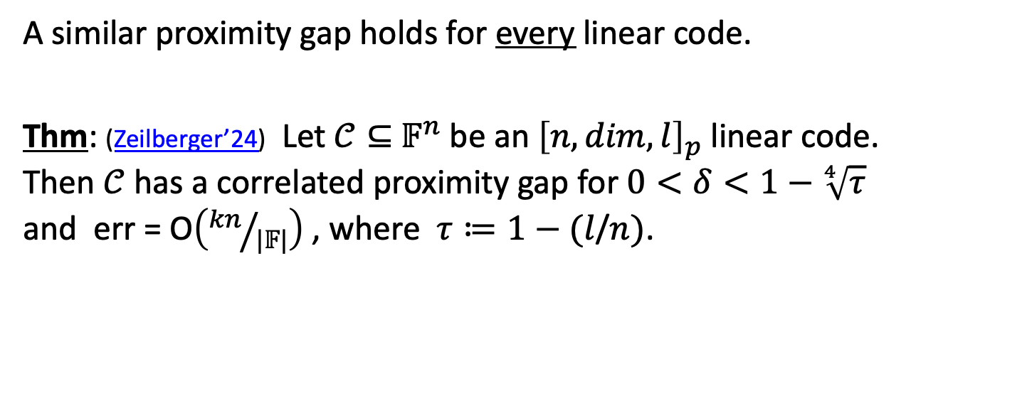
Proximity gaps for other linear codes?
A similar proximity gap holds for every linear code.
Thm: (Zeilberger’24) Let $𝒞⊆{ 𝔽}^{n}$ be an ${\left[n,dim,l\right]}_{p}$linear code.
Then $𝒞$ has a correlated proximity gap for $0<δ<1−\sqrt[4]{τ}$
and err = O$\left({kn}/{|𝔽|}\right)$ , where $τ≔1−(l$/$n)$.
min. distance
(For RS-code $τ≈ρ$, so this gap is much weaker than BCIKS’20)
This can be used in a $𝒞$-proximity IOPP (e.g., Basefold, Blaze)

Slide 14
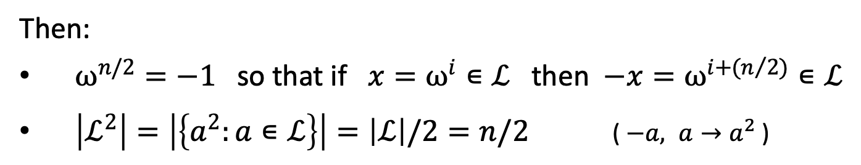
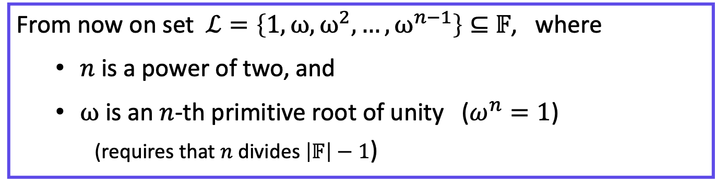
2nd Distance preserving example: 2-way folding
From now on set $ℒ=\left\{1,ω,ω^{2},…,ω^{n−1}\right\}⊆$ $𝔽$, where
  $n$ is a power of two, and
  $ω$ is an $n$-th primitive root of unity ($ω^{n}=1$)
  (requires that $n$ divides $\left|𝔽\right|−1$)
Then:
$ω^{n/2}=−1$ so that if $x=ω^{i}∊ℒ$ then $−x=ω^{i+(n/{2)}}∊ℒ$
$\left|ℒ^{2}\right|=\left|\left\{a^{2}:a∊ℒ\right\}\right|=\left|ℒ\right|/2=n/2$ ( $−a, a→a^{2}$ )

Slide 15
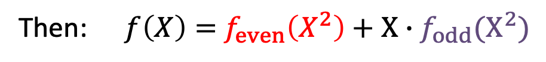
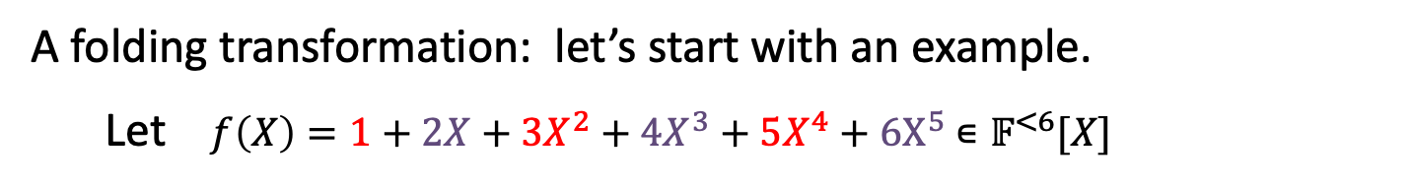
2-way folding a polynomial
A folding transformation: let’s start with an example.
Let $f\left(X\right)=1+2X+3X^{2}+4X^{3}+5X^{4}+6X^{5}$ $∊𝔽^{<6}[X]$
Define $f_{even}(X)$ $≔1+3X+5X^{2}$ and $f_{odd}\left(X\right)≔2+4X+6X^{2}$
Then: $f\left(X\right)=$ $f_{even}\left(X^{2}\right)+X∙$ $f_{odd}(X^{2})$
Define: for $r∊𝔽$ define $f_{fold,r}≔f_{even}\text{+ }r{∙f}_{odd}$ $∊𝔽^{<3}[X]$

Slide 16
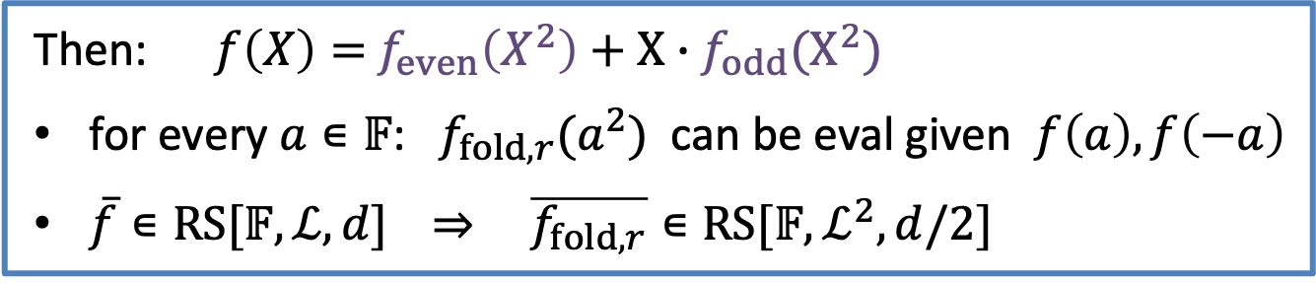
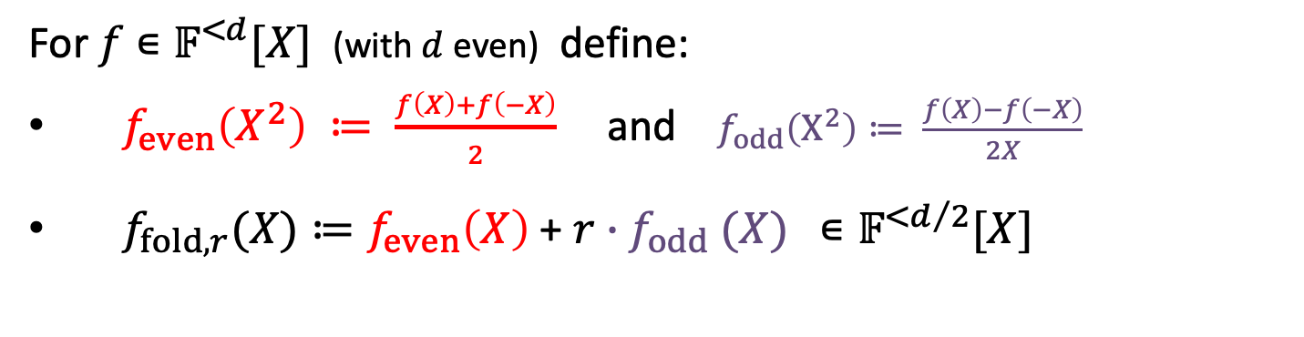
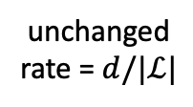
2-way folding a polynomial: more generally
For $f$ $∊𝔽^{<d}[X]$ (with $d$ even) define:
$f_{even}\left(X^{2}\right) ≔ \frac{f\left(X\right)+f\left(−X\right)}{2}$ and $f_{odd}\left(X^{2}\right)≔ \frac{f\left(X\right)−f\left(−X\right)}{2X}$
$f_{fold,r}(X)≔f_{even}\left(X\right) \text{+ }r{∙f}_{odd}(X)$ $∊𝔽^{<d/2}[X]$
Then: $f\left(X\right)=$ $f_{even}\left(X^{2}\right)+X∙$ $f_{odd}(X^{2})$
for every $a∊𝔽$: $f_{fold,r}(a^{2})$ can be eval given $f\left(a\right), f\left(−a\right)$
$\overline{f}∊RS[𝔽,ℒ,d]$ ⇒ $\overline{f_{fold,r}}∊RS[𝔽,ℒ^{2},d/2]$
unchanged
rate = $d/|ℒ|$

Slide 17


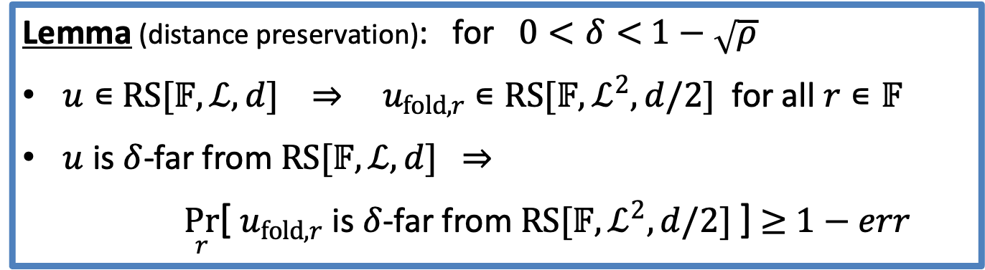
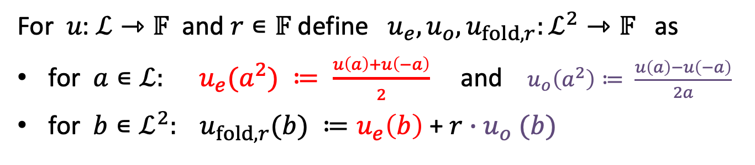
Folding an arbitrary word $u\text{:} ℒ⇾𝔽$
For $u\text{:} ℒ⇾𝔽$ and $r∊𝔽$ define $u_{e}, u_{o}, u_{fold,r}:ℒ^{2}⇾𝔽$ as
for $a∊ℒ: u_{e}(a^{2}) ≔ \frac{u\left(a\right)+u\left(−a\right)}{2}$ and $u_{o}\left(a^{2}\right)≔ \frac{u\left(a\right)−u\left(−a\right)}{2a}$
for $b∊ℒ^{2}: u_{fold,r}(b) ≔u_{e}\left(b\right) \text{+ }r{∙u}_{o}(b)$
(recall $\left|ℒ^{2}\right|=\left|ℒ\right|/2$)
Lemma (distance preservation): for $0<δ<$ $1−\sqrt{ρ}$
$u∊$ $RS[𝔽,ℒ,d]$ ⇒ $u_{fold,r}$ $∊RS[𝔽,ℒ^{2},d/2]$ for all $r∊𝔽$
$u$ is $δ$-far from $RS[𝔽,ℒ,d]$ ⇒
$\underset{r}{Pr}$[ $u_{fold,r}$ is $δ$-far from $RS[𝔽,ℒ^{2},d/2]$ ] $≥$ $1−err$
Notes:
The error err comes from the proximity gap theorem.

Slide 18
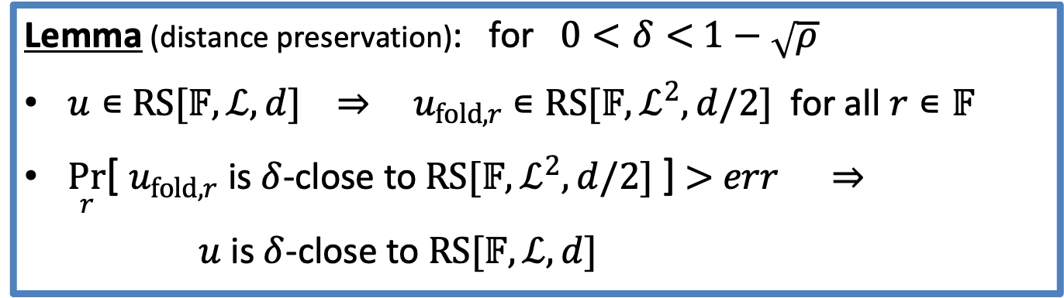
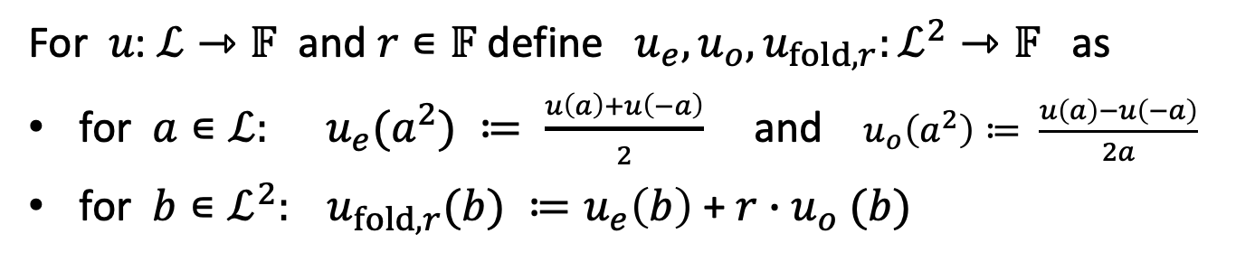
Folding an arbitrary word $u\text{:} ℒ⇾𝔽$
For $u\text{:} ℒ⇾𝔽$ and $r∊𝔽$ define $u_{e}, u_{o}, u_{fold,r}:ℒ^{2}⇾𝔽$ as
for $a∊ℒ: u_{e}(a^{2}) ≔ \frac{u\left(a\right)+u\left(−a\right)}{2}$ and $u_{o}\left(a^{2}\right)≔ \frac{u\left(a\right)−u\left(−a\right)}{2a}$
for $b∊ℒ^{2}: u_{fold,r}(b) ≔u_{e}\left(b\right) \text{+ }r{∙u}_{o}(b)$
(recall $\left|ℒ^{2}\right|=\left|ℒ\right|/2$)
Lemma (distance preservation): for $0<δ<$ $1−\sqrt{ρ}$
$u∊$ $RS[𝔽,ℒ,d]$ ⇒ $u_{fold,r}$ $∊RS[𝔽,ℒ^{2},d/2]$ for all $r∊𝔽$
$\underset{r}{Pr}$[ $u_{fold,r}$ is $δ$-close to $RS[𝔽,ℒ^{2},d/2]$ ] $>$ $err$ ⇒
$u$ is $δ$-close to $RS[𝔽,ℒ,d]$
(contra-positive)
Notes:
The error err comes from the proximity gap theorem.

Slide 19
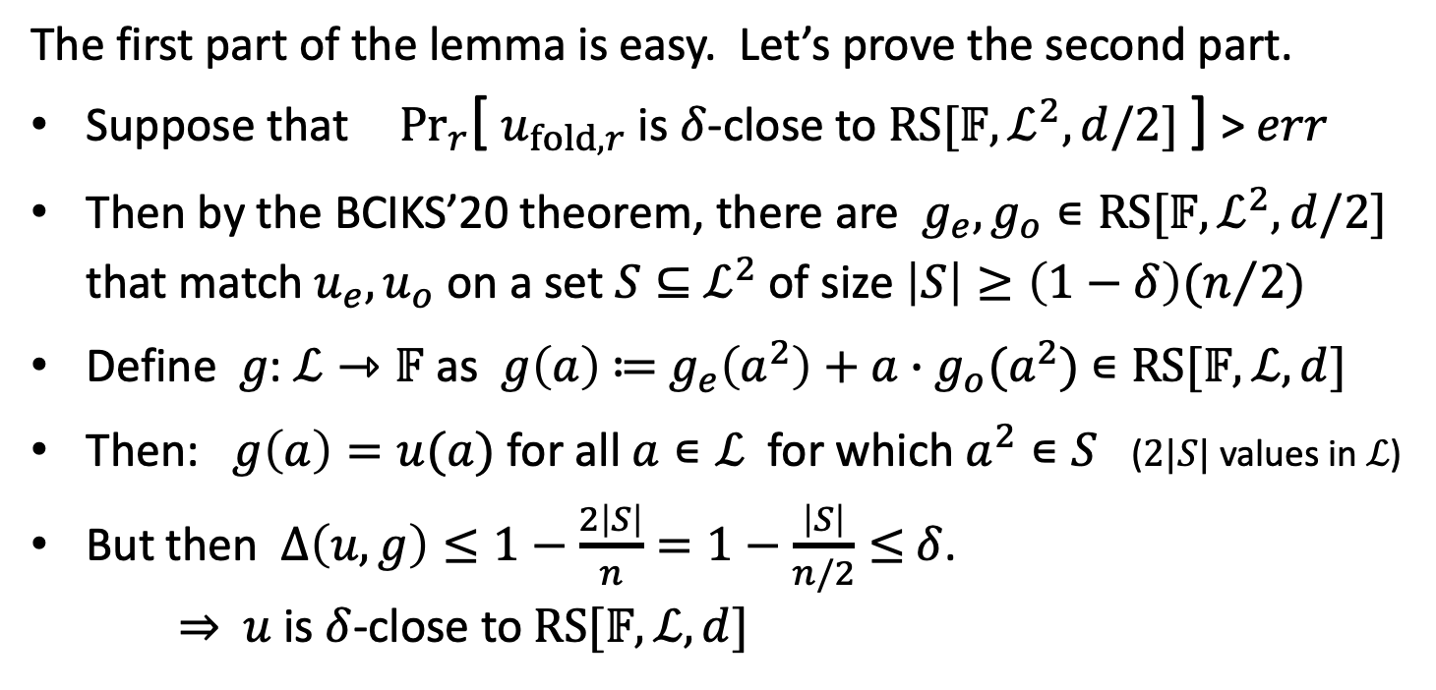
Why is this true?
The first part of the lemma is easy. Let’s prove the second part.
Suppose that ${Pr}_{r}$[ $u_{fold,r}$ is $δ$-close to $RS[𝔽,ℒ^{2},d/2]$ ] > $err$
Then by the BCIKS’20 theorem, there are $g_{e},g_{o}∊RS[𝔽,ℒ^{2},d/2]$
that match $u_{e}, u_{o}$ on a set $S⊆$ $ℒ^{2}$ of size $\left|S\right|≥\left(1−δ\right)(n/2)$
Define $g\text{:} ℒ⇾𝔽$ as $g\left(a\right)$ $≔$ $g_{e}\left(a^{2}\right)+a∙$ $g_{o}(a^{2})$ $∊RS[𝔽,ℒ,d]$
Then: $g\left(a\right)=u(a)$ for all $a∊ℒ$ for which $a^{2}∊S$ ($2|S|$ values in $ℒ$)
But then $∆\left(u,g\right)≤1−\frac{2\left|S\right|}{n}=1−\frac{\left|S\right|}{n/2}≤$ $δ$.
⇒ $u$ is $δ$-close to $RS[𝔽,ℒ,d]$

Slide 20

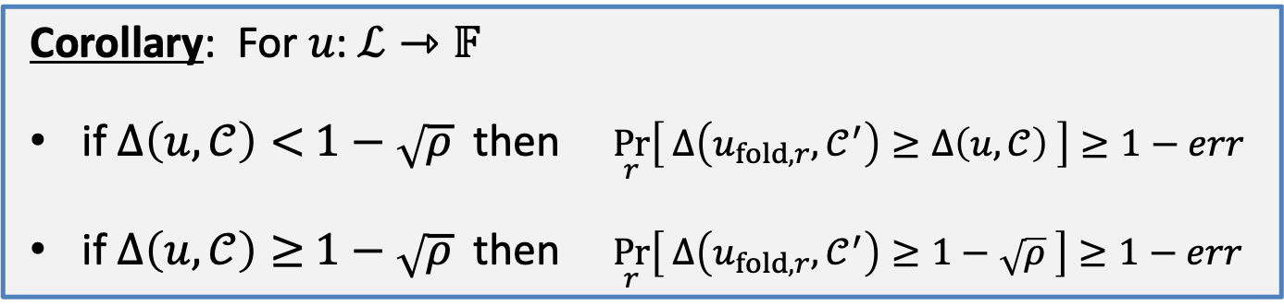
An important corollary
Let $𝒞=$ $RS[𝔽,ℒ,d]$ and $𝒞′=$ $RS[𝔽,ℒ^{2},d/2]$
Corollary: For $u\text{:} ℒ⇾𝔽$
if $∆\left(u,𝒞\right)<$ $1−\sqrt{ρ}$ then $\underset{r}{Pr}\left[ ∆\left(u_{fold,r},𝒞^{′}\right)≥∆\left(u,𝒞\right) \right]≥1−err$
if $∆\left(u,𝒞\right)≥$ $1−\sqrt{ρ}$ then $\underset{r}{Pr}\left[ ∆\left(u_{fold,r},𝒞^{′}\right)≥1−\sqrt{ρ} \right]≥1−err$
(folding does not decrease distance, w.h.p)
Recall: $∆\left(u,𝒞\right)≤δ$ ⟺ $u$ is $δ$-close to $𝒞$
Notes:
Proof of 1: given u, find the smallest $δ$ such that $\underset{r}{Pr}$[$∆\left(u_{fold,r},𝒞^{′}\right)≤δ$ ] $>$ $err$ ($δ$ is in a discrete set, so min exists).
Then $∆\left(u,𝒞\right)≤δ$ by the lemma, and moreover $\underset{r}{Pr}$[$∆\left(u_{fold,r},𝒞^{′}\right)$≥$δ$ ] $≥$ 1-$err$ (otherwise $\underset{r}{Pr}$[$∆\left(u_{fold,r},𝒞^{′}\right)<δ$ ] $>err$ meaning $δ$ is not smallest, it can be reduced by 1/n). Now part 1 follows.
Proof of 2: given u, suppose towards a contradiction that $\underset{r}{Pr}\left[ ∆\left(u_{fold,r},𝒞^{′}\right)≥1−\sqrt{ρ} \right]<1−err$. Then $\underset{r}{Pr}\left[ ∆\left(u_{fold,r},𝒞^{′}\right)<1−\sqrt{ρ} \right]>err$. By the proof of lemma, $∆\left(u,𝒞\right)<1−\sqrt{ρ}$, which contradicts the assumption on u.

Slide 21

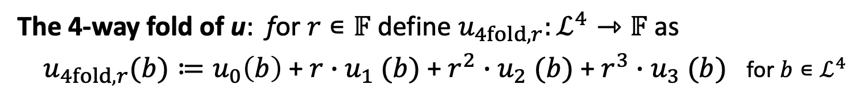
4-way folding $u\text{:} ℒ⇾𝔽$ (using $i^{2}=−1)$
For $u\text{:} ℒ⇾𝔽$ define $u_{0}, u_{1}, u_{2},u_{3} :ℒ^{4}⇾𝔽$ for $a∊ℒ$ as
(a degree-4 FFT)
The 4-way fold of u: for $r∊𝔽$ define $u_{4fold,r}:ℒ^{4}⇾𝔽$ as
$u_{4fold,r}(b)≔u_{0}\left(b\right) \text{+ }r{∙u}_{1}(b)$ $\text{+ }r^{2}{∙u}_{2}(b)$ $\text{+ }r^{3}{∙u}_{3}(b)$ for $b∊ℒ^{4}$
Evaluating $u_{4fold,r}(X)$ at $b∊ℒ^{4}$ requires four evals. of $u(X)$.
Notes:
Evaluation $u_{4fold,r}$(b) requires opening u at four points: the four fourth roots of b.
In general, can do a 2^k-way fold.

Slide 22
4-way folding $u\text{:} ℒ⇾𝔽$ (using $i^{2}=−1)$
For $u\text{:} ℒ⇾𝔽$ define $u_{0}, u_{1}, u_{2},u_{3} :ℒ^{4}⇾𝔽$ for $a∊ℒ$ as
(a degree-4 FFT)
The 4-way fold of u: for $r∊𝔽$ define $u_{4fold,r}:ℒ^{4}⇾𝔽$ as
$u_{4fold,r}(b)≔u_{0}\left(b\right) \text{+ }r{∙u}_{1}(b)$ $\text{+ }r^{2}{∙u}_{2}(b)$ $\text{+ }r^{3}{∙u}_{3}(b)$ for $b∊ℒ^{4}$
Fact: the same distance preservation corollary holds for $u_{4fold,r}$
Notes:
Evaluation $u_{4fold,r}$(b) requires opening u at four points: the four fourth roots of b.
In general, can do a 2^k-way fold.

Slide 23

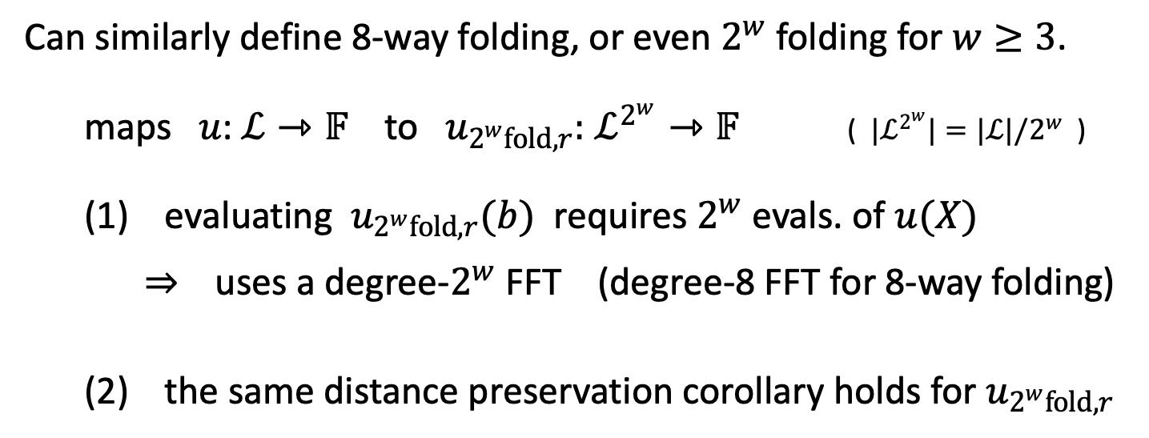
8-way folding $u\text{:} ℒ⇾𝔽$ (using an 8th root of unity$)$
Can similarly define 8-way folding, or even $2^{w}$ folding for $w≥3$.
maps $u\text{:} ℒ⇾𝔽$ to $u_{2^{w}fold,r}:$ $ℒ^{2^{w}}⇾𝔽$ ( $|ℒ^{2^{w}}|=|ℒ|/2^{w}$ )
(1) evaluating $u_{2^{w}fold,r}(b)$ requires $2^{w}$ evals. of $u(X)$
⇒ uses a degree-$2^{w}$ FFT (degree-8 FFT for 8-way folding)
(2) the same distance preservation corollary holds for $u_{2^{w}fold,r}$
Notes:
Evaluation $u_{4fold,r}$(b) requires opening u at four points: the four fourth roots of b.
In general, can do a 2^k-way fold.

Slide 24

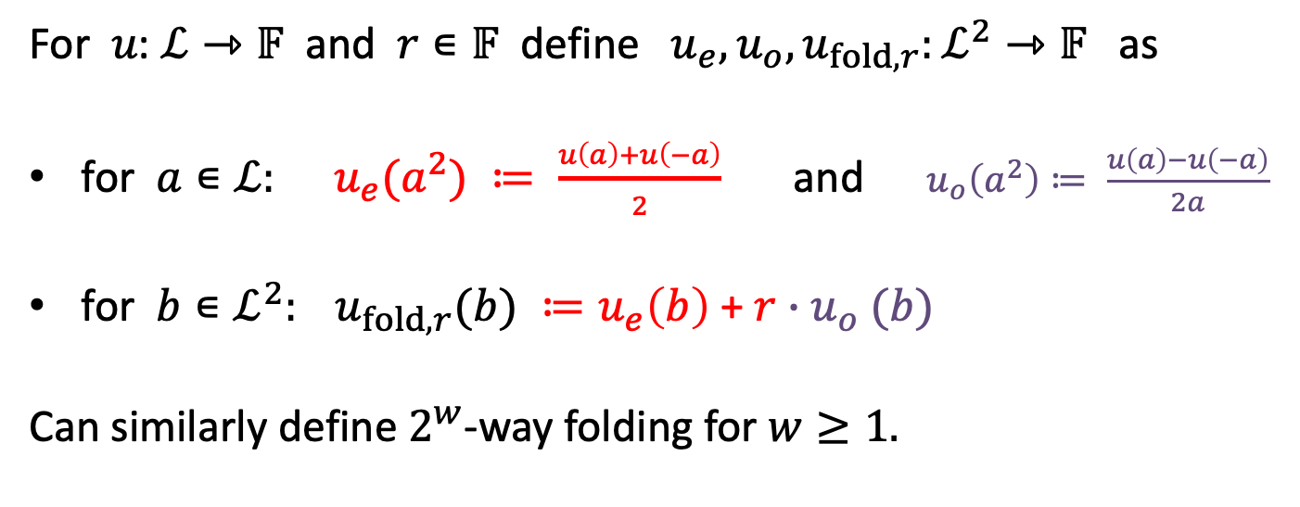
Review: 2-way folding an arbitrary word $u\text{:} ℒ⇾𝔽$
For $u\text{:} ℒ⇾𝔽$ and $r∊𝔽$ define $u_{e}, u_{o}, u_{fold,r}:ℒ^{2}⇾𝔽$ as
for $a∊ℒ: u_{e}(a^{2}) ≔ \frac{u\left(a\right)+u\left(−a\right)}{2}$ and $u_{o}\left(a^{2}\right)≔ \frac{u\left(a\right)−u\left(−a\right)}{2a}$
for $b∊ℒ^{2}: u_{fold,r}(b) ≔u_{e}\left(b\right) \text{+ }r{∙u}_{o}(b)$
Can similarly define $2^{w}$-way folding for $w≥1.$
Recall $\left|ℒ^{2}\right|=\left|ℒ\right|/2$
Notes:
The error err comes from the proximity gap theorem.

Slide 25
How FRI works
A Reed-Solomon IOP of Proximity (RS-IOPP)

Slide 26








FRI phase 1: commit phase
Let $𝒞=RS[𝔽,ℒ,d]$, $u_{0}:ℒ⇾$ $𝔽$, and $δ∊[0,1]$
Prover $P\left(𝒞,u_{0}, ∙\right)$
Verfier $V^{u_{0}}\left(𝒞\right)$
Phase 1: (commit)
sample $r_{1}←𝔽$
honest prover:
$$u_{1}≔{(u_{0})}_{fold,r_{1}}$$
$$u_{1}:ℒ^{2}⇾𝔽$$
|$ℒ^{2}|=|ℒ|/2$
honest prover:
sample $r_{2}←𝔽$
$$u_{2}≔{\left(u_{1}\right)}_{fold,r_{2}}$$
$$u_{2}:ℒ^{4}⇾𝔽$$
|$ℒ^{4}|=|ℒ|/4$
Notes:
In reality, this means sending a MerkleCommit(u_1) then MerkleCommit(u_2), and so on.

Slide 27




FRI phase 1: commit phase
Let $𝒞=RS[𝔽,ℒ,d]$, $u_{0}:ℒ⇾$ $𝔽$, and $δ∊[0,1]$
Prover $P\left(𝒞,u_{0}, ∙\right)$
Verfier $V^{u_{0}}\left(𝒞\right)$
Phase 1: (commit)
sample $r_{1}←𝔽$
honest prover:
$$u_{1}≔{(u_{0})}_{fold,r_{1}}$$
$$u_{1}:ℒ^{2}⇾𝔽$$
sample $r_{t}←𝔽$
honest prover:
$$u_{t}≔{\left(u_{t−1}\right)}_{fold,r_{t}}$$
$$u_{t}:ℒ^{2^{t}}⇾𝔽$$
|$ℒ^{2^{t}}|=|ℒ|/2^{t}$

Slide 28


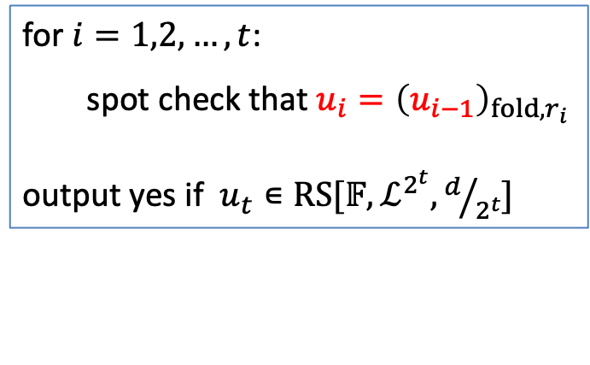



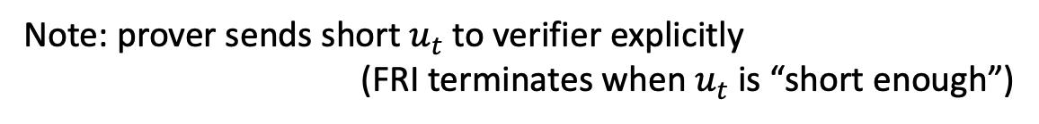
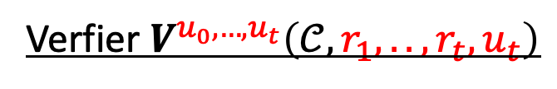

FRI phase 2: query phase
Let $𝒞=RS[𝔽,ℒ,d]$, $u_{0}:ℒ⇾$ $𝔽$, and $δ∊[0,1]$
Phase 2: (query)
Verfier $V^{u_{0},…,u_{t}}\left(𝒞,r_{1},..,r_{t},u_{t}\right)$
$$u_{1}:ℒ^{2}⇾𝔽$$
for $i=1,2,…,t$:
spot check that $u_{i}={\left(u_{i−1}\right)}_{fold,r_{i}}$
output yes if $u_{t}∊RS[𝔽,ℒ^{2^{t}},d/{2^{t}}]$
$$u_{2}:ℒ^{4}⇾𝔽$$
$$⋮$$
$$⋮$$
$$u_{t}:ℒ^{2^{t}}⇾𝔽$$
[Prover sent Merkle commits to $u_{1},…,u_{t}$]
Note: prover sends short $u_{t}$ to verifier explicitly
(FRI terminates when $u_{t}$ is “short enough”)
Notes:
No more prover. Only interact with oracles.

Slide 29
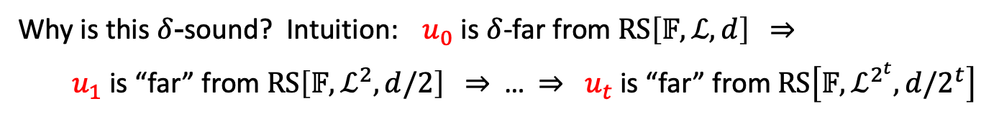
FRI phase 2: query phase
Let $𝒞=RS[𝔽,ℒ,d]$, $u_{0}:ℒ⇾$ $𝔽$, and $δ∊[0,1]$
Phase 2: (query)
Verfier $V^{u_{0},…,u_{t}}\left(𝒞,r_{1},..,r_{t},u_{t}\right)$
$$u_{1}:ℒ^{2}⇾𝔽$$
for $i=1,2,…,t$:
spot check that $u_{i}={\left(u_{i−1}\right)}_{fold,r_{i}}$
output yes if $u_{t}∊RS[𝔽,ℒ^{2^{t}},d/{2^{t}}]$
$$u_{2}:ℒ^{4}⇾𝔽$$
$$⋮$$
$$u_{t}:ℒ^{2^{t}}⇾𝔽$$
Why is this $δ$-sound? Intuition: $u_{0}$ is $δ$-far from $RS\left[𝔽,ℒ,d\right]$ ⇒
$u_{1}$ is “far” from $RS\left[𝔽,ℒ^{2},d/2\right]$ ⇒ … ⇒ $u_{t}$ is “far” from $RS\left[𝔽,ℒ^{2^{t}},d/2^{t}\right]$
Notes:
No more prover. Only interact with oracles.
Folding is distance preserving. So as long as we can ensure that u_i is a folding of u_{i-1}, the protocol should be sound.

Slide 30

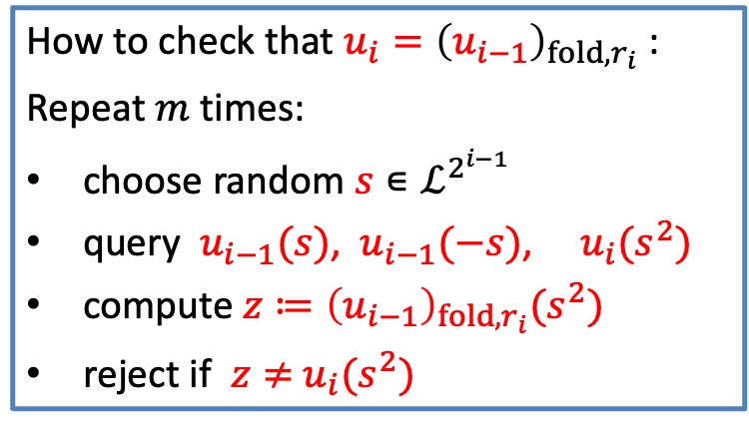
How to spot check: method 1
Let $𝒞=RS[𝔽,ℒ,d]$, $u_{0}:ℒ⇾$ $𝔽$, and $δ∊[0,1]$
Phase 2: (query)
Verfier $V^{u_{0},…,u_{t}}\left(𝒞,r_{1},..,r_{t},u_{t}\right)$
$$u_{1}:ℒ^{2}⇾𝔽$$
How to check that $u_{i}={\left(u_{i−1}\right)}_{fold,r_{i}}$ :
Repeat $m$ times:
choose random $s∊ℒ^{2^{i−1}}$
query $u_{i−1}(s)$, $u_{i−1}(−s)$, $u_{i}(s^{2})$
compute ${z≔\left(u_{i−1}\right)}_{fold,r_{i}}(s^{2})$
reject if $z≠$ $u_{i}(s^{2})$
$$u_{2}:ℒ^{4}⇾𝔽$$
$$⋮$$
$$u_{t}:ℒ^{2^{t}}⇾𝔽$$
$$z=\frac{u_{i−1}(s)+u_{i−1}(−s)}{2}+r_{i}∙\frac{u_{i−1}(s)−u_{i−1}(−s)}{2s}$$
Notes:
No more prover. Only interact with oracles.

Slide 31







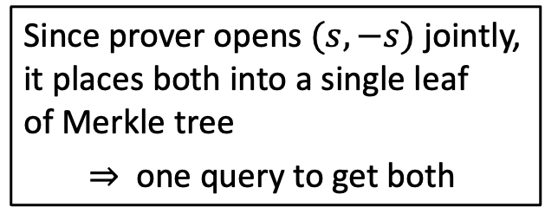

How to spot check in a picture
$m=2$: (spot check at two random spots per oracle)
-$s$
$$s$$
$$u_{0}:ℒ⇾𝔽$$
$u_{1}(s^{2})$ ≟ $\frac{u_{0}(s)+u_{0}(−s)}{2}+r_{i}∙\frac{u_{0}(s)−u_{0}(−s)}{2s}$
$$u_{1}:ℒ^{2}⇾𝔽$$
$${−s}^{2} s^{2}$$
Since prover opens $(s,−s)$ jointly,
it places both into a single leaf
of Merkle tree
⇒ one query to get both
$$u_{2}:ℒ^{4}⇾𝔽$$
$$u_{3}:ℒ^{8}⇾𝔽$$
Reject if any spot checks fail
Total of $2mt$ queries to oracles: $2m$ per inner oracle ($u_{1},u_{2}$).
Notes:
Verifier makes m queries to first oracle, 2m queries to second oracle, and finally m queries to final oracle.

Slide 32
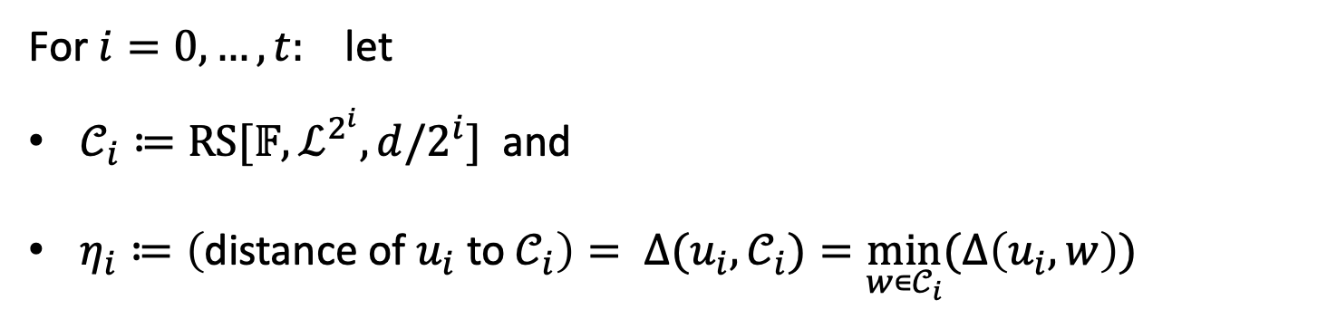
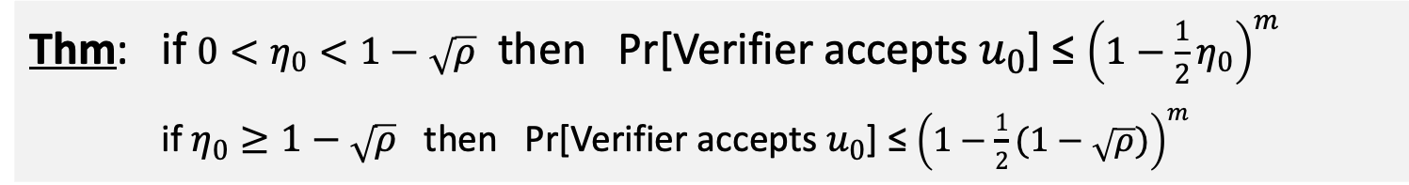
Why is this protocol sound?
For $i=0,…,t:$ let
$𝒞_{i}≔RS[𝔽,ℒ^{2^{i}},d/2^{i}]$ and
$η_{i}≔\left(\text{distance} \text{of} u_{i} \text{to} 𝒞_{i}\right)= ∆(u_{i},𝒞_{i})=\min_{w∊𝒞_{i}}⁡(∆\left(u_{i},w\right))$
(simplified bound)
Thm: if $0<η_{0}<1−\sqrt{ρ}$ then Pr[Verifier accepts $u_{0}$] ≤ ${\left(1−\frac{1}{2}η_{0}\right)}^{m}$
if $η_{0}≥1−\sqrt{ρ}$ then Pr[Verifier accepts $u_{0}$] ≤ ${\left(1−\frac{1}{2}(1−\sqrt{ρ})\right)}^{m}$
(recall: $m$ is the number of spot checks per round, and $ρ≔$ (rate of $𝒞_{i}$) $=d/|ℒ$| )
Notes:
Pr[accept] is increased by an additive term$t∗err$.

Slide 33

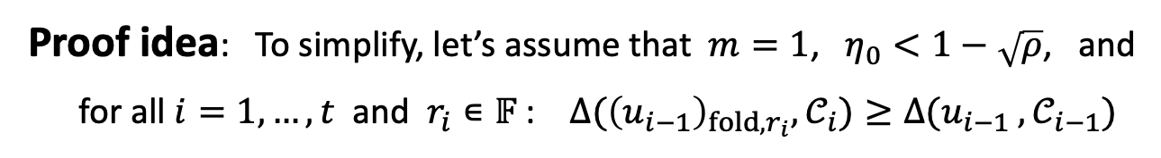
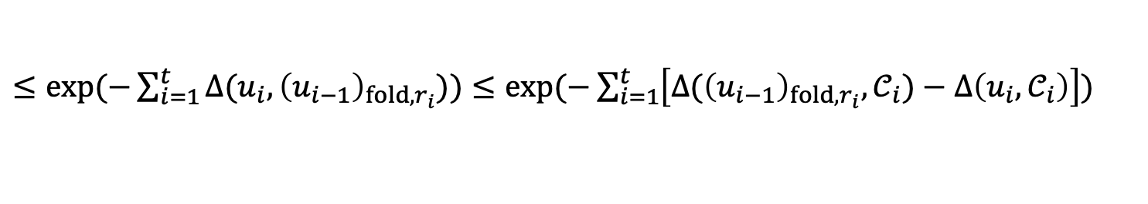
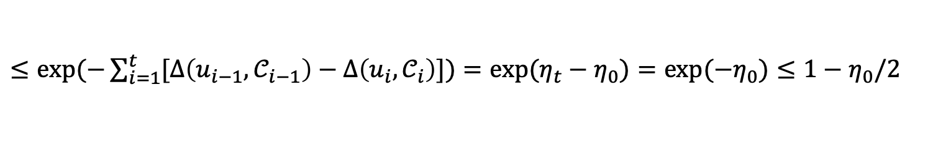



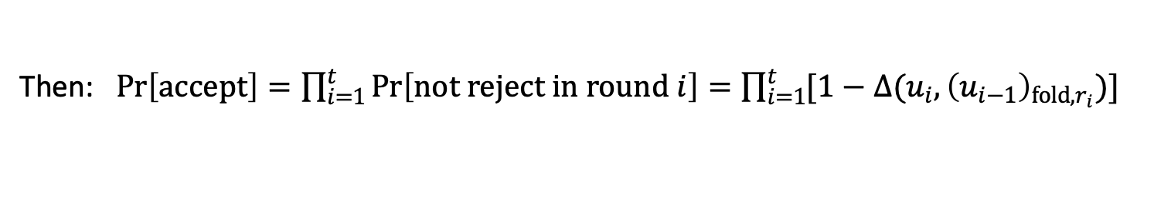

Why is this protocol sound?
Proof idea: To simplify, let’s assume that $m=1$, $η_{0}<1−\sqrt{ρ}$, and
for all $i=1,…,t$ and $r_{i}∊𝔽$ : ${∆(\left(u_{i−1}\right)}_{fold,r_{i}},𝒞_{i})≥{∆(u_{i−1}}_{ },𝒞_{i−1})$
folding does not decrease distance
($∗$)
(note: this only holds w.h.p over $r_{i}∊𝔽$ by folding corollary)
Then: $\operatorname{Pr}\left[accept\right]=\prod_{i=1}^{t}{\operatorname{Pr}\left[not reject in round i\right]}=\prod_{i=1}^{t}{[1−{∆(u_{i},\left(u_{i−1}\right)}_{fold,r_{i}})]}$
independent spot checks per round
prob. $u_{i}$ is accepted after one spot check
$≤exp⁡(−\sum_{i=1}^{t}{{∆(u_{i},\left(u_{i−1}\right)}_{fold,r_{i}}))}≤exp⁡(−\sum_{i=1}^{t}{\left[{∆(\left(u_{i−1}\right)}_{fold,r_{i}},𝒞_{i})−∆\left(u_{i},𝒞_{i}\right)\right])}$
$$∀x: 1−x≤e^{−x}=exp(−x)$$
triangular inequality
$η_{t}=0$ otherwise, Verifier rejects
$≤exp⁡(−\sum_{i=1}^{t}{[∆\left(u_{i−1},𝒞_{i−1}\right)−∆\left(u_{i},𝒞_{i}\right)])}=$ ${exp⁡(η}_{t}−η_{0})={exp⁡(−η}_{0})≤1−η_{0}/2$
($∗$)
Notes:
This proof ignores the probability that (*) does not hold, which happens with probability at most t*err. So, Pr[accept] is increased by t*err.

Slide 34



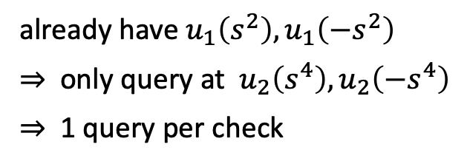

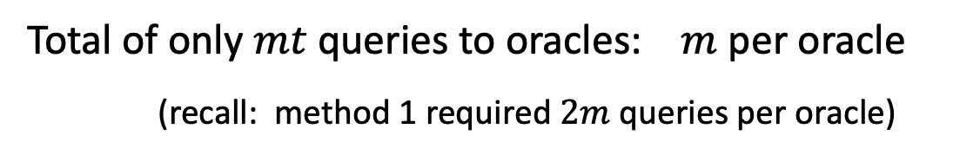


How to spot check: method 2 (the FRI method)
Correlated spot checks: spot check starting at a random $s∊ℒ$
-$s$
$$s$$
$$u_{0}:ℒ⇾𝔽$$
already have $u_{1}\left(s^{2}\right),u_{1}\left(−s^{2}\right)$
⇒ only query at $u_{2}\left(s^{4}\right),u_{2}\left({−s}^{4}\right)$
⇒ 1 query per check
$$u_{1}:ℒ^{2}⇾𝔽$$
$${−s}^{2} s^{2}$$
$$u_{2}:ℒ^{4}⇾𝔽$$
$${−s}^{4} s^{4}$$
$$u_{3}:ℒ^{8}⇾𝔽$$
$${−s}^{8} s^{8}$$
Total of only $mt$ queries to oracles: $m$ per oracle
(recall: method 1 required $2m$ queries per oracle)

Slide 35
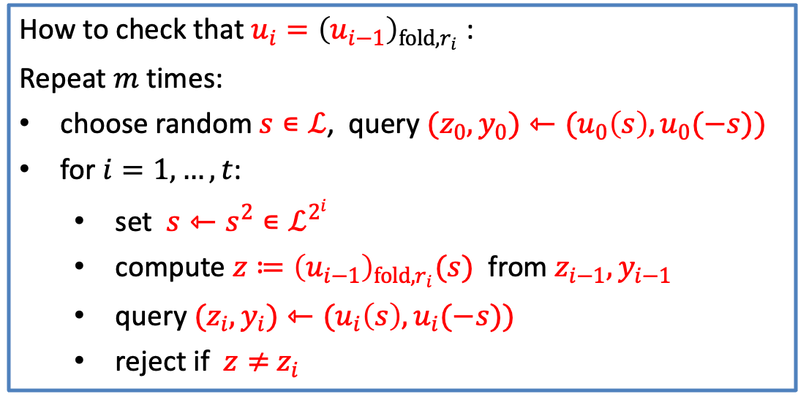
How to spot check: the FRI method
Let $𝒞=RS[𝔽,ℒ,d]$, $u_{0}:ℒ⇾$ $𝔽$
How to check that $u_{i}={\left(u_{i−1}\right)}_{fold,r_{i}}$ :
Repeat $m$ times:
choose random $s∊ℒ$, query ${(z}_{0},y_{0})⇽{(u}_{0}\left(s\right),u_{0}(−s))$
for $i=1,…,t$:
  set $s⇽s^{2}∊ℒ^{2^{i}}$
  compute ${z≔\left(u_{i−1}\right)}_{fold,r_{i}}(s)$ from $z_{i−1},y_{i−1}$
  query ${(z}_{i},y_{i})⇽{(u}_{i}\left(s\right),u_{i}(−s))$
  reject if $z≠$ $z_{i}$
only one
query
per round
Notes:
No more prover. Only interact with oracles.

Slide 36
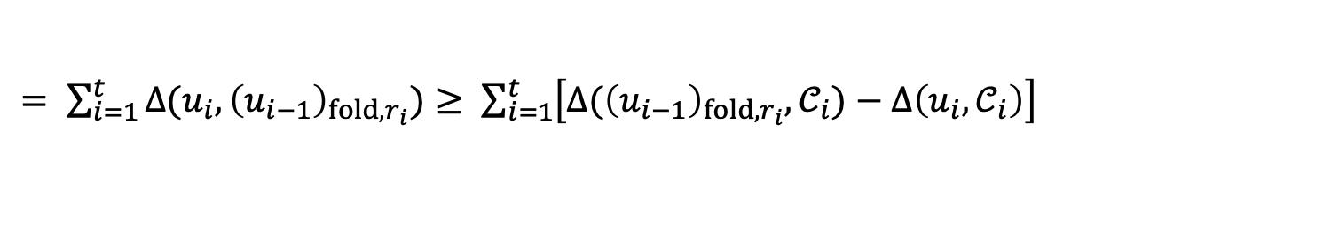




Why is this sound? (using notation as in earlier proof)
[BKS’18, Thm 7.2]
Proof idea: To simplify, let’s assume that $m=1$, $η_{0}<1−\sqrt{ρ}$, and
for all $i=1,…,t$ and $r_{i}∊𝔽$ : ${∆(\left(u_{i−1}\right)}_{fold,r_{i}},𝒞_{i})≥{∆(u_{i−1}}_{ },𝒞_{i−1})$
folding does not decrease distance
($∗$)
Then: $\operatorname{Pr}\left[reject\right]=\operatorname{Pr}\left[\bigcup_{i=1}^{t}{(not reject in round i)}\right]=\sum_{i=1}^{t}{\operatorname{Pr}\left[not reject in round i\right]}$
can be made into a union of disjoint events
$= \sum_{i=1}^{t}{{∆(u_{i},\left(u_{i−1}\right)}_{fold,r_{i}})}≥ \sum_{i=1}^{t}{\left[{∆(\left(u_{i−1}\right)}_{fold,r_{i}},𝒞_{i})−∆\left(u_{i},𝒞_{i}\right)\right]}$
triangular inequality
$η_{t}=0$ otherwise, Verifier rejects
$≥ \sum_{i=1}^{t}{\left[∆\left(u_{i−1},𝒞_{i−1}\right)−∆\left(u_{i},𝒞_{i}\right)\right]} =$ $η_{0}−η_{t} = η_{0} ⇒ \operatorname{Pr}\left[accept\right]≤1−η_{0}$
($∗$)
Notes:
This proof ignores the probability that (*) does not hold, which happens with probability at most t*err. So, Pr[reject] is decreeased by t*err.

Slide 37

Comparing methods 1 vs. 2
The FRI method has better soundness: for $η_{0}= ∆\left(u_{0},𝒞_{0}\right)<$ $1−\sqrt{ρ}$
method 1: Pr[Verifier accepts $u_{0}$] ≤ ${\left(1−{\frac{1}{2}η}_{0}\right)}^{m}$
FRI method: Pr[Verifier accepts $u_{0}$] ≤ ${\left(1−η_{0}\right)}^{m}$ (lower prob. ⇒ better bound)
To obtain a SNARK via the BCS’16 compiler we need round-by-round soundness
method 1: independent spot checks ⇒ easy to prove R-by-R soundness
FRI method: correlated spot checks ⇒ harder to prove R-by-R soundness
(see [BJKTTZ’23] for R-by-R analysis of FRI)

Slide 38






The number of spot checks $m$
Goal: $u_{0}$ is $δ$-far from $RS\left[𝔽,ℒ,d\right]$ ⇒ Pr[Verifier accepts $u_{0}$] ≤ $1/2^{128}$
For $δ<1−\sqrt{ρ}$ : when $u_{0}$ is $δ$-far from $RS\left[𝔽,ℒ,d\right]$ we know that
Pr[ FRI Verifier accepts $u_{0} ]≤(1−$ $δ)^{m}$
So: we want $m$ where $(1− δ)^{m} ≤1/2^{128}$
⇒ $m≥−128/\log_{2}{(1−δ})$
$$m$$
$$δ$$
Main point: (1) the bigger $δ$ is, the smaller $m$ needs to be
(2) smaller $m$ ⇒ shorter proof and faster verifier

Slide 39



Choosing the code rate $ρ=d/|ℒ|$
in practice, set $δ=δ_{max}≈1−\sqrt{ρ}$ (to get smallest possible $m$)
Example 1: $ρ=1/2$
⇒ $δ_{max}≈0.29$ , $\left|ℒ\right|=2d$
Example 2 : $ρ=1/4$
⇒ $δ_{max}≈0.5$ , $\left|ℒ\right|=4d$
(Plonky3)
Proof length: Longer Shorter (smaller $m$)
Prover work: Less More
shorter codewords ⇒ less work for Prover to commit
Notes:
d = degree of the polynomial we are committing to.
We can set $δ=1−\sqrt{ρ}$ because our Poly-IOP ➔ IOP compiler works for such $δ$ (because DEEP works). Also FRI analysis works.

Slide 40

Is 128-bit security enough??
Suppose $m$ is such that Pr[ FRI Verifier accepts a far $u_{0}$ ] ≤ $2^{−128}$
Fact 1: An adversary that runs FRI $2^{128}$ times will find a run with favorable spot checks (and forge a proof) with probability $≈1/2$
Fact 2: An adversary that runs FRI $2^{80}$ times will find a run with favorable spot checks (and forge a proof) with probability $≈2^{−48}$
For most applications this is sufficient
⇒ do not use less than 120-bits of security; otherwise a $2^{80}$ adv. will forge proofs.
Notes:
Commits to different u_1 every time to randomize the set of queries.
“Forge proof” means “create a valid proof of a false statement”
$$2^{−48}≈{10}^{−14}$$

Slide 41
FRI variants
Higher-order folding
Batch FRI for varying degrees
Reduce proof size by grinding
STIR and WHIR variants

Slide 42




















(1) The benefits of higher-order folding
$$|ℒ|=n$$
2-way folding three times
8-way folding once
$$s$$
…
$$sμ^{3}$$
…
$$sμ^{7}$$
$−s$ $s$
$$u_{0}:ℒ⇾𝔽$$
$$coset of roots of s^{8}$$
degree-8
FFT
$$η^{8}=1$$
$$u_{1}:ℒ^{2}⇾𝔽$$
$$s^{2}$$
-$s^{2}$
$$u_{2}:ℒ^{4}⇾𝔽$$
$$s^{4}$$
Shorter
proof
$$u_{3}:ℒ^{8}⇾𝔽$$
$$s^{8}$$
$$s^{8}$$
Protocol has $t=\log_{2}{n}$ rounds
Protocol has $\log_{8}{n}=t/3$ rounds
But: total of 6 queries per 8-way step
vs. total of 8 queries per 8-way step
Can shrink Merkle proofs by placing entire coset in one leaf of Merkle tree:
⇒ 3 Merkle proofs are about $3\log_{2}n$ hashes
⇒ 1 Merkle proof is about $\log_{2}n$ hashes
Notes:
Fewer rounds means fewer Merkle commitments. Fewer queries means fewer Merkle proofs. But we can batch Merkle proofs.

Slide 43



(2) Batch FRI for varying degrees: two methods
Poly-IOPP often do multiple RS proximity tests:
Let $u_{j}:$ $ℒ_{j}$⇾ $𝔽$ be words for $j=1,…,k$
All $u_{1},…,u_{k}$ are encoded with the same rate $ρ=d_{j}/|ℒ_{j}|$
Goal: reject if for any $j$, $u_{j}$is $δ$-far from $RS\left[𝔽,ℒ_{j},d_{j}\right]$
different $d_{j}$
The plan: test all $k$ words as a batch.

Slide 44









Method 1: degree padding
Let $d_{max}≔\max_{j}{d_{j}}$ , $ℒ_{max}$ $≔\bigcup_{j}{ℒ_{j}}$
$u_{1}:$ $ℒ_{1}$⇾ $𝔽$
$d_{1}=d_{max}$ ($=$ $ρ∙\left|ℒ_{max}\right|$ )
$u_{2}$: $ℒ_{2}$⇾ $𝔽$
$$d_{2}=d_{max}/4$$
$u_{3}$: $ℒ_{3}$⇾ $𝔽$
$$d_{3}=d_{max}/2$$
$u_{4}$: $ℒ_{4}$⇾ $𝔽$
$$d_{4}=d_{max}$$
Honest prover can interpolate all $u_{1},…,u_{k}$ to $ℒ_{max}$

Slide 45





Method 1: degree padding
Let $d_{max}≔\max_{j}{d_{j}}$ , $ℒ_{max}$ $≔\bigcup_{j}{ℒ_{j}}$
$u_{1}:$ $ℒ_{max}$⇾ $𝔽$
$d_{1}=d_{max}$ ($=$ $ρ∙\left|ℒ_{max}\right|$ )
$u_{2}$: $ℒ_{max}$⇾ $𝔽$
$$d_{2}=d_{max}/4$$
pad
$u_{3}$: $ℒ_{max}$⇾ $𝔽$
$$d_{3}=d_{max}/2$$
$u_{4}$: $ℒ_{max}$⇾ $𝔽$
$$d_{4}=d_{max}$$
Prover can interpolate all $u_{1},…,u_{k}$ to $ℒ_{max}$

Slide 46








Method 1: degree padding
Now, batch as follows: Verifier samples a random $r∊𝔽$, sends to prover
Honest prover defines: $v_{r}$: $ℒ_{max}⇾𝔽$ as
$$v_{r}\left(a\right) ≔ \sum_{j=0}^{k}{ \sum_{i=0}^{d_{max}−d_{j}}{r^{e_{i,j}}}∙{[a}^{i}∙u_{j}\left(a\right)}]$$
where $e_{i,j}$ is a running counter
Example: suppose $\left(u_{1},d_{1}\right),\left(u_{2},d_{2}\right),\left(u_{3},d_{3}\right)$ s.t. $d_{1}=3, d_{2}=4,{ d}_{3}=5.$
$v_{r}(a)$ $≔$ ${[u}_{1}(a)+r$ $∙{au}_{1}\left(a\right)+r^{2}∙{a^{2}u}_{1}\left(a\right)]+{[r}^{3}{∙u}_{2}\left(a\right)+r^{4}∙{au}_{2}\left(a\right)]+r^{5}{∙u}_{3}(a)$
linear comb. of $u_{1}\left(a\right), au_{1}\left(a\right), { a}^{2}u_{1}\left(a\right)$
linear comb. of $u_{2}\left(a\right), au_{2}\left(a\right)$
$u_{1}∊RS\left[𝔽,ℒ_{1},3 \right]$ ⇒ $a^{2}u_{1}\left(a\right)∊RS\left[𝔽,ℒ_{1},5 \right]$
$u_{2}∊RS\left[𝔽,ℒ_{2},4 \right]$ ⇒ $au_{2}\left(a\right)∊RS\left[𝔽,ℒ_{2},4 \right]$
Notes:
So all of u1, u2, u3 are now elevated to be degree 5.

Slide 47

Method 1: degree padding
Lemma: [STIR, Lemma 4.13] the transform $\left(u_{1},…,u_{k};r\right)⇾v_{r}$ is distance preserving
case 1: (the honest case)
if ${∀j: u}_{j}∈RS[𝔽,ℒ_{j},d_{j}]$ then $v_{r}∈RS[𝔽,ℒ_{max},d_{max}]$ for all $r$.
case 2: (the dishonest case)
if some $u_{j}$ is $δ$-far from $RS[𝔽,ℒ_{j},d_{j}]$ then
$v_{r}$ is $δ$-far from $RS[𝔽,ℒ_{max},d_{max}]$, w.h.p over $r$.
The proof follows directly from the RS proximity gap (the BCIKS’20 theorem)
Prover now uses an RS-IOPP to prove that $v_{r}$ is $δ$-close to $RS[𝔽,ℒ_{max},d_{max}]$

Slide 48











Method 2: pipelining (no padding or interpolation)
Prover $P\left(𝒞,{(u}_{1},u_{2},u_{3}), ∙\right)$
Verfier $V^{u_{1},u_{2},u_{3}}\left(𝒞\right)$
suppose $d_{2}=d_{1}/2$ and $d_{3}=d_{1}/4$
Phase 1: (commit)
sample $r_{1}←𝔽$
honest prover:
$$w_{1}≔{\left(u_{1}\right)}_{fold,r_{1}}+r_{1}^{2}u_{2}$$
$$w_{1}:ℒ^{2}⇾𝔽$$
|$ℒ^{2}|=|ℒ|/2$
(fold $u_{2}$ into $w_{1}$)
honest prover:
sample $r_{2}←𝔽$
$$w_{2}≔{\left(w_{1}\right)}_{fold,r_{2}}+r_{2}^{2}u_{3}$$
$$w_{2}:ℒ^{4}⇾𝔽$$
|$ℒ^{4}|=|ℒ|/4$
(fold $u_{3}$ into $w_{2}$)
⋮
⋮

Slide 49







(3) Grinding to reduce # of spot checks
Prover $P\left(\left(𝒞,δ\right),u_{0}, ∙\right)$
Verfier $V^{u_{0}}\left(\left(𝒞,δ\right)\right)$
Commit phase:
$$u_{1}:ℒ^{2}⇾𝔽$$
$$u_{2}:ℒ^{4}⇾𝔽$$
MerkleCommits (including $u_{0}$)
$$u_{3}:ℒ^{8}⇾𝔽$$
Query phase:
(Fiat-Shamir)
Derive queries for spot checks by hashing all MerkleCommits
Goal: reduce the number of spot checks $m$ (to reduce proof size)
The problem: reducing $m$ below the computed bound enables adversary to try
multiple MerkleCommits, until it finds a favorable set of spot checks

Slide 50





Grinding to reduce # of spot checks
One option: add a grinding phase after commit phase (often used in FRI)
Commit phase:
$$u_{1}:ℒ^{2}⇾𝔽$$
$$u_{2}:ℒ^{4}⇾𝔽$$
MerkleCommits (including $u_{0}$)
$$u_{3}:ℒ^{8}⇾𝔽$$
Grind:
Find $G$ s.t. MSB(SHA3($G,$MerkleCommits,nonce)) $=0^{64}$
Query phase:
(Fiat-Shamir)
Derive queries for spot checks by hashing
all MerkleCommits AND $G$
Nonce prevents adversary from pre-computing $G$ (e.g, nonce = head of blockchain)
Notes:
https://eprint.iacr.org/2021/582.pdf (Section 3.11.3)

Slide 51


Why does grinding help?
Adversary: wants $δ$-far $u_{0}$ for which it can generate an RS-proximity proof
FRI without grinding:
$m$ is set so that E[time to find $δ$-far $u_{0}$ with favorable queries] ≥ $2^{128}$
⇒ time to find a false proximity proof is $≈2^{128}$
FRI with grinding: every $u_{0}$ attempt takes time $≈2^{64}$ to find $G$
⇒ suffice that E[time to find $δ$-far $u_{0}$ with favorable queries] ≥ $2^{64}$
⇒ can halve the number of spot checks $m$
⇒ shrink proof length by about $×2$
(${128}/{−\log_{2}{(1−δ})} ⇾$ ${64}/{−\log_{2}{(1−δ})}$ )
Notes:
https://eprint.iacr.org/2021/582.pdf (Section 3.11.3)

Slide 52











(4) STIR: an FRI variant [ACFY’24]
Recall: in FRI, distances and # spot checks $m$ are fixed round-to-round
# spot
checks
Honest prover
Dishonest prover
input: $u_{0}$
distance $u_{0}$ to $RS\left[𝔽,ℒ,d\right]$:
0
$$1−\sqrt{ρ}$$
1
0
$$1−\sqrt{ρ}$$
1
round 1: (4-way fold)
distance $u_{1}$ to $RS\left[𝔽,ℒ^{4},d/4\right]$:
$$m$$
0
$$1−\sqrt{ρ}$$
1
0
$$1−\sqrt{ρ}$$
1
round 2: (4-way fold)
distance $u_{2}$ to $RS\left[𝔽,ℒ^{16},d/16\right]$:
$$m$$
0
$$1−\sqrt{ρ}$$
1
0
$$1−\sqrt{ρ}$$
1

Slide 53










STIR: an FRI variant [ACFY’24]
STIR main idea: in each round reduce the rate and increase distance
⇒ # spot checks can be decreased from round to round
Honest prover
Dishonest prover
# spot
checks
input: $u_{0}$
distance $u_{0}$ to $RS\left[𝔽,ℒ,d\right]$:
(rate $ρ$)
0
$$1−\sqrt{ρ}$$
1
0
1
round 1: (4-way fold)
distance $u_{1}$ to $RS\left[𝔽,ℒ_{1},d/4\right]$:
$$m_{1}$$
(rate $ρ/2$)
0
1
0
$$1−\sqrt{ρ/2}$$
1
round 2: (4-way fold)
distance $u_{2}$ to $RS\left[𝔽,ℒ_{2},d/16\right]$:
smaller
$$m_{2}$$
(rate $ρ/4$)
0
1
0
$$1−\sqrt{ρ/4}$$
1
Notes:
Explain in the diagram how the rate decreases from round to round. This then mean that the distance can increase.
We just need a transformation that has the required properties: keep in RS word in RS, and increases the distance of a far away word.

Slide 54







STIR: an FRI variant [ACFY’24]
Idea 1: reduce the code rate by making the honest prover interpolate
Goal: prove $u_{0}$ is $δ$-close to $RS[𝔽,ℒ,d]$
rate = $ρ=d/|ℒ|$
$u_{0}:ℒ$ ⇾ $𝔽$
4-way fold
$$v_{0}$$
send $v_{0}$:${ωℒ}^{2}$⇾ $𝔽$ to Verifier
honest prover interpolates $v_{0}$ from ${{(u}_{0})}_{4fold,r}$
interpolate
domain = $ℒ^{4}$
domain = ${ωℒ}^{2}$ (half the size of $ℒ$)
New goal: prove $v_{0}$ is $δ$-close to $RS[𝔽,{ωℒ}^{2},d/4]$
rate $=(d/4)/({|ℒ|}/2)$ $=ρ/2$ ⇒ lower rate

Slide 55

STIR: an FRI variant [ACFY’24]
Idea 1: reduce the code rate by making the honest prover interpolate
Goal: prove $u_{0}$ is $δ$-close to $RS[𝔽,ℒ,d]$
rate = $ρ=d/|ℒ|$
$u_{0}:ℒ$ ⇾ $𝔽$
4-way fold
$$v_{0}$$
send $v_{0}$:${ωℒ}^{2}$⇾ $𝔽$ to Verifier
honest prover interpolates $v_{0}$ from ${{(u}_{0})}_{4fold,r}$
interpolate
domain = $ℒ^{4}$
domain = ${ωℒ}^{2}$ (half the size of $ℒ$)
Main point: Lower rate $ρ/2$means # spot checks for new goal $v_{0}$ can be smaller.
Rate drops by a factor of 2 after every folding step ⇒ shorter overall proof
Notes:
${{(u}_{0})}_{4fold,r}$ defines a polynomial. Compute u1 by evaluating this polynomial on ${ωℒ}^{2}$ .

Slide 56




STIR: an FRI variant [ACFY’24]
The problem: now we cannot spot check $v_{0}$:${ωℒ}^{2}$⇾ $𝔽$
$u_{0}:ℒ$ ⇾ $𝔽$
4-way fold
$$v_{0}$$
send $v_{0}$:${ωℒ}^{2}$⇾ $𝔽$ to Verifier
interpolate
how to spot check this?
Its 4th roots are not in $ℒ$ !!
Can only spot check here
Idea 2: use quotienting for two things:
  spot checks on $v_{0}$ , and
  for a malicious prover, increase distance to $RS[𝔽,{ωℒ}^{2},d/4]$

Slide 57









How to spot check $v_{0}$by quotienting
How? Honest prover will quotient $v_{0}$ by the query points
Verfier $V$
$u_{0}:ℒ$ ⇾ $𝔽$
4-way fold
$$v_{0}$$
send $v_{0}$:${ωℒ}^{2}$⇾ $𝔽$ to Verifier
Verifier sends an out of domain query $t∈𝔽∖ℒ^{4}$
force prover to choose
one $f∊𝔽^{<d/4}\left[X\right]$ s.t.
$\overline{f}∊List$[$v_{0}, d/4$, $1−\sqrt{ρ/2}$ $]$
Prover sends back $y≔f(t)$
Honest prover will use $f∊𝔽^{<d/4}\left[X\right]$ s.t. $\overline{f}={{(u}_{0})}_{4fold,r}$ on $ℒ^{4}$

Slide 58




How to spot check $v_{0}$by quotienting
How? Honest prover will quotient $v_{0}$ by the query points
Verfier $V$
$u_{0}:ℒ$ ⇾ $𝔽$
4-way fold
$$v_{0}$$
send $v_{0}$:${ωℒ}^{2}$⇾ $𝔽$ to Verifier
Verifier sends an out of domain query $t∈𝔽∖ℒ^{4}$
Honest prover defines $u_{1}$ as
the result of quotienting $v_{0}$ by
{ $(t,y), (s_{1},y_{1}),…,(s_{m},y_{m})$}
Prover sends back $y≔f(t)$
Verifier sends spot check points $s_{1},…,s_{m}∊ℒ^{4}$
Prover sends back $y_{i}≔f\left(s_{i}\right)$, $i=1,…,m$
$u_{1}$:${ωℒ}^{2}$⇾ $𝔽$
Notes:
Verifier defines the quotienting polynomial $I(X)$ itself.

Slide 59

How to spot check $v_{0}$by quotienting
How? Honest prover will quotient $v_{0}$ by the query points
Verfier $V$
$u_{0}:ℒ$ ⇾ $𝔽$
4-way fold
$$v_{0}$$
send $v_{0}$:${ωℒ}^{2}$⇾ $𝔽$ to Verifier
Verifier sends an out of domain query $t∈𝔽∖ℒ^{4}$
That is, $u_{1}\left(a\right)≔\frac{v_{0}\left(a\right)−I(a)}{V(a)}$ where
$I\left(t\right)=y$ and $I\left(s_{i}\right)=y_{i}$
$V\left(t\right)=0$ and $V\left(s_{i}\right)=0$
Prover sends back $y≔f(t)$
Verifier sends spot check points $s_{1},…,s_{m}∊ℒ^{4}$
Prover sends back $y_{i}≔f\left(s_{i}\right)$, $i=1,…,m$
$u_{1}$:${ωℒ}^{2}$⇾ $𝔽$
In query phase, Verifier computes $y_{i}$ itself by querying $u_{0}$ at $4m$ points and folding

Slide 60
How to spot check $v_{0}$by quotienting
How? Honest prover will quotient $v_{0}$ by the query points
Verfier $V$
$u_{0}:ℒ$ ⇾ $𝔽$
4-way fold
$$v_{0}$$
send $v_{0}$:${ωℒ}^{2}$⇾ $𝔽$ to Verifier
Verifier sends an out of domain query $t∈𝔽∖ℒ^{4}$
That is, $u_{1}\left(a\right)≔\frac{v_{0}\left(a\right)−I(a)}{V(a)}$ where
$I\left(t\right)=y$ and $I\left(s_{i}\right)=y_{i}$
$V\left(t\right)=0$ and $V\left(s_{i}\right)=0$
Prover sends back $y≔f(t)$
Verifier sends spot check points $s_{1},…,s_{m}∊ℒ^{4}$
Prover sends back $y_{i}≔f\left(s_{i}\right)$, $i=1,…,m$
$u_{1}$:${ωℒ}^{2}$⇾ $𝔽$
Iterate to prove that $u_{1}$ is $(1−\sqrt{ρ/2}$ )-close to $RS[𝔽,{ωℒ}^{2},d/4]$ with a smaller $m$

Slide 61


STIR: summary
Main benefit: STIR proof is about $2×$ shorter than FRI proof
Cons:
Prover is a bit slower because of interpolation and quotienting
Verifier is a bit slower because of quotienting
Batching via pipelining is more cumbersome:
  Often, functions to batch are all defined using the same rate $ρ$,
  but STIR iterations use a different rate in every round
  ⇒ Prover will need to interpolate functions to expand to lower rate
(using the same rate $ρ$ for the input $u_{0}$)
Notes:
To batch via pipelining, honest prover will need to interpolate the batched polynomials to the correct rate.

Slide 62

WHIR: better than STIR [ACFY’24]
WHIR: combines all spot checks into a Sumcheck ⇒ no quotienting
Fold $k$ levels per round, but Verifier now does fewer field ops.
⇒ fast verifier ($≈$1.9M gas in the EVM)
Supports queries to a multilinear polynomial (not just univariate)
How? Not today. (Builds on BaseFold)
Notes:
Quotienting requires interpolating a polynomial of degree m on random points, which is slow.
EVM cost: For a multivariate polynomial of 22 variables and 100 bits of security, verification costs are 1.9m gas.

Slide 63


WHIR: better than STIR [ACFY’24]
Goal: fold $k$ levels at a time where $k=O(\log{\log{d)}}$.
Further shrinks the proof size.
The problem: with FRI or STIR, this results in many field ops for Verifier per round (for computing the folding and quotienting)
WHIR: combines all spot checks into a Sumcheck ⇒ no quotienting
Fold $k$ levels per round, but Verifier now does fewer field ops.
⇒ fast verifier ($≈$1.9M gas in the EVM)
Supports queries to a multilinear polynomial (not just univariate)
How? Not today. (Builds on BaseFold)
Notes:
Quotienting requires interpolating a polynomial of degree m on random points, which is slow.
EVM cost: For a multivariate polynomial of 22 variables and 100 bits of security, verification costs are 1.9m gas.

Slide 64
The future: other codes
Are there better codes than Reed-Solomon?

Slide 65

The problem with RS-based SNARKs
Not field agnostic: requires an $n$-th primitive root of unity in $𝔽$
⇒ can only use fields where $n=|ℒ|$ divides $|𝔽|−1$
⇒ difficult to support specific fields (e.g., for ECDSA arithmetic)
Encoding is done via an FFT: takes time $O(n∙log{n)}$
⇒ when $n≈2^{20}$, the $(\log_{2}{n)}$ causes $20×$ work for prover
FRI enables: a (univariate Poly-IOP) ⇾ IOP compiler
⇒ what about (multilinear Poly-IOP) ⇾ IOP compiler??
e.g., $g\left(x_{1},x_{2},x_{3}\right)=5x_{1}+2x_{2}+4x_{1}x_{2}+12x_{1}x_{3}+7x_{1}x_{2}x_{3}$
Notes:
multilinear Poly-IOP lead to faster SNARKs.

Slide 66



FRI-like proximity proof for other linear codes
FRI can be generalized to any ${\left[n,k,l\right]}_{p}$ linear code $𝒞⊆{ 𝔽}^{n}$ where:
  There is a sequence of linear codes $𝒞=𝒞_{0}, 𝒞_{1}, … , 𝒞_{t}$ s.t.
  $𝒞_{i}$ is a ${\left[n_{i},k_{i},l_{i}\right]}_{p}$ linear code where $n=n_{0}>n_{1}>…>n_{t}$
  and $n_{t}$ is “sufficiently small”,
  there are distance preserving maps $𝒞_{i−1}⇾ 𝒞_{i}$ for $i=1,…,t$ ,
  there is a “fast” encoding algorithm ${ 𝔽}^{k}⇾𝒞$, and
  min-distance of $𝒞_{0}$ is sufficiently large
(to reduce # of spot checks)
$$k$$
$$n$$

Slide 67

A proximity proof for other linear codes
A field agnostic proximity test: (e.g., FRI over the ECDSA prime)
Gives a (univariate Poly-IOPP) ⇾ IOPP over an arbitrary prime $p$
ECFFT [BCKL’22]:
FRI using functions over an elliptic curve $E/𝔽_{p}$ ,
where the order of $E(𝔽_{p})$is divisible by $n$
(even though $p$ is not)
(2) a proximity proof for algebraic geometric codes [BLNR’20].
Here polynomials are replaced with “functions on a curve”

Slide 68



A proximity proof for other linear codes
Circle Stark [HLP’24]: Let $M_{11}≔2^{31}−1$ (the 11th Mersenne prime)
arithmetic mod $M_{11}$ is super fast, ($x mod M_{11}$ is just an addition)
but $M_{11}−1$ is not divisible by a high power of 2
Instead: run FRI over the projective line mod $M_{11}$ whose size is $M_{11}+1$
One way to represent the projective line is as points on a circle:
$$∞$$
divisible by a high power of 2
$$𝔽_{p}$$
0
So: the circle ($x^{2}+y^{2}=1$) is the same as $𝔽_{p}∪\{∞\}$ ⇒ $(p+1)$ points

Slide 69
BaseFold [ZCF’23]
BaseFold: generalizes FRI to any foldable code
⇒ The generalization gives a field agnostic proximity test
[note: every foldable code is a multilinear Reed-Muller code]
For a (multilinear Poly-IOPP) ⇾ IOPP compiler need a multilinear PCS
The problem: quotienting only applies to univariates
BaseFold solution:
build a multilinear PCS from Sumcheck and a proximity test
(also adopted into Whir)
How? Not today.

Slide 70












Evaluation proofs for multlinear polymomials
(multilinear Poly-IOPP) ⇾ IOPP compiler using a linear code $𝒞:{ 𝔽}^{2^{k}}⇾{ 𝔽}^{n}$
$$P$$
$$V$$
$$P$$
$$V$$
$$f∊𝔽[X_{1},…,X_{k}]$$
$$π= ∊{ 𝔽}^{n}$$
honest prover: $π≔𝒞(coefs(f))∊{ 𝔽}^{n}$
eval $f$ at $a_{1}∊𝔽∖ℒ$
Define subcode of dimension $2^{k}−1$ :
$𝒞_{a,b}≔$ { $𝒞(coefs(g))$ : $g\left(a\right)=b$}$⊆{ 𝔽}^{n}$
$b_{1}⇽f(a_{1}$)
$$g∊𝔽[X_{1},…,X_{k}]$$
if $π$ can only be $δ$-close to
one $𝒞_{a,b}$ then verifier is
convinced that $f(a)=b$
$δ$-IOPP to prove that $π$ is $δ$-close to $𝒞_{a,b}$
for $δ<$ JohnsonBound($𝒞_{a,b}$)

Slide 71


More SNARK-useful linear codes
Spielman codes: [BCG’20, Breakdown’21, Orion’22]
Linear codes with a good minimum distance
and a very fast (linear time) encoding algorithm $𝔽^{k}⇾𝒞$.
Also field-agnostic.
Cons: large IOPP proof ⇒ large SNARK proof
Expand Accumulate codes: [BFKTWZ’24]
Field-agnostic codes, but shorter proofs than Breakdown
Cons: $O(n∙log{n)}$ time encoding.

Slide 72

More SNARK-useful linear codes
Repeat-Accumulate-Accumulate (RAA) codes: [Blaze’24]
Constructs a multilinear polynomial commitment over $𝔽_{2^{k}}$ with a fast (linear time) prover time and $O(\log^{2}{n})$ proof size
⇒ $𝔽_{2^{k}}$ is friendly to modern CPU instructions
The commitment uses the tensor code approach of [BCG’20] (making use of Sumcheck).
Much more to do in non-RS based SNARKs

Slide 73
Further reading
FRI (2018) and analysis (2018): Fast Reed–Solomon Interactive Oracle Proofs of Proximity
DEEP-FRI (2019): Out of domain sampling improves soundness
BCIKS (2020): Proximity Gaps for Reed–Solomon Codes
CircleSTARK (2024): FRI using a Mersenne prime
STIR (2024): Reed–Solomon proximity testing with fewer queries
WHIR (2024): Reed–Solomon proximity testing with a fast verifier
Beyond Reed-Solomon codes (a few recent results):
Breakdown (2021), Orion (2022): Polynomial commitments with a fast prover
BaseFold (2023): Efficient Polynomial commitments from foldable codes
Blaze (2024): Fast SNARKs from Interleaved RAA Codes
Notes:
More and more Basefold (2024): beyond the unique decoding distance
Also round-by-round soundness of FRI (https://eprint.iacr.org/2023/1071)

Slide 74
END OF MODULE

