Slide 1
FRI and Proximity Proofs:
What they are what they are for
Dan Boneh
Stanford University

Slide 2

Recap: a General Paradigm for a Modern SNARK
$ℱ$-functional commitment
scheme
SNARK for
general circuits
(cryptographic object)
$ℱ$-interactive
oracle proof
($ℱ$− IOP)
(info. theoretic object)

Slide 3



Recap: three function families
$n$ = size of comp. trace
Polynomial-IOP (PIOP) +
Polynomial Commitment
PLONK +
KZG
SNARK
$O(nlogn)$ time prover
Multilinear-IOP (MIOP) +
Multilinear Commitment
HyperPLONK +
Mercury
SNARK
$O(n)$ time prover
Vector-IOP (IOP) +
Vector Commitment
??? +
MerkleTree
???

Slide 4
Papers we discuss in this lecture and the next
FRI (2018) and analysis (2018): Fast Reed–Solomon Interactive Oracle Proofs of Proximity
DEEP-FRI (2019): Out of domain sampling improves soundness
BCIKS (2020): Proximity Gaps for Reed–Solomon Codes
CircleSTARK (2024): FRI using a Mersenne prime
STIR (2024): Reed–Solomon proximity testing with fewer queries
WHIR (2024): Proximity testing with a faster verifier
Beyond Reed-Solomon codes (a few recent results):
Breakdown (2021), Orion (2022): Polynomial commitments with a fast prover
BaseFold (2023): Polynomial commitments from foldable codes with shorter proofs
Blaze (2024): Fast SNARKs from Interleaved RAA Codes
Notes:
More and more Basefold (2024): beyond the unique decoding distance
Also round-by-round soundness of FRI (https://eprint.iacr.org/2023/1071)

Slide 5
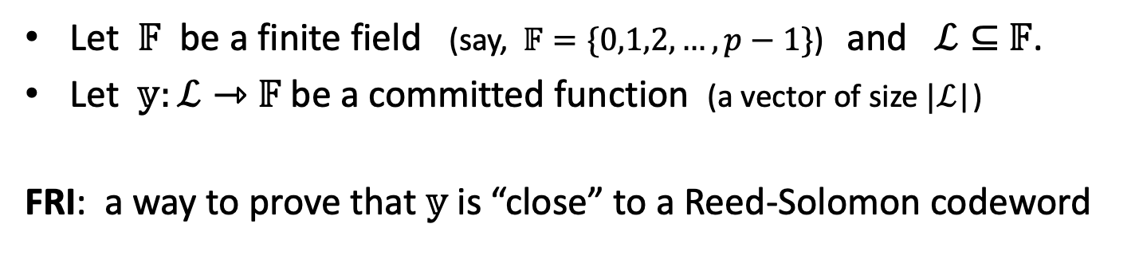
FRI: Fast Reed-Solomon IOPP
Let $𝔽$ be a finite field (say, $𝔽=\{0,1,2,…,p−1\}$) and $ℒ⊆$ $𝔽$.
Let $𝕪:ℒ⇾$ $𝔽$ be a committed function (a vector of size $|ℒ$|)
FRI: a way to prove that $𝕪$ is “close” to a Reed-Solomon codeword
So what? Who cares? What does this even mean?
Let’s get started … first some background

Slide 6
Background
Codes
(2) IOP and IOPP
(3) Poly-IOP

Slide 7
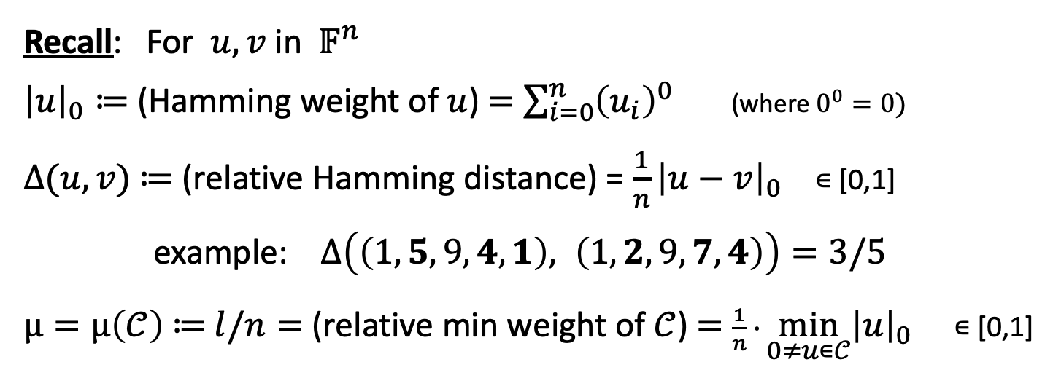
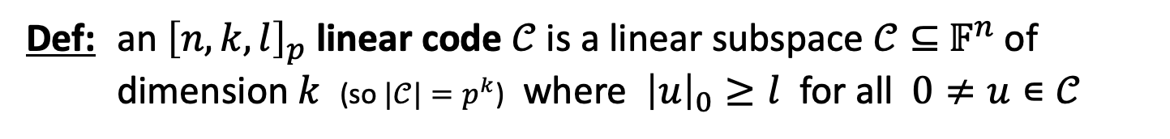
(1) Linear codes
Def: an ${\left[n,k,l\right]}_{p}$ linear code $𝒞$is a linear subspace $𝒞⊆{ 𝔽}^{n}$ of dimension $k$ (so $|𝒞|=p^{k}$) where ${\left|u\right|}_{0}≥l$ for all $0≠u∊𝒞$
Recall: For $u,v$ in ${ 𝔽}^{n}$
${\left|u\right|}_{0}≔$(Hamming weight of $u$) $=$ $\sum_{i=0}^{n}{{\left(u_{i}\right)}^{0}}$ (where $0^{0}=0)$
$∆(u,v)$ ≔ (relative Hamming distance) = ${\frac{1}{n}\left|u−v\right|}_{0}$ ∊ [0,1]
example: $∆\left(\left(1,5,9,4,1\right), \left(1,2,9,7,4\right)\right)=3/5$
$μ=μ\left(𝒞\right) \text{≔} l/n=$ (relative min weight of $𝒞$) $=$ $\frac{1}{n} ∙\min_{0≠u∊𝒞}{{\left|u\right|}_{0}}$ ∊ [0,1]
(sum as integers)

Slide 8
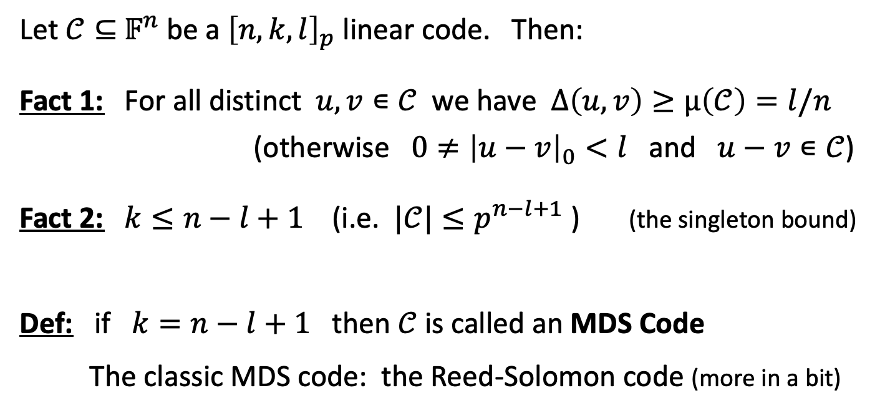
(1) Linear codes
Let $𝒞⊆{ 𝔽}^{n}$ be a ${\left[n,k,l\right]}_{p}$ linear code. Then:
Fact 1: For all distinct $u,v∊𝒞$ we have $∆\left(u,v\right)≥μ\left(𝒞\right)=l/n$
(otherwise ${0≠\left|u−v\right|}_{0}<l$ and $u−v∊𝒞$)
Fact 2: $k≤n−l+1$ (i.e. $|𝒞|≤p^{n−l+1}$ ) (the singleton bound)
Def: if $k=n−l+1$ then $𝒞$is called an MDS Code
The classic MDS code: the Reed-Solomon code (more in a bit)
Notes:
To prove the singleton bound: deleting l-1 coordinates from every codeword is an injective map.
MDS: maximum distance separable

Slide 9
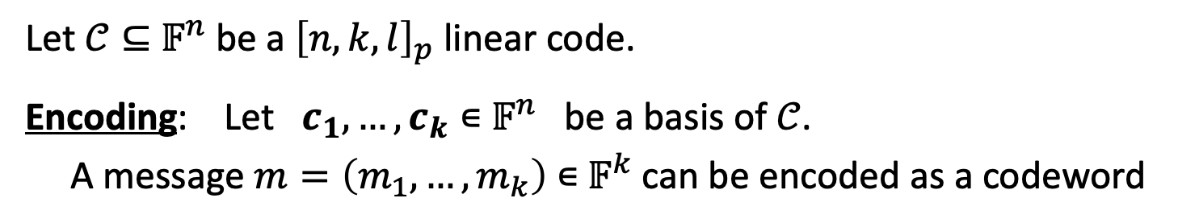



Encoding a message as a codeword
Let $𝒞⊆{ 𝔽}^{n}$ be a ${\left[n,k,l\right]}_{p}$ linear code.
Encoding: Let $c_{1},…,c_{k}∊{ 𝔽}^{n}$ be a basis of $𝒞$.
A message $m=\left(m_{1},…,m_{k}\right)$ $∊{ 𝔽}^{k}$ can be encoded as a codeword
$m∊𝔽^{k}$
encode
$$m_{1}c_{1}+…+m_{k}c_{k}∊𝔽^{n}$$
( $1/ρ$ expansion)
We can treat $𝒞$ as a linear map $𝒞:𝔽^{k}⇾𝔽^{n}$ that encodes messages in $𝔽^{k}$
Def: The rate of a code is $ρ≔k/n∊[0,1]$ (e.g., $ρ=0.5)$
In practice: for fast encoding, want $ρ$ as large as possible ($ρ$=0.5 ⇒ $n$=$2k$)

Slide 10
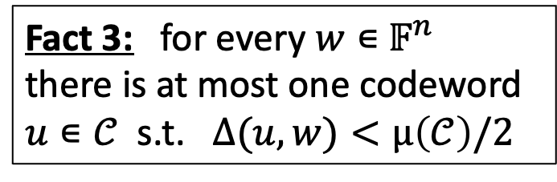






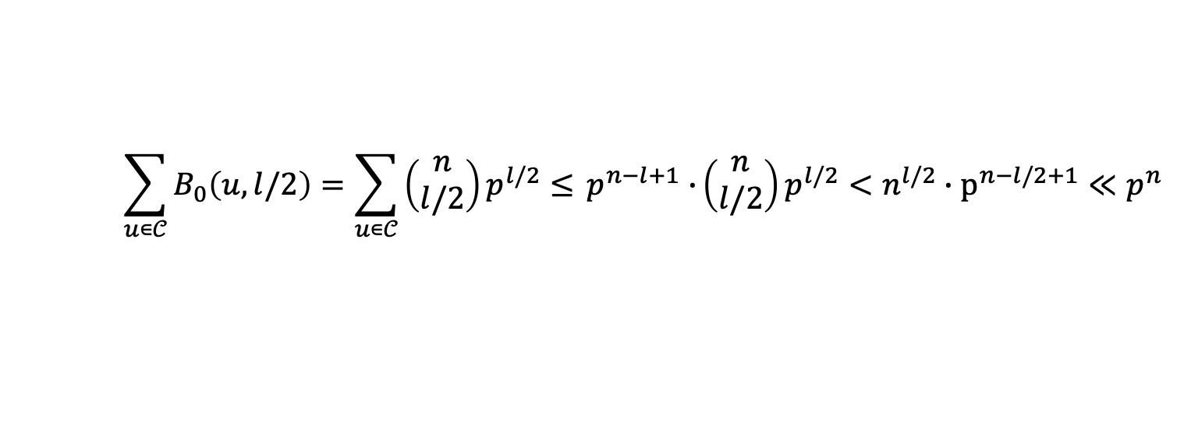

Unique decoding distance (${\left[n,k,l\right]}_{p}$ linear code)
$$w∊{ 𝔽}^{n}$$
Fact 3: for every $w∊{ 𝔽}^{n}$
there is at most one codeword
$u∊𝒞$ s.t. $∆(u,w)<μ\left(𝒞\right)/2$
$$∆(u,v)≥μ\left(𝒞\right)$$
$$v∊𝒞$$
$$u∊𝒞$$
(by triangular inequality)
Def: $μ\left(𝒞\right)/2$ in $[0,0.5]$ is called the unique decoding distance of 𝒞
Most $w∊{ 𝔽}^{n}$ are not uniquely decodable
$$n<p$$
$$\sum_{u∊𝒞}{B_{0}\left(u,l/2\right)=\sum_{u∊𝒞}{\left(\begin{matrix}n \\ l/2\end{matrix}\right)p^{l/2}≤} p^{n−l+1}∙}\left(\begin{matrix}n \\ l/2\end{matrix}\right)p^{l/2}<n^{l/2}∙p^{n−l/2+1}≪p^{n}$$
Notes:
Namely: most $w∊{ 𝔽}^{n}$ are not within $∆\left(𝒞\right)/2$ of any codeword in $𝒞$.

Slide 11

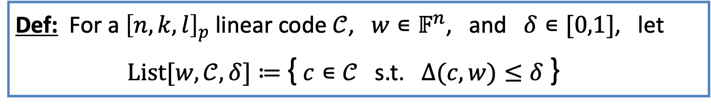
List decoding
Def: For a ${\left[n,k,l\right]}_{p}$ linear code $𝒞$, $w∊𝔽^{n}$, and $δ∊[0,1]$, let
$List[w,𝒞, δ]≔$ { $c∊𝒞$ s.t. $∆(c,w)≤δ$ }
Then $δ<$ $μ\left(𝒞\right)/2$ ⇒ |$List[w,𝒞, δ]$|$≤1$
(unique decoding distance)

Slide 12


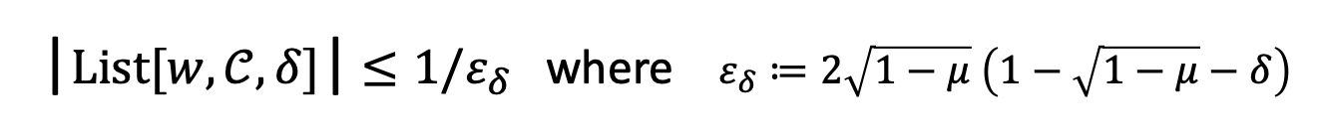




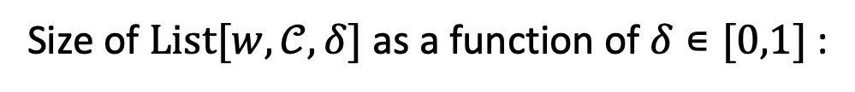




List decoding
The Johnson bound: For $𝒞⊆{ 𝔽}^{n}$, $w∊𝔽^{n}$, $0<δ<1−\sqrt{1−μ}$
|$List[w,𝒞, δ]$|$≤1/ε_{δ}$ where $ε_{δ}≔2\sqrt{1−μ}$ $\left(1−\sqrt{1−μ}−δ\right)$
( blows up as $δ$ approaches$1−\sqrt{1−μ}$ )
Size of $List[w,𝒞, δ]$ as a function of $δ∊[0,1]$ :
$$𝒞$$
size ≤1
size ≤ $1/ε_{δ}$
depends on $𝒞$
$$≥p$$
$$δ=0$$
$μ$/2
$$1−\sqrt{1−μ}$$
$$μ$$
$$1$$
(uniqueness bound)
(Johnson bound)
(capacity bound)

Slide 13
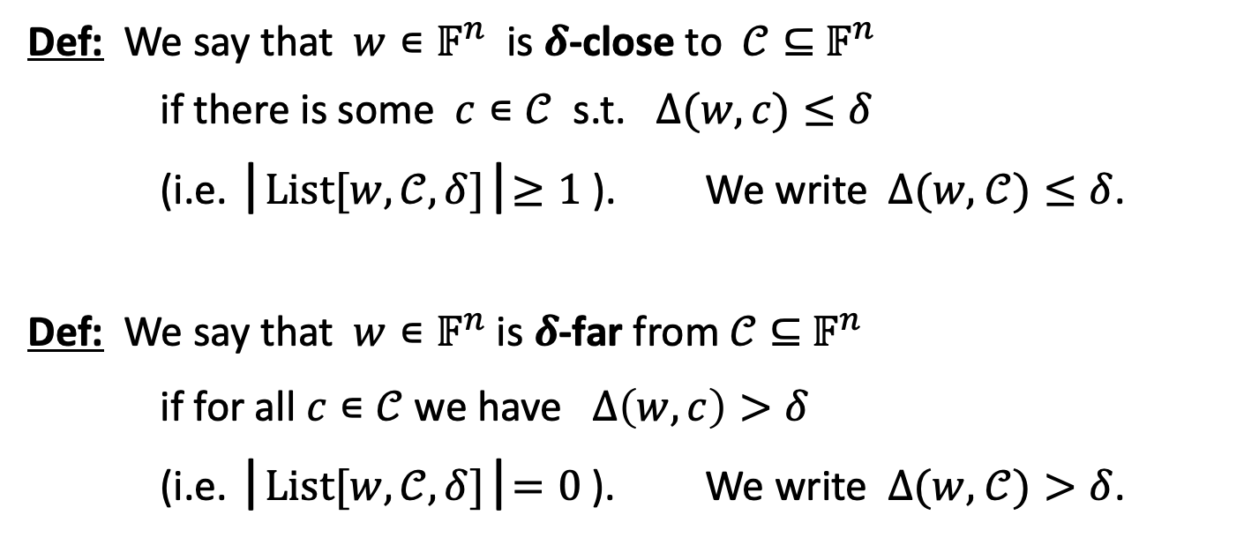

Convenient terms: $δ$-close and $δ$-far
Def: We say that $w∊𝔽^{n}$ is $δ$-close to $𝒞⊆{ 𝔽}^{n}$
if there is some $c∊𝒞$ s.t. $∆(w,c)≤δ$
(i.e. |$List[w,𝒞, δ]$|$≥1$ ). We write $∆(w,$ $𝒞)≤δ$.
Def: We say that $w∊𝔽^{n}$ is $δ$-far from $𝒞⊆{ 𝔽}^{n}$
if for all $c∊𝒞$ we have $∆\left(w,c\right)>δ$
(i.e. |$List[w,𝒞, δ]$|$=0$ ). We write $∆(w,$ $𝒞)>δ$.

Slide 14

The classic MDS code: Reed-Solomon
First, polynomials over a field $𝔽$
$𝔽^{<d}[X]$: set of all univariate polynomials over $𝔽$ of degree $<d$
For a polynomial $f∊𝔽^{<d}[X]$ and $ℒ⊆$ $𝔽$
write $\overline{f}:ℒ⇾𝔽$ for the restriction of $f$ to the domain $ℒ$
A function $w:ℒ⇾$ $𝔽$, where $n≔\left|ℒ\right|$, can be treated as a vector
$vec\left(w\right)≔ \left(w\left(a_{1}\right),…,w\left(a_{n}\right)\right)∊{ 𝔽}^{n}$
where $ℒ=\{a_{1},…,a_{n}\}$ $⊆$ $𝔽$ has a natural ordering

Slide 15

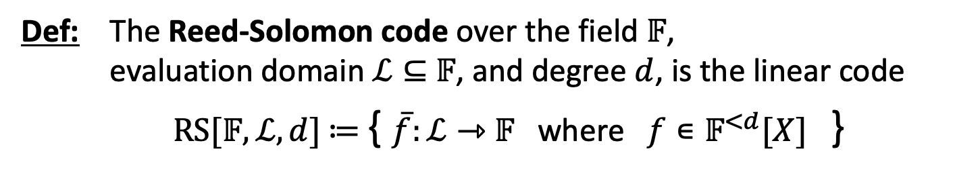


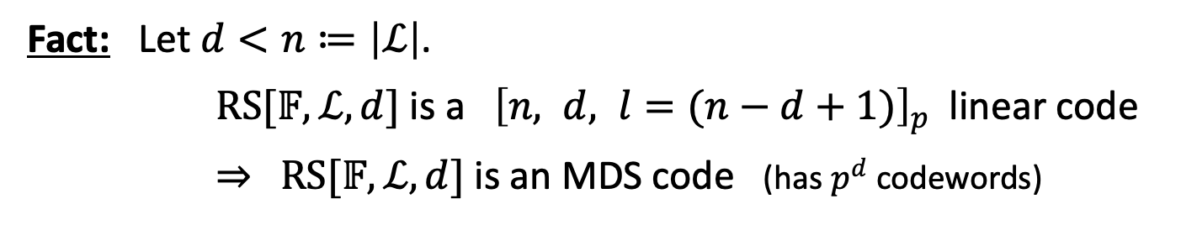
The classic MDS code: Reed-Solomon
Def: The Reed-Solomon code over the field $𝔽$,
evaluation domain $ℒ⊆$ $𝔽$, and degree $d$, is the linear code
$RS[𝔽,ℒ,d]$ $≔$ { $\overline{f}:ℒ⇾$ $𝔽$ where $f∊𝔽^{<d}[X]$ }
Fact: Let $d<n≔\left|ℒ\right|$.
$RS[𝔽,ℒ,d]$ is a ${\left[n, d, l=(n−d+1)\right]}_{p}$ linear code
⇒ $RS[𝔽,ℒ,d]$ is an MDS code (has $p^{d}$ codewords)
Def: The rate of $RS[𝔽,ℒ,d]$ is $ρ≔d/n∊[0,1]$ (e.g., $ρ=0.5)$
$m∊𝔽^{d}$
encode
$$vec({\overline{f}}_{m})∊𝔽^{n}$$
( $1/ρ$ expansion)

Slide 16
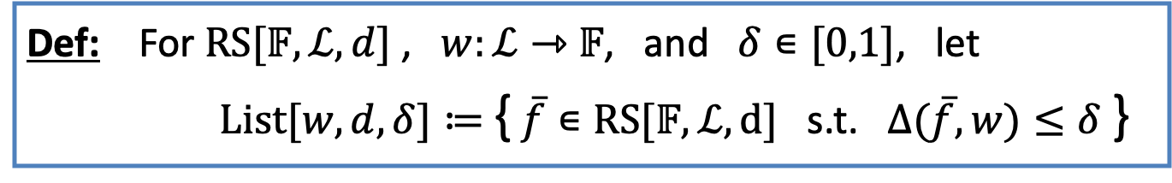
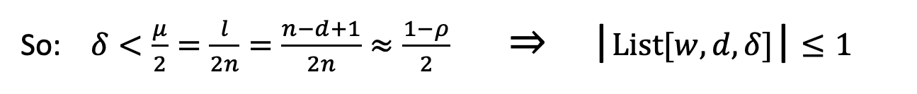
Unique decoding and list decoding
Def: For $RS[𝔽,ℒ,d]$ , $w:ℒ⇾$ $𝔽$, and $δ∊[0,1]$, let
$List[w,d, δ]≔$ { $\overline{f}∊RS[𝔽,ℒ,d]$ s.t. $∆(\overline{f},w)≤δ$ }
So: $δ<\frac{μ}{2}=\frac{l}{2n}=\frac{n−d+1}{2n}≈\frac{1−ρ}{2}$ ⇒ |$List[w,d, δ]$|$≤1$
(unique decoding distance)
Recall: $ρ≔d/n∊[0,1]$ where $n≔\left|ℒ\right|$. For MDS code: $μ≈1−ρ$.

Slide 17





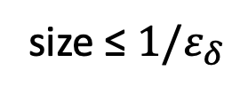
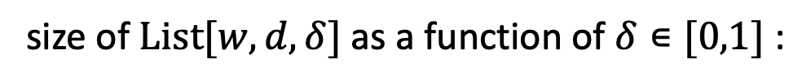


Unique decoding and list decoding
The Johnson bound: For $RS[𝔽,ℒ,d]$, $w:ℒ⇾$ $𝔽$, $δ<1−\sqrt{ρ}$
|$List[w,d, δ]$|$≤1/ε_{δ}$ where $ε_{δ}≔2\sqrt{ρ}$($1−\sqrt{ρ}−δ$) $∊ (0,1)$
( blows up as $δ$ approaches$1−\sqrt{ρ}$ )
size of $List[w,d, δ]$ as a function of $δ∊[0,1]$ :
$$𝒞$$
size ≤1
size ≤ $1/ε_{δ}$
unknown
$$≥p$$
$$δ=0$$
$(1−ρ)$/2
$$1−\sqrt{ρ}$$
$1−$ $ρ$
$$1$$
(uniqueness bound)
(Johnson bound)
(capacity bound)

Slide 18
Unique decoding and list decoding
The Johnson bound: For $RS[𝔽,ℒ,d]$, $w:ℒ⇾$ $𝔽$, $δ<1−\sqrt{ρ}$
|$List[w,d, δ]$|$≤1/ε_{δ}$ where $ε_{δ}≔2\sqrt{ρ}$($1−\sqrt{ρ}−δ$) $∊ (0,1)$
( blows up as $δ$ approaches$1−\sqrt{ρ}$ )
size of $List[w,d, δ]$ as a function of $δ∊[0,1]$ :
size ≤1
size ≤ $1/ε_{δ}$
unknown
$$≥p$$
$$δ=0$$
$(1−ρ)$/2
$$1−\sqrt{ρ}$$
$1−$ $ρ$
$$1$$
Conjectured to be poly($n$) size (true for random $ℒ⊆$ $𝔽$ [BGM’24] )

Slide 19


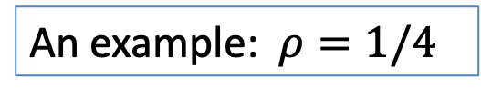
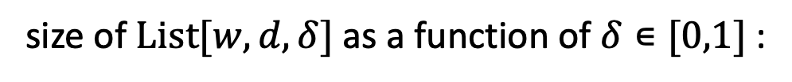

Unique decoding and list decoding
The Johnson bound: For $RS[𝔽,ℒ,d]$, $w:ℒ⇾$ $𝔽$, $δ<1−\sqrt{ρ}$
|$List[w,d, δ]$|$≤1/ε_{δ}$ where $ε_{δ}≔2\sqrt{ρ}$($1−\sqrt{ρ}−δ$) $∊ (0,1)$
( blows up as $δ$ approaches$1−\sqrt{ρ}$ )
size of $List[w,d, δ]$ as a function of $δ$ $∊[0,1]$ :
size ≤1
size ≤ $1/ε_{δ}$
unknown
$$≥p$$
$$δ=0$$
$$3/8$$
$$1/2$$
$$3/4$$
$$1$$
An example: $ρ=1/4$

Slide 20
Background on IOPs
Review (1) IOP and IOPP
(2) Poly-IOP

Slide 21
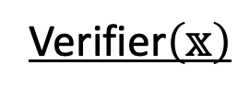
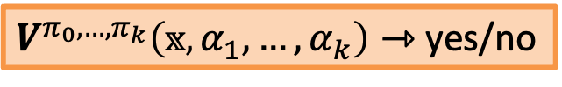

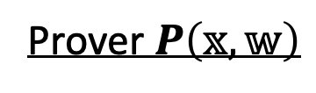








Interactive Oracle Proofs (IOP) [BCS’16, RRR’16]
Let $R=\left\{\left(𝕩,𝕨\right)\right\}$ be a poly-time relation (e.g., $𝕩=sha3(𝕨$) )
Def: an $IOP$ for $R$ is a pair of algorithms $(P,V)$ s.t.:
Prover $P\left(𝕩,𝕨\right)$
Verifier$\left(𝕩\right)$
$$π_{0}=$$
$α_{i}$: short random challenges
$$α_{1}⇽ 𝔘$$
$π_{i}$: poly-size strings (oracles)
$$π_{1}=$$
$$⋮$$
$V$ can query for cells of $π_{i}$
$$α_{k}⇽ 𝔘$$
$$π_{k}=$$
$V^{π_{0},…,π_{k}}\left(𝕩,α_{1},…,α_{k}\right)⇾$yes/no
Notes:
IOP: let’s us talk about proof systems without worrying about the vector commitment.
Poly-time relation: given $\left(𝕩,𝕨\right)$we can efficiently test if they are in the relation.

Slide 22
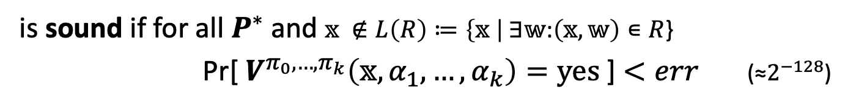


Interactive Oracle Proofs (IOP) [BCS’16, RRR’16]
Let $R=\left\{\left(𝕩,𝕨\right)\right\}$ be a poly-time relation (e.g., $𝕩=sha3(𝕨$) )
Def: an $IOP$ $(P,V)$ for $R$
is complete if for all $\left(𝕩,𝕨\right)∊R$, when $V$ interacts with $P$
Pr[ $V^{π_{0},…,π_{k}}\left(𝕩,α_{1},…,α_{k}\right)=yes$ ]$=1$
is sound if for all $P^{∗}$ and $𝕩 ∉L\left(R\right)≔\left\{𝕩 \right| ∃𝕨$:$\left(𝕩,𝕨\right)∊R$}
Pr[ $V^{π_{0},…,π_{k}}\left(𝕩,α_{1},…,α_{k}\right)=yes$ ] $<err$ (≈$2^{−128}$)
is knowledge sound (informally) if for all $P^{∗}$,
$V$ accepts $𝕩$ ⇒ prover “knows” $𝕨$s.t. $\left(𝕩,𝕨\right)∊R$
Notes:
These requirements are satisfied by the trivial prover that simply sends $𝕨$ to the verifier.

Slide 23
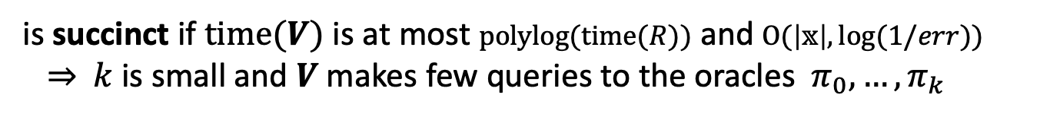
Interactive Oracle Proofs (IOP) [BCS’16, RRR’16]
Let $R=\left\{\left(𝕩,𝕨\right)\right\}$ be a poly-time relation (e.g., $𝕩=sha3(𝕨$) )
Def: an $IOP$ $(P,V)$ for $R$
is complete if for all $\left(𝕩,𝕨\right)∊R$, when $V$ interacts with $P$
Pr[ $V^{π_{0},…,π_{k}}\left(𝕩,α_{1},…,α_{k}\right)=yes$ ]$=1$
is sound if for all $P^{∗}$ and $𝕩 ∉L\left(R\right)≔\left\{𝕩 \right| ∃𝕨$:$\left(𝕩,𝕨\right)∊R$}
Pr[ $V^{π_{0},…,π_{k}}\left(𝕩,α_{1},…,α_{k}\right)=yes$ ] $<err$ (≈$2^{−128}$)
is succinct if $time(V)$ is at most $polylog(time(R))$ and $O(\left|𝕩\right|,log(1/err))$
⇒ $k$is small and $V$makes few queries to the oracles $π_{0},…,π_{k}$
Notes:
Now sending $𝕨$ to V doesn’t work: V doesn’t have time to verify that $𝕨$ is valid, and may not even have time to read $𝕨$.

Slide 24




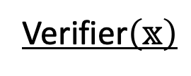
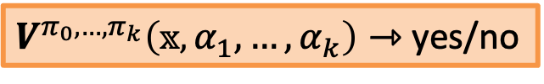
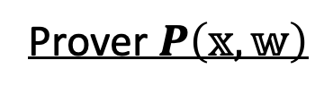


IOP for $R$ ⇒ SNARK for $R$ (the BCS’16 compiler)
We obtain an
interactive proof (IP)
Step 1: replace $π_{0}$,…, $π_{k}$ by Merkle commitments
Prover $P\left(𝕩,𝕨\right)$
Verifier$\left(𝕩\right)$
MerkleCommit($π_{0}$)
Security now depends
on collision resistance
of Merkle hash function
$$α_{1}⇽ 𝔘$$
MerkleCommit($π_{1}$)
$$⋮$$
$$α_{k}⇽ 𝔘$$
MerkleCommit($π_{k})$
$V^{π_{0},…,π_{k}}\left(𝕩,α_{1},…,α_{k}\right)⇾$yes/no
$V$ queries $π_{i}$ at cell $j$ ⇒ $P$ responds with a Merkle proof for cell $j$
Notes:
BCS’16: Eli Ben-Sasson, Alessandro Chiesa, and Nicholas Spooner. (TCC’16)

Slide 25








IOP for $R$ ⇒ SNARK for $R$ (the BCS’16 compiler)
Step 2: Make non-interactive using the Fiat-Shamir transform
Prover $P\left(𝕩,𝕨\right)$
$c_{0}≔$MerkleCommit($π_{0}$)
SNARK
Proof
$$α_{1}⇽Hash(𝕩,c_{0})$$
$c_{1}≔$MerkleCommit($π_{1}$)
$$⋮$$
$$α_{k}⇽Hash(𝕩,c_{0},α_{1},c_{1}…,c_{k−1})$$
$c_{k}≔$MerkleCommit($π_{k})$
$$V^{π_{0},…,π_{k}}\left(𝕩,α_{1},…,α_{k}\right)$$
MerkleProofs (one per $V$query)

Slide 26

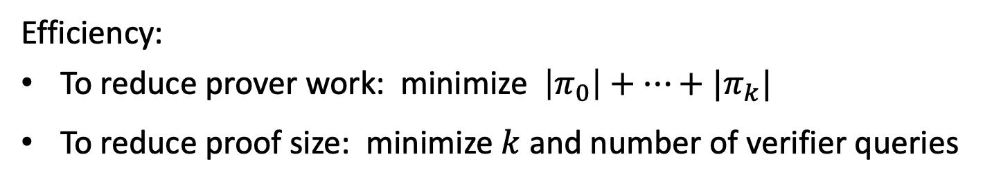
IOP for $R$ ⇒ SNARK for $R$ (the BCS’16 compiler)
“Thm” (BCS’16, CCH+’19, Hol’19):
the IOP has round-by-round soundness
⇒
the derived SNARG is secure in the random oracle model
(see also Chiesa-Yogev SNARK book)
Efficiency:
To reduce prover work: minimize $\left|π_{0}\right|+…+|π_{k}|$
To reduce proof size: minimize $k$ and number of verifier queries
⇒ Merkle Commitments
⇒ Merkle Proofs ($O_{λ}(\log{|π_{i}|})$ size)

Slide 27



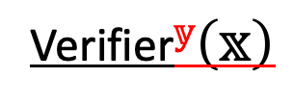
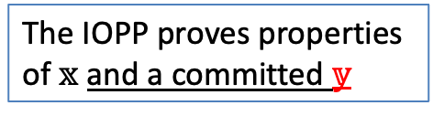
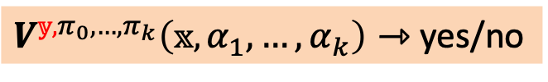
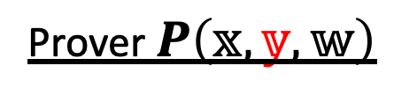

A generalization: IOP of Proximity (IOPP)
Let $R=\left\{\left(𝕩,𝕪,𝕨\right)\right\}$ be a poly-time relation
($𝕪=$ )
Def: an $IOPP$ for $R$ is a pair of algorithms $(P,V)$ s.t.:
Prover $P\left(𝕩,𝕪,𝕨\right)$
Verifier$𝕪\left(𝕩\right)$
$$π_{0}=$$
${𝕪,π}_{i}$: poly-size strings (oracles)
$$α_{1}⇽ 𝔘$$
$V$ can query for cells of ${𝕪,π}_{i}$
$$π_{1}=$$
$$⋮$$
The IOPP proves properties
of $𝕩$and a committed $𝕪$
$$α_{k}⇽ 𝔘$$
$$π_{k}=$$
$V^{{𝕪,π}_{0},…,π_{k}}\left(𝕩,α_{1},…,α_{k}\right)⇾$yes/no

Slide 28
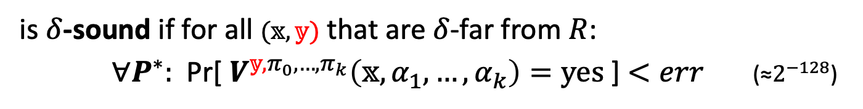
Completeness and proximity soundness
Let $R=\left\{\left(𝕩,𝕪,𝕨\right)\right\}$ be a poly-time relation
($𝕪=$ )
Def: $(𝕩,𝕪)$ is $δ$-far from $R$, if $(𝕩,𝕪′,𝕨)∉R$for all $𝕪′,𝕨$ with $∆(𝕪$, $𝕪′)≤δ$
Def: an $IOPP$ $(P,V)$ for $R$
is complete if for all $\left(𝕩,𝕪,𝕨\right)∊R$ the Verifier $V$ always accepts $P$
is $δ$-sound if for all $(𝕩,𝕪)$ that are $δ$-far from $R$:
$∀P^{∗}:$Pr[ $V^{𝕪,π_{0},…,π_{k}}\left(𝕩,α_{1},…,α_{k}\right)=yes$ ] $<err$ (≈$2^{−128}$)
if $\left(𝕩,𝕪\right)$ is neither, then no guarantee on the output of $V$
Notes:
Note: if $δ$=0 then soundness is the same as for an IOP.

Slide 29
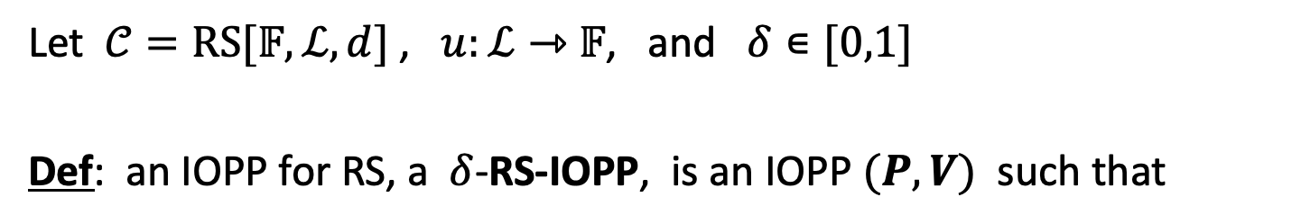
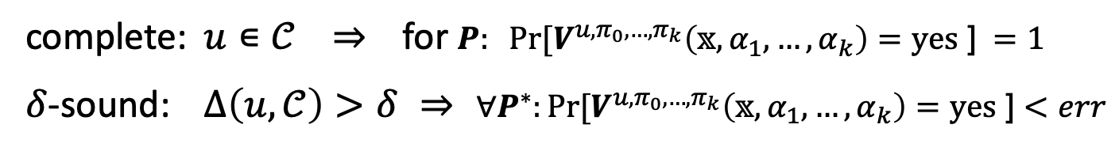
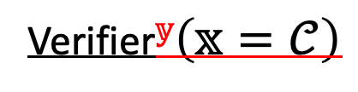

An important example: a Reed-Solomon IOPP
Let $𝒞=RS[𝔽,ℒ,d]$ , $u:ℒ⇾$ $𝔽$, and $δ∊[0,1]$
Def: an IOPP for RS, a $δ$-RS-IOPP, is an IOPP $(P,V)$ such that
$$P\left(𝕩=𝒞, 𝕪=u,𝕨=⊥\right)$$
Verifier$𝕪\left(𝕩=𝒞\right)$
complete: $u∊𝒞$ ⇒ for $P: Pr⁡[V^{u,π_{0},…,π_{k}}\left(𝕩,α_{1},…,α_{k}\right)=yes\text{ ]} =1$
$δ$-sound: $∆\left(u,𝒞\right)>$ $δ$ ⇒ $∀P^{∗}:Pr⁡[V^{u,π_{0},…,π_{k}}\left(𝕩,α_{1},…,α_{k}\right)=yes\text{ ]}<err$
FRI is an efficient RS-IOPP. But why is this useful?
Notes:
Technically, the relation R is ($𝕩,𝕪,$*) where $𝕩=\left(𝒞,δ\right),$ and $𝕪∊ 𝒞$.

Slide 30

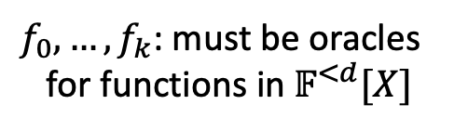



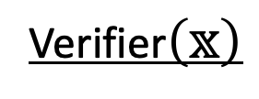
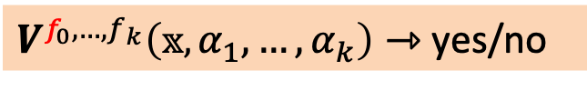
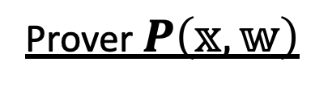


A special type of IOP: Poly-IOP
Let $R=\left\{\left(𝕩,𝕨\right)\right\}$ be a poly-time relation
Def: a Poly-$IOP$ for $R$ is a pair of algorithms $(P,V)$ s.t.:
Prover $P\left(𝕩,𝕨\right)$
Verifier$\left(𝕩\right)$
$$f_{0}∊𝔽^{<d}[X]$$
$f_{0},…,f_{k}$: must be oracles
for functions in $𝔽^{<d}[X]$
$$α_{1}⇽𝔽$$
$$f_{1}∊𝔽^{<d}[X]$$
$$⋮$$
$V$ can eval $f_{i}$ at any $x∊𝔽$
$$α_{k}⇽𝔽$$
$$f_{k}∊𝔽^{<d}[X]$$
$V^{f_{0},…,f_{k}}\left(𝕩,α_{1},…,α_{k}\right)⇾$yes/no

Slide 31

A special type of IOP: Poly-IOP
Let $R=\left\{\left(𝕩,𝕨\right)\right\}$ be a poly-time relation
Def: a Poly-$IOP$ for $R$ is a pair of algorithms $(P,V)$ s.t.:
Prover $P\left(𝕩,𝕨\right)$
Verifier$\left(𝕩\right)$
Completeness and soundness as for an IOP
$$α_{k}⇽ 𝔘$$
$$f_{k}∊𝔽^{<d}[X]$$
$V^{f_{0},…,f_{k}}\left(𝕩,α_{1},…,α_{k}\right)⇾$yes/no

Slide 32
Compiling a Poly-IOP to a SNARK
Method 1: use an algebraic polynomial commitment
univariate IOP: use KZG
multilinear IOP: use Zeromorph or Mercury
Method 2: use an IOPP
Fast: using only a Merkle tree

Slide 33
Compiling a Poly-IOP to a SNARK
Using a Reed-Solomon IOP of Proximity
An important application of an RS-IOPP

Slide 34
Poly-IOP ⇒ IOP ⇒ SNARK
A direct SNARK construction:
RS-IOPP
(such as FRI)
Merkle
commitments
Fiat-Shamir
Polynomial
interactive
oracle proof
(Poly-IOP)
IOP
Interactive
Proof (IP)
(zk)SNARK for
general circuits

Slide 35






The interesting step: Poly-IOP ⇒ IOP
Poly-IOP
IOP
$$f_{i}∊𝔽^{<d}[X]$$
↺
$$π_{i}=$$
↺
eval $f_{i}$ at $x_{i}∊𝔽$
open $π_{i}$ at cell $j$
↺
↺
$y_{i}⇽ f_{i}(x_{i}$)
$$y_{i}⇽π_{i}[j\text{]}$$
Challenge: how to build a polynomial eval oracle from a list lookup oracle??

Slide 36
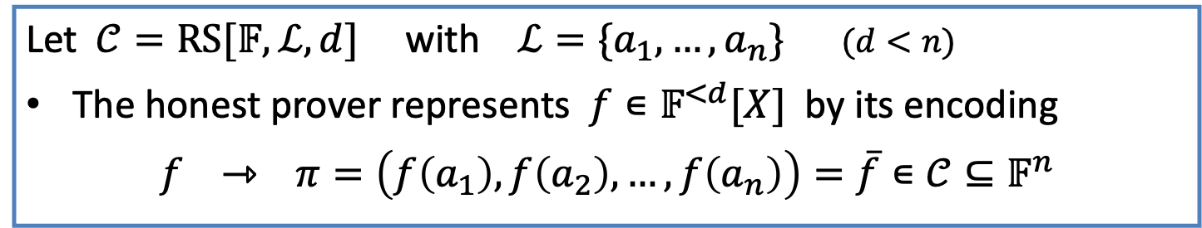
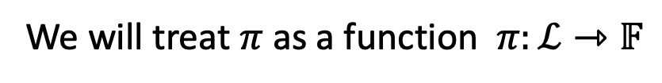
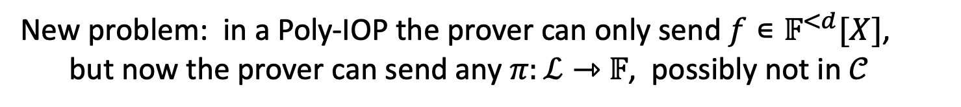
Representing a polynomial as an IOP oracle
The problem: $f∊𝔽^{<d}[X]$ ⇾ string $π$: $∊𝔽^{n}$
Let $𝒞=RS[𝔽,ℒ,d]$ with $ℒ=\{a_{1},…,a_{n}\}$ $(d<n)$
The honest prover represents $f∊𝔽^{<d}[X]$ by its encoding
$f$ ⇾ $π=\left(f\left(a_{1}\right),f\left(a_{2}\right),…,f\left(a_{n}\right)\right)=\overline{f}∊𝒞⊆𝔽^{n}$
We will treat $π$ as a function $π:ℒ⇾$ $𝔽$
New problem: in a Poly-IOP the prover can only send $f∊𝔽^{<d}[X]$,
but now the prover can send any $π:ℒ⇾$ $𝔽$, possibly not in $𝒞$

Slide 37
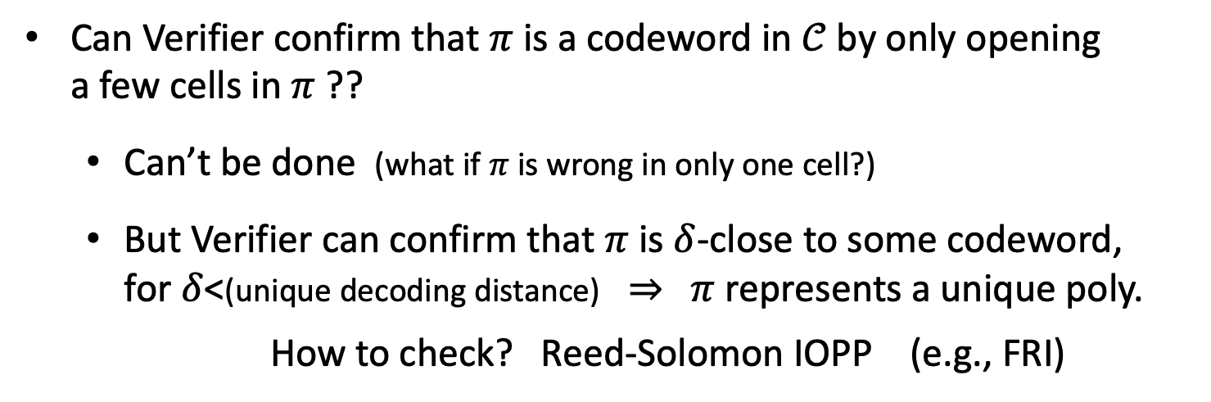
Representing a polynomial as an IOP oracle
The new problem: prover sends an oracle $π:ℒ⇾$ $𝔽$
Can Verifier confirm that $π$ is a codeword in $𝒞$by only opening
a few cells in $π$ ??
  Can’t be done (what if $π$ is wrong in only one cell?)
  But Verifier can confirm that $π$ is $δ$-close to some codeword,
  for $δ$<(unique decoding distance) ⇒ $π$ represents a unique poly.
  How to check? Reed-Solomon IOPP (e.g., FRI)
But this is not yet a PCS. First, let’s develop some tools …
Notes:
How to open $π$ at input x in F ?

Slide 38
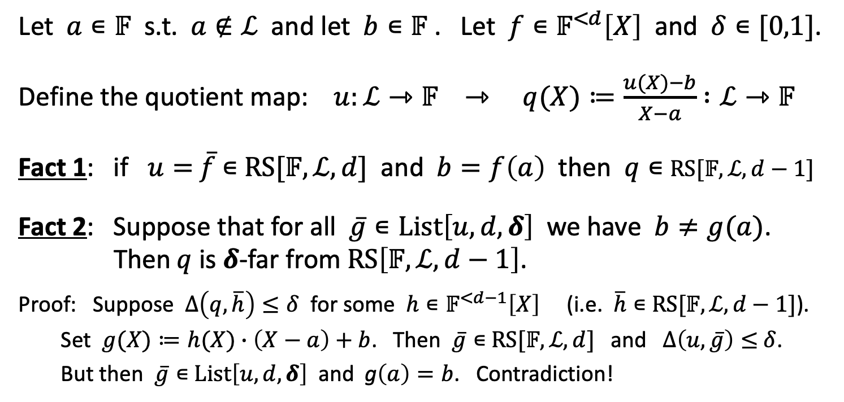
Quotienting
Let $a∊𝔽$ s.t. $a∉ℒ$ and let $b∊𝔽$ . Let $f∊𝔽^{<d}\left[X\right]$ and $δ∊[0,1]$.
Define the quotient map: $u:ℒ⇾𝔽 ⇾ q(X)≔\frac{u(X)−b}{X−a}$ $:ℒ⇾𝔽$
Fact 1: if $u=$ $\overline{f}$ $∊$ $RS[𝔽,ℒ,d]$ and $b=f\left(a\right)$ then $q∊$ $RS[𝔽,ℒ,d−1]$
Fact 2: Suppose that for all $\overline{g}∊List\left[u,d,δ\right]$ we have $b≠g(a)$.
Then $q$ is $δ$-far from $RS\left[𝔽,ℒ,d−1\right]$.
Proof: Suppose $∆\left(q, \overline{h}\right)≤δ$ for some $h∊𝔽^{<d−1}\left[X\right]$ (i.e. $\overline{h}∊$ $RS[𝔽,ℒ,d−1]$).
Set $g(X)≔h(X)∙\left(X−a\right)+b$. Then $\overline{g}∊$ $RS[𝔽,ℒ,d]$ and $∆\left(u, \overline{g}\right)≤$ $δ$.
But then $\overline{g}∊$ $List\left[u,d,δ\right]$ and g$\left(a\right)=b$. Contradiction!

Slide 39


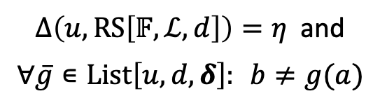

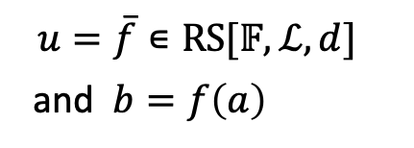

Visualizing Quotienting
The quotient map for $a∊𝔽∖ℒ$: $u:ℒ⇾𝔽 ⇾ q(X)≔\frac{u(X)−b}{X−a}$ $:ℒ⇾𝔽$
Honest prover
Dishonest prover
$$u=\overline{f}∊RS[𝔽,ℒ,d]$$
and $b=f\left(a\right)$
$∆\left(u,RS\left[𝔽,ℒ,d\right]\right)=η$ and
$∀\overline{g}∊List\left[u,d,δ\right]:$ $b≠g(a)$
distance $u$ to $RS\left[𝔽,ℒ,d\right]$:
$$η$$
0
1
0
1
distance $q$ to $RS\left[𝔽,ℒ,d−1\right]$:
$$δ$$
0
1
0
1

Slide 40
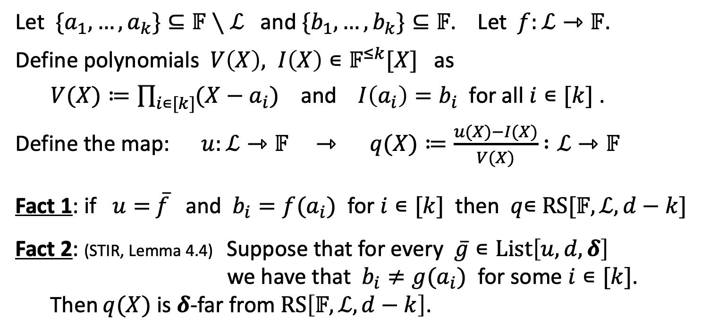
Quotienting by more values
Let $\{a_{1},…,a_{k}\}⊆𝔽∖ℒ$ and $\{b_{1},…,b_{k}\}⊆𝔽$. Let $f:ℒ⇾𝔽$.
Define polynomials $V\left(X\right), I\left(X\right)∊𝔽^{≤k}[X]$ as
$V(X)≔\prod_{i∊[k]}{(X−a_{i})}$ and $I\left(a_{i}\right)=b_{i}$ for all $i∊[k]$ .
Define the map: $u:ℒ⇾𝔽 ⇾ q(X)≔\frac{u(X)−I(X)}{V(X)}$ $:ℒ⇾𝔽$
Fact 1: if $u=$ $\overline{f}$ and $b_{i}=f(a_{i})$ for $i∊[k]$ then $q$∊ $RS[𝔽,ℒ,d−k]$
Fact 2: (STIR, Lemma 4.4) Suppose that for every $\overline{g}∊List\left[u,d,δ\right]$
we have that $b_{i}≠g(a_{i})$ for some $i∊[k]$.
Then $q(X)$ is $δ$-far from $RS\left[𝔽,ℒ,d−k\right]$.

Slide 41





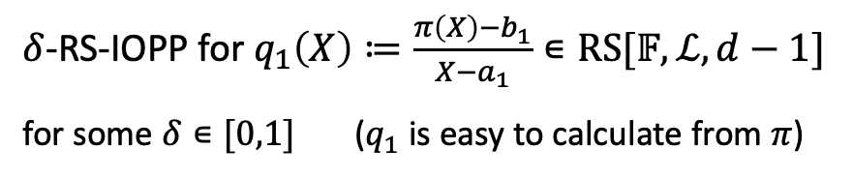





Poly-IOP ⇒ IOP: first attempt
$$P$$
$$V$$
$$P$$
$$V$$
$$f∊𝔽^{<d}[X]$$
$π=$ $:ℒ⇾𝔽$
honest prover: $π≔\overline{f}∊RS[𝔽,ℒ,d]$
eval $f$ at $a_{1}∊𝔽∖ℒ$
$δ$-RS-IOPP for $q_{1}\left(X\right)≔\frac{π\left(X\right)−b_{1}}{X−a_{1}}∊RS[𝔽,ℒ,d−1]$
for some $δ∊[0,1]$ ($q_{1}$ is easy to calculate from $π$)
$b_{1}⇽f(a_{1}$)
$δ$-RS-IOPP accepts ⇒ $∆\left(q_{1},RS\left[𝔽,ℒ,d\right]\right)<δ$ ⇒
there is a codeword ${\overline{f}}_{1}∊List\left[π,d,δ\right]$ s.t. $f_{1}\left(a_{1}\right)=b_{1}$
Notes:
Honest prover: encode $f$ as a codeword in $RS[𝔽,ℒ,d]$
Prover does not send over $q_{1}$ !! This $q_{1}$ is easy to calculate from $π$.
$a_{2}$ is chosen adaptively after the response from $a_{1}$
Verifier concludes by Fact 2. The problem: prover is not committed to a single polynomial.

Slide 42




Poly-IOP ⇒ IOP: first attempt
$$P$$
$$V$$
$$P$$
$$V$$
$$f∊𝔽^{<d}[X]$$
$π=$ $:ℒ⇾𝔽$
honest prover: $π≔\overline{f}∊RS[𝔽,ℒ,d]$
eval $f$ at $a_{1}∊𝔽∖ℒ$
$δ$-RS-IOPP for $q_{1}\left(X\right)≔\frac{π\left(X\right)−b_{1}}{X−a_{1}}∊RS[𝔽,ℒ,d−1]$
for some $δ∊[0,1]$ ($q_{1}$ is easy to calculate from $π$)
$b_{1}⇽f(a_{1}$)
eval $f$ at $a_{2}∊𝔽∖ℒ$
$δ$-RS-IOPP for $q_{2}\left(X\right)≔\frac{π\left(X\right)−b_{2}}{X−a_{2}}∊RS[𝔽,ℒ,d−1]$
$b_{2}⇽f(a_{2}$)
Verifier can conclude: there are ${\overline{f}}_{1},\overline{f_{2}}∊List\left[π,d,δ\right]$ s.t. $\left\{\begin{aligned}f_{1}\left(a_{1}\right)=b_{1} \\ f_{2}\left(a_{2}\right)=b_{2}\end{aligned}\right.$
Insufficient! What if $f_{1}≠f_{2} ?$ (can happen if $δ$>unique decoding distance)
Notes:
Honest prover: encode $f$ as a codeword in $RS[𝔽,ℒ,d]$
Prover does not send over $q_{1}$ !! This $q_{1}$ is easy to calculate from $π$.
$a_{2}$ is chosen adaptively after the response from $a_{1}$
Verifier concludes by Fact 2. The problem: prover is not committed to a single polynomial.

Slide 43








A simple observation (DEEP)
$$P$$
$$V$$
$$P$$
$$V$$
$$f∊𝔽^{<d}[X]$$
$π=$ $:ℒ⇾𝔽$
Honest prover: $π≔\overline{f}∊RS[𝔽,ℒ,d]$
sample random $r∊𝔽∖ℒ$
Claim: $(r,s)$ commits prover to
one $f∊List\left[π,d,δ\right]$
return $s∊𝔽$ . Honest prover: $s≔f(r)$
Fact: Let $BAD$ be the event that $∃ {\overline{f}}_{1}≠\overline{f_{2}}∊List\left[π,d,δ\right]$ s.t. $f_{1}\left(r\right)=f_{2}\left(r\right)=s$
Pr[$BAD$] $≤$ $\left({|List\left[π,d,δ\right]| \atop 2}\right) ∙ \frac{d}{\left|𝔽\right|−|ℒ|}$
$$r$$
union bound
over all pairs
Pr[BAD] for a fixed $f_{1},f_{2}$
Notes:
DEEP: Domain Extension for Eliminating Pretenders

Slide 44


A simple observation
Fact: Let $BAD$ be the event that $∃ {\overline{f}}_{1}≠\overline{f_{2}}∊List\left[π,d,δ\right]$ s.t. $f_{1}\left(r\right)=f_{2}\left(r\right)=s$
Pr[$BAD$] $≤$ $\left({|List\left[π,d,δ\right]| \atop 2}\right) ∙ \frac{d}{\left|𝔽\right|−|ℒ|}$
$$r$$
When $δ<1−\sqrt{ρ}$ (Johnson bound) then |$List\left[π,d,δ\right]$| < const$δ$
⇒ If $𝔽$is sufficiently large then $\operatorname{Pr}\left[BAD\right]<2^{−128}$ (negligible)
(otherwise, repeat with multiple random $r_{1},…,r_{t}∊𝔽∖ℒ$)
⇒ Only one $f$∊$List\left[π,d,δ\right]$ satisfies $f\left(r\right)=s$, with high probability
Notes:
When $\left|𝔽\right|$ is small, a k-time repetition gives us ${\left(\frac{d}{\left|𝔽\right|−\left|ℒ\right|}\right)}^{k}$

Slide 45






Poly-IOP ⇒ IOP: second attempt
$$P$$
$$V$$
$$P$$
$$V$$
$$f∊𝔽^{<d}[X]$$
$π=$ $:ℒ⇾𝔽$
Honest prover: $π≔\overline{f}∊RS[𝔽,ℒ,d]$
$$V\left(X\right)≔(X−a_{1})(X−r)$$
sample random $r∊𝔽∖ℒ$
$I\left(a_{1}\right)≔b_{1}$, $I\left(r\right)=s$
return $s∊𝔽$ . Honest prover: $s≔f(r)$
eval $f$ at $a_{1}∊𝔽∖ℒ$
$b_{1}⇽f(a_{1}$)
$δ$-RS-IOPP for $q_{1}\left(X\right)≔\frac{π\left(X\right)−I\left(X\right)}{V\left(X\right)}∊RS[𝔽,ℒ,d−2]$
Verifier can conclude: there is ${\overline{f}}_{1}∊List\left[π,d,δ\right]$ s.t. $\left\{\begin{aligned}f_{1}\left(a_{1}\right)=b_{1} \\ f_{1}\left(r\right)=s\end{aligned}\right.$
Notes:
This conclusions holds even if verifier makes more adaptive queries to $f(X)$.

Slide 46





Poly-IOP ⇒ IOP: second attempt
$$P$$
$$V$$
$$P$$
$$V$$
$$f∊𝔽^{<d}[X]$$
$π=$ $:ℒ⇾𝔽$
Honest prover: $π≔\overline{f}∊RS[𝔽,ℒ,d]$
$$V\left(X\right)≔(X−a_{2})(X−r)$$
sample random $r∊𝔽∖ℒ$
$I\left(a_{2}\right)≔b_{2}$, $I\left(r\right)=s$
return $s∊𝔽$ . Honest prover: $s≔f(r)$
eval $f$ at $a_{2}∊𝔽∖ℒ$
$b_{2}⇽f(a_{2}$)
$δ$-RS-IOPP for $q_{2}\left(X\right)≔\frac{π\left(X\right)−I\left(X\right)}{V\left(X\right)}∊RS[𝔽,ℒ,d−2]$
Verifier can conclude: there is ${\overline{f}}_{2}∊List\left[π,d,δ\right]$ s.t. $f_{2}\left(a_{2}\right)=b_{2}, f_{2}\left(r\right)=s$
Now: $δ<1−\sqrt{ρ}$ and $f_{1}\left(r\right)=f_{2}\left(r\right)=s$ ⇒ $f_{1}=f_{2}$ w.h.p, as required
Notes:
This conclusions holds even if verifier makes more adaptive queries to $f(X)$.

Slide 47

Poly-IOP ⇒ IOP: summary
The IOP prover encodes $f∊𝔽^{<d}[X]$ using a linear code (RS)
(other linear codes can be used, possibly with a faster encoding than RS)
$δ$-RS-IOPP applied to a quotient $q(X)≔\frac{π\left(X\right)−I\left(X\right)}{V\left(X\right)}$
proves evaluations of the encoded polynomial to the Verifier.
For $δ<1−\sqrt{ρ}$ : an out of domain query $(r,s)$ ensures that the prover is bound to a unique polynomial, w.h.p
Notes:
The fact that the quotient is $δ$-close to an RS code, proves that there is some polynomial at distance $δ$ from π with the correct evaluation.

Slide 48
Poly-IOP ⇒ IOP ⇒ SNARK
A direct SNARK construction:
RS-IOPP
(such as FRI)
Merkle
commitments
Fiat-Shamir
Polynomial
interactive
oracle proof
(Poly-IOP)
IOP
Interactive
Proof (IP)
(zk)SNARK for
general circuits
An RS-IOPP is the key ingredient in compilation
Notes:
RS-IOPP is the main ingredient in the compilation.

Slide 49


Poly-IOP ⇒ IOP: remarks
Remark 1: what if Poly-IOP Verifier wants to query $f$ at $a∈ℒ$ ??
The problem: $q\left(X\right)≔\frac{π\left(X\right)−I(X)}{(X−a)(X−r)}$ $:ℒ⇾𝔽$
is undefined at $X=a$ (not a problem when $a∉ℒ$)
Solution: $Q(X)≔\left(f\left(X\right)−I\left(X\right)\right)/(X−a)(X−r$) is a poly. in $𝔽^{<d−2}[X]$.
Honest prover defines $q\left(a\right)≔Q(a)$ and runs the RS-IOPP on $q$.
Remark 2: naively, the IOP uses one RS-IOPP per query to $f$
In practice, we can batch many RS-IOPPs into one RS-IOPP
Let’s see how … first we need some tools
Notes:
Up until now we assume that Verifier queries at $a∉ℒ$.
The paper eprint/2024/1279 shows that q’(a) can be computed using L'Hôpital's rule for finite fields$: q^{′}\left(a\right)=\left(f^{′}\left(a\right)−I^{′}\left(a\right)\right)/(2a−\left(a+r\right))$.
Proof: if g(X) = h(X) * q(X) and h(a)=g(a)=0 then g’(X) = h’(X)*q(X) + h(X)*q’(X) so: g’(a) = h’(a)*q(a) so q(a) = g’(a)/h’(a).

Slide 50
Distance Preserving Transformations
One last topic before the break:
Towards an efficient RS-IOPP

Slide 51

Distance Preserving Transformations
Let $ℒ,ℒ′⊆$ $𝔽$, $d,d^{′}$ some degree bounds, and $δ∊[0,1]$.
Def: A distance preserving transformation is a randomized map
$$T\left(u_{1},…,u_{k};r\right)⇾u$$
that maps $u_{1},…,u_{k}:ℒ⇾𝔽$ to $u:ℒ′⇾𝔽$ such that:
case 1: (the honest case)
if $u_{1},…,u_{k}$∊ $RS[𝔽,ℒ,d]$ then $u$∊ $RS[𝔽,ℒ′,d′]$ for all $r$.
case 2: (the dishonest case)
if some $u_{j}$ is $δ$-far from $RS[𝔽,ℒ,d]$ then
$u$ is $δ$-far from $RS[𝔽,ℒ′,d′]$, w.h.p over $r$.

Slide 52

Example 1: batch RS-IOPP
Setting: Prover has $u_{0},…,u_{k}\text{:} ℒ⇾𝔽$, Verifier has oracles for $u_{0},…,u_{k}$.
Goal: convince Verifier that all $u_{0},…,u_{k}$ are $δ$-close to $RS[𝔽,ℒ,d]$.
Naively: run $k$ RS-IOPP protocols ⇒ expensive
Better: batch all $k$ into a single function $u\text{:} ℒ⇾𝔽$
step 1: Verifier samples random $r$ in $𝔽$; sends to prover
step 2: Prover sets $u≔u_{0}+r∙u_{1}+r^{2}u_{2}+…+r^{k}u_{k}\text{:} ℒ⇾𝔽$
step 3: Both run RS-IOPP on $u:ℒ⇾𝔽$
when Verifier wants $u$(a) for some $a∊ℒ$, prover opens all $u_{0}(a),…, u_{k}(a)$

Slide 53


Why is this distance preserving?
Case 1: (an honest prover)
if $u_{0},…,u_{k}$∊ $RS[𝔽,ℒ,d]$ then $u$∊ $RS\left[𝔽,ℒ,d\right]$ for all $r∊𝔽$
Case 2: (a dishonest prover)
if some $u_{j}$ is $δ$-far from $RS\left[𝔽,ℒ,d\right]$, we need to argue that
$u$ is $δ$-far from $RS[𝔽,ℒ,d]$, with high probability over $r∊𝔽$
When $δ∊\left[0,1−\sqrt{ρ}\right)$, Case 2 follows from the
celebrated BCIKS proximity gap theorem.

Slide 54



The proximity gap theorem
Thm (BCIKS’20, Thm. 6.2): $RS[𝔽,ℒ,d]$ an RS-code with const. rate $ρ≔d/n$ (say, $ρ=0.5$)
Let $u_{0},…,u_{k}\text{:} ℒ⇾𝔽$ and $0<δ<1−1.01\sqrt{ρ}$ .
For $r∊𝔽$ define $u^{(r)}≔u_{0}+r∙u_{1}+r^{2}u_{2}+…+r^{k}u_{k}$ .
Suppose that Pr$r$[ $u^{(r)}$is $δ$-close to $RS[𝔽,ℒ,d]$ ] > $err$
then all $u_{j}$ are $δ$-close to $RS\left[𝔽,ℒ,d\right]$,
where $err$ $=O\left(\frac{kn}{\left|𝔽\right|}\right)$ for $0<δ<\frac{1−ρ}{2}$
$err$ $=$ $O\left(\frac{kn^{2}}{\left|𝔽\right|}\right)$ for $\frac{1−ρ}{2}<δ<$ $1−1.01\sqrt{ρ}$
$n≔|ℒ$|
We will assume that
err is negligible, i.e.
err $<1/{2^{128}}$
(if not, use multiple $r$)
Notes:
1.01 can be replace by $\left(1+ε\right)$ and this only affects the value of $err$.
When err is negligible: if $u\left(r\right)$ is $δ$-close to $RS[𝔽,ℒ,d]$ for a random r, we can conclude that all $u_{j}$ are $δ$-close, as required for batching.
If F is small, then use multiple r, or use an extension field.
This paper by Gao et al. (https://eprint.iacr.org/2024/1810.pdf) claims to give a linear error bound up to 1.5*(Johnson bound).

Slide 55





The proximity gap theorem
Suppose that Pr$r$[ $u^{(r)}$ is $δ$-close to $RS[𝔽,ℒ,d]$ ] > $err$
then all $u_{j}$ are $δ$-close to $RS\left[𝔽,ℒ,d\right]$
Contra-positive: if some $u_{j}$ is $δ$-far from $RS\left[𝔽,ℒ,d\right]$
then $u^{(r)}$ is $δ$-far with high probability, over $r$.
conjectured to
be small
Proximity gap error ($err$) as a function of $δ∊[0,1]$ :
O$\left({kn}/{|𝔽|}\right)$
O$\left({kn^{2}}/{|𝔽|}\right)$
unknown
vacuous
$$δ=0$$
$(1−ρ)$/2
$$1−\sqrt{ρ}$$
$1−$ $ρ$
$$1$$
(uniqueness bound)
(Johnson bound)
(capacity bound)
$n≔|ℒ$|
Notes:
When $δ$>capacity bound, then every function is $δ$-close to the code. So the thm becomes vacuous.
Conjecture lets us build more efficient SNARKs, but we don’t know if it is true.
This paper by Gao et al. (https://eprint.iacr.org/2024/1810.pdf) claims to give a linear error bound up to 1.5*(Johnson bound).

Slide 56


A stronger form: correlated proximity
Thm (BCIKS’20, Thm. 6.2):
Let $u_{0},…,u_{k}\text{:} ℒ⇾𝔽$ and $0<δ<1−1.01\sqrt{ρ}$ .
Suppose that Pr$r$[ $u^{(r)}$ is $δ$-close to $RS[𝔽,ℒ,d]$ ] > $err$
then there is an $S⊆$ $ℒ$ such that $\left|S\right|≥(1−$ $δ$)$∙|ℒ|$ and
for all $j$: $∃f_{j}∊RS[𝔽,ℒ,d]$ s.t. $∀x∊S: {u_{j}\left(x\right)=f}_{j}(x)$
⇒ $u_{0},…,u_{k}$ are $δ$-close to $RS[𝔽,ℒ,d]$ on the same positions $S$ .
(recall $u^{(r)}≔u_{0}+r∙u_{1}+r^{2}u_{2}+…+r^{k}u_{k}$ )
Notes:
In Thm 1.6 they prove exactly the Johnson bound (no 1.01) when $u\left(r\right)$ is a random linear combination of $u_{0},…u_{k}$.

Slide 57








Why is this called a proximity gap??
Suppose that Pr$r$[ $u^{(r)}$ is $δ$-close to $RS[𝔽,ℒ,d]$ ] > $err$ then
all $u_{j}$ are $δ$-close to $RS\left[𝔽,ℒ,d\right]$ on the same positions $S⊆$ $ℒ$
But if all $u_{0},…,u_{k}\text{:} ℒ⇾𝔽$ are $δ$-close to $RS\left[𝔽,ℒ,d\right]$
on positions $S⊆$ $ℒ$, then $u^{(r)}$ is $δ$-close for all $r∊𝔽$.
So Pr$r$[ $u^{(r)}$ is $δ$-close to $RS[𝔽,ℒ,d]$ ] exhibits a gap:
not possible
$$0$$
$$err$$
$$1$$
$u^{(r)}$ is $δ$-close for few $r$
$u^{(r)}$ is $δ$-close for all $r$
Notes:
Once the probability goes above err, it must jump all the way to 1.

Slide 58

Proximity gaps for other linear codes?
A similar proximity gap holds for every linear code.
Thm: (Zeilberger’24) Let $𝒞⊆{ 𝔽}^{n}$ be an ${\left[n,dim,l\right]}_{p}$linear code.
Then $𝒞$ has a correlated proximity gap for $0<δ<1−\sqrt[4]{τ}$
and err = O$\left({kn}/{|𝔽|}\right)$ , where $τ≔1−(l$/$n)$.
min. distance
(For RS-code $τ≈ρ$, so this gap is much weaker than BCIKS’20)
This can be used in a $𝒞$-proximity IOPP (e.g., Basefold, Blaze)

Slide 59


2nd Distance preserving example: 2-way folding
From now on set $ℒ=\left\{1,ω,ω^{2},…,ω^{n−1}\right\}⊆$ $𝔽$, where
  $n$ is a power of two, and
  $ω$ is an $n$-th primitive root of unity ($ω^{n}=1$)
  (requires that $n$ divides $\left|𝔽\right|−1$)
Then:
$ω^{n/2}=−1$ so that if $x=ω^{i}∊ℒ$ then $−x=ω^{i+(n/{2)}}∊ℒ$
$\left|ℒ^{2}\right|=\left|\left\{a^{2}:a∊ℒ\right\}\right|=\left|ℒ\right|/2=n/2$ ( $−a, a→a^{2}$ )

Slide 60


2-way folding a polynomial
A folding transformation: let’s start with an example.
Let $f\left(X\right)=1+2X+3X^{2}+4X^{3}+5X^{4}+6X^{5}$ $∊𝔽^{<6}[X]$
Define $f_{even}(X)$ $≔1+3X+5X^{2}$ and $f_{odd}\left(X\right)≔2+4X+6X^{2}$
Then: $f\left(X\right)=$ $f_{even}\left(X^{2}\right)+X∙$ $f_{odd}(X^{2})$
Define: for $r∊𝔽$ define $f_{fold,r}≔f_{even}\text{+ }r{∙f}_{odd}$ $∊𝔽^{<3}[X]$

Slide 61



2-way folding a polynomial: more generally
For $f$ $∊𝔽^{<d}[X]$ (with $d$ even) define:
$f_{even}\left(X^{2}\right) ≔ \frac{f\left(X\right)+f\left(−X\right)}{2}$ and $f_{odd}\left(X^{2}\right)≔ \frac{f\left(X\right)−f\left(−X\right)}{2X}$
$f_{fold,r}(X)≔f_{even}\left(X\right) \text{+ }r{∙f}_{odd}(X)$ $∊𝔽^{<d/2}[X]$
Then: $f\left(X\right)=$ $f_{even}\left(X^{2}\right)+X∙$ $f_{odd}(X^{2})$
for every $a∊𝔽$: $f_{fold,r}(a^{2})$ can be eval given $f\left(a\right), f\left(−a\right)$
$\overline{f}∊RS[𝔽,ℒ,d]$ ⇒ $\overline{f_{fold,r}}∊RS[𝔽,ℒ^{2},d/2]$
unchanged
rate = $d/|ℒ|$

Slide 62




Folding an arbitrary word $u\text{:} ℒ⇾𝔽$
For $u\text{:} ℒ⇾𝔽$ and $r∊𝔽$ define $u_{e}, u_{o}, u_{fold,r}:ℒ^{2}⇾𝔽$ as
for $a∊ℒ: u_{e}(a^{2}) ≔ \frac{u\left(a\right)+u\left(−a\right)}{2}$ and $u_{o}\left(a^{2}\right)≔ \frac{u\left(a\right)−u\left(−a\right)}{2a}$
for $b∊ℒ^{2}: u_{fold,r}(b) ≔u_{e}\left(b\right) \text{+ }r{∙u}_{o}(b)$
(recall $\left|ℒ^{2}\right|=\left|ℒ\right|/2$)
Lemma (distance preservation): for $0<δ<$ $1−\sqrt{ρ}$
$u∊$ $RS[𝔽,ℒ,d]$ ⇒ $u_{fold,r}$ $∊RS[𝔽,ℒ^{2},d/2]$ for all $r∊𝔽$
$u$ is $δ$-far from $RS[𝔽,ℒ,d]$ ⇒
$\underset{r}{Pr}$[ $u_{fold,r}$ is $δ$-far from $RS[𝔽,ℒ^{2},d/2]$ ] $≥$ $1−err$
Notes:
The error err comes from the proximity gap theorem.

Slide 63


Folding an arbitrary word $u\text{:} ℒ⇾𝔽$
For $u\text{:} ℒ⇾𝔽$ and $r∊𝔽$ define $u_{e}, u_{o}, u_{fold,r}:ℒ^{2}⇾𝔽$ as
for $a∊ℒ: u_{e}(a^{2}) ≔ \frac{u\left(a\right)+u\left(−a\right)}{2}$ and $u_{o}\left(a^{2}\right)≔ \frac{u\left(a\right)−u\left(−a\right)}{2a}$
for $b∊ℒ^{2}: u_{fold,r}(b) ≔u_{e}\left(b\right) \text{+ }r{∙u}_{o}(b)$
(recall $\left|ℒ^{2}\right|=\left|ℒ\right|/2$)
Lemma (distance preservation): for $0<δ<$ $1−\sqrt{ρ}$
$u∊$ $RS[𝔽,ℒ,d]$ ⇒ $u_{fold,r}$ $∊RS[𝔽,ℒ^{2},d/2]$ for all $r∊𝔽$
$\underset{r}{Pr}$[ $u_{fold,r}$ is $δ$-close to $RS[𝔽,ℒ^{2},d/2]$ ] $>$ $err$ ⇒
$u$ is $δ$-close to $RS[𝔽,ℒ,d]$
(contra-positive)
Notes:
The error err comes from the proximity gap theorem.

Slide 64

Why is this true?
The first part of the lemma is easy. Let’s prove the second part.
Suppose that ${Pr}_{r}$[ $u_{fold,r}$ is $δ$-close to $RS[𝔽,ℒ^{2},d/2]$ ] > $err$
Then by the BCIKS’20 theorem, there are $g_{e},g_{o}∊RS[𝔽,ℒ^{2},d/2]$
that match $u_{e}, u_{o}$ on a set $S⊆$ $ℒ^{2}$ of size $\left|S\right|≥\left(1−δ\right)(n/2)$
Define $g\text{:} ℒ⇾𝔽$ as $g\left(a\right)$ $≔$ $g_{e}\left(a^{2}\right)+a∙$ $g_{o}(a^{2})$ $∊RS[𝔽,ℒ,d]$
Then: $g\left(a\right)=u(a)$ for all $a∊ℒ$ for which $a^{2}∊S$ ($2|S|$ values in $ℒ$)
But then $∆\left(u,g\right)≤1−\frac{2\left|S\right|}{n}=1−\frac{\left|S\right|}{n/2}≤$ $δ$.
⇒ $u$ is $δ$-close to $RS[𝔽,ℒ,d]$

Slide 65


An important corollary
Let $𝒞=$ $RS[𝔽,ℒ,d]$ and $𝒞′=$ $RS[𝔽,ℒ^{2},d/2]$
Corollary: For $u\text{:} ℒ⇾𝔽$
if $∆\left(u,𝒞\right)<$ $1−\sqrt{ρ}$ then $\underset{r}{Pr}\left[ ∆\left(u_{fold,r},𝒞^{′}\right)≥∆\left(u,𝒞\right) \right]≥1−err$
if $∆\left(u,𝒞\right)≥$ $1−\sqrt{ρ}$ then $\underset{r}{Pr}\left[ ∆\left(u_{fold,r},𝒞^{′}\right)≥1−\sqrt{ρ} \right]≥1−err$
(folding does not decrease distance, w.h.p)
Recall: $∆\left(u,𝒞\right)≤δ$ ⟺ $u$ is $δ$-close to $𝒞$
Notes:
Proof of 1: given u, find the smallest $δ$ such that $\underset{r}{Pr}$[$∆\left(u_{fold,r},𝒞^{′}\right)≤δ$ ] $>$ $err$ ($δ$ is in a discrete set, so min exists).
Then $∆\left(u,𝒞\right)≤δ$ by the lemma, and moreover $\underset{r}{Pr}$[$∆\left(u_{fold,r},𝒞^{′}\right)$≥$δ$ ] $≥$ 1-$err$ (otherwise $\underset{r}{Pr}$[$∆\left(u_{fold,r},𝒞^{′}\right)<δ$ ] $>err$ meaning $δ$ is not smallest, it can be reduced by 1/n). Now part 1 follows.
Proof of 2: given u, suppose towards a contradiction that $\underset{r}{Pr}\left[ ∆\left(u_{fold,r},𝒞^{′}\right)≥1−\sqrt{ρ} \right]<1−err$. Then $\underset{r}{Pr}\left[ ∆\left(u_{fold,r},𝒞^{′}\right)<1−\sqrt{ρ} \right]>err$. By the proof of lemma, $∆\left(u,𝒞\right)<1−\sqrt{ρ}$, which contradicts the assumption on u.

Slide 66


4-way folding $u\text{:} ℒ⇾𝔽$ (using $i^{2}=−1)$
For $u\text{:} ℒ⇾𝔽$ define $u_{0}, u_{1}, u_{2},u_{3} :ℒ^{4}⇾𝔽$ for $a∊ℒ$ as
(a degree-4 FFT)
The 4-way fold of u: for $r∊𝔽$ define $u_{4fold,r}:ℒ^{4}⇾𝔽$ as
$u_{4fold,r}(b)≔u_{0}\left(b\right) \text{+ }r{∙u}_{1}(b)$ $\text{+ }r^{2}{∙u}_{2}(b)$ $\text{+ }r^{3}{∙u}_{3}(b)$ for $b∊ℒ^{4}$
Evaluating $u_{4fold,r}(X)$ at $b∊ℒ^{4}$ requires four evals. of $u(X)$.
Notes:
Evaluation $u_{4fold,r}$(b) requires opening u at four points: the four fourth roots of b.
In general, can do a 2^k-way fold.

Slide 67
4-way folding $u\text{:} ℒ⇾𝔽$ (using $i^{2}=−1)$
For $u\text{:} ℒ⇾𝔽$ define $u_{0}, u_{1}, u_{2},u_{3} :ℒ^{4}⇾𝔽$ for $a∊ℒ$ as
(a degree-4 FFT)
The 4-way fold of u: for $r∊𝔽$ define $u_{4fold,r}:ℒ^{4}⇾𝔽$ as
$u_{4fold,r}(b)≔u_{0}\left(b\right) \text{+ }r{∙u}_{1}(b)$ $\text{+ }r^{2}{∙u}_{2}(b)$ $\text{+ }r^{3}{∙u}_{3}(b)$ for $b∊ℒ^{4}$
Fact: the same distance preservation corollary holds for $u_{4fold,r}$
Notes:
Evaluation $u_{4fold,r}$(b) requires opening u at four points: the four fourth roots of b.
In general, can do a 2^k-way fold.

Slide 68


8-way folding $u\text{:} ℒ⇾𝔽$ (using an 8th root of unity$)$
Can similarly define 8-way folding, or even $2^{w}$ folding for $w≥3$.
maps $u\text{:} ℒ⇾𝔽$ to $u_{2^{w}fold,r}:$ $ℒ^{2^{w}}⇾𝔽$ ( $|ℒ^{2^{w}}|=|ℒ|/2^{w}$ )
(1) evaluating $u_{2^{w}fold,r}(b)$ requires $2^{w}$ evals. of $u(X)$
⇒ uses a degree-$2^{w}$ FFT (degree-8 FFT for 8-way folding)
(2) the same distance preservation corollary holds for $u_{2^{w}fold,r}$
Notes:
Evaluation $u_{4fold,r}$(b) requires opening u at four points: the four fourth roots of b.
In general, can do a 2^k-way fold.

Slide 69

End of lecture: Brief Summary
For a linear code $𝒞$: $List\left[u,𝒞,δ\right]$ is small up to $δ<1−\sqrt{1−μ}$
Poly-IOP ⇾ IOP compiler:
Honest $P$ Commits to $f∊𝔽^{<d}[X]$ by sending its encoding $\overline{f}$ to $V$
Prove evaluation of $f$ using RS-IOPP on quotient of sent word $u$
Out-of-domain eval. commits $P$ to unique word in $List\left[u,𝒞,δ\right]$
Folding:
$(u\text{:} ℒ⇾𝔽)$ ⇾ ($u_{fold,r}\text{:} ℒ^{2}⇾𝔽)$ is a distance preserving map
Proof using the BCIKS’20 proximity gap theorem

Slide 70
Let’s put all this machinery to use
See you in the next lecture …
Notes:
Evaluation $u_{4fold,r}$(b) requires opening u at four points: the four fourth roots of b.
In general, can do a 2^k-way fold.

Slide 71
THE END

