Slide 1
Solidity
CS251 Fall 2025
(cs251.stanford.edu)
Dan Boneh
https://docs.soliditylang.org/en/latest/

Slide 2
Recap
World state: set of accounts identified by 20-byte address.
Two types of accounts:
  owned accounts (EOA): address = H(pk)
  (2) contracts: address = H(CreatorAddr, CreatorNonce)
  every contract has its own storage array S[bytes32] ⇾ bytes32

Slide 3
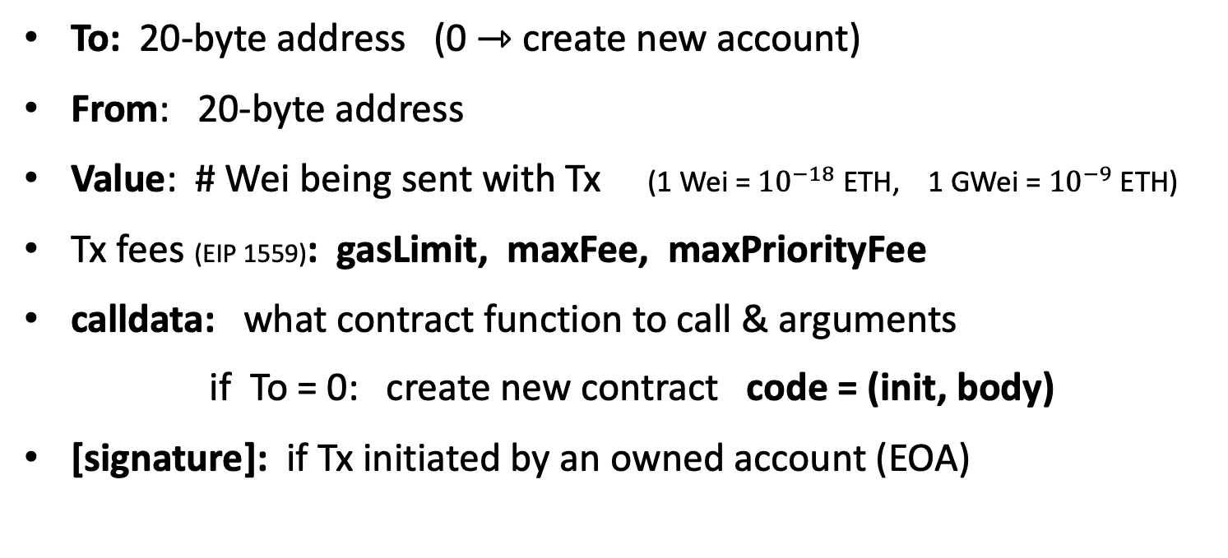
Recap: Transactions
To: 20-byte address (0 ⇾ create new account)
From: 20-byte address
Value: # Wei being sent with Tx (1 Wei = ${10}^{−18}$ ETH, 1 GWei = ${10}^{−9}$ ETH)
Tx fees (EIP 1559): gasLimit, maxFee, maxPriorityFee
calldata: what contract function to call & arguments
if To = 0: create new contract code = (init, body)
[signature]: if Tx initiated by an owned account (EOA)

Slide 4
Recap: Blocks
Validators collect Tx from users:
⇒ run Tx sequentially on current world state
⇒ new block contains updated world state, Tx list, log msgs

Slide 5
The Ethereum blockchain: abstractly
prev hash
prev hash
…
…
accts.
accts.
updated
world
state
Tx
log
messages
updated
world
state
Tx
log
messages

Slide 6
EVM mechanics: execution environment
Write code in Solidity (or another front-end language)
⇒ compile to EVM bytecode, e.g., using solc compiler
⇒ validators run the contract’s EVM bytecode in response to a Tx

Slide 7
The EVM

Slide 8
The EVM
see https://www.evm.codes
Stack machine (like Bitcoin) but with JUMP
max stack depth = 1024
program aborts if stack size exceeded; block proposer keeps gas
A contract can create or call another contract
There are several ways to call another contract
Using the CALL instruction to call another contract
creates a new execution frame that is deleted on return

Slide 9
The EVM
see https://www.evm.codes
The EVM maintains three types of zero initialized memory per contract.
All three are private to the contract that owns them (e.g., nameCoin)
Persistent storage (on blockchain): SLOAD, SSTORE (expensive)
Volatile memory (lives for a single Tx, one per execution frame):
MLOAD, MSTORE (very cheap, 3 Gas)
Transient memory (lives for a single Tx, one per contract):
TLOAD, TSTORE (cheap, 100 Gas)
LOG0(data): write data to log (easily read by a block explorer)
Tx calldata (16 gas/byte): read-only, readable by EVM only in current Tx
Notes:
MLOAD/MSTORE: 3 Gas. TLOAD/STORE: 100 Gas.
Transient memory (EIP 1153): shared across all execution frames of a contract within a single transaction.

Slide 10
Every instruction costs gas
Why charge gas?
Tx fees (gas) prevents submitting Tx that runs for many steps.
During high load: block proposer chooses Tx from mempool
that maximize its income.
if gasUsed ≥ gasLimit: block proposer keeps gas fees (from Tx originator)
calculated by EVM
specified in Tx

Slide 11
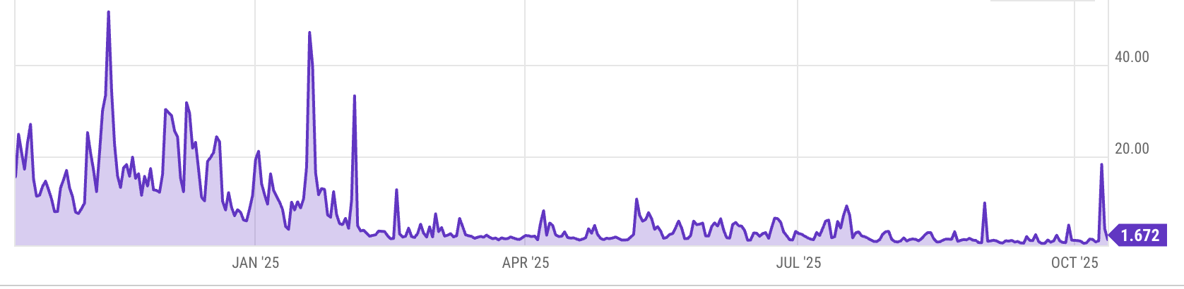
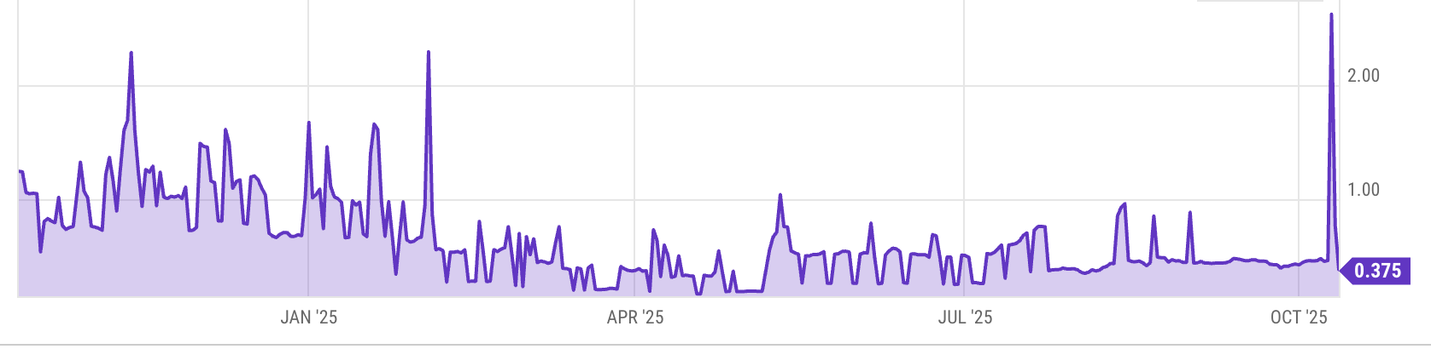
Gas prices spike during congestion
GasPrice in Gwei: 1.672 Gwei = 1.672×10⁻⁹ ETH
congestion
Average Tx fee in USD:
Notes:
https://ycharts.com/indicators/ethereum_average_gas_price
https://ycharts.com/indicators/ethereum_average_transaction_fee

Slide 12
Gas calculation: EIP1559
Every block has a “baseFee”: the minimum gasPrice for Tx in the block
baseFee is computed from total gas in earlier blocks:
earlier blocks at gas limit (45M gas) ⟹ base fee goes up 12.5%
earlier blocks empty ⟹ base fee decreases by 12.5%
If earlier blocks at “target size” (22.5M gas) ⟹ baseFee does not change
interpolate
in between

Slide 13
Gas calculation
A transaction specifies three parameters:
gasLimit: max total gas allowed for Tx
maxFee: maximum allowed gas price
maxPriorityFee: additional “tip” to be paid to block proposer
bid
Computed gasPrice bid (in Wei = 10⁻¹⁸ ETH):
gasPrice ⇽ min(maxFee, baseFee + maxPriorityFee)
Max Tx fee: gasLimit × gasPrice
Notes:
gas for each instruction defined by a hard coded table.

Slide 14

Gas calculation (informal)
gasUsed ⇽ gas used by Tx
Send gasUsed×(gasPrice – baseFee) to block proposer
BURN gasUsed× baseFee
⇒ total supply of ETH can decrease
Notes:
gas for each instruction defined by a hard coded table.
BURN: deflates the currency

Slide 15
Gas calculation
if gasPrice < baseFee: abort
If gasLimit×gasPrice > msg.sender.balance: abort
deduct gasLimit×gasPrice from msg.sender.balance
set Gas ⇽ gasLimit
execute Tx: deduct gas from Gas for each instruction
if at end (Gas < 0): abort, Tx is invalid (proposer keeps gasLimit×gasPrice)
(6) Refund Gas×gasPrice to msg.sender.balance (leftover change)
(7) gasUsed ⇽ gasLimit – Gas
(7a) BURN gasUsed× baseFee
(7b) Send gasUsed×(gasPrice – baseFee) to block producer
Notes:
gas for each instruction defined by a hard coded table.
BURN: deflates the currency

Slide 16
Example baseFee and effect of burn
block # | gasUsed | baseFee (Gwei) | ETH burned
23573600 | 10,243,205 | 0.12574 | 0.001288
23573599 | 19,388,322 | 0.12794 | 0.002481
23573598 | 26,354,665 | 0.12525 | 0.003301
23573597 | 23,873,377 | 0.12429 | 0.002967
23573596 | 21,155,077 | 0.12523 | 0.002649
23573595 | 44,988,950 | 0.11132 | 0.005008
↓
(<22.5M)
↓
(>22.5M)
↓
(<22.5M)
↓
(>22.5M)
≈ gasUsed×baseFee
new issuance > burn ⇒ ETH inflates
new issuance < burn ⇒ ETH deflates
Notes:
https://etherscan.io/blocks
When previous block is light (<15M gas), baseFee goes down. When previous block is heavy (>15M gas), baseFee goes up.

Slide 17
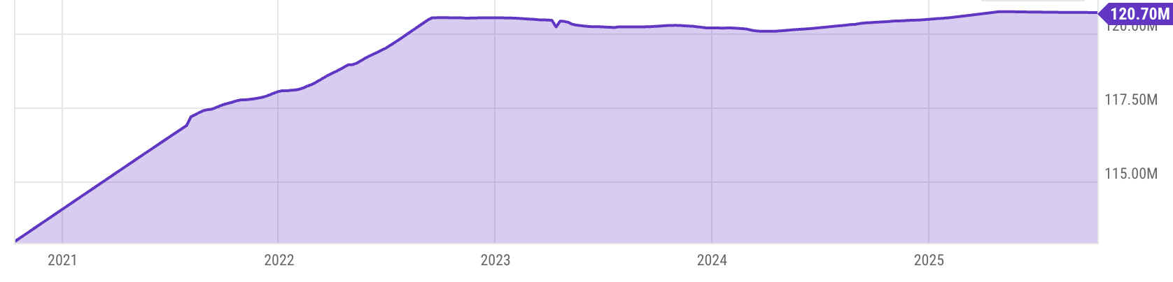
Eth total supply (last 5 years)
Notes:
https://ycharts.com/indicators/ethereum_supply

Slide 18
Why burn ETH ???
EIP1559 goals (informal):
users incentivized to bid their true utility for posting Tx,
block proposer incentivized to not create fake Tx, and
disincentivize off chain agreements.
Suppose no burn (i.e., baseFee given to block producer):
⟹ in periods of low Tx volume proposer would try to increase volume by offering to refund the baseFee to users.
Notes:
If a second price auction were used: proposers would be incentivized to create fake transactions.
See https://arxiv.org/pdf/2106.01340.pdf for an analysis.

Slide 19
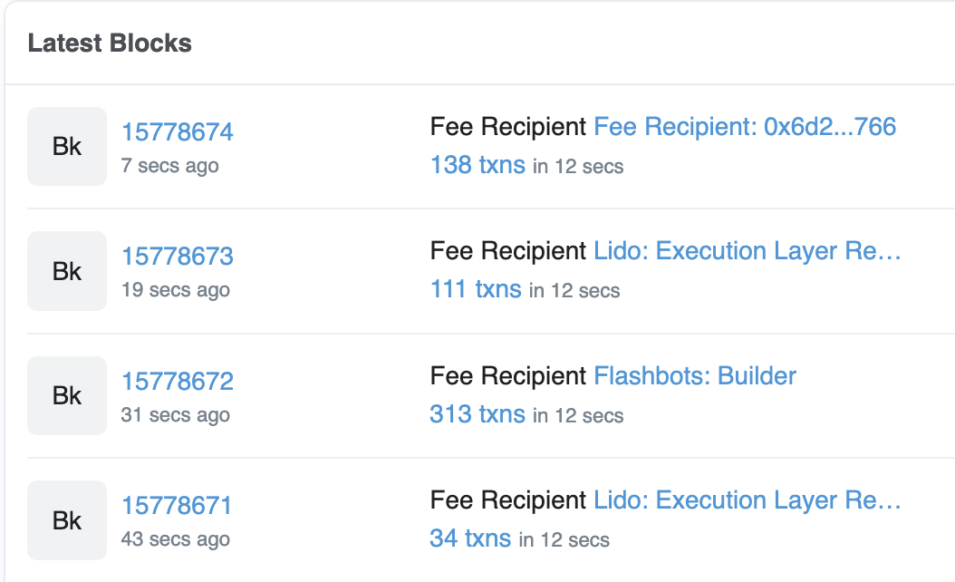
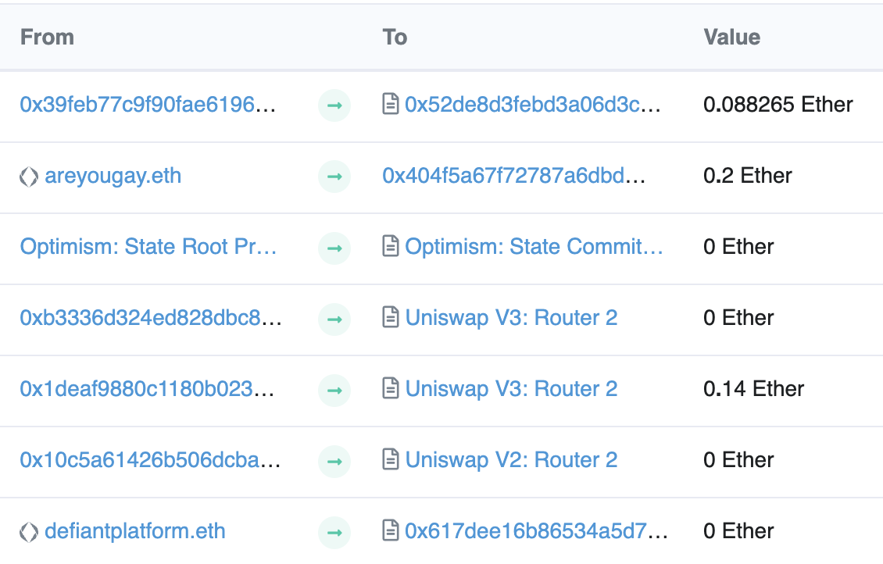
Let’s look at the Ethereum blockchain
etherscan.io:
From/to address
Tx value

Slide 20
Let’s look at a transaction …
Transaction ID: 0x14b1a03534ce3c460b022185b4 …
From: 0x1deaf9880c1180b02307e940c1e8ef936e504b6a
To: Contract 0x68b3465833fb72a70ecdf485e0e4c7bd8665fc45
(Uniswap V3: Router 2)
Value: 0.14 Ether ($182)
Data: Function: multicall() [calls multiple methods in a single call]
Contract generated a call to Contract 0xC02aaA39b22 … (value:0.14)

Slide 21
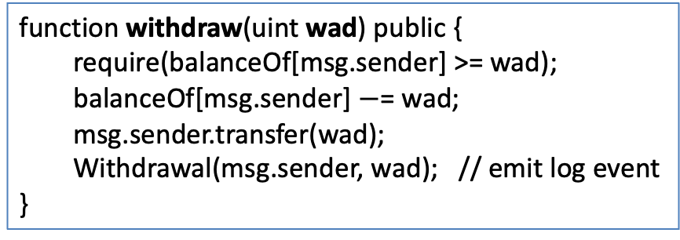
Let’s look at the To contract …
Contract 0xC02aaA39b223FE8D0A0e5C4F27eAD9083C756Cc2
(Wrapped ETH: called from Uniswap V3: Router 2)
Balance: 4,133,236 Ether
Code: 81 lines of solidity
anyone can read
function withdraw(uint wad) public {
require(balanceOf[msg.sender] >= wad);
balanceOf[msg.sender] $−$= wad;
msg.sender.transfer(wad);
Withdrawal(msg.sender, wad); // emit log event
}
code snippet

Slide 22
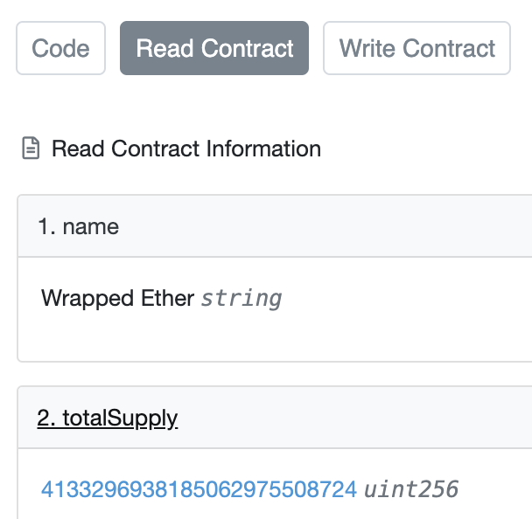
Remember: contracts cannot keep secrets!
Contract 0xC02aaA39b223FE8D0A0e5C4F27eAD9083C756Cc2
(Wrapped ETH)
etherscan.io
(storage)
(see API)
Anyone can read contract
state in storage array
⟹ never store secrets
in contract!
Solidity variables stored in S[] array
Notes:
Code tab shows code.

Slide 23
Solidity
docs: https://docs.soliditylang.org/en/latest/
Several IDE’s available

Slide 24
Contract structure
interface IERC20 {
function transfer(address _to, uint256 _value) external returns (bool);
function totalSupply() external view returns (uint256);
…
}
contract ERC20 is IERC20 { // inheritance
address owner;
constructor() public { owner = msg.sender; }
function transfer(address _to, uint256 _value) external returns (bool) {
… implementation …
} }

Slide 25
Value types
uint256
address (bytes20) // address is a 20-byte value
  _address.balance, _address.send(value), _address.transfer(value)
  call: send Tx to another contract
  (bool success,) = _address.call{value: msg.value/2, gas: 1000}(args);
  delegatecall: load code from another contract into current context
bytes32
bool
Notes:
send(): returns false on failure. transfer() raises exception on failure.

Slide 26
Reference types
struct Person {
uint128 age;
uint128 balance;
address addr;
}
Person[10] public people;
structs
arrays
bytes
strings
mappings:
  Declaration: mapping (address => uint256) balances;
  Assignment: balances[addr] = value;

Slide 27
Globally available variables
block: .blockhash, .coinbase, .gaslimit, .number, .timestamp
gasLeft()
msg: .data, .sender, .sig, .value
tx: .gasprice, .origin
abi: encode, encodePacked, encodeWithSelector, encodeWithSignature
Keccak256(bytes), sha256(bytes)
require, assert e.g.: require(msg.value > 100, “insufficient funds sent”)
A ⇾ B ⇾ C ⇾ D:
at D: msg.sender == C
tx.origin == A
Notes:
block.coinbase: fee recipient address. block.gaslimit: block gas limit. gasleft() returns (uint256): Remaining gas.
require: for checking inputs. assert: for validating internal state (failure means a bug). Either way, triggers reversion.
Require(cond,…) is mostly the same as if (!cond ) revert(…)

Slide 28
Function visibilities
external: function can only be called from outside contract.
Arguments read from calldata
public: function can be called externally and internally.
function foo(bytes memory data) public {} // data is always copied from calldata to memory
function foo(bytes data) public {} // data is not copied to memory, therefore read-only
private: only visible inside contract
internal: only visible in this contract and contracts deriving from it
view: only read storage (no writes to storage)
pure: does not touch storage
function f(uint a) private pure returns (uint b) { return a + 1; }

Slide 29
Inheritance
contract owned {
address owner;
constructor() { owner = msg.sender; }
modifier onlyOwner {
require(msg.sender == owner); _; } }
Inheritance
  contract Destructable is owned {
  function destroy() public onlyOwner { selfdestruct(owner) };
  }
  code of contract “owned” is compiled into contract Destructable
Libraries: library code is executed in the context of calling contract
  library Search { function IndexOf(); }
  contract A { function B { Search.IndexOf(); } }
Notes:
SafeMath can be declared as a library: Library SafeMath { } (instead of a contract)
Libraries are called using DELEGATECALL

Slide 30
ERC20 tokens
https://github.com/ethereum/EIPs/blob/master/EIPS/eip-20.md
A standard API for fungible tokens that provides basic functionality to transfer tokens or allow the tokens to be spent by a third party.
An ERC20 token is itself a smart contract that maintains all user balances:
mapping(address => uint256) internal balances;
A standard interface allows other contracts to interact with every ERC20 token. No need for special logic for each token.

Slide 31
ERC20 token interface
function transfer(address _to, uint256 _value) external returns (bool);
function transferFrom(address _from, address _to, uint256 _value) external returns (bool);
function approve(address _spender, uint256 _value) external returns (bool);
function totalSupply() external view returns (uint256);
function balanceOf(address _owner) external view returns (uint256);
function allowance(address _owner, address _spender) external view returns (uint256);
Notes:
transfer: transfer from Tx sender.
transferFrom: transfer from some other account. Function will check permissions.
approve: allow _spender to spend _value from Tx sender’s account
totalSupply: total coins in all accounts
allowance: how much can _spender spend from _owner’s acccount?

Slide 32
How are ERC20 tokens transferred?
contract ERC20 is IERC20 {
mapping (address => uint256) internal balances;
function transfer(address _to, uint256 _value) external returns (bool) {
require(balances[msg.sender] >= _value, "ERC20_INSUFFICIENT_BALANCE");
balances[msg.sender] −= _value;
balances[_to] += _value;
emit Transfer(msg.sender, _to, _value); // write log message
return true;
}}
Tokens can be minted by a special function mint(address _to, uint256 _value)
Notes:
All coins initially belong to creator, set by constructor.
Admin can call the mint() function to add tokens to someone’s account.
No need to check for overflow: solc performs safemath from v0.8.0

Slide 33
Calling other contracts
Addresses can be cast to contract types:
      address _token = 0x2b34aced3456781243651234de348791;
      ERC20Token tokenContract = ERC20Token(_token); // type cast
When calling a function on an external contract, Solidity will automatically handle ABI encoding, copying to memory, and copying return values.
  // call the `transfer` function at address tokenContract
  (bool success,) = tokenContract.transfer(_to, _value);
  this causes the EVM to send a message from origin contract to tokenContract.

Slide 34
ABI encoding and decoding
When calling a contract, the calldata in the transaction is an ABI encoding of:
(1) First 4 bytes of calldata: a function selector indicating what function in the contract to run
  The function selector is the first 4 bytes of the hash of the function signature:
  for `transfer`, this looks like bytes4(keccak256(“transfer(address,uint256)”);
(2) The rest of calldata is an ABI encoding of the function arguments
Contracts can also have two special ``last resort’’ functions: receive and fallback
These functions are called if no function in the contract matches the selector in calldata
receive() external payable { code } // called if calldata is empty (i.e., pure ETH transfer)
fallback() external payable { code } // called if calldata is not empty
Notes:
fallback and receive are activated if no function in the contract matches the 4-byte function selector in the calldata. These functions are declared *without* the function keyword. They are both keywords themselves. There can be only *one* of each per contract.

Slide 35
An example ABI encoding
ERC20Token tokenContract = ERC20Token(_token);
address _to;
The easy way to call the transfer function:
// Solidity compiler creates the ABI encoding
(bool success,) = tokenContract.transfer( _to, 1 ether);
Or you can do the ABI encoding yourself:
action = abi.encodeWithSelector( tokenContract.transfer.selector, _to, 1 ether);
(bool success,) = tokenContract.call(action);
the function selector
for `transfer`

Slide 36
Stack variables
Stack variables generally cost the least gas
  can be used for any simple types (anything that is <= 32 bytes).
  uint256 a = 123;
All simple types are represented as bytes32 at the EVM level.
Only 16 stack variables can exist within a single scope.

Slide 37
Calldata
Calldata is a read-only byte array.
Every byte of a transaction’s calldata costs gas
(16 gas per non-zero byte, 4 gas per zero byte).
It is cheaper to load variables directly from calldata, rather than copying them to memory.
  This can be done by marking a function as `external` or `public`
  without marking the argument as `memory`

Slide 38
Memory (compiled to MSTORE, MLOAD)
Memory is a byte array.
Complex types (anything > 32 bytes such as structs, arrays, and strings) must be stored in memory or in storage.
  string memory name = “Alice”;
Memory is cheap, but the cost of memory grows quadratically.

Slide 39
Storage array (compiled to SSTORE, SLOAD)
Using storage is very expensive and should be used sparingly.
Writing to storage is most expensive.
Reading from storage is cheaper, but still relatively expensive.
mappings and state variables are always in storage.
Some gas is refunded when storage is deleted or set to 0
Trick for saving gas: variables < 32 bytes can be packed into 32 byte slots.

Slide 40
Event logs
Event logs are a cheap way of storing data that
does not need to be accessed by any contracts.
Events are stored in transaction receipts, rather than in storage.

Slide 41
Security considerations
Are we checking math calculations for overflows and underflows?
    done by the compiler since Solidity 0.8.
What assertions should be made about function inputs,
return values, and contract state?
Who is allowed to call each function?
Are we making any assumptions about the functionality of external contracts that are being called?

Slide 42
Reentrency bugs

Slide 43
contract Bank {
mapping(address => uint256) public userBalances;
function getUserBalance(address user) constant public returns(uint256) {
return userBalances[user]; }
function addToBalance() public payable { // customer deposits funds
userBalances[msg.sender] = userBalances[msg.sender] + msg.value; }
function withdrawBalance() public { // customer withdraws its entire balance
uint256 amountToWithdraw = userBalances[msg.sender];
// send ETH from Bank contract to caller ... vulnerable!
(bool succ,) = msg.sender.call{value: amountToWithdraw}("");
require(succ, "Withdraw failed");
userBalances[msg.sender] = 0; // if success, clear user’s balance
}}

Slide 44
contract Attacker {
Bank bank;
constructor(address bankAddress) payable {
bank = Bank(bankAddress);
bank.addToBalance{value: 75}(); // Deposit 75 Wei
}
function triggerAttack() public { bank.withdrawBalance(); }
receive() external payable {
// repeat as long as we have enough gas and the bank still has funds
if (gasleft() > 10000 && address(bank).balance >= 75) {
bank.withdrawBalance();
}
} }
ETH balance of Bank contract

Slide 45
Why is this an attack?
step 1: Attacker ⇾ Bank.addToBalance(75)
step 2: Attacker ⇾ Bank.withdrawBalance ⇾
Attacker.receive ⇾ Bank.withdrawBalance ⇾
Attacker.receive ⇾ Bank.withdrawBalance ⇾ …
Withdraw 75 Wei from Bank contract at each recursive step !!
Need to ensure overall transaction does not fail; ensured by if

Slide 46
How to fix: method 1
function withdrawBalance() public {
uint amountToWithdraw = userBalances[msg.sender];
// checks
require(amountToWithdraw > 0, "No balance to withdraw");
// effects
userBalances[msg.sender] = 0; // clear user’s balance
// interactions
(bool success, ) = msg.sender.call{value:amountToWithdraw}("");
require(success); // revert transaction on failure
}

Slide 47
How to fix: method 2
bool transient locked; // a flag in the contract’s transient memory
modifier nonReentrant {
require(!locked, "Reentrancy attempt"); // function prologue
locked = true;
_;
locked = false; // reset guard in function epilogue
}
function withdrawBalance() public nonReentrant { // a protected function
…
}
Notes:
revert() causes the transaction to fail and returns all funds

Slide 48
END OF LECTURE
Next lecture: DeFi contracts

