Slide 1
Ethereum: mechanics
CS251 Fall 2025
(cs251.stanford.edu)
Dan Boneh
Note: HW#2 posted. Due Oct. 21.

Slide 2
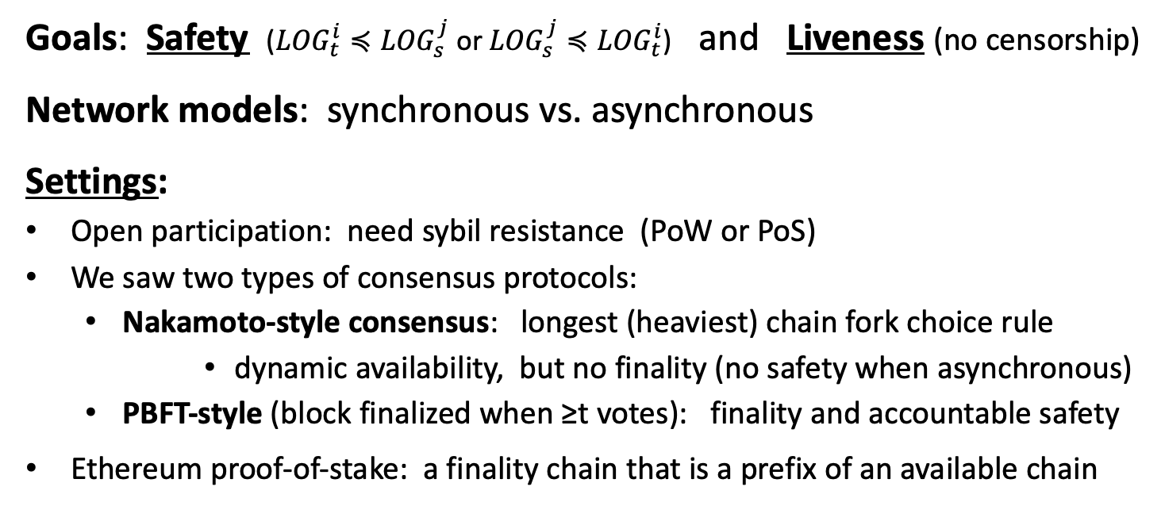
Consensus (SMR): quick summary
Goals: Safety (${LOG}_{t}^{i}≼{LOG}_{s}^{j}$ or ${LOG}_{s}^{j}≼{LOG}_{t}^{i}$) and Liveness (no censorship)
Network models: synchronous vs. asynchronous
Settings:
Open participation: need sybil resistance (PoW or PoS)
We saw two types of consensus protocols:
  Nakamoto-style consensus: longest (heaviest) chain fork choice rule
      dynamic availability, but no finality (no safety when asynchronous)
  PBFT-style (block finalized when ≥t votes): finality and accountable safety
Ethereum proof-of-stake: a finality chain that is a prefix of an available chain
Notes:
GST: global stabilization time.

Slide 3
New topic: limitations of Bitcoin
Recall: UTXO contains (hash of) ScriptPK
simple script: indicates conditions when UTXO can be spent
Limitations:
Difficult to maintain state in multi-stage contracts
Difficult to enforce global rules on assets
A simple example: rate limiting. My wallet manages 100 UTXOs.
Desired policy: can only transfer 2BTC per day out of my wallet
Notes:
a UTXO being spent cannot tell how many of my other UTXOs were spent during that day.

Slide 4
An example: DNS
Domain name system on the blockchain: [google.com ⇾ IP addr]
Need support for three operations:
Name.new(OwnerAddr, DomainName): intent to register
Name.update(DomainName, newVal, newOwner, OwnerSig)
Name.lookup(DomainName)
Note: also need to ensure no front-running on Name.new()

Slide 5
A broken implementation
Name.new() and Name.upate() create a UTXO with ScriptPK:
DUP HASH256 <OwnerAddr> EQVERIFY CHECKSIG VERIFY
<DNS> <DomainName> <IPaddr> <1>
only owner can “spend” this UTXO to update domain data
Contract: (should be enforced by miners)
if domain google.com is registered,
no one else can register that domain
Problem: this contract cannot be enforced using Bitcoin script
verify
sig is valid
ensure top
of stack is 1
Notes:
Script: top line checks that owner properly signed Tx; bottom line pushes data onto stack and ensures that top of stack ends in <1> to make script succeed.
Here <NAMECOIN> pushes the word NAMECOIN onto the stack so everyone can tell that this UTXO is a NameCoin UTXO.

Slide 6

What to do?
NameCoin: a fork of Bitcoin that implements this contract
(see also the Ethereum Name Service -- ENS)
Can we build a blockchain that natively supports generic contracts like this?
⇒ Ethereum

Slide 7
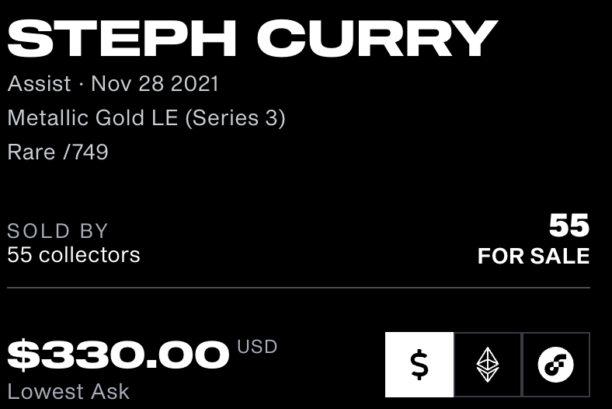

Ethereum: enables a world of applications
A world of Ethereum Decentralized apps (DAPPs)
New coins: ERC-20 standard interface
DeFi: exchanges, lending, stablecoins, derivatives, etc.
Insurance
DAOs: decentralized organizations
NFTs: Managing asset ownership (ERC-721 interface)
dappradar.com/rankings/protocol/ethereum
Notes:
CryptoPunks, NBA TopShots,

Slide 8
Bitcoin as a state transition system
world state
updated world state
UTXO₁
UTXO₂
⋮
UTXO₁
UTXO₃
⋮
input
…
…
Tx: UTXO₂ ⇾ UTXO₃
Bitcoin rules:
F_{bitcoin} : S × I ⇾ S
S: set of all possible world states, s₀ ∈ S genesis state
I: set of all possible inputs

Slide 9
Ethereum as a state transition system
Much richer state transition functions
⇒ one transition executes an entire program
Ethereum
world state
updated Ethereum
world state
input
…
…
Tx

Slide 10
Running a program on a blockchain (DAPP)
… blockchain …
Tx1
Tx2
state₂
…
state₀
state₁
program code
create a DAPP
compute layer (execution chain): The EVM
consensus layer (beacon chain)

Slide 11
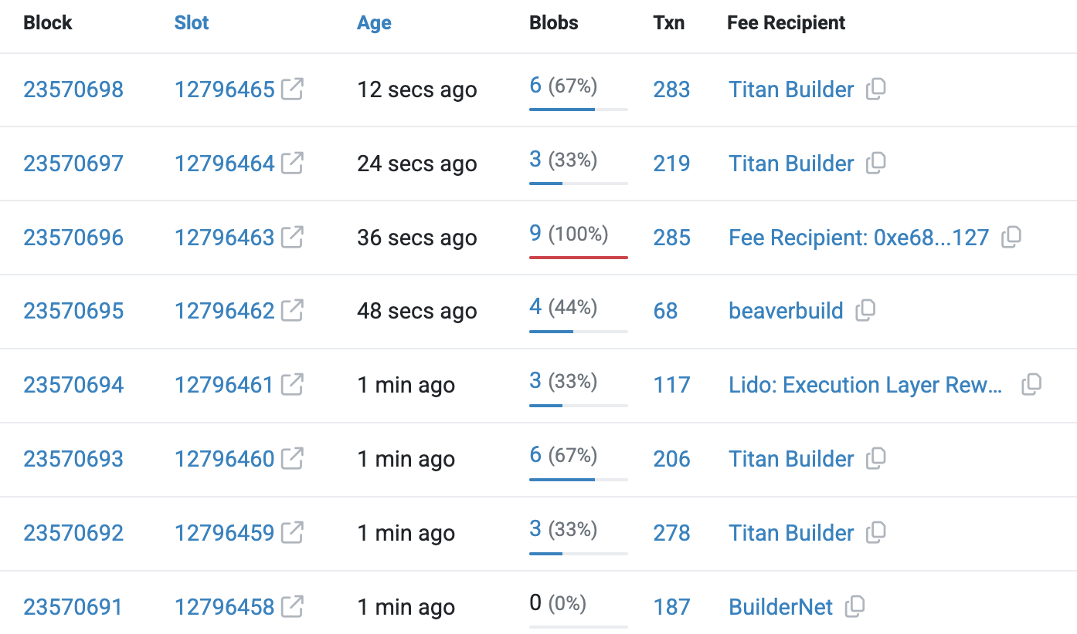
The Ethereum system
Proof-of-Stake consensus
One slot every 12 seconds.
(about 200 Tx per block)
One block proposer chosen for each slot (from validator set)
If it sends a valid block, receives Tx fees for block
(along with other rewards)
source: etherscan.io
Notes:
https://etherscan.io/blocks
If ≥ 2/3 validators vote for a checkpoint (first block of an epoch), then Checkpoint becomes JUSTIFIED.
If next epoch's checkpoint is also justified, then previous checkpoint becomes FINALIZED.
See: https://beaconcha.in/charts/slotviz

Slide 12
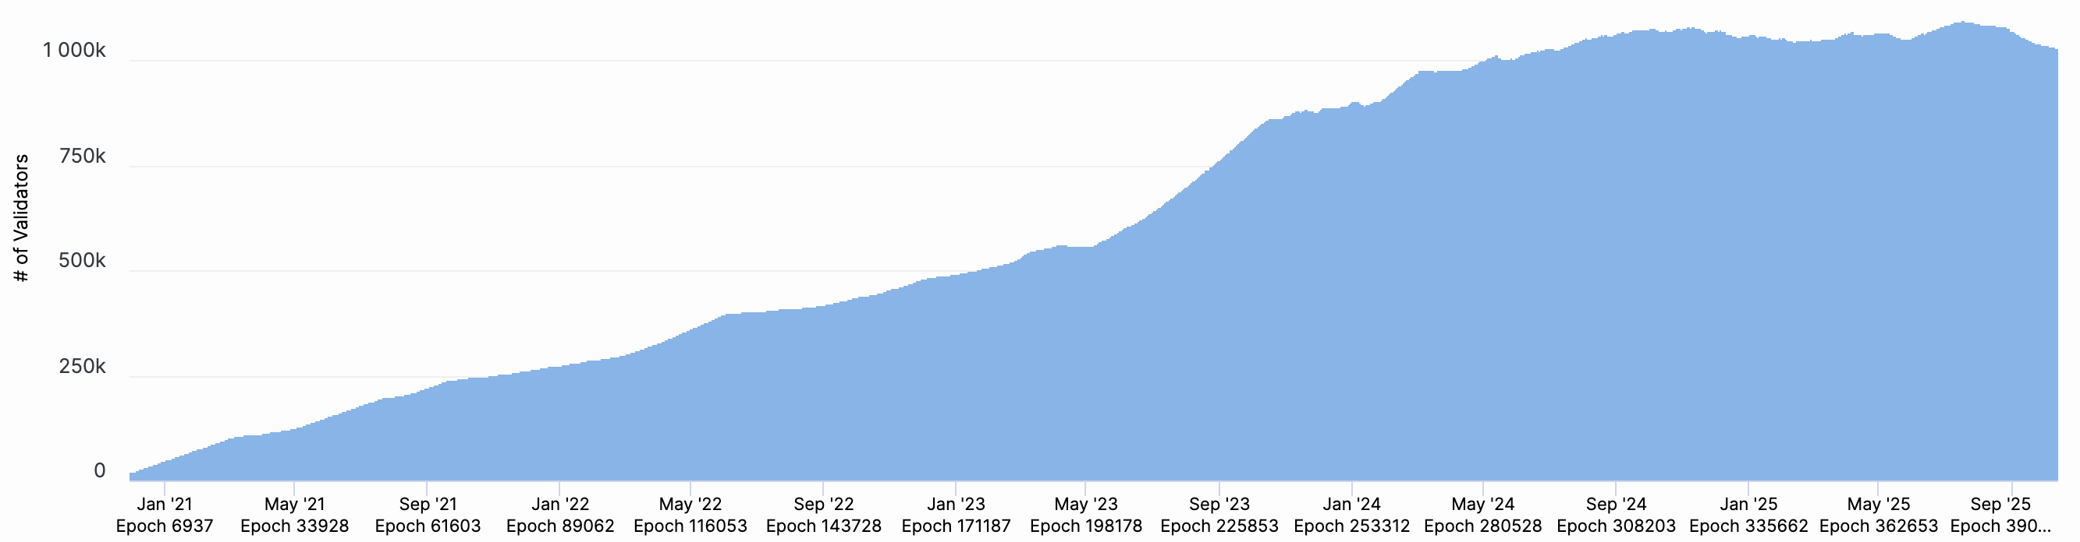
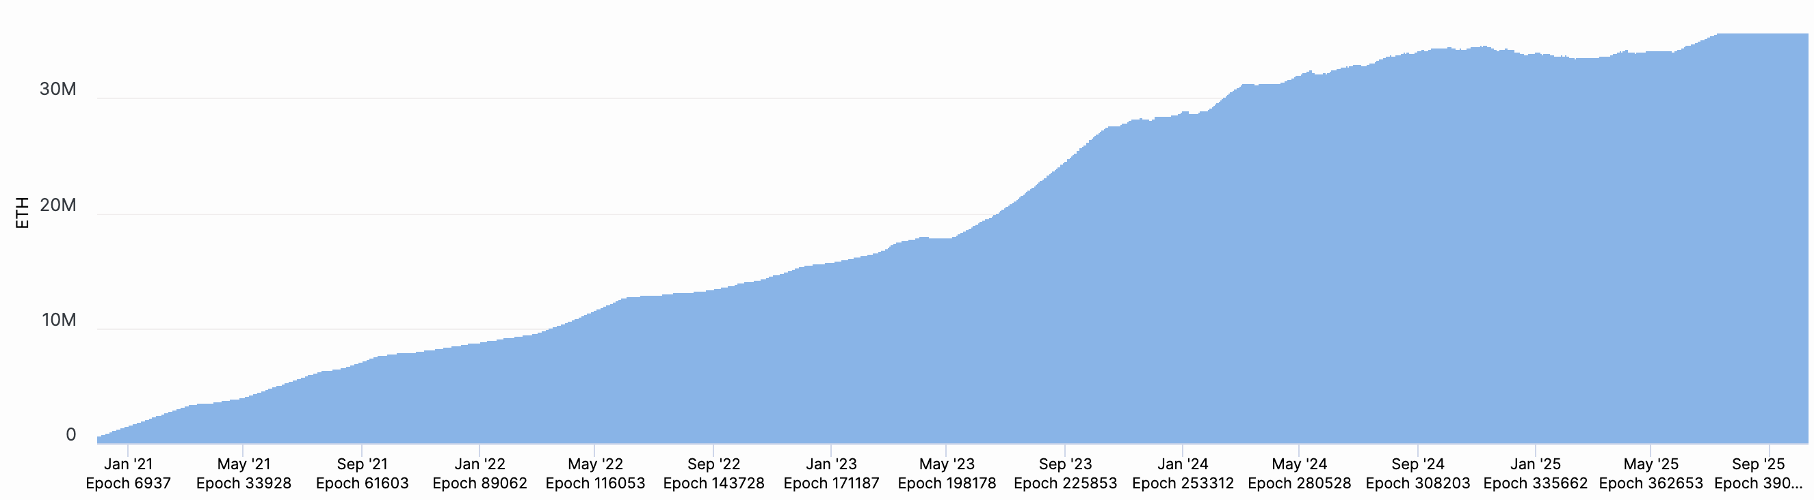
A bit about the beacon chain (Eth2 consensus layer)
To become a validator: stake (lock up) 32 ETH … or use Lido.
Validators: - sign blocks to express correctness (finalized once enough sigs)
- occasionally act as block proposer (chosen at random)
- correct behavior ⇒ issued new ETH every epoch (32 blocks)
- incorrect behavior ⇒ slashed
(lots of details)
Staked ETH
(35.7M ≈ 29.4% of all ETH)
# Validators
(≈1M)
Notes:
Since Pectra (May 2025): a validator can stake up to 2048 ETH. So #Validators should drop over time.
https://beaconcha.in/charts/validators
https://beaconcha.in/charts/staked_ether
Correct behavior: don’t sign two different blocks for same slot and other mischief.
https://explorer.rated.network/network?network=mainnet&timeWindow=1d&rewardsMetric=average&geoDistType=all&hostDistType=all&soloProDist=stake

Slide 13
The economics of staking
Validator locks up 32 ETH. Oct 2025: 35.7M ETH staked (total)
Annual validator income (an example):
Sources: issuance, Tx fees (tips), MEV
Total: 0.93 ETH/year (2.93% on 32 ETH staked)
In practice: staking provider (e.g., Lido) takes a cut of the returns
Notes:
https://ultrasound.money/#monetary-premium (see validator rewards section)
Also see: https://www.coinbase.com/earn/staking/ethereum
https://dune.com/LidoAnalytical/Lido-Finance-Extended
slashing statistics: https://explorer.rated.network/slashings?network=mainnet&timesSlashedPage=1&slashesReportedPage=1

Slide 14
An Ethereum node
update
world state
compute layer (execution chain)
notify_new_payload(payload) [Engine API]
sends transactions to compute layer
32 slots
in an epoch
(12sec ×32 = 6.4 mins)
consensus layer (beacon chain)
Notes:
32 slots make an epoch (a slot may or may not contain a block). Then validators vote on slots to finalize them.
Finality after two epochs (12.8 minutes).

Slide 15
The Ethereum Compute Layer:
The EVM

Slide 16
Ethereum compute layer: the EVM
World state: set of accounts identified by 20-byte address.
Two types of accounts:
  externally owned accounts (EOA):
  controlled by ECDSA signing key pair (pk,sk).
sk: signing key known only to account owner
(2) contracts: controlled by code.
code set at account creation time, does not change
Since May 2025:
EOA can also be controlled by code
Notes:
ERC 7702: EOAs can have code. A new transaction type: “set code transaction”.

Slide 17
Data associated with an account
Account data Owned (EOA) Contracts
address (computed): H(pk) H(CreatorAddr, CreatorNonce)
code: ⊥ CodeHash
(or address)
storage root (state): ⊥ StorageRoot
balance (in Wei): balance balance (1 Wei = 10⁻¹⁸ ETH)
nonce: nonce nonce
(#Tx sent) + (#accounts created): anti-replay mechanism
Notes:
The computed address for a contract created with CREATE is H(CreatorAddr, CreatorNonce) as shown in the table above. Same when contract is created by an owned account. However, the computed address for a contract created with CREATE2 is H(CreatorAddr, InitCodeOfNewContract, Salt). This means that CREATE2 can be used to overwrite the code of a previous contract that resided in that address. This is only possible if the earlier contract did a SELFDESTRUCT. Either way, the nonce of a newly created contract is initialized to zero.
ERC 7702: set-code-transaction transaction type writes (or clears) a delegation address to the EOA’s code. The code at that address can control the EOA.

Slide 18
Account state: persistent storage
Every contract has an associated storage array S[]:
S[0], S[1], … , S[2²⁵⁶-1]: each cell holds 32 bytes, init to 0.
Account storage root: Merkle Patricia Tree hash of S[]
  Cannot compute full Merkle tree hash: 2²⁵⁶ leaves
0
0, a
S[000] = a
S[010] = b
S[011] = c
S[110] = d
time to compute
root hash:
≤ 2×|S|
0
0
⊥, b
root
1
1
10, d
1
⊥, c
|S| = # non-zero cells
Notes:
Store suffix in nodes. Ethereum’s Merkle Patricia Tree has a branching factor of 16.

Slide 19
State transitions: Tx and messages
Transactions: signed data by initiator
To: 32-byte address of target (0 ⇾ create new account)
From, [Signature]: initiator address and signature on Tx (if owned)
Value: # Wei being sent with Tx (1 Wei = 10⁻¹⁸ ETH)
Tx fees (EIP 1559): gasLimit, maxFee, maxPriorityFee (later)
if To = 0: create new contract code = (init, body)
if To ≠ 0: data (what function to call & arguments)
nonce: must match current nonce of sender (prevents Tx replay)
chain_id: ensures Tx can only be submitted to the intended chain
Notes:
nonce must match current nonce of sender in sender’s account data. When Tx processed successfully, nonce in sender’s account data is incremented by 1.
chain_id: ensures that a Tx signed for the testnet cannot be submitting on the mainnet (same with L1/L2 confusion).

Slide 20
State transitions: Tx and messages
Transaction types:
owned ⇾ owned: transfer ETH between users
owned ⇾ contract: call contract with ETH & data

Slide 21
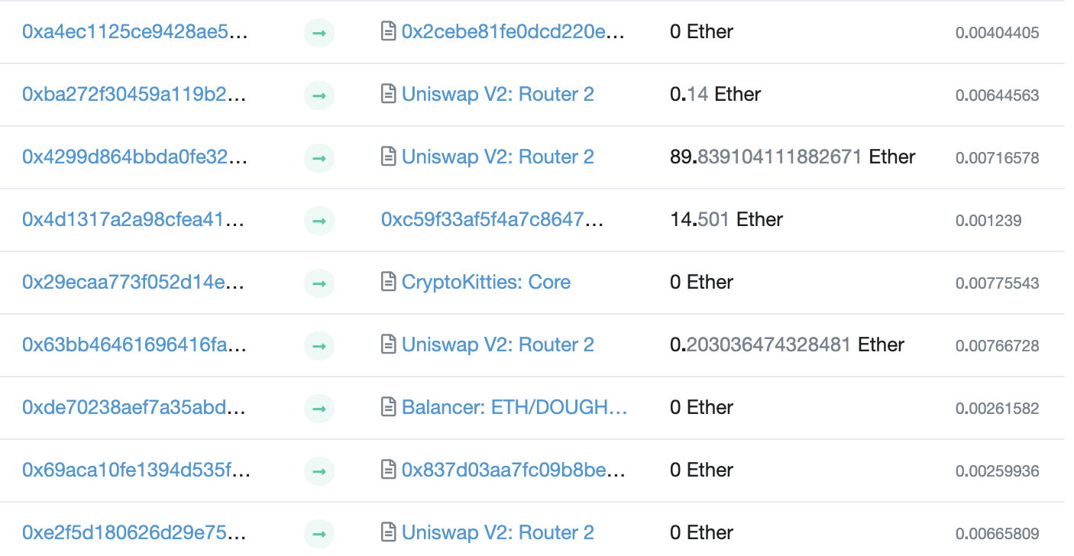
Example (block #10993504)
From
To
msg.value
Tx fee (ETH)
Notes:
Some Tx go to contracts, others go to owned addresses

Slide 22
Messages: virtual Tx initiated by a contract
Same as Tx, but no signature (contract has no signing key)
contract ⇾ owned: contract sends funds to user
contract ⇾ contract: one program calls another (and sends funds)
One Tx from user: can lead to many Tx processed. Composability!
Tx from owned addr ⇾ contract ⇾ another contract
another contract ⇾ different owned

Slide 23
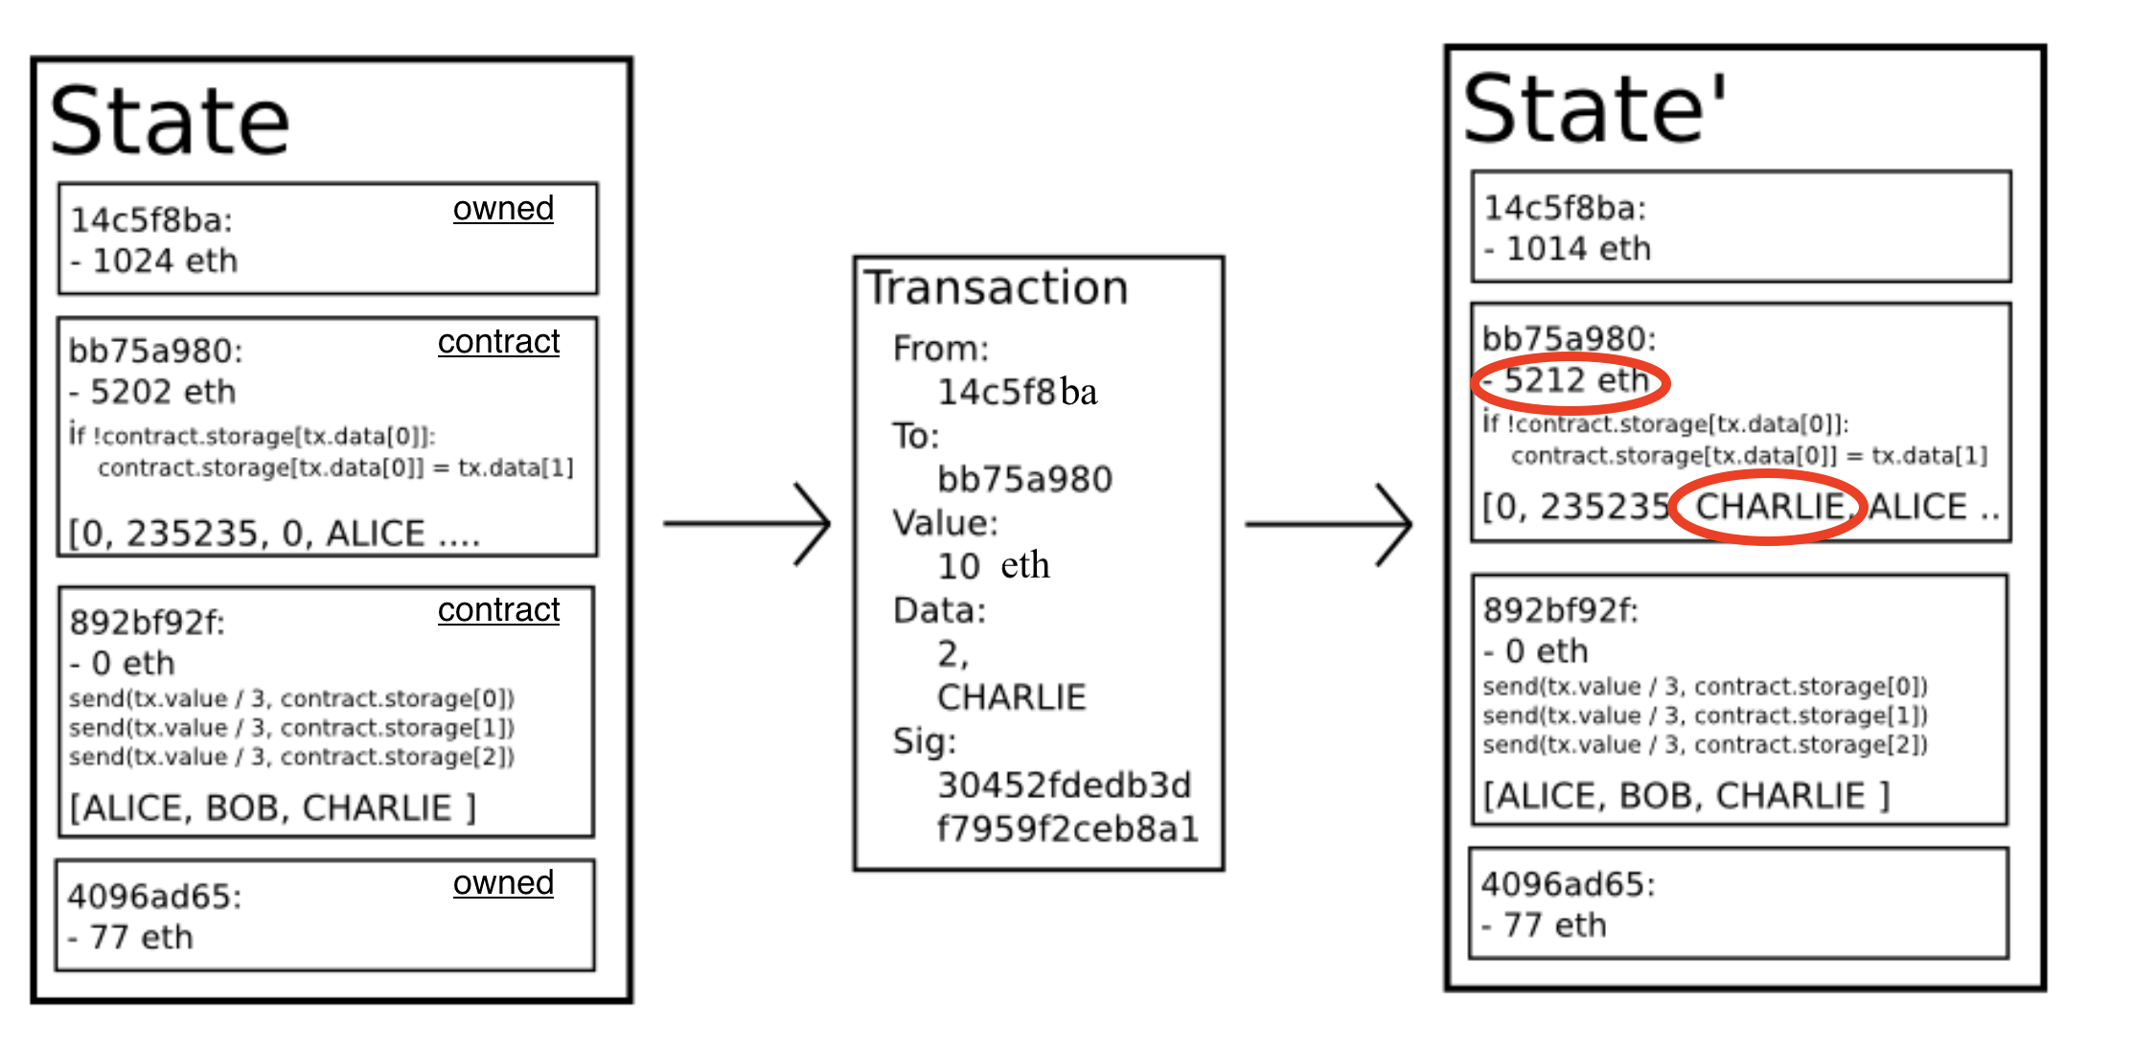
Example Tx
world state (four accounts)
updated world state

Slide 24
An Ethereum Block
Block proposer creates a block of n Tx: (from Txs submitted by users)
To produce a block do:
    for i=1,…,n: execute state change of Tx_{i} sequentially
    (can change state of >n accounts)
    record updated world state in block
Other validators re-execute all Tx to verify block ⇒
sign block if valid ⇒ enough sigs, epoch is finalized.
Notes:
Other blockchains allow for non-interfering parallel execution: Flow, Avalanche.

Slide 25
Block header data (simplified)
consensus data: proposer ID, parent hash, votes, etc.
address of gas beneficiary: where Tx fees will go
world state root: updated world state
Merkle Patricia Tree hash of all accounts in the system
(4) Tx root: Merkle hash of all Tx processed in block
(5) Tx receipt root: Merkle hash of log messages generated in block
(6) Gas Used: used to adjust the gas price (max gas per block is 45M)
Notes:
Max 45M gas per block.

Slide 26
The Ethereum blockchain: abstractly
prev hash
prev hash
…
…
accts.
accts.
updated
world
state
Tx
log
messages
updated
world
state
Tx
log
messages

Slide 27
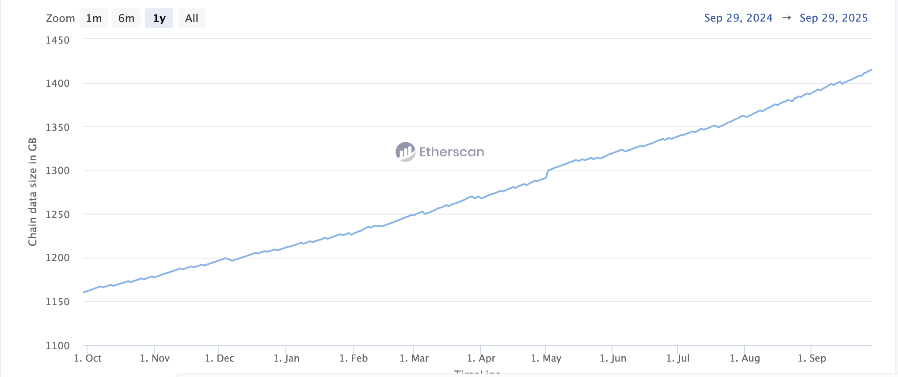
Amount of memory to run a node
≈1.4 TB
≈1.1 TB
(a year ago)
ETH total blockchain size (archival): 24 TB (Oct. 2025)
Notes:
https://etherscan.io/chartsync/chaindefault
https://etherscan.io/chartsync/chainarchive

Slide 28
An example contract: NameCoin
contract nameCoin { // Solidity code (next lecture)
struct nameEntry {
address owner; // address of domain owner
bytes32 value; // IP address
}
// array of all registered domains
mapping (bytes32 => nameEntry) data;

Slide 29

An example contract: NameCoin
function nameNew(bytes32 name) {
// registration costs is 100 Wei
if (data[name] == 0 && msg.value >= 100) {
data[name].owner = msg.sender // record domain owner
emit Register(msg.sender, name) // log event
}}
Code ensures that no one can take over a registered name
Serious bug in this code!
Front running.
Solved using commitments.

Slide 30
An example contract: NameCoin
function nameUpdate(
bytes32 name, bytes32 newValue, address newOwner) {
// check if message is from domain owner,
// and update cost of 10 Wei is paid
if (data[name].owner == msg.sender && msg.value >= 10) {
data[name].value = newValue; // record new value
data[name].owner = newOwner; // record new owner
}}}

Slide 31
An example contract: NameCoin
function nameLookup(bytes32 name) {
return data[name];
}
} // end of contract
Used by other contracts
Humans do not need this
(use etherscan.io)

Slide 32
EVM mechanics: execution environment
Write code in Solidity (or another front-end language)
⇒ compile to EVM bytecode, e.g., using solc compiler
(some projects use WASM or BPF bytecode)
⇒ validators use the EVM to execute contract bytecode
in response to a Tx

Slide 33
The EVM
Stack machine (like Bitcoin) but with JUMP
max stack depth = 1024
program aborts if stack size exceeded; block proposer keeps gas
a contract can create or call another contract
  There are several ways to call another contract
  Using CALL to call a contract that is different from the caller creates a new volatile execution frame that is deleted on return.
see https://www.evm.codes

Slide 34
The EVM memory types
The EVM has three types of zero initialized memory per contract.
All three are private to the contract that owns them (e.g., nameCoin)
Persistent storage (on blockchain): SLOAD, SSTORE (expensive)
Volatile memory (for a single Tx, one per execution frame):
MLOAD, MSTORE (very cheap, 3 Gas)
Transient memory (for a single Tx, but behaves like storage):
TLOAD, TSTORE (cheap, 100 Gas)
LOG0(data): write data to log
see https://www.evm.codes
Notes:
MLOAD/MSTORE: 3 Gas. TLOAD/STORE: 100 Gas.
Transient memory (EIP 1153): shared across all execution frames of a contract within a single transaction.

Slide 35
Every instruction costs gas, examples:
SSTORE addr (32 bytes), value (32 bytes)
zero ⇾ non-zero: 20,000 gas
non-zero ⇾ non-zero: 5,000 gas (for a cold slot)
non-zero ⇾ zero: 15,000 gas refund (example)
Refund is given for reducing size of blockchain state
CREATE : 32,000 + 200×(code size) gas; CALL maxgas, addr, value, args
SELFDESTRUCT addr: kill current contract (5000 gas + 25K gas if addr is empty)
Notes:
Selfdestruct addr: sends all account funds to specified address. If address is empty and a positive amount is sent to it, then the address must be created, so this costs 25K gas.
CREATE: create a new contract
CALL: contract at address addr, with max gas, and value

Slide 36
Gas calculation
Why charge gas?
Tx fees (gas) prevents submitting Tx that runs for many steps.
During high load: block proposer chooses Tx from mempool
that maximize its income.
Old EVM: (prior to EIP1559, live on 8/2021)
Every Tx contains a gasPrice ``bid’’ (gas ⇾ Wei conversion price)
Producer chooses Tx with highest gasPrice (max sum(gasPrice×gasLimit))
⟹ not an efficient auction mechanism (first price auction)

Slide 37
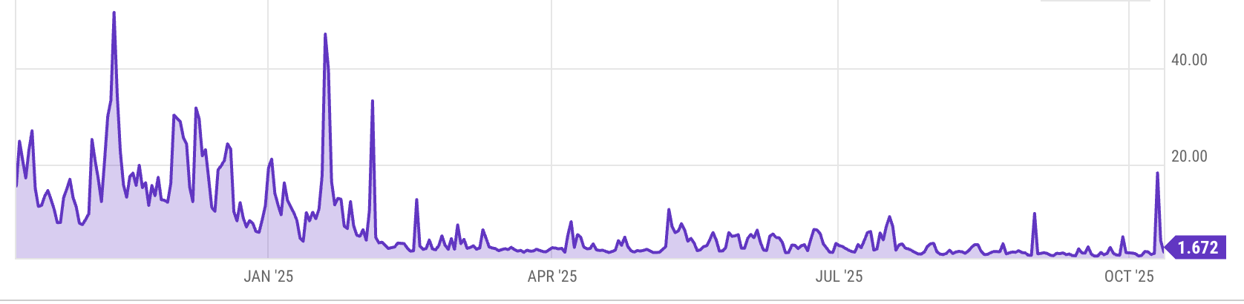
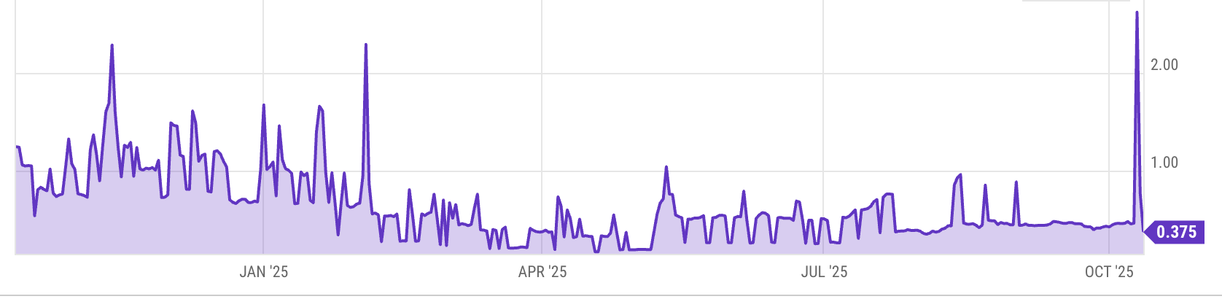
Gas prices spike during congestion
GasPrice in Gwei: 1.672 Gwei = 1.672×10⁻⁹ ETH
Average Tx fee in USD:
congestion
Notes:
https://ycharts.com/indicators/ethereum_average_gas_price
https://ycharts.com/indicators/ethereum_average_transaction_fee

Slide 38
Gas calculation: EIP1559 (since 8/2021)
EIP1559 goals (informal):
users incentivized to bid their true utility for posting Tx,
block proposer incentivized to not create fake Tx, and
disincentivize off chain agreements.
[ Transaction Fee Mechanism Design, by T. Roughgarden, 2021 ]
Notes:
If a second price auction were used: proposers would be incentivized to create fake transactions.
See https://arxiv.org/pdf/2106.01340.pdf for an analysis.

Slide 39
Gas calculation: EIP1559
Every block has a “baseFee”:
the minimum gasPrice for all Tx in the block
baseFee is computed from total gas in earlier blocks:
earlier blocks at gas limit (45M gas) ⟹ base fee goes up 12.5%
earlier blocks empty ⟹ base fee decreases by 12.5%
If earlier blocks at “target size” (22.5M gas) ⟹ base fee does not change
interpolate
in between

Slide 40
Gas calculation
EIP1559 Tx specifies three parameters:
gasLimit: max total gas allowed for Tx
maxFee: maximum allowed gas price (max gas ⇾ Wei conversion)
maxPriorityFee: additional “tip” to be paid to block proposer
Computed gasPrice bid:
gasPrice ⇽ min(maxFee, baseFee + maxPriorityFee)
Max Tx fee: gasLimit × gasPrice
Notes:
gas for each instruction defined by a hard coded table.

Slide 41

Gas calculation (informal)
gasUsed ⇽ gas used by Tx
Send gasUsed×(gasPrice – baseFee) to block proposer
BURN gasUsed× baseFee
⇒ total supply of ETH can decrease
Notes:
gas for each instruction defined by a hard coded table.
BURN: deflates the currency

Slide 42
Gas calculation
if gasPrice < baseFee: abort
If gasLimit×gasPrice < msg.sender.balance: abort
deduct gasLimit×gasPrice from msg.sender.balance
set Gas ⇽ gasLimit
execute Tx: deduct gas from Gas for each instruction
if at end (Gas < 0): abort, Tx is invalid (proposer keeps gasLimit×gasPrice)
(6) Refund Gas×gasPrice to msg.sender.balance
(7) gasUsed ⇽ gasLimit – Gas
(7a) BURN gasUsed× baseFee
(7b) Send gasUsed×(gasPrice – baseFee) to block producer
Notes:
gas for each instruction defined by a hard coded table.
BURN: deflates the currency

Slide 43
Why burn ETH ???
Recall: EIP1559 goals (informal)
users incentivized to bid their true utility for posting Tx,
block proposer incentivized to not create fake Tx, and
disincentivize off chain agreements.
Suppose no burn (i.e., baseFee given to block producer):
⟹ in periods of low Tx volume proposer would try to increase volume by offering to refund the baseFee off chain to users.
Notes:
If a second price auction were used: proposers would be incentivized to create fake transactions.
See https://arxiv.org/pdf/2106.01340.pdf for an analysis.

Slide 44
END OF LECTURE
Next lecture: writing Solidity contracts

