Slide 1
Incentives and Accountability in Consensus:
Proof-of-Stake
CS251 Fall 2025
(cs251.stanford.edu)

Slide 2
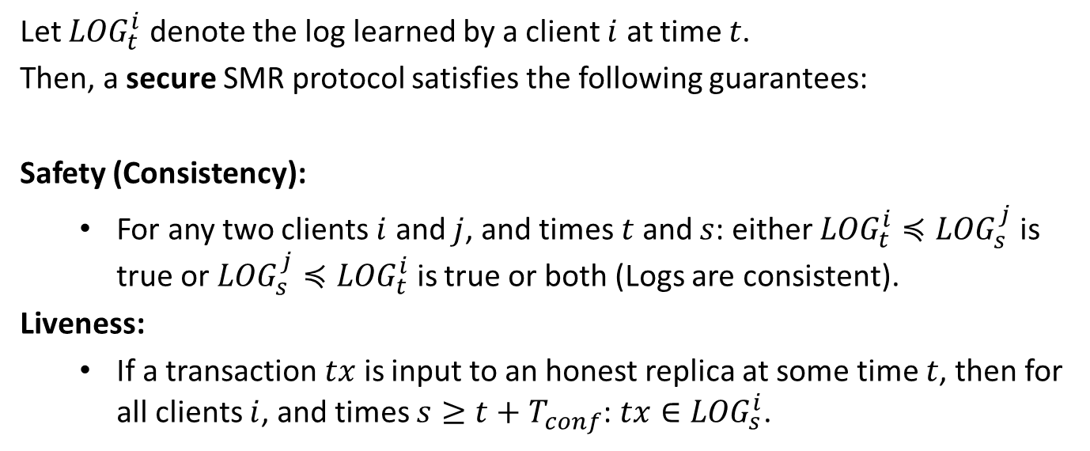
Recap: Security for SMR
Let ${LOG}_{t}^{i}$ denote the log learned by a client $i$ at time $t$.
Then, a secure SMR protocol satisfies the following guarantees:
Safety (Consistency):
  For any two clients $i$ and $j$, and times $t$ and $s$: either ${LOG}_{t}^{i}≼{LOG}_{s}^{j}$ is true or ${LOG}_{s}^{j}≼{LOG}_{t}^{i}$ is true or both (Logs are consistent).
Liveness:
  If a transaction $tx$ is input to an honest replica at some time $t$, then for all clients $i$, and times $s≥t+T_{conf}$: $tx∈{LOG}_{s}^{i}$.
No double spend
No censorship

Slide 3
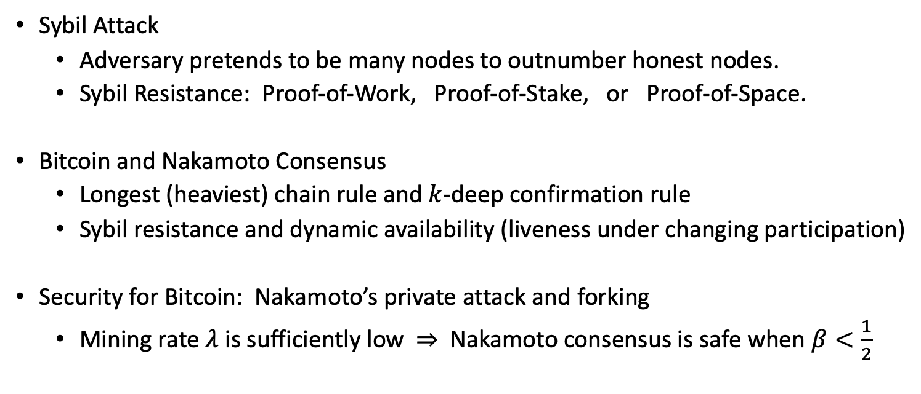
Recap of the Last Lecture
Sybil Attack
    Adversary pretends to be many nodes to outnumber honest nodes.
    Sybil Resistance: Proof-of-Work, Proof-of-Stake, or Proof-of-Space.
  Bitcoin and Nakamoto Consensus
    Longest (heaviest) chain rule and $k$-deep confirmation rule
    Sybil resistance and dynamic availability (liveness under changing participation)
Security for Bitcoin: Nakamoto’s private attack and forking
  Mining rate $λ$ is sufficiently low ⇒ Nakamoto consensus is safe when $β<\frac{1}{2}$

Slide 4
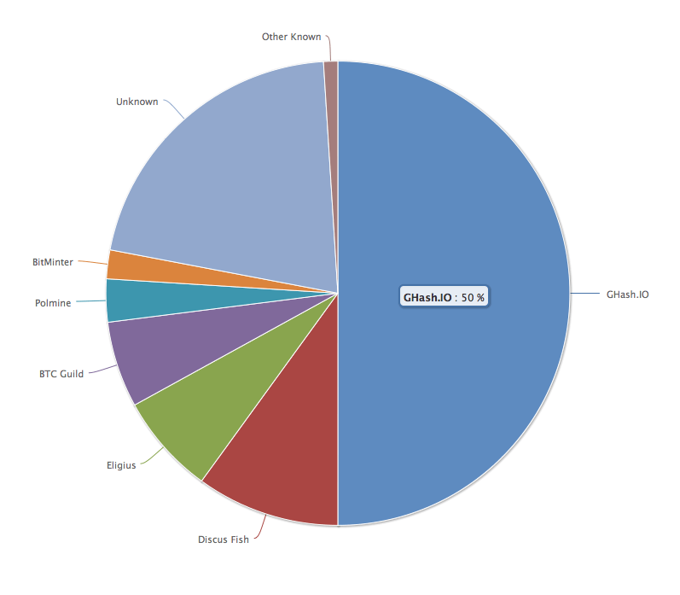
Do entities ever have 51% of hash power?
Ghash.IO had >50% in 2014
Gave up mining power
Why are visible attacks not more frequent?
Miners care about the Bitcoin price
Not quite a valid argument:
They can ‘short’ the chain for profit!
… but then no more block rewards
No guarantees for the future!

Slide 5
Incentives in Bitcoin
How does Bitcoin incentivize miners to participate in consensus and mine new blocks?
Block rewards – currently 3.125 Bitcoin – halved every 210,000 blocks (≈4 years)
Transaction fees
Do these incentives guarantee honest participation?
Not necessarily!
Example: selfish mining attack
(see the optional slides for the details.)

Slide 6

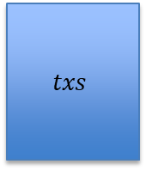
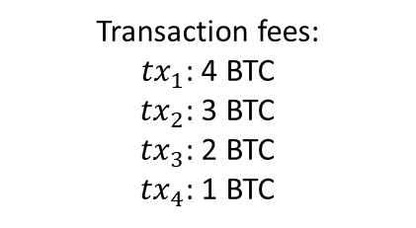
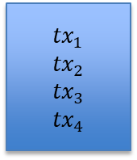

Incentives in Bitcoin
$k+1$-deep
Transaction fees:
${tx}_{1}$: 4 BTC
${tx}_{2}$: 3 BTC
${tx}_{3}$: 2 BTC
${tx}_{4}$: 1 BTC
Miner A
Genesis
$$txs$$
$${tx}_{1}$$
$${tx}_{2}$$
$${tx}_{3}$$
$${tx}_{4}$$
…
Miner B
(wants to steal 10 BTC in fees)

Slide 7

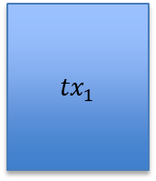
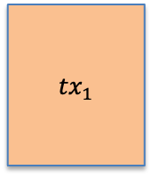
Incentives in Bitcoin
$k+1$-deep
Transaction fees:
${tx}_{1}$: 4 BTC
${tx}_{2}$: 3 BTC
${tx}_{3}$: 2 BTC
${tx}_{4}$: 1 BTC
Miner A
Genesis
$$txs$$
$${tx}_{1}$$
$${tx}_{2}$$
$${tx}_{3}$$
$${tx}_{4}$$
…
3 BTC earned
$${tx}_{1}$$
Miner C:
can get 6 BTC in Tx fees by extending B’s chain
Miner B

Slide 8
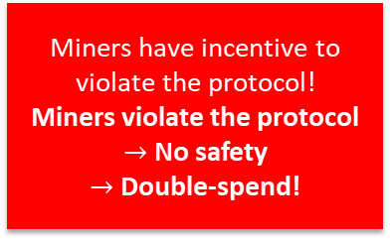

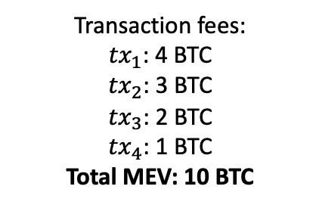

Incentives in Bitcoin
$k+1$-deep
Transaction fees:
${tx}_{1}$: 4 BTC
${tx}_{2}$: 3 BTC
${tx}_{3}$: 2 BTC
${tx}_{4}$: 1 BTC
Total MEV: 10 BTC
Miner A
Miner A’s block got ‘reorged’:
It was part of the longest chain before but not anymore!!
Genesis
$$txs$$
$${tx}_{1}$$
$${tx}_{2}$$
$${tx}_{3}$$
$${tx}_{4}$$
…
Maximal extractable value (MEV):
a measure of miner’s profit via inclusion, exclusion or re-ordering of transactions within its block
$${tx}_{1}$$
$${tx}_{2}$$
Miners have incentive to violate the protocol!
Miners violate the protocol $→$ No safety
$→$ Double-spend!
…
Miner B
Miner C
$k+1$-deep
MEV gives miners incentive to violate the protocol

Slide 9
From Bitcoin to Proof-of-Stake
1982
2008
2015
2022
…
Time
The Byzantine Generals Problem
Bitcoin
PoW Ethereum
PoS Ethereum
Consensus in the Internet Setting
Sybil resistance
Dynamic availability
  (Liveness under changing part.)
Block rewards (carrot)
  to incentivize participation!
Consensus in the Internet Setting
  Sybil resistance
  Dynamic availability
Block rewards (carrot)
Finality and accountable safety
Slashing (stick)
  to punish protocol violation!
The Byzantine Generals Problem (1982)
Bitcoin: A Peer-to-Peer Electronic Cash System (2008)
Ethereum: A Next-Generation Smart Contract and Decentralized Application Platform. (2015)
Combining GHOST and Casper (2020)

Slide 10
Proof-of-Stake (PoS): introduction
The more coins staked by a node…
Higher the probability that the node is elected as a leader.
Leader collects block rewards,
a form of interest on locked stake
In a Proof-of-Stake protocol, nodes lock up (i.e., stake) their coins in the protocol to become eligible to participate in consensus.
If a node is caught doing an adversarial action (e.g., certifying two blocks), it can be punished by burning its locked coins (stake)! This is called slashing.
Thus, in a Proof-of-Stake protocol, nodes can be held accountable for their actions (unlike in Bitcoin, where nodes do not lock up coins).

Slide 11










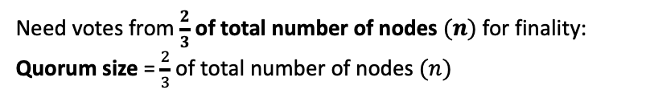


A Simple (PBFT-style) PoS Protocol*
Need votes from $\frac{2}{3}$ of total number of nodes $(n)$ for finality:
Quorum size = $\frac{2}{3}$ of total number of nodes $(n)$
Staked Coins
epochs
e
(9 nodes)
e+1
…
Vote by a node: Signature of the node on the block and the epoch
Alice’s log:
$${txs}_{1}$$
$${txs}_{4}$$
PBFT: Practical Byzantine Fault Tolerance. (1999)
Notes:
This simple protocol has a liveness problem (see slides at end): the leader can propose one Tx to n/2 nodes, and a different transaction to the other n/2 nodes. Now no Tx gets finalized.

Slide 12


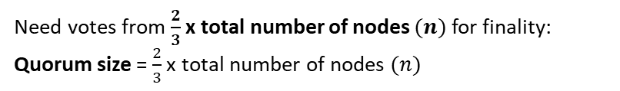


A Simple (PBFT-style) PoS Protocol*
Need votes from $\frac{2}{3}$ x total number of nodes $(n)$for finality:
Quorum size = $\frac{2}{3}$ x total number of nodes $(n)$
Staked Coins
epochs
e
Votes for ${txs}_{4}$
Votes for ${txs}_{5}$
$$≥\frac{2}{3}n$$
$$≥\frac{2}{3}n$$
e+1
…
Vote by a node: Signature of the node on the block and the epoch
Alice’s log:
$${txs}_{1}$$
$${txs}_{4}$$
PBFT: Practical Byzantine Fault Tolerance. (1999)

Slide 13
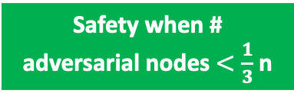
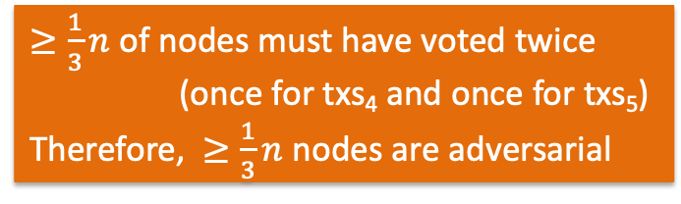

A Simple (PBFT-style) PoS Protocol*
Need votes from $\frac{2}{3}$ x total number of nodes $(n)$for finality:
Quorum size = $\frac{2}{3}$ x total number of nodes $(n)$
Staked Coins
epochs
e
Votes for ${txs}_{4}$
Votes for ${txs}_{5}$
$$≥\frac{2}{3}n$$
$$≥\frac{1}{3}n$$
$$≥\frac{2}{3}n$$
e+1
…
$≥\frac{1}{3}n$ of nodes must have voted twice
(once for txs₄ and once for txs₅)
Therefore, $≥\frac{1}{3}n$ nodes are adversarial
Safety when # adversarial nodes $<\frac{1}{3}$ n
Alice’s log:
$${txs}_{1}$$
$${txs}_{4}$$

Slide 14



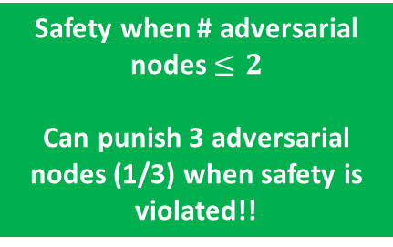
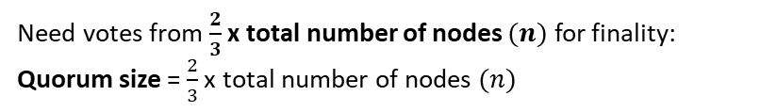
A Simple (PBFT-style) PoS Protocol*
Need votes from $\frac{2}{3}$ x total number of nodes $(n)$ for finality:
Quorum size = $\frac{2}{3}$ x total number of nodes $(n)$
Staked Coins
epochs
e
e+1
…
safety violation!
Alice’s log:
$${txs}_{1}$$
$${txs}_{4}$$
Bob’s log:
$${txs}_{1}$$
$${txs}_{5}$$

Slide 15


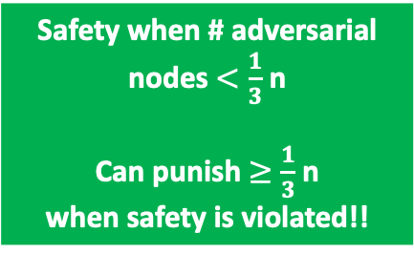
A Simple (PBFT-style) PoS Protocol*
Need votes from $\frac{2}{3}$ x total number of nodes $(n)$ for finality:
Quorum size = $\frac{2}{3}$ x total number of nodes $(n)$
Staked Coins
epochs
e
e+1
Safety when # adversarial nodes $<\frac{1}{3}$ n
Can punish $≥\frac{1}{3}$ n
when safety is violated!!
…
Protocol violators!
safety violation!
Alice’s log:
$${txs}_{1}$$
$${txs}_{4}$$
Bob’s log:
$${txs}_{1}$$
$${txs}_{5}$$
Notes:
Slashing statistics: https://explorer.rated.network/slashings?network=mainnet&timesSlashedPage=1&slashesReportedPage=1

Slide 16
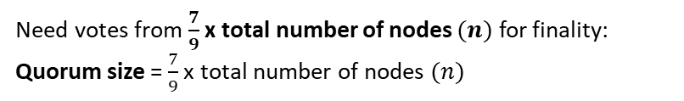
A Simple (PBFT-style) PoS Protocol*
Need votes from $\frac{7}{9}$ x total number of nodes $(n)$ for finality:
Quorum size = $\frac{7}{9}$ x total number of nodes $(n)$
Staked Coins
epochs
e
e+1
…

Slide 17
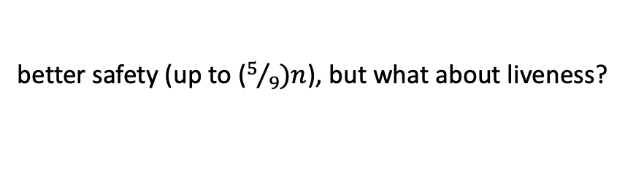
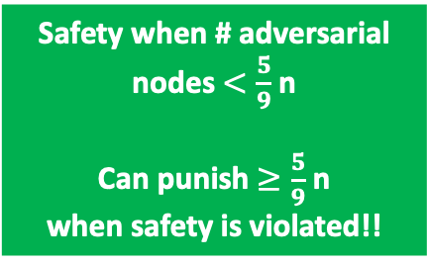
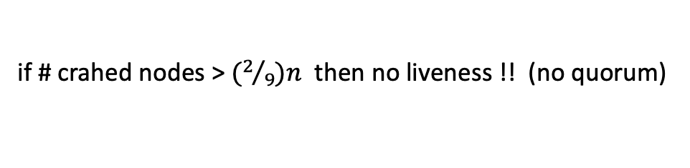
A Simple (PBFT-style) PoS Protocol*
Need votes from $\frac{7}{9}$ x total number of nodes $(n)$ for finality:
Quorum size = $\frac{7}{9}$ x total number of nodes $(n)$
Staked Coins
epochs
e
e+1
Safety when # adversarial nodes $<\frac{5}{9}$ n
Can punish $≥\frac{5}{9}$ n
when safety is violated!!
…
Protocol violators!
better safety (up to ($5/9)n$), but what about liveness?
if # crahed nodes > $(2/9)n$ then no liveness !! (no quorum)
Notes:
We have 7+7=14 votes. So, at least five nodes must have voted twice. Punish them.

Slide 18
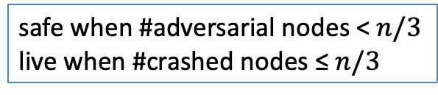
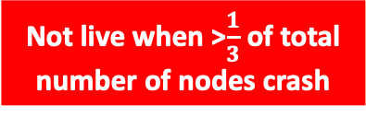
A Simple (PBFT-style) PoS Protocol*
Need votes from $\frac{2}{3}$ x total number of nodes $(n)$ for finality:
Quorum size = $\frac{2}{3}$ x total number of nodes $(n)$
Staked Coins
epochs
e
e+1
…
safe when #adversarial nodes < $n/3$
live when #crashed nodes ≤ $n/3$
Not live when >$\frac{1}{3}$ of total number of nodes crash
Alice’s log:
$${txs}_{1}$$
Notes:
AlpenGlow (Solana): liveness if #crashed nodes < 20%. Safety if #adversarial nodes < 60%. (quorum=80%)

Slide 19
A Simple (PBFT-style) PoS Protocol*
Sybil resistance mechanism determines how to select the nodes that are eligible to participate in consensus and propose/vote for transactions/blocks.
Consensus protocol specifies the instructions for honest nodes so that given a set of eligible nodes with sufficiently many being honest, safety and liveness are satisfied.
Sybil resistance mechanism: Consensus protocol (SMR): | Proof-of-Work | Proof-of-Stake
Nakamoto consensus (longest chain) | Bitcoin | Ouroboros
PBFT-style (with votes) | ?? | Ethereum* Simple PBFT-style PoS protocol
satisfies dynamic availability
satisfies finality and accountable safety
Ouroboros Genesis: Composable Proof-of-Stake Blockchains with Dynamic Availability. (2019)

Slide 20
Accountable Safety
In a protocol with resilience of n/3:
  The protocol is secure (safe & live) if there are less than n/3 adversarial nodes.
  Example: The simple proof-of-stake protocol.
In a protocol with accountable safety resilience of n/3:
  The protocol is secure if there are less than n/3 adversarial nodes.
  If there is ever a safety violation, all observers of the protocol can provably identify (i.e., catch) at least n/3 adversarial nodes as protocol violators.
  No honest node is ever identified (no false accusation).
  Examples: The simple proof-of-stake protocol , PBFT, Tendermint, HotStuff …
Casper the Friendly Finality Gadget. (2017)
BFT Protocol Forensics (2021)

Slide 21
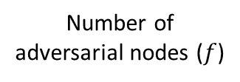




Accountable Safety
Accountable safety is a stronger notion than just security.
Number of adversarial nodes ($f$)
$$0$$
$$n/3$$
$$2n/3$$
$$1$$
Resilience of n/3
Safety & Liveness ☺
No Safety or Liveness ☹
No Safety or Liveness ☹
Accountable safety resilience of n/3
No liveness ☹
If safety is violated, catch and punish adversarial nodes ☺
Safety & Liveness ☺

Slide 22
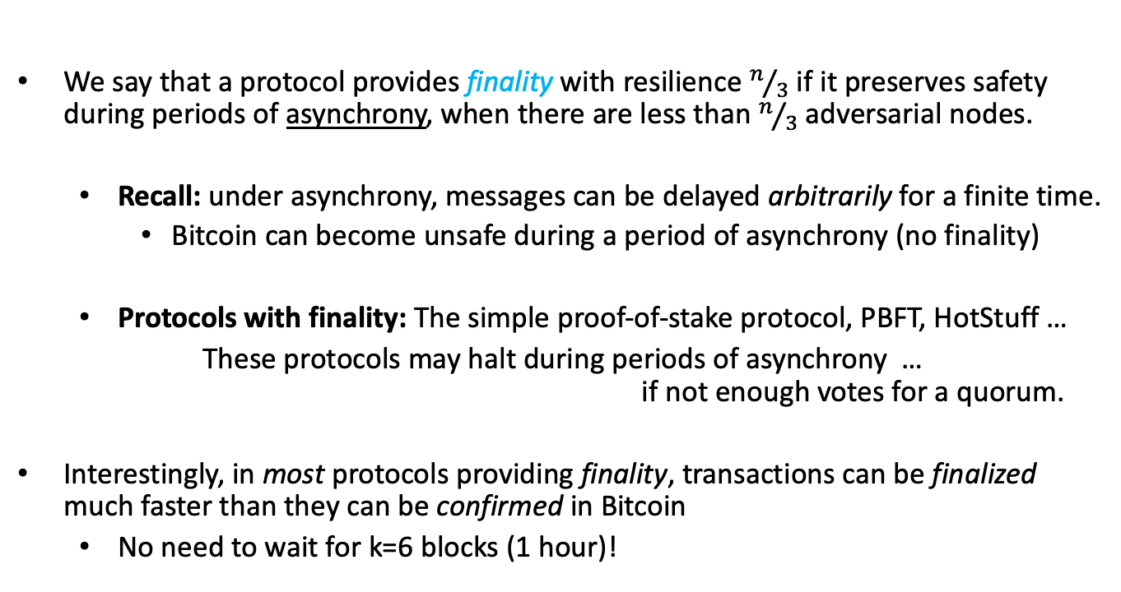
Finality
We say that a protocol provides finality with resilience $n/3$ if it preserves safety during periods of asynchrony, when there are less than $n/3$ adversarial nodes.
  Recall: under asynchrony, messages can be delayed arbitrarily for a finite time.
    Bitcoin can become unsafe during a period of asynchrony (no finality)
  Protocols with finality: The simple proof-of-stake protocol, PBFT, HotStuff …
  These protocols may halt during periods of asynchrony …
  if not enough votes for a quorum.
Interestingly, in most protocols providing finality, transactions can be finalized much faster than they can be confirmed in Bitcoin
  No need to wait for k=6 blocks (1 hour)!
Notes:
Bitcoin can become unsafe during a network partition.

Slide 23

Accountability implies Finality
Accountability implies Finality:
Accountable safety (with resilience $\frac{n}{3}$) implies finality (with resilience $\frac{n}{3}$).
Accountably safe protocols:
can punish the adversary
Finalizing
protocols: safe under asynchrony
???
HotStuff-null
(but not Nakamoto)
Simple proof-of-stake protocol, PBFT, HotStuff, …
BFT Protocol Forensics (2021)
Accountable Safety Implies Finality (2023)

Slide 24
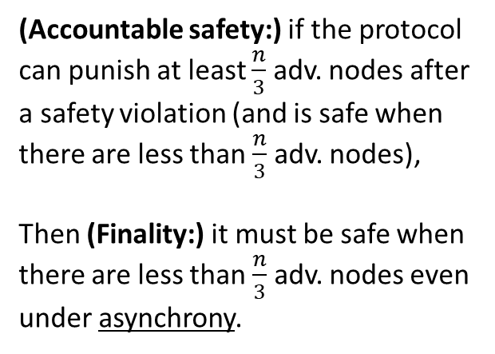
Accountability implies Finality
Accountability implies Finality:
Accountable safety (with resilience $\frac{n}{3}$) implies finality (with resilience $\frac{n}{3}$).
(Accountable safety:) if the protocol can punish at least $\frac{n}{3}$ adv. nodes after a safety violation (and is safe when there are less than $\frac{n}{3}$ adv. nodes),
Then (Finality:) it must be safe when there are less than $\frac{n}{3}$adv. nodes even under asynchrony.
Accountably safe protocols:
can punish the adversary
Finalizing
protocols: safe under asynchrony
HotStuff-null
Simple proof-of-stake protocol, PBFT, HotStuff, …
BFT Protocol Forensics (2021)
Accountable Safety Implies Finality (2023)

Slide 25
Holy Grail of Internet Scale Consensus
We want Sybil resistance: Proof-of-Work or Proof-of-Stake…
We want dynamic availability so that…
  Transactions continue to be confirmed even when there is low participation.
  Satisfied by Nakamoto consensus.
We want finality and accountable safety so that…
  Finality: There cannot be safety violations (double-spends) during asynchrony.
  Accountable safety: Nodes can be held accountable for safety violations
  caused by their actions.
  Satisfied by our simple proof-of-stake protocol, PBFT, HotStuff, …
Let’s focus on having dynamic availability and finality for now…

Slide 26
Holy Grail of Internet Scale Consensus
Is there a SMR protocol that provides both dynamic availability and finality with any resilience?
No: The Blockchain CAP Theorem!!
CAP: Consistency, Availability, Partition tolerance
Dynamically available protocols:
live under changing part.
Accountably safe protocols:
can punish the adversary
Finalizing
protocols:
safe under asynchrony
Simple proof-of-stake protocol, PBFT, HotStuff, …
Nakamoto consensus
Resource Pools and the CAP Theorem (2020)

Slide 27





Blockchain CAP Theorem
For contradiction, suppose our SMR protocol has both dynamic availability and finality.
World 1
Log: ${tx}_{1}{tx}_{2}{tx}_{3}$
Nodes/miners
Nodes/miners
Log: ${tx}_{1}{tx}_{2}{tx}_{3}$
Log: ${tx}_{1}{tx}_{2}{tx}_{3}$
“I didn’t hear from the other nodes; they are probably offline.”
Correct log: ${tx}_{1}{tx}_{2}{tx}_{3}$
Dynamic Availability:
Liveness under changing participation
Client: Alice
Log learned by Alice: ${tx}_{1}{tx}_{2}{tx}_{3}$

Slide 28





Blockchain CAP Theorem
For contradiction, suppose our SMR protocol has both dynamic availability and finality.
World 2
Nodes/miners
Log: ${tx}_{3}{tx}_{2}{tx}_{1}$
Nodes/miners
Replicas/miners
Log: ${tx}_{3}{tx}_{2}{tx}_{1}$
Log: ${tx}_{3}{tx}_{2}{tx}_{1}$
Correct log: ${tx}_{3}{tx}_{2}{tx}_{1}$
“I didn’t hear from the other nodes; they are probably offline.”
Dynamic Availability:
Liveness under changing participation
Client: Bob
Log learned by Bob: ${tx}_{3}{tx}_{2}{tx}_{1}$

Slide 29





Blockchain CAP Theorem
For contradiction, suppose our SMR protocol has both dynamic availability and finality.
World 3
Asynchrony:
Network partition
Log: ${tx}_{1}{tx}_{2}{tx}_{3}$
Nodes/miners
Log: ${tx}_{3}{tx}_{2}{tx}_{1}$
Nodes/miners
Replicas/miners
Log: ${tx}_{1}{tx}_{2}{tx}_{3}$
Log: ${tx}_{3}{tx}_{2}{tx}_{1}$
Log: ${tx}_{1}{tx}_{2}{tx}_{3}$
Log: ${tx}_{3}{tx}_{2}{tx}_{1}$
“I didn’t hear from the other nodes; they are probably offline. I am in world 1.”
Correct log: ${tx}_{1}{tx}_{2}{tx}_{3}$
Correct log: ${tx}_{3}{tx}_{2}{tx}_{1}$
“I didn’t hear from the other nodes; they are probably offline. I am in world 2.”
Safety violation!
No safety under asynchrony!
(i.e., no finality)
Client: Alice
Client: Bob
Log learned by Alice: ${tx}_{1}{tx}_{2}{tx}_{3}$
Log learned by Bob: ${tx}_{3}{tx}_{2}{tx}_{1}$
⇒ proves the CAP theorem: cannot have both dynamic availability and finality

Slide 30
What to do: Nested Ledgers/Chains
Impossible!
Due to the CAP Theorem!
Single chain: tx₁, tx₂, tx₃, …
Finality: Safe under asynchrony
Dynamic availability: Live under changing participation
Accountable finalized chain
Available chain
Prefix property: Prefix of the available chain.
Accountably safe under asynchrony.
Live once the network becomes synchronous and if enough nodes are online.
Not live under low participation.
Safe and live under synchrony and changing participation.
Not safe under asynchrony.
Ebb-and-Flow Protocols: A Resolution of the Availability-Finality Dilemma (2020)

Slide 31






What to do: Nested Ledgers/Chains
Accountable finalized chain
Available chain
Prefix property: Prefix of the available chain.
Accountably safe under asynchrony.
Live once the network becomes synchronous and if enough nodes are online.
Not live under small participation.
Safe and live under synchrony and dynamic participation.
Not safe under asynchrony.
Nakamoto consensus
$$Π_{ava}$$
Safety-favoring client:
trusts acc. finalized chain
Liveness-favoring client:
trusts available chain
$$Π_{fin}$$
PBFT
Client chooses!
Can interact with each other thanks to the prefix property!!
Ebb-and-Flow Protocols: A Resolution of the Availability-Finality Dilemma (2020)

Slide 32
What to do: Nested Ledgers/Chains
Accountable finalized chain
Available chain
Prefix property: Prefix of the available chain.
Accountably safe under asynchrony.
Live once the network becomes synchronous and if enough nodes are online.
Not live under small participation.
Safe and live under synchrony and dynamic participation.
Not safe under asynchrony.
Nakamoto consensus
$$Π_{ava}$$
Safety-favoring client:
trusts acc. finalized chain
Liveness-favoring client:
trusts available chain
$$Π_{fin}$$
PBFT
Client chooses!
Ledgers can be inconsistent!
No prefix property!
Can interact with each other thanks to the prefix property!!
Ebb-and-Flow Protocols: A Resolution of the Availability-Finality Dilemma (2020)

Slide 33
What to do: Nested Ledgers/Chains
Safety-favoring client:
trusts acc. finalized chain
Liveness-favoring client:
trusts available chain
Client chooses!
When the participation seems low at the weekend, it can either be that participation is actually low due to nodes taking time off or there is in fact a network partition.
In this case, the boba vendor is willing to follow the available chain and risk a safety violation (and some double spend) due to a partition, since its transactions are of less value. By following the available chain, it can in turn keep selling boba at the weekends. Indeed, most of the time, there will not be a network partition, and participation will be low at the weekends due to nodes taking time off.
However, the car vendor’s transactions have large value, and the car vendor cannot afford even one double spend! Therefore, it will follow the accountable, finalized chain that never has safety violations, but stops when there is low participation, e.g., at the weekends. This is fine since the car vendor has few transactions and can afford to wait the weekend. Indeed, on Monday, the accountable, finalized chain regains its liveness with higher participation.

Slide 34
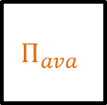
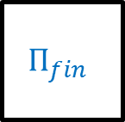
How to obtain the nested chains?
Latest checkpoint
Checkpointing Protocol
e.g., PBFT-style finality gadgets
Accountable
finalized chain
txs
$$Π_{ava}$$
$$Π_{fin}$$
Proposal to checkpoint
Available chain
Dynamically Available Protocol
e.g., Nakamoto consensus
Combining GHOST and Casper. (2020)

Slide 35




How to obtain the nested chains?
Nested Chains
Orange: available (full) chain
Blue: accountable, final (prefix) chain
Checkpointing Protocol
Propose “txs5”
A
C votes “txs5”
B votes “txs5”
D votes “txs5”
C
Propose “txs6”
A votes “txs6”
B
C votes “txs6”
Always extend the last checkpoint!!
D votes “txs6”
D
Dynamic Availability: Longest chain keeps growing.
Finality: Thanks to votes, checkpoints are safe even under asynchrony.

Slide 36
Ethereum
Latest checkpoint
Casper the Friendly Finality Gadget
Accountable
finalized chain
txs
LMD
GHOST
Casper
FFG
Proposal to checkpoint
Available chain
Latest Message Driven - Greedy Heaviest Observed Subtree
Combining GHOST and Casper. (2020)

Slide 37
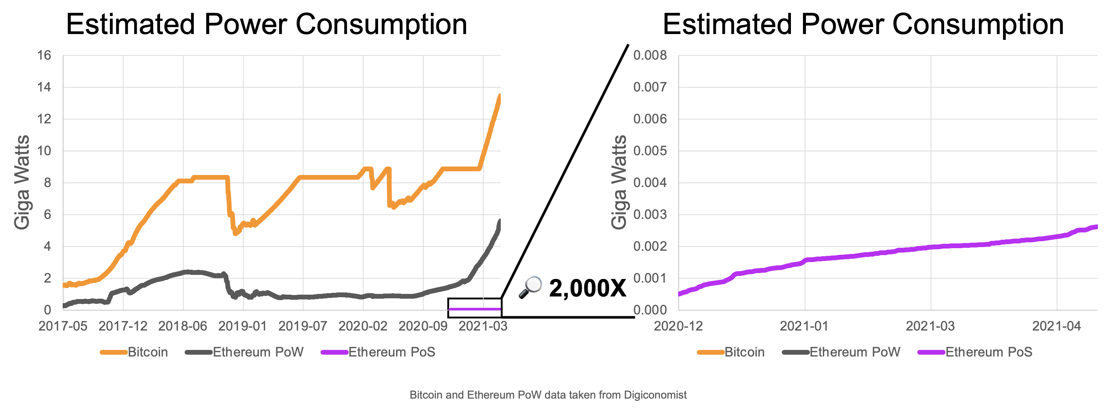
A Greener Future for Blockchains?
Taken from the article “Ethereum's energy usage will soon decrease by ~99.95%” that appeared at the ‘ethereum foundation blog’ on May 18th 2021.

Slide 38
END OF LECTURE
Next lecture: the Ethereum execution layer

Slide 39
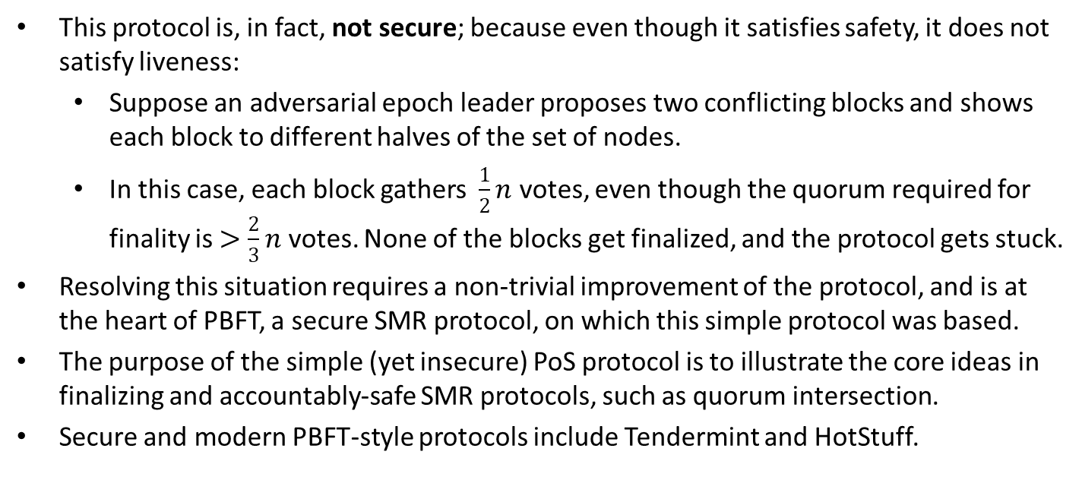
*A Note on the Simple PoS Protocol
This protocol is, in fact, not secure; because even though it satisfies safety, it does not satisfy liveness:
  Suppose an adversarial epoch leader proposes two conflicting blocks and shows each block to different halves of the set of nodes.
  In this case, each block gathers $\frac{1}{2}n$ votes, even though the quorum required for finality is $>\frac{2}{3}n$ votes. None of the blocks get finalized, and the protocol gets stuck.
Resolving this situation requires a non-trivial improvement of the protocol, and is at the heart of PBFT, a secure SMR protocol, on which this simple protocol was based.
The purpose of the simple (yet insecure) PoS protocol is to illustrate the core ideas in finalizing and accountably-safe SMR protocols, such as quorum intersection.
Secure and modern PBFT-style protocols include Tendermint and HotStuff.

Slide 40
Optional Slides
Slides going forward is optional material and investigate the Selfish Mining Attack.

Slide 41
Selfish Mining Attack (Optional)
Attacker keeps its blocks private until sufficiently many honest blocks are mined.
It then publishes the hidden blocks to ‘reorg’ the honest blocks.
Block Reward
Block Reward
Block Reward
Block Reward
Block Reward
Block Reward
Majority is not Enough: Bitcoin Mining is Vulnerable (2013)

Slide 42
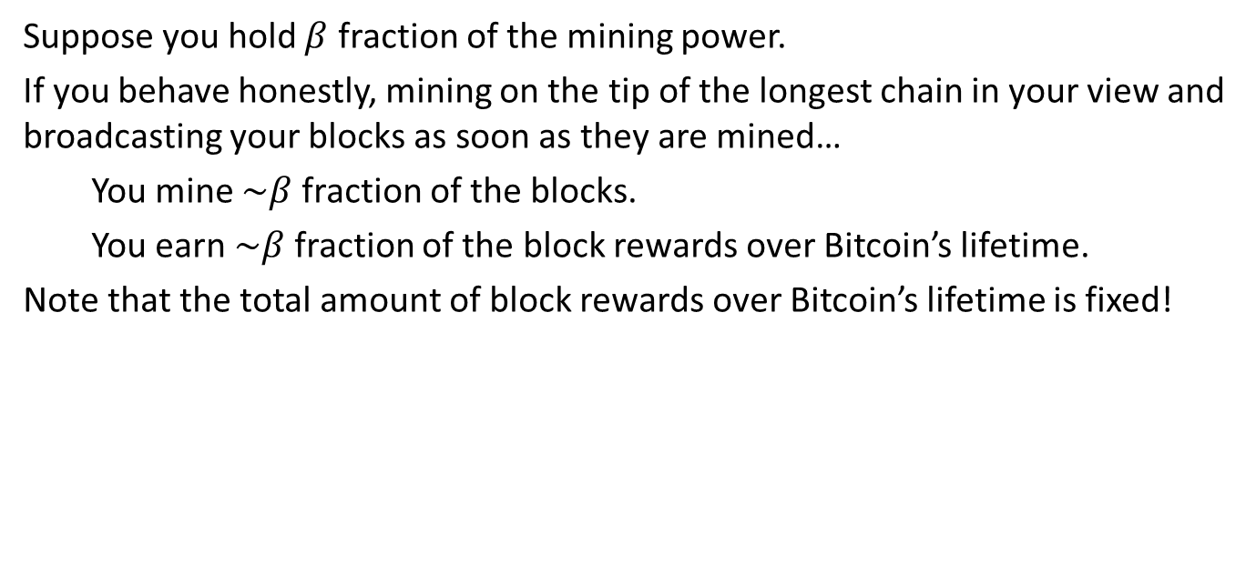
Selfish Mining Attack (Optional)
Suppose you hold $β$ fraction of the mining power.
If you behave honestly, mining on the tip of the longest chain in your view and broadcasting your blocks as soon as they are mined…
You mine $\sim β$ fraction of the blocks.
You earn $\sim β$ fraction of the block rewards over Bitcoin’s lifetime.
Note that the total amount of block rewards over Bitcoin’s lifetime is fixed!

Slide 43


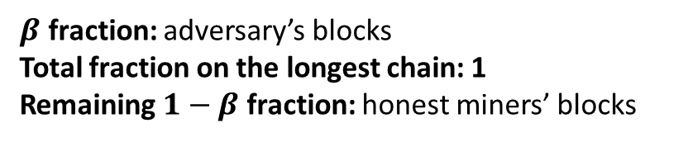
Selfish Mining Attack (Optional)
…
…
…
$β$ fraction: adversary’s blocks
Total fraction on the longest chain: 1
Remaining $1−β$ fraction: honest miners’ blocks

Slide 44
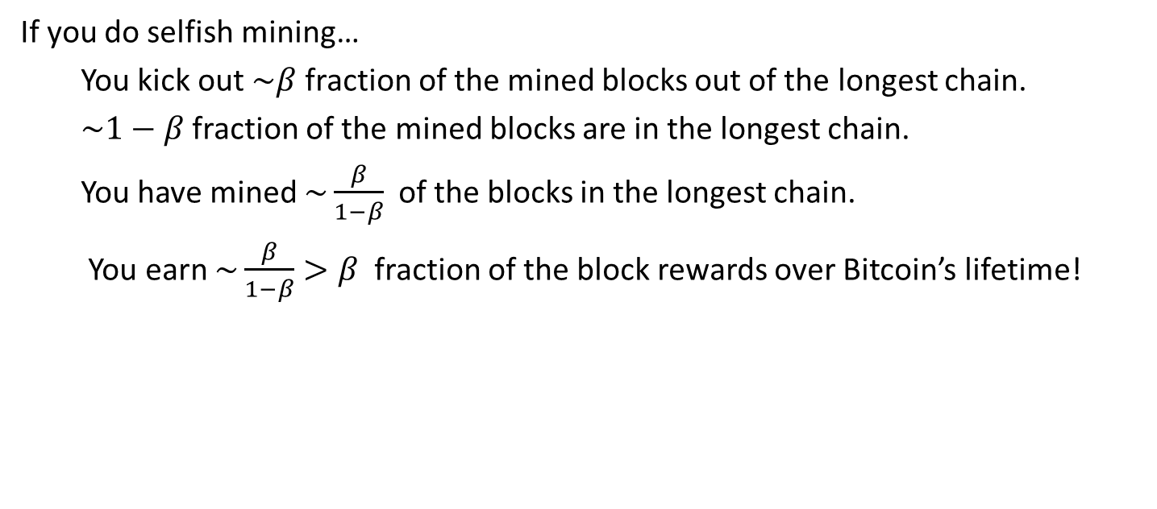
Selfish Mining Attack (Optional)
If you do selfish mining…
You kick out $\sim β$ fraction of the mined blocks out of the longest chain.
$\sim 1−β$ fraction of the mined blocks are in the longest chain.
You have mined $\sim \frac{β}{1−β}$ of the blocks in the longest chain.
You earn $\sim \frac{β}{1−β}>β$ fraction of the block rewards over Bitcoin’s lifetime!

Slide 45
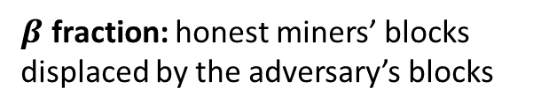
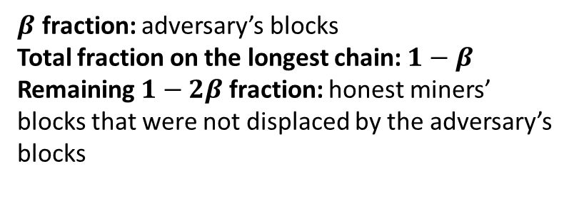
Selfish Mining Attack (Optional)
$β$ fraction: honest miners’ blocks displaced by the adversary’s blocks
…
…
…
…
$β$ fraction: adversary’s blocks
Total fraction on the longest chain: $1−β$
Remaining $1−2β$ fraction: honest miners’ blocks that were not displaced by the adversary’s blocks

Slide 46
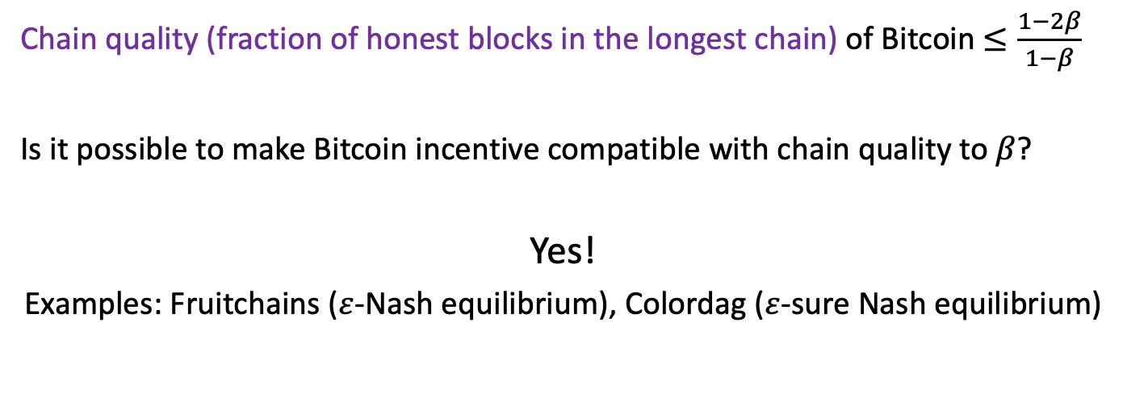
Selfish Mining Attack (Optional)
Chain quality (fraction of honest blocks in the longest chain) of Bitcoin $≤\frac{1−2β}{1−β}$
Is it possible to make Bitcoin incentive compatible with chain quality to $β$?
Yes!
Examples: Fruitchains ($ε$-Nash equilibrium), Colordag ($ε$-sure Nash equilibrium)
Fruitchains: A Fair Blockchain (2017)
Colordag: An Incentive-Compatible Blockchain (2022)

