Slide 1
Consensus in the Internet Setting
CS251 Fall 2025
(cs251.stanford.edu)

Slide 2
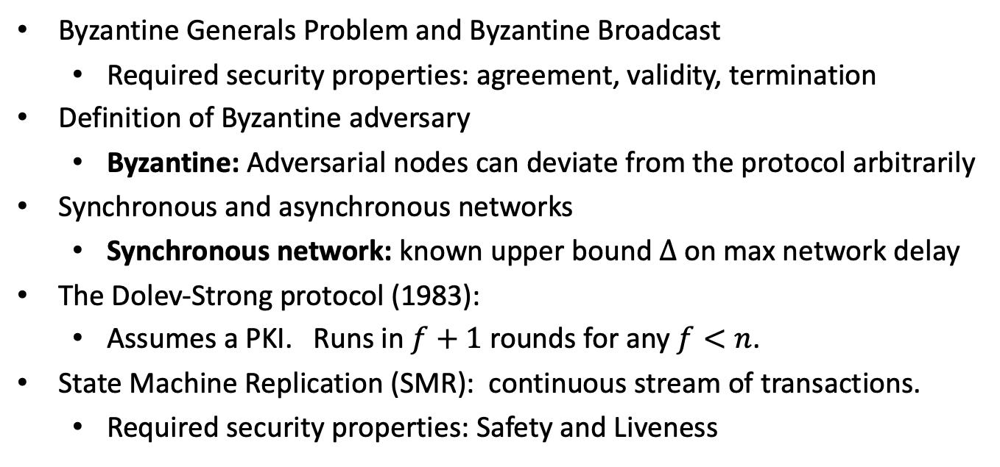
Recap of the Last Lecture
Byzantine Generals Problem and Byzantine Broadcast
  Required security properties: agreement, validity, termination
Definition of Byzantine adversary
  Byzantine: Adversarial nodes can deviate from the protocol arbitrarily
Synchronous and asynchronous networks
  Synchronous network: known upper bound $Δ$ on max network delay
The Dolev-Strong protocol (1983):
  Assumes a PKI. Runs in $f+1$ rounds for any $f<n$.
State Machine Replication (SMR): continuous stream of transactions.
  Required security properties: Safety and Liveness
Notes:
Agreement: all non-corrupt parties output the same bit,
Validity: if leader is not corrupt, all non-corrupt parties output the same bit as the leader.
Safety: for all honest nodes I,j and times u,v the LOG at I at time u is a prefix or the LOG at j at time v, or vice versa.
Liveness: there is a constant t, such that if a Tx appears on some honest LOG at time u, then it appears on *all* honest LOGs by time u+t.

Slide 3

Sybil Attack
How to select the nodes that participate in consensus?
Two variants:
Permissioned: There is a fixed set of nodes (previous lecture – historic consensus).
Permissionless: Anyone is free to join the protocol at any time -- Bitcoin.
Can we accept any node that has a signing key to participate in consensus?
How can an attacker maximize its disruptive power?
Sybil Attack!

Slide 4
Sybil Attack
How to select the nodes that participate in consensus?
Two variants:
Permissioned: There is a fixed set of nodes (previous lecture).
Permissionless: Anyone is free to join the protocol at any time.
In a sybil attack, a single adversary impersonates many different nodes, outnumbering the honest nodes and potentially disrupting consensus.

Slide 5
Sybil Resistance
Consensus protocols with Sybil resistance are based on a bounded resource:
 | Resource dedicated to the protocol | Some Example Blockchains
Proof-of-Work | Total computational power | Bitcoin
Proof-of-Stake | Total number of coins | PoS Ethereum, Cardano, Cosmos, …
Proof-of-Space/Time | Total storage across time | Chia, Filecoin, …
How does Proof-of-Work prevent Sybil attacks?
We assume that the adversary controls a small fraction of the scarce resource
⇒ Adversary has less influence than the totality of honest nodes.

Slide 6

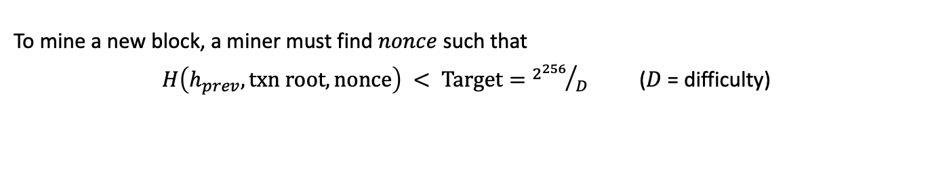


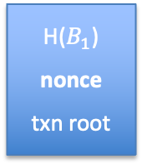
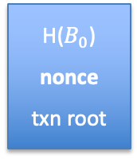
Bitcoin: Mining
To mine a new block, a miner must find $nonce$ such that
$H\left(h_{prev},txn root, nonce\right) < Target={2^{256}}/D$ ($D$ = difficulty)
Every miner tries random nonces until a miner finds a nonce that satisfies the above equation.
Expected total work is $D$ hashes. Bitcoin uses $H(x)=SHA256(SHA256(x))$.
$$B_{0}$$
$$B_{1}$$
$$B_{2}$$
Genesis
H($B_{0}$)
nonce
txn root
H($B_{1}$)
nonce
txn root
H
H
Block headers
New block: a random process but one every
≈ 10 minutes
coinbase Tx
Notes:
Technically, the nonce (4 bytes) is not enough to satisfy the proof-of-work, so miners also use randomness in the coinbase Tx for this.

Slide 7
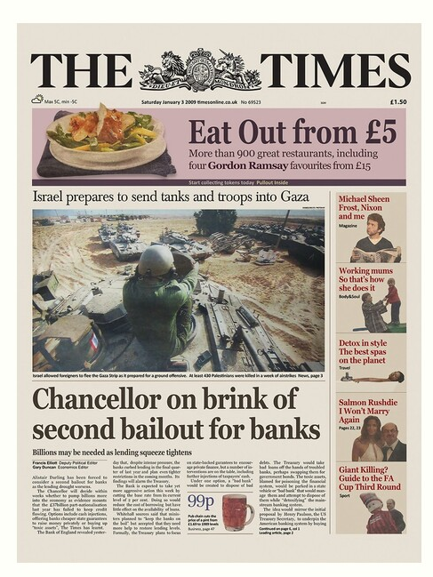
Bitcoin: Mining
genesis
block
B₁
B₂
version (4 bytes)
prev (32 bytes)
time (4 bytes)
bits (4 bytes)
nonce (4 bytes)
tx root (32 bytes)
prev
tx root
H
H
80 bytes
coinbase Tx
coinbase Tx

Slide 8
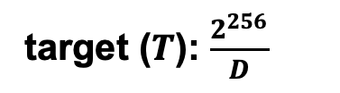
Bitcoin: Mining
genesis
block
B₁
B₂
version (4 bytes)
prev (32 bytes)
time (4 bytes)
bits (4 bytes)
nonce (4 bytes)
tx root (32 bytes)
prev
tx root
H
H
target ($T$): $\frac{2^{256}}{D}$
80 bytes
coinbase Tx
coinbase Tx

Slide 9
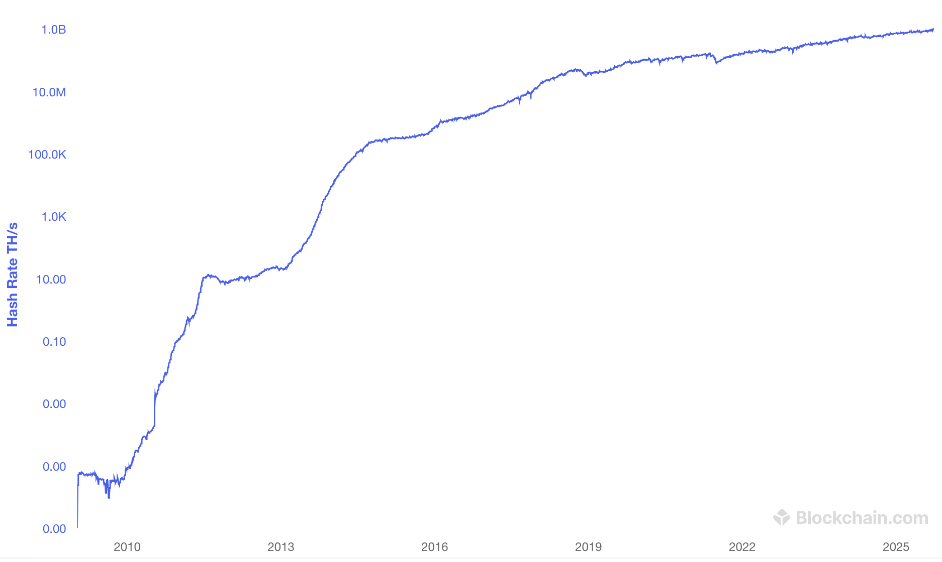
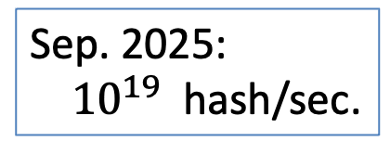
Bitcoin hash rate over time
Sep. 2025:
${10}^{19}$ hash/sec.
MacBook: 15M/sec
Notes:
https://www.blockchain.com/explorer/charts/hash-rate
To measure speed on macbook: openssl speed -evp sha256 (list speed for double-SHA256)

Slide 10
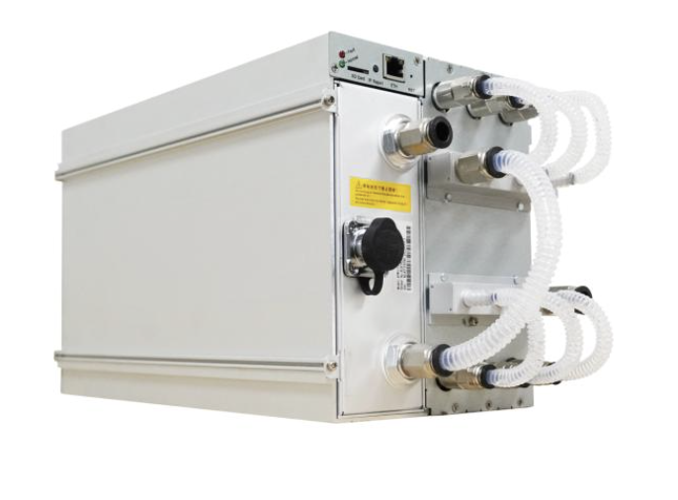
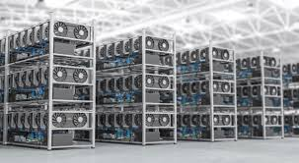
ANTMINER
SHA256 Hydro-cooling Miner
5.5 kW, 580 TeraHash/sec, 13.5 Kg
Bitcoin mining data center

Slide 11


Nakamoto Consensus
Chain with the highest difficulty, i.e, largest sum of the difficulty D within blocks!
Bitcoin uses Nakamoto consensus:
Fork-choice / proposal rule: At any given time, every honest miner attempts to extend (i.e., mines on the tip of) the heaviest chain held in its view.
(ties broken arbitrarily)
(genesis)
a miner that sees all blocks
but green will extend here
G
Numbers indicate difficulty values on each block
3
5
a miner that sees all these
blocks will extend here
3
5
1
1
A block $B$ will be discarded if a heavier chain that does not contain $B$ appears.

Slide 12
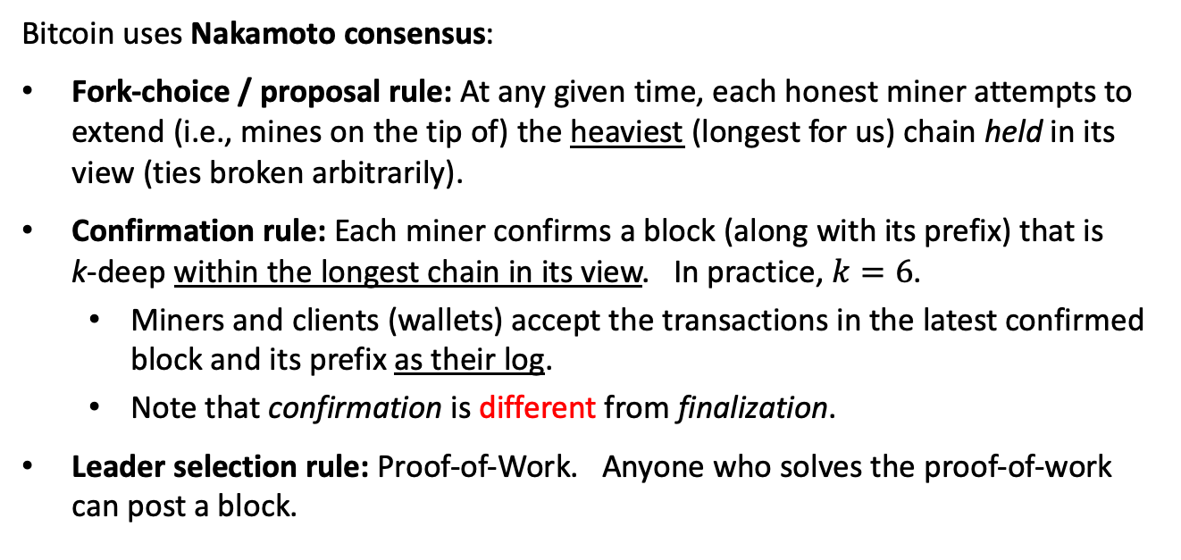
Nakamoto Consensus
Bitcoin uses Nakamoto consensus:
Fork-choice / proposal rule: At any given time, each honest miner attempts to extend (i.e., mines on the tip of) the heaviest (longest for us) chain held in its view (ties broken arbitrarily).
Confirmation rule: Each miner confirms a block (along with its prefix) that is
k-deep within the longest chain in its view. In practice, $k=6$.
  Miners and clients (wallets) accept the transactions in the latest confirmed block and its prefix as their log.
  Note that confirmation is different from finalization.
Leader selection rule: Proof-of-Work. Anyone who solves the proof-of-work can post a block.

Slide 13









Nakamoto Consensus
k=2
Available under
dynamic participation
Confirmed
Alice’s log:
$${txs}_{1}$$
$${txs}_{3}$$

Slide 14


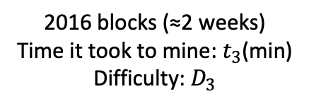
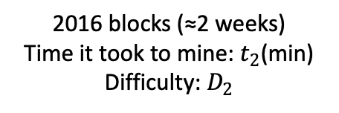
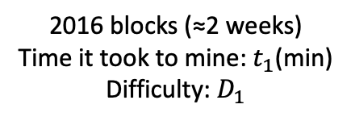
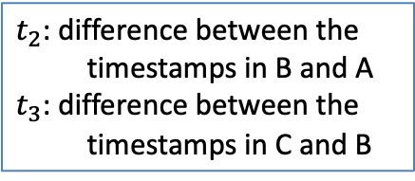
Bitcoin: difficulty adjusts every two weeks
New difficulty: $D_{2}=D_{1}$ $\frac{2016×10 mins}{t_{1}}$
New difficulty: $D_{3}=D_{2}$ $\frac{2016×10 mins}{t_{2}}$
…
A
…
B
…
C
2016 blocks (≈2 weeks)
Time it took to mine: $t_{1}$(min)
Difficulty: $D_{1}$
2016 blocks (≈2 weeks)
Time it took to mine: $t_{2}$(min)
Difficulty: $D_{2}$
2016 blocks (≈2 weeks)
Time it took to mine: $t_{3}$(min)
Difficulty: $D_{3}$
$t_{2}$: difference between the timestamps in B and A
$t_{3}$: difference between the timestamps in C and B
New difficulty is not allowed to be more than 4x old target.
New difficulty is not allowed to be less than ¼ x old target.
The Bitcoin Backbone Protocol with Chains of Variable Difficulty (2016)

Slide 15
Consensus in the Internet Setting
Characterized by open participation. Challenges:
Adversary can create many Sybil nodes to take over the protocol.
Honest nodes can come and go at will.
Requirements:
Limit adversary’s participation.
  Sybil resistance (e.g., by Proof-of-Work)
Maintain availability (liveness) when the honest nodes come and go at will, resulting in changes in the number of nodes.
  Dynamic availability
Achieved by Bitcoin!

Slide 16
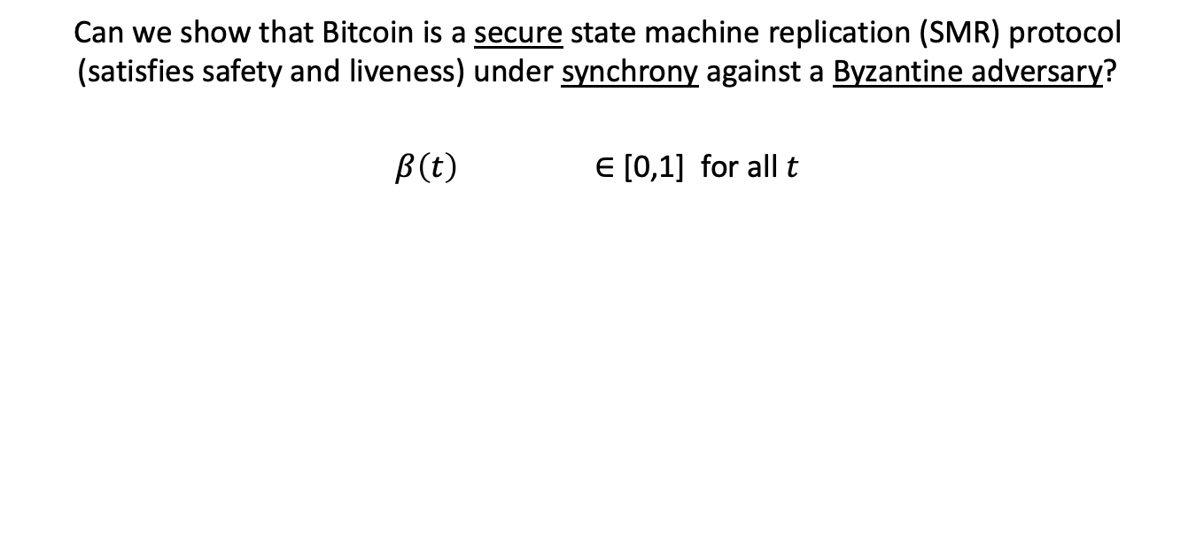
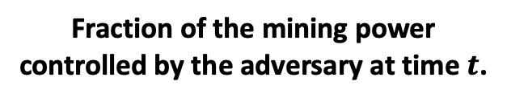
Security?
Can we show that Bitcoin is a secure state machine replication (SMR) protocol (satisfies safety and liveness) under synchrony against a Byzantine adversary?
$β\left(t\right)$ ∈ [0,1] for all $t$
Fraction of the mining power controlled by the adversary at time $t$.
What is the highest $β\left(t\right)$ for which Bitcoin is secure??

Slide 17

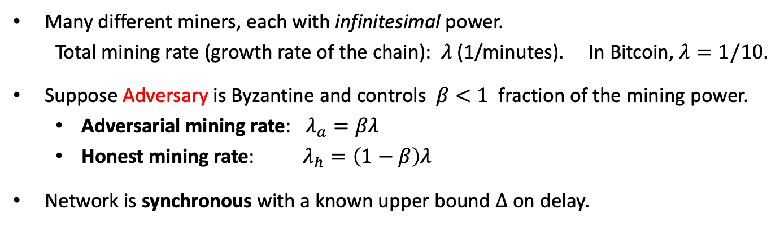





Model for Bitcoin
Many different miners, each with infinitesimal power.
Total mining rate (growth rate of the chain): $λ$ (1/minutes). In Bitcoin, $λ=1/10.$
Suppose Adversary is Byzantine and controls $β<1$ fraction of the mining power.
  Adversarial mining rate: $λ_{a}=βλ$
  Honest mining rate: $λ_{h}=\left(1−β\right)λ$
Network is synchronous with a known upper bound $Δ$ on delay.
$$t_{0}=0$$
$$t_{1}$$
$$t_{2}$$
$$t_{3}$$
$$t_{4}$$
$$t_{5}$$
times when blocks are mined (red indicates Byzantine miner)

Slide 18



Reminder: Why is safety important?
Eve
Suppose Eve has a UTXO.
$tx_{1}$: transaction spending Eve’s UTXO to pay to car vendor Alice.
$tx_{2}$: transaction spending Eve’s UTXO to pay to car vendor Bob.
$$UTXO_{Eve}$$
$$t_{0}=0$$
$$t_{1}$$
$$t_{2}$$
spent to pay Alice
spent to pay Bob
Alice’s ledger at time $t_{1}$ contains $tx_{1}:$
$$LOG_{t_{1}}^{Alice}=<tx_{1}>$$
Alice thinks it received Eve’s payment and sends over the car.
Bob’s ledger at time $t_{2}$ contains $tx_{2}:$
$$LOG_{t_{2}}^{Bob}=<tx_{2}>$$
Bob thinks it received Eve’s payment and sends over the car.
Alice
Bob

Slide 19
Reminder: Why is safety important?
Eve
Suppose Eve has a UTXO.
$tx_{1}$: transaction spending Eve’s UTXO to pay to car vendor Alice.
$tx_{2}$: transaction spending Eve’s UTXO to pay to car vendor Bob.
$$UTXO_{Eve}$$
$$t_{0}=0$$
$$t_{1}$$
safety violation
$$t_{2}$$
spent to pay Alice
spent to pay Bob
Alice’s ledger at time $t_{1}$ contains $tx_{1}:$
$$LOG_{t_{1}}^{Alice}=<tx_{1}>$$
Alice thinks it received Eve’s payment and sends over the car.
Bob’s ledger at time $t_{2}$ contains $tx_{2}:$
$$LOG_{t_{2}}^{Bob}=<tx_{2}>$$
Bob thinks it received Eve’s payment and sends over the car.
Alice
Bob
When safety is violated, Eve can double-spend!

Slide 20



















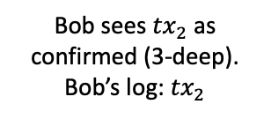


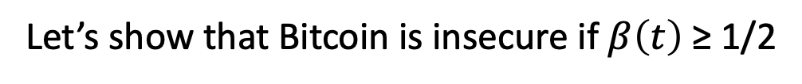
Nakamoto’s Private Attack: $β≥$ 1/2
Bob
checks tx2
$$t_{0}=0$$
$$t_{1}$$
$$t_{2}$$
$$t_{3}$$
$$t_{4}$$
$$t_{5}$$
$$t_{6}$$
$$t_{7}$$
Bob sees ${tx}_{2}$ as confirmed (3-deep).
Bob’s log: ${tx}_{2}$
k deep confirmation rule
(k=3 in our example)
$${tx}_{2}$$
$${tx}_{4}$$
$${tx}_{6}$$
Hidden
$${tx}_{1}$$
$${tx}_{3}$$
$${tx}_{5}$$
Let’s show that Bitcoin is insecure if $β\left(t\right)$ ≥ 1/2
A Peer-to-Peer Electronic Cash System (2008)

Slide 21

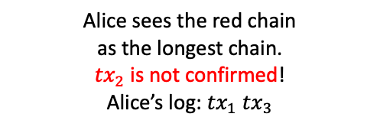
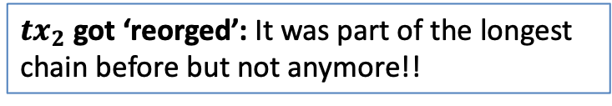

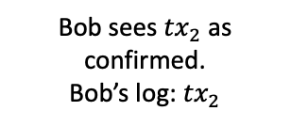
Nakamoto’s Private Attack: $β≥$ 1/2
safety violation!
double spend!
Bob
checks tx2
Adv releases
Alice
checks tx1
$$t_{0}=0$$
$$t_{1}$$
$$t_{2}$$
$$t_{3}$$
$$t_{4}$$
$$t_{5}$$
$$t_{6}$$
$$t_{7}$$
Bob sees ${tx}_{2}$ as confirmed.
Bob’s log: ${tx}_{2}$
k deep confirmation rule
(k=3 in our example)
$${tx}_{2}$$
$${tx}_{4}$$
$${tx}_{6}$$
$$λ_{h}$$
Honest mining rate
Alice sees the red chain
as the longest chain.
${tx}_{2}$ is not confirmed!
Alice’s log: ${tx}_{1} {tx}_{3}$
$${tx}_{1}$$
$${tx}_{3}$$
$${tx}_{5}$$
$$λ_{a}$$
Private attack succeeds!
Adversarial mining rate
${tx}_{2}$ got ‘reorged’: It was part of the longest chain before but not anymore!!
A Peer-to-Peer Electronic Cash System (2008)

Slide 22
Nakamoto’s Private Attack: $β≥$ 1/2
safety violation!
double spend!
Bob
checks tx2
Adv releases
Alice
checks tx1
$$t_{0}=0$$
$$t_{1}$$
$$t_{2}$$
$$t_{3}$$
$$t_{4}$$
$$t_{5}$$
$$t_{6}$$
$$t_{7}$$
Bob sees ${tx}_{2}$ as confirmed.
Bob’s log: ${tx}_{2}$
k deep confirmation rule
(k=3 in our example)
$${tx}_{2}$$
$${tx}_{4}$$
$${tx}_{6}$$
$$λ_{h}$$
Honest mining rate
Alice sees the red chain
as the longest chain.
${tx}_{2}$ is not confirmed!
Alice’s log: ${tx}_{1} {tx}_{3}$
$${tx}_{1}$$
$${tx}_{3}$$
$${tx}_{5}$$
$$λ_{a}$$
Private attack succeeds!
Adversarial mining rate
Private attack succeeds (w.h.p) if $λ_{a}≥$ $λ_{h}$, i.e., if $β≥$ $1−β$, i.e., if $β≥\frac{1}{2}$.
Private attack fails (w.h.p) if $λ_{a}<$ $λ_{h}$, i.e., if $β<$ $1−β$, i.e., if $β<\frac{1}{2}$.
Is there a more powerful attack?

Slide 23











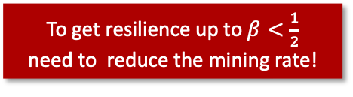
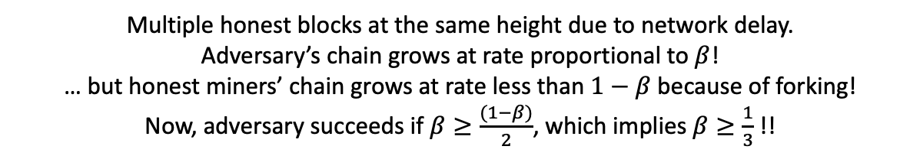



Problem: forking slows down honest miners’ chain growth
C
A
B
To get resilience up to $β<\frac{1}{2}$
need to reduce the mining rate!
Tx
${ λ}_{h} ∝$ e.g., $\frac{(1−β)}{2}$,
Hidden
$λ_{a}$ $∝$ $β$
D
E
$$Δ$$
$$Δ$$
$$Δ$$
$$t_{0}=0$$
$$t_{1}$$
$$t_{2}$$
$$t_{3}$$
$$t_{4}$$
$$t_{5}$$
$$t_{6}$$
$$t_{7}$$
$$t_{8 }$$
Multiple honest blocks at the same height due to network delay.
Adversary’s chain grows at rate proportional to $β$!
… but honest miners’ chain grows at rate less than $1−β$ because of forking!
Now, adversary succeeds if $β≥\frac{(1−β)}{2}$, which implies $β≥\frac{1}{3}$ !!

Slide 24
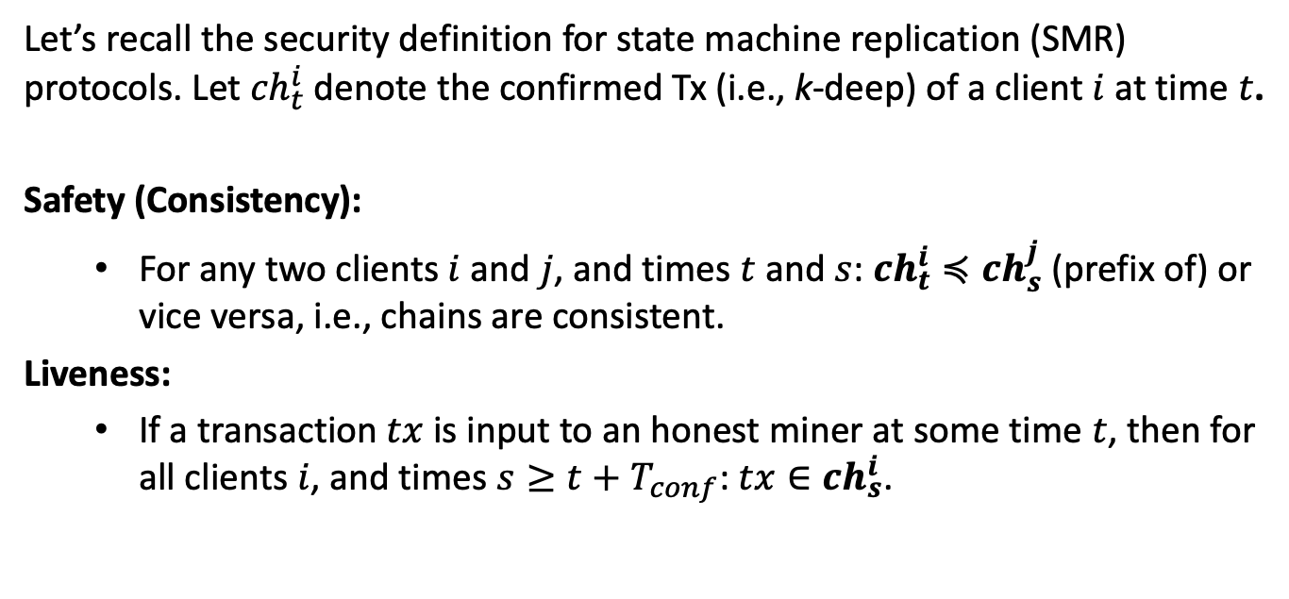
Reminder for SMR Security
Let’s recall the security definition for state machine replication (SMR) protocols. Let ${ch}_{t}^{i}$ denote the confirmed Tx (i.e., k-deep) of a client $i$ at time $t$.
Safety (Consistency):
  For any two clients $i$ and $j$, and times $t$ and $s$: ${ch}_{t}^{i}≼{ch}_{s}^{j}$ (prefix of) or vice versa, i.e., chains are consistent.
Liveness:
  If a transaction $tx$ is input to an honest miner at some time $t$, then for all clients $i$, and times $s≥t+T_{conf}$: $tx∈{ch}_{s}^{i}$.
No double spend
No censorship

Slide 25
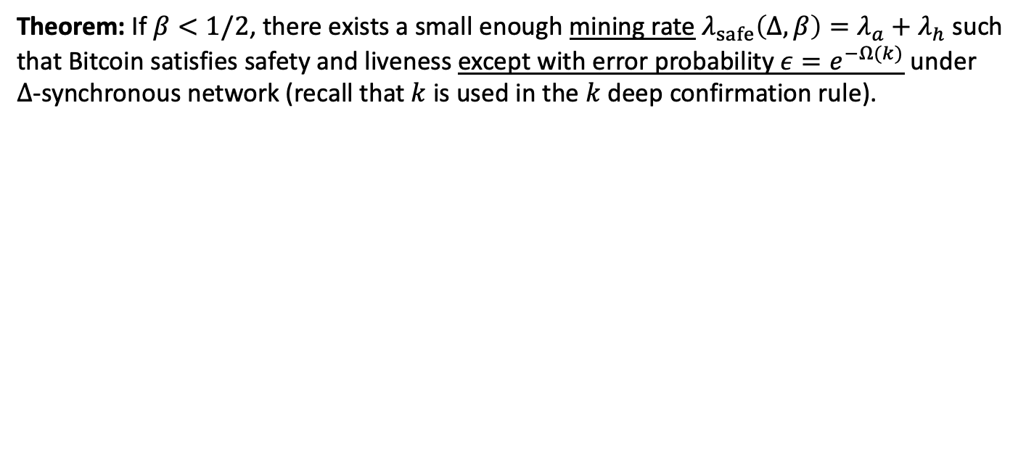

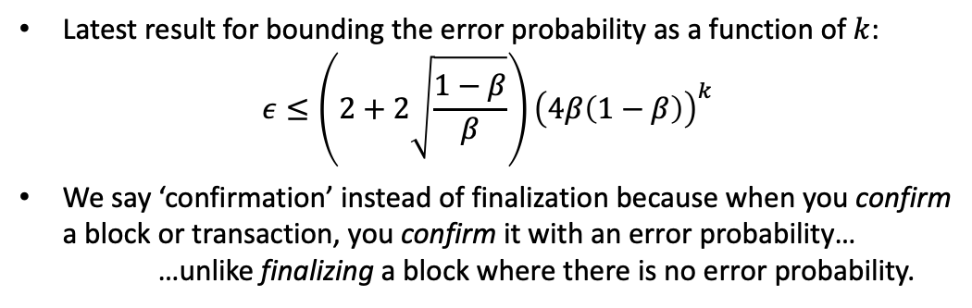
Security Theorem
Theorem: If $β<1/2$, there exists a small enough mining rate $λ_{safe}\left(Δ,β\right)=λ_{a}+λ_{h}$ such that Bitcoin satisfies safety and liveness except with error probability $ε=e^{−Ω(k)}$ under
$Δ$-synchronous network (recall that $k$ is used in the $k$ deep confirmation rule).
Latest result for bounding the error probability as a function of $k$:
$$ε≤\left(2+2\sqrt{\frac{1−β}{β}}\right){\left(4β\left(1−β\right)\right)}^{k}$$
We say ‘confirmation’ instead of finalization because when you confirm a block or transaction, you confirm it with an error probability…
…unlike finalizing a block where there is no error probability.
(exp. small in $k$)
The Bitcoin Backbone Protocol: Analysis and Applications (2015)
Analysis of the Blockchain Protocol in Asynchronous Networks (2016)
Analysis of Nakamoto Consensus (2019)
Everything is a Race and Nakamoto Always Wins (2022)
Bitcoin’s Latency–Security Analysis Made Simple (2022)
Now, we see why Bitcoin has 1 block every 10 minutes, instead of 1 block every second…

Slide 26
Proof of the Security Theorem
See the optional slides at the end of the deck …

Slide 27


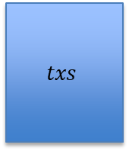

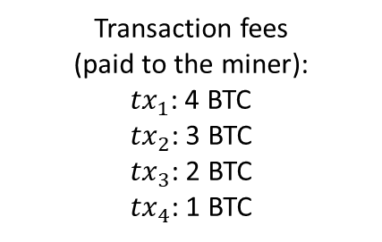
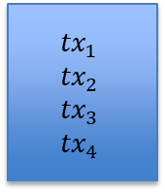
Would $β<1/2$ hold in practice?
+0 BTC earned
Transaction fees
(paid to the miner):
${tx}_{1}$: 4 BTC
${tx}_{2}$: 3 BTC
${tx}_{3}$: 2 BTC
${tx}_{4}$: 1 BTC
A
Genesis
$$txs$$
$${tx}_{1}$$
$${tx}_{2}$$
$${tx}_{3}$$
$${tx}_{4}$$
>0 BTC earned

Slide 28
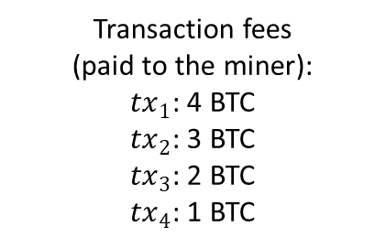
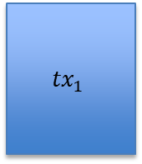
Would $β<1/2$ hold in practice?
+0 BTC earned
Transaction fees
(paid to the miner):
${tx}_{1}$: 4 BTC
${tx}_{2}$: 3 BTC
${tx}_{3}$: 2 BTC
${tx}_{4}$: 1 BTC
A
Genesis
$$txs$$
$${tx}_{1}$$
$${tx}_{2}$$
$${tx}_{3}$$
$${tx}_{4}$$
>0 BTC earned
$${tx}_{1}$$

Slide 29

Would $β<1/2$ hold in practice?
Transaction fees
(paid to the miner):
${tx}_{1}$: 4 BTC
${tx}_{2}$: 3 BTC
${tx}_{3}$: 2 BTC
${tx}_{4}$: 1 BTC
A
Genesis
$$txs$$
$${tx}_{1}$$
$${tx}_{2}$$
$${tx}_{3}$$
$${tx}_{4}$$
$${tx}_{1}$$
$${tx}_{2}$$
…

Slide 30
Would $β<1/2$ hold in practice?
Transaction fees
(paid to the miner):
${tx}_{1}$: 4 BTC
${tx}_{2}$: 3 BTC
${tx}_{3}$: 2 BTC
${tx}_{4}$: 1 BTC
A
Genesis
$$txs$$
$${tx}_{1}$$
$${tx}_{2}$$
$${tx}_{3}$$
$${tx}_{4}$$
Miner (maximal) extractable value (MEV): a measure of miner’s profit via inclusion, exclusion or re-ordering of transactions within its block
$${tx}_{1}$$
$${tx}_{2}$$
- Miners have incentive to violate the protocol!
- Can lead to double spends!
…
MEV gives miners incentive to violate the protocol!!

Slide 31
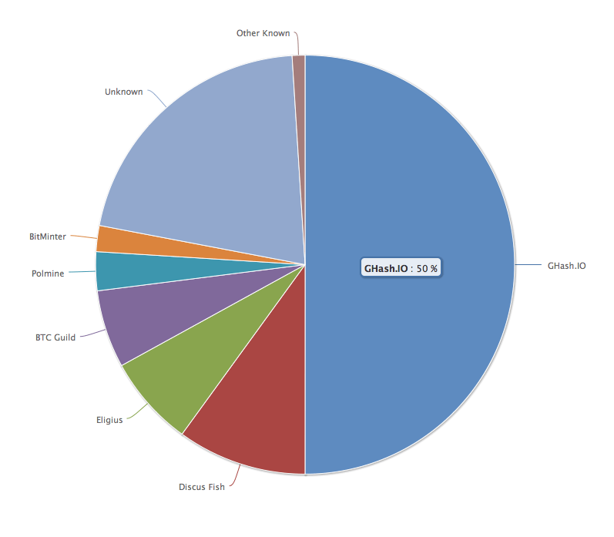
No Attacks on Bitcoin?
Ghash.IO had >50% in 2014
Gave up mining power
Why are visible attacks not more frequent?
Miners care about the Bitcoin price?
Not quite a valid argument.
They can ‘short’ the chain for profit!
… but then no more block rewards
No guarantees for the future!

Slide 32
Is Bitcoin the Endgame?
Bitcoin provides Sybil resistance and dynamic availability.
Is it the Endgame for consensus?
No!
Bitcoin is secure only under synchrony and loses security during periods of asynchrony.
It confirms blocks with an error probability depending on k, i.e., blocks are not finalized.
Energy consumption?
Can we have low-energy consensus with finality? Answer: yes! Using proof-of-stake

Slide 33
From Bitcoin to Proof-of-Stake
1982
2008
2015
2022
…
Time
The Byzantine Generals Problem
Bitcoin
PoW Ethereum
PoS Ethereum
Consensus in the Internet Setting
Sybil resistance
Dynamic availability
  (Liveness under changing part.)
Block rewards (carrot)
  to incentivize participation!
Consensus in the Internet Setting
  Sybil resistance
  Dynamic availability
Block rewards (carrot)
Finality and accountable safety
Slashing (stick)
  to punish protocol violation!
The Byzantine Generals Problem (1982)
Bitcoin: A Peer-to-Peer Electronic Cash System (2008)
Ethereum: A Next-Generation Smart Contract and Decentralized Application Platform. (2015)
Combining GHOST and Casper (2020)

Slide 34
A few words on Proof-of-Stake (PoS)
In a Proof-of-Stake protocol, nodes lock up (i.e., stake) their coins in the protocol to become eligible to participate in consensus.
The more coins staked by a node…
Higher the probability that the node is elected as a leader.
Larger the weight of that node’s actions.
If a node is caught doing an adversarial action (e.g., signing two blocks), it can be punished by burning its locked coins (stake)! This is called slashing.
Thus, in a Proof-of-Stake protocol, nodes can be held accountable for their actions (unlike in Bitcoin, where nodes do not lock up coins).

Slide 35
END OF LECTURE
How?
Next lecture: Incentives and Accountability in Consensus

Slide 36



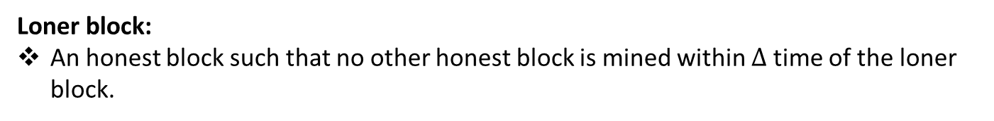






Optional: Security Proof
Loner block:
An honest block such that no other honest block is mined within $∆$ time of the loner block.
$$t_{0}=0$$
$$t_{1}$$
$$t_{2}$$
$$t_{3}$$
$$t_{4}$$
$$t_{5}$$
$$t_{6}$$
$$t_{7}$$
$$t_{8}$$
Analysis of Nakamoto Consensus (2019)
The Sleepy Model of Consensus (2016)

Slide 37




Optional: Security Proof
Loner block:
An honest block such that no other honest block is mined within $∆$ time of the loner block.
Not loners!
Loner!
$$t_{0}=0$$
$$t_{1}$$
$$t_{2}$$
$$t_{3}$$
$$t_{4}$$
$$t_{5}$$
$$t_{6}$$
$$t_{7}$$
$$t_{8}$$
$$∆$$
$$∆$$
$$∆$$
$$∆$$
Length of the shortest chain among the longest chains observed by the clients at time $t$: $L\left(t\right)$
Analysis of Nakamoto Consensus (2019)
The Sleepy Model of Consensus (2016)

Slide 38















Optional: Security Proof
Loner block:
An honest block such that no other honest block is mined within $∆$ time of the loner block.
Loner!
Loner!
Loner!
Loner!
Not loners!
$$t_{0}=0$$
$$t_{1}$$
$$t_{2}$$
$$t_{3}$$
$$t_{4}$$
$$t_{5}$$
$$t_{6}$$
$$t_{7}$$
$$t_{8}$$
Lemma: For any$s>t, L\left(s\right)−L\left(t\right)≥$“number of loners mined in the interval $(t+Δ,s−Δ]"$.
Proof sketch: Each loner increases the length of the longest chains observed by the clients by one block. For instance;
$$t_{8}$$
$$t_{1}$$
$$t_{3}$$
$$t_{4}$$
$$t_{5}$$
$$t_{7}$$
Analysis of Nakamoto Consensus (2019)
The Sleepy Model of Consensus (2016)

Slide 39









Optional: Security Proof
Pivot block:
In any interval covering the mining time of the pivot block, more loner blocks are mined than adversarial blocks.
Pivot block is a loner.
2 loners
0 adversarial
$$t_{0}=0$$
$$t_{1}$$
$$t_{2}$$
$$t_{3}$$
$$t_{4}$$
$$t_{5}$$
$$t_{6}$$
$$t_{7}$$
$$t_{8}$$
pivot

Slide 40
Optional: Security Proof
Pivot block:
In any interval covering the mining time of the pivot block, more loner blocks are mined than adversarial blocks.
Pivot block is a loner.
2 loner
1 adversarial
$$t_{0}=0$$
$$t_{1}$$
$$t_{2}$$
$$t_{3}$$
$$t_{4}$$
$$t_{5}$$
$$t_{6}$$
$$t_{7}$$
$$t_{8}$$
pivot

Slide 41
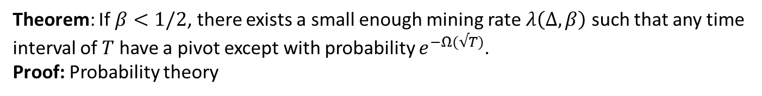
Optional: Security Proof
Pivot block:
In any interval covering the mining time of the pivot block, more loner blocks are mined than adversarial blocks.
Pivot block is a loner.
4 loner
2 adversarial
$$t_{0}=0$$
$$t_{1}$$
$$t_{2}$$
$$t_{3}$$
$$t_{4}$$
$$t_{5}$$
$$t_{6}$$
$$t_{7}$$
$$t_{8}$$
Theorem: If $β<1/2$, there exists a small enough mining rate $λ\left(Δ,β\right)$ such that any time interval of $T$ have a pivot except with probability $e^{−Ω(√T)}$.
Proof: Probability theory

Slide 42




Optional: Security Proof
Theorem: Suppose a block mined at time $t$ is a pivot. Then, the pivot block is on every (longest) chain held by any client at all times $≥t$.
Proof: For contradiction, suppose there exists a minimum time $s≥t$ such that a client Bob holds a chain conflicting with the pivot block.
pivot
G
…
…
tx
…
$$t$$
…
…
…
Bob’s chain
Heights
$h_{0}$=0
time s
time t

Slide 43




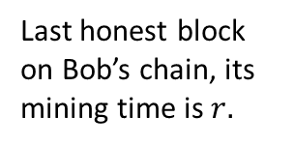



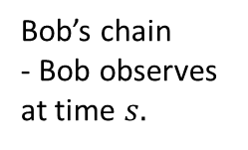
Optional: Security Proof
Theorem: If a client holds a chain containing a pivot block, then no client can hold a chain conflicting with the pivot block after the pivot block is mined.
Proof continued:
pivot
G
…
…
tx
…
$$t$$
…
…
$$r$$
…
Bob’s chain
- Bob observes at time $s.$
$h_{0}$=0
Last honest block on Bob’s chain, its mining time is $r.$
$$h_{1}$$
$$h_{2}$$
$r<s$ by definition.
$r<t$ because otherwise $s$ is not the first time a conflicting chain is held a client or honest miner.

Slide 44
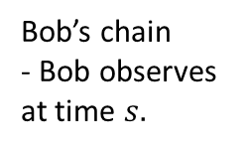
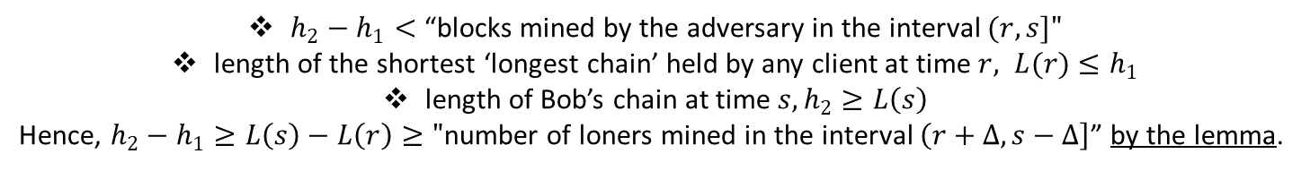





Optional: Security Proof
pivot
Proof continued:
Proof continued:
G
…
…
tx
…
$$t$$
…
…
$$r$$
…
Bob’s chain
- Bob observes at time $s.$
$h_{0}$=0
$$h_{1}$$
$$h_{2}$$
$h_{2}−h_{1}<$ “blocks mined by the adversary in the interval $(r,s]"$
length of the shortest ‘longest chain’ held by any client at time $r, L(r)$ $≤h_{1}$
length of Bob’s chain at time $s, h_{2}≥L\left(s\right)$
Hence, $h_{2}−h_{1}≥L\left(s\right)−L\left(r\right)≥"$number of loners mined in the interval $\left(r+Δ,s−Δ\right]$” by the lemma.

Slide 45
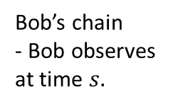
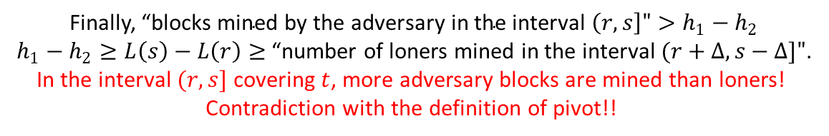





Optional: Security Proof
Proof continued:
Proof continued:
pivot
G
…
…
tx
…
$$t$$
…
…
$$r$$
…
Bob’s chain
- Bob observes at time $s.$
$h_{0}$=0
$$h_{1}$$
$$h_{2}$$
Finally, “${\text{blocks} \text{mined} \text{by} \text{the} \text{adversary} \text{in} \text{the} \text{interval} \left(r,s\right]">h}_{1}−h_{2}$
$h_{1}−h_{2}≥L\left(s\right)−L\left(r\right)≥$“number of loners mined in the interval $(r+Δ,s−Δ]"$.
In the interval $(r,s]$ covering $t$, more adversary blocks are mined than loners!
Contradiction with the definition of pivot!!

Slide 46


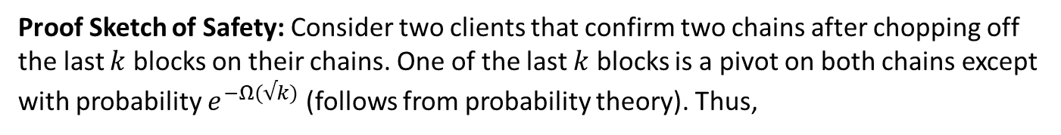


Optional: Security Proof
Proof Sketch of Liveness: The pivot is mined by an honest miner and contains all transactions input to the honest miners. Since it is on all chains held by all clients at all times, liveness is satisfied.
Proof Sketch of Safety: Consider two clients that confirm two chains after chopping off the last $k$ blocks on their chains. One of the last $k$ blocks is a pivot on both chains except with probability $e^{−Ω(√k)}$ (follows from probability theory). Thus,
…
Alice’s chain
G
pivot
pivot
$$k$$
…
Bob’s chain
$$k$$

Slide 47
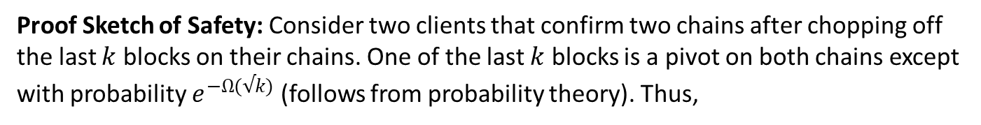
Optional: Security Proof
Proof Sketch of Liveness: The pivot is mined by an honest miner and contains all transactions input to the honest miners. Since it is on all chains held by all clients at all times, liveness is satisfied.
Proof Sketch of Safety: Consider two clients that confirm two chains after chopping off the last $k$ blocks on their chains. One of the last $k$ blocks is a pivot on both chains except with probability $e^{−Ω(√k)}$ (follows from probability theory). Thus,
…
G
$$k$$
Pivots:
The same block appears in Alice’s chain by the Theorem.
Chains are consistent!!
…
$$k$$

