Slide 1
Fundamentals of Consensus
CS251 Fall 2025

Slide 2

The goal of consensus (informally for now)
Tx1, Tx2, Tx3, Tx4
Tx1, Tx2, Tx3, Tx4
Tx1
Tx3
The good case:
all copies are consistent
Tx2
Tx4
Tx1, Tx2, Tx3, Tx4
Tx1, Tx2, Tx3, Tx4

Slide 3
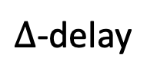
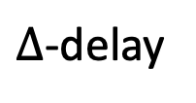
Why is consensus a hard problem?
Tx1, Tx2, Tx3, Tx4
Tx3, Tx4, Tx1, Tx2
Tx1
$∆$-delay
Tx3
Problems:
Network delays
can affect Tx order
Tx2
Tx4
$∆$-delay
Tx1, Tx2, Tx4, Tx3
Tx4, Tx3, Tx1, Tx2
Notes:
In case of network partition: can stop accepting transactions (Paxos), or can accept transactions and resolve fork once partition heals (Bitcoin).

Slide 4

Why is consensus a hard problem?
Tx1, Tx2
Tx3, Tx4
Tx1
Tx3
Problems:
Network delays
Network partition
network
partition
Tx2
Tx4
Tx1, Tx2
Tx3, Tx4
Notes:
In case of network partition: can stop accepting transactions (Paxos), or can accept transactions and resolve fork once partition heals (Bitcoin).

Slide 5
Why is consensus a hard problem?
Tx1, Tx2, Tx4
crashed
Tx1
Tx3??
Problems:
crash
Tx2
Tx4
Tx1, Tx2, Tx4
Tx1, Tx2, Tx4
Notes:
Goal: security when 51% of nodes are honest.

Slide 6

Why is consensus a hard problem?
???
Tx1
Problems:
crash
malice
Tx2
Tx4
???
???
Notes:
Goal: security when 51% of nodes are honest.

Slide 7
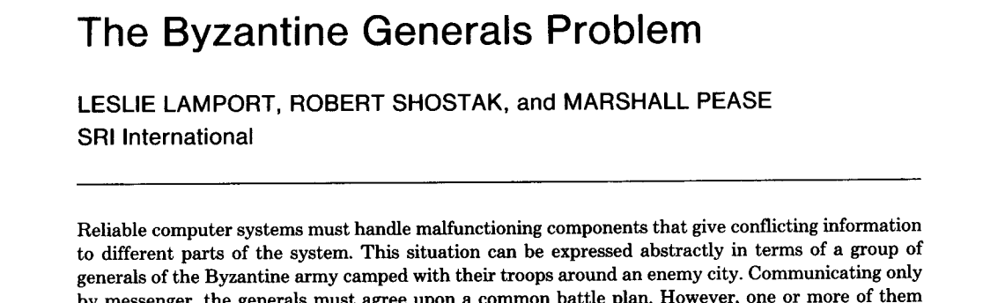
Let’s get started …
July 1982

Slide 8
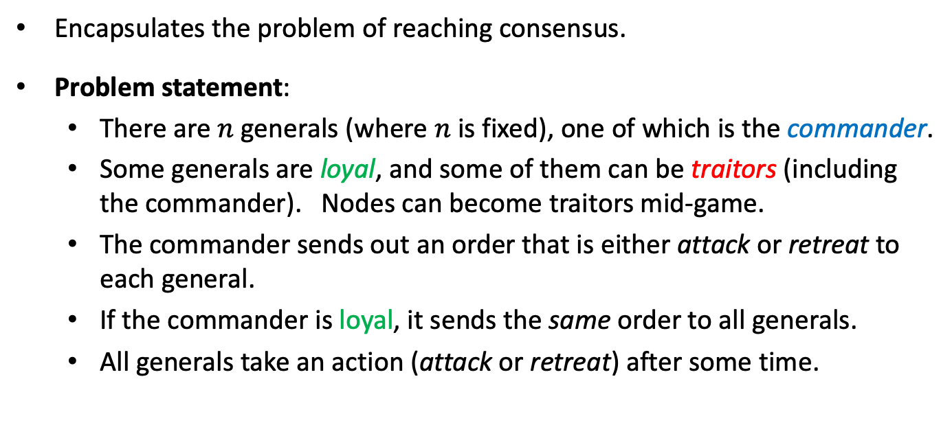
The Byzantine Generals Problem
Encapsulates the problem of reaching consensus.
Problem statement:
  There are $n$ generals (where $n$ is fixed), one of which is the commander.
  Some generals are loyal, and some of them can be traitors (including the commander). Nodes can become traitors mid-game.
  The commander sends out an order that is either attack or retreat to each general.
  If the commander is loyal, it sends the same order to all generals.
  All generals take an action (attack or retreat) after some time.

Slide 9
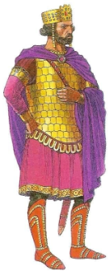


Byzantine Generals Problem
Goal:
Agreement: No two loyal generals take different actions.
Validity: If the commander is loyal, then all loyal generals must take the action suggested by the commander.
Termination: All loyal generals must eventually take some action.
loyal
retreat
retreat
retreat
retreat
loyal
loyal
loyal
traitor
retreat
retreat
retreat
attack

Slide 10
Byzantine Generals Problem
Goal:
Agreement: No two loyal generals take different actions.
Validity: If the commander is loyal, then all loyal generals must take the action suggested by the commander.
Termination: All loyal generals must eventually take some action.
traitor
retreat
retreat
attack
retreat
loyal
loyal
loyal
traitor
retreat
retreat
retreat
attack

Slide 11
Byzantine Generals Problem
Goal:
Agreement: No two loyal generals take different actions.
Validity: If the commander is loyal, then all loyal generals must take the action suggested by the commander.
Termination: All loyal generals must eventually take some action.
traitor
retreat
retreat
attack
retreat
loyal
loyal
loyal
traitor
retreat
retreat
retreat
attack

Slide 12
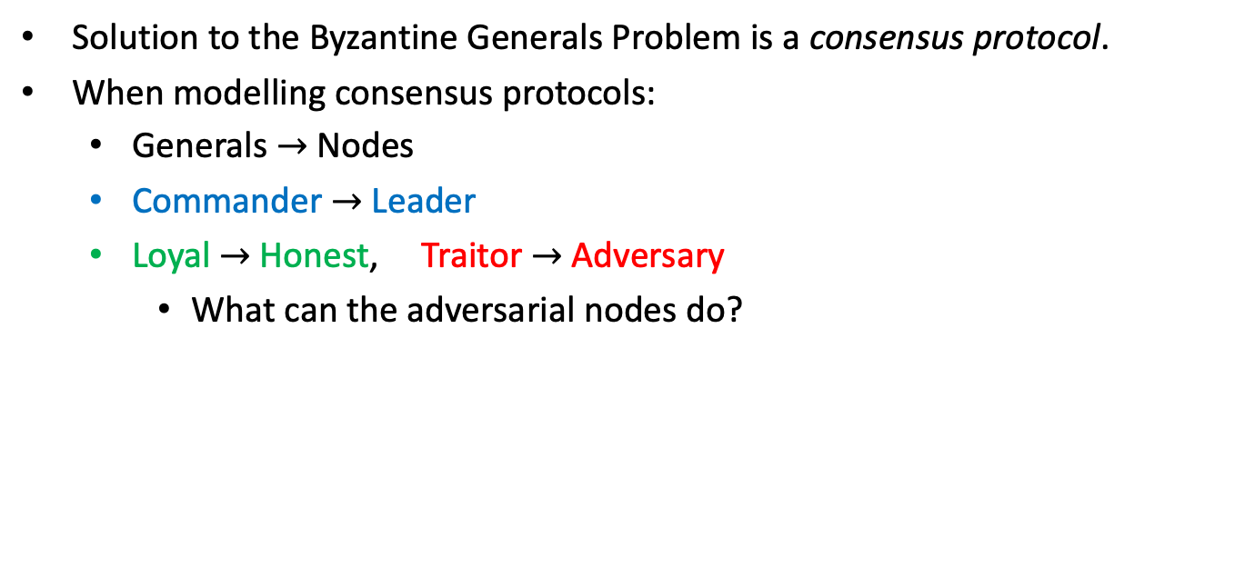
From Generals to Nodes
Solution to the Byzantine Generals Problem is a consensus protocol.
When modelling consensus protocols:
  Generals $→$ Nodes
  Commander $→$ Leader
  Loyal $→$ Honest, Traitor $→$ Adversary
    What can the adversarial nodes do?

Slide 13





Adversary
The adversary can corrupt nodes, after which they are called adversarial.
  Crash faults if the adversarial nodes do not send or receive any messages.
  Omission faults if the adversarial nodes can selectively choose to drop or let through each message sent or received.
  Byzantine faults (Byzantine adversary) if the adversarial nodes can deviate from the protocol arbitrarily.

Slide 14
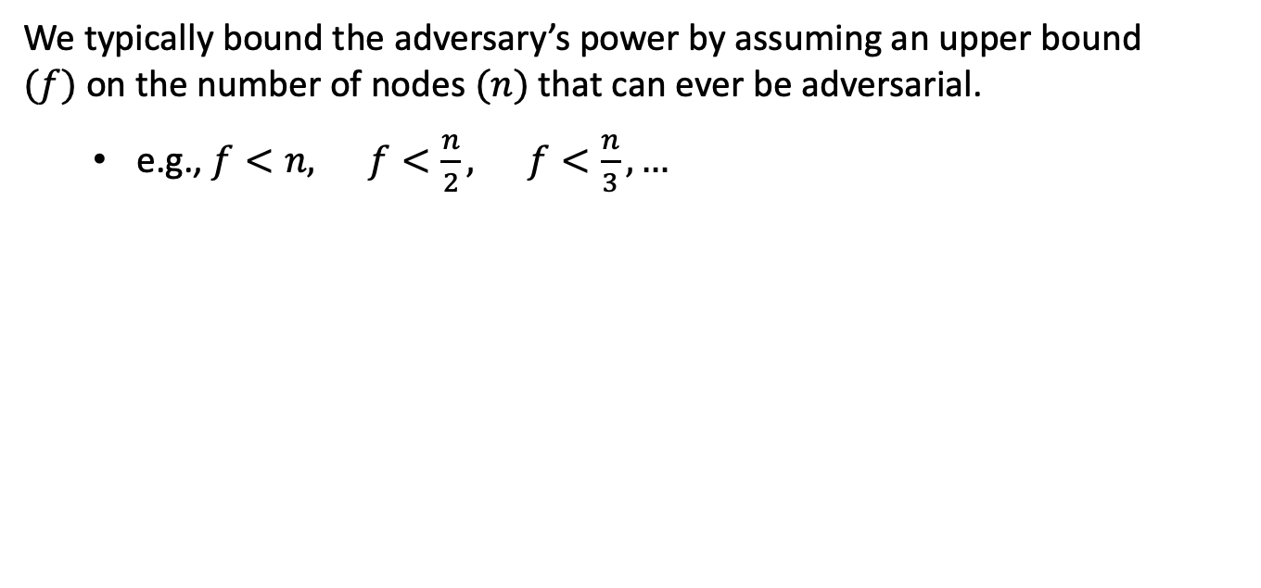
Adversary
We typically bound the adversary’s power by assuming an upper bound $(f)$on the number of nodes $(n)$ that can ever be adversarial.
  e.g., $f<n, f<\frac{n}{2}, f<\frac{n}{3}, …$

Slide 15

Communication
Nodes can send messages to each other, authenticated by signatures.
There is a public key infrastructure (PKI) setup.
  Adversary cannot simulate honest nodes! (i.e. control honest nodes)
  There are other ways to prevent such simulation (e.g., proof-of-work).
Consensus protocols typically assume that the adversary
cannot forge signatures of honest nodes.

Slide 16
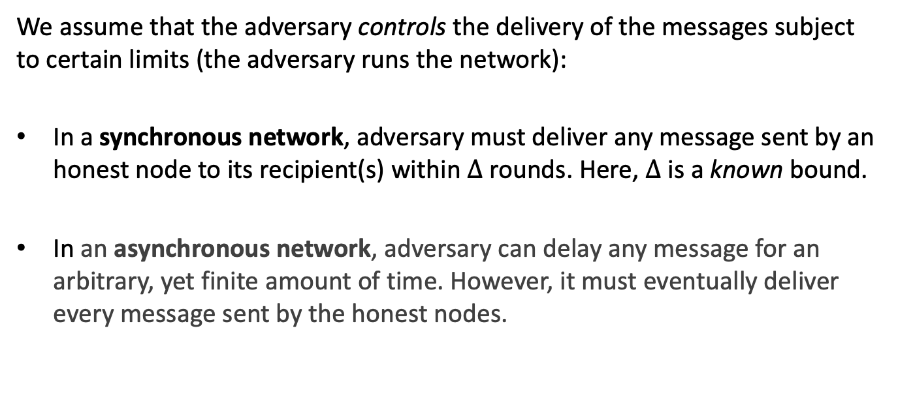
Network Models
We assume that the adversary controls the delivery of the messages subject to certain limits (the adversary runs the network):
In a synchronous network, adversary must deliver any message sent by an honest node to its recipient(s) within $∆$ rounds. Here, $∆$ is a known bound.
In an asynchronous network, adversary can delay any message for an arbitrary, yet finite amount of time. However, it must eventually deliver every message sent by the honest nodes.

Slide 17

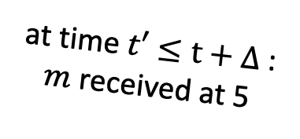
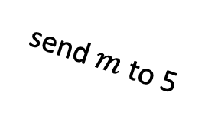


A synchronous network (abstractly)
The adversary runs the network, subject to $∆$-synchronicity constraint
1
6
at time $t$
2
send $m$ to 5
at time $t′≤t+∆$ :
$m$ received at 5
5
$$m$$
3
4

Slide 18
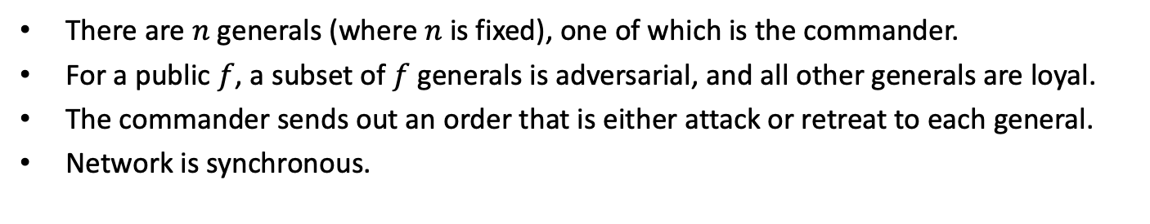
Byzantine Generals Problem
There are $n$ generals (where $n$ is fixed), one of which is the commander.
For a public $f$, a subset of $f$ generals is adversarial, and all other generals are loyal.
The commander sends out an order that is either attack or retreat to each general.
Network is synchronous.
Byzantine Generals Problem:
Agreement: No two loyal generals take different actions.
Validity: If the commander is loyal, then all loyal generals must take the action suggested by the commander.
Termination: All loyal generals must eventually take some action.
Notes:
Motivate Byzantine Broadcast by giving the example of a single transaction, Alice paying Bob $5. Does everyone agree on this, even when the leader is adversarial?

Slide 19
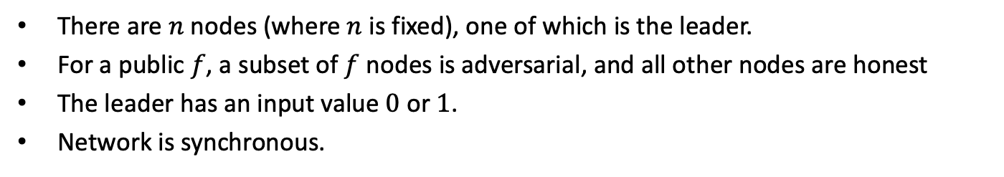
Byzantine Broadcast (BB)
There are $n$ nodes (where $n$ is fixed), one of which is the leader.
For a public $f$, a subset of $f$ nodes is adversarial, and all other nodes are honest
The leader has an input value $0$ or $1$.
Network is synchronous.
Byzantine Broadcast Problem:
Agreement: No two honest nodes output different values.
Validity: Leader is honest ⇒ All honest nodes output the value input to the leader.
Termination: All honest nodes eventually output some value.
Notes:
Motivate Byzantine Broadcast by giving the example of a single transaction, Alice paying Bob $5. Does everyone agree on this, even when the leader is adversarial?

Slide 20
Byzantine Broadcast (BB)
There are $n$ nodes (where $n$ is fixed), one of which is the leader.
For a public $f$, a subset of $f$ nodes is adversarial, and all other nodes are honest
The leader has an input value $0$ or $1$.
Network is synchronous.
Byzantine Broadcast Problem:
Agreement: No two honest nodes output different values.
Validity: Leader is honest ⇒ All honest nodes output the value input to the leader.
Termination: All honest nodes eventually output some value.
even when the leader is adversarial!!
Notes:
Motivate Byzantine Broadcast by giving the example of a single transaction, Alice paying Bob $5. Does everyone agree on this, even when the leader is adversarial?

Slide 21
Byzantine Broadcast (BB)
There are $n$ nodes (where $n$ is fixed), one of which is the leader.
For a public $f$, a subset of $f$ nodes is adversarial, and all other nodes are honest
The leader has an input value $0$ or $1$.
Network is synchronous.
No double spend
Byzantine Broadcast Problem:
Agreement: No two honest nodes output different values.
Validity: Leader is honest ⇒ All honest nodes output the value input to the leader.
Termination: All honest nodes eventually output some value.
even when the leader is adversarial!!
No censorship
Notes:
Motivate Byzantine Broadcast by giving the example of a single transaction, Alice paying Bob $5. Does everyone agree on this, even when the leader is adversarial?

Slide 22

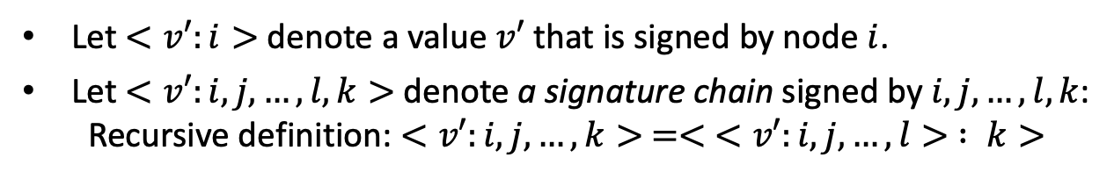

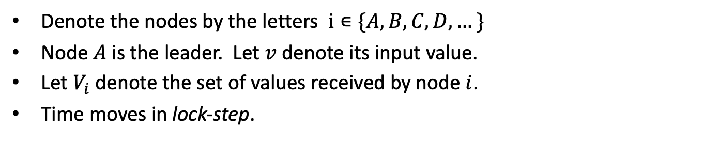


Protocol for BB: Setup
Denote the nodes by the letters $i∊\{A,B,C,D,…\}$
Node $A$ is the leader. Let $v$ denote its input value.
Let $V_{i}$ denote the set of values received by node $i$.
Time moves in lock-step.
$$<v^{′}:A>$$
$$<v^{′}:A,B>$$
$$<v^{′}:A,B,C>$$
Let $<v′:i>$ denote a value $v′$ that is signed by node $i$.
Let $<v′:i,j,…,l,k>$ denote a signature chain signed by $i,j,…,l,k$:
  Recursive definition: $<v′:i,j,…,k> =< <v′:i,j,…,l> : k>$

Slide 23
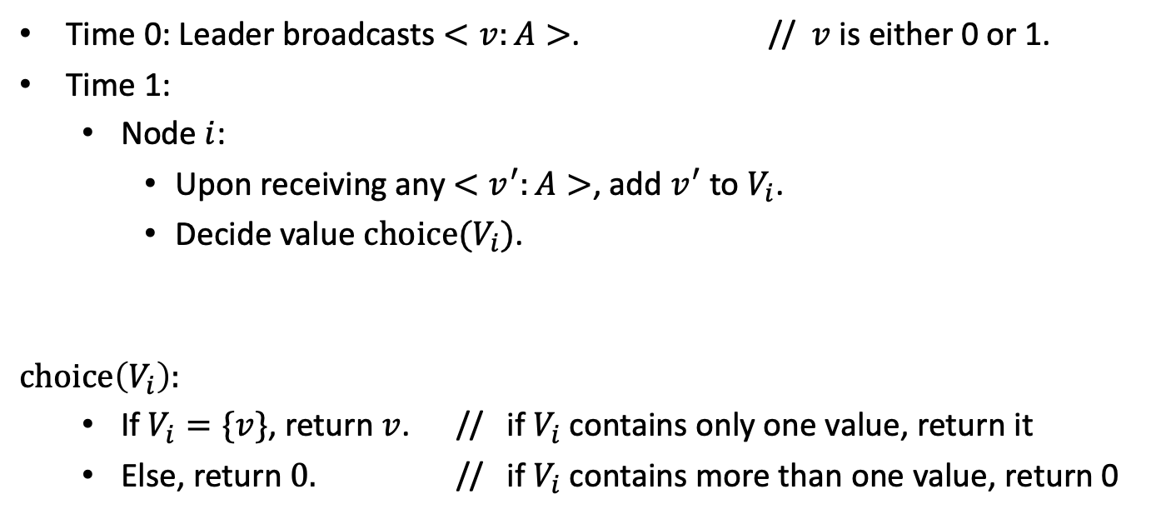

Strawman Protocol I (assuming $∆=1)$
Time 0: Leader broadcasts $<v:A>$. // $v$ is either 0 or 1.
Time 1:
  Node $i$:
    Upon receiving any $<v^{′}:A>$, add $v^{′}$ to $V_{i}$.
    Decide value $choice(V_{i})$.
$$choice\left(V_{i}\right):$$
  If $V_{i}=\{v\}$, return $v$. // if $V_{i}$ contains only one value, return it
  Else, return $0.$ // if $V_{i}$ contains more than one value, return 0
(the broadcast value)

Slide 24






Strawman Protocol I
A: honest
Input value is 1.
$$<1:A>$$
$$<1:A>$$
B: honest
C: honest
$V_{1}$= {}
$V_{2}$= {}
Time 0

Slide 25




Strawman Protocol I
A: honest
Input value is 1.
$$<1:A>$$
$$<1:A>$$
B: honest
C: honest
$V_{1}$= {1}
$V_{2}$= {1}
Time 1
1
1
Validity is satisfied!

Slide 26
Strawman Protocol I
Problem: what if the leader is adversarial?
A: adversarial
<1:A>
<0:A>
B: honest
C: honest
$V_{1}$= {}
$V_{2}$= {}
Time 0

Slide 27

Strawman Protocol I
Problem: what if the leader is adversarial?
A: adversarial
<1:A>
<0:A>
B: honest
C: honest
$V_{1}$= {1}
$V_{2}$= {0}
Time 1
1
0
Agreement is violated!

Slide 28
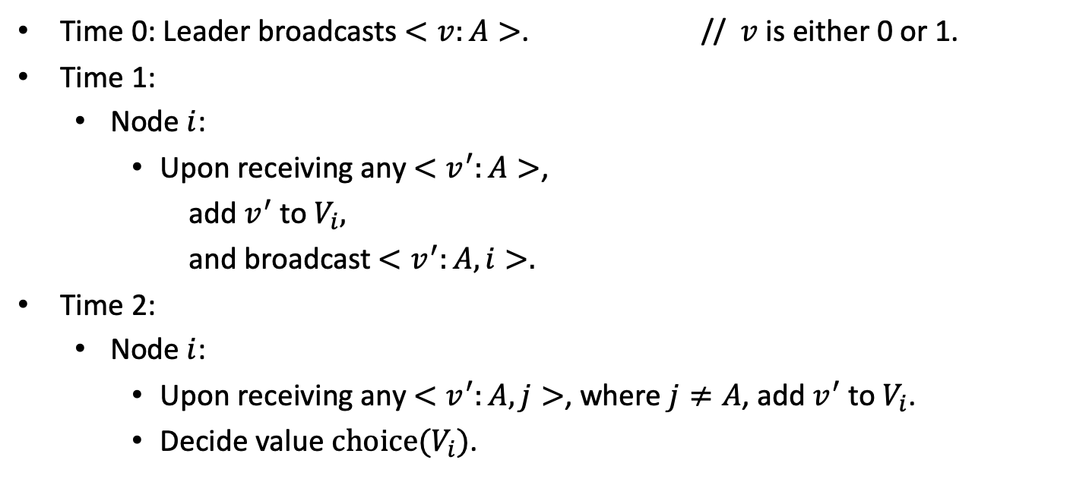
Strawman Protocol II
Time 0: Leader broadcasts $<v:A>$. // $v$ is either 0 or 1.
Time 1:
  Node $i$:
    Upon receiving any $<v^{′}:A>$,
      add $v^{′}$ to $V_{i},$
      and broadcast $<v^{′}:A,i>.$
Time 2:
  Node $i$:
    Upon receiving any $<v^{′}:A,j>$, where $j≠A$, add $v^{′}$ to $V_{i}$.
    Decide value $choice(V_{i})$.
(the broadcast value)

Slide 29


Strawman Protocol II
A: adversarial
<1:A>
<0:A>
B: honest
C: honest
$V_{1}$= {}
$V_{2}$= {}
Time 0

Slide 30


Strawman Protocol II
A: adversarial
<1:A>
<0:A>
B: honest
0
1
C: honest
$V_{1}$= {1}
$V_{2}$= {0}
Time 1

Slide 31


Strawman Protocol II
A: adversarial
<1:A>
<0:A>
B: honest
0
1
C: honest
$V_{1}$= {0,1}
$V_{2}$= {0,1}
Time 2
0
0
Agreement is satisfied!

Slide 32


Strawman Protocol II
Problem: what if one of the nodes is adversarial?
A: honest
Input value is 1.
$$<1:A>$$
$$<1:A>$$
B: honest
C: adversarial
$V_{1}$= {}
Time 0

Slide 33


Strawman Protocol II
Problem: what if one of the nodes is adversarial?
A: honest
Input value is 1.
$$<1:A>$$
$$<1:A>$$
$$<0:C,C>$$
B: honest
C: adversarial
$$<1:A,B>$$
$V_{1}$= {1}
Time 1

Slide 34
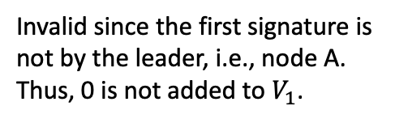

Strawman Protocol II
Problem: what if one of the nodes is adversarial?
A: honest
Input value is 1.
$$<1:A>$$
$$<1:A>$$
$$<0:C,C>$$
B: honest
C: adversarial
$$<1:A,B>$$
$V_{1}$= {1}
Time 1
Invalid since the first signature is not by the leader, i.e., node A.
Thus, 0 is not added to $V_{1}$.

Slide 35


Strawman Protocol II
Problem: what if one of the nodes is adversarial?
A: honest
Input value is 1.
$$<1:A>$$
$$<1:A>$$
$$<0:C,C>$$
B: honest
C: adversarial
$$<1:A,B>$$
$V_{1}$= {1}
Time 2
1
Validity is satisfied as well!
So are agreement and termination!

Slide 36
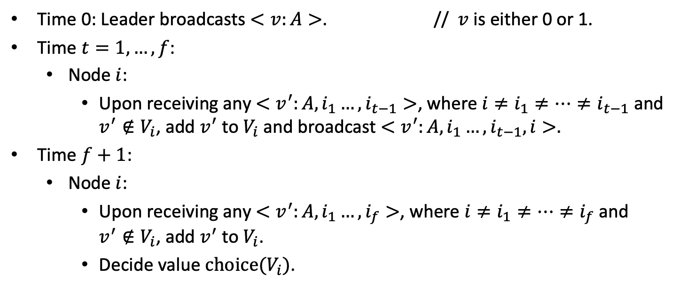
Dolev-Strong (1983)
Time 0: Leader broadcasts $<v:A>$. // $v$ is either 0 or 1.
Time $t=1,…,f$:
  Node $i$:
    Upon receiving any $<v^{′}:A,i_{1}…,i_{t−1}>$, where $i≠i_{1}≠…≠i_{t−1}$ and $v^{′}∉V_{i}$, add $v^{′}$ to $V_{i}$ and broadcast $<v^{′}:A,i_{1}…,i_{t−1},i>.$
Time $f+1$:
  Node $i$:
    Upon receiving any $<v^{′}:A,i_{1}…,i_{f}>$, where $i≠i_{1}≠…≠i_{f}$ and $v^{′}∉V_{i}$, add $v^{′}$ to $V_{i}$.
    Decide value $choice(V_{i})$.
(the broadcast value)
Authenticated Algorithms for Byzantine Agreement (1983)

Slide 37
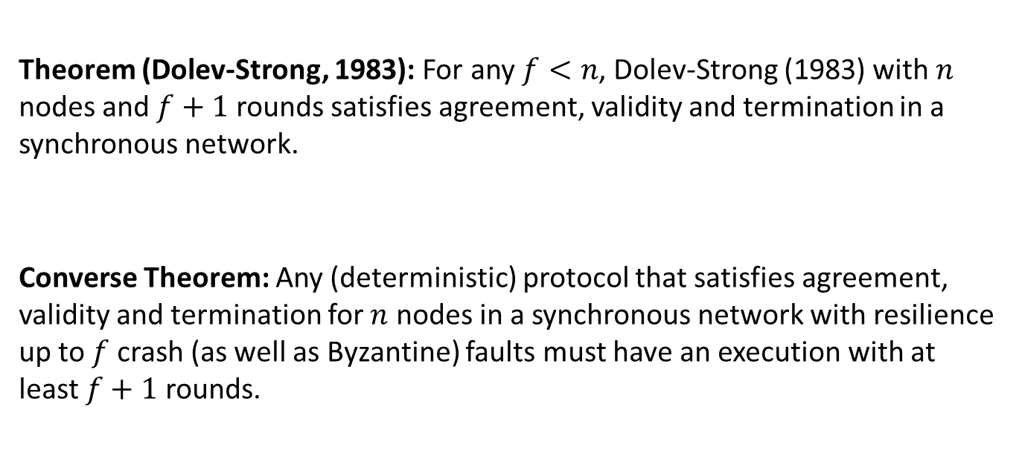
Security of Dolev-Strong (1983)
Theorem (Dolev-Strong, 1983): For any $f<n$, Dolev-Strong (1983) with $n$ nodes and $f+1$ rounds satisfies agreement, validity and termination in a synchronous network.
Converse Theorem: Any (deterministic) protocol that satisfies agreement, validity and termination for $n$ nodes in a synchronous network with resilience up to $f$ crash (as well as Byzantine) faults must have an execution with at least $f+1$ rounds.
(try to prove yourself … the proof is in the slides at the end of the deck)
Authenticated Algorithms for Byzantine Agreement (1983)
Distributed Algorithms (1996)
A Simple Bivalency Proof that t-Resilient Consensus Requires t + 1 Rounds (1998)
Notes:
Related story: cheating husbands puzzle (https://www.cs.cornell.edu/home/halpern/papers/cheathus.pdf)

Slide 38
State Machine Replication
A Repeated Byzantine Generals Problem

Slide 39








State Machine Replication (SMR)
A Centralized Bank
Blockchain (State Machine Replication)
$${tx}_{i}$$
$$y_{i}$$
$${st}_{i−1}$$
$${st}_{i}$$
Log (Ledger): an ever-growing, linearly-ordered sequence of transactions.
$${tx}_{2}{tx}_{1}{tx}_{4}…$$
$${tx}_{2}{tx}_{1}{tx}_{4}…$$
$${tx}_{2}{tx}_{1}{tx}_{4}…$$
$${tx}_{2}{tx}_{1}{tx}_{4}…$$

Slide 40

















State Machine Replication (SMR)
Two parties of SMR:
Replicas receive transactions, execute the SMR protocol and determine the log.
Clients are the learners: They communicate with the replicas to learn the log.
Goal of SMR is to ensure that the clients learn the same log.
$${tx}_{1}$$
$${tx}_{3}$$
$${tx}_{2}$$
$${tx}_{4}$$
$$R_{a}$$
$$R_{c}$$
$$R_{b}$$
$$R_{d}$$
$$R_{e}$$
$$R_{f}$$
Replicas
(miners)
Execute the SMR protocol
$${tx}_{2}{tx}_{1}{tx}_{4}…$$
$${tx}_{2}{tx}_{1}{tx}_{4}…$$
$${tx}_{2}{tx}_{1}{tx}_{4}…$$
$${tx}_{2}{tx}_{1}{tx}_{4}…$$
$${tx}_{1}{tx}_{2}{tx}_{3}…$$
$${tx}_{2}{tx}_{1}{tx}_{4}…$$

Slide 41


























State Machine Replication (SMR)
$${tx}_{1}$$
$${tx}_{3}$$
$${tx}_{2}$$
$${tx}_{4}$$
Wallet asking for the log + response
$$R_{a}$$
$$R_{c}$$
$$R_{b}$$
$$R_{d}$$
$$R_{e}$$
$$R_{f}$$
Replicas
(miners)
Execute the SMR protocol
$${tx}_{2}{tx}_{1}{tx}_{4}…$$
$${tx}_{2}{tx}_{1}{tx}_{4}…$$
$${tx}_{2}{tx}_{1}{tx}_{4}…$$
$${tx}_{2}{tx}_{1}{tx}_{4}…$$
$${tx}_{1}{tx}_{2}{tx}_{3}…$$
$${tx}_{2}{tx}_{1}{tx}_{4}…$$
$$C_{1}$$
$$C_{2}$$
Wallets are an example of a client.
Wallets ask the replicas what the correct log is.
Wallets do not execute the SMR protocol and do not talk to each other.
$${LOG}_{t}^{1}={tx}_{2}{tx}_{1}{tx}_{4}…$$
$${LOG}_{t}^{2}={tx}_{2}{tx}_{1}{tx}_{4}…$$
Clients (Wallets)
Clients (Wallets)
$$C_{3}$$
$$C_{4}$$
$${LOG}_{t}^{3}={tx}_{2}{tx}_{1}{tx}_{4}…$$
$${LOG}_{t}^{4}={tx}_{2}{tx}_{1}{tx}_{4}…$$

Slide 42










State Machine Replication (SMR)
$${tx}_{1}$$
$${tx}_{3}$$
$${tx}_{2}$$
$${tx}_{4}$$
Wallet asking for the log + response
$$R_{a}$$
$$R_{c}$$
$$R_{b}$$
$$R_{d}$$
$$R_{e}$$
$$R_{f}$$
Replicas
Execute the SMR protocol
$${tx}_{2}{tx}_{1}{tx}_{4}…$$
$${tx}_{2}{tx}_{1}{tx}_{4}…$$
$${tx}_{2}{tx}_{1}{tx}_{4}…$$
$${tx}_{2}{tx}_{1}{tx}_{4}…$$
$${tx}_{1}{tx}_{2}{tx}_{3}…$$
$${tx}_{2}{tx}_{1}{tx}_{4}…$$
$$C_{1}$$
How does a wallet learn the correct log from the replicas?
It asks the replicas what the correct log is.
Wallet then accepts the answer given by majority of the replicas as its log.
Wallet learns the correct log if over half of the replicas are honest!
$$C_{2}$$
$${LOG}_{t}^{1}={tx}_{2}{tx}_{1}{tx}_{4}…$$
$${LOG}_{t}^{2}={tx}_{2}{tx}_{1}{tx}_{4}…$$
Clients (Wallets)
Clients (Wallets)
$$C_{3}$$
$$C_{4}$$
$${LOG}_{t}^{3}={tx}_{2}{tx}_{1}{tx}_{4}…$$
$${LOG}_{t}^{4}={tx}_{2}{tx}_{1}{tx}_{4}…$$

Slide 43
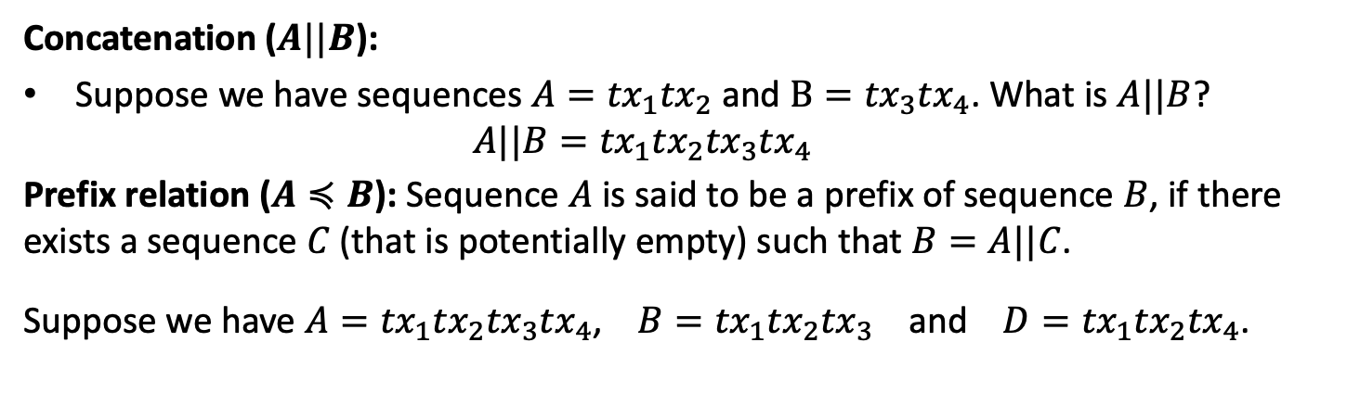
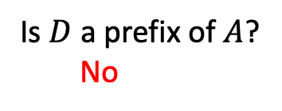
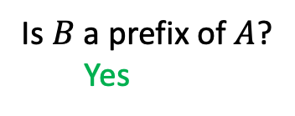
Security for SMR: Definitions
Concatenation ($A||B$):
Suppose we have sequences $A={tx}_{1}{tx}_{2}$ and $B={tx}_{3}{tx}_{4}$. What is $A||B$?
  $$A||B={tx}_{1}{tx}_{2}{tx}_{3}{tx}_{4}$$
Prefix relation ($A≼B$): Sequence $A$ is said to be a prefix of sequence $B$, if there exists a sequence $C$ (that is potentially empty) such that $B=A||C$.
Suppose we have $A={tx}_{1}{tx}_{2}{tx}_{3}{tx}_{4}$, $B={tx}_{1}{tx}_{2}{tx}_{3}$ and $D={tx}_{1}{tx}_{2}{tx}_{4}$.
Is $B$ a prefix of $A$?
  Yes
Is $D$ a prefix of $A$?
  No

Slide 44
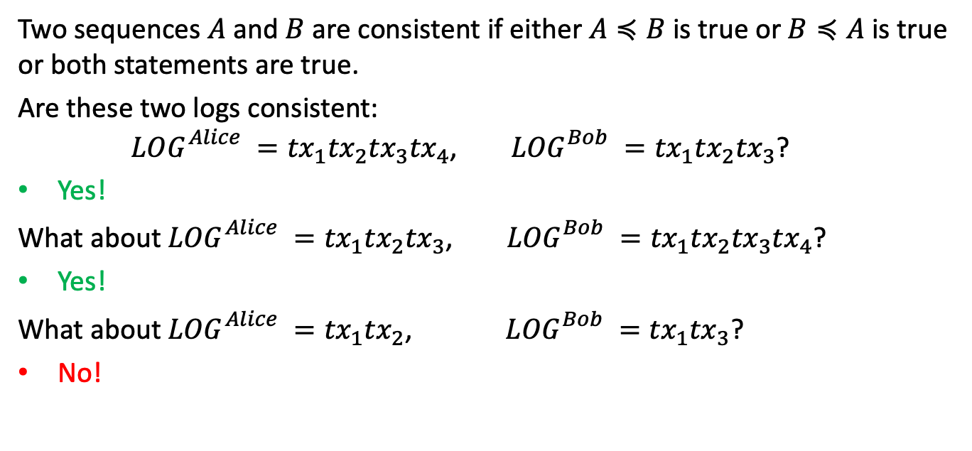
Security for SMR: Definitions
Two sequences $A$and $B$ are consistent if either $A≼B$ is true or$B≼A$ is true or both statements are true.
Are these two logs consistent:
${LOG}_{}^{Alice} ={tx}_{1}{tx}_{2}{tx}_{3}{tx}_{4}$, ${LOG}_{}^{Bob} ={tx}_{1}{tx}_{2}{tx}_{3}$?
Yes!
What about ${LOG}_{}^{Alice} ={tx}_{1}{tx}_{2}{tx}_{3}$, ${LOG}_{}^{Bob} ={tx}_{1}{tx}_{2}{tx}_{3}{tx}_{4}$?
Yes!
What about ${LOG}_{}^{Alice} ={tx}_{1}{tx}_{2}$, ${LOG}_{}^{Bob} ={tx}_{1}{tx}_{3}$?
No!

Slide 45
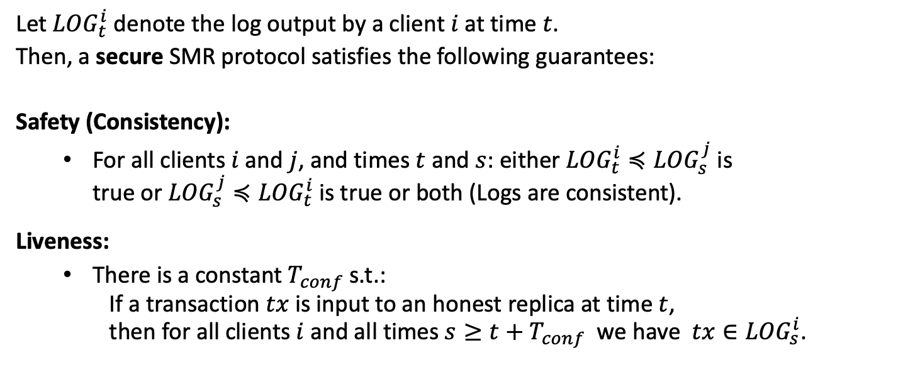
Security for SMR
Let ${LOG}_{t}^{i}$ denote the log output by a client $i$ at time $t$.
Then, a secure SMR protocol satisfies the following guarantees:
Safety (Consistency):
  For all clients $i$ and $j$, and times $t$ and $s$: either ${LOG}_{t}^{i}≼{LOG}_{s}^{j}$ is
  true or ${LOG}_{s}^{j}≼{LOG}_{t}^{i}$ is true or both (Logs are consistent).
Liveness:
  There is a constant $T_{conf}$s.t.:
  If a transaction $tx$ is input to an honest replica at time $t$,
  then for all clients $i$ and all times $s≥t+T_{conf}$ we have $tx∈{LOG}_{s}^{i}$.
Similar to agreement!
Similar to validity and termination!

Slide 46
Security for SMR
Let ${LOG}_{t}^{i}$ denote the log output by a client $i$ at time $t$.
Then, a secure SMR protocol satisfies the following guarantees:
Safety (Consistency):
  For all clients $i$ and $j$, and times $t$ and $s$: either ${LOG}_{t}^{i}≼{LOG}_{s}^{j}$ is
  true or ${LOG}_{s}^{j}≼{LOG}_{t}^{i}$ is true or both (Logs are consistent).
Liveness:
  There is a constant $T_{conf}$s.t.:
  If a transaction $tx$ is input to an honest replica at time $t$,
  then for all clients $i$ and all times $s≥t+T_{conf}$ we have $tx∈{LOG}_{s}^{i}$.
No double spend
Similar to agreement!
Similar to validity and termination!
No censorship

Slide 47




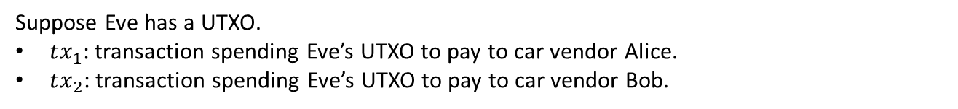
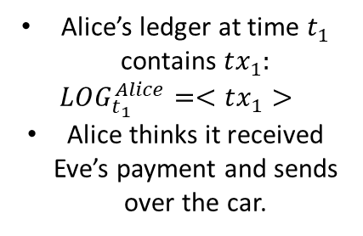
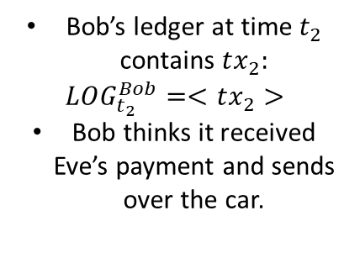



Why is safety important?
Eve
Suppose Eve has a UTXO.
$tx_{1}$: transaction spending Eve’s UTXO to pay to car vendor Alice.
$tx_{2}$: transaction spending Eve’s UTXO to pay to car vendor Bob.
$$UTXO_{Eve}$$
$$t_{0}=0$$
$$t_{1}$$
$$t_{2}$$
spent to pay Alice
spent to pay Bob
Alice’s ledger at time $t_{1}$ contains $tx_{1}:$
$$LOG_{t_{1}}^{Alice}=<tx_{1}>$$
Alice thinks it received Eve’s payment and sends over the car.
Bob’s ledger at time $t_{2}$ contains $tx_{2}:$
$$LOG_{t_{2}}^{Bob}=<tx_{2}>$$
Bob thinks it received Eve’s payment and sends over the car.
Alice
Bob

Slide 48
Why is safety important?
Eve
Suppose Eve has a UTXO.
$tx_{1}$: transaction spending Eve’s UTXO to pay to car vendor Alice.
$tx_{2}$: transaction spending Eve’s UTXO to pay to car vendor Bob.
$$UTXO_{Eve}$$
$$t_{0}=0$$
$$t_{1}$$
safety violation
$$t_{2}$$
spent to pay Alice
spent to pay Bob
Alice’s ledger at time $t_{1}$ contains $tx_{1}:$
$$LOG_{t_{1}}^{Alice}=<tx_{1}>$$
Alice thinks it received Eve’s payment and sends over the car.
Bob’s ledger at time $t_{2}$ contains $tx_{2}:$
$$LOG_{t_{2}}^{Bob}=<tx_{2}>$$
Bob thinks it received Eve’s payment and sends over the car.
Alice
Bob
When safety is violated, Eve can double-spend!

Slide 49
SMR vs. Byzantine Broadcast
Single shot vs. Multi-shot
  Broadcast is single shot consensus. Each node outputs a single value.
  State Machine Replication is multi-shot. Each client continuously outputs a log, which is a sequence of transactions (values).
Who are the learners?
  In Broadcast, the nodes executing the protocol are the same as the nodes that output decision values.
  In State Machine Replication, protocol is executed by the replicas, whereas the goal is for the clients to learn the log.
    Replicas must ensure that the clients learn the same log.

Slide 50
Let’s build an SMR protocol
Next lecture …

Slide 51
END OF LECTURE
Next lecture: Consensus in the Internet Setting
Notes:
Add last slide on comparison to HotStuff

Slide 52
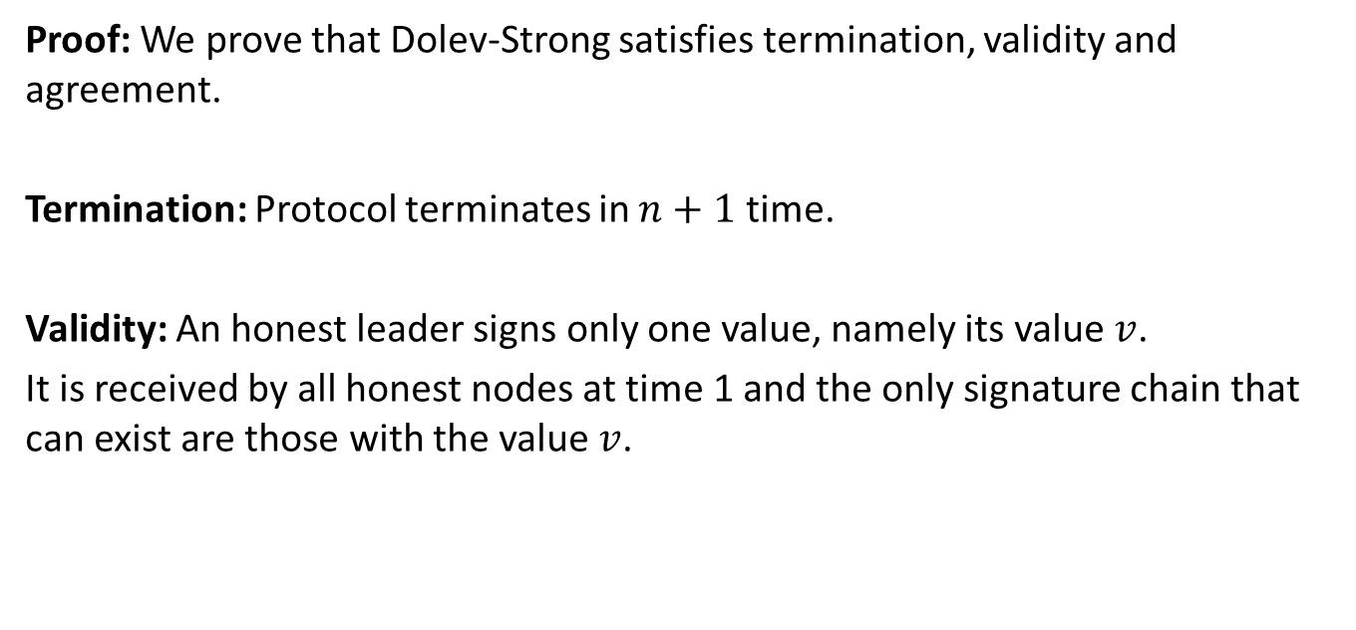
Security Proof for Dolev-Strong (1983)
Proof: We prove that Dolev-Strong satisfies termination, validity and agreement.
Termination: Protocol terminates in $n+1$ time.
Validity: An honest leader signs only one value, namely its value $v$.
It is received by all honest nodes at time 1 and the only signature chain that can exist are those with the value $v$.

Slide 53
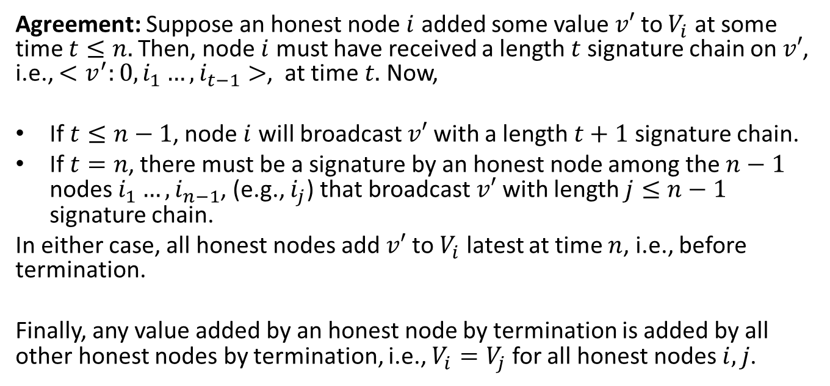
Security Proof for Dolev-Strong (1983)
Agreement: Suppose an honest node $i$ added some value $v′$ to $V_{i}$ at some time $t≤n.$Then, node $i$ must have received a length $t$ signature chain on $v′$, i.e., $<v^{′}:0,i_{1}…,i_{t−1}>$, at time $t.$ Now,
If $t≤n−1$, node $i$ will broadcast $v′$ with a length $t+1$ signature chain.
If $t=n$, there must be a signature by an honest node among the $n−1$ nodes $i_{1}…,i_{n−1}$, (e.g., $i_{j}$) that broadcast $v′$ with length $j≤n−1$ signature chain.
In either case, all honest nodes add $v′$ to $V_{i}$ latest at time $n$, i.e., before termination.
Finally, any value added by an honest node by termination is added by all other honest nodes by termination, i.e., $V_{i}=V_{j}$ for all honest nodes $i,j$.

