Slide 1
Bitcoin Mechanics
CS251 Fall 2025
(cs251.stanford.edu)
Dan Boneh
Reminder: proj #1 is posted on the course web site. Due Oct. 1

Slide 2
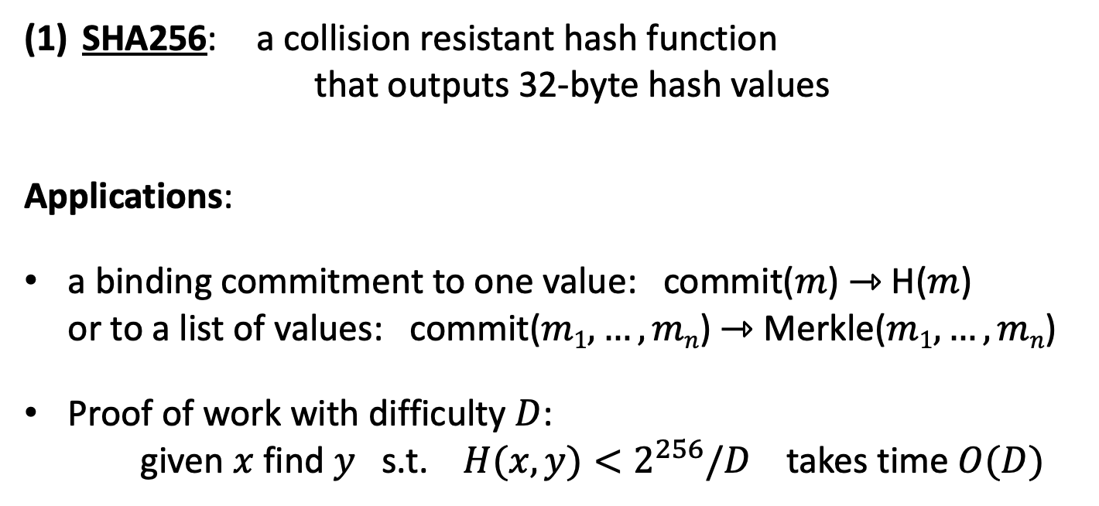
Recap
SHA256: a collision resistant hash function
that outputs 32-byte hash values
Applications:
a binding commitment to one value: commit($m$) ⇾ H($m$)
or to a list of values: commit($m1, …, mn$) ⇾ Merkle($m1,…,mn$)
Proof of work with difficulty $D$:
given $x$ find $y$ s.t. $H(x,y)<2^{256}/D$ takes time $O(D)$

Slide 3
Digital signatures: syntax
Digital signatures: (Gen, Sign, Verify)
Gen() ⇾ (pk, sk)
Sign(sk, m) ⇾ σ, Verify(pk, m, σ) ⇾ accept/reject
signing key
verification key

Slide 4
Families of signature schemes
RSA: (not used in blockchains)
  long sigs and public keys (≥256 bytes), fast to verify
Schnorr and ECDSA
  short sigs (48 or 64 bytes) and public key (32 bytes)
BLS: 48 bytes, aggregatable, easy threshold
Post-quantum signatures: long (≥600 bytes)
(Bitcoin, Ethereum)
(Ethereum, Solana, Chia)
details in CS255

Slide 5


Signatures on the blockchain
Signatures are used everywhere:
ensure Tx authorization
governance votes
consensus protocol votes
$$sk_{1}$$
data
signatures
signing
keys
$$sk_{2}$$
data
signatures

Slide 6
Bitcoin mechanics

Slide 7
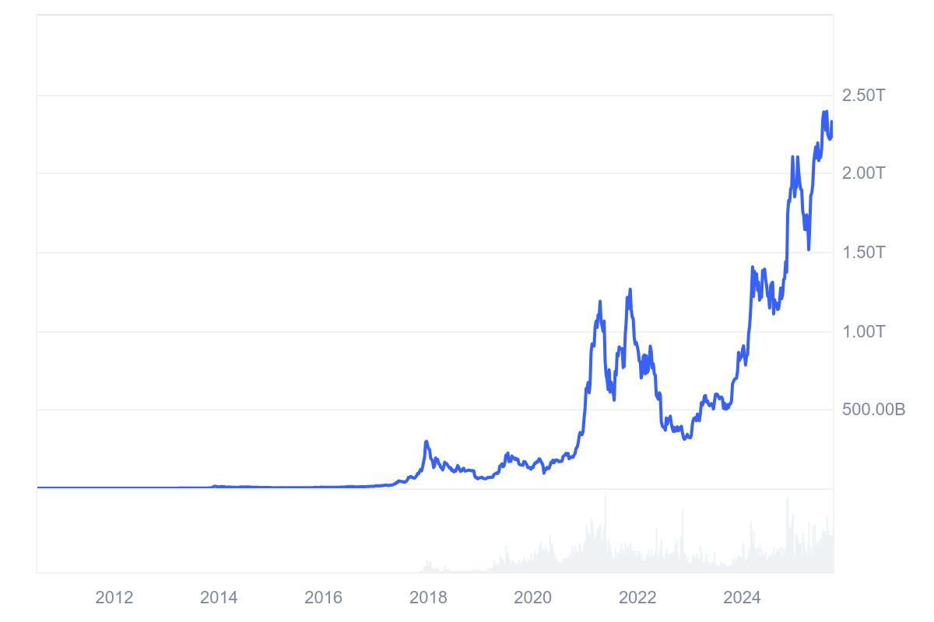
This lecture: Bitcoin mechanics
Oct. 2008: paper by Satoshi Nakamoto
Jan. 2009: Bitcoin network launched
Total market value:
Sep. 2025: $2.23T
Notes:
https://coinmarketcap.com/currencies/bitcoin/

Slide 8
This lecture: Bitcoin mechanics
user facing tools (cloud servers)
applications (DAPPs, smart contracts)
Execution engine (blockchain computer)
today
Sequencer: orders transactions
Data Availability / Consensus Layer
next week

Slide 9
First: overview of the Bitcoin consensus layer
Bitcoin P2P network
end users
signed Tx
sk_{A}
sk_{B}
sk_{C}
typically, miners are connected to
eight other peers (anyone can join)

Slide 10
First: overview of the Bitcoin consensus layer
mempool
miners broadcast received Tx
to the P2P network
every miner:
validates received Tx and
stores them in its mempool
(unconfirmed Tx)
note: miners see all Tx before they are posted on chain
Bitcoin P2P network
Notes:
Minters may decide to front run a Tx, if it is profitable.

Slide 11
First: overview of the Bitcoin consensus layer
blockchain
I am the leader
Every ≈10 minutes:
Every miner creates a candidate
block from Tx in its mempool
a “random” miner is selected
(how: next week), and broadcasts
its block to P2P network
all miners validate the new block
Bitcoin P2P network
Notes:
Tx in new block are removed from the mempool.

Slide 12
First: overview of the Bitcoin consensus layer
blockchain
3.125 BTC
Selected miner is paid 3.125 BTC
in coinbase Tx (first Tx in the block)
only way new BTC is created
block reward halves every four years
⇒ max 21M BTC (currently 19.9M BTC)
note: miner chooses order of Tx in block
Notes:
Miners want to be selected as often as possible: can join multiple times -- Sybil attack -- to increase their chances. Need to prevent that.
Next halving: Mar. 2028, 1.56 BTC/block

Slide 13
Properties (very informal)
Next week:
  Safety / Persistence:
  to remove a block, need to convince 51% of mining power *
  Liveness:
  to block a Tx from being posted, need to convince 51% of
  mining power **
  (some sub 50% censorship attacks, such as feather forks)

Slide 14
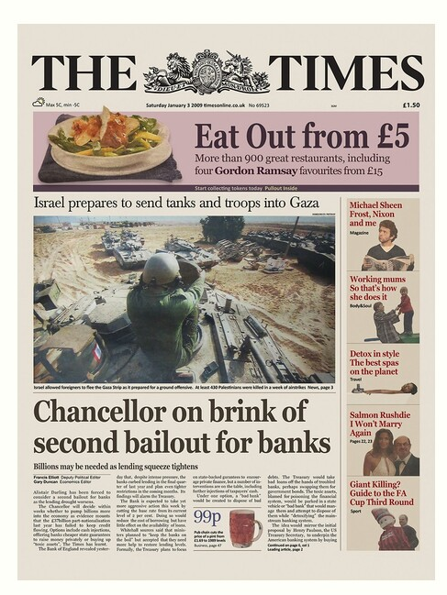
Bitcoin blockchain: a sequence of block headers, 80 bytes each
genesis
block
BH₃
BH₁
BH₂
version (4 bytes)
prev (32 bytes)
time (4 bytes)
bits (4 bytes)
nonce (4 bytes)
Tx root (32 bytes)
prev
Tx root
prev
Tx root
H
H
H
…
80 bytes
coinbase Tx
coinbase Tx
Notes:
The London Times front page from 03/Jan/2009.

Slide 15
Bitcoin blockchain: a sequence of block headers, 80 bytes each
time: time miner assembled the block. Self reported.
(block rejected if too far in past or future)
bits: proof of work difficulty
nonce: proof of work solution
Merkle tree: payer can give a short proof that Tx is in the block
new block every ≈10 minutes.
for choosing a leader (next week)

Slide 16
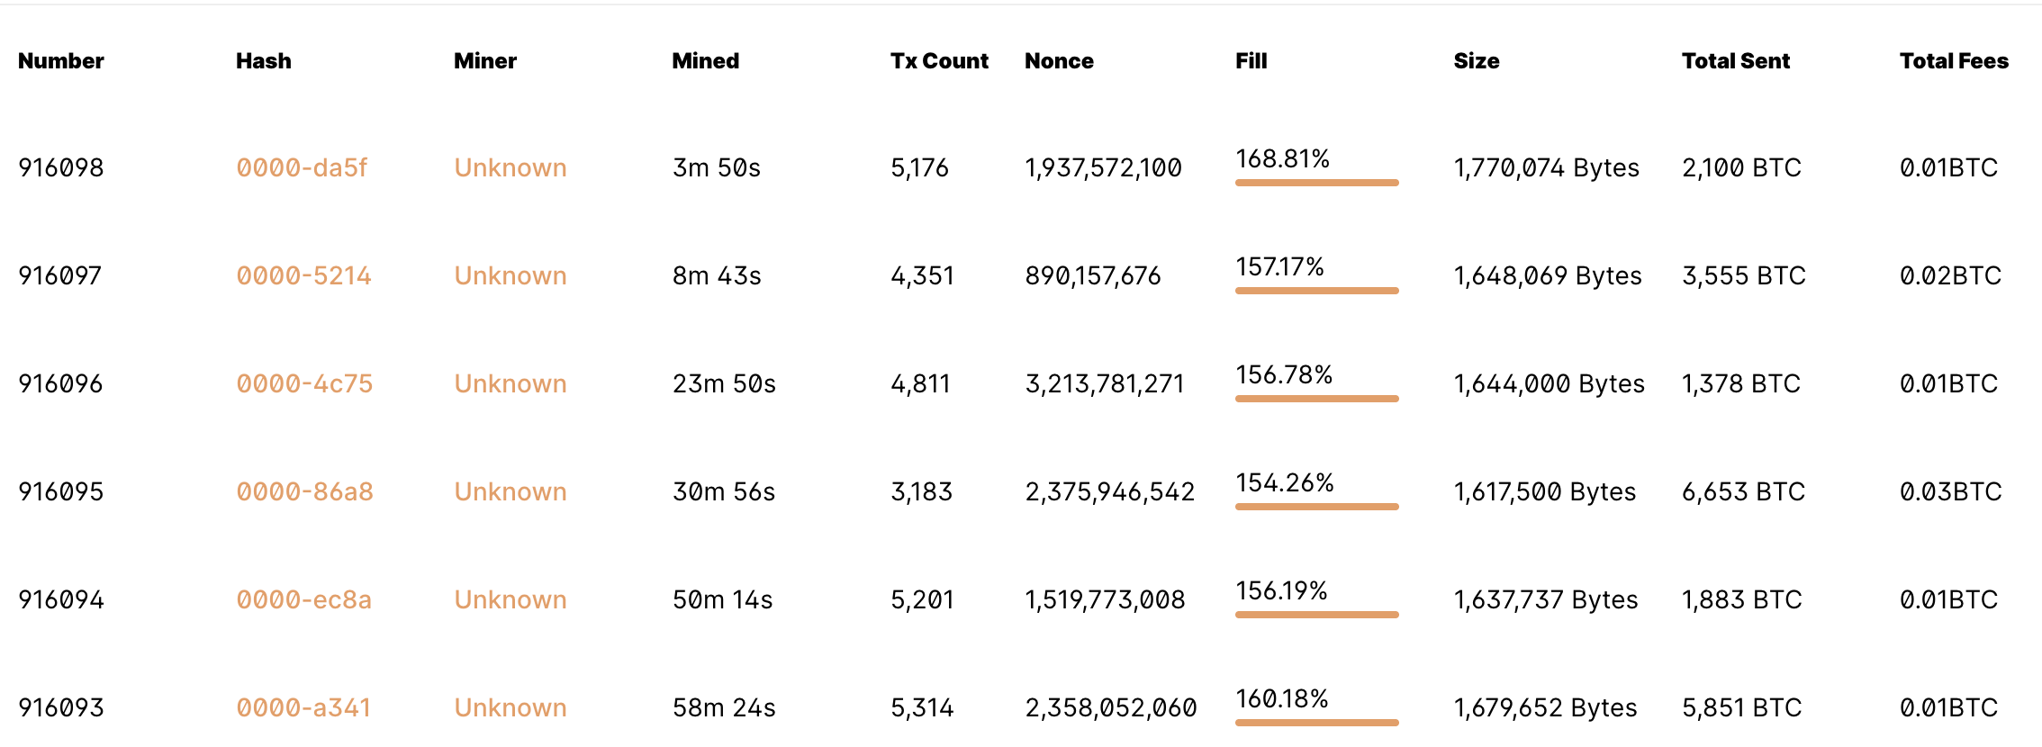
An example
(block height)
Tx Data
Notes:
https://www.blockchain.com/explorer/blocks/btc

Slide 17
Block 916096 (Sep. 23, 2025, 15:54:50)
Miner: AntPool (from coinbase Tx)
Num. of Tx: 4811 (1377.59 BTC transferred, ≈$154M)
Difficulty (D): 142,342,602,928,674.94 (adjusts every two weeks)
Merkle root: 4cef12cf0d7d116a60ea1ec35e5325b17c28c83c84a6846251d4364de1e233d3
Block Reward: 3.125 BTC
Fee: 0.01335727 BTC (Tx fee given to miner in coinbase Tx)
Notes:
https://www.blockchain.com/explorer/blocks/btc/916096

Slide 18
This lecture
View the blockchain as a sequence of Tx (append-only)
…
coinbase Tx

Slide 19
Tx structure (non-coinbase)
input[0]
input[1]
input[2]
output[0]
output[1]
witnesses
(part of input)
locktime
TxID
out-index
ScriptSig
seq
32 byte hash
input:
inputs
4 byte index
program
TxID = H(Tx)
ignore
outputs
(excluding witnesses)
output:
value
ScriptPK
8 bytes
(segwit)
program
(4 bytes)
#BTC = value/10⁸
earliest block # that can include Tx
Notes:
10⁻⁸ BTC = 1 Satoshi ~ 0.01 cent
TxID are unique – two Tx cannot have the same TxID, because inputs are unique. The only exception is the coinbase Tx, which has no inputs, so that two coinbase Tx can have the same TxID. To solve that, every coinbase Tx includes the block height in its ScriptPk (BIP 34).

Slide 20
Example
null locktime
TxIn[0]
TxOut[0]
TxOut[1]
Tx1:
input
2
ScriptPK
5
ScriptPK
0
(funding Tx)
value
value
UTXO₁
UTXO₂
UTXO: unspent Tx output
TxIn[0]
TxOut[0]
TxOut[1]
Tx2:
TxID
1
ScriptSig
output
output
0
(spending Tx)
identifies
a UTXO
UTXO₃
UTXO₄
Notes:
ScriptPK specifies who or how can spend.

Slide 21
Example
☓
null locktime
TxIn[0]
TxOut[0]
TxOut[1]
Tx1:
input
2
ScriptPK
5
ScriptPK
0
(funding Tx)
value
value
UTXO₁
UTXO₂
UTXO: unspent Tx output
TxIn[0]
TxOut[0]
TxOut[1]
Tx2:
TxID
1
ScriptSig
output
output
0
(spending Tx)
identifies
a UTXO
UTXO₃
UTXO₄
Notes:
ScriptPK specifies who or how can spend.

Slide 22
Validating Tx2
program from funding Tx:
under what conditions
can UTXO be spent
Miners check (for each input):
The program ScriptSig | ScriptPK returns true
TxID | index is in the current UTXO set
sum input values ≥ sum output values
After Tx2 is posted, miners remove UTXO₂ from UTXO set
program from spending Tx:
proof that conditions
are met
Notes:
Spent UTXOs can be forgotten. They are no longer needed for block validation.

Slide 23
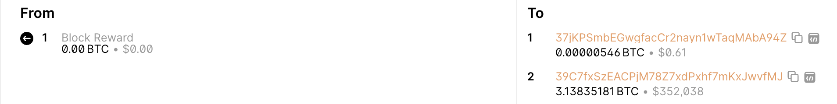
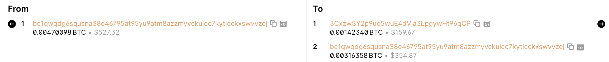
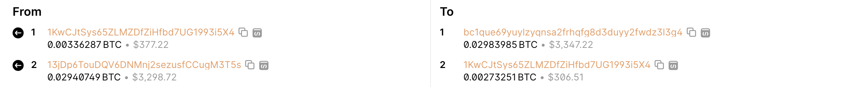
An example (block 916096) [4811 Tx in block]
Tx0 (coinbase)
total out = 3.138357 BTC
Tx5
Fee = 0.000114 BTC
Tx6
Fee = 0.000198 BTC
Fee is chosen by Tx creator; if too low, Tx will wait in mempool
Sum of fees in block added to coinbase Tx
Notes:
Fees: Tx5 0.000114 BTC ≈ 10$,
Low Tx fee in Tx means Tx will remain unconfirmed (sit in mempool).
To frontrun a Tx: submit a Tx with a higher Tx fee.

Slide 24
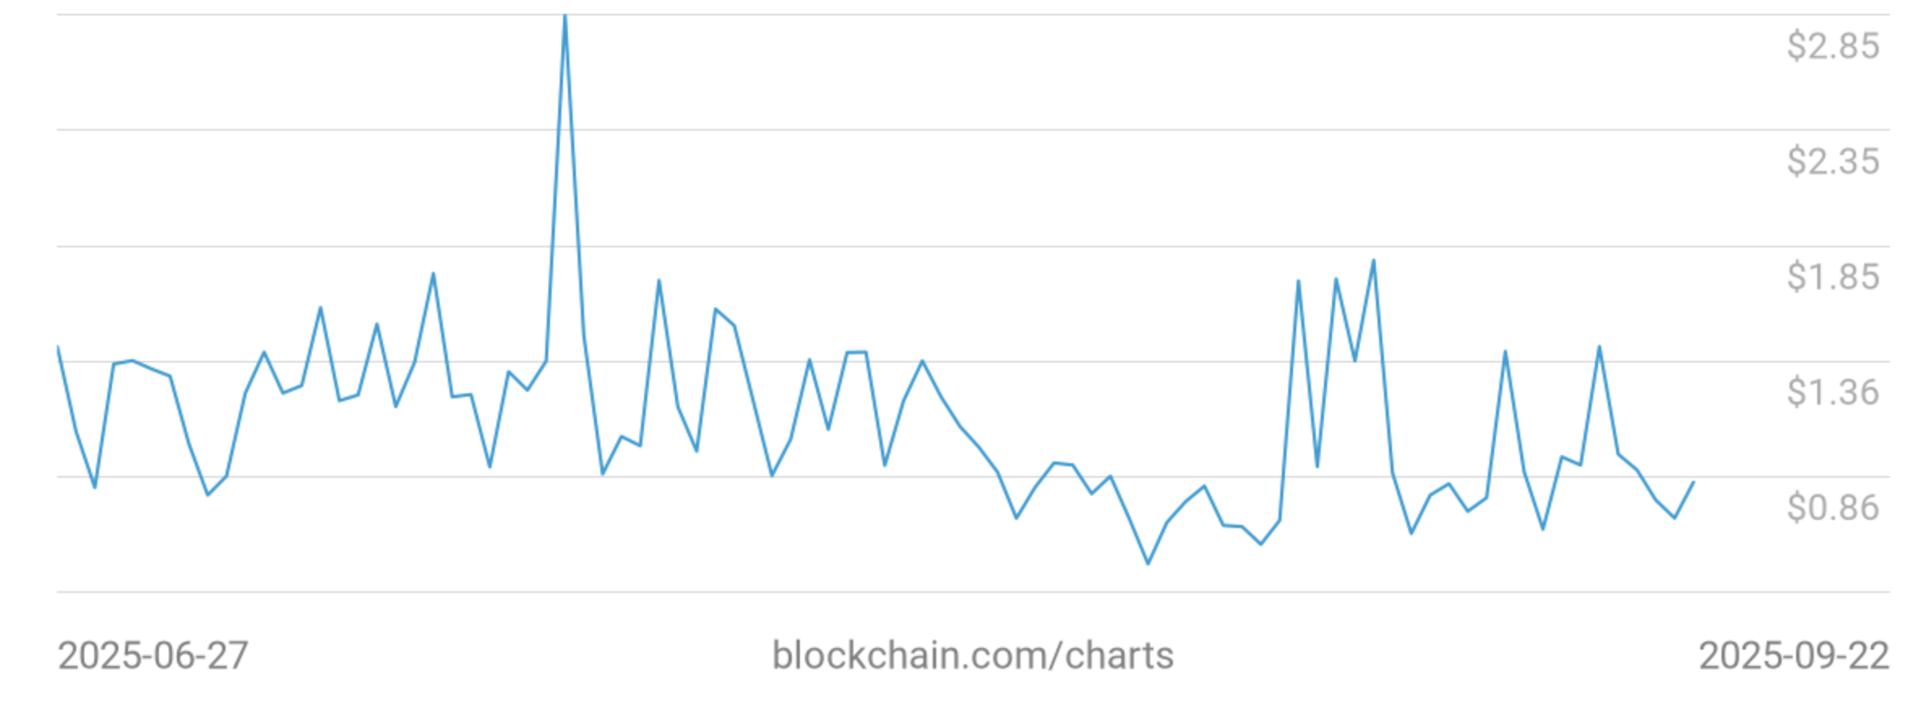
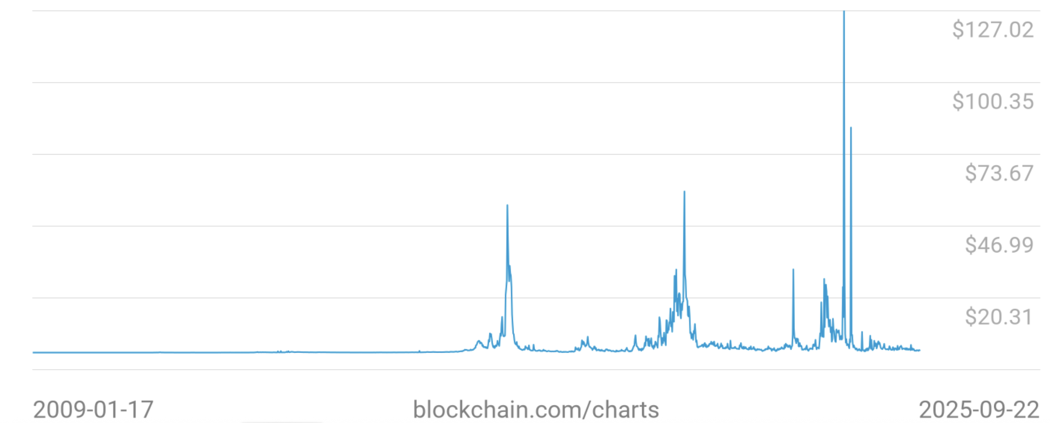

Tx fees
Bitcoin daily average Tx fees in USD (last 90 days, sep. 2025)
$0.83/Tx
Bitcoin average Tx fees in USD (all time)
Fees depend on
network congestion
Notes:
Fee depends on network congestion, price of BTC.
https://www.blockchain.com/charts/fees-usd-per-transaction

Slide 25
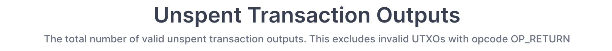
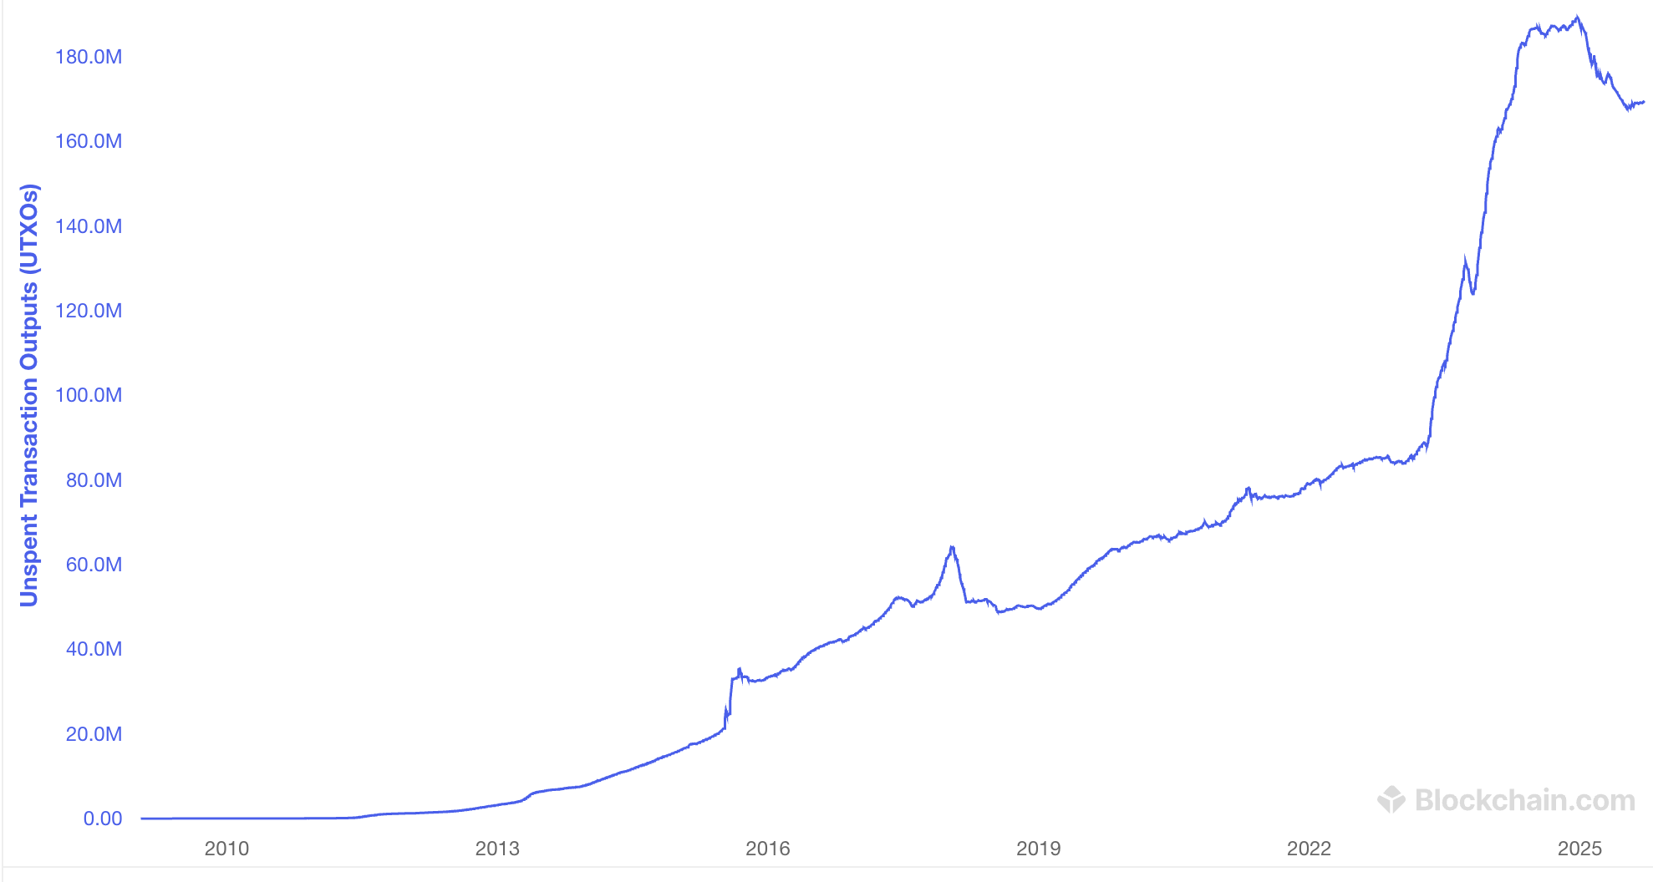
All value in Bitcoin is held in UTXOs
169M
Sep. 2025: miners need to store ≈169M UTXOs in memory
Notes:
How many Bitcoins do I have: need to find all the UTXOs on chain that I can spend. Typically done by wallet software (next lecture).
https://www.blockchain.com/charts/utxo-count

Slide 26
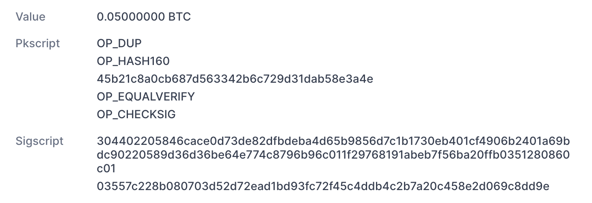
Focusing on one Tx input
from UTXO
(Bitcoin script)
Pkscript: a program that specifies the
conditions needed to spend the UTXO
from TxInp[0]

Slide 27
Bitcoin Script
A stack machine. Not Turing Complete: no loops.
Quick survey of op codes:
1. OP_TRUE (OP_1), OP_2, …, OP_16: push value onto stack
2. OP_DUP: push top of stack onto stack
81
82
96
118

Slide 28
Bitcoin Script
control:
OP_IF <statements> OP_ELSE <statements> OP_ENDIF
OP_VERIFY: abort fail if top = false
OP_RETURN: abort and fail
what is this for? ScriptPK = [OP_RETURN, <data>]
OP_EQVERIFY: pop, pop, abort fail if not equal
99
105
106
136

Slide 29
Bitcoin Script
4. arithmetic:
OP_ADD, OP_SUB, OP_AND, …: pop two items, add, push
5. crypto:
OP_SHA256: pop, hash, push
OP_CHECKSIG: pop pk, pop sig, verify sig. on Tx, push 0 or 1
Time: OP_CheckLockTimeVerify (CLTV):
fail if value at the top of stack > Tx locktime value.
usage: UTXO can specify min-time when it can be spent
Notes:
Tx locktime comes from the spending Tx (current height must be ≥ locktime). Value at top of stack could come from ScriptPK in the UTXO. So, UTXO can only be spent if current-height ≥ value-at-top-of-stack.

Slide 30
Example: a common script
<sig> <pk> DUP HASH256 <pkhash> EQVERIFY CHECKSIG
stack: empty init
<sig> <pk> push values
<sig> <pk> <pk> DUP
<sig> <pk> <hash> HASH256
<sig> <pk> <hash> <pkhash> push value
<sig> <pk> EQVERIFY
1 CHECKSIG
⇒ successful termination
verify(pk, Tx, sig)

Slide 31
What’s up with OP_CAT
OP_CAT: stack = <abc> <def> ⇒ stack = <abcdef>
The problem script:
OP_DUP OP_CAT OP_DUP OP_CAT … (repeat 50 times)
⇒ Miner would run out of memory
Satoshi’s solution (2010): disable OP_CAT
⇒ quite sad: Bitcoin cannot verify Merkle proofs
Today: stack cell is limited to 520 bytes (script fails if exceeded)
… but OP_CAT still not re-enabled.

Slide 32
Transaction types: (1) P2PKH
pay to public key hash
Alice want to pay Bob 5 BTC:
step 1: Bob generates sig key pair (pk_{B}, sk_{B}) ⇽ Gen()
step 2: Bob computes his Bitcoin address as addr_{B} ⇽ H(pk_{B})
step 3: Bob sends addr_{B} to Alice
step 4: Alice posts Tx:
UTXO_{B} for Bob
UTXO_{A} for Alice (change)
Point to Alice’s UTXO
input
7 BTC
5
ScriptPK_{B}
2
ScriptPK_{A}
0
ScriptPK_{B}:
DUP HASH256 <addr_{B}> EQVERIFY CHECKSIG

Slide 33
Transaction types: (1) P2PKH
pay to public key hash
“input” contains ScriptSig that authorizes spending Alice’s UTXO
example: ScriptSig contains Alice’s signature on Tx
⟹ miners cannot change ScriptPK_{B} (will invalidate Alice’s signature)
UTXO_{B} for Bob
UTXO_{A} for Alice (change)
Point to Alice’s UTXO
input
7 BTC
5
ScriptPK_{B}
2
ScriptPK_{A}
0
ScriptPK_{B}:
DUP HASH256 <addr_{B}> EQVERIFY CHECKSIG

Slide 34
Transaction types: (1) P2PKH
Later, when Bob wants to spend his UTXO: create a Tx_{spend}
Tx_{spend}:
TxID
0
ScriptSig_{B}
output
output
0
points to
UTXO_{B}
<sig> <pk_{B}>
(authorizes spending UTXO_{B})
<sig> = Sign(sk_{B}, Tx) where Tx = (Tx_{spend} excluding all ScriptSigs) (SIGHASH_ALL)
Miners validate that ScriptSig_{B} | ScriptPK_{B} returns true
Notes:
Bob’s <sig> ensures that miners cannot change the Tx outputs.

Slide 35
P2PKH: comments
Alice specifies recipient’s pk in UTXO_{B}
Recipient’s pk is not revealed until UTXO is spent
  ⇒ Some security against quantum attacks on pk
  ⇒ Unfortunately, first 200K coinbase Tx are P2PK (no hash)
Miner cannot change <Addr_{B}> and steal funds:
invalidates Alice’s signature that created UTXO_{B}
Notes:
1.7M BTC in thoser coinbase Tx are vulnerable. About $170B.

Slide 36
Segregated Witness
ECDSA malleability:
Given (m, sig) anyone can create (m, sig’) with sig ≠ sig’
⇒ miner can change sig in Tx and change TxID = SHA256(Tx)
⇒ Tx issuer cannot tell what TxID is, until Tx is posted
⇒ leads to problems and attacks
Segregated witness: signature is moved to witness field in Tx
TxID = Hash(Tx without witnesses)
Notes:
Mt. Gox attack

Slide 37
Transaction types: (2) P2SH: pay to script hash
(pre SegWit in 2017)
Let’s payer specify a redeem script (instead of just pkhash)
Usage: payee publishes hash(redeem script) ⟵ Bitcoint addr.
payer sends funds to that address
ScriptPK in UTXO: HASH160 <H(redeem script)> EQUAL
ScriptSig to spend: <sig₁> <sig₂> … <sig_{n}> <redeem script>
payer can specify complex conditions for when UTXO can be spent

Slide 38
P2SH
Miner verifies:
<ScriptSig> ScriptPK = true ⟵ payee gave correct script
(2) ScriptSig = true ⟵ script is satisfied

Slide 39
Example P2SH: multisig
Goal: spending a UTXO requires t-out-of-n signatures
Redeem script for 2-out-of-3: (set by payer)
<2> <PK₁> <PK₂> <PK₃> <3> CHECKMULTISIG
hash gives P2SH address
ScriptSig to spend: (by payee) <0> <sig1> <sig3> <redeem script>
Notes:
Note: redeem script becomes public when spending Tx. Several tricks make it possible to keep redeem script secret, unless there is a dispute (Taproot)

Slide 40
END OF LECTURE
Next lecture: interesting scripts,
wallets, and how to manage crypto assets

