Slide 1
Final Topics:
Bridging, Post-quantum Blockchains, and DAOs
CS251 Fall 2025
(cs251.stanford.edu)
Dan Boneh
Invited talk final lecture. Final exam next Tuesday (on Gradescope)

Slide 2
Many more topics to cover …
Blockchain interoperability (bridging)
Governance: How to decide on updates to, say, on Uniswap
Post-quantum blockchains: security against quantum computers
Account abstraction
Re-staking: using your stake to secure multiple applications
Data Availability Sampling (DAS) to handle large blocks
Recoverable tokens: how to protect your tokens from theft (ERC-20R)
Many more cryptography techniques (see slides at end)
Notes:
Maybe also embedded wallets.

Slide 3
More topics …
Where can I learn more?
  CS255 and CS355: Cryptography (Winter and Spring)
  EE374: Scaling blockchains with fast consensus
  MS&E247: Economics and DeFi
  Science of blockchain conference (SBC): July 2026
  Stanford blockchain club
A career in blockchains? Where to start? [link]

Slide 4
Interoperability between blockchain
How to bridge chains

Slide 5
Many L1 blockchains
Bitcoin: Bitcoin scripting language
Ethereum: EVM.
EVM compatible blockchains: Celo, Avalanche, BSC, …
Higher Tx rate ⟹ lower Tx fees
EVM compatibility ⟹ easy project migration and user support
Other fast non-EVM blockchains: Solana, Aptos, Sui, Flow, …
Higher Tx rate ⟹ lower Tx fees
Notes:
User support on EVM-compatible chains: just use metamask by telling it to use a different network.

Slide 6

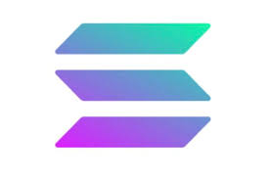

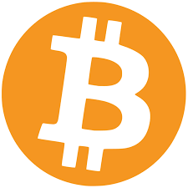

The problem: siloes
Aptos
Cosmos
Ethereum
Osmosis DEX
Can I use Osmosis??
Bitcoin
Solana
How???
20 SOL
Notes:
Much like networking before the Internet

Slide 7
Interoperability
Interoperability:
User owns funds or assets on one blockchain system
Goal: enable user to move assets to another chain
Composability:
Enable a DAPP on one chain to call a DAPP on another
Both are easy if the entire world used Ethereum
In reality: many blockchain systems that need to interoperate
The solution: bridges

Slide 8
A first example: BTC in Ethereum
How to move BTC to Ethereum ?? Goal: enable BTC in DeFi.
⟹ need new ERC20 on Ethereum pegged to BTC
(e.g., use it for providing liquidity in DeFi projects)
The solution: wrapped coins
Asset X on one chain appear as wrapped-X on another chain
For BTC: several solutions (e.g., wBTC, cbBTC, tBTC, …)

Slide 9
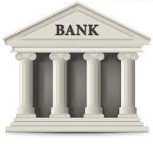
wBTC and cbBTC: a lock-and-mint bridge
Let’s start with wBTC: moving 1 BTC to Ethereum
Alice on
Ethereum
Alice
1₿ verified
(signed)
1 ₿
mint 1 wBTC
credit Alice’s address
ERC20
1 ₿
1 ₿
custodian’s
BTC address
bridge contract
1 wBTC
(lock 1 BTC)
to use in DeFi
(watch for deposits)
custodian
Notes:
cbBTC: Coinbase Wrapped BTC

Slide 10

Alice wants her 1 BTC back
Moving 1 wBTC back to the Bitcoin network:
deduct 1 wBTC
from Alice
Alice on
Ethereum
Alice
Bitcoin Tx
(signed)
1 ₿
burn my 1 wBTC
(signed)
1 ₿
1 ₿
custodian’s
BTC address
bridge contract
(1 BTC unlocked)
(watch for burns)
custodian

Slide 11
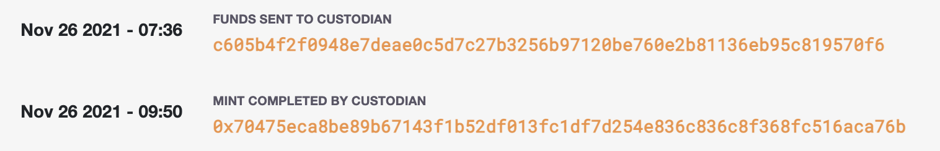
wBTC
Example BTC ⇾ Ethereum:
(Bitcoin Tx: ≈4,000 BTC)
(Ethereum Tx: )
Why two hours?
… make sure no Bitcoin re-org
The problem: trusted custodian
Can we do better?
Notes:
Custodian can run away with BTC, or require high redemption fees.

Slide 12
tBTC (v2): no single point of trust
A new bridge address created every two weeks
Managed by 100 custodians selected from a pool of signers
A threshold of custodians must sign minting and burning transactions
Bridging operations take several hours

Slide 13
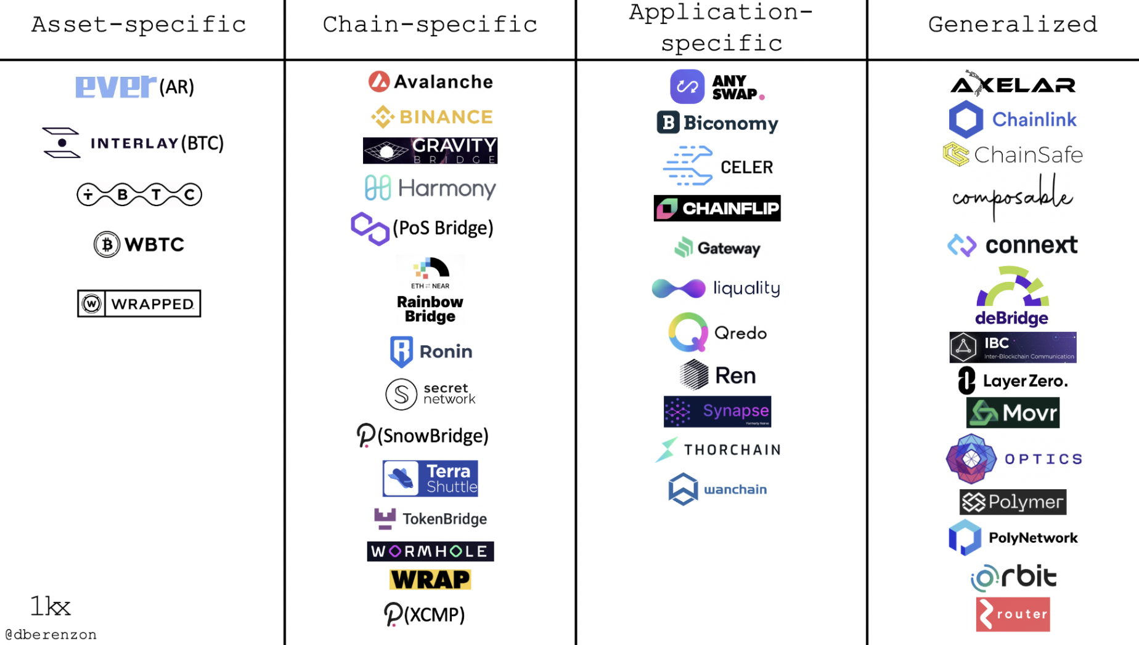
Bridging smart chains (with Dapp support)
A very active area:
Many super interesting ideas
https://medium.com/1kxnetwork/blockchain-bridges-5db6afac44f8

Slide 14
Two types of bridges
Type 1: a lock-and-mint bridge
SRC ⇾ DEST: user locks funds on SRC side,
wrapped tokens are minted on the DEST side
DEST ⇾ SRC: funds are burned on the DEST side,
and released from lock on the SRC Side
Type 2: a liquidity pool bridge
Liquidity providers provide liquidity on both sides
SRC ⇾ DEST: user sends funds on SRC side,
equivalent amount released from pool on DEST side

Slide 15
Bridging smart chains (with Dapp support)
Step 1 (hard): a secure cross-chain messaging system
Source
Chain S
message to Y
on chain T: data
DAPP-X
relayer
(contract)
I believe it
message from X
on chain S: data
Target
Chain T
DAPP-Y
relayer
(contract)
Step 2 (easier): build a bridge using messaging system

Slide 16
Bridging smart chains (with Dapp support)
Step 1 (hard): a secure cross-chain messaging system
Source
Chain S
Target
Chain T
DAPP-X
DAPP-Y
Step 2 (easier): build a bridge using messaging system
DAPP-X ⇾ DAPP-Y: “I received 3 CELO, ok to mint 3 wCELO”
DAPP-Y ⇾ DAPP-X: “I burned 3 wCELO, ok to release 3 CELO”
If messaging system is secure, no one can steal locked funds at S
Notes:
… or “I received CryptoPunk#6587, ok to let Alice use it as collateral on chain T”

Slide 17
Primarily two types of messaging systems
(1) Externally verified: external parties verify message on chain S
verify sig and dispatch
to recipients
collect msgs D[]
Relayer on S received
messages D[] (signed)
Source
Chain S
Target
Chain T
relayerS
relayerT
Trustees (watch relayerS)
RelayerT dispatches only if all trustees signed
⟹ if DAPP-Y trusts trustees, it knows DAPP-X sent message
Notes:
This is a simplified version of Celo Optics. Same with Wormhole: 2/3 of guardians need to sign.

Slide 18
Primarily two types of messaging systems
(1) Externally verified: external parties verify message on chain S
verify sig and dispatch
to recipients
collect msgs D[]
Relayer on S received
messages D[] (signed)
Source
Chain S
Target
Chain T
relayerS
relayerT
Trustees (watch relayerS)
What if trustees sign and post a fake message to relayerT?
anyone can send trustee’s signature to relayerS ⟹ trustee slashed on S
Notes:
What about replay attacks? Can also handle trustees that double-post a message to relayerT.

Slide 19
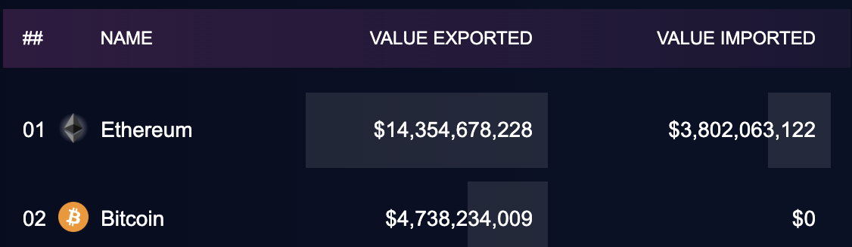
Activity
https://cryptoflows.info/
Notes:
https://cryptoflows.info/

Slide 20

Primarily two types of messaging systems
(2) On-chain verified: chain T verifies block header of chain S
send messages D[] to relayerT,
along with finalized
block header on chain S,
and consensus data
verify and dispatch
receive msgs
Source
Chain S
Target
Chain T
relayerS
relayerT
oracle
no trustees
relayerT runs a light-client for chain S to verify
that relayerS received messages D[]
assumes security of light client
Notes:
Oracle is not really trusted because it is only relaying *finalized* blocks.

Slide 21
Primarily two types of messaging systems
SNARK prover
(proof of state on chain S)
verify SNARK proof and dispatch
msgs D[]
receive msgs
D[], BH, proof
Source
Chain S
Target
Chain T
relayerS
relayerT
chain S block header (BH)
and consensus data
oracle
Problem: high gas costs on chain T to verify state of source chain S.
Solution: zkBridge: use SNARK to reduce work for relayerT
Notes:
Oracle is not really trusted because it is only relaying *finalized* blocks.

Slide 22
Primarily two types of messaging systems
SNARK prover
(proof of state on chain S)
verify SNARK proof and dispatch
msgs D[]
receive msgs
D[], BH, proof
Source
Chain S
Target
Chain T
relayerS
relayerT
chain S block header (BH)
and consensus data
oracle
This is called a “proof-of-consensus”
Notes:
Third type of messaging system: optimistic bridges (using fraud proofs) as implemented by Nomad.

Slide 23
Bridging: the future vision
User can hold assets on any chain
Assets move cheaply and quickly from chain to chain
A project’s liquidity is available on all chains
Users and projects choose the chain that is best suited for their application and asset type
We are not there yet …

Slide 24
Post-Quantum Blockchains

Slide 25
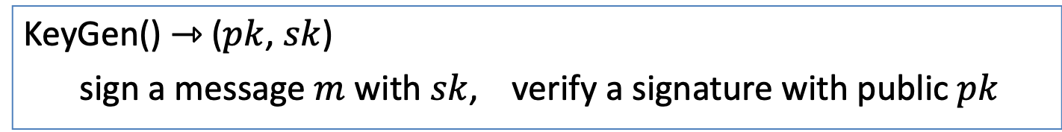
Recall: signature schemes
KeyGen() ⇾ ($pk$, $sk$)
sign a message $m$ with $sk$, verify a signature with public $pk$
What signatures schemes are used in practice:
Bitcoin uses ECDSA and Schnorr to sign Tx
… but UTXO may only reveal Hash(pk)
Ethereum uses ECDSA for native ETH, and BLS for PoS consensus
Solana uses EdDSA (a variant of Schnorr)

Slide 26

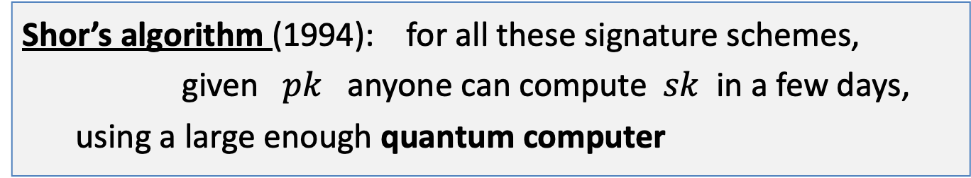
The quantum threat
Shor’s algorithm (1994): for all these signature schemes,
given $pk$ anyone can compute $sk$ in a few days,
using a large enough quantum computer
What is large enough? Quite large (compared to what we have today)
When is Q-day? 🤷‍♀️ (lots of guesses on )
(Is a quantum computer good for anything else?)

Slide 27
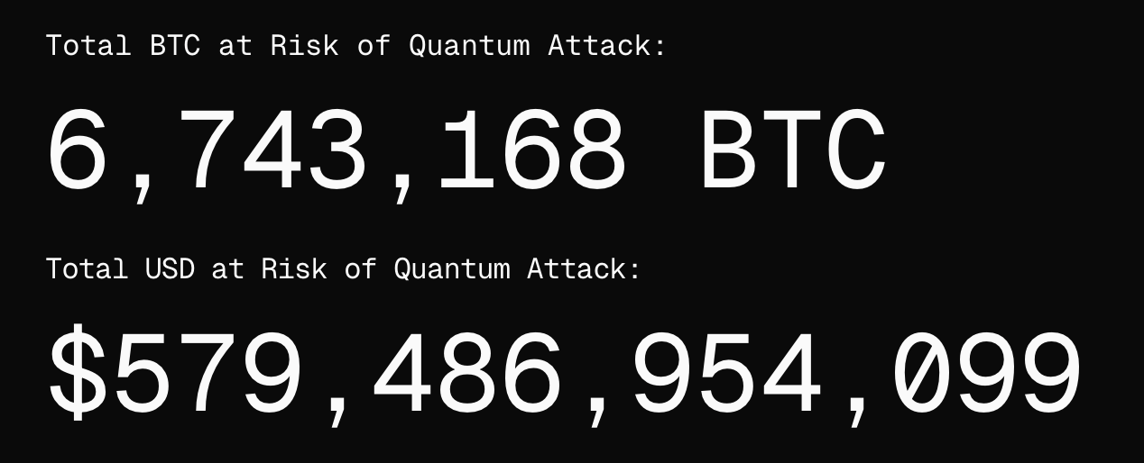
What is at stake?
… also Proof-of-Stake consensus, if validator signing keys are exposed
https://www.projecteleven.com/bitcoin-risq-list

Slide 28
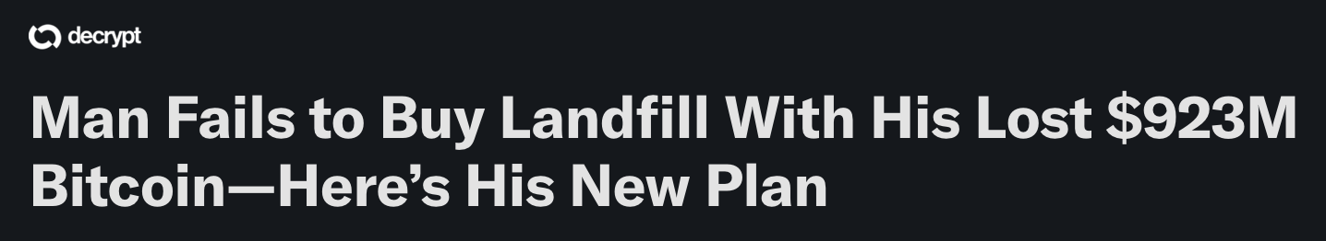
The risks …
What if a rogue nation is the first to develop a large QC?
What if whoever builds a QC steals the Bitcoin and dumps it all?
⇒ will collapse the price of Bitcoin
The positive: people who lost their keys, can get their coins back
(8000 BTC)

Slide 29

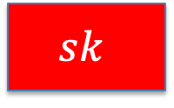
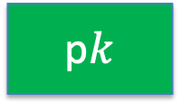
What to do?
The “lucky” EdDSA trick:
seed
$$H(∙)$$
$$sk$$
p$k$
EdDSA KeyGen:
Idea: once a QC is imminent, blockchain rejects EdDSA sigs by sk
Instead: to sign a Tx, user provides a SNARK proof that it knows
a hash preimage of sk (such a proof can be made into a signature)

Slide 30
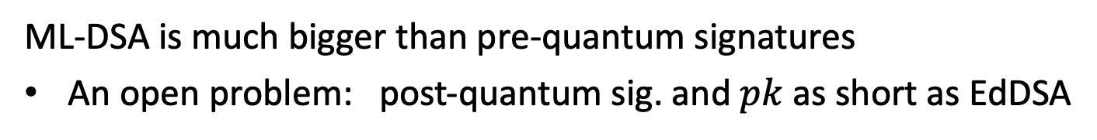
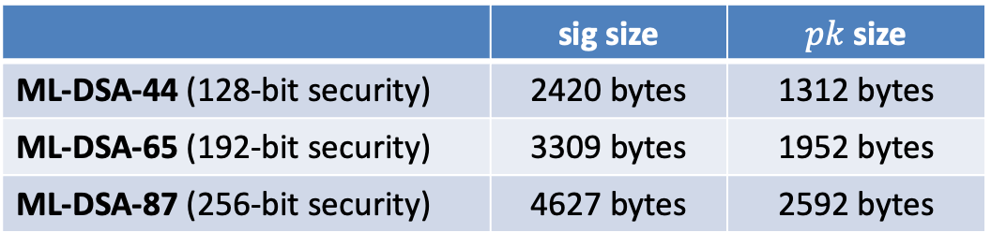
What to do? The NIST sig. standards
ML-DSA: a signature scheme that remains secure even if adversary has a large QC (as far a we know)
 | sig size | $pk$ size
ML-DSA-44 (128-bit security) | 2420 bytes | 1312 bytes
ML-DSA-65 (192-bit security) | 3309 bytes | 1952 bytes
ML-DSA-87 (256-bit security) | 4627 bytes | 2592 bytes
EdDSA
48 bytes
32 bytes
ML-DSA is much bigger than pre-quantum signatures
An open problem: post-quantum sig. and $pk$ as short as EdDSA

Slide 31
Exciting times ahead
Moving blockchains to a post-quantum signature scheme
⇒ Everyone (the entire world) will need to update their accounts:
On Bitcoin: move to a new address (BIP-360)
On Ethereum: move all funds to an on-chain wallet (AA)
  Can be done with a single transaction using EIP-7702
  Requires Ethereum to deprecate EOA signing after a flag day
On Aptos: update the authorization key for your account
⋯

Slide 32
What happens to people who don’t update?
Option 1: nothing, until a large Quantum Computer is built
Option 2: introduce a flag date, after which all pre-quantum addresses are canceled
Which option will Bitcoin take?
Probably fork: one fork with option (1) and another with (2)
Let the market choose which fork to assign value to
… not hard to guess which fork will be chosen

Slide 33
Blockchain Governance (DAOs)

Slide 34


Decentralized Orgs (DAO)
What is a DAO?
A Dapp deployed on-chain at a specific address
Anyone (globally) can send funds to DAO treasury
Anyone can submit a proposal to DAO
⟹ participants vote
⟹ approved ⇾ proposal executes
snapshot.org
Notes:
Movie studio DAO: participants decide what movie scripts to fund, and then share in profits from movie.
SafeSnap: uses Reality.eth to implement an oracle that pushes vote results on-chain.

Slide 35
Examples of DAOs
Collector DAOs: PleasrDAO, flamingoDAO, ConstitutionDAO, …
(see art collection at https://gallery.so/pleasrdao )
  PleasrDAO: 103 members.
      Manages a treasury, has full time employees.
      Deliberations over what to acquire over telegram.

Slide 36
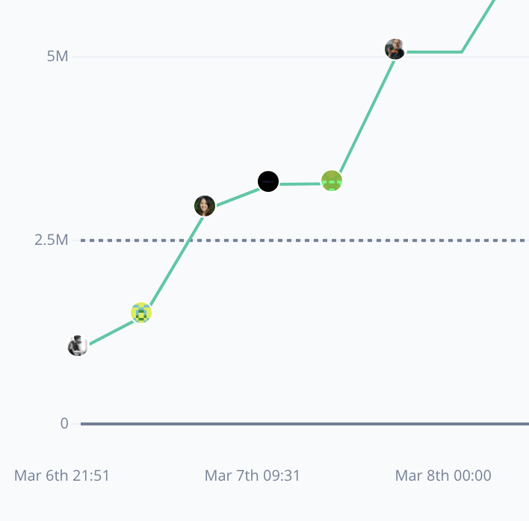
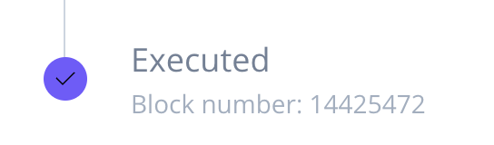
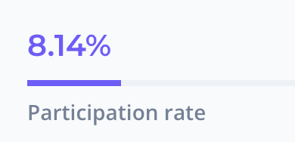
Examples of DAOs
Collector DAOs: PleasrDAO, flamingoDAO, ConstitutionDAO, …
Grants DAOs: gitcoin (83K members), …
Proposal ID 21: This proposal looks to ratify the allocation of 30,000 GTC from
the Community Treasury to the MMM workstream.
(tally.com)
Notes:
MMM: Merch Memes Marketing

Slide 37
Examples of DAOs
Collector DAOs: PleasrDAO, flamingoDAO, ConstitutionDAO, …
Grants DAOs: gitcoin, …
Protocol DAOs: manages operation of a specific protocol
Uniswap DAO (74K), Compound DAO (8K), …
Social DAOs: FWB, …
Investment DAOs: many

Slide 38
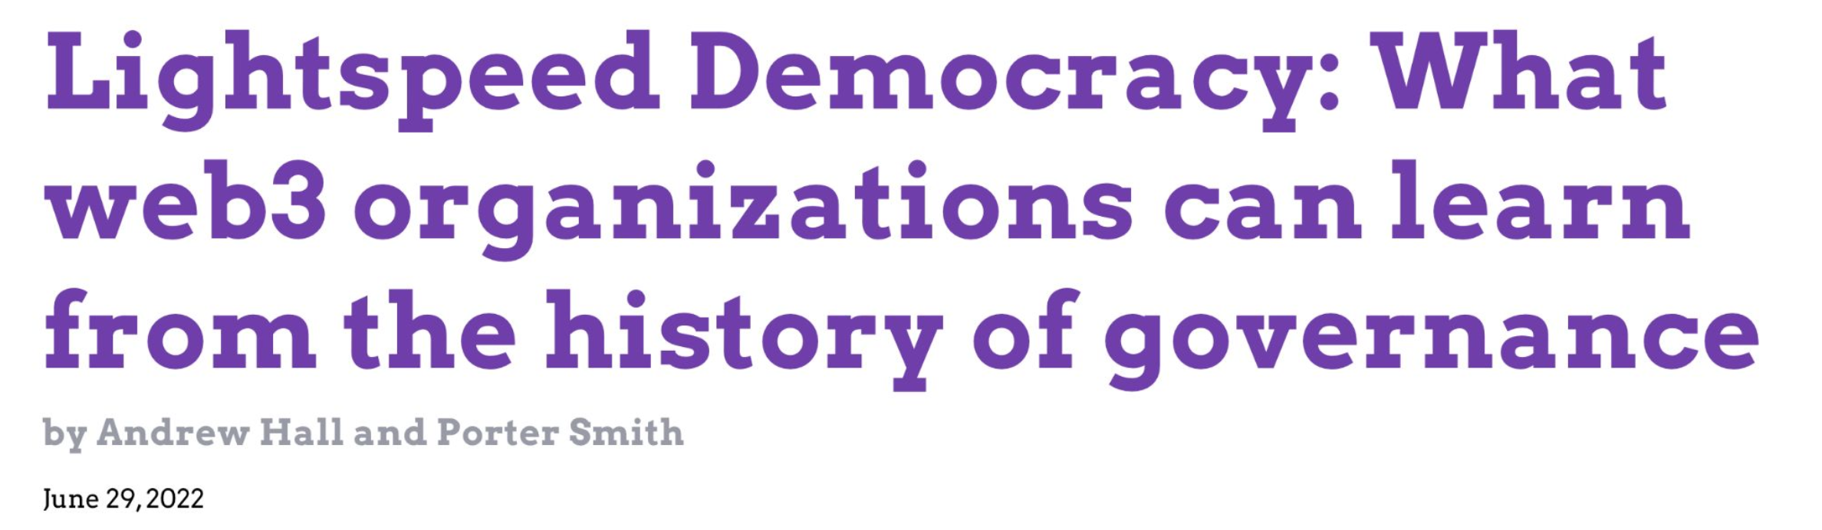
Many DAO governance experiments
Who can vote? How to vote? What voting mechanism?
DAOs: a platform for experimenting with governance mechanisms

Slide 39
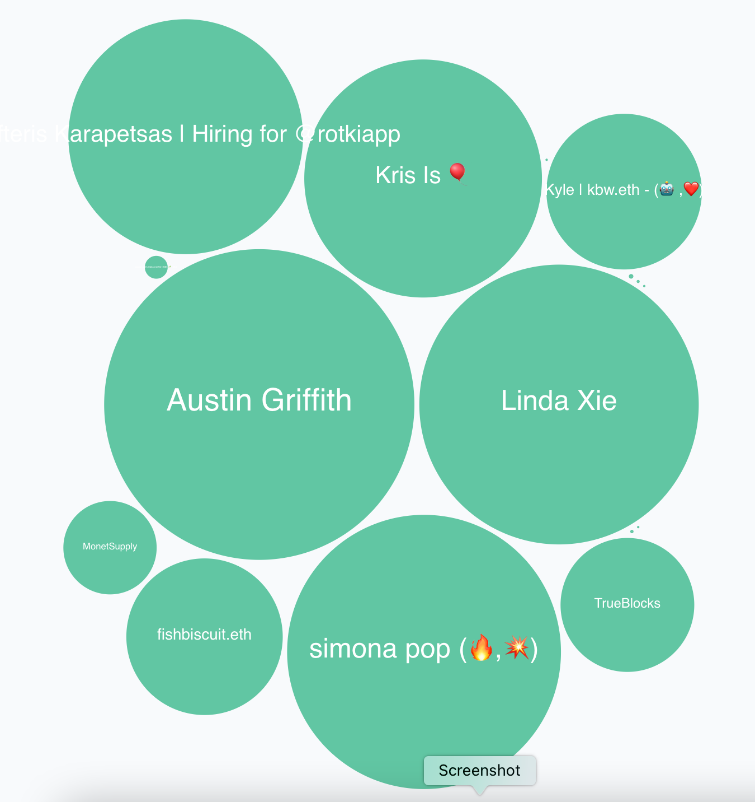
Governance method
One token one vote: (most common)
Members receive tokens based on their contribution
Everyone can vote
In reality: low participation rate (8%)
⇒ delegation
proposal 21 (tally.com)

Slide 40
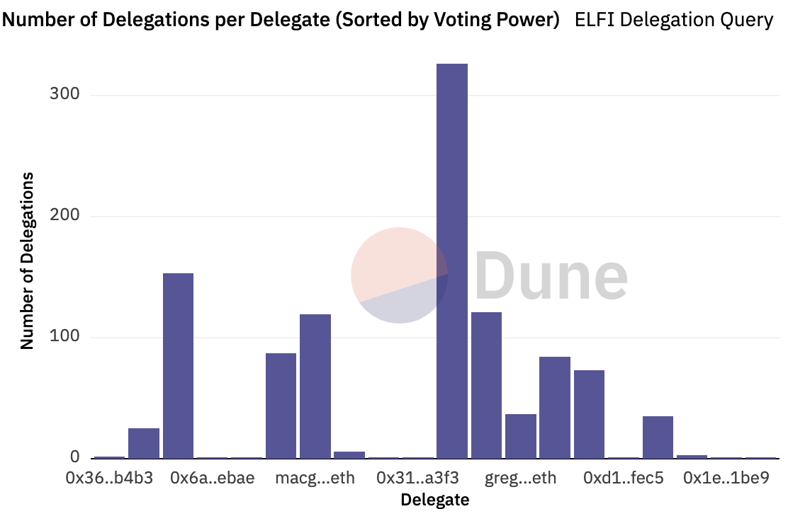
Delegation example: element
≈300 addresses
delegated tokens
to this address

Slide 41
Governor Bravo
Governor alpha (Jan. 2020) updated to Bravo (March 2021):
A collection of smart contracts used for governance
Forked and used by many other protocols
Other alternatives:
OpenZeppelin Governor protocol
Notes:
https://docs.compound.finance/v2/governance/#governance
Bravo: supports updating protocol global parameters (in three slides). Alpha fixed them.

Slide 42
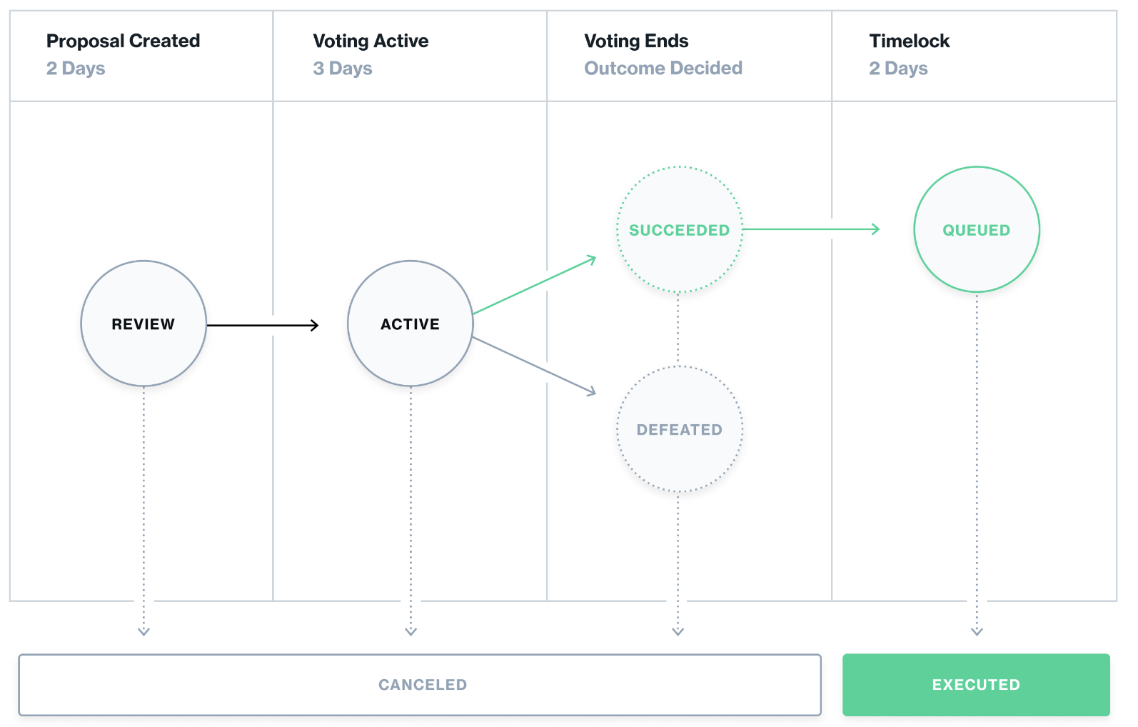
The life cycle of a proposal

Slide 43
Governor Bravo
Implements an ERC-20 governance token. Let’s call it GOV.
An address that owns GOV tokens can vote on proposals
0: against
1: in favor
2: abstain
The proposal I am voting for
(with all my allotted voting tokens)
function castVote(uint proposalID, uint8 support)
(cannot vote partially)
Notes:
Voter can re-delegate to move tokens to someone else.

Slide 44
Governor Bravo
Implements an ERC-20 governance token. Let’s call it GOV.
… or delegate its GOV tokens to another address
delegate all my voting tokens
function delegate(address delegatee)
can re-delegate at any time by calling function again
An address can only delegate all its tokens to one address at a time
… but I can hold my GOV tokens at multiple addresses
Notes:
Voter can re-delegate to move tokens to someone else.

Slide 45
Creating a proposal
The function to call on governor contract
function propose(
address[] targets,
uint[] values,
string[] signatures,
bytes[] calldatas,
string description) // proposal description
returns (uint)
If proposal passes,
how to execute it:
what functions to call (actions)
and with what arguments
(human readable)
The ID of newly created proposal

Slide 46
Global contract parameters
quorumVotes: the minimum # of votes for a proposal to pass
proposalThreshold: min # votes needed to create a proposal
votingDelay: # blocks to wait until voting can begin after a proposal is created (e.g., two days)
votingPeriod: # blocks when voting is open (e.g., three days)
All these parameters can be changed by governance in Bravo

Slide 47
Proposal execution
Once proposal gets enough votes and delays expire:
anyone can call: function execute(uint proposalID)
⇒ prescribed functions in proposal get called

Slide 48
The limits of democracy
Anytime before execution
“guardian” can call cancel() to cancel a proposal
Who is this guardian??
set at Governor contract creation time
can abdicate at any time by calling _abdicate()

Slide 49
DAO privacy questions
Private DAO participation: keep membership list private
Private voting: keep who voted how on each proposal private
Privately delegate voting rights
Private treasury
… while complying with all relevant laws.

Slide 50
Some DAOs made mistakes and were attacked
Attack on Beanstalk governance: $182M
Attack on Yam Finance governance: thwarted
Attack on Build Finance governance $1.5M
Attack on Mango governance: $115M
Steem governance drama
What happened? What can we learn?

Slide 51
(1) Beanstalk (Apr. 2022)
An Ethereum-based stablecoin Bean. Governance token Stalk.
The problem:
an attacker can buy Stalk tokens,
submit a proposal,
vote on proposal, and
have proposal execute
all in a single
transaction

Slide 52
Beanstalk: the attack
Recall: flashloan (has many applications)
a loan that is taken out and repaid back in a single transaction
No risk to lender ⇒ unbounded amount can be borrowed
The attack:
Attacker took a huge flashloan from Aave, bought lots of Stalk,
Passed a proposal to pay $80M to the attacker from the treasury,
Sold the Stalk, and repaid the flashloan,
Sent the proceeds to Tornado cash (donated $250K to Ukraine)

Slide 53
The lesson
The protocol relaunched four months later.
The lesson: governance requires delays
Require token holders to hold token for a long period of time
Build a delay between proposal genesis, voting, and execution

Slide 54
(2) Yam Finance (July 2022)
A DeFi project running on Ethereum. Governed token YAM.
What happened? (within a single day)
Attacker bought 224739 YAM with borrowed funds
Attacker submitted a governance proposal
granting it control of project reserves ($3M USD)
Voted on proposal with borrowed 224739 YAM, hitting quorum
Borrowed YAM exchanged for Eth and paid back

Slide 55
What happened next?
Yam Finance team: noticed the proposal shortly after it hit quorum
⇒ retained cancel power, and canceled the proposal.
Lesson:
Illustrates the positive power of a veto
The problem: power can never be taken away
(unless voluntarily given away)

Slide 56
END OF LECTURE
Next lecture: super cool final guest lecture
Notes:
Olaf

Slide 57
Account abstraction
… as designed in ERC-4337

Slide 58
The Goals of Account Abstraction (AA)
Recall: an asset held in an Externally Owned Account (EOA) is completely controlled by the EOA’s signing key
What if I want two keys to control the asset? Or rate limits? …
Two primary goals for AA:
Goal 1: arbitrary complex policies for controlling an asset
Goal 2: a 3rd party (bundler, paymaster) pays Tx gas for users
⇒ improves user experience – no need to get ETH
⇒ asset canot be held by an EOA

Slide 59
Assets are held by a smart contract wallet
on chain
dApp
off chain
on chain
pays gas
Tx
Alice’s assets: X, Y, Z
call
Uniswap
UserOp
Alice
Bundler
(relay)
contract Wallet {
function execOp(
UserOperation op);
}
UserOperation:
  address sender,
  bytes callData, // args for dApp
  bytes signature,
  bytes nonce, // anti-replay
  …
smart contract
wallet (sender)

Slide 60
Smart contract wallet
on chain
dApp
off chain
on chain
pays gas
Tx
assets: X, Y, Z
call
Uniswap
UserOp
Alice
Bundler
(relay)
contract Wallet {
function execOp(
UserOperation op);
}
Problems:
How to reimburse the bundler for the gas it paid?
Bundler doesn’t want to call (potentially malicious) wallet code
UserOperation:
  address sender,
  bytes callData, // args for dApp
  bytes signature,
  bytes nonce, // anti-replay
  …
smart contract
wallet (sender)

Slide 61
The EntryPoint trusted contract
off chain
on chain
deposit
max
gas fees
assets: X, Y, Z
Tx
UserOp
call
UserOp
Alice
contract Wallet {
function execOp(
UserOperation op);
}
gas
fees
execOp
UserOp
Bundler
(relay)
EntryPoint
contract
smart contract
wallet (sender)
0x5FF137D4b0FDCD49 …
Notes:
The Bundler does not want to call untrusted code. Instead, it calls the trusted EntryPoint contract.
EntryPoint contract lives at 0x5FF137D4b0FDCD49DcA30c7CF57E578a026d2789

Slide 62
The EntryPoint trusted contract
off chain
on chain
deposit
max
gas fees
assets: X, Y, Z
Tx
UserOp
call
UserOp
Alice
contract Wallet {
function execOp(
UserOperation op);
}
gas
fees
execOp
UserOp
Bundler
(relay)
More problems:
DoS: Anyone can issue invalid UserOp (e.g., with a bad sig)
to EntryPoint, causing Wallet to keep paying gas to bundler.
EntryPoint
contract
smart contract
wallet (sender)
0x5FF137D4b0FDCD49 …
Notes:
The Bundler does not want to call untrusted code. Instead, it calls the trusted EntryPoint contract.
EntryPoint contract lives at 0x5FF137D4b0FDCD49DcA30c7CF57E578a026d2789

Slide 63
Solution: validateOp
off chain
on chain
deposit
max
gas fees
Tx
assets: X, Y, Z
UserOp
call
UserOp
Alice
validateOp
UserOp
contract Wallet {
function ValidateOp(
UserOperation op);
function execOp(
UserOperation op);
}
gas
fees
Bundler
(relay)
execOp
UserOp
EntryPoint
contract
smart contract
wallet (sender)
Notes:
The Bundler does not want to call untrusted code. Instead, it calls the trusted EntryPoint contract.
EntryPoint contract lives at 0x5FF137D4b0FDCD49DcA30c7CF57E578a026d2789

Slide 64
Solution: validateOp
off chain
on chain
deposit
max
gas fees
Tx
assets: X, Y, Z
UserOp
call
UserOp
Alice
validateOp
UserOp
contract Wallet {
function ValidateOp(
UserOperation op);
function execOp(
UserOperation op);
}
gas
fees
Bundler
(relay)
EntryPoint steps: (simplified)
  step 1: call validateOp(UserOp)
  step 2: if fail, stop and Bundler pays the gas
  step 3: call ExecOp(UserOp), and Wallet reimburses Bundler for gas
execOp
UserOp
EntryPoint
contract
smart contract
wallet (sender)
Notes:
The Bundler does not want to call untrusted code. Instead, it calls the trusted EntryPoint contract.
EntryPoint contract lives at 0x5FF137D4b0FDCD49DcA30c7CF57E578a026d2789

Slide 65
More problems …
1. Need to ensure that Wallet does not execute op in validateOp
⇒ Bundler will be stuck with execution fees
2. Before issuing Tx, Bundler needs to run validateOp in its head
(a.k.a simulates validateOp) to ensure that UserOp is valid
⇒ need to ensure that simulation and on-chain execution of validateOp produce the same output
Solution: validateOp is restricted in what EVM opcodes it can use
[execOp is not restricted because Wallet is paying gas fees]
Notes:
The reason for (2): without simulation, Bundler might submit an invalid UserOp and get stuck with gas fees.
A malicious validateOp could use TIMESTAMP or BLOCKHASH to behave differently in simulation and during real on-chain execution.
validateOp can only access its own Wallet storage, or another contract’s storage at its wallet address in an [address=>value mapping].

Slide 66
Bundling and Paymasters
off chain
on chain
Alice
Wallet
call
one Tx
UserOp
UserOps[]
Bob
Wallet
call
UserOp
gas
fees
Carol
Wallet
call
UserOp
EntryPoint
contract
Bundler
(relay)
Paymaster:
function AgreeToPay(
UserOperation op);
As usual, Users pay Bundler a fee to be placed in Tx
Notes:
Every wallet and Paymaster maintains a balance with the EntryPoint contract.
Bundler runs a mempool and sequences UserOps into a Tx. Bundless collects EIP1559 style fees, along with MEV for sequencing.

Slide 67
Very complex … is this real?
Bundler’s already exists, such as Pimlico
Simple Tx now consume a lot of gas:
  Simple ETH transfer from Alice⇾Bob: 4X more expensive
  ERC20 transfer from Alice⇾Bob: 2X more expensive
  Recall: gas on L2 is not as expensive as gas on Ethereum
Main reason for adoption:
Can be deployed now with no changes to dApps !!

Slide 68
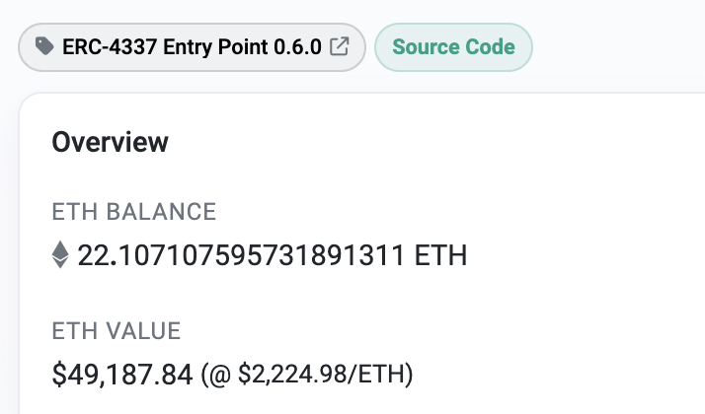
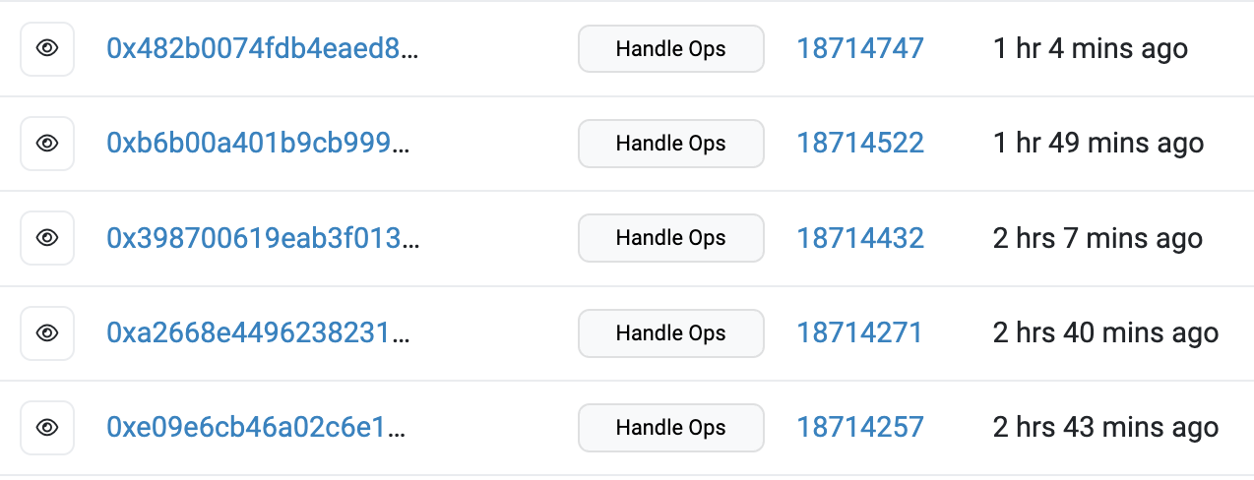
An example
The EntryPoint contract
on Ethereum
Some Tx from bundlers

Slide 69
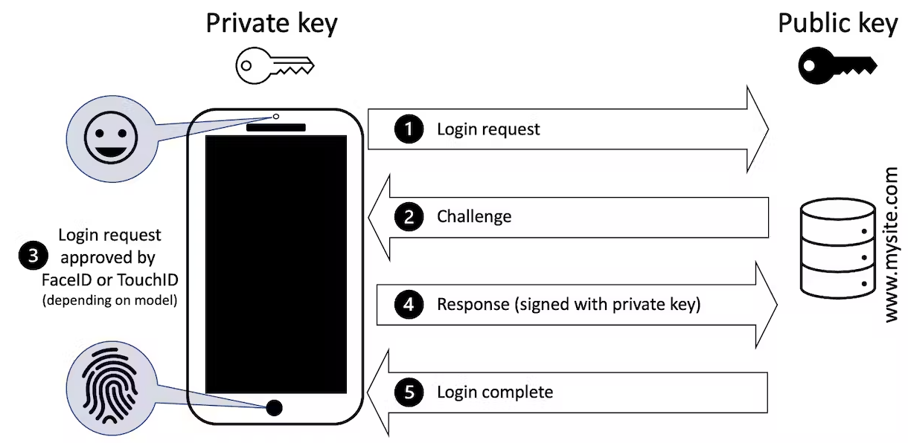
An interesting application of AA: Passkey Tx
User authenticates Tx to
AA wallet using TouchID
Good user experience:
Signing key is backed up
to iCloud
Signing key is available
on all user devices
The challenge: Passkeys uses sig. scheme not supported in the EVM
⇒ need to use a SNARK to prove valid sig to on-chain wallet.

Slide 70
Fun crypto tricks

Slide 71
BLS signatures
one Bitcoin block
inputs
outputs
Signatures make up
most of Tx data.
Can we compress
signatures?
Yes: aggregation!
not possible for ECDSA
Tx1:
sig
sig
sig
Tx2:
sig
sig
sig
sig
Tx3:
sig
sig
Tx4:
sig
sig
sig

Slide 72
BLS Signatures
Used in modern blockchains: Ehtereum 2.0, Dfinity, Chia, etc.
The setup:
G = {1, g, …, g^{q-1}} a cyclic group of prime order q
H: M × G ⇾ G a hash function (e.g., based on SHA256)

Slide 73
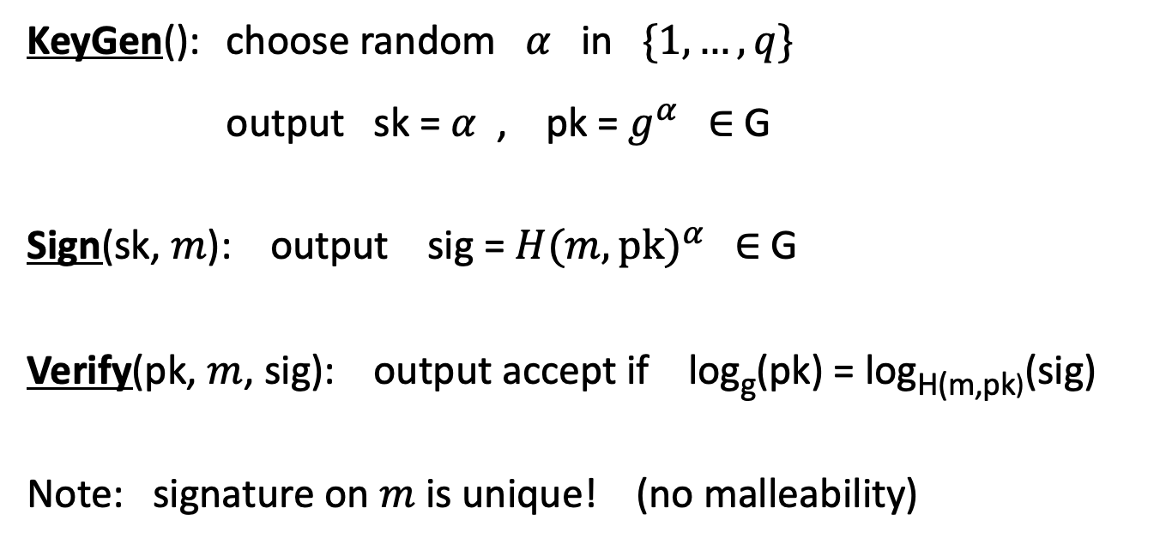
BLS Signatures
KeyGen(): choose random $α$ in $\{1, …, q\}$
output sk = $α$ , pk = $g^{α}$ ∈ G
Sign(sk, $m$): output sig = ${H(m,pk)}^{α}$ ∈ G
Verify(pk, $m$, sig): output accept if log_{g}(pk) = log_{H(m,pk)}(sig)
Note: signature on $m$ is unique! (no malleability)

Slide 74
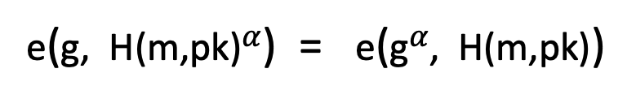
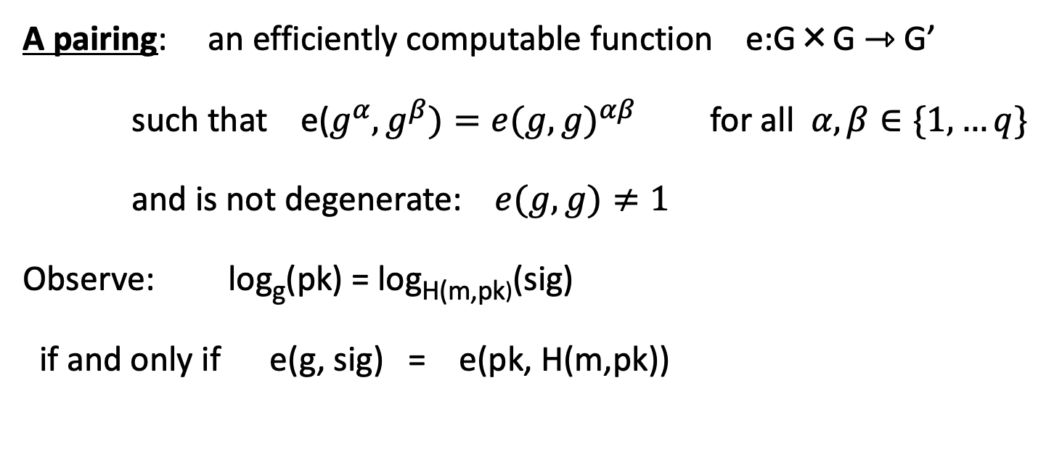
How does verify work?
A pairing: an efficiently computable function e:G×G ⇾ G’
such that e($g^{α},g^{β})={e(g,g)}^{αβ}$ for all $α,β∈\{1,…q\}$
and is not degenerate: $e(g, g)≠1$
Observe: log_{g}(pk) = log_{H(m,pk)}(sig)
if and only if e(g, sig) = e(pk, H(m,pk))
verify test
=
=
e(g, H(m,pk)$α$) = e(g$α$, H(m,pk))

Slide 75
Properties: signature aggregation [BGLS’03]
Anyone can compress n signatures into one
Verify( pk , m , σ* ) = “accept”
convinces verifier that
for i=1,…,n:
user i signed msg m_{i}
pk₁ , m₁ ⟶ σ₁
⋮
aggregate
⟶ σ*
pk_{n} , m_{n} ⟶ σ_{n}
single short signature

Slide 76
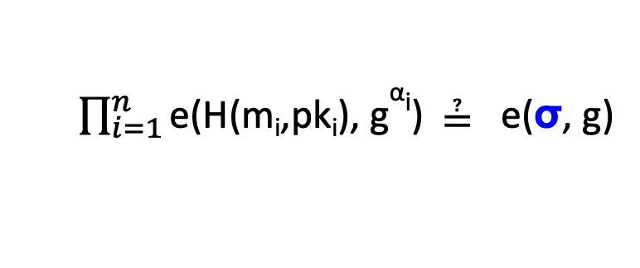
Aggregation: how
user 1: pk₁ = g^{α1} , m₁ ⟶ σ₁=H(m₁,pk₁)^{α1}
σ ⟵ σ₁⋯ σ_{n}
user n: pk_{n} = g^{αn} , m_{n} ⟶ σ_{n}=H(m_{n},pk_{n})^{αn}
Verifying an aggregate signature: (incomplete)
  $\prod_{i=1}^{n}{\text{e}\text{(}\text{H}\text{(}\text{mi}\text{,}\text{pki}\text{), }\text{g}\text{α}\text{i}\text{)}}$ ≟ e(σ, g)
=
=
Π_{i=1} e(H(m_{i},pk_{i})^{αi}, g) = e(Π_{i=1}H(m_{i},pk_{i})^{αi}, g)

Slide 77
Compressing the blockchain with BLS
one Bitcoin block
if needed:
compress all signatures in a block into a single aggregate signatures
⇒ shrink block
or: aggregate in smaller batches
inputs
outputs
sig*
Tx1:
sig
sig
sig
Tx2:
sig
sig
sig
sig
Tx3:
sig
sig
Tx4:
sig
sig
sig

Slide 78
Taproot: semi-private scripts in Bitcoin

Slide 79
Script privacy
Currently: Bitcoin scripts must be fully revealed in spending Tx
Can we keep the script secret?
Answer: Yes, easily! when all goes well …

Slide 80
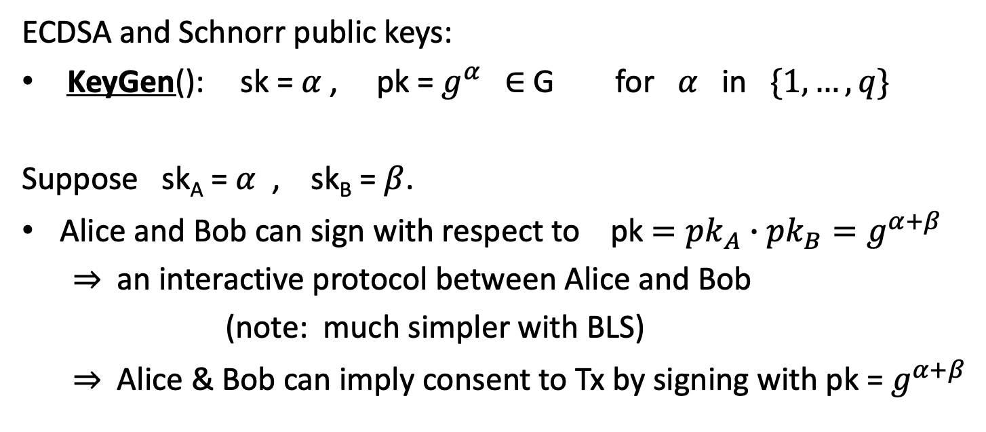
How?
ECDSA and Schnorr public keys:
KeyGen(): sk = $α$ , pk = $g^{α}$ ∈ G for $α$ in $\{1, …, q\}$
Suppose sk_{A} = $α$ , sk_{B} = $β$.
Alice and Bob can sign with respect to pk $={pk}_{A}∙{pk}_{B}=g^{α+β}$
⇒ an interactive protocol between Alice and Bob
(note: much simpler with BLS)
⇒ Alice & Bob can imply consent to Tx by signing with pk = $g^{α+β}$

Slide 81
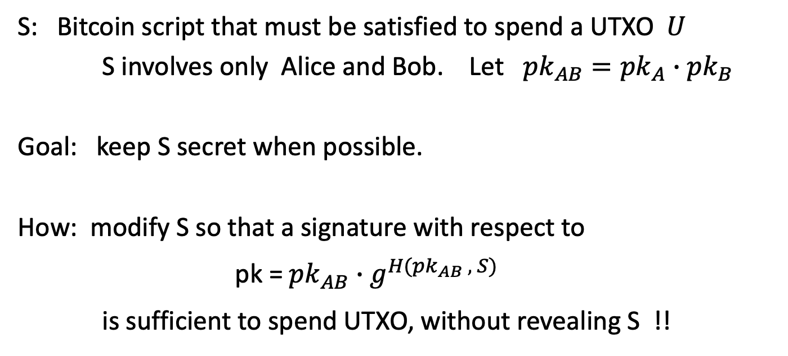
How?
S: Bitcoin script that must be satisfied to spend a UTXO $U$
S involves only Alice and Bob. Let ${pk}_{AB}={pk}_{A}∙{pk}_{B}$
Goal: keep S secret when possible.
How: modify S so that a signature with respect to
pk =${pk}_{AB}∙$ $g^{H({pk}_{AB} , S)}$
is sufficient to spend UTXO, without revealing S !!

Slide 82
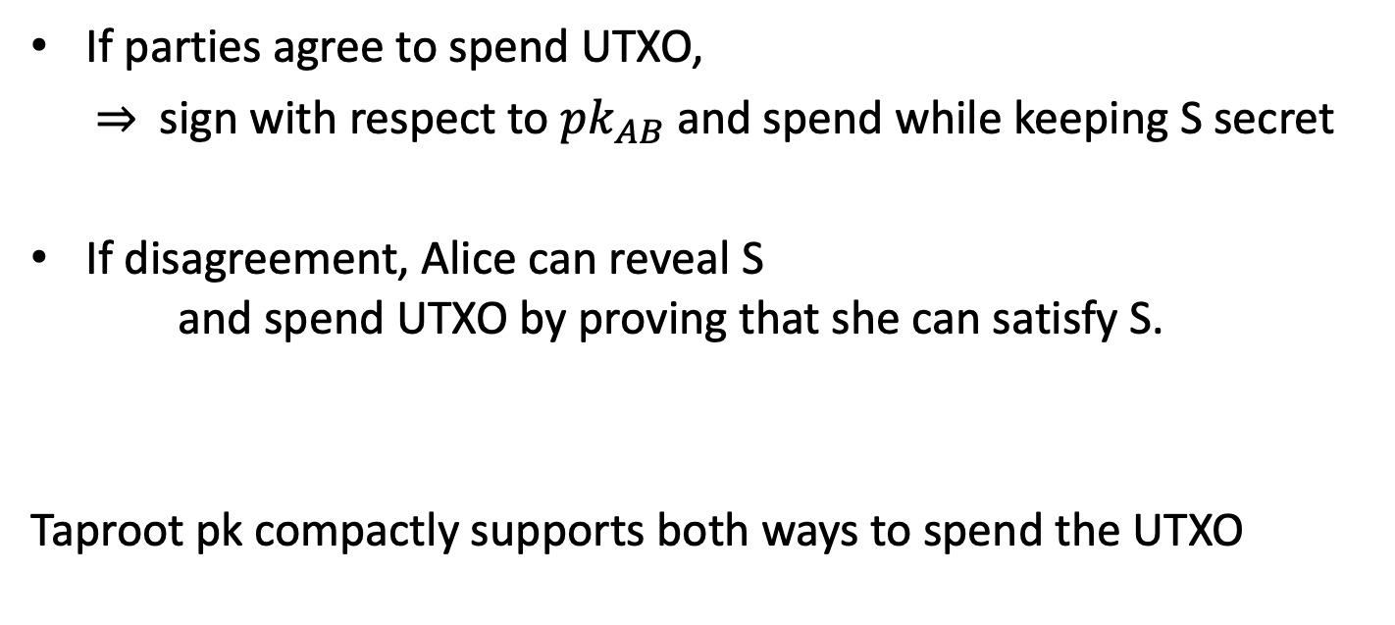
The main point
If parties agree to spend UTXO,
  ⇒ sign with respect to ${pk}_{AB}$ and spend while keeping S secret
If disagreement, Alice can reveal S
and spend UTXO by proving that she can satisfy S.
Taproot pk compactly supports both ways to spend the UTXO

