Slide 1
Scaling the blockchain part II:
Rollups
CS251 Fall 2025
(cs251.stanford.edu)
Dan Boneh

Slide 2
Scaling the blockchain: the problem
Transaction rates (Tx/sec):
Bitcoin: can process about 7 (Tx/sec)
Ethereum: can process about 15 (Tx/sec)
The visa network: can process up to 24,000 (Tx/sec)
Tx Fees fluctuate:
2$ to 60$ for simple Tx
Can we scale blockchains to visa speeds? … with low Tx fees

Slide 3
How to process more Tx per second
Many ideas:
Use a faster consensus protocol
Parallelize: split the chain into independent shards
Today: Rollups, move the work somewhere else
Payment channels: reduce the need to touch the chain
  Requires locking up funds; mostly designed for payments.
reduces
composability

Slide 4
Recall: a basic layer-1 blockchain
A layer-1 blockchain
(e.g., Ethereum)
Can handle 15 Tx/sec …
current world state
Tx_{A}
updated world state
Tx_{B}
⋮
updated world state
World state: balances, storage, etc.

Slide 5
Rollup idea 1: batch many Tx into one
updated Rollup state root, and Tx list
A layer-1 blockchain
(e.g., Ethereum)
Rollup
coordinator
Tx_{A}
current world state
(Rollup state Merkle root)
Tx_{B}
(Tx list)
Tx_{C}
updated world state
(updated Rollup state root)
Rollup state:
Alice’s balance
Bob’s balance
…

Slide 6
Rollup idea 1: batch many Tx into one
A layer-1 blockchain
(e.g., Ethereum)
Key point:
Hundreds of transactions
on Rollup state are batched into
a single transaction on layer-1
⇒ 100x speed up in Tx/sec
Let’s see how …
current world state
(Rollup state Merkle root)
(Tx list)
updated world state
(updated Rollup state root)
Rollup state:
Alice’s balance
Bob’s balance
…

Slide 7


Rollup operation (simplified)
Rollup coordinator
[A⇾B: 2 ETH], ${sig}_{A}$
Layer 1 blockchain
(e.g. Ethereum)
atomic swap:
[B⇾Z: 1 ETH]
[Z⇾B: 2 USDC]
Rollup state root
block 354
$${sig}_{B} {sig}_{Z}$$
Merkle Tree
Alice:
5 DAI
3 ETH
Bob:
2 ETH
Zoe:
1 ETH
3 USDC
Tx
…

Slide 8
Rollup operation (simplified)
Rollup coordinator
[A⇾B: 2 ETH], ${sig}_{A}$
Layer 1 blockchain
(e.g. Ethereum)
atomic swap:
[B⇾Z: 1 ETH]
[Z⇾B: 2 USDC]
new Rollup root
block 354
new root, Tx list
$${sig}_{B} {sig}_{Z}$$
Merkle Tree
block 361
Alice:
5 DAI
1 ETH
Bob:
3 ETH
2 USDC
Zoe:
2 ETH
1 USDC
Tx
…

Slide 9
In more detail
Rollup contract on
layer-1 holds assets
of all Rollup accounts
(and Merkle state root)
Rollup state (L2)
Alice:
4 ETH, 1 DAI
Bob:
3 ETH, 2 DAI
…
(coordinator stores state)
Alice:
state
Bob:
state
Uniswap:
state
Rollup contract:
root
…
7 ETH, 3 DAI,
Layer-1 blockchain (L1)

Slide 10

Transfers inside Rollup are easy (L2 ⇾ L2)
Rollup state (L2)
[A⇾B: 2 ETH], ${sig}_{A}$
Alice:
4 ETH, 1 DAI
Bob:
3 ETH, 2 DAI
…
(with hundreds of Tx)
Alice:
state
Bob:
state
Uniswap:
state
Rollup contract:
…
7 ETH, 3 DAI,
root
Layer-1 blockchain (L1)
Notes:
Tx summary recorded on L1 chain as calldata into Rollup contract.

Slide 11
Transfers inside Rollup are easy (L2 ⇾ L2)
Coordinator updates root on Rollup contract
Rollup state (L2)
[A⇾B: 2 ETH], ${sig}_{A}$
Alice:
2 ETH, 1 DAI
Bob:
5 ETH, 2 DAI
…
(with hundreds of Tx)
new Merkle root,
Tx list
Alice:
state
Bob:
state
Uniswap:
state
Rollup contract:
…
7 ETH, 3 DAI,
root
Layer-1 blockchain (L1)
Notes:
Tx summary recorded on L1 chain as calldata into Rollup contract.

Slide 12
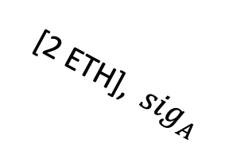
Transferring funds into Rollup (L1 ⇾ L2)
Alice issues an L1 Tx: slow and expensive
Rollup state (L2)
Alice:
2 ETH, 1 DAI
Bob:
5 ETH, 2 DAI
…
[2 ETH], ${sig}_{A}$
Alice:
state
Bob:
state
Uniswap:
state
Rollup contract:
…
7 ETH, 3 DAI,
root
2 ETH
Layer-1 blockchain (L1)

Slide 13
Transferring funds into Rollup (L1 ⇾ L2)
Alice issues an L1 Tx: slow and expensive
Rollup state (L2)
Alice:
4 ETH, 1 DAI
Bob:
5 ETH, 2 DAI
…
[2 ETH], ${sig}_{A}$
new Merkle root,
Tx list
Alice:
state
Bob:
state
Uniswap:
state
Rollup contract:
…
9 ETH, 3 DAI,
root
2 ETH
Layer-1 blockchain (L1)

Slide 14

Transferring funds out of Rollup (L2 ⇾ L1)
Requires extra gas on L1 to process transfer
Rollup state
[withdraw 4 ETH], ${sig}_{A}$
Alice:
4 ETH, 1 DAI
Bob:
5 ETH, 2 DAI
…
(plus hundreds of Tx)
Alice:
state
Bob:
state
Uniswap:
state
Rollup contract:
…
9 ETH, 3 DAI,
root
Layer-1 blockchain (L1)

Slide 15
Transferring funds out of Rollup (L2 ⇾ L1)
Requires extra gas on L1 to process transfer
Rollup state
[withdraw 4 ETH], ${sig}_{A}$
Alice:
0 ETH, 1 DAI
Bob:
5 ETH, 2 DAI
…
(plus hundreds of Tx)
new Merkle root,
Tx list
Alice:
state
Bob:
state
Uniswap:
state
Rollup contract:
…
5 ETH, 3 DAI,
root
4 ETH
Layer-1 blockchain (L1)

Slide 16
Summary: transferring Rollup assets
Transactions within a Rollup are easy:
Batch settlement on L1 network (e.g., Ethereum)
Moving funds into or out of Rollup system (L1 ⟺ L2) is expensive:
Requires posting more data on L1 network ⟹ higher Tx fees.
Moving funds from one Rollup system to another (L2 ⟺ L2)
Either via L1 network (expensive),
or via a direct L2 ⟺ L2 bridge (cheap)

Slide 17
Running contracts on a Rollup?
Two copies of Uniswap
Rollup state (L2)
Alice:
4 ETH, 1 DAI
Bob:
3 ETH, 2 DAI
…
⇒ Rollup users can cheaply interact with Uniswap on Rollup
Bob:
state
Uniswap:
state
Rollup contract:
root
Alice:
state
Uniswap:
state
…
7 ETH, 3 DAI,
Layer-1 blockchain (L1)

Slide 18
Running contracts on a Rollup?
Rollup state (L2)
Uniswap:
state
Alice:
4 ETH, 1 DAI
Bob:
3 ETH, 2 DAI
…
Coordinator maintains state of all contracts on Rollup system:
It updates the Uniswap Merkle leaf after every Tx to Uniswap
Writes updated Rollup state Merkle root to L1 chain

Slide 19
Running contracts on a Rollup?
Rollup state (L2)
Uniswap:
state
Alice:
4 ETH, 1 DAI
Bob:
3 ETH, 2 DAI
…
Rollup functions as Ethereum, but …
It relies on the L1 chain to attest to the current Rollup state

Slide 20
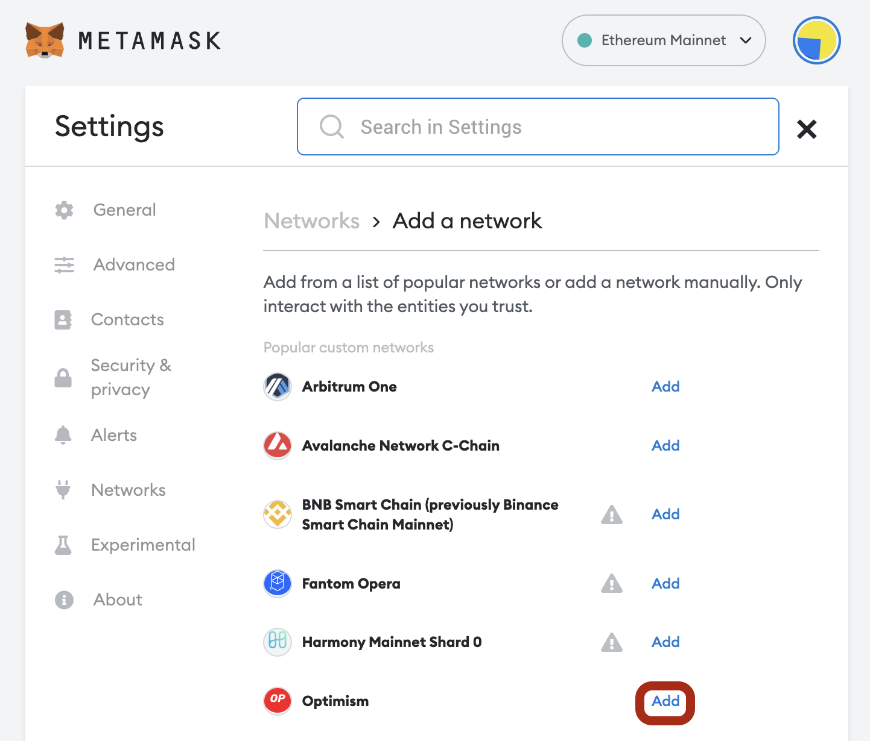
How to send Tx to the coordinator
Enduser configures its
wallet to send Tx to the RPC
points of the selected Rollup.
(by default Metamask sends Tx to the
Ethereum Mainnet RPC points)

Slide 21
The role of the Coordinator
The Coordinator has multiple tasks:
Sequence incoming Tx from Rollup users into a stream of Tx
⇒ can extract MEV from searchers, in addition to Tx fees
⇒ very profitable to be a Rollup coordinator
Execute the stream of Tx on the latest Rollup state
Push updates to the L1 chain
Shared coordinator: one coordinator for multiple Rollups (not today)

Slide 22
Coordinator architectures
A centralized coordinator:
availability and censorship concerns,
… but cannot steal assets (as we will see)
A decentralized coordinator:
a set of parties that run a fast consensus protocol
At every epoch one party is chosen to sequence, execute, and push updates to the L1
[Based Rollup (e.g., Tyco): L2 sequencing is done by L1 validators]
Importantly: L1 provides ground truth of the Rollup state
Notes:
Why do we need an L1 if the L2 runs its own consensus? The L2 consensus can be tuned differently from L1 consensus and can be faster.

Slide 23
Tx rate on L2 is higher than on L1
L2 block
381
L2 chain
batch of blocks
batch of blocks
L1 chain
Finalize on L1
Finalize on L1

Slide 24
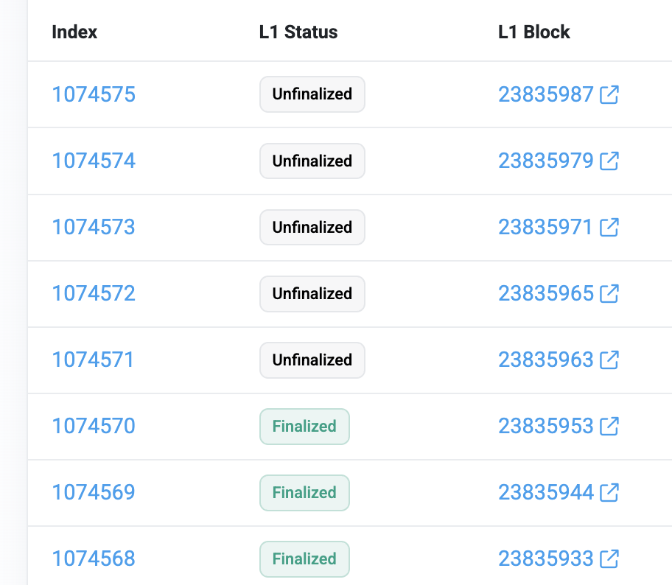
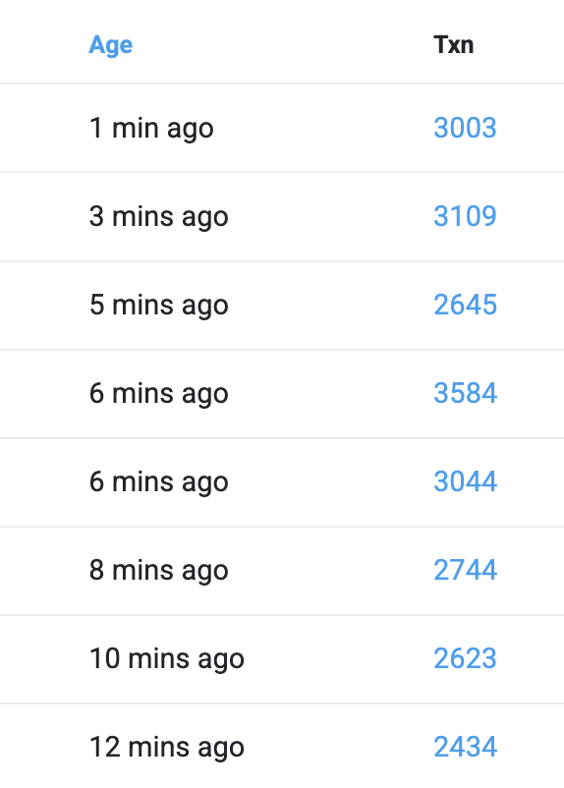
An example (Arbitrum – an optimisitic Rollup)
#blocks in batch
381
416
440
110
302
492
545
581
A batch of blocks is posted on L1 (Ethereum) about every two minutes
Notes:
https://arbiscan.io/batches
Ethereum finality time is at least 6.4 minutes

Slide 25
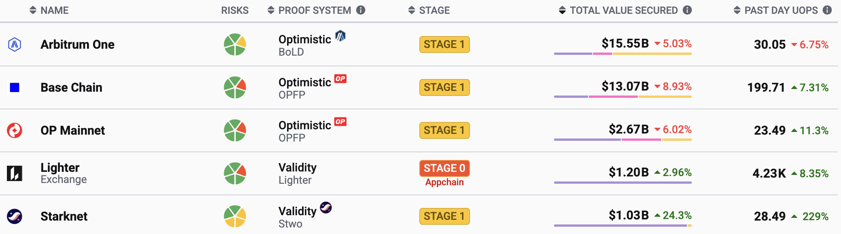
Volume on some L2 systems (Nov. 2025)
Cost per user op
$0.000377
$0.000375
$0.000147
$0.000003
$0.000148
UOPS: User Operations Per Second
Ethereum cost per user op: 0.3 USD/Tx
Notes:
https://l2beat.com/scaling/summary
https://l2beat.com/scaling/costs

Slide 26
Not so simple …

Slide 27
Problems …
Problem 1: what if coordinator is dishonest?
It could steal funds from the Rollup contract
It could issue fake Tx on behalf of users
Problem 2: what if coordinator stops providing service?
If Rollup state is lost, how can users issue Tx?
… can’t compute updated Rollup Merkle root.

Slide 28
Problem 1: what if coordinator is dishonest?
Can coordinator steal funds from Rollup users?
No! L1 chain verifies that Rollup state updates are valid.
⇒ all Tx are valid and properly signed by the Rollup users
Challenge: how to do this cheaply ?? (with little gas on L1)
Alice:
state
Bob:
state
Rollup contract:
…
7 ETH, 3 DAI,
root
Layer-1 blockchain (L1)

Slide 29
Verifying Rollup state updates
Approach 1: validity proofs (called a zk-Rollup)
Succinct proof proves that a batch of hundreds of Tx is valid
Layer 1 blockchain
(e.g. Ethereum)
Tx_{A}
Rollup
coordinator
updated
state
root
SNARK
proof of
valid Tx
Rollup contract
Tx_{B}
accept new root
only if valid proof
Tx list

Slide 30
What the SNARK proof proves
SNARK proof is short and fast to verify:
⇒ Cheap to verify proof on the slow L1 chain (with EVM support)
(usually not a zero knowledge proof)
Public statement: (old state root, new state root, Tx list)
Witness: (state of each touched account pre- and post- batch,
Merkle proofs for touched accounts, user sigs)
SNARK proof proves that:
(1) all user sigs on Tx are valid, (2) all Merkle proofs are valid,
(3) post-state is the result of applying Tx list to pre-state

Slide 31

zkEVM
When a contract (e.g. Uniswap) runs on a Rollup:
coordinator builds a SNARK proof of correct execution of
an EVM program ⇒ called a zkEVM
Generating proof is a heavyweight computation
… verifying proof is fast
Rollup
coordinator
Flavors of EVM block execution proofs:
Directly prove that EVM bytecode ran correctly
(Polygon zkEVM, Scroll)
Compile Reth to RISC-V, prove in a RISC-V zkVM
(MatterLabs, Succint, Zisk, Risc0, …)
(lots of GPUs)

Slide 32
The end result
Rollup contract on L1 ensures coordinator cannot cheat:
all submitted Tx must have been properly signed by users
all state updates are valid
⇒ Rollup contract on L1 will accept any update with a valid proof
⇒ Anyone can act as a coordinator (with enough compute power)

Slide 33
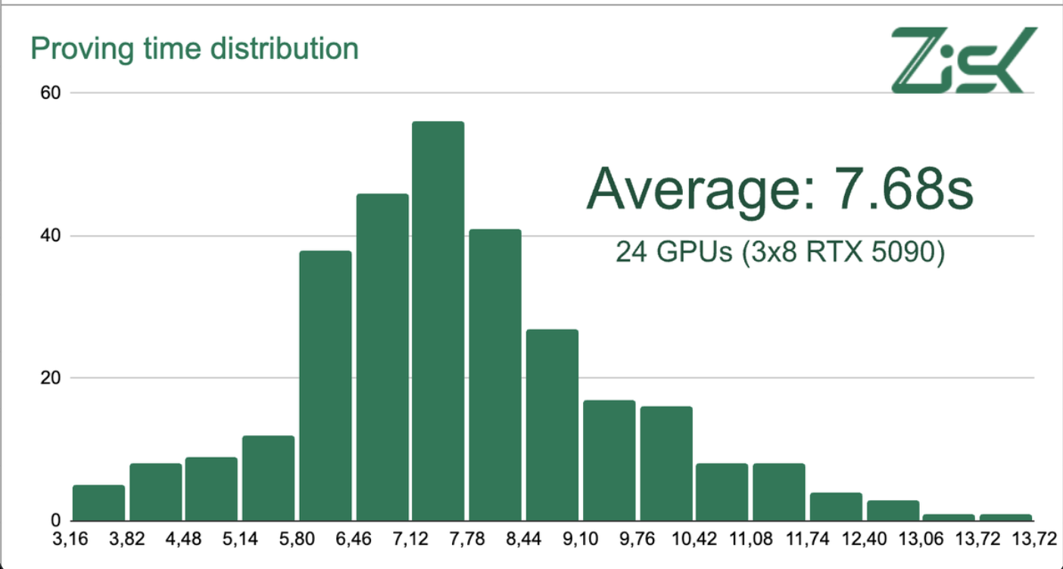
Generating a proof in under 12 seconds!
12 sec.
Distribution of the time to generate a proof for a block.
Oct. 28, 2025

Slide 34
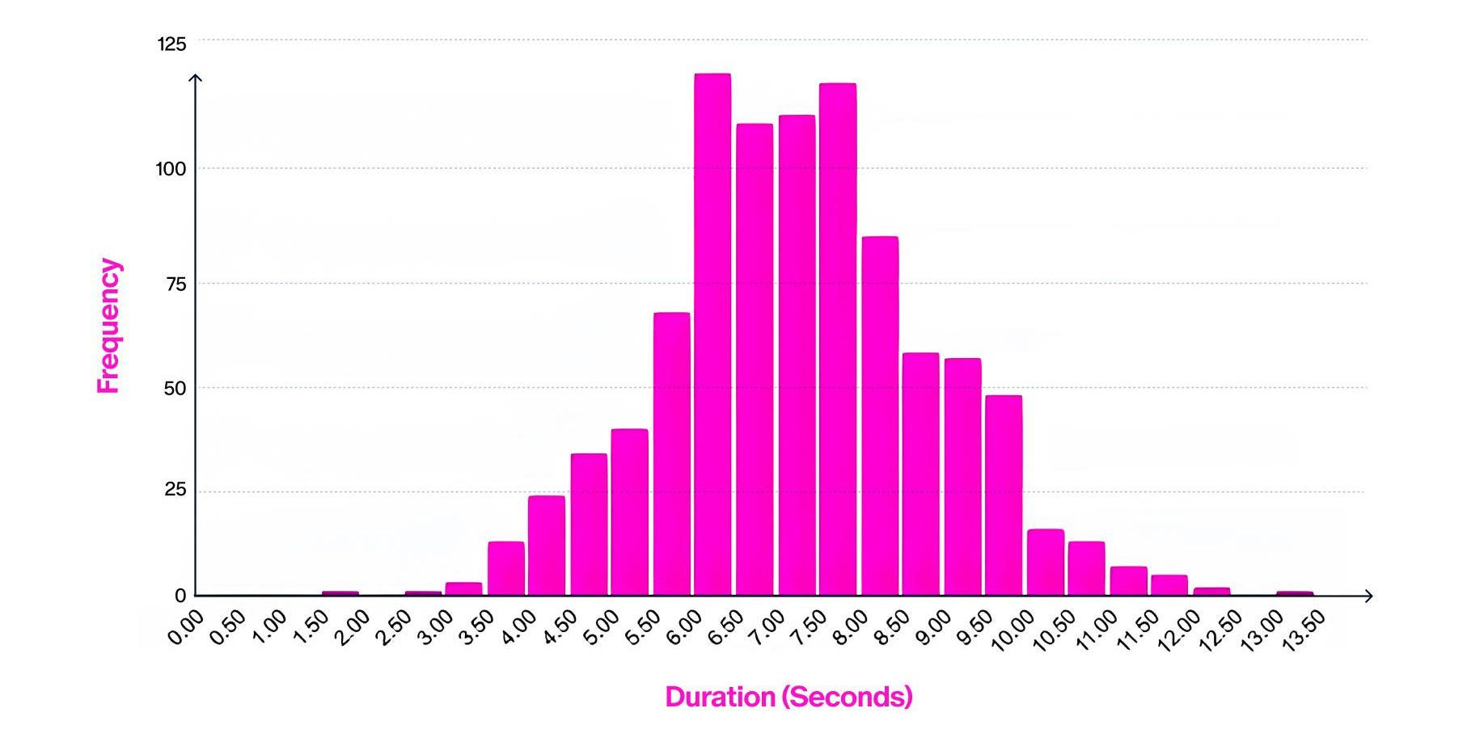
Generating a proof in under 12 seconds!
SP1 Hypercube with only 16 GPUs
12 sec.
Distribution of the time to generate a proof for a block
Nov. 18, 2025

Slide 35
Verifying Rollup state updates
Approach 2: fault proofs (called an optimistic Rollup)
Operation: Coordinator submits state updates to L1 w/o a proof
If update is invalid: anyone has seven days to submit a fault proof
  Successful fault proof reverts the update (and rewards validator)
  Unsuccessful fault proof costs complainer a fee
Challenge: how to prove a fault to the Rollup contract on L1 ??
Naively: L1 can re-execute all Tx in batch ⇒ expensive and slow
Notes:
The reward for a successful fault proof could come from some locked stake by the coordinator. So, a cheating attempt by the coordinator just turns into a DoS attack.

Slide 36
Fault Proof game
pre-root
Tx list
fault claim
coordinator
Coordinator computes Merkle
tree of all states.
Sends Merkle root to L1
different
post-root
claimed
post-root
pre-
state
post-
state
break computation into small steps

Slide 37



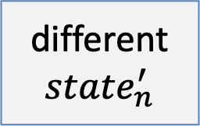
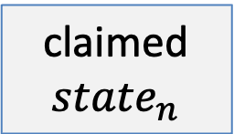
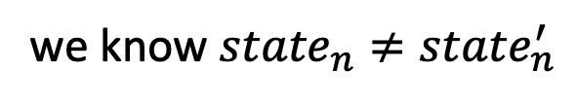
Fault Proof game
pre-root
Tx list
we know ${state}_{n}≠{state}_{n}^{′}$
fault claim
coordinator
Merkle root
different
$${state}_{n}^{′}$$
claimed
$${state}_{n}$$
hash_{[0⇾n/2]}
hash_{[n/2⇾n]}
hash_{[0⇾n/4]}
hash_{[n/4⇾n/2]}
$${state}_{0}$$
$${state}_{n/2}$$
$${state}_{n}$$

Slide 38
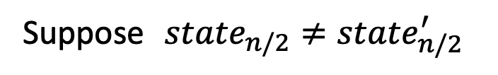
Fault Proof game: binary search
pre-root
Tx list
Suppose ${state}_{n/2}≠{state}_{n/2}^{′}$
fault claim
coordinator
Merkle root
different
$${state}_{n}^{′}$$
claimed
$${state}_{n}$$
hash_{[0⇾n/2]}
hash_{[n/2⇾n]}
hash_{[0⇾n/4]}
hash_{[n/4⇾n/2]}
$${state}_{0}$$
$${state}_{n/2}$$
$${state}_{n}$$

Slide 39
Fault Proof game: binary search
pre-root
Tx list
Suppose ${state}_{n/2}≠{state}_{n/2}^{′}$
fault claim
coordinator
Merkle root
different
$${state}_{n}^{′}$$
claimed
$${state}_{n}$$
hash_{[0⇾n/2]}
hash_{[n/2⇾n]}
hash_{[0⇾n/4]}
hash_{[n/4⇾n/2]}
Coordinator sends hash_{[0⇾n/2]} to L1
Alice sends “left” to L1
$${state}_{0}$$
$${state}_{n/2}$$

Slide 40

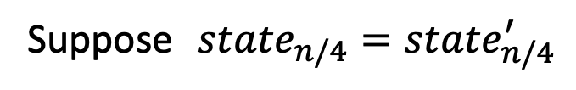
Fault Proof game: binary search
pre-root
Tx list
Suppose ${state}_{n/4}={state}_{n/4}^{′}$
fault claim
coordinator
Merkle root
different
$${state}_{n}^{′}$$
claimed
$${state}_{n}$$
hash_{[0⇾n/2]}
hash_{[n/2⇾n]}
hash_{[0⇾n/4]}
hash_{[n/4⇾n/2]}
Coordinator sends hash_{[n/4⇾n/2]} to L1
Alice sends “right” to L1
$${state}_{0}$$
$${state}_{n/4}$$
$${state}_{n/2}$$

Slide 41
Fault Proof game: binary search
pre-root
Tx list
Suppose ${state}_{n/4}={state}_{n/4}^{′}$
fault claim
coordinator
Merkle root
different
$${state}_{n}^{′}$$
claimed
$${state}_{n}$$
hash_{[0⇾n/2]}
hash_{[n/2⇾n]}
hash_{[0⇾n/4]}
hash_{[n/4⇾n/2]}
Coordinator sends hash_{[n/4⇾n/2]} to L1
Alice sends “right” to L1
$${state}_{n/4}$$
$${state}_{n/2}$$

Slide 42
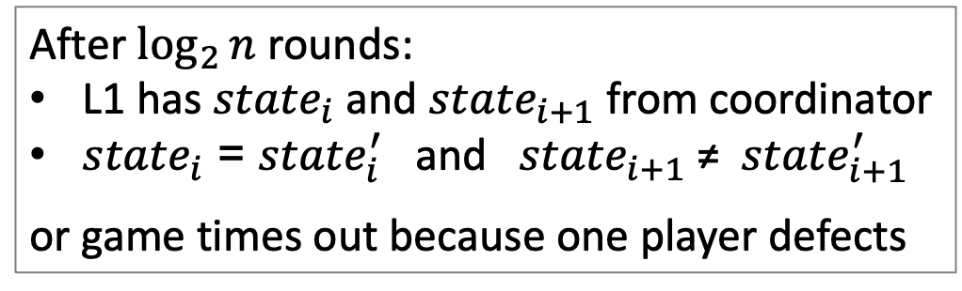
Fault Proof game: binary search
pre-root
Tx list
coordinator
After $\log_{2}{n}$ rounds:
L1 has ${state}_{i}$ and ${state}_{i+1}$ from coordinator
${state}_{i}$ = ${state}_{i}^{′}$ and ${state}_{i+1}$ ≠ ${state}_{i+1}^{′}$
or game times out because one player defects
⇒ Now L1 can verify fault proof by checking one computation step!

Slide 43
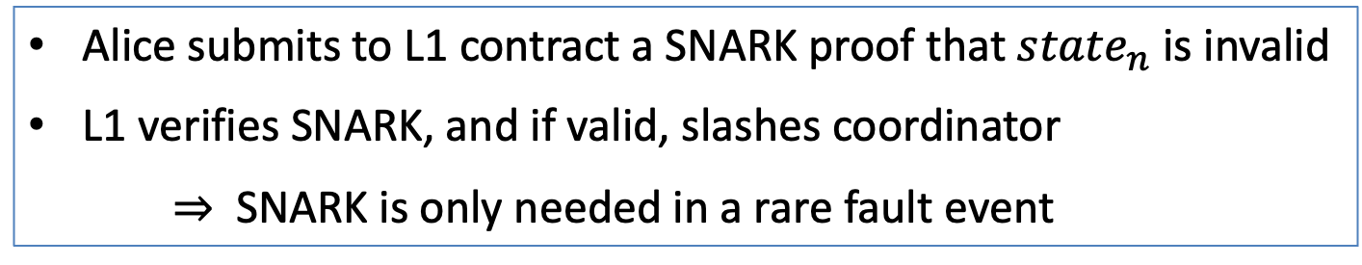
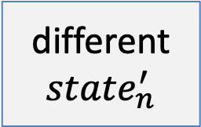
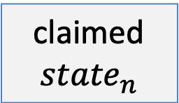
A simpler alternative
pre-root
Tx list
different
$${state}_{n}^{′}$$
claimed
$${state}_{n}$$
Alice submits to L1 contract a SNARK proof that ${state}_{n}$ is invalid
L1 verifies SNARK, and if valid, slashes coordinator
⇒ SNARK is only needed in a rare fault event

Slide 44
Some difficulties with optimistic approach
(1) Transactions only settle after 7 days (after fault window expires)
Alice needs to wait 7 days to withdraw funds from Rollup
(Rollup contract will only send her the funds after 7 days)
For fungible tokens, a 3rd party can advance the funds to Alice after checking validity of Alice’s withdraw Tx. Does not apply to non-fungible tokens.
(2) Suppose a successful fault proof 4 days after batch is posted
⇒ all subsequent Tx need to be reprocessed

Slide 45
The end result
Can easily port any smart contract to an optimistic Rollup
The Rollup EVM can be enhanced with new features (opcodes)
High Tx throughput: in principle, up to 4000 tx/s
No need for special hardware at the coordinator
Anyone can act as a coordinator and a fault verifier
Downside: 7 day finality delay

Slide 46
Problem 2: centralized coordinator, what if it stops providing service?
… ok, so coordinator cannot submit invalid Tx.
(censorship)
Solution: setup a new coordinator
… but need the latest Rollup state
Where to get state?? The data availability problem

Slide 47
Ensuring Rollup state is always available
The definition of a Rollup:
Rollup state can always be reconstructed from
data on the L1 chain
Layer 1 blockchain
(e.g. Ethereum)
updated
state
root
coordinator
Tx list
Rollup contract
state root
Sent to Rollup contract on L1 as part of state update message

Slide 48
Ensuring Rollup state is always available
To reconstruct current Rollup state:
Read all Rollup update messages and re-execute Tx.
⇒ anyone can become a coordinator
Rollups use L1 for data storage
What to store?
For zk-Rollup: send Tx summary to L1, without user signatures
(SNARK proof proves validity of signatures)
For optimistic: need to send Tx summary *and* signatures to L1
Notes:
EIP-4444: history expiry makes it possible to remove user signatures from chain after the dispute window elapses.

Slide 49
Ensuring Rollup state is always available
The downside: expensive
Tx list is sent as calldata: 16 gas per non-zero byte
Ethereum’s solution: blobs [Fusaka upgrade, Dec. 3rd, 2025]
Every block can contain up to 21 blobs (128 KB each)
Validators store blobs for 30 days (sharded using PeerDAS)
Blobs cost far less gas than calldata of the same size
  Price determined by auction among Rollups (like EIP-1559)
What not store Tx data off chain?
Notes:
https://eprint.iacr.org/2025/1414

Slide 50
Data Availability Committee (DAC)
To reduce fees due to Tx storage cost on L1:
Store L2 state root (small) on the L1 chain
Store Tx data (large) with a Data Availability Committee (DAC):
  a set of nodes trusted to keep the data available
  cheaper than storage on L1
  L1 accepts an update only if all DAC members sign it
  ⇒ ensures that all DAC members accepted Tx data
Setting up a new coordinator depends on availability of the DAC

Slide 51
Validium
Validium: an L2 using a DAC and validity proofs (SNARKs)
Well suited for lower value assets.
Potential privacy benefits … only DAC members see Tx data
An example: StarkEx uses a five member DAC
Users can choose between Validium or Rollup modes
(Tx data off-L1-chain vs. Tx data on-L1-chain)
cheaper Tx fees,
but only secure as DAC
More expensive Tx,
but same as L1 security

Slide 52
Summary: types of L2
Scaling the blockchain: Payment channels and Rollups (L2 scaling)
 | SNARK validity proofs | Fraud proofs
Tx data on L1 chain | zkRollup | optimistic Rollup, 7 day finality
Tx data in a DAC | Validium (reduced fees, but higher risk) | ”Plasma”
security
availability

Slide 53
Can coordinator censor a Tx?
What if coordinators refuse to process a Tx?
What to do? One option:
enduser can post Tx directly to the L1 Rollup contract
The L1 Rollup contract will then refuse to accept updates until an update includes that Tx
⇒ censorship will cause the entire Rollup to freeze

Slide 54
SNARK recursion
Layer 3 and beyond …

Slide 55

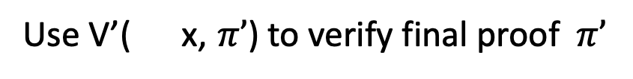
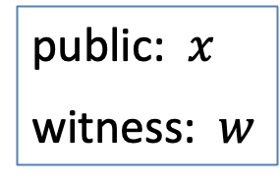
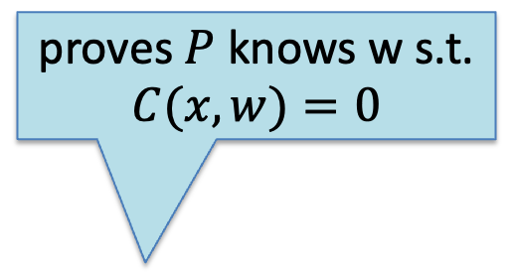


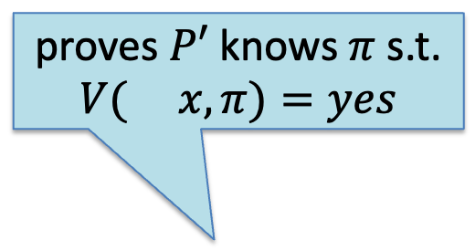

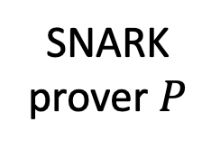
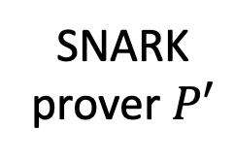

SNARK recursion
Two level recursion: proving knowledge of a proof
Use V’( x, $π’$) to verify final proof $π’$
$$vp′,$$
public: $x$
witness: $w$
proves $P$ knows w s.t.
$$C(x,w)=0$$
proves $P′$ knows $π$ s.t.
$$V( x,π)=yes$$
$$vp,$$
SNARK
prover $P$
$$x$$
SNARK
prover $P′$
π
π’
$$(S, P, V)$$
$$(S′, P′, V′)$$
Notes:
Three level: proving knowledge of a proof of knowledge of a proof.

Slide 56


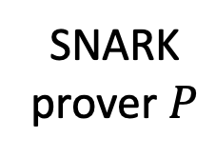
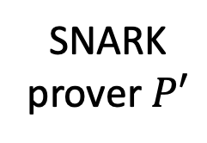
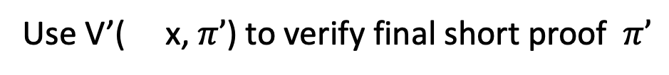
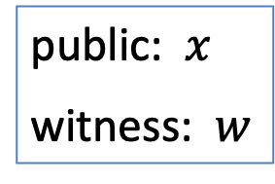





Application 1: proof compression
Use V’( x, $π’$) to verify final short proof $π’$
$$vp′,$$
public: $x$
witness: $w$
fast prover, but
outputs a large proof
slower prover,
small final proof
SNARK
prover $P$
$$x$$
SNARK
prover $P′$
π
π’
$$(S, P, V)$$
$$(S′, P′, V′)$$
prove $C(x,w)=0$
prove $V( x,π)=yes$
$$vp,$$

Slide 57
Application 2: Layer three and beyond
Alice:
state
Bob:
state
L3 Rollup state (any VM)
…
L2 Rollup state
L3 Rollup contract:
state root
Alice:
2 ETH, 1 DAI
Bob:
5 ETH, 2 DAI
…
Alice:
state
Uniswap:
state
Rollup contract:
…
7 ETH, 3 DAI,
root
Layer-1 blockchain (L1)

Slide 58
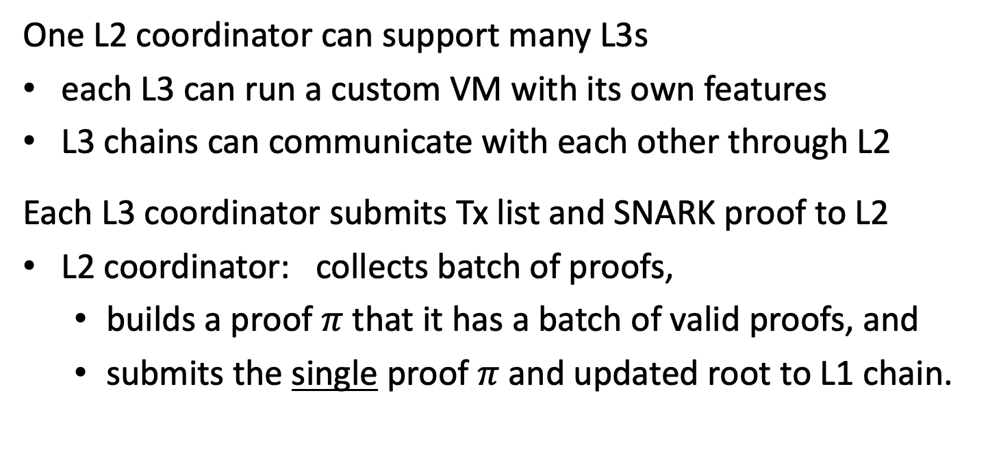
Layer three and beyond
One L2 coordinator can support many L3s
each L3 can run a custom VM with its own features
L3 chains can communicate with each other through L2
Each L3 coordinator submits Tx list and SNARK proof to L2
L2 coordinator: collects batch of proofs,
  builds a proof $π$ that it has a batch of valid proofs, and
  submits the single proof $π$and updated root to L1 chain.
Notes:
Bridging between L3’s is done without touching L1.

Slide 59
END OF LECTURE
Next lecture: final topics

