Slide 1
Using zk-SNARKs for Privacy on the Blockchain
CS251 Fall 2025
(cs251.stanford.edu)
Dan Boneh

Slide 2
The need for privacy in the financial system
Supply chain privacy:
  A manufacturer does not want to reveal
  how much it pays its supplier for parts.
Payment privacy:
  A company that pays its employees in crypto wants to keep list of employees and salaries private.
  Endusers need privacy for rent, donations, purchases
Business logic privacy: Can the code of a smart contract be private?

Slide 3
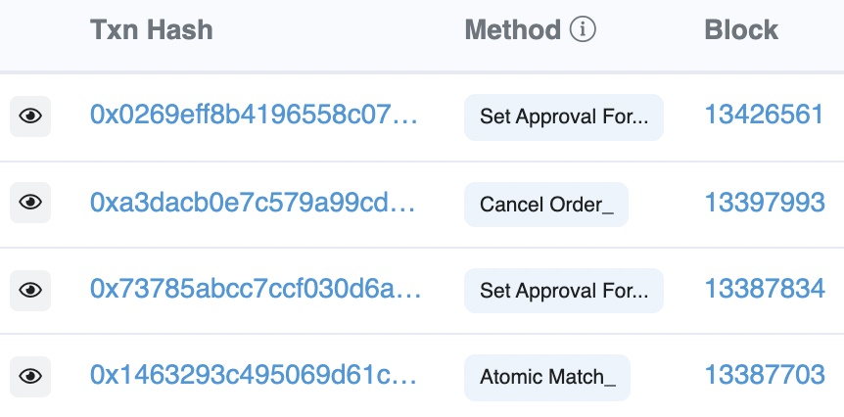
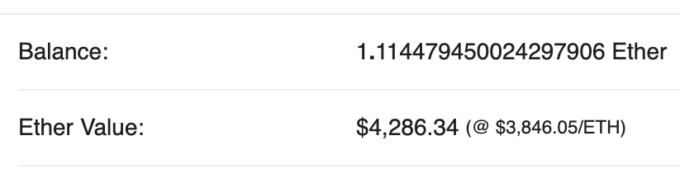
Previous lecture
Neither Bitcoin nor Ethereum are private
etherscan.io:
Address 0x1654b0c3f62902d7A86237…
This lecture: general tools for privacy on the blockchain

Slide 4
Review: what is a zk-SNARK?
Succinct zero knowledge proofs:
an important tool for privacy on the blockchain

Slide 5
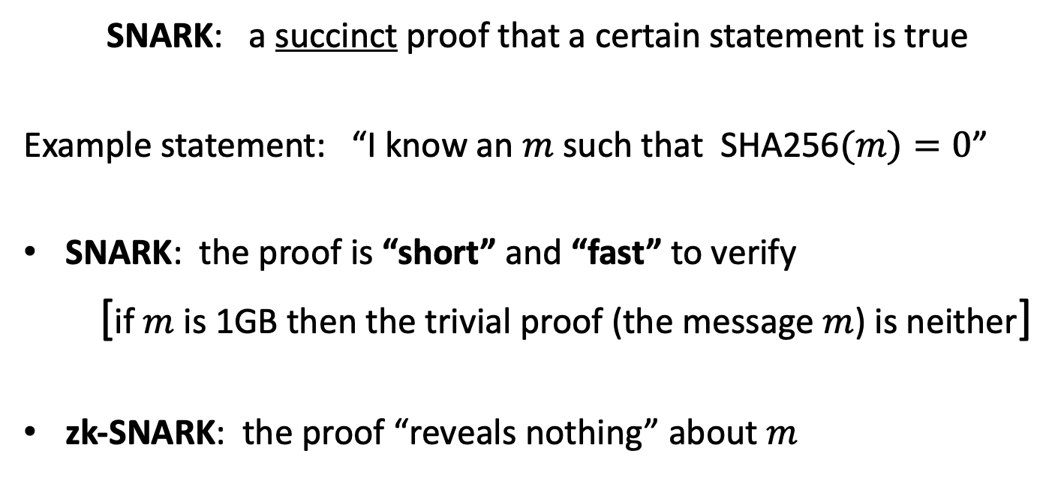
What is a zk-SNARK ? (intuition)
SNARK: a succinct proof that a certain statement is true
Example statement: “I know an $m$ such that SHA256$(m)=0$”
SNARK: the proof is “short” and “fast” to verify
[if $m$ is 1GB then the trivial proof (the message $m$) is neither]
zk-SNARK: the proof “reveals nothing” about $m$

Slide 6



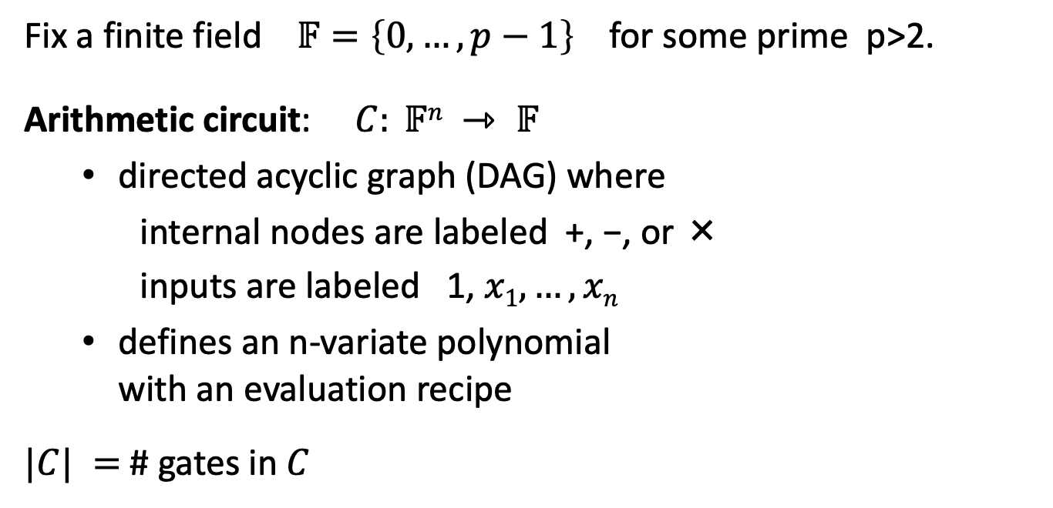




Review: arithmetic circuits
Fix a finite field $𝔽=\left\{0, …, p−1\right\}$ for some prime p>2.
Arithmetic circuit: $C: 𝔽n ⇾ 𝔽$
  directed acyclic graph (DAG) where
    internal nodes are labeled +, −, or ×
    inputs are labeled 1, $x1, …, xn$
  defines an n-variate polynomial
  with an evaluation recipe
$|C| =$ # gates in $C$
$$x1(x1+x2+1)(x2−1)$$
$$\text{×}$$
$$+$$
$$−$$
$$x1$$
$$x2$$
$$1$$

Slide 7
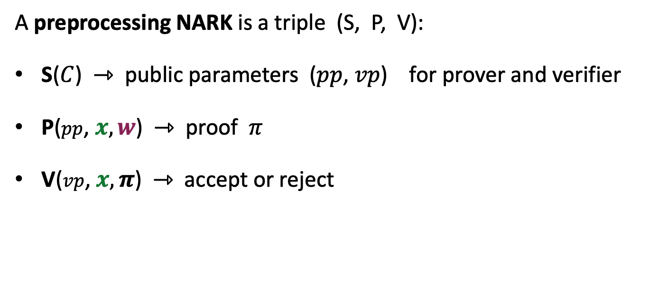
(preprocessing) NARK: Non-interactive ARgument of Knowledge
A preprocessing NARK is a triple (S, P, V):
S($C$) ⇾ public parameters ($pp$, $vp$) for prover and verifier
P($pp$, $x, w$) ⇾ proof $π$
V($vp$, $x, π$) ⇾ accept or reject
all algs. and adversary have
access to a random oracle

Slide 8


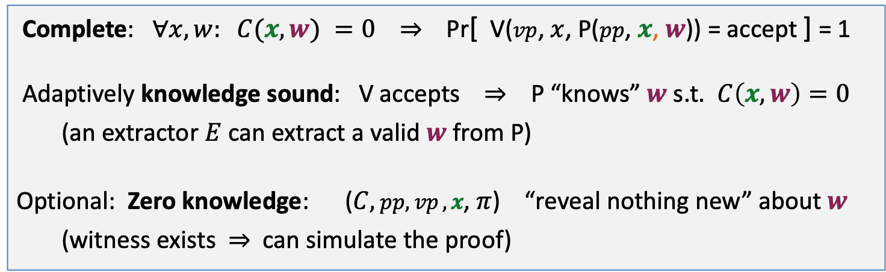

NARK: requirements (informal)
Prover P($pp$, $x, w$)
Verifier V ($vp$, $x$, $π$)
proof $π$
accept or reject
Complete: $∀x, w: C(x, w) =0$ ⇒ Pr[ V($vp$, $x$, P($pp$, $x$, $w$)) = accept ] = 1
Adaptively knowledge sound: V accepts ⇒ P “knows” $w$ s.t. $C\left(x, w\right)=0$
(an extractor $E$ can extract a valid $w$ from P)
Optional: Zero knowledge: ($C,$ $pp,vp ,x$, $π$) “reveal nothing new” about $w$
(witness exists ⇒ can simulate the proof)

Slide 9
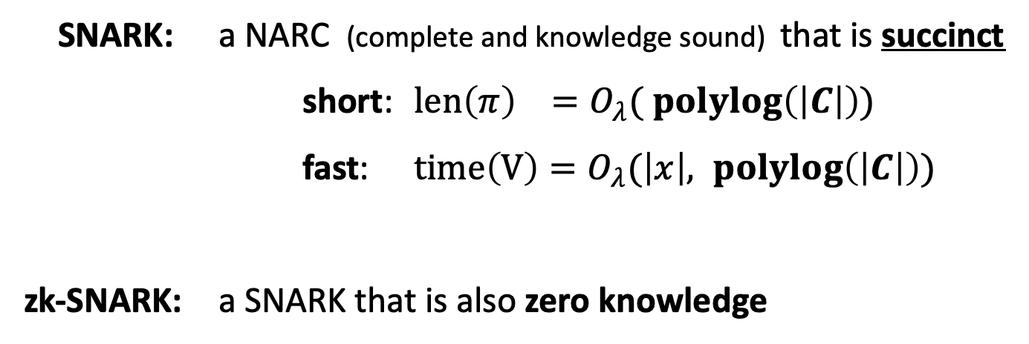
SNARK: a Succinct ARgument of Knowledge
SNARK: a NARC (complete and knowledge sound) that is succinct
short: $len\left(π\right) =O_{λ}( \operatorname{polylog}\left(\left|C\right|\right))$
fast: $time\left(V\right)=O_{λ}(\left|x\right|, \operatorname{polylog}\left(\left|C\right|\right))$
zk-SNARK: a SNARK that is also zero knowledge

Slide 10
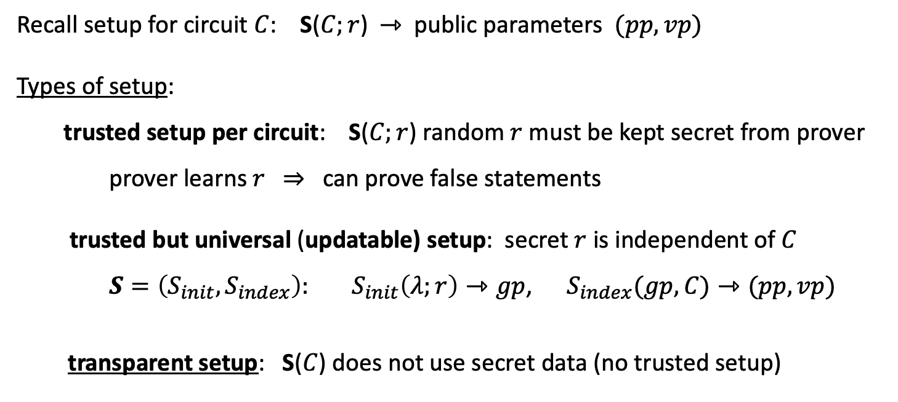
Types of preprocessing Setup
Recall setup for circuit $C$: S($C;r$) ⇾ public parameters $(pp, vp)$
Types of setup:
trusted setup per circuit: S($C;r$) random $r$ must be kept secret from prover
prover learns $r$ ⇒ can prove false statements
trusted but universal (updatable) setup: secret $r$ is independent of $C$
$S=\left(S_{init}, S_{index}\right): S_{init}\left(λ;r\right)⇾gp$, $S_{index}(gp,C)⇾(pp, vp)$
transparent setup: S($C$) does not use secret data (no trusted setup)
random bits
better
one-time
no secret data from prover

Slide 11
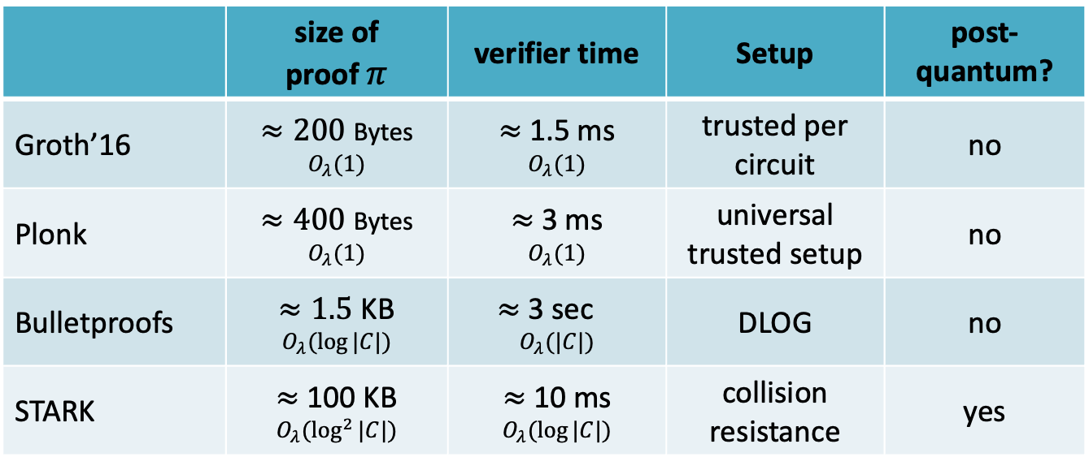
Significant progress in recent years (partial list)
 | size of proof $π$ | verifier time | Setup | post-quantum?
Groth’16 | $≈200$ Bytes $$O_{λ}(1)$$ | $≈$ 1.5 ms $$O_{λ}(1)$$ | trusted per circuit | no
Plonk | $≈400$ Bytes $$O_{λ}(1)$$ | $≈$ 3 ms $$O_{λ}(1)$$ | universal trusted setup | no
Bulletproofs | $≈1.5$ KB $$O_{λ}(log⁡|C|)$$ | $≈$ 3 sec⁡ $$O_{λ}(|C|)$$ | DLOG | no
STARK | $≈$ 100 KB $$O_{λ}(\log^{2}⁡|C|)$$ | $≈$ 10 ms $$O_{λ}(log⁡|C|)$$ | collision resistance | yes
(for a circuit with 2²⁰ gates)
Notes:
no trusted setup: log-size proof. but shorter Sp.

Slide 12
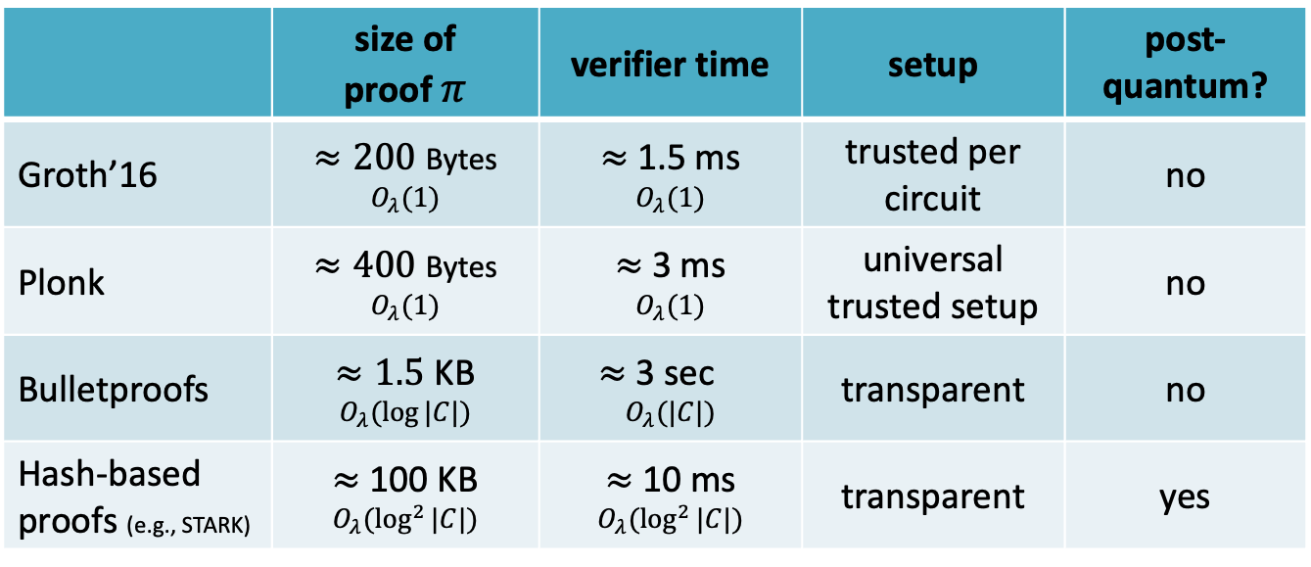
Significant progress in recent years (partial list)
 | size of proof $π$ | verifier time | setup | post-quantum?
Groth’16 | $≈200$ Bytes $$O_{λ}(1)$$ | $≈$ 1.5 ms $$O_{λ}(1)$$ | trusted per circuit | no
Plonk | $≈400$ Bytes $$O_{λ}(1)$$ | $≈$ 3 ms $$O_{λ}(1)$$ | universal trusted setup | no
Bulletproofs | $≈1.5$ KB $$O_{λ}(log⁡|C|)$$ | $≈$ 3 sec⁡ $$O_{λ}(|C|)$$ | transparent | no
Hash-based proofs (e.g., STARK) | $≈$ 100 KB $$O_{λ}(\log^{2}⁡|C|)$$ | $≈$ 10 ms $$O_{λ}(\log^{2}⁡|C|)$$ | transparent | yes
⋮
⋮
(for a circuit with 2²⁰ gates)
Notes:
no trusted setup: log-size proof. but shorter Sp.

Slide 13

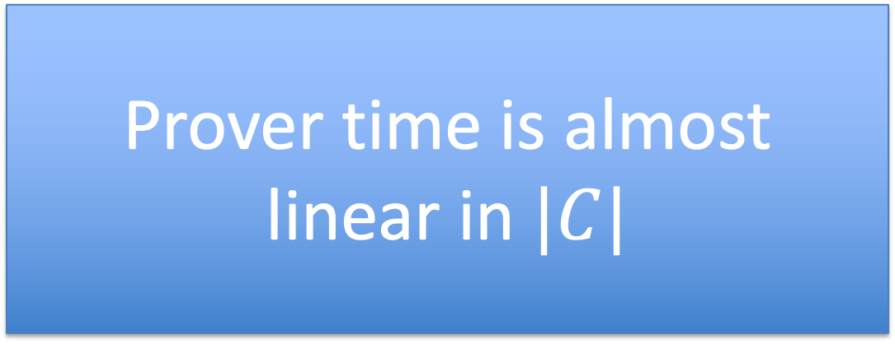
Significant progress in recent years (partial list)
 | size of proof $π$ | verifier time | setup | post-quantum?
Groth’16 | $≈200$ Bytes $$O_{λ}(1)$$ | $≈$ 1.5 ms $$O_{λ}(1)$$ | trusted per circuit | no
Plonk | $≈400$ Bytes $$O_{λ}(1)$$ | $≈$ 3 ms $$O_{λ}(1)$$ | universal trusted setup | no
Bulletproofs | $≈1.5$ KB $$O_{λ}(log⁡|C|)$$ | $≈$ 3 sec⁡ $$O_{λ}(|C|)$$ | transparent | no
Hash-based proofs (e.g., STARK) | $≈$ 100 KB $$O_{λ}(\log^{2}⁡|C|)$$ | $≈$ 10 ms $$O_{λ}(log⁡|C|)$$ | transparent | yes
Prover time is almost
linear in $|C|$
⋮
⋮
(for a circuit with 2²⁰ gates)
Notes:
no trusted setup: log-size proof. but shorter Sp.

Slide 14
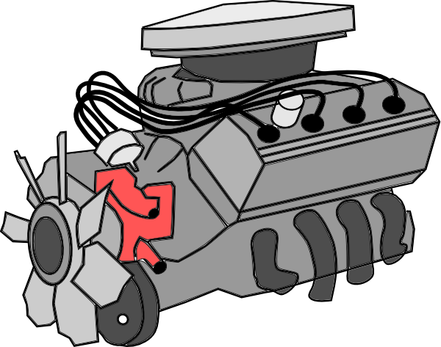
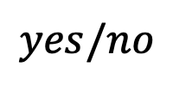



More generally: proving computation (zk-VM)
Rust
program
compiler
RISC-V
assembly
$$π$$
public input,
secret witness
zk-VM prover
(cpu+memory)
(zk) proof of
correct
computation
Current proving speeds:
≈30 M RISC-V / sec
(on a single GPU)
$vp$, public input
$$yes/no$$
proof $π$
zk-VM verifier
Notes:
Think of this as a 30 MhZ computer.

Slide 15
Why is this possible now?
The breakthrough: new fast SNARK provers
Proof generation time is linear (or quasilinear) in computation size
Many beautiful ideas … next lecture
a large bibliography: a16zcrypto.com/zero-knowledge-canon
Notes:
GGPR 2013: Gennaro, Gentry, Parno, Reykova . Quadratic span programs.

Slide 16
How to define “knowledge soundness” and “zero knowledge”?

Slide 17
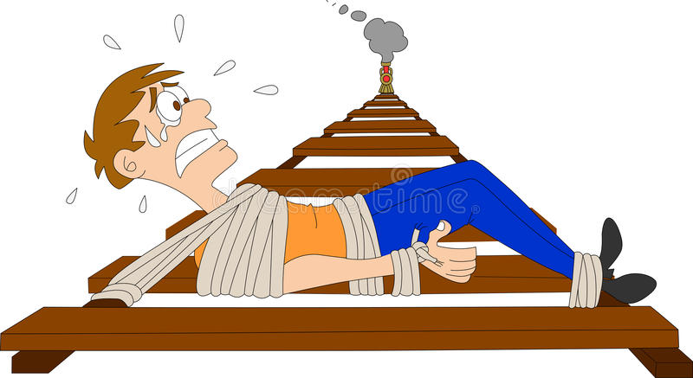
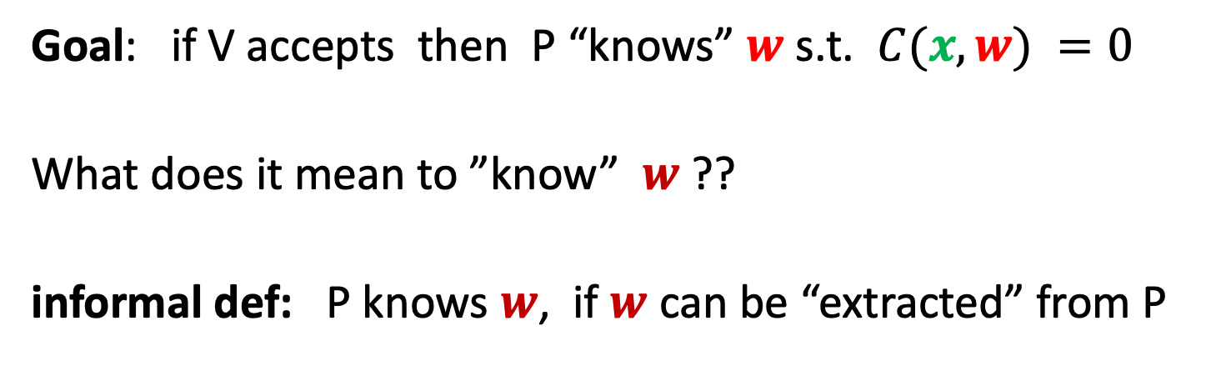
Definitions: (1) knowledge sound
Goal: if V accepts then P “knows” $w$ s.t. $C(x, w) =0$
What does it mean to ”know” $w$ ??
informal def: P knows $w$, if $w$ can be “extracted” from P
P

Slide 18
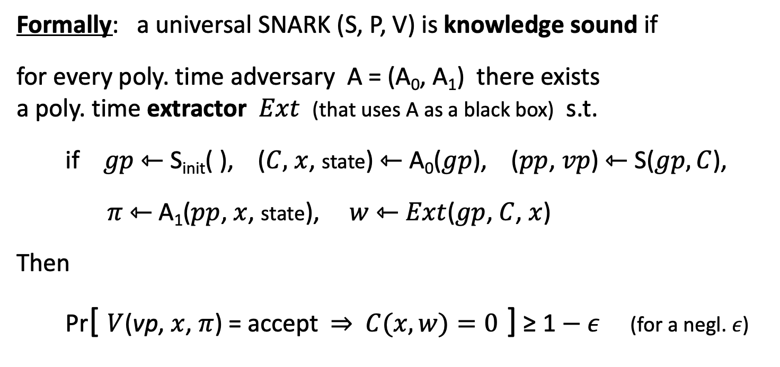
Definitions: (1) knowledge sound (simplified)
Formally: a universal SNARK (S, P, V) is knowledge sound if
for every poly. time adversary A = (A₀, A₁) there exists
a poly. time extractor $Ext$ (that uses A as a black box) s.t.
if $gp$ ⇽ S_{init}( ), ($C,$ $x$, state) ⇽ A₀($gp$), ($pp$, $vp$) ⇽ S($gp,C$),
$π$ ⇽ A₁($pp$, $x$, state), $w$ ⇽ $Ext$($gp$, $C$, $x$)
Then
Pr[ $V$(vp, $x$, $π$) = accept ⇒ $C(x,w)=0$ ] ≥ 1 $− ε$ (for a negl. $ε$)
extracted witness

Slide 19


Definitions: (2) Zero knowledge
Where is
Waldo?

Slide 20

Definitions: (2) Zero knowledge
A story about the lady sipping tea

Slide 21
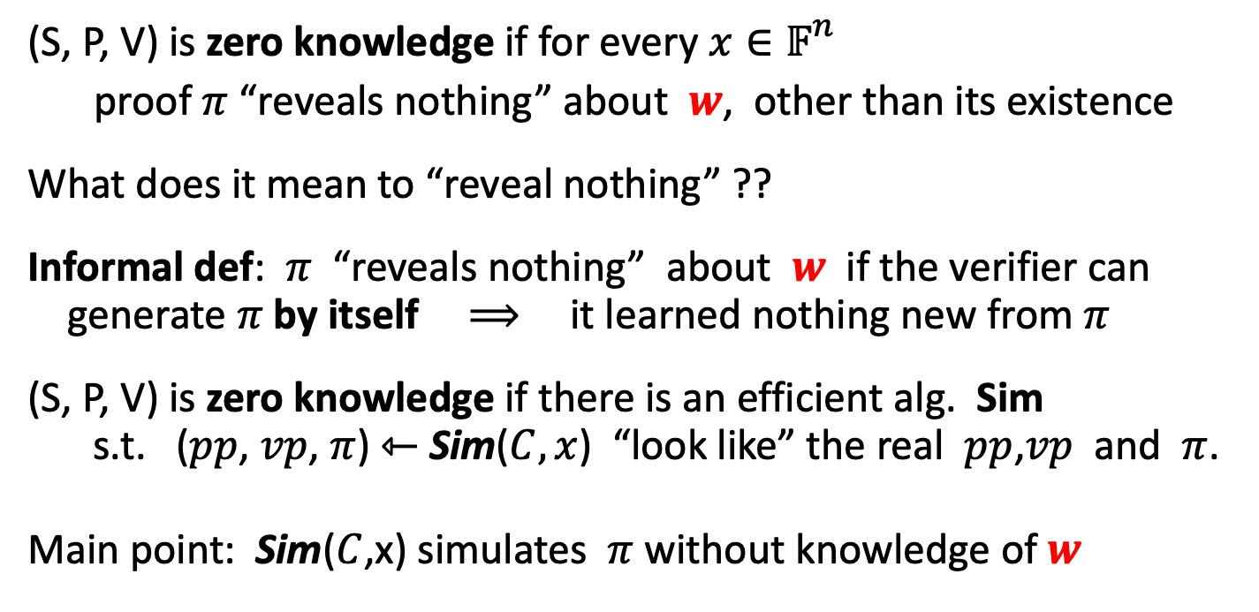
Definitions: (2) Zero knowledge (simplified)
(S, P, V) is zero knowledge if for every $x∈𝔽_{}^{n}$
proof $π$ “reveals nothing” about $w$, other than its existence
What does it mean to “reveal nothing” ??
Informal def: $π$ “reveals nothing” about $w$ if the verifier can
generate $π$ by itself ⟹ it learned nothing new from $π$
(S, P, V) is zero knowledge if there is an efficient alg. Sim
s.t. ($pp$, $vp$, $π$) ⇽ Sim($C,x$) “look like” the real $pp$,$vp$ and $π$.
Main point: Sim($C$,x) simulates $π$ without knowledge of $w$
Notes:
Honest verifier because we are assuming S is honest (treating S as part o the verifier).
Note: this definition means that (Sp, Sv) are only good for a single proof. The correct definition gives (Sp, Sv) as input to Sim, but then it is not clear what is Sim’s advantage. Sim can program the random oracle, but we are not at a point where we can explain that.

Slide 22
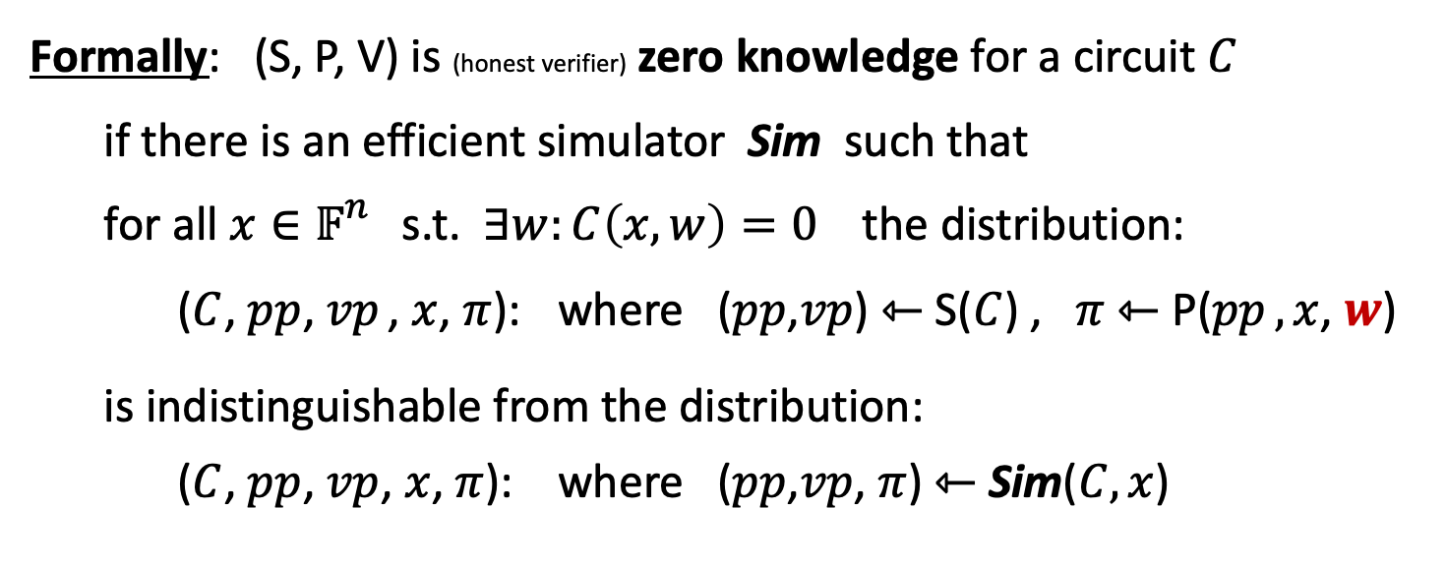
Definitions: (2) Zero knowledge (simplified)
Formally: (S, P, V) is (honest verifier) zero knowledge for a circuit $C$
if there is an efficient simulator Sim such that
for all $x∈𝔽_{}^{n}$ s.t. $∃w:C\left(x,w\right)=0$ the distribution:
($C$, $pp$, $vp$ , $x$, $π$): where ($pp$,$vp$) ⇽ S($C$) , $π$ ⇽ P($pp$ $,x$, $w$)
is indistinguishable from the distribution:
($C$, $pp$, $vp$, $x$, $π$): where ($pp$,$vp$, $π$) ⇽ Sim($C,x$)
Main point: Sim($C$,x) simulates $π$ without knowledge of $w$
Notes:
Honest verifier because we are assuming S is honest (treating S as part o the verifier)

Slide 23
How to build a zk-SNARK?
Recall: prover generates a short proof that is fast to verify
How to build a zk-SNARK ??
Next lecture

Slide 24
Applications of zk-SNARKs:
(1) Tornado cash: a zk-based mixer
Launched on the Ethereum blockchain on May 2020 (v2)

Slide 25
Tornado Cash: a ZK-mixer
A common denomination (1000 USDC) is needed to prevent linking
Alice to her fresh address using the deposit/withdrawal amount
1000 USDC
MIX
NFT
market
???
buy NFT
privately
1000 USDC
1000 USDC
account
fresh
address
(1000 USDC)
1000 USDC
Tornado.cash
contract
Notes:
If Alice deposits and withdraws 1547.3 USDC then that creates a link between the deposit and the withdrawal events.

Slide 26
The tornado cash contract (simplified)
H₁, H₂: R ⇾ {0,1}²⁵⁶
CRHF
100 USDC pool:
each coin = 100 USDC
Treasury: 300 USDC
nf₁
Coins
Merkle
root
coins
Merkle
root
nf₂
(32 bytes)
tree of
height 20
(2²⁰ leaves)
Currently:
three coins in pool
contract has 300 USDC
two nullifiers stored
next = 4
nullifiers
C₁ C₂ C₃ 0 0 … 0
contract state
public list of coins
explicit list:
one entry per spent coin

Slide 27
Tornado cash: deposit (simplified)
H₁, H₂: R ⇾ {0,1}²⁵⁶
100 USDC pool:
each coin = 100 USDC
Treasury: 300 USDC
nf₁
Coins
Merkle
root
coins
Merkle
root
nf₂
Alice deposits 100 USDC:
(32 bytes)
tree of
height 20
(2²⁰ leaves)
100 USDC
C₄ , MerkleProof(4)
next = 4
nullifiers
C₁ C₂ C₃ 0 0 … 0
Build Merkle proof for leaf #4:
MerkleProof(4) (leaf=0)
choose random k, r in R
set C₄ = H₁(k, r)
contract state
public list of coins
explicit list:
one entry per spent coin
Notes:
Note: one Tx per block. Alice needs to know what leaf her coin will occupy.

Slide 28
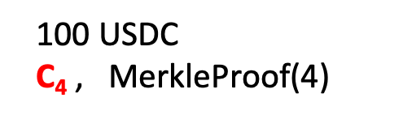
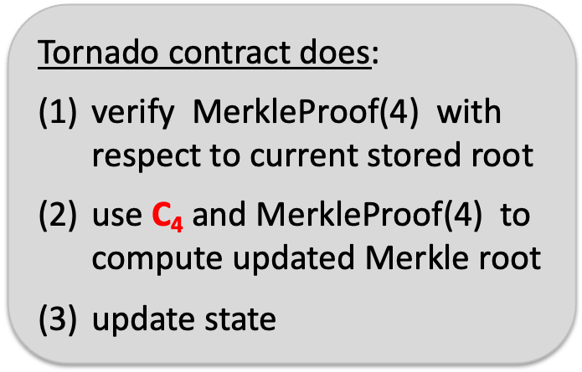
Tornado cash: deposit (simplified)
H₁, H₂: R ⇾ {0,1}²⁵⁶
coins
Merkle
root
100 USDC
C₄ , $\text{MerkleProof}\text{(4)}$
Coins
Merkle
root
(32 bytes)
Tornado contract does:
verify $\text{MerkleProof}\text{(4)}$ with respect to current stored root
use C₄ and MerkleProof(4) to
compute updated Merkle root
update state
tree of
height 20
(2²⁰ leaves)
next = 4
Tornado contract
C₁ C₂ C₃ 0 0 … 0
public list of coins

Slide 29
Tornado cash: deposit (simplified)
H₁, H₂: R ⇾ {0,1}²⁵⁶
coins
Merkle
root
100 USDC
C₄ , $\text{MerkleProof}\text{(4)}$
updated
Merkle
root
(32 bytes)
Tornado contract does:
verify $\text{MerkleProof}\text{(4)}$ with respect to current stored root
use C₄ and MerkleProof(4) to
compute updated Merkle root
update state
tree of
height 20
(2²⁰ leaves)
next = 4
Tornado contract
C₁ C₂ C₃ C₄ 0 … 0
public list of coins

Slide 30
Tornado cash: deposit (simplified)
100 USDC pool:
each coin = 100 USDC
Treasury: 400 USDC
nf₁
updated
Merkle
root
updated
Merkle
root
nf₂
Alice deposits 100 USDC:
(32 bytes)
tree of
height 20
(2²⁰ leaves)
100 USDC
C₄ , MerkleProof(4)
next = 5
nullifiers
C₁ C₂ C₃ C₄ 0 … 0
updated contract state
public list of coins
note: (k, r)
Alice keeps secret
(one note per coin)
Every deposit: new Coin added sequentially to tree
an observer sees who
owns which leaves
Notes:
Observer: Alice owns C4.

Slide 31
Tornado cash: withdrawal (simplified)
H₁, H₂: R ⇾ {0,1}²⁵⁶
100 USDC pool:
each coin = 100 USDC
Treasury: 400 USDC
Merkle
root
coins
Merkle
root
nf₁
nf₂
Withdraw coin #3
to addr A:
tree of
height 20
(2²⁰ leaves)
(32 bytes)
has note= (k’, r’)
next = 5
C₁ C₂ C₃ C₄ 0 … 0
nullifiers
set nf = H₂(k’)
contract state
public list of coins
Bob proves “I have a note for some leaf in the coins tree, and its nullifier is nf”
(without revealing which coin)
Notes:
Bob does not reveal which coin is being spent.

Slide 32
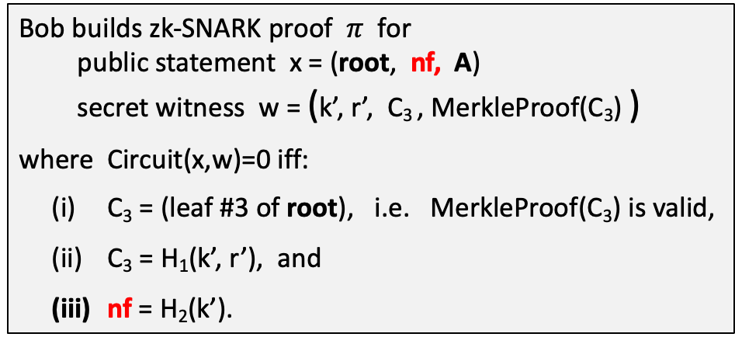
Tornado cash: withdrawal (simplified)
H₁, H₂: R ⇾ {0,1}²⁵⁶
Withdraw coin #3 to addr A:
Merkle
root
has note= (k’, r’)
set nf = H₂(k’)
tree of
height 20
(2²⁰ leaves)
Bob builds zk-SNARK proof $π$ for
public statement x = (root, nf, A)
secret witness w = (k’, r’, C₃ , MerkleProof(C₃) )
where Circuit(x,w)=0 iff:
C₃ = (leaf #3 of root), i.e. MerkleProof(C₃) is valid,
C₃ = H₁(k’, r’), and
nf = H₂(k’).
C₁ C₂ C₃ C₄ 0 … 0
(address A not used in Circuit)
Notes:
Bob proves “I know some leaf in the coins tree whose nullifier is nf”. He does not which coin is being spent, which is why C3 is part of the secret witness.
Tornado uses Groth16. Lava.cash (same thing on Solana) uses zk-STARKs.

Slide 33
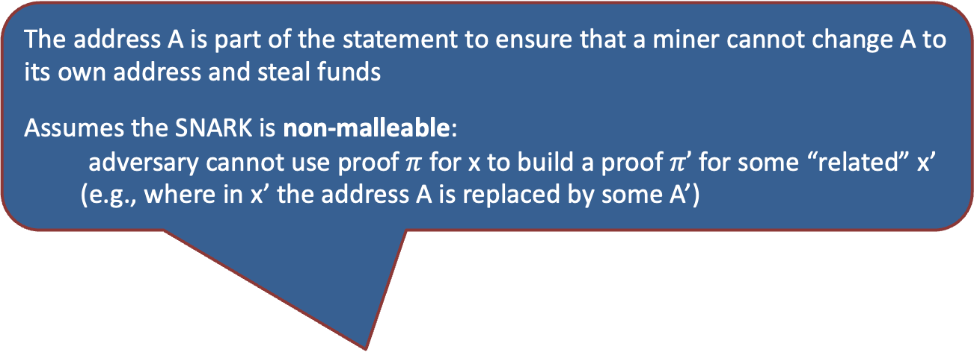
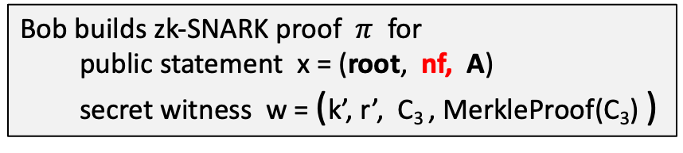
Tornado cash: withdrawal (simplified)
H₁, H₂: R ⇾ {0,1}²⁵⁶
Withdraw coin #3 to addr A:
The address A is part of the statement to ensure that a miner cannot change A to its own address and steal funds
Assumes the SNARK is non-malleable:
adversary cannot use proof $π$ for x to build a proof $π’$ for some “related” x’
(e.g., where in x’ the address A is replaced by some A’)
Merkle
root
has note= (k’, r’)
set nf = H₂(k’)
tree of
height 20
(2²⁰ leaves)
C₁ C₂ C₃ C₄ 0 … 0
Bob builds zk-SNARK proof $π$ for
public statement x = (root, nf, A)
secret witness w = (k’, r’, C₃ , MerkleProof(C₃) )
Notes:
Bob proves “I know some leaf in the coins tree whose nullifier is nf”. He does not which coin is being spent, which is why C3 is part of the secret witness.

Slide 34
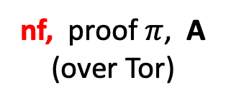
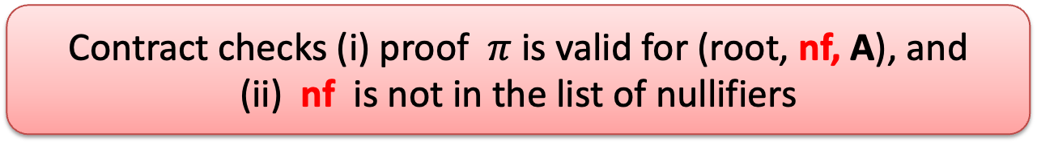
Tornado cash: withdrawal (simplified)
H₁, H₂: R ⇾ {0,1}²⁵⁶
100 USDC pool:
each coin = 100 USDC
Treasury: 400 USDC
Merkle
root
coins
Merkle
root
nf₁
Withdraw coin #3
to addr A:
nf₂
tree of
height 20
(2²⁰ leaves)
nf, proof $π$, A
(over Tor)
(32 bytes)
next = 5
C₁ C₂ C₃ C₄ 0 … 0
Bob’s ID and coin C₃
are not revealed
nullifiers
contract state
public list of coins
Contract checks (i) proof $π$ is valid for (root, nf, A), and
(ii) nf is not in the list of nullifiers
Notes:
Gas can be payed by a relayer, so that Bob’s account is not recorded.

Slide 35
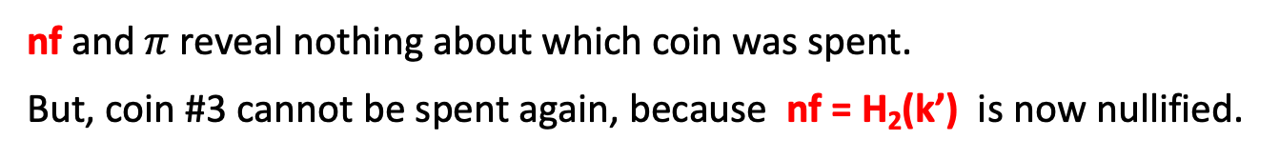
Tornado cash: withdrawal (simplified)
H₁, H₂: R ⇾ {0,1}²⁵⁶
100 USDC pool:
each coin = 100 USDC
Treasury: 300 USDC
Merkle
root
coins
Merkle
root
nf₁
Withdraw coin #3
to addr A:
nf₂
tree of
height 20
(2²⁰ leaves)
(32 bytes)
nf
nf, proof $π$, A
(over Tor)
next = 5
C₁ C₂ C₃ C₄ 0 … 0
100 USDC
nullifiers
to address A
contract state
public list of coins
… but observer does not
know which are spent
nf and $π$ reveal nothing about which coin was spent.
But, coin #3 cannot be spent again, because nf = H₂(k’) is now nullified.
Notes:
Stress that H1 is collision resistant.

Slide 36
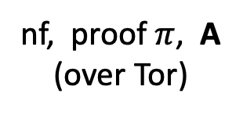
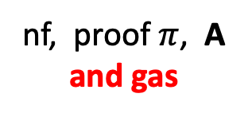
Who pays the withdrawal gas fee?
Problem: how does Bob pay for gas for the withdrawal Tx?
If paid from Bob’s address, then fresh address is linked to Bob
Tornado’s solution: Bob uses a relay
nf, proof $π$, A
and gas
nf, proof $π$, A
(over Tor)
(100-gas) USDC
to address A
gas
relay
tornado
contract
Note: relay and Tornado also charge a fee

Slide 37
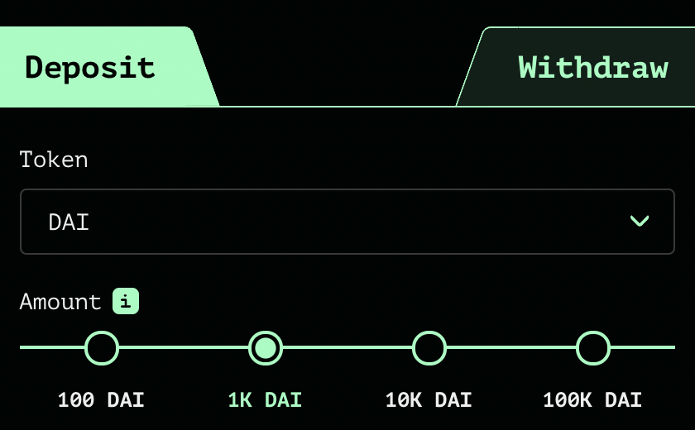
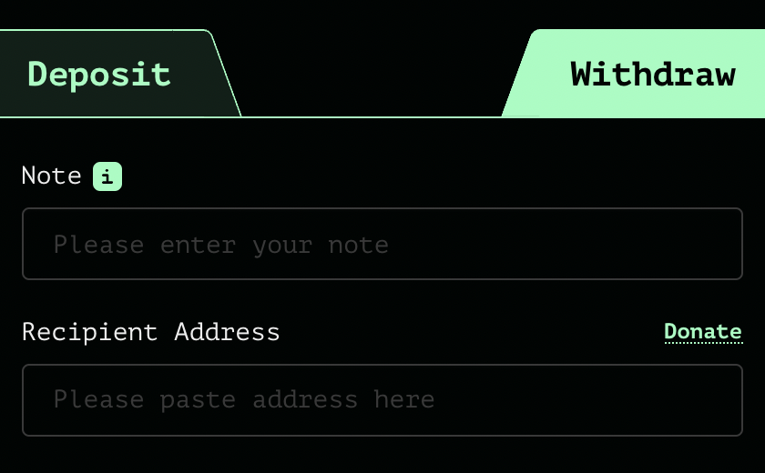
Tornado Cash: the UI
enter note here
address
After deposit: get a note
Later, use note to withdraw
(wait before withdrawing)

Slide 38
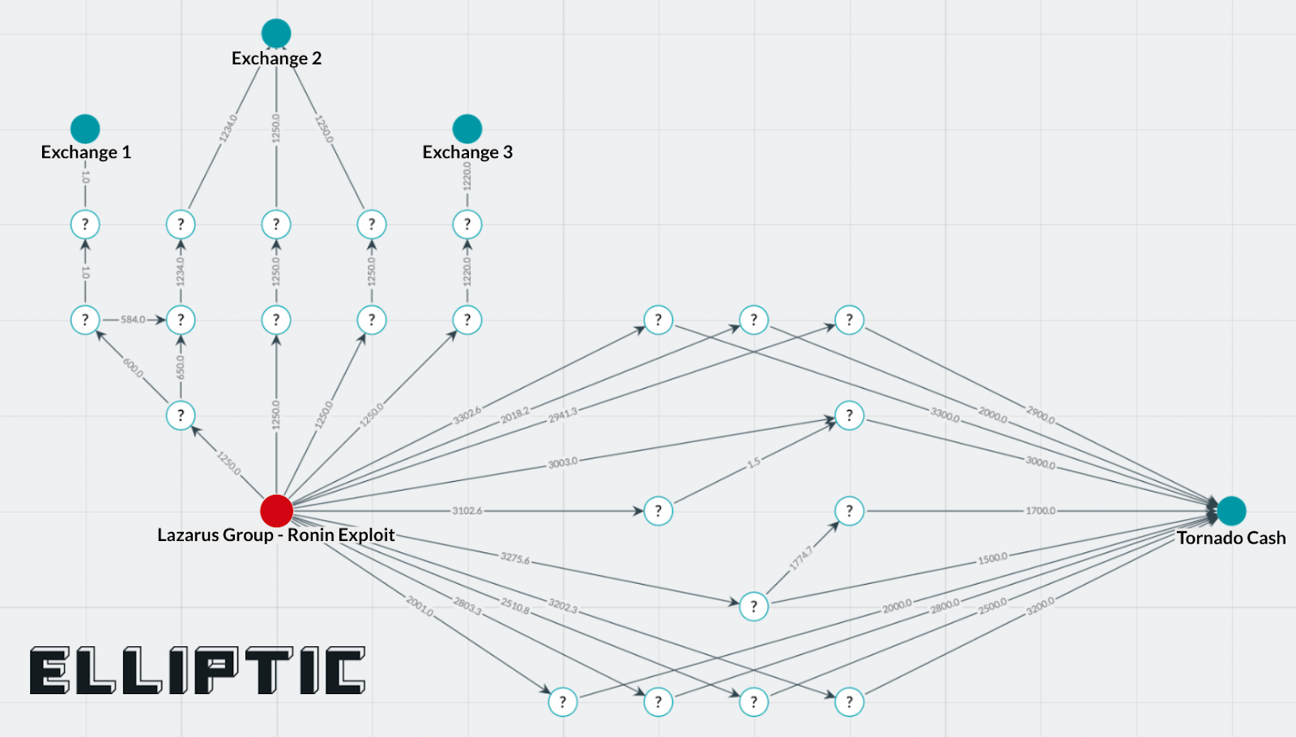
Tornado trouble … U.S. sanctions
The Ronin-bridge hack (2022):
In late March: ≈600M USD stolen … $80M USD sent to Tornado
April: Lazarus Group suspected of hack
August: “U.S. Treasury Sanctions Virtual Currency Mixer Tornado Cash”
  Lots of collateral damage … and two lawsuits
Tornado
The lesson: complete anonymity in the
payment system is problematic

Slide 39
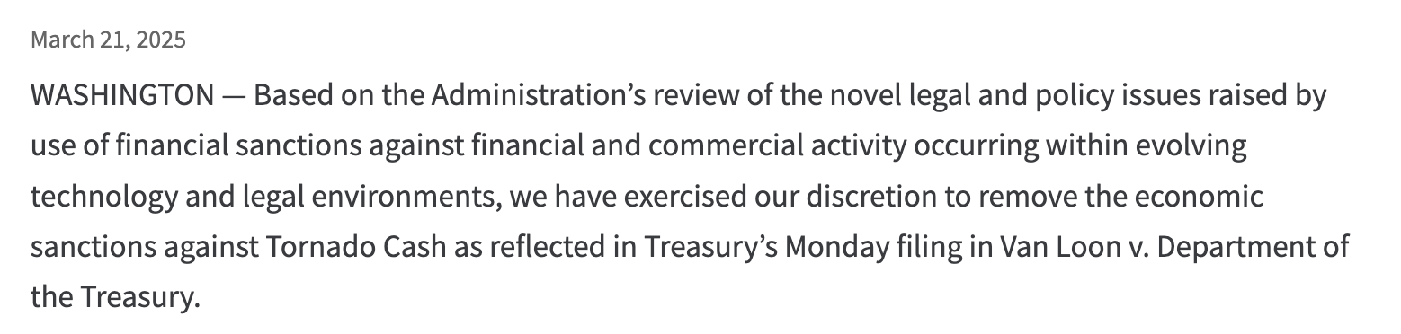
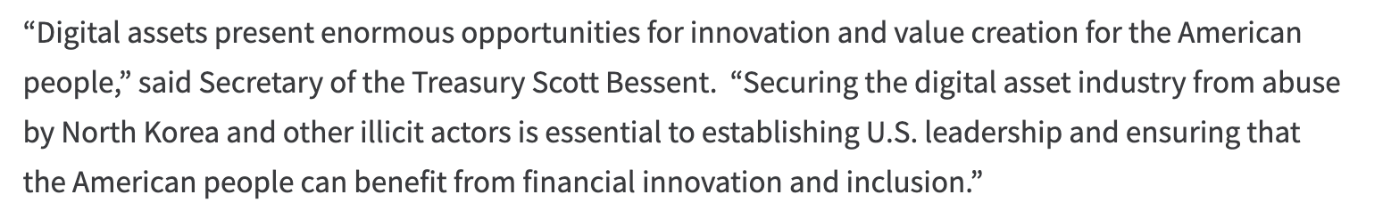
Sanctions removed: March 2025
…
https://home.treasury.gov/news/press-releases/sb0057

Slide 40
Building a Compliant Mixer?
Examples: Railgun, PrivacyPools
(2021)
(2025)

Slide 41
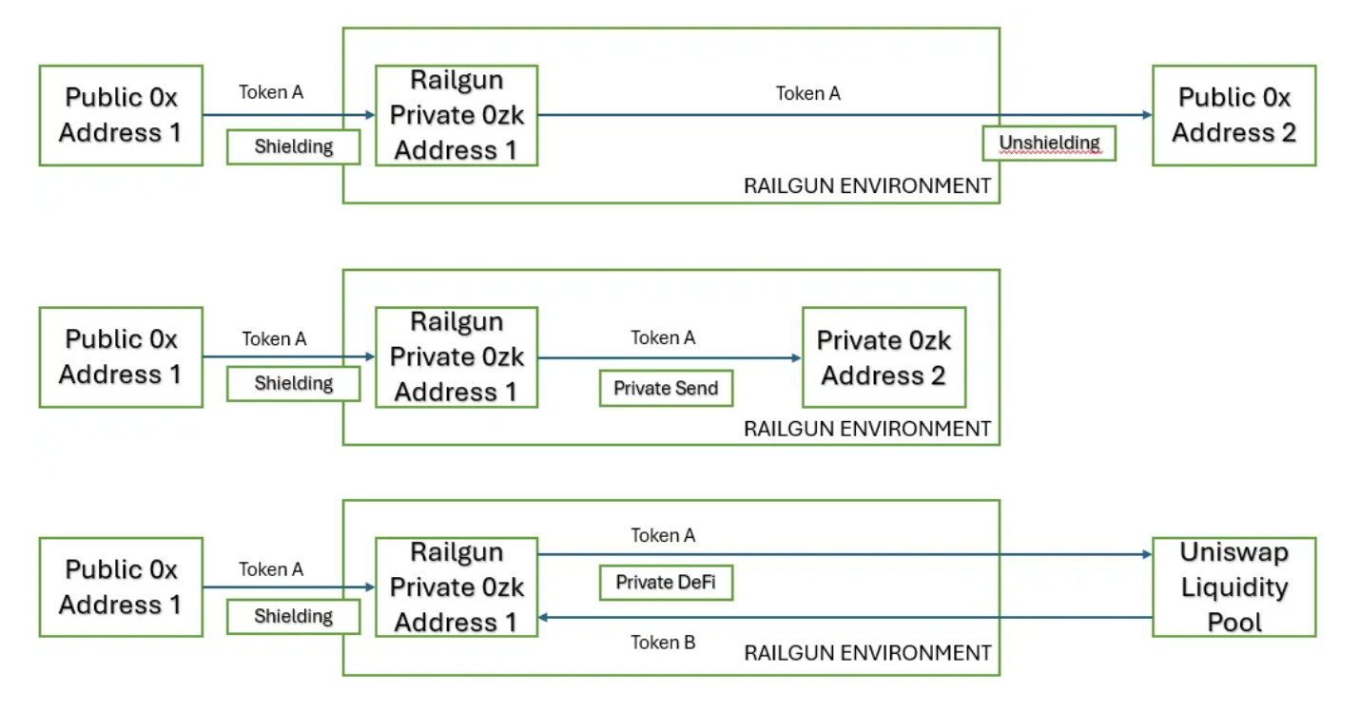
Railgun Functionality
Notes:
Code: https://etherscan.io/address/0xc0BEF2D373A1EfaDE8B952f33c1370E486f209Cc#code

Slide 42
A compliant mixer
Defense #1: deposit filtering. Ensure incoming funds are not sanctioned
Chainalysis SanctionsList contract:
function isSanctioned(address addr) public view returns (bool) {
return sanctionedAddresses[addr] == true ;
}
When funds are moved into Railgun they are locked for an hour
Victim of a theft has an hour to report the theft
… funds rejected if source address is reported to be a bad actor

Slide 43
A compliant mixer
Defense #2: withdrawal filtering. At withdrawal, require a ZK proof that the source of funds is not currently on a sanctioned list
How?
modify the way Tornado computes Merkle leaves during deposit to include msg.sender.
in our example Alice sets: C₄ = [ H₁(k, r), msg.sender ]
During withdrawal Bob proves in ZK that msg.sender in his leaf is not currently on a sanctioned list (Proof-of-Innocence, PoI)
Notes:
Discourages bad behavior in Tornado: the funds of sanctioned addressed become trapped inside Tornado.

Slide 44
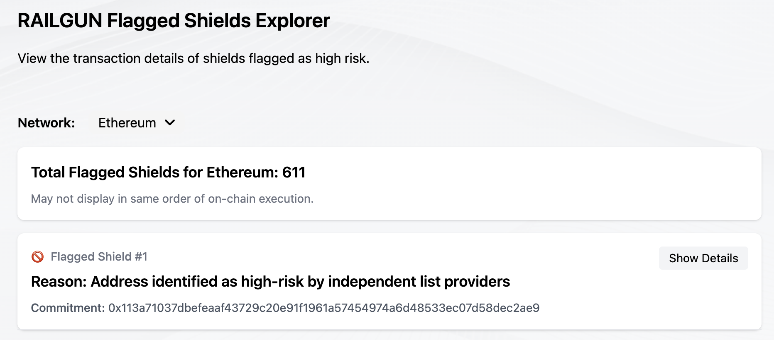
Proof of innocence providers
Several Proof of Innocence (PoI) list providers:
Elliptic, ScamSniffer, PureFi, SlowMist, Chainalysis
Railgun:
PoI is provided
on deposit (!)
Notes:
https://docs.railgun.org/wiki/assurance/private-proofs-of-innocence

Slide 45
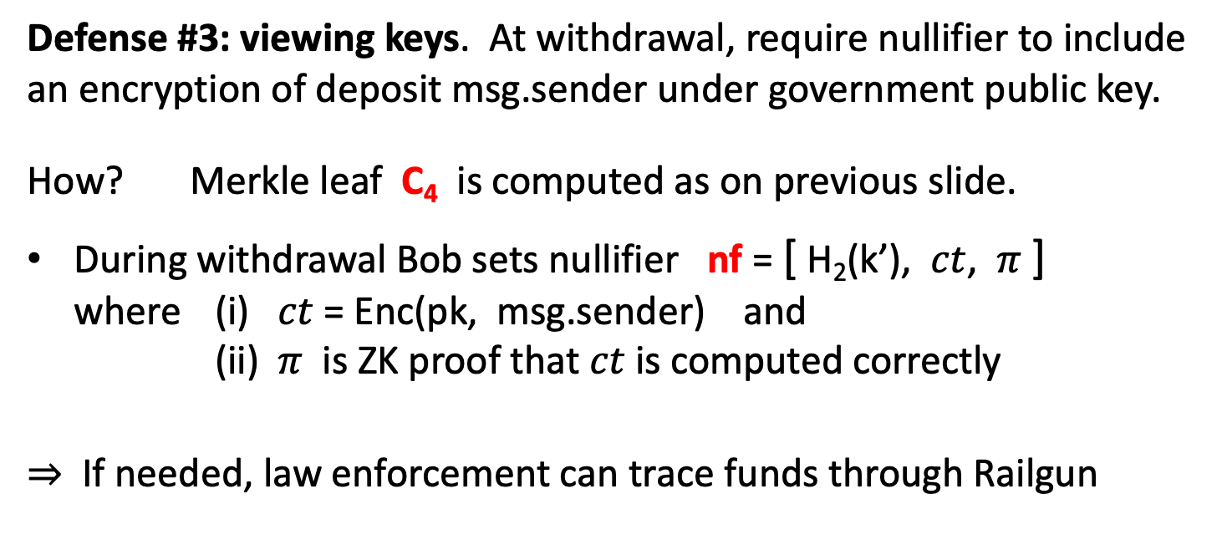
A compliant mixer
Defense #3: viewing keys. At withdrawal, require nullifier to include an encryption of deposit msg.sender under government public key.
How? Merkle leaf C₄ is computed as on previous slide.
During withdrawal Bob sets nullifier nf = [ H₂(k’), $ct$, $π$ ]
where (i) $ct$ = Enc(pk, msg.sender) and
(ii) $π$ is ZK proof that $ct$ is computed correctly
⇒ If needed, law enforcement can trace funds through Railgun
Notes:
User chooses which pk to use. How to control access to the secret key sk? What if sk is lost or stolen?

Slide 46
So only good actors?
Jan. 2023: a wallet associated with the Harmony Bridge hack sent 897 ETH through Railgun.
A single deposit Tx using 31 distinct smart contract events,
many of which escaped detection by investigative tools
Notes:
https://www.anchain.ai/blog/railgun-proof-of-innocence

Slide 47
Other approaches to compliant privacy?
Example: ERC-7984 (ConfidentialFungibleToken)
A confidential ERC-20.
  All account balances are encrypted under a global public key
  The secret decryption key is held by a trusted party (or parties)
Transfers are done using homomorphic encryption
Authorized parties can request to decrypt current balance
  account owner, relevant law-enforcement
Importantly: hides amount, but not who is paying who
Notes:
https://docs.openzeppelin.com/confidential-contracts/api/token#ERC7984

Slide 48
END OF LECTURE
Next lecture: how to build a SNARK

