Slide 1
Privacy on the Blockchain
CS251 Fall 2025
(cs251.stanford.edu)
Dan Boneh

Slide 2
The need for privacy in the financial system
Supply chain privacy:
  A manufacturer does not want to reveal
  how much it pays its supplier for parts.
Payment privacy:
  A company that pays its employees in crypto wants to keep list of employees and salaries private.
  Endusers need privacy for rent, donations, purchases
Business logic privacy: Can the code of a smart contract be private?

Slide 3
The need for privacy in the financial system
The bottom line:
Blockchains cannot reach their full potential
without some form of private transactions
Either (i) hide transaction amount, but not the end points, or
(ii) hide both the amount and the end points.

Slide 4
Types of Privacy
Pseudonymity: (weak privacy)
Every user has a long-term consistent pseudonym (e.g. reddit)
  Pros: reputation
  Cons: link to real-world identity can leak over time
Full anonymity: User’s transactions are unlinkable
No one can tell if two transactions are from the same address
Notes:
Example: User timezone can be inferred. My travel schedule can result in linking.

Slide 5
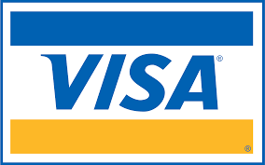
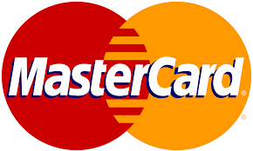

A difficult question: privacy from who?
No privacy:
Everyone can see all transactions in the clear
Privacy from the public:
Only a trusted operator can see transactions
Semi-full privacy:
only “local” law enforcement can see transactions
full privacy:
no one can see transactions

Slide 6
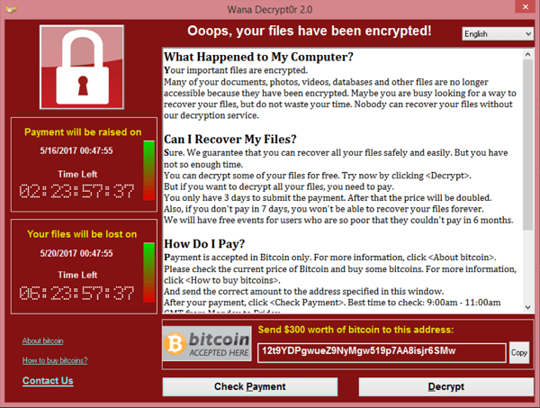
Negative aspects of full privacy
How to prevent criminal activity?
The challenge:
How to support positive applications of
private payments, but prevent the negative ones?
Can we ensure legal compliance while preserving privacy?
Yes! The key technology: zero knowledge proofs
Notes:
wanacry

Slide 7
Are Bitcoin and Ethereum Private?
The base systems are definitely not …

Slide 8
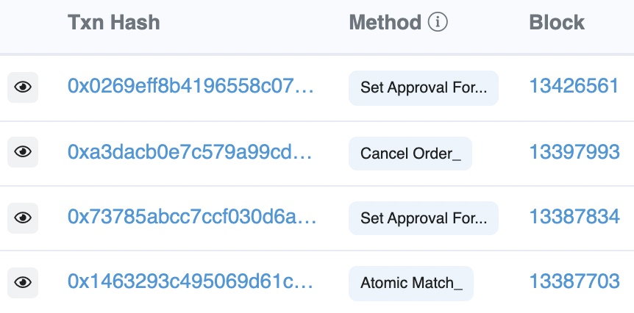
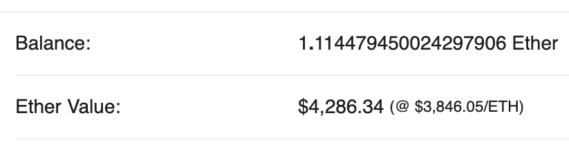
Privacy in Ethereum?
Every account balance is public
For Dapps: code and internal state are public
All account transactions are linked to account
etherscan.io:
Address 0x1654b0c3f62902d7A86237…

Slide 9
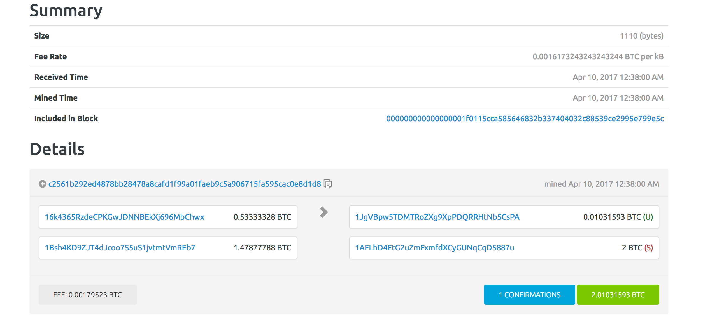
Privacy in Bitcoin?
from addresses amounts
to addresses amounts
Alice can have many addresses (creating address is free)
Transaction data can be used
to link an address to a physical identity
(chainalysis)
Inputs: A1:4, A2: 5 out: B:6, A3:3
Change address
Alice’s addresses
Bob’s address
Notes:
Can build clusters of linked addresses.

Slide 10
Linking an addresses to an identity
inputs: A1: 4, A2: 5 outputs: B: 6, A3: 3
Alice buys a book from a merchant:
Alice learns one of merchant’s address (B)
Merchant links three addresses to Alice (A1, A2, A3)
Alice uses an exchange (ETH ↔︎ USD)
BSA: a US exchange must do KYC (know your customer)
… collect and verify Alice’s ID
Exchange links Alice to her addresses (A1, A2, A3)
Notes:
BSA: Bank Secrecy Act

Slide 11


At the network layer …
Miners/validators learn Alice’s IP address
end users
sk_{A}
signed Tx
sk_{B}
sk_{C}
P2P network
Solution:

Slide 12
De-anonymization strategy: Idioms of use
A general strategy for de-anonymizing Bitcoin addresses
Heuristic 1:
Two addresses are input to a TX
⇒ both addresses are controlled by same entity

Slide 13
De-anonymization strategy: Idioms of use
Heuristic 2:
Change address is controlled by the same user as input address
Which is the change address?
  Heuristic: a new address that receives less than every input

Slide 14
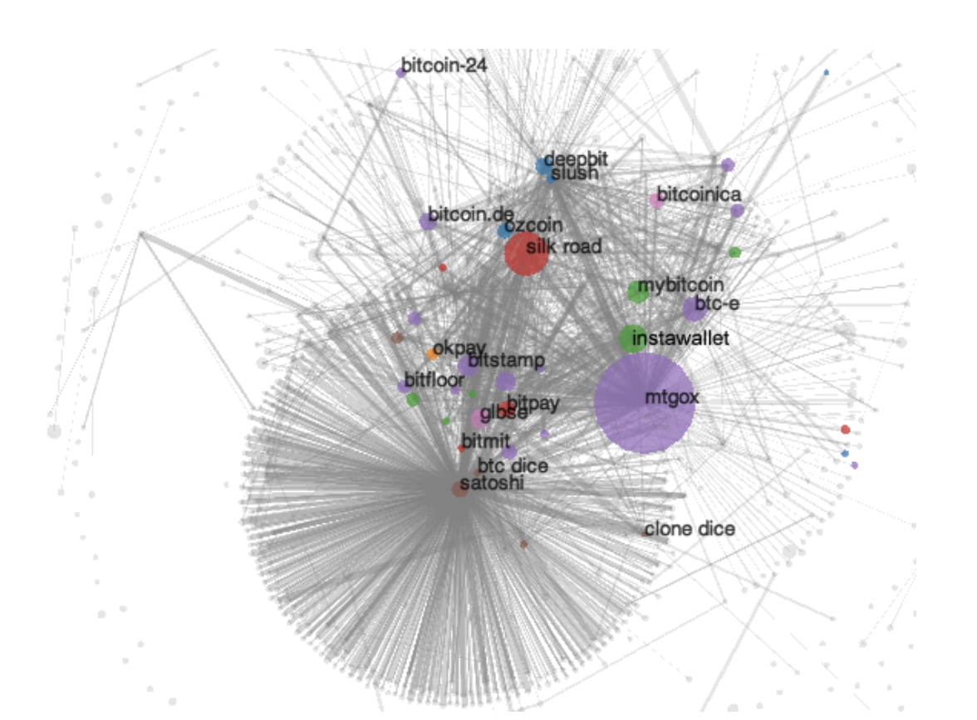
A Bitcoin experiment [Meiklejohn, et al.]
step 1: Heuristic 1 and 2 ⇒ 3.3M clusters
step 2: 1070 addresses identified by interacting with merchants
  Coinbase, Kraken, …
step 3: now 15% of all addresses identified
  Learn total assets for all clusters
Commercial efforts: Chainalysis, Elliptic, …
Notes:
https://arxiv.org/abs/2205.13882

Slide 15
Private coins on a Public Blockchain

Slide 16
Attempt 1: simple mixing
mixer
address: M
1 ETH to M
from Alice
fresh addr X
from Alice
TLS
Send:
1 ETH to X
1 ETH to Y
1 ETH to Z
1 ETH to M
from Bob
fresh addr Y
from Bob
TLS
1 ETH to M
from Carol
fresh addr Z
from Carol
has 3 ETH
blockchain
TLS
Observer knows Y belongs to one of {Alice, Bob, Carol} but does not know which one
⟹ anonymity set of size 3.
Problems: (i) mixer M knows shuffle, (ii) mixer can abscond with 3 ETH !!

Slide 17
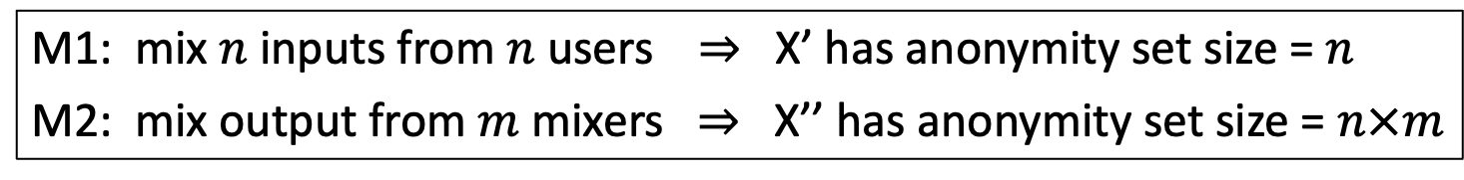
Increasing the anonymity set
Mixer
M1
Mixer
M2
addr X
X’
X’’
M1: mix $n$ inputs from $n$ users ⇒ X’ has anonymity set size = $n$
M2: mix output from $m$ mixers ⇒ X’’ has anonymity set size = $n×m$
Privacy: as long as one of M1 or M2 are honest

Slide 18
Secure mixing without a mixer?
Problem: Mixer can abscond with funds or reveal the shuffle.
Can we securely mix without a trusted mixer? Answer: yes!
on Bitcoin: CoinJoin (used by, e.g., Wasabi wallet)
on Ethereum: Tornado cash, Railgun, Privacy Pools, …
… a single mixer using ZK proofs – next lecture

Slide 19

CoinJoin: Bitcoin Mixing without Mixer
The setup: Alice, Bob, and Carol want to mix together.
Alice owns UTXO A1:5, Bob owns UTXO B1:3, Carol owns C1:2
A1: 5, A3 (change addr)
A2 (post mix address over Tor)
A1: 5, A3
B1: 3, B3
C1: 2, C3
B2, A2, C2
B1: 3, B3 (change addr)
mix
addresses
B2 (post mix address over Tor)
(same as Alice and Bob)
public forum
Notes:
Each participants knows which mix address is theirs, but knows nothing about the other mix addresses.

Slide 20
CoinJoin: Bitcoin Mixing without Mixer
CoinJoin TX: all three prepare and sign the following Tx:
inputs (not private): A1: 5, B1: 3, C1: 2
outputs (private): B2: 2, A2: 2, C2: 2
outputs (not private): A3: 3, B3: 1
mix addresses
Mixed UTXOs all have same value = min of inputs (2 in this case)
All three post sigs on Pastebin ⇒ one of them posts Tx on chain.

Slide 21
Coinjoin drawbacks
In practice: each CoinJoin Tx mixes about 40 inputs
Large Tx: 40 inputs, 80 outputs
All participants must sign CoinJoin Tx for it to be valid
⇒ ensures all of them approve the CoinJoin Tx
… but any one of them can disrupt the process

Slide 22
Beyond simple mixing
Private Tx on a public blockchain

Slide 23
Can we have private transactions
on a public blockchain?
Naïve reasoning:
universal verifiability ⇒ transaction data must be public
otherwise, how we can verify Tx ??
crypto magic ⇒ private Tx on a publicly verifiable blockchain
Crypto tools: commitments and zero knowledge proofs

Slide 24

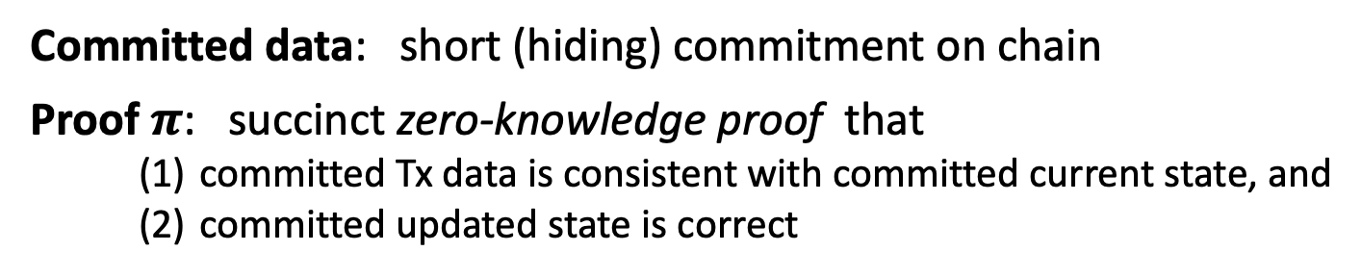
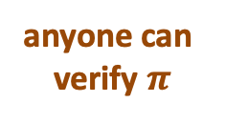
A paradigm for Private Tx
public blockchain
committed state
Tx
$$π$$
updated
committed state
anyone can
verify $π$
committed
Tx data
(reveals nothing about Tx data or state)
Committed data: short (hiding) commitment on chain
Proof $π$: succinct zero-knowledge proof that
    committed Tx data is consistent with committed current state, and
    committed updated state is correct

Slide 25
Review: cryptographic commitments
Cryptographic commitment: emulates an envelope
data
data
Many applications: e.g., a DAPP for a sealed bid auction
Every participant commits to its bid,
Once all bids are in, everyone opens their commitment

Slide 26
Cryptographic Commitments
Syntax: a commitment scheme is two algorithms
commit(msg, r) ⇾ com
verify(msg, com, r) ⇾ accept or reject
anyone can verify that commitment was opened correctly
secret randomness
commitment string

Slide 27
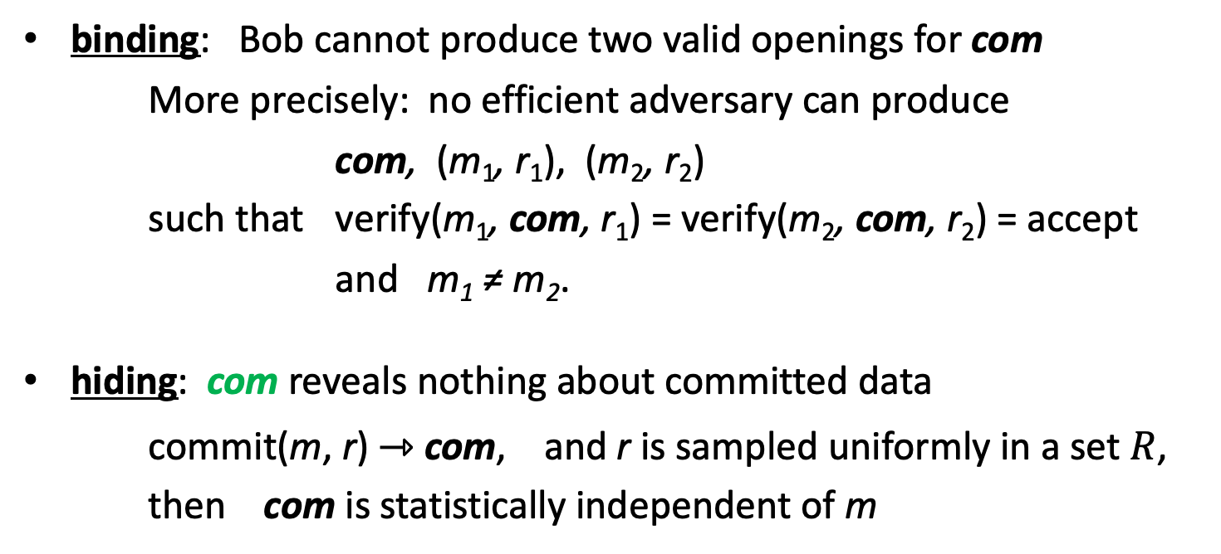
Commitments: security properties
binding: Bob cannot produce two valid openings for com
More precisely: no efficient adversary can produce
com, (m₁, r₁), (m₂, r₂)
such that verify(m₁, com, r₁) = verify(m₂, com, r₂) = accept
and m₁ ≠ m₂.
hiding: com reveals nothing about committed data
commit(m, r) ⇾ com, and r is sampled uniformly in a set $R$,
then com is statistically independent of m

Slide 28
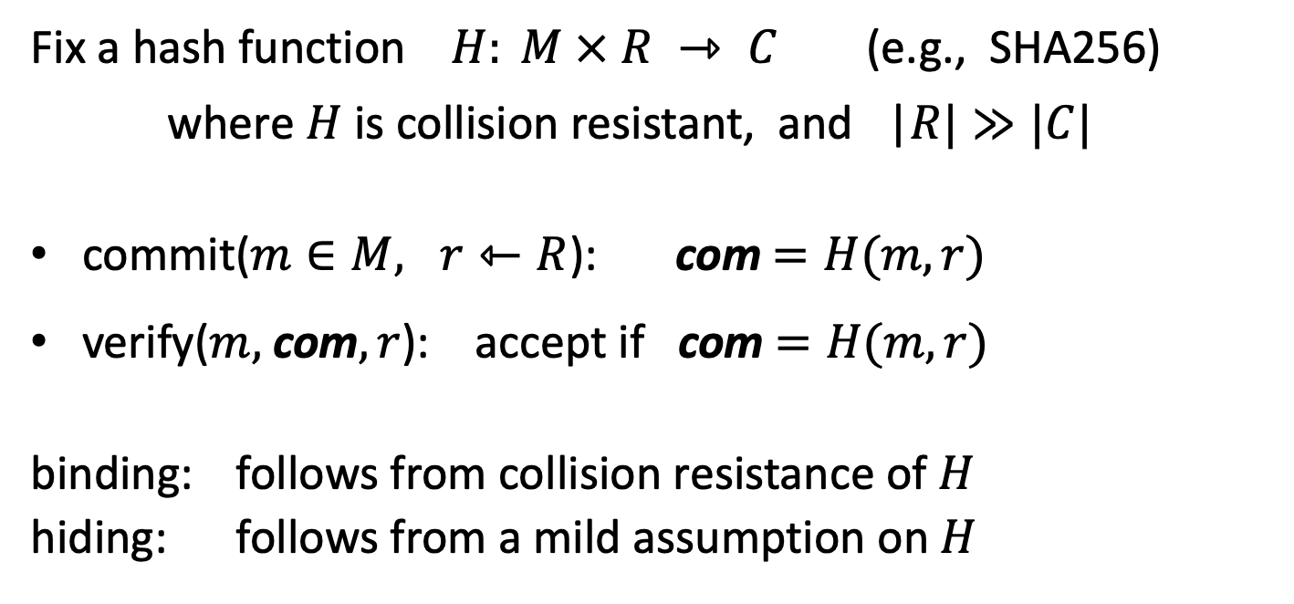
Example: hash-based commitment
Fix a hash function $H: M × R ⇾ C$(e.g., SHA256)
where $H$ is collision resistant, and |$R|≫|C|$
commit($m∈M, r⇽R$): com$=H(m,r)$
verify($m,$com$, r$): accept if com $=H(m,r)$
binding: follows from collision resistance of $H$
hiding: follows from a mild assumption on $H$

Slide 29
What is a zk-SNARK?
Succinct zero knowledge proofs:
an important tool for privacy on the blockchain

Slide 30
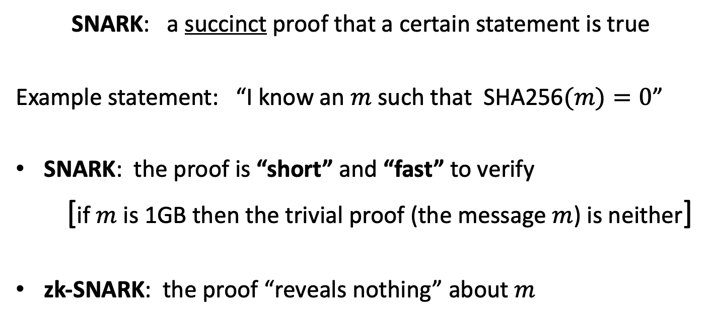
What is a zk-SNARK ? (intuition)
SNARK: a succinct proof that a certain statement is true
Example statement: “I know an $m$ such that SHA256$(m)=0$”
SNARK: the proof is “short” and “fast” to verify
[if $m$ is 1GB then the trivial proof (the message $m$) is neither]
zk-SNARK: the proof “reveals nothing” about $m$

Slide 31
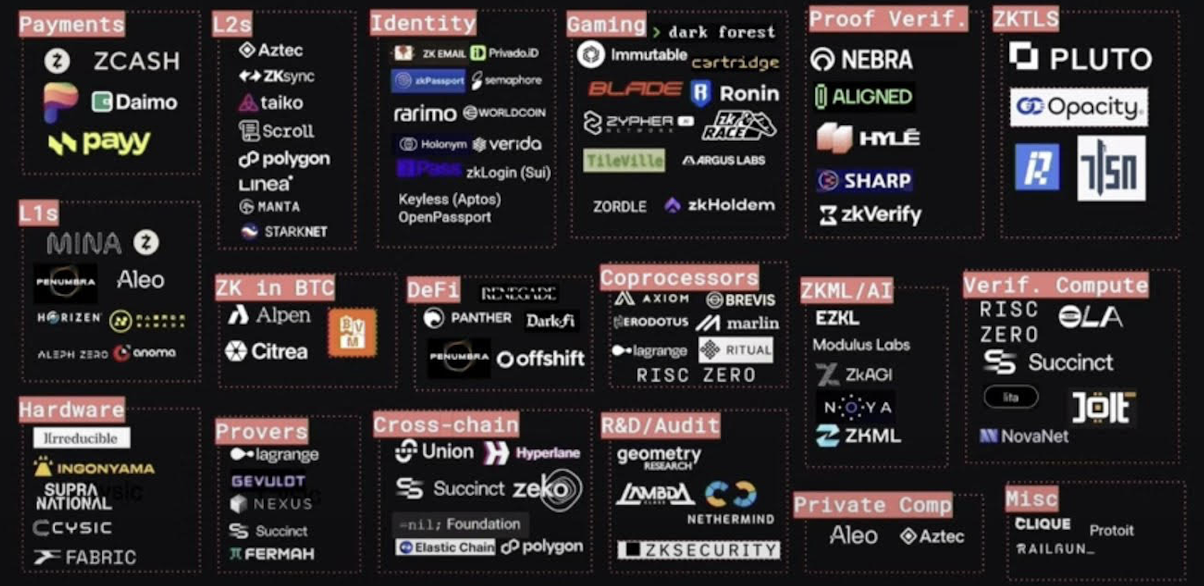
Commercial interest in SNARKs
Many more companies using (zk)-SNARKs: https://zkhack.dev/the-map-of-zk/

Slide 32
Blockchain Applications I
Outsourcing computation: (no need for zero knowledge)
L1 chain quickly verifies the work of an off-chain service
Examples:
Scalability: proof-based Rollups (zkRollup)
off-chain service processes a batch of Tx;
L1 chain verifies a succinct proof that Tx were processed correctly
Bridging blockchains: proof of consensus (zkBridge)
Chain A produces a succinct proof about its state. Chain B verifies.
To minimize gas: need a short proof, fast to verify
Notes:
Stress non-interactive aspect of proof.

Slide 33
Blockchain Applications II
Some applications require zero knowledge (privacy):
Private Tx on a public blockchain:
  zk proof that a private Tx is valid (Tornado cash, Railgun, Zcash, Aleo)
Compliance:
  Proof that a private Tx is compliant with banking laws
  Proof that an exchange is solvent in zero-knowledge (Proven)
More on these blockchain applications in a minute

Slide 34
Many non-blockchain applications
Blockchains drive the development of SNARKs
… but many non-blockchain applications benefit

Slide 35



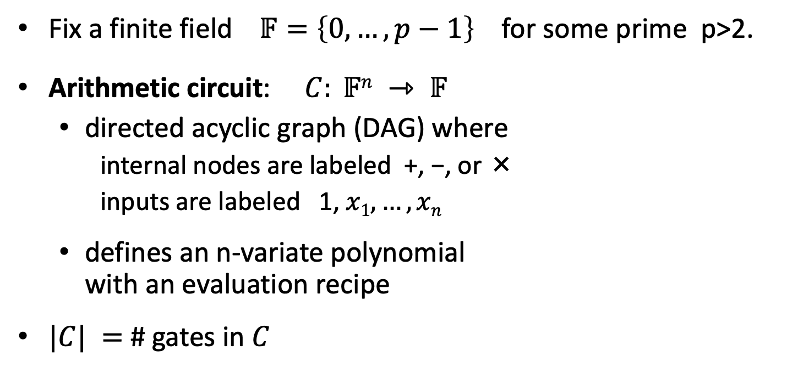




Arithmetic circuits
Fix a finite field $𝔽=\left\{0, …, p−1\right\}$ for some prime p>2.
Arithmetic circuit: $C: 𝔽n ⇾ 𝔽$
  directed acyclic graph (DAG) where
    internal nodes are labeled +, −, or ×
    inputs are labeled 1, $x1, …, xn$
  defines an n-variate polynomial
  with an evaluation recipe
$|C| =$ # gates in $C$
$$x1(x1+x2+1)(x2−1)$$
$$\text{×}$$
$$+$$
$$−$$
$$x1$$
$$x2$$
$$1$$

Slide 36
Interesting arithmetic circuits
Examples:
C_{hash}(h, m): outputs 0 if SHA256(m) = h , and ≠0 otherwise
C_{hash}(h, m) = (h – SHA256(m)) , |C_{hash}| ≈ 20K gates
C_{sig}(pk, m, σ): outputs 0 if σ is a valid ECDSA signature
on m with respect to pk
Notes:
WRITE: and m_i (1– m_i) = 0 for all i=1,…,256

Slide 37
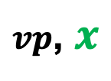
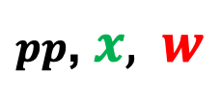



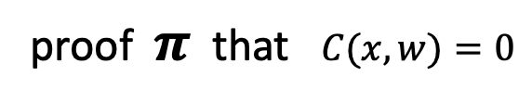
(preprocessing) NARK: Non-interactive ARgument of Knowledge
Public arithmetic circuit: $C( x, w ) ⇾ 𝔽$
public statement in $𝔽_{}^{n}$
secret witness in $𝔽_{}^{m}$
Preprocessing (setup): S($C$) ⇾ public parameters ($pp$, $vp$ )
$pp$, $x,$ $w$
$vp$, $x$
proof $π$ that $C(x,w)=0$
Prover
Verifier
accept or
reject
Notes:
Knowledge is stronger the soundness.

Slide 38
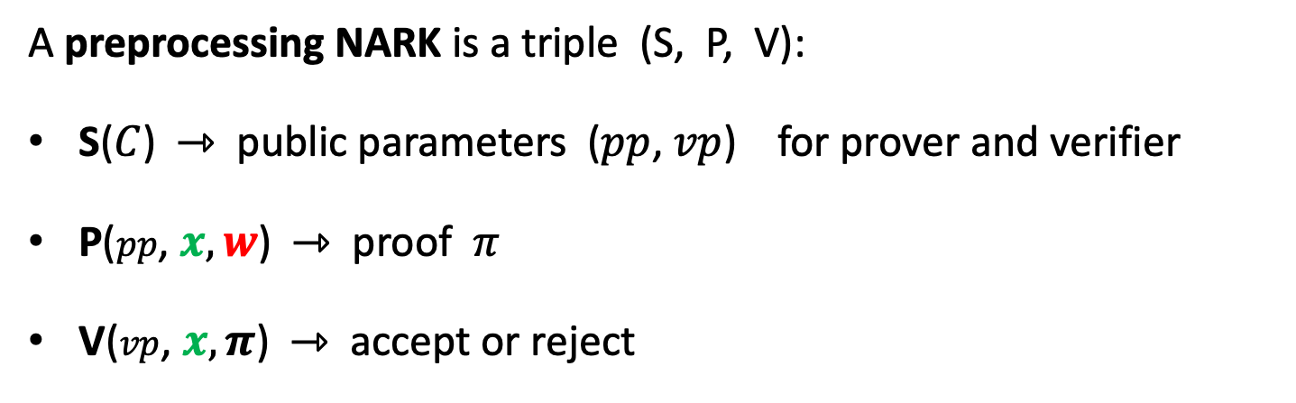
(preprocessing) NARK: Non-interactive ARgument of Knowledge
A preprocessing NARK is a triple (S, P, V):
S($C$) ⇾ public parameters ($pp$, $vp$) for prover and verifier
P($pp$, $x, w$) ⇾ proof $π$
V($vp$, $x, π$) ⇾ accept or reject

Slide 39


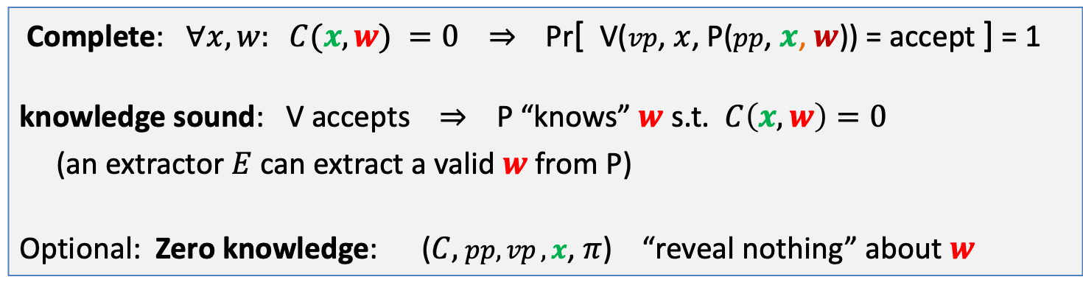

NARK: requirements (informal)
Prover P($pp$, $x, w$)
Verifier V ($vp$, $x$, $π$)
proof $π$
accept or reject
Complete: $∀x, w: C(x, w) =0$ ⇒ Pr[ V($vp$, $x$, P($pp$, $x$, $w$)) = accept ] = 1
knowledge sound: V accepts ⇒ P “knows” $w$ s.t. $C\left(x, w\right)=0$
(an extractor $E$ can extract a valid $w$ from P)
Optional: Zero knowledge: ($C,$ $pp,vp ,x$, $π$) “reveal nothing” about $w$

Slide 40
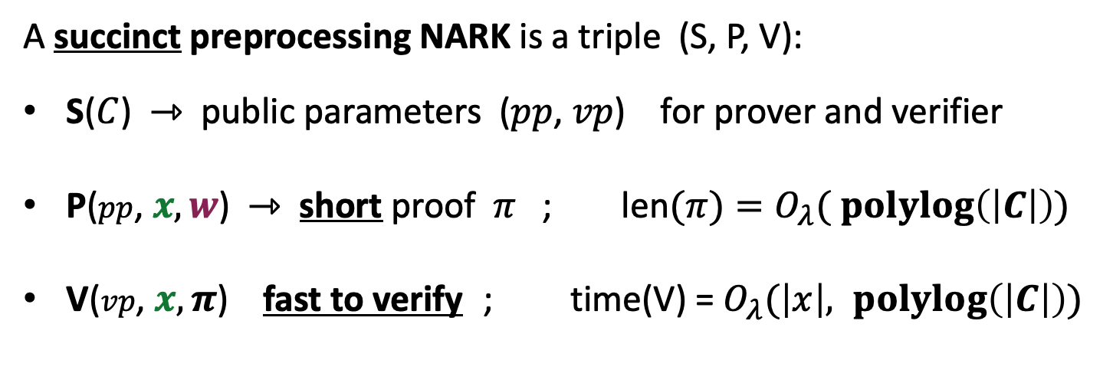
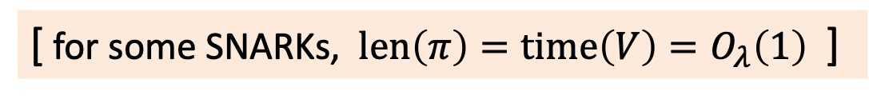

SNARK: a Succinct ARgument of Knowledge
A succinct preprocessing NARK is a triple (S, P, V):
S($C$) ⇾ public parameters ($pp$, $vp$) for prover and verifier
P($pp$, $x, w$) ⇾ short proof $π$ ; len$(π)=O_{λ}( \operatorname{polylog}\left(\left|C\right|\right))$
V($vp$, $x, π$) fast to verify ; time(V) = $O_{λ}(\left|x\right|, \operatorname{polylog}\left(\left|C\right|\right))$
short “summary” of circuit
V has no time to read $C$ !!
[ for some SNARKs, $len\left(π\right)=time\left(V\right)=O_{λ}\left(1\right)$ ]
Notes:
log |C| is bigger than log |w|, so this is not as strict as requiring proof size to be log |w|. In many SNARKs, proof size and verify time is independent of |C| or |w|.

Slide 41
SNARK: a Succinct ARgument of Knowledge
SNARK: a NARC (complete and knowledge sound) that is succinct
zk-SNARK: a SNARK that is also zero knowledge

Slide 42
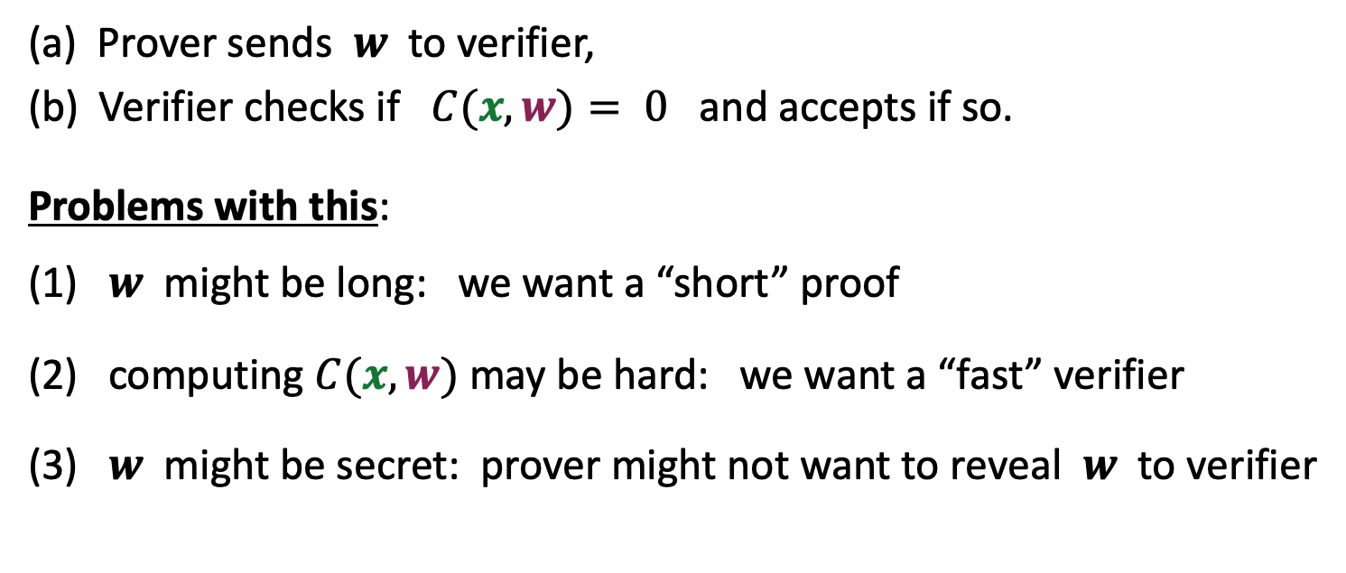
The trivial SNARK is not a SNARK
(a) Prover sends $w$ to verifier,
(b) Verifier checks if $C(x, w)= 0$ and accepts if so.
Problems with this:
(1) $w$ might be long: we want a “short” proof
(2) computing $C(x, w)$may be hard: we want a “fast” verifier
(3) $w$ might be secret: prover might not want to reveal $w$ to verifier

Slide 43


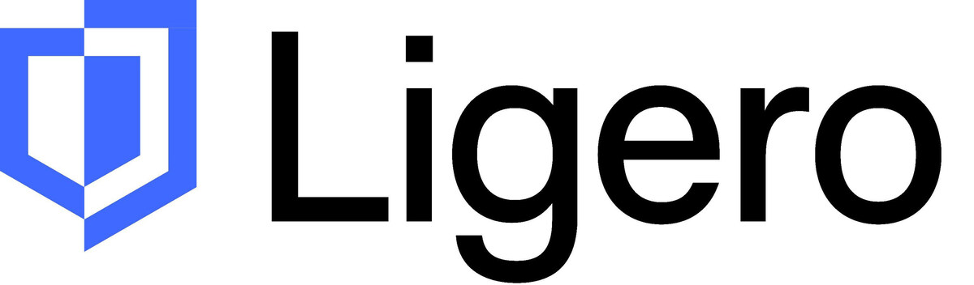

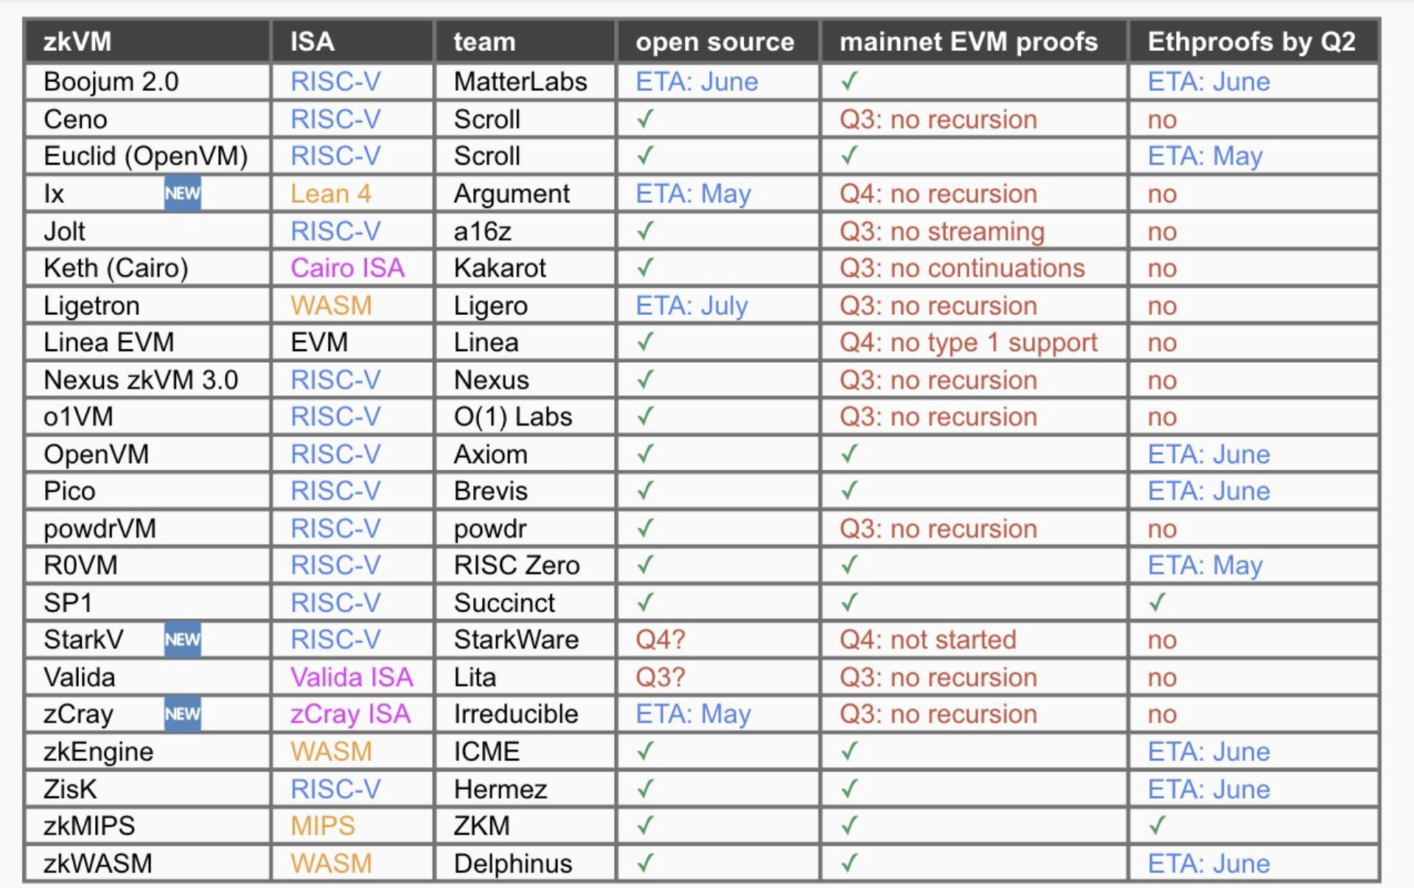

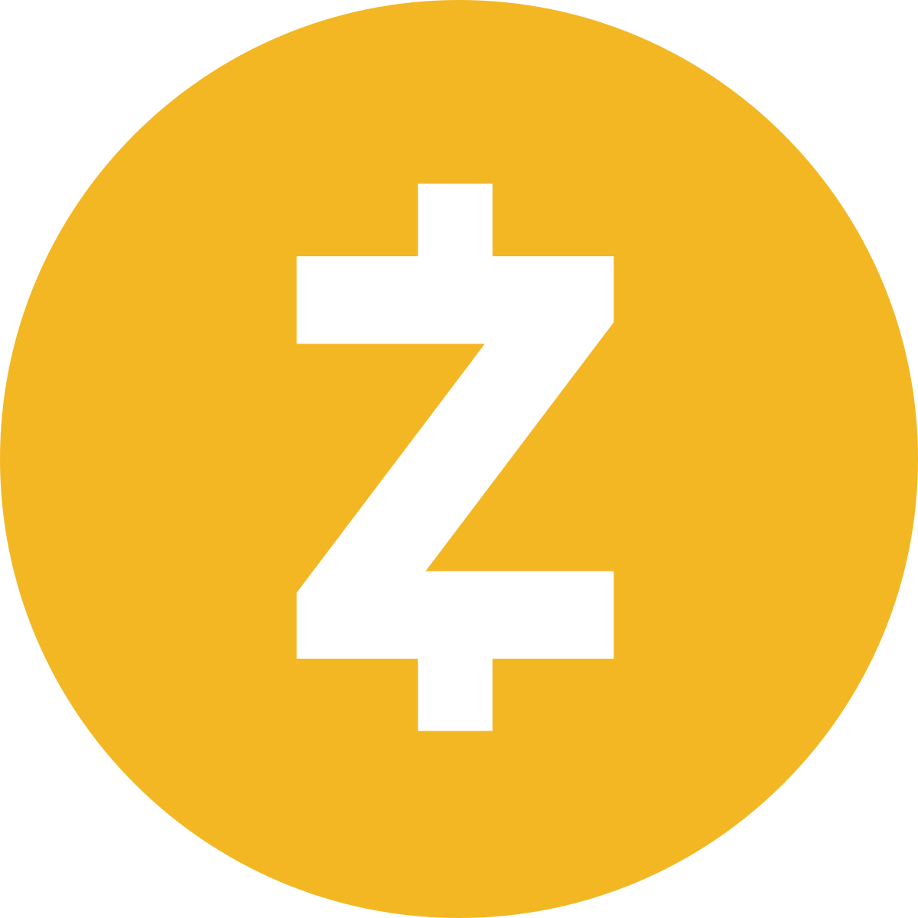
The SNARK zoo (a sub-sample) …
WHIR 🌪️
FRI-Binius
Greyhound
Blaze
Cambrian explosion of SNARKs
Basefold
STIR 🥣
Lasso
FICS
Hyperplonk
Mangrove
DewTwo
Brakedown
Gemini
Jolt
Binius
Ligetron
Mercury
Ligero++
fflonk
Plonky2
RedShift
SPARK
Halo Infinite
LaBRADOR
TinySpartan
DEEP-FRI
MIRAGE
Orion
SLAP 👋
Supersonic
Zeromorph
Dory
Halo
Virgo
Sonic
FRI
Fractal
STARK
Ligero
Plonk
Aurora
Bulletproofs
Marlin
BCS
Spartan
PST
Hyrax
Groth16
GGPR’13
DARK
KZG
zk Virtual Machines
Libra
2010
Time
2019
Credit: Giacomo Fenzi

Slide 44
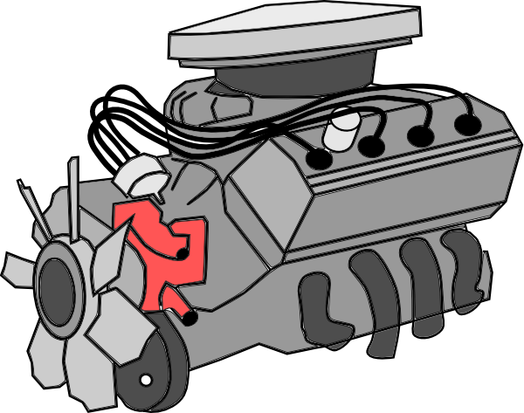

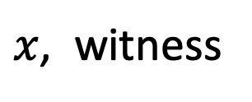
SNARKs in practice: two approaches
DSL
program
Circom,
Gnark
Leo,
Zinc,
Noir,
SNARK
friendly
format
circuit,
R1CS,
Plonkish,
heavy
computation
compiler
SNARK
prover
$$π$$
compiler
RISC-V
Virtual
Machine
(CPU + memory)
Rust
program
$x$, witness
Notes:
DSL: domain specific language

Slide 45
END OF LECTURE
Next lecture:
more on zk-SNARKs and their applications

