Slide 1
Other layer-1 architectures:
Solana, Sui, Aptos
CS251 Fall 2025
(cs251.stanford.edu)
Dan Boneh

Slide 2
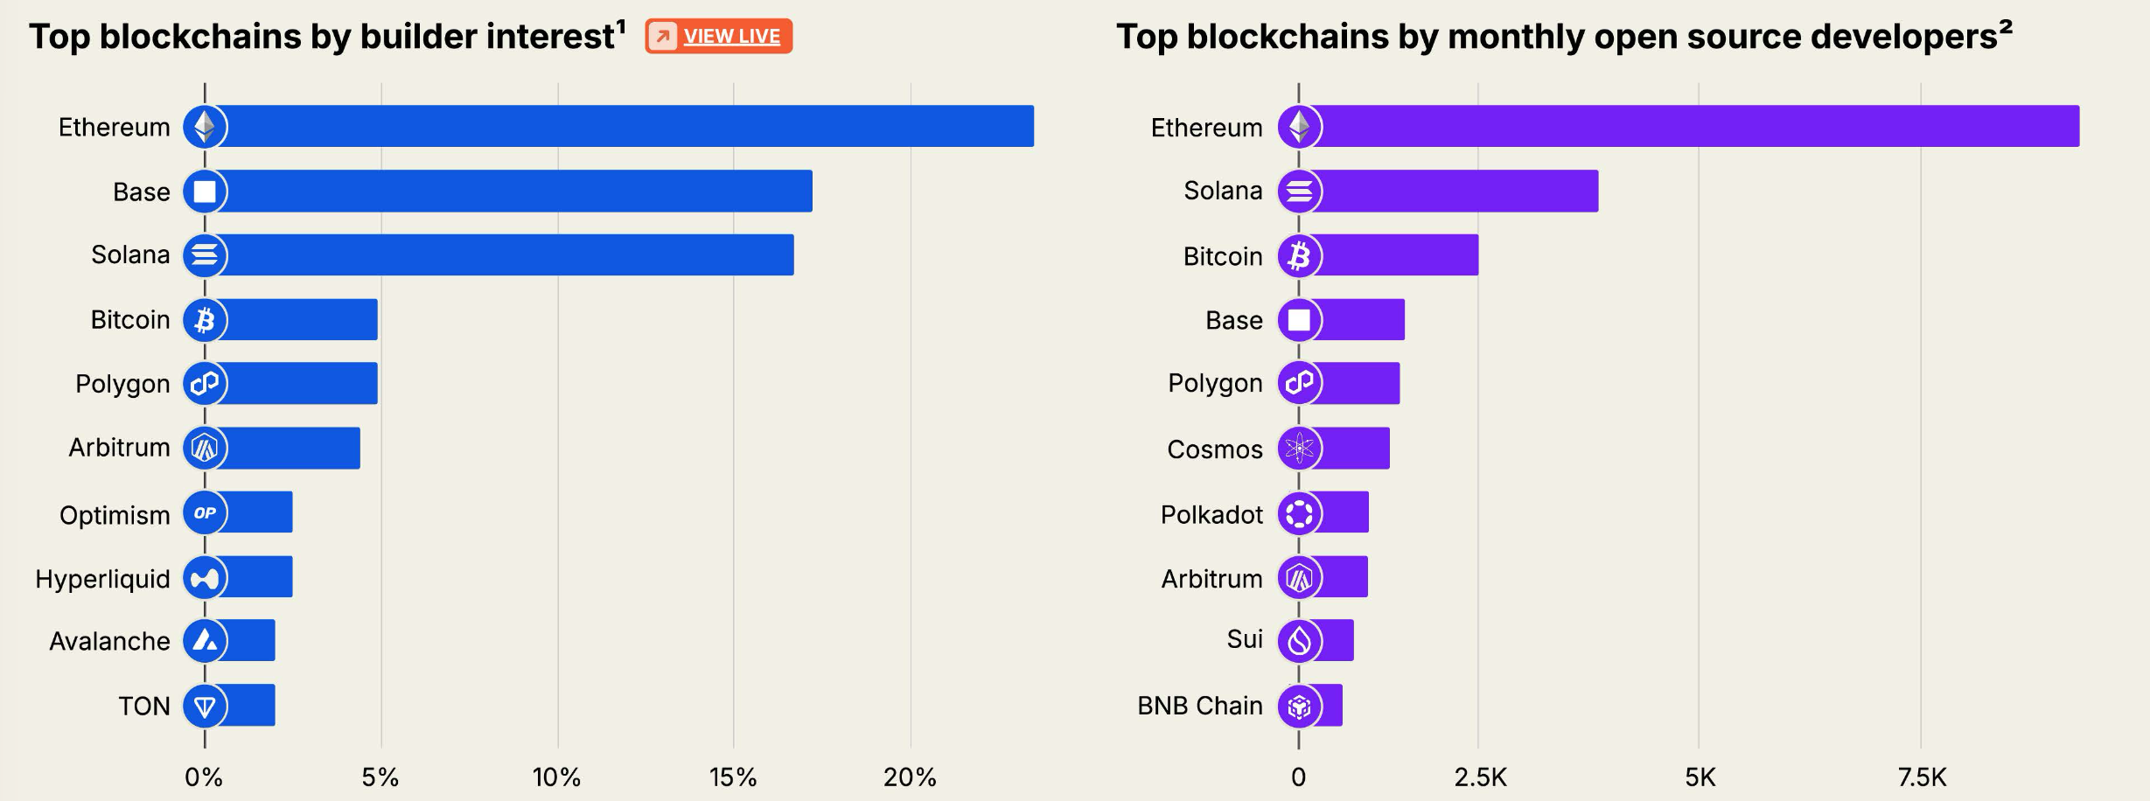
This lecture: non-EVM chains
EVM
EVM
EVM
Solana VM (SVM)
this lecture
Solana VM (SVM)
EVM
EVM
EVM
EVM
EVM
EVM
EVM
this lecture
EVM
and Aptos
SuiVM and MVM
EVM

Slide 3
Key differences from the EVM
Recall: the EVM runs a single thread for the entire world
transactions execute in a sequential order
Monad an EVM compatible chain, 10,000 Tx/sec !
A re-implementation of the EVM that
optimistically executes transactions in parallel.
It re-executes transactions for which a conflict is detected
Consensus: 0.400 sec. block time, 0.8 sec. to block finality

Slide 4
Types of Parallelism
A different approach: design a new VM for parallel execution
Solana, Aptos, Sui, Avalanche, Flow, …
Solana: sealevel execution engine
Every transaction explicitly lists the accounts that is touches
None-overlapping transactions are executed in parallel
Aptos: Block-STM
Optimistically execute transactions in parallel
Re-execute sequentially if a conflict is discovered post-execution
Sui: Mysticeti consensus
OwnedObject Tx (fast path) vs. SharedObject Tx (slow path)
Notes:
STM: Software Transactional Memory

Slide 5
Consensus block finality times
Ethereum: 12 sec. slot, 12.8 minutes to finalize an epoch
Solana:
  Today: 0.4 sec. block time, 12.8 sec. to full finality
  Coming Alpenglow consensus: 0.13 sec full finality
Aptos/Sui: sub-second finality per block

Slide 6
Solana: a crash course
https://solana.com/docs
Mainnet launched on Mar. 2020 (genesis)

Slide 7
Node design
Ethereum philosophy: anyone can run an Ethereum node
Low-end and high-end machines ⇒ high resiliency
Solana philosophy: high-end servers, multi-core systems
⇒ lower network delays, faster execution time
971 (staked) validators
Top 20 validators hold >33% of stake
    can halt chain or censor transactions
(for Ethereum this is 3)
Notes:
https://solanabeach.io/validators
https://beaconcha.in/entities

Slide 8
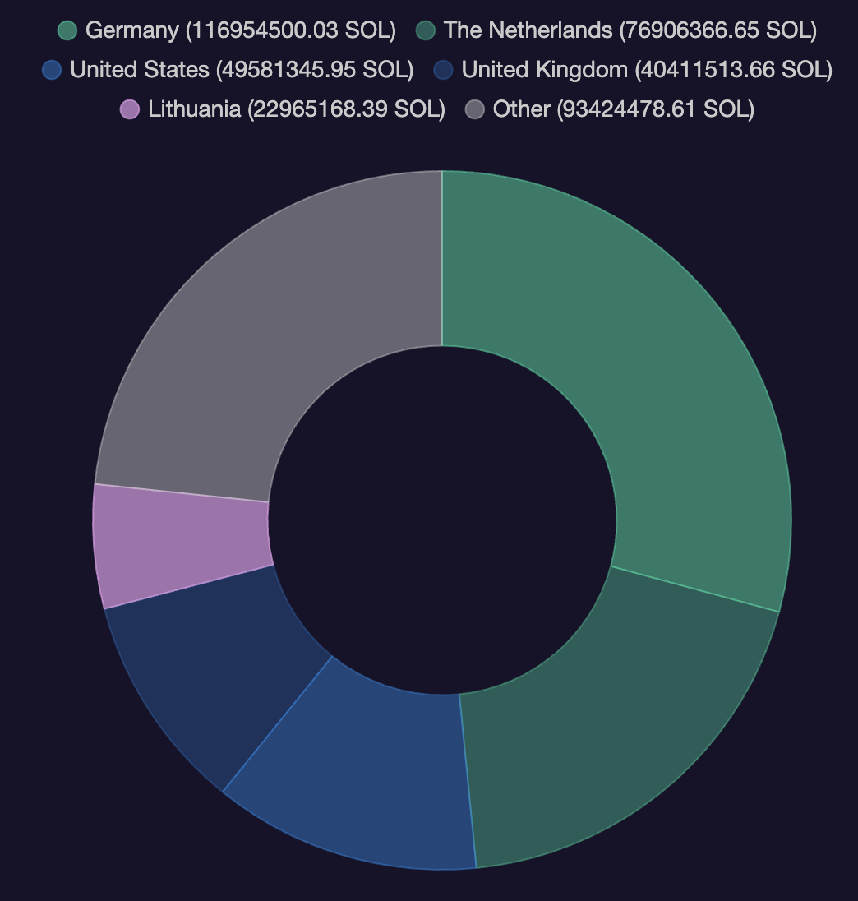
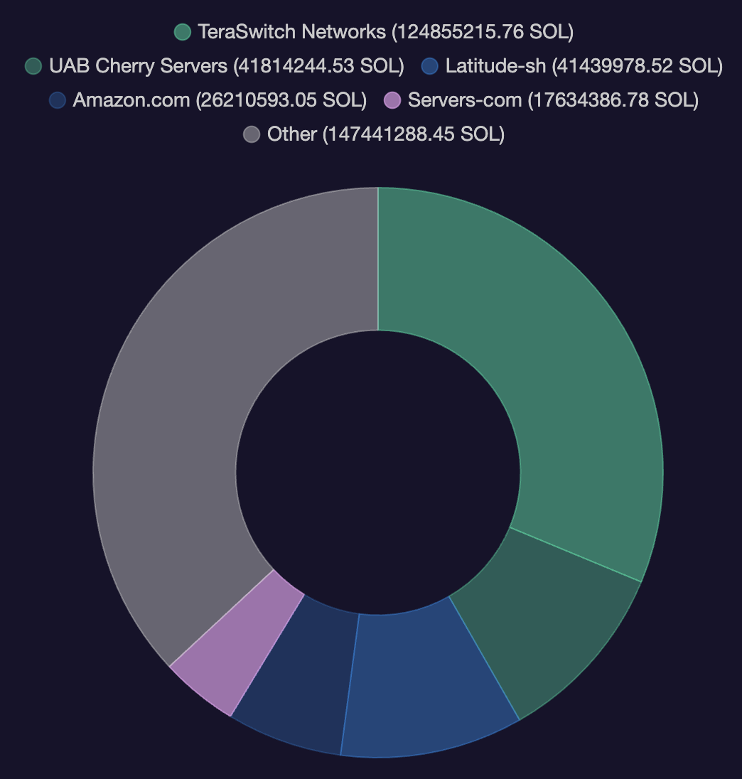
Validator distribution
Notes:
https://www.validators.app/data-centers?locale=en&network=mainnet&sort_by=asn

Slide 9
Solana account model
Ethereum: smart contracts carry code *and* state (the storage array)
Solana: programs carry code but are stateless !
state must be passed to a program to operate on.
ERC-20:
code and state
Token
Program
Mint account
Solana VM
EVM
ERC-20:
code and state
Mint account
ERC-20:
code and state
Mint account
(code, no data)
(data, no code)
Notes:
Creating a new token just means allocating a new account state for the Token Program.

Slide 10
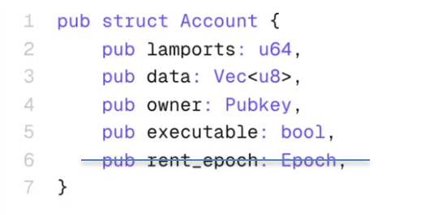
Solana account model
A Solana account contains either:
State: data that is meant to be read from and persisted.
(balances, user data, etc.)
Executable Program: code (sBPF byte code)
account balance
code or data
flag: code or data
Lamports are the smallest unit of SOL. 1 SOL = 10^9 lamports.

Slide 11
A Solana transaction
Four parts:
An array of accounts to read or write from
One or more signatures to authorize transaction
One or more instructions
    each instruction can be a function call to a program
    call depth is ≤4 per instruction (no reentrency problems)
A recent blockhash or nonce:
    transaction is only valid for 150 blocks after blockhash
Notes:
Call depth four across accounts. Within an account the max call depth is 64.

Slide 12
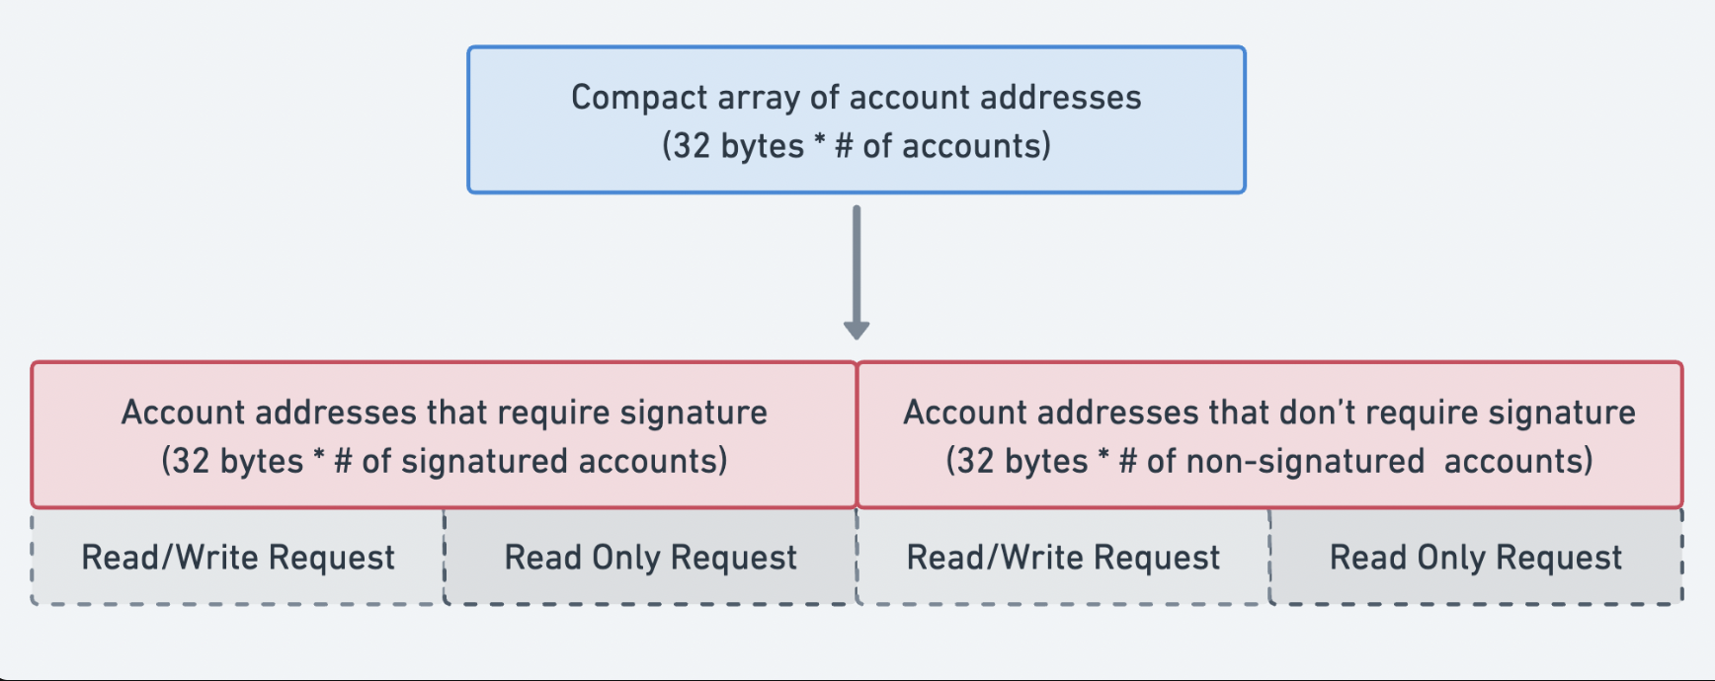
Solana
Every transaction includes a list of all accessed accounts:

Slide 13
Solana mempool?
There is no mempool!
Leader schedule is pre-determined in advance
  Chosen at random (by stake) from the set of validators
All Tx are forwarded to the leader, who builds the block
Left-over Tx are forwarded to the next leader
No need for a gossip protocol to replicate
the mempool across all validators

Slide 14
Alpenglow consensus
Validators vote on a proposed block from current leader:
Fast path: if 80% of stake is responsive, block is finalized in a single round.
Slow path: if 60% of stake is responsive, block is finalized in two rounds.
Otherwise, no block: slot is empty.
>20% of stake is needed to violate safety
>40% of stake is needed to violate liveness

Slide 15
Aptos: a crash course
Move VM vs. EVM
Mainnet launched on Oct. 2022 (genesis)

Slide 16
Data is stored in a distributed way on Aptos
Recall: in an EVM ERC-20 contract
The balances of all holders stored in a single mapping in contract
⇒ every transaction touches global ERC-20 state
In Aptos:
every user’s balance is stored in an object owned by that user
⇒ similar to Solana’s account model
Better performance ⇒ can parallelize transaction execution
    a user transaction only touches that user’s data
Notes:
Move VM vs EVM: https://aptos.dev/build/get-started/ethereum-cheatsheet

Slide 17
Signer as source of access control
On EVM, tx.origin is just the address of the initiating EOA.
Recall: address of EOA is hash(PublicKey). Same in Bitcoin and Solana.
On Aptos an address stores its associated authentication key as a data field
⇒ can change authentication key without changing the address.
⇒ easier post-quantum transition
On Aptos there’s a special signer type:
An entry function can require multiple signers in order to be called.
function that can be
the target of a Tx

Slide 18
Static dispatch vs. dynamic dispatch
Cross contract call on EVM is flexible, even if you don’t have the ABI or the source code, you can still make the call.
Aptos is static by design: you need (i) the bytecode, or
(ii) source code, or (iii) mock interface, to make the call.
More recently: function value
functions can be passed around as arguments
Notes:
This is design for verifiability.

Slide 19
The MOVE language

Slide 20
Ready-made Smart Contract Frameworks
Objects
A framework to organize your data as extensible objects
Digital Assets
Allow to manage different form of assets on top of Aptos Objects
Smart Data Structures
Collection types which automatically adapt to your usage scenarios
Multisigner Transactions
The ability to authorize a transaction by more than one signer
Aggregators
Making sequential workloads execute in parallel
Safe Randomness
Supports safe, unbiased generation of random values
Keyless Accounts
Supports any OIDC (OpenID Connect) provider (Google, Facebook, Github, Apple, …)
Fungible Asset Dynamic Dispatch
Allow to register transfer functions for dynamic dispatch

Slide 21
module my_addr::hello_blockchain {
use std::string::String;
struct Message has key, copy, drop {
message: String
}
public entry fun create(
caller: &signer,
msg: String
) {
move_to(caller, Message {message: msg})
}
// ..
}
Your First Contract
Move syntax is similar to Rust
Everything is a module

Slide 22
Two types of Move Programs
module my_addr::example {
struct Foo {}
public fun do_something() {
..
}
..
}
script {
fun main() {
..
}
}
Script
Module
Executes a series of commands in a single transaction, without being stored on-chain
Stored on-chain.
Code reuse and composability

Slide 23
module 0x42::hello_blockchain {
use std::string::String;
struct Message has key, copy, drop {
message: String
}
public entry fun create(
caller: &signer,
msg: String
) {
move_to(caller, Message {message: msg})
}
// ..
}
Module Definition
Modules are defined by
Published address in global storage (can be a string or a literal address)
Module name
Items scoped to modules
Notes:
An address (also called an account) can hold multiple modules, called a package. The address also holds data resources.

Slide 24
module my_addr::hello_blockchain {
use std::string::String;
struct Message has key, copy, drop {
message: String
}
public entry fun create(
caller: &signer,
msg: String
) {
move_to(caller, Message {message: msg})
}
// ..
}
Import Definition
Imports are defined as use
use lets you import other libraries, structs, or functions

Slide 25
module my_addr::hello_blockchain {
use std::string::String;
struct Message has key, copy, drop {
message: String
}
public entry fun create(
caller: &signer,
msg: String
) {
move_to(caller, Message {message: msg})
}
// ..
}
Struct Definition
Structs are custom data
Similar to most languages
Identified by:
Module address
Module name
Struct name
Scoped to a module

Slide 26
Struct can have four abilities: copy, drop, store, key
drop: allows the struct to be dropped when it goes out of scope. None droppable structs must be explicitly destroyed at the end of a function. Tokens are usually not droppable.
key: allows the struct to be used as a top-level key in the global storage
(automatically has store)
copy: allows the struct to be copied. Non-copyable structs change ownership when moved. Tokens are usually not copyable.
store: allows the struct to be stored in the global storage
(also as part of another Struct)
struct Person has copy, drop, store, key {
name: string,
age: u64,
}

Slide 27
Using abilities
By combining abilities (or lack thereof), it is possible to achieve properties underlying safe use of resources
Example: a Coin struct that is storable but cannot be arbitrarily duplicated or destroyed!
struct Coin has store {
name: string,
age: u64,
}

Slide 28
Struct Definition: Inner Types
module my_addr::hello_blockchain {
use std::string::String;
struct Message has key, copy, drop {
message: String
}
public entry fun create(
caller: &signer,
msg: String
) {
move_to(caller, Message {message: msg})
}
// ..
}
Structs allow for any inner types
Can be other store structs
Inner types can only be accessed in the module

Slide 29
Move Primitive Types
Others
Integers
Tuples
(not storable, only as return values)
bool
address
u8
u16
u32
unit type: ()
vector<T>
u64
u128
u256
tuple: (T1, T2, ..)
References
Authentication
(not storable, only as input and return values)
Function Type
immutable: &T
mutable: &mut T
signer
|T| V

Slide 30
Function Definitions: Signature
module my_addr::hello_blockchain {
use std::string::String;
struct Message has key, copy, drop {
message: String
}
public entry fun create(
caller: &signer,
msg: String
) {
move_to(caller, Message {message: msg})
}
}
Visibility can be
public: called from any module
friend: can only be called from modules declared as friends
private (no keyword): can only be called from inside module
entry: callable by a transaction
inline: inserted into calling code at compile time

Slide 31
Function Signature: Arguments
module my_addr::hello_blockchain {
use std::string::String;
struct Message has key, copy, drop {
message: String
}
public entry fun create(
caller: &signer, // Tx must contain signature
msg: String
) {
move_to(caller, Message {message: msg})
}
}
Functions can take any type as input, including structs
Entry functions
Signers must match the number of signatures in Tx
Notes:
The argument caller must be an address that is signed by the corresponding public key.

Slide 32
Functions
Function Declaration
fun double(x: u64): u64 { x*2 }
// multiple return values
fun foo(): u64, bool { (0, true) }
public
entry
inline
fun id<T>(x: T): T { x }
arguments and their types
type of return value

Slide 33
Function Signature: Function Body
module my_addr::hello_blockchain {
use std::string::String;
struct Message has key, copy, drop {
message: String
}
public entry fun create(
caller: &signer,
msg: String
) {
move_to(caller, Message {message: msg})
}
}
Here it moves a Message struct to the caller’s address
This is the simplest example of global storage
The Message object is created under address my_addr and then moved to caller

Slide 34
The Global Storage
Global Storage
Address 0x1
Address 0x2
Address 0x3
module trade
Both code and data (structs) can be stored under an address
These stored structs are often referred to as “resources”
Each address can store at most one resource value of a given type
struct Coin
Notes:
Address and account is the same thing.
An address can have multiple modules, called a package.

Slide 35
Move offers 4 operations to interact with the global storage
  exists<T>(addr): checks whether a resource exists under the given address
  move_to<T>(&signer, resource)
      publishes a new resource under the address of to the given signer
  move_from<T>(addr): removes a resource from the given address and returns it
  borrow_global<T>(addr) / borrow_global_mut<T>(addr)
    obtains a reference to a resource under the given address
These ops can only be used within the module that defines the struct

Slide 36
View Functions: External Reads
module my_addr::hello_blockchain {
use std::string::String;
#[view]
public fun show_message(
account: address): String {
Message[account].message
}
}
Allows for externally reading state with Move
Here it reads from global storage the Message struct, and reads the message field

Slide 37
Function Logic: Aborts and Asserts
module my_addr::hello_blockchain {
use std::string::String;
/// No message to fetch
const E_NO_MESSAGE: u64 = 1;
public fun get_message(account: address)
: String {
assert!(
exists<Message>(account),
E_NO_MESSAGE
);
Message[account].message
}
}
Allows for aborting a transaction
Gives a user friendly message from comments
assert! or abort

Slide 38
Bonus topic: DAOs
Decentralized Organizations

Slide 39


Decentralized Orgs (DAO)
What is a DAO?
A Dapp deployed on-chain at a specific address
Anyone (globally) can send funds to DAO treasury
Anyone can submit a proposal to DAO
⟹ participants vote
⟹ approved ⇾ proposal executes
snapshot.org
Notes:
Movie studio DAO: participants decide what movie scripts to fund, and then share in profits from movie.
SafeSnap: uses Reality.eth to implement an oracle that pushes vote results on-chain.

Slide 40
Examples of DAOs
Collector DAOs: PleasrDAO, flamingoDAO, ConstitutionDAO, …
(see art collection at https://gallery.so/pleasrdao )
  PleasrDAO: 103 members.
      Manages a treasury, has full time employees.
      Deliberations over what to acquire over telegram.

Slide 41
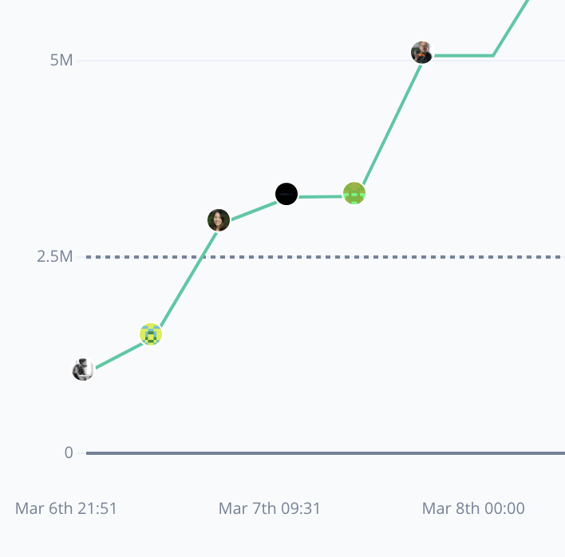
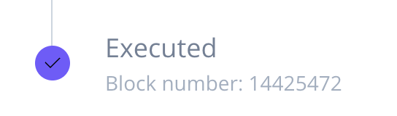
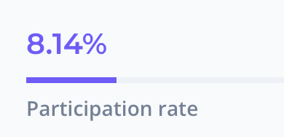
Examples of DAOs
Collector DAOs: PleasrDAO, flamingoDAO, ConstitutionDAO, …
Grants DAOs: gitcoin (83K members), …
Proposal ID 21: This proposal looks to ratify the allocation of 30,000 GTC from
the Community Treasury to the MMM workstream.
(tally.com)
Notes:
MMM: Merch Memes Marketing

Slide 42
Examples of DAOs
Collector DAOs: PleasrDAO, flamingoDAO, ConstitutionDAO, …
Grants DAOs: gitcoin, …
Protocol DAOs: manages operation of a specific protocol
Uniswap DAO (74K), Compound DAO (8K), …
Social DAOs: FWB, …
Investment DAOs: many

Slide 43
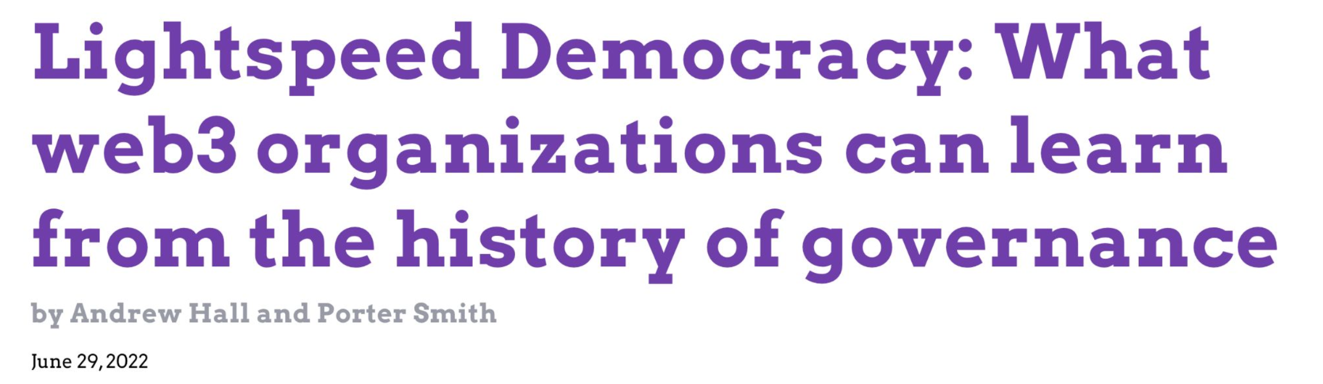
Many DAO governance experiments
Who can vote? How to vote? What voting mechanism?
DAOs: a platform for experimenting with governance mechanisms

Slide 44
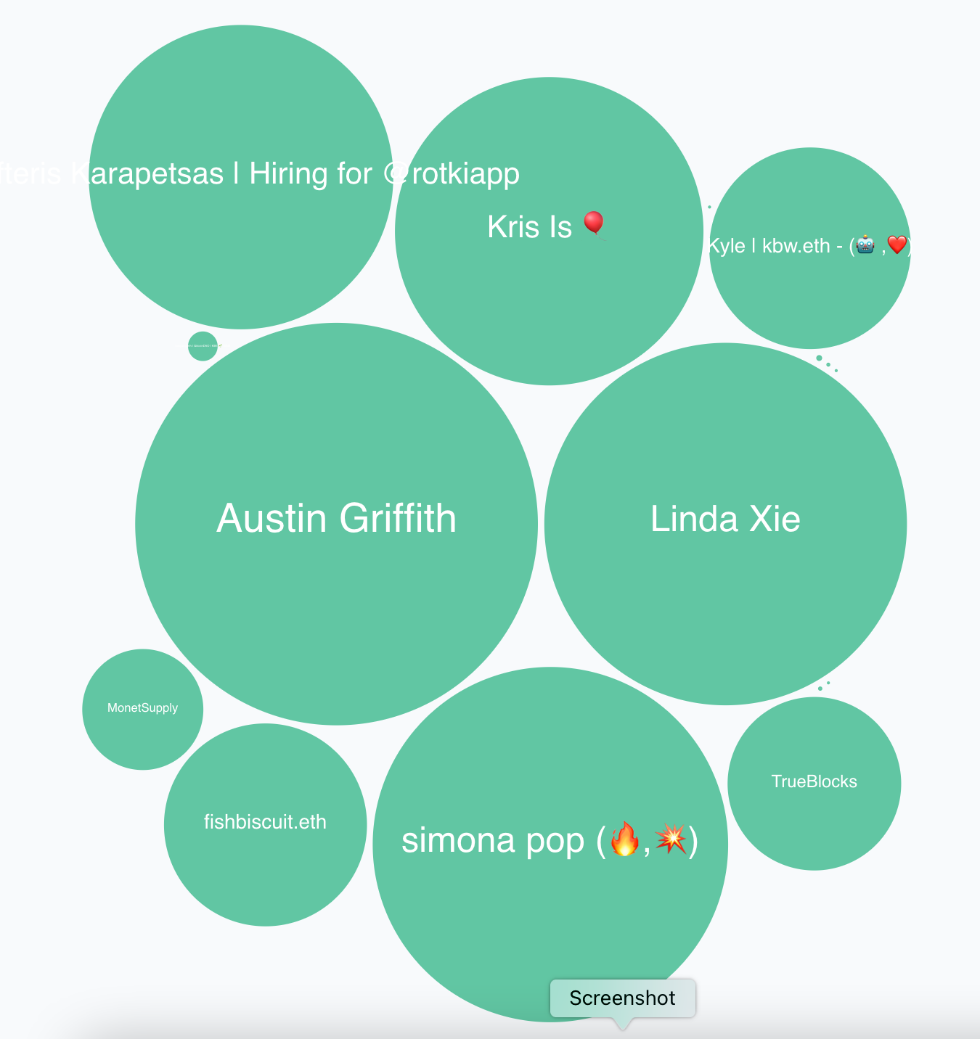
Governance method
One token one vote: (most common)
Members receive tokens based on their contribution
Everyone can vote
In reality: low participation rate (8%)
⇒ delegation
proposal 21 (tally.com)

Slide 45
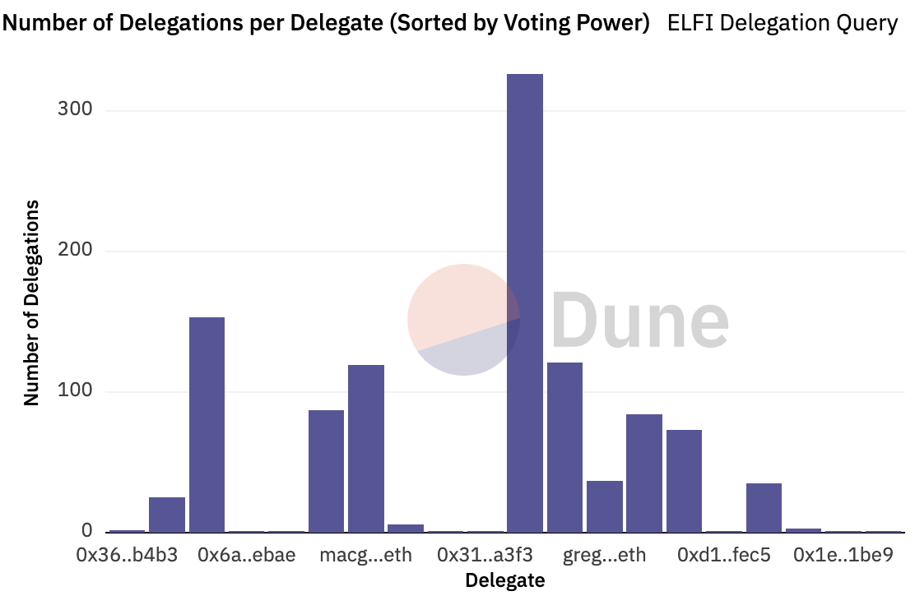
Delegation example: element
≈300 addresses
delegated tokens
to this address

Slide 46
Governor Bravo
Governor alpha (Jan. 2020) updated to Bravo (March 2021):
A collection of smart contracts used for governance
Forked and used by many other protocols
Other alternatives:
OpenZeppelin Governor protocol
Notes:
https://docs.compound.finance/v2/governance/#governance
Bravo: supports updating protocol global parameters (in three slides). Alpha fixed them.

Slide 47
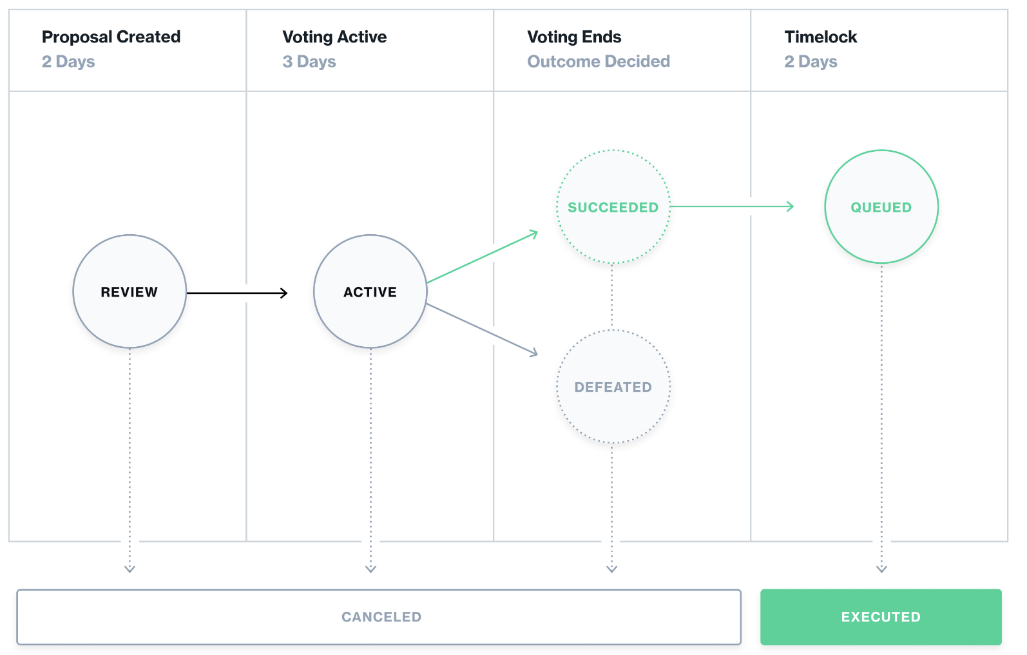
The life cycle of a proposal

Slide 48
Governor Bravo
Implements an ERC-20 governance token. Let’s call it GOV.
An address that owns GOV tokens can vote on proposals
0: against
1: in favor
2: abstain
The proposal I am voting for
(with all my allotted voting tokens)
function castVote(uint proposalID, uint8 support)
(cannot vote partially)
Notes:
Voter can re-delegate to move tokens to someone else.

Slide 49
Governor Bravo
Implements an ERC-20 governance token. Let’s call it GOV.
… or delegate its GOV tokens to another address
delegate all my voting tokens
function delegate(address delegatee)
can re-delegate at any time by calling function again
An address can only delegate all its tokens to one address at a time
… but I can hold my GOV tokens at multiple addresses
Notes:
Voter can re-delegate to move tokens to someone else.

Slide 50
Creating a proposal
The function to call on governor contract
function propose(
address[] targets,
uint[] values,
string[] signatures,
bytes[] calldatas,
string description) // proposal description
returns (uint)
If proposal passes,
how to execute it:
what functions to call (actions)
and with what arguments
(human readable)
The ID of newly created proposal

Slide 51
Global contract parameters
quorumVotes: the minimum # of votes for a proposal to pass
proposalThreshold: min # votes needed to create a proposal
votingDelay: # blocks to wait until voting can begin after a proposal is created (e.g., two days)
votingPeriod: # blocks when voting is open (e.g., three days)
All these parameters can be changed by governance in Bravo

Slide 52
Proposal execution
Once proposal gets enough votes and delays expire:
anyone can call: function execute(uint proposalID)
⇒ prescribed functions in proposal get called

Slide 53
The limits of democracy
Anytime before execution
“guardian” can call cancel() to cancel a proposal
Who is this guardian??
set at Governor contract creation time
can abdicate at any time by calling _abdicate()

Slide 54
DAO privacy questions
Private DAO participation: keep membership list private
Private voting: keep who voted how on each proposal private
Privately delegate voting rights
Private treasury
… while complying with all relevant laws.

Slide 55
Some DAOs made mistakes and were attacked
Attack on Beanstalk governance: $182M
Attack on Yam Finance governance: thwarted
Attack on Build Finance governance $1.5M
Attack on Mango governance: $115M
Steem governance drama
What happened? What can we learn?

Slide 56
(1) Beanstalk (Apr. 2022)
An Ethereum-based stablecoin Bean. Governance token Stalk.
The problem:
an attacker can buy Stalk tokens,
submit a proposal,
vote on proposal, and
have proposal execute
all in a single
transaction

Slide 57
Beanstalk: the attack
Recall: flashloan (has many applications)
a loan that is taken out and repaid back in a single transaction
No risk to lender ⇒ unbounded amount can be borrowed
The attack:
Attacker took a huge flashloan from Aave, bought lots of Stalk,
Passed a proposal to pay $80M to the attacker from the treasury,
Sold the Stalk, and repaid the flashloan,
Sent the proceeds to Tornado cash (donated $250K to Ukraine)

Slide 58
The lesson
The protocol relaunched four months later.
The lesson: governance requires delays
Require token holders to hold token for a long period of time
Build a delay between proposal genesis, voting, and execution

Slide 59
(2) Yam Finance (July 2022)
A DeFi project running on Ethereum. Governed token YAM.
What happened? (within a single day)
Attacker bought 224739 YAM with borrowed funds
Attacker submitted a governance proposal
granting it control of project reserves ($3M USD)
Voted on proposal with borrowed 224739 YAM, hitting quorum
Borrowed YAM exchanged for Eth and paid back

Slide 60
What happened next?
Yam Finance team: noticed the proposal shortly after it hit quorum
⇒ retained cancel power, and canceled the proposal.
Lesson:
Illustrates the positive power of a veto
The problem: power can never be taken away
(unless voluntarily given away)

Slide 61
END OF LECTURE
Next lecture: Privacy on chain

