Slide 1
Maximal Extractable Value (MEV)
CS251 Fall 2025
(cs251.stanford.edu)
Dan Boneh
HW#3 posted, guest next lecture (please come in person)

Slide 2
Where we are in the course
How consensus protocols work
Bitcoin: the UTXO model, and the Bitcoin scripting language
Ethereum (the blockchain computer): the EVM and Solidity
Current topic: decentralized finance
on-chain: lending, exchanges, stablecoins, today: MEV
Next: privacy on the blockchain, scaling the blockchain,
and interoperability across blockchains

Slide 3
Decentralized Finance (DeFi)
Permissionless: any financial instrument can be implemented
and deployed with a few lines of Solidity code
(a centralized system could refuse to deploy a competing service)
Transparent: Dapp code and Dapp state are public
  ⟹ Anyone can inspect and verify
Composable: Dapps can call one another
ERC-20 standard enables interoperability (6 functions)
Notes:
Unlike traditional finance where there is very little transparency.

Slide 4
Why DeFi? Failures of the existing financial system
Cross border inefficiency:
    send $10 to south america ⇒ 36% fees
The high cost of being poor in america:
In 2019, 5.4 percent of US households were unbanked
Economies with an unstable fiat currency
Patchwork of technologies developed over time

Slide 5
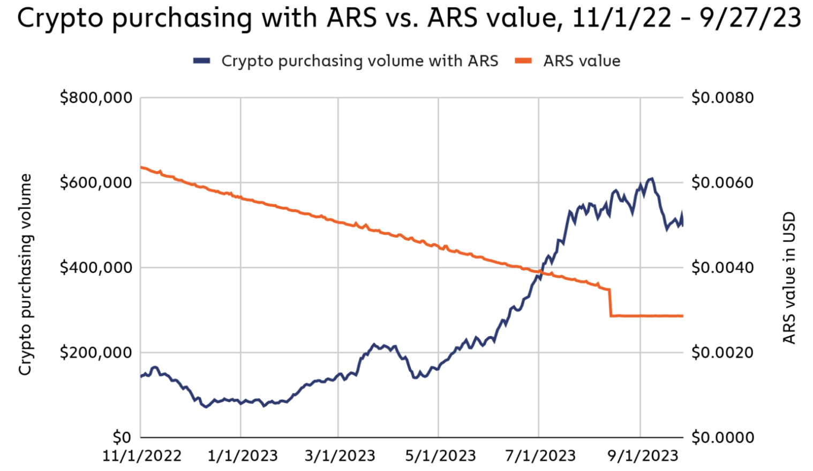
Why DeFi? Failures of the existing financial system
“As crypto adoption has grown,
lots of people [in Argentina] will now
get their paycheck and immediately
put it into USDT or USDC.”
Alfonso Martel Seward, Lemon Cash
USDC/USDT daily purchasing volume
in Argentina during inflation
https://www.chainalysis.com/blog/latin-america-cryptocurrency-adoption/
Notes:
As value of Peso drops, crypto volume increases.

Slide 6
Maximal Extractable Value (MEV)

Slide 7
Searchers
Ethereum gives rise to a new type of business: searchers
Arbitrage: Uniswap DAI/USDC exchange rate is 1.001
whereas at Sushiswap the rate is 1.002
⇒ a searcher posts Tx to equalize the markets and profits
Liquidation: suppose there is a liquidation opportunity on Aave
⇒ a searcher posts a liquidation Tx and profits
Many other examples … often using a sequence of Tx (a bundle)
Notes:
“Searcher” is now a job description.
Arbitrage: take a loan in DAI, exchange DAI for USDC on Uniswap, exchange USDC for DAI on Sushiswap, repay loan.
Another example: searcher discovers a bug in the contract (the dark forest post, https://medium.com/@danrobinson/ethereum-is-a-dark-forest-ecc5f0505dff)

Slide 8
The MEV problem
What happens when a searcher posts a Tx to the mempool?
Validator: create a new Tx’ with itself as beneficiary, and place it before Sam’s Tx in the proposed block
Another searcher: create a new Tx’ with itself as beneficiary, and posts it with a higher maxPrioriyFee
⇒ this action is now mostly automated by copy-paste bots
Tx’
Sam
mempool
Tx: credit Sam
maxPrioriyFee: X
Tx’: credit Alice
maxPrioriyFee: 2X
Notes:
A paper on copy-paste-bots: https://www.usenix.org/system/files/sec23fall-prepub-331-qin.pdf

Slide 9

The MEV problem
Tx’
Sam
mempool
Tx: credit Sam
maxPrioriyFee: X
Tx’: credit Alice
maxPrioriyFee: 2X
Notes:
A paper on copy-paste-bots: https://www.usenix.org/system/files/sec23fall-prepub-331-qin.pdf

Slide 10
The result harms honest users
Price Gas Auctions (PGA): many searchers compete
Repeatedly submit a Tx with higher and higher maxPriorityFee until a validator chooses one … happens within a few seconds
⇒ causes congestion (lots of Tx in mempool) and high gas fees
Tx’
Sam
mempool
Tx: credit Sam
maxPrioriyFee: X
Tx’: credit Alice
maxPrioriyFee: 2X
Notes:
If MEV Tx makes $10K, then gas price can go as high as $7K in practice.

Slide 11
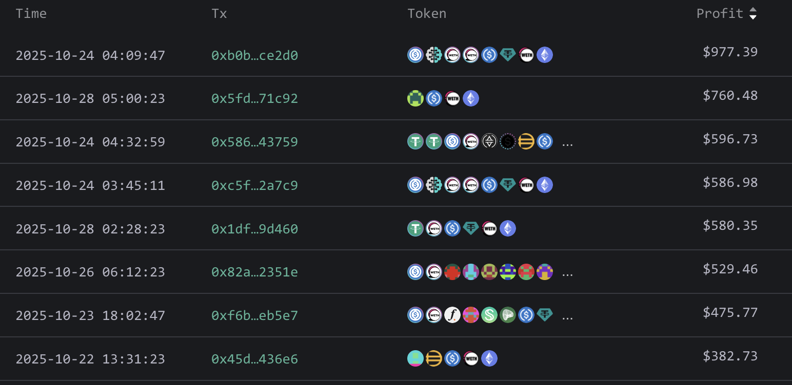
A sandwich every 30 seconds
Top sandwich Txs
in a 24 hours
window
Notes:
https://eigenphi.io/mev/ethereum/sandwich

Slide 12
The result harms consensus
Undercutting attack on longest-chain consensus (not Ethereum):
Rational miner: can cause a re-org by taking one MEV Tx for
itself and leave two for other miners
3 MEV Tx
block 1
block 3
Miners incentivized
to build here
miner #1
miner #2
miner #3
The problem: MEV Tx generate extra revenue for miners, higher than block rewards
Notes:
See Flashboys 2.0: https://arxiv.org/abs/1904.05234

Slide 13
The result causes centralization
Validators can steal MEV Tx from searchers
Searchers only send Tx to a validator they trust
(have a business relation with)
These validators do not propagate Tx to the network,
but put them in blocks themselves
In the long run: a few validators will handle the bulk of all Tx
⇒ Private mempools

Slide 14
What to do??

Slide 15
Two options
Option 1:
Accept MEV is unavoidable; minimize its harm to the ecosystem
⇒ Proposer-Builder Separation (PBS)
Option 2: Try to prevent some MEV:
Hide Tx data while Tx is in the mempool, or
Remove the block proposer’s choice in ordering Tx in a block

Slide 16
Option 1: Proposer Builder Separation (PBS)
Goals:
Eliminate price gas auctions in the public mempool
  Instead, create an off-chain market for searchers to compete
  on the position of their bundles in a block
Prevent validator concentration: make it possible for every validator to earn MEV payments from searchers
Current PBS implementation: MEV-boost (a sidecar for beacon nodes)

Slide 17
The participants in PBS (as in MEV-boost)
Users have Tx and searchers have bundles (sequence of Tx)
searcher wants its bundle posted in a block unmodified
build block from
Tx and bundles
choose best block
searchers
bundle
builder A
block
validator
(the current block proposer)
relay 1
blockHdr
bundle
block
bundle
builder B
blockHdr
block
relay 2
signature
Tx
mempool
send block to
eth network
user

Slide 18
MEV-boost
Builder: collects bundles and Tx, builds a block (≈300 bundles/block)
includes a MEV offer to validator (feeRecipient)
Relay: collects blocks, chooses block with max MEV offer
sends block header (and MEV offer) to block proposer
Can’t expose Tx in block to proposer (proposer could steal Tx)
Proposer: chooses best offer and signs header with its staking key
⇒ Then Relay sends block to network, making it public
⇒ Now, proposer cannot steal MEV (would be exposed to slashing)
https://writings.flashbots.net/searching-post-merge
Notes:
Searchers have to win two auctions for their bundle to be included: builder auction and relay auction. Note: this is a first-price auction (unlike gas fee).
Searchers have to work with a builder they trust not steal Tx. Similarly, they need to trust the relay that the builder works with. This is done via business relations. However, Searchers don’t have to trust the proposer – that can by anyone.
Proposer cannot miss slot: if relay does not provide a valid block, validator must build a block locally itself.
Once proposer signs block header, it cannot sign another block header, or it will be slashed by the network (Relay can prove the proposer signed to block headers for that slot)
Future PBS: merge validator and relay into consensus protocol

Slide 19
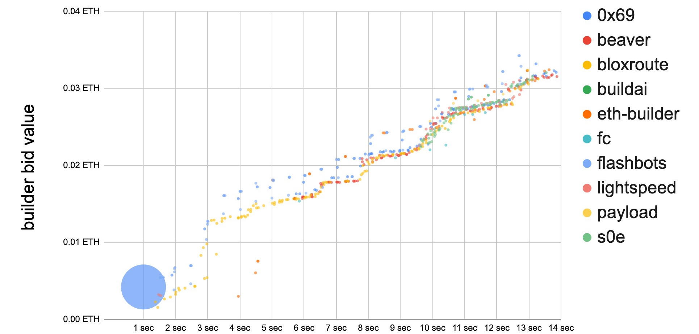
Many block options per slot
A relay might receive 500 blocks per slot from builders
Each builder might send 20 blocks to relay for one slot
Why? The longer builder waits the more MEV opportunities …
slot 5,680,917
builder’s bid goes up
the longer it waits
credit: Justin Drake and Shea Ketsdever

Slide 20
Operating relays
Flashbots: Filters out OFAC sanctioned addresses,
aims to maximize validator payout
(so that many validators will work with it)
BloXroute: (runs two identical relays) same as Flashbots relay
UltraSound (the largest relay): not for profit, non censoring
…
Notes:
https://github.com/eth-educators/ethstaker-guides/blob/main/MEV-relay-list.md

Slide 21
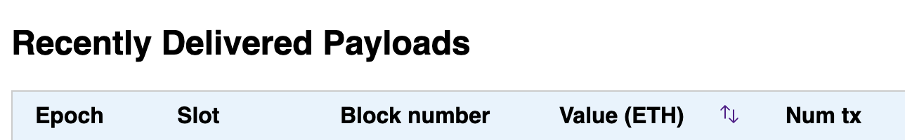
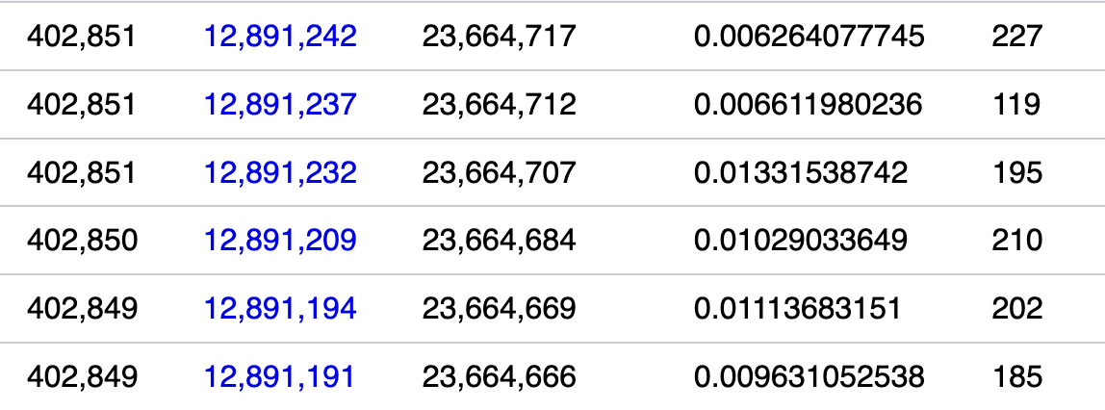
An example: flashbots relay
fee to validator
Notes:
https://boost-relay.flashbots.net/
About 67% of blocks are created by this relay, but not all blocks.

Slide 22
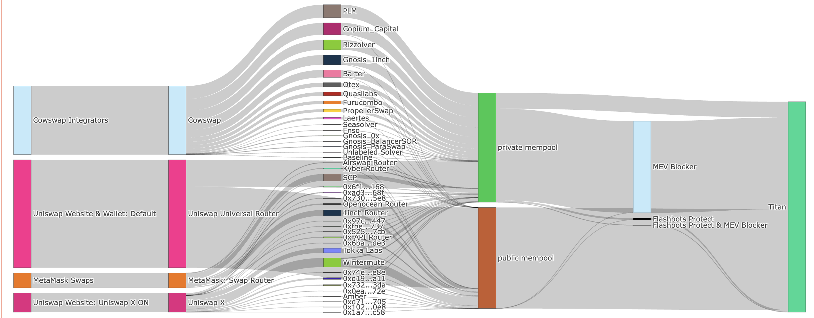
Transaction flow: an example
solver
private
mempool
Titan
builder
Tx source
router
public
mempool
Notes:
https://orderflow.art/?isOrderflow=true&frontend=Uniswap+Website+%26+Wallet%3A+Default&frontend=MetaMask+Swaps&frontend=Cowswap+Integrators&frontend=Uniswap+Website%3A+Uniswap+X+ON&builder=Titan

Slide 23
The race condition problem
(exploited in Apr. 2023)
The problem
relay
blockHdr
validator
(the current block proposer)
signature
send alternate block
with stolen Tx
send block to
eth network
Block proposer will be slashed (why?) ⇒ Lose 1 ETH
… but can gain much more in stolen MEV.
Notes:
https://collective.flashbots.net/t/post-mortem-april-3rd-2023-mev-boost-relay-incident-and-related-timing-issue/1540
Exploited for $25M.
Mitigation: no complete mitigation currently

Slide 24
Are we done? Not quite …
Builder concentration: three builders build 88% of all blocks !!
Centralization in the builder market
Enables censorship by builders
Proposers hold all the power (first price auction among builders)
⇒ Most MEV profits flow to block proposers
a potential solution: Multiple Concurrent Proposers (MCP)
MEV-boost is not designed for cross-chain MEV
For cross-chain arbitrage, no atomicity guarantee for bundle
(Titan Builder, BuilderNet, Quasar)
Notes:
https://explorer.rated.network/builders?network=mainnet&timeWindow=1d&page=1

Slide 25

The next step: BuilderNet
Goal: decentralized block building
Why? Better block building when builders share order flow
… but transactions should remain private until sent to relay
… even builders should not see the transactions.
How? Trusted Execution Environment (TEE), such as Intel TDX
Code and data inside enclave are not visible outside
Not even to the OS or a malicious admin
Is TDX a strongly secure TEE? Well, not quite …
TDX

Slide 26
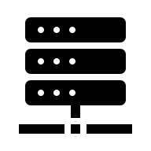



Block Building inside of a TEE (way simplified)
Bob (the builder)
block sent
to relay
$$pk$$
tx1
tx3
tx1
(aTLS cert)
tx2
tx2
$pk$-encrypted
$$sk$$
signed
by TEE
tx from other Bob’s
Trusted Execution
Environment (TEE)
Main point: building strategy is public and attested (enforced by TEE)
Tx remain hidden in TEE until sent to relay
Notes:
https://buildernet.org/docs/architecture

Slide 27
Reducing MEV Using an
Encrypted Mempool
Goal: Tx is only decrypted after it is confirmed on chain
… by then it is too late to front run it

Slide 28


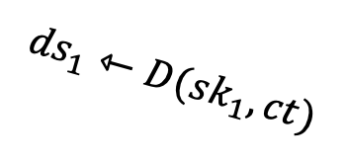
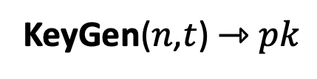

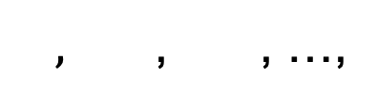
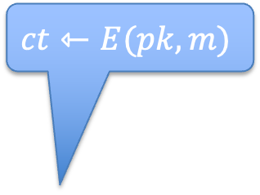





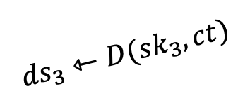
How? Threshold decryption
What is threshold decryption?
$$sk_{2}$$
$,$ , , …,
$$sk_{3}$$
KeyGen($n$,$t$) ⇾ $pk$
$$sk_{1}$$
$$ct⇽E(pk,m)$$
2-out-of-3
$$ct$$
$${ds}_{1}⇽D(sk_{1},ct)$$
$$ct$$
$$m$$
$$ct$$
$${ds}_{3}⇽D(sk_{3},ct)$$
Security: one $sk_{i}$ “reveals nothing”
Notes:
Solana achieves this property using secret sharing.

Slide 29


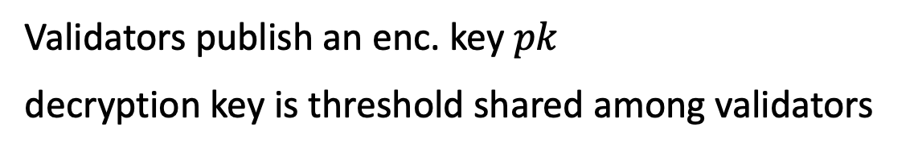


A shielded mempool via threshold decryption
Aptos / Osmosis / Shutter chains:
tx1
tx2
tx1
read
Confirmed Block
tx2
tx3
tx3
Mempool
validators
Validators publish an enc. key $pk$
decryption key is threshold shared among validators
$$sk_{1}$$
$$sk_{2}$$
$$sk_{3}$$
dec.
shares
Notes:
also future part of timeboost.

Slide 30
A shielded mempool via threshold decryption
Aptos / Osmosis / Shutter chains:
Sequencing Tx in block is done on encrypted Tx
Block is executed only once it is decrypted
Typically:
decryption threshold == confirmation threshold
consensus liveness ⇒ enough decryption shares
dec.
shares
Notes:
confirmation threshold = (2/3) N
But two rounds slows down Tx execution. With more work, this can be done in one round.

Slide 31
Option 2: Fair ordering
A different idea: force fair ordering of transactions in block
(not currently used)

Slide 32
How to force fair ordering?
Randomize transactions before executing
Downside: spamming with identical extracting transaction
Time-Based Order-Fairness
Blind Order-Fairness (e.g., via encrypted mempools)
More ideas? Your idea here …
Notes:
TEE-based: Tesseract, SRBV-2021, Automata/XATA, SecretSwap/SecretNetwork

Slide 33
Aequitas: Time-Based Order-Fairness
Basic idea: if most validators received tx1 before tx2,
then tx1 should precede tx2 in the final ordering.
The problem of Condorcet cycles:
  validator #1: [tx1, tx2, tx3]
  validator #2: [tx2, tx3, tx1]
  validator #3: [tx3, tx1, tx2]
Two received (tx1 before tx2) AND
two received (tx2 before tx3) AND
two received (tx3 before tx1)
⇒ No ordering !!
A possible solution: reject entire cycle if Tx in cycle conflict.
[Kelkar-Zhang-Goldfeder-Juels 2020]

Slide 34
Aequitas: Time-Based Order-Fairness
Block-Fair-Ordering protocol:
Validators broadcast their order preferences.
Build a graph of transactions:
  Vertices = transactions present in a large number of orderings,
  Edge(tx1 ⇾ tx2) if tx1 comes before tx2 in most orderings.
Collapse strongly connected components to a single vertex.
Topologically sort vertices.
Finalize an ordering that respects the sort.
[Kelkar-Zhang-Goldfeder-Juels 2020]
Notes:
Oversimplification

Slide 35
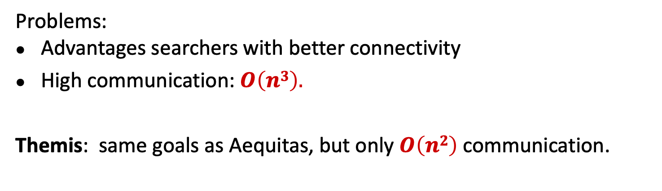
More Time-Based Order-Fairness Protocols
Problems:
Advantages searchers with better connectivity
High communication: $O\left(n3\right).$
Themis: same goals as Aequitas, but only $O\left(n2\right)$ communication.
“Themis: Fast, Strong Order-Fairness in Byzantine Consensus” by Kelkar-Deb-Long-Juels-Kannan 2021

Slide 36
More ideas needed!
An active area of research

Slide 37
Bonus topic: DAOs
Decentralized Organizations

Slide 38


Decentralized Orgs (DAO)
What is a DAO?
A Dapp deployed on-chain at a specific address
Anyone (globally) can send funds to DAO treasury
Anyone can submit a proposal to DAO
⟹ participants vote
⟹ approved ⇾ proposal executes
snapshot.org
Notes:
Movie studio DAO: participants decide what movie scripts to fund, and then share in profits from movie.
SafeSnap: uses Reality.eth to implement an oracle that pushes vote results on-chain.

Slide 39
Examples of DAOs
Collector DAOs: PleasrDAO, flamingoDAO, ConstitutionDAO, …
(see art collection at https://gallery.so/pleasrdao )
  PleasrDAO: 103 members.
      Manages a treasury, has full time employees.
      Deliberations over what to acquire over telegram.

Slide 40
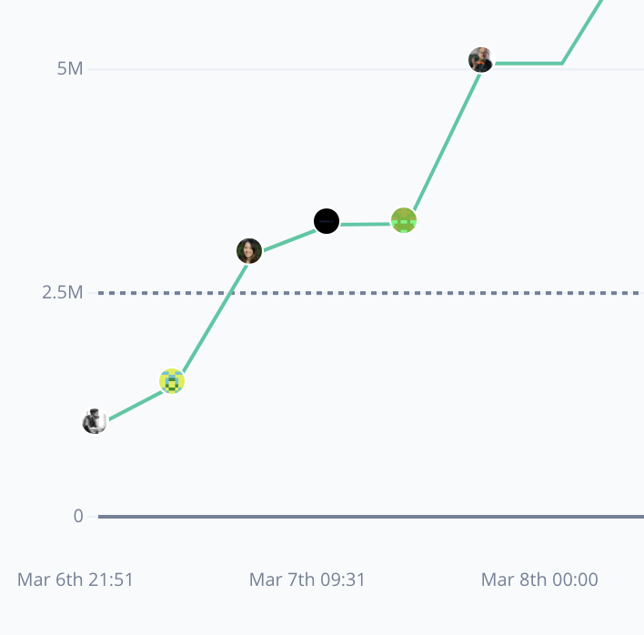
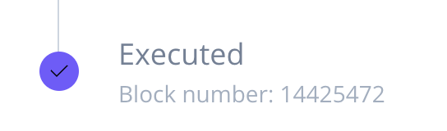
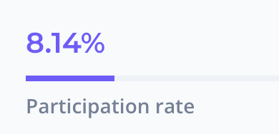
Examples of DAOs
Collector DAOs: PleasrDAO, flamingoDAO, ConstitutionDAO, …
Grants DAOs: gitcoin (83K members), …
Proposal ID 21: This proposal looks to ratify the allocation of 30,000 GTC from
the Community Treasury to the MMM workstream.
(tally.com)
Notes:
MMM: Merch Memes Marketing

Slide 41
Examples of DAOs
Collector DAOs: PleasrDAO, flamingoDAO, ConstitutionDAO, …
Grants DAOs: gitcoin, …
Protocol DAOs: manages operation of a specific protocol
Uniswap DAO (74K), Compound DAO (8K), …
Social DAOs: FWB, …
Investment DAOs: many

Slide 42
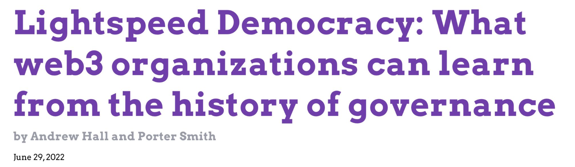
Many DAO governance experiments
Who can vote? How to vote? What voting mechanism?
DAOs: a platform for experimenting with governance mechanisms

Slide 43
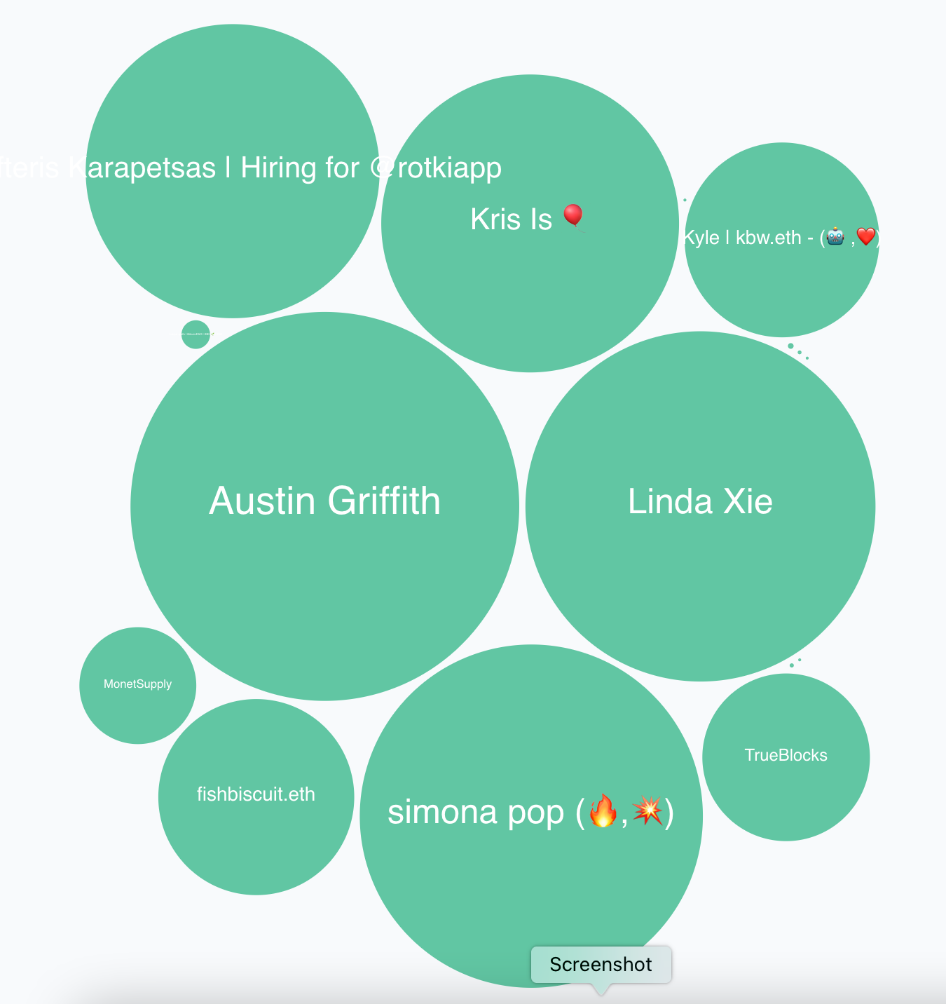
Governance method
One token one vote: (most common)
Members receive tokens based on their contribution
Everyone can vote
In reality: low participation rate (8%)
⇒ delegation
proposal 21 (tally.com)

Slide 44
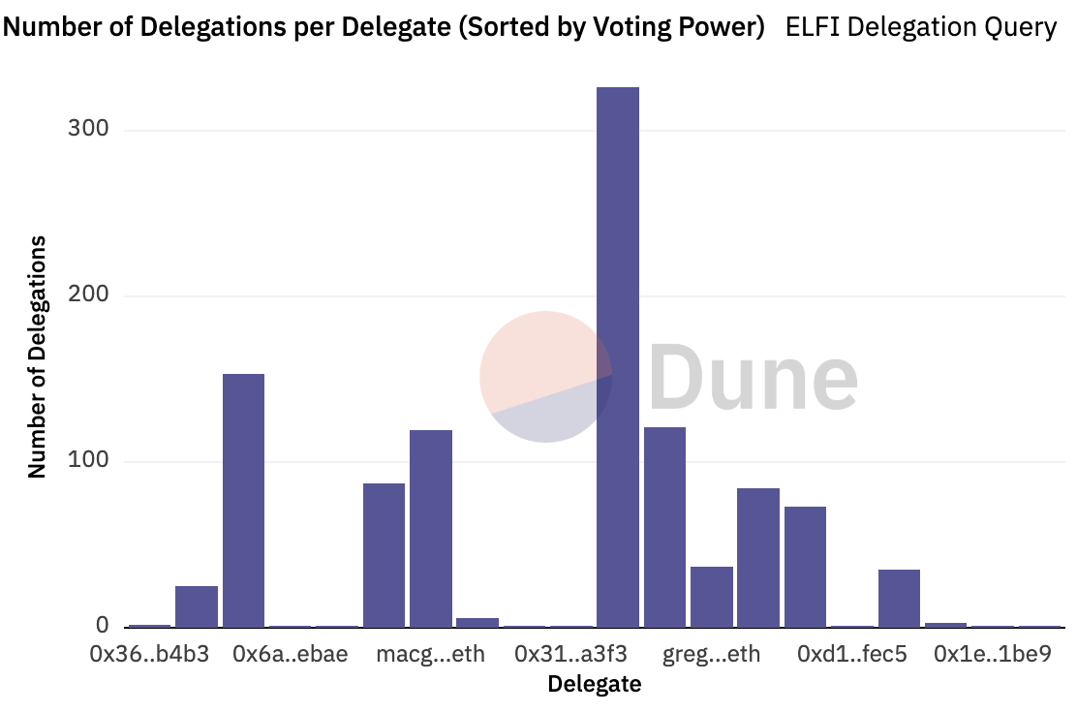
Delegation example: element
≈300 addresses
delegated tokens
to this address

Slide 45
Governor Bravo
Governor alpha (Jan. 2020) updated to Bravo (March 2021):
A collection of smart contracts used for governance
Forked and used by many other protocols
Other alternatives:
OpenZeppelin Governor protocol
Notes:
https://docs.compound.finance/v2/governance/#governance
Bravo: supports updating protocol global parameters (in three slides). Alpha fixed them.

Slide 46
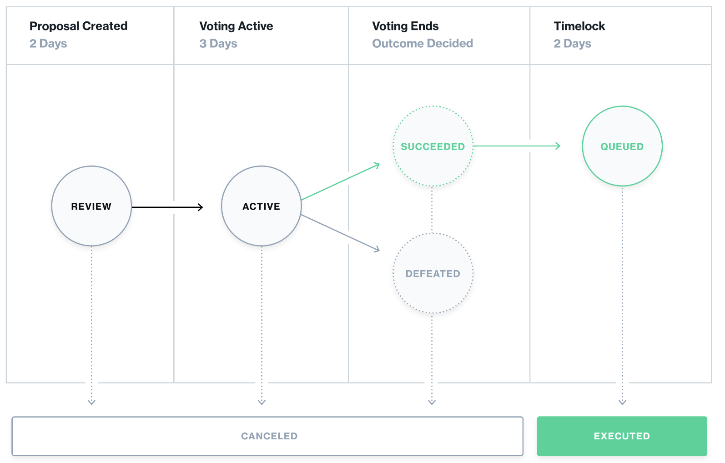
The life cycle of a proposal

Slide 47
Governor Bravo
Implements an ERC-20 governance token. Let’s call it GOV.
An address that owns GOV tokens can vote on proposals
0: against
1: in favor
2: abstain
The proposal I am voting for
(with all my allotted voting tokens)
function castVote(uint proposalID, uint8 support)
(cannot vote partially)
Notes:
Voter can re-delegate to move tokens to someone else.

Slide 48
Governor Bravo
Implements an ERC-20 governance token. Let’s call it GOV.
… or delegate its GOV tokens to another address
delegate all my voting tokens
function delegate(address delegatee)
can re-delegate at any time by calling function again
An address can only delegate all its tokens to one address at a time
… but I can hold my GOV tokens at multiple addresses
Notes:
Voter can re-delegate to move tokens to someone else.

Slide 49
Creating a proposal
The function to call on governor contract
function propose(
address[] targets,
uint[] values,
string[] signatures,
bytes[] calldatas,
string description) // proposal description
returns (uint)
If proposal passes,
how to execute it:
what functions to call (actions)
and with what arguments
(human readable)
The ID of newly created proposal

Slide 50
Global contract parameters
quorumVotes: the minimum # of votes for a proposal to pass
proposalThreshold: min # votes needed to create a proposal
votingDelay: # blocks to wait until voting can begin after a proposal is created (e.g., two days)
votingPeriod: # blocks when voting is open (e.g., three days)
All these parameters can be changed by governance in Bravo

Slide 51
Proposal execution
Once proposal gets enough votes and delays expire:
anyone can call: function execute(uint proposalID)
⇒ prescribed functions in proposal get called

Slide 52
The limits of democracy
Anytime before execution
“guardian” can call cancel() to cancel a proposal
Who is this guardian??
set at Governor contract creation time
can abdicate at any time by calling _abdicate()

Slide 53
DAO privacy questions
Private DAO participation: keep membership list private
Private voting: keep who voted how on each proposal private
Privately delegate voting rights
Private treasury
… while complying with all relevant laws.

Slide 54
Some DAOs made mistakes and were attacked
Attack on Beanstalk governance: $182M
Attack on Yam Finance governance: thwarted
Attack on Build Finance governance $1.5M
Attack on Mango governance: $115M
Steem governance drama
What happened? What can we learn?

Slide 55
(1) Beanstalk (Apr. 2022)
An Ethereum-based stablecoin Bean. Governance token Stalk.
The problem:
an attacker can buy Stalk tokens,
submit a proposal,
vote on proposal, and
have proposal execute
all in a single
transaction

Slide 56
Beanstalk: the attack
Recall: flashloan (has many applications)
a loan that is taken out and repaid back in a single transaction
No risk to lender ⇒ unbounded amount can be borrowed
The attack:
Attacker took a huge flashloan from Aave, bought lots of Stalk,
Passed a proposal to pay $80M to the attacker from the treasury,
Sold the Stalk, and repaid the flashloan,
Sent the proceeds to Tornado cash (donated $250K to Ukraine)

Slide 57
The lesson
The protocol relaunched four months later.
The lesson: governance requires delays
Require token holders to hold token for a long period of time
Build a delay between proposal genesis, voting, and execution

Slide 58
(2) Yam Finance (July 2022)
A DeFi project running on Ethereum. Governed token YAM.
What happened? (within a single day)
Attacker bought 224739 YAM with borrowed funds
Attacker submitted a governance proposal
granting it control of project reserves ($3M USD)
Voted on proposal with borrowed 224739 YAM, hitting quorum
Borrowed YAM exchanged for Eth and paid back

Slide 59
What happened next?
Yam Finance team: noticed the proposal shortly after it hit quorum
⇒ retained cancel power, and canceled the proposal.
Lesson:
Illustrates the positive power of a veto
The problem: power can never be taken away
(unless voluntarily given away)

Slide 60
END OF LECTURE
Next lecture: The regulatory landscape

