Slide 1
Decentralized Exchanges
CS251 Fall 2025
(cs251.stanford.edu)
Dan Boneh

Slide 2
First: review of lending protocols
Over-collateralized loans: to borrow, borrower has to provide
0.8×value(collateral) > value(debt)
Loan-to-Value (LTV) ratio
Liquidation Threshold
Liquidation:
if 0.83×value(collateral) < value(debt)
  then collateral is liquidated to pay debt until inequality flips
  (liquidation reduces both sides of the inequality)

Slide 3
Lending protocols
Liquidity providers send asset to the lending smart contract
  Get tokens representing their assets in the protocol
  Can redeem tokens at any time to get back their assets
Borrowers borrow from the smart contract
  Interest payments flow to the liquidity providers
  In case of a default, borrower loses (part) of its collateral
  In case of a liquidation, borrower loses (part) of its collateral

Slide 4
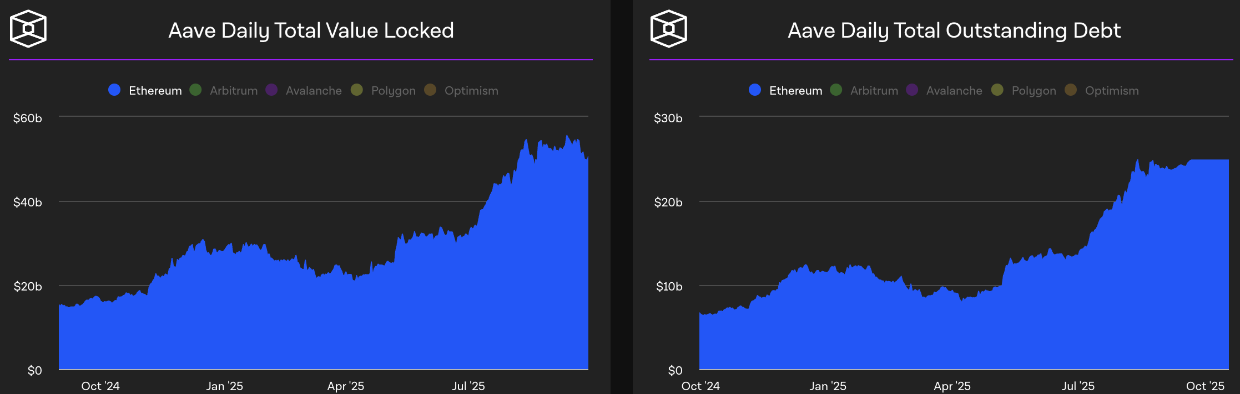
Stats
DeFi lending usage (on Ethereum):
Notes:
https://www.theblockcrypto.com/data/decentralized-finance/cryptocurrency-lending

Slide 5
A unique concept: flash loans

Slide 6
What is a flash loan?
A flash loan is taken and repaid in a single transaction
⟹ zero risk for lender ⟹ borrower needs no collateral
Initiating
contract
borrow $1M
Flash
Loan
Provider
do stuff
with funds
return funds
(Tx is valid only if funds are returned in same Tx)
“Attacking the DeFi Ecosystem with Flash Loans for Fun and Profit”

Slide 7
Use cases
Risk free arbitrage
Collateral swap
DeFi attacks: price oracle manipulation
⋮

Slide 8
Risk free arbitrage
Alice finds a USDC/DAI price difference in two pools
Aave (flash loan provider)
Flash loan 1M USDC
Repay 1M USDC loan
Uniswap
USDC⇾DAI
1M USDC
1.002M DAI
Curve
DAI⇾USDC
1.002M DAI
1.001M USDC
1USDC = 1.002DAI
1USDC = 1.001DAI
keep 0.001M USDC
All in a single transaction

Slide 9
Collateral swap
start:
end goal:
Alice @Compound
Alice @Compound
-1000 DAI
+1 cETH
Take 1000 DAI flash loan
Repay 1000 DAI debt (@Compund)
Redeem 1 cETH (from Compound)
Swap 1 cETH for 1500 cUSDC
Deposit 1500 cUSDC as collateral
Borrow 1000 DAI
Repay 1000 DAI flash loan
-1000 DAI
+1500 cUSDC
borrowed DAI using
ETH as collateral
borrowed DAI using
USDC as collateral
(a single Ethereum transaction)
Notes:
Alice is worried ETH value will fall and she will be liquidated. Wants to swap ETH collateral for equivalent USDC.

Slide 10
Aave v1 implementation
function flashLoan(address _receiver, uint256 _amount) {
…
// transfer funds to the receiver
core.transferToUser(_reserve, userPayable, _amount);
// execute action of the receiver
receiver.executeOperation(_reserve, _amount, amountFee, _params);
…
// abort if loan is not repaid
require( availableLiquidityAfter == availableLiquidityBefore.add(amountFee),
"balance inconsistent");
}
Notes:
The fee was paid to the pool, so LiquidityAfter is bigger than LiquidityBefore.
https://github.com/aave/aave-protocol/blob/master/contracts/lendingpool/LendingPool.sol#L835%23L902

Slide 11



Flash loans on Aave
(24h period on 10/2025)
Notes:
https://eigenphi.io/mev/ethereum/flashloan

Slide 12
Decentralized Exchanges
(Dex)

Slide 13
Two types of exchanges (roughly speaking)
Spot exchange:
Exchange (X of asset A) for (Y of asset B) based on
the current A to B exchange rate (spot price)
Perpetual exchange:
Place a bet on the future exchange rate between A and B
(e.g., pay X now for soy beans to be delivered in three months)
Both exchange types are are implemented on-chain in smart contracts
We will focus on spot exchanges

Slide 14
What is a spot exchange?
Many types of ERC-20 tokens on Ethereum:
WETH: ETH wrapped as an ERC-20, stETH: staked ETH
USDC, USDT, DAI: USD stablecoins
Governance tokens (e.g., GTC for Gitcoin),
Gaming tokens
…
An exchange: used to convert one token to another (e.g., USDC ⇾ GTC)
What is the exchange rate?
How to connect sellers and buyers?

Slide 15

First approach: a centralized exchange (CeX)
I want to exchange 2 ETH for USDC
The exchange rate: 1600 USDC/ETH
Ok. Sends 2 ETH to exchange
CeX
Sends 3200 USDC to Bob
1000: ETH
5 ETH
10000: USDC
Treasury
10: GTC

Slide 16
First approach: a centralized exchange (CeX)
I want to exchange 2 ETH for USDC
The exchange rate: 1600 USDC/ETH
Ok. Sends 2 ETH to exchange
CeX
Sends 3200 USDC to Bob
1002: ETH
3: ETH
1600: USDC
6800: USDC
Treasury
10: GTC

Slide 17
First approach: a centralized exchange (CeX)
Many order types
Example: Limit order:
I am willing to buy
1 ETH for up to 1700 USDC
[for the next 24 hours]
CeX
The exchange either ”fills” the order, or not.
A list of such buy/sell orders is called an order book

Slide 18
Some issues …
How is exchange rate determined?
  By supply and demand at the exchange (not transparent)
  Competition with other exchanges (bad user experience)
Security: What if exch. takes Bob’s 2 ETH, but never sends USDC?
Censorship: What if exchange refuses to do business with Bob?

Slide 19
A more trusted solution: DeX
What is a DEX?
a marketplace where transactions occur directly between participants, without a trusted intermediary
Properties:
Programmable: can be used as a service by other contracts
Transparent: code is available for everyone to see
Permissionless: anyone can use
Non-Custodial (never holds user assets)

Slide 20
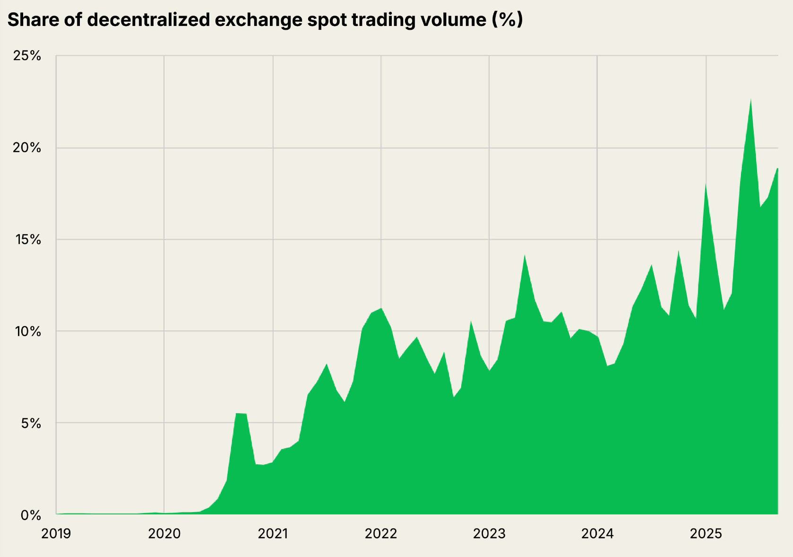
Share of trading on DeX vs. CeX
source: state of crypto 2025 report

Slide 21
How to build a DeX?
First idea: on-chain order book
Liquidity providers place buy/sell orders on chain
Traders fill them on chain
Problem: gas costs.
Orders cost gas: when placed, when filled, when canceled.
Matching buy orders to sell orders takes lots of gas (but see here)
Only feasible on chains with cheap gas … which exist!
Notes:
Market maker: a large bank.
Example chain: Hyperliquid

Slide 22
How to build a DeX?
Next idea: off-chain order book
Liquidity providers sign buy/sell orders off chain
    Post orders on a centralized web site
User signs an order it wants to fill and submits it on chain.
Example: 0x Protocol
Problem: order book is not accessible to contracts (dAPPs)

Slide 23
How to build a DeX?
A very elegant idea: Automated Market Maker (AMM)
Liquidity providers deposit assets into an on-chain pool
Users trade with the on-chain pool
    exchange rate is determined algorithmically
Examples: Uniswap, Balancer, Bancor, …
Benefits: Gas-efficient, accessible to contracts, easy to bootstrap

Slide 24
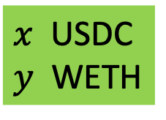
Automated Market Maker
Goal: People want to exchange USDC ⟺ WETH
stable
volitile
Uniswap
USDC-WETH pool
(dAPP)
Liquidity
providers
USDC, WETH
$x$ USDC
$y$ WETH
USDC, WETH
(earn interest)
Notes:
This means that the UNI and USDC ERC-20 contracts transfer coins from LP’s address to pool’s address.

Slide 25
Automated Market Maker
Goal: People want to exchange USDC ⟺ WETH
Calculate exchange rate
Uniswap
USDC-WETH pool
(dAPP)
user
want to sell
12 WETH for USDC
say, 1 WETH = 1.5 USDC
$x$ USDC
$y$ WETH
18 USDC

Slide 26
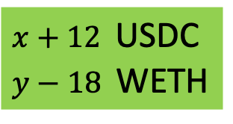
Automated Market Maker
Goal: People want to exchange USDC ⟺ WETH
Calculate exchange rate
Uniswap
USDC-WETH pool
(dAPP)
user
want to sell
12 WETH for USDC
say, 1 WETH = 1.5 USDC
$x+12$ USDC
$y−18$ WETH
18 USDC
updated pool state

Slide 27
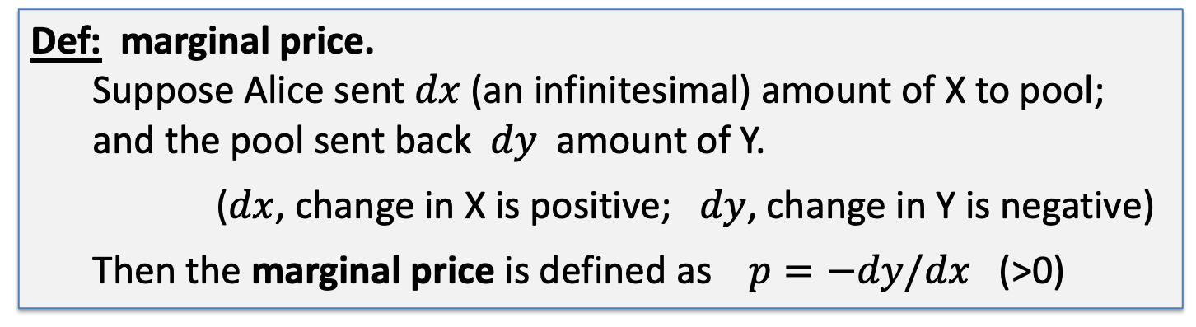
How to determine exchange rate?
Pool has (x units of X) and (y units of Y)
Def: marginal price.
Suppose Alice sent $dx$(an infinitesimal) amount of X to pool;
and the pool sent back $dy$ amount of Y.
($dx$, change in X is positive; $dy$, change in Y is negative)
Then the marginal price is defined as $p=−dy/dx$ (>0)
The price of a small amount Y in units of X
Notes:
$dx$>0, $dy<0$, so p>0.

Slide 28
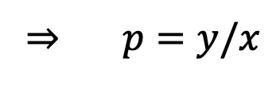
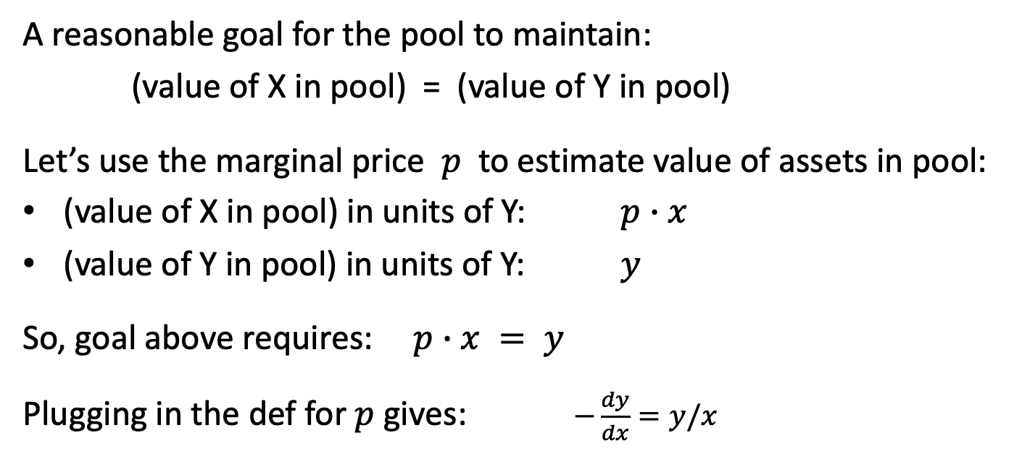
How to determine exchange rate?
A reasonable goal for the pool to maintain:
(value of X in pool) = (value of Y in pool)
Let’s use the marginal price $p$ to estimate value of assets in pool:
(value of X in pool) in units of Y: $p∙x$
(value of Y in pool) in units of Y: $y$
So, goal above requires: $p∙x = y$
Plugging in the def for $p$ gives: $−\frac{dy}{dx}=y/x$
⇒ $p=y/x$

Slide 29
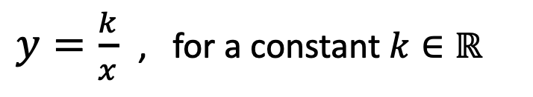
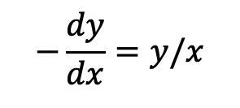
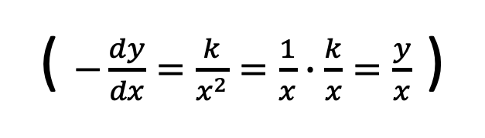
How to determine exchange rate?
$$−\frac{dy}{dx}=y/x$$
The diff. eq.
has a unique solution:
indeed:
$y=\frac{k}{x}$ , for a constant $k∈ℝ$
( $−\frac{dy}{dx}=\frac{k}{x^{2}}=\frac{1}{x}∙\frac{k}{x}=\frac{y}{x}$ )
or equivalently, the pool must maintain: $x∙y=k$
… the famous constant product formula

Slide 30
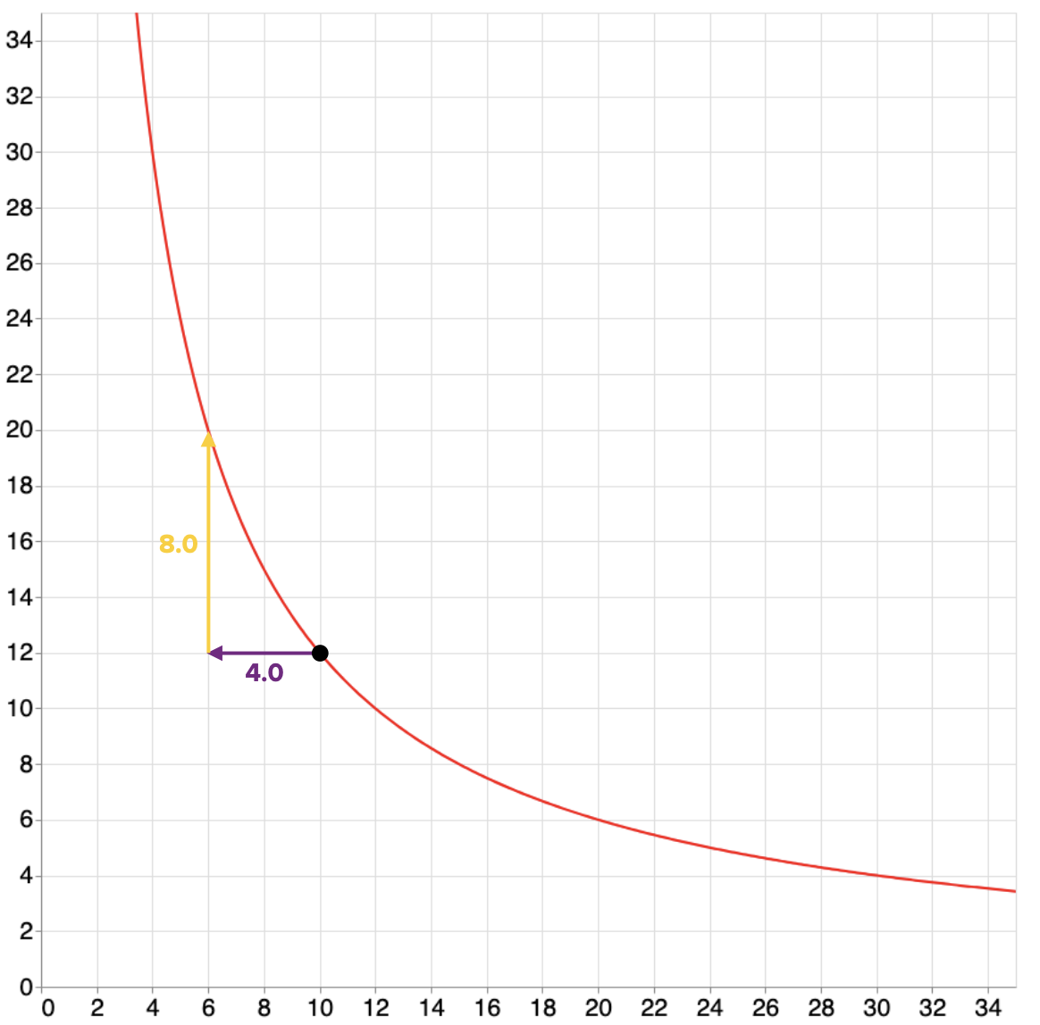
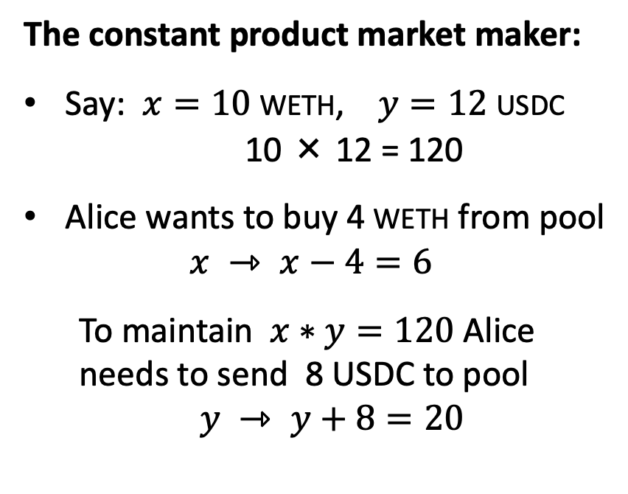


So what does $x∙y=k$ mean ??
$$x∙y=120$$
The constant product market maker:
Say: $x=10$WETH, $y=12$USDC
10 × 12 = 120
Alice wants to buy 4 WETH from pool
$x ⇾ x−4=6$
To maintain $x∗y=120$ Alice
needs to send 8 USDC to pool
$y ⇾ y+8=20$
new
state
USDC
current
state of pool
WETH

Slide 31
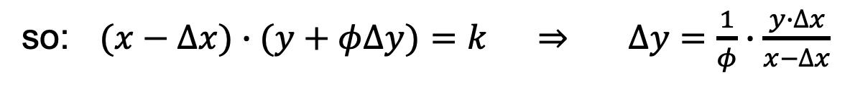
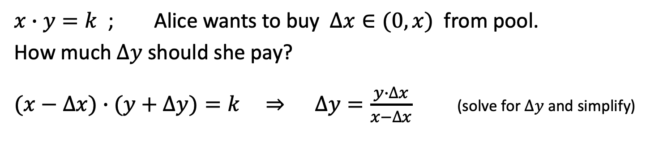
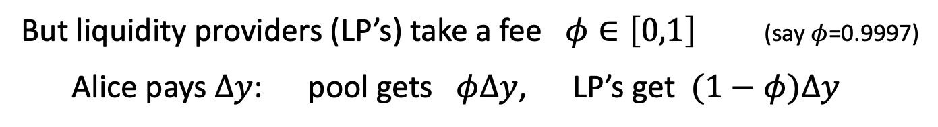
More generally: Uniswap v2
$x∙y=k$ ; Alice wants to buy $∆x∈(0,x)$ from pool.
How much $∆y$ should she pay?
$(x−∆x)∙(y+∆y)=k$ ⇒ $∆y=\frac{y∙∆x}{x−∆x}$ (solve for $∆y$and simplify)
But liquidity providers (LP’s) take a fee $φ∈\left[0,1\right]$ (say $φ$=0.9997)
Alice pays $∆y$: pool gets $φ∆y$, LP’s get $(1−φ)∆y$
so: $(x−∆x)∙(y+φ∆y)=k$ ⇒ $∆y=\frac{1}{φ}∙\frac{y∙∆x}{x−∆x}$

Slide 32
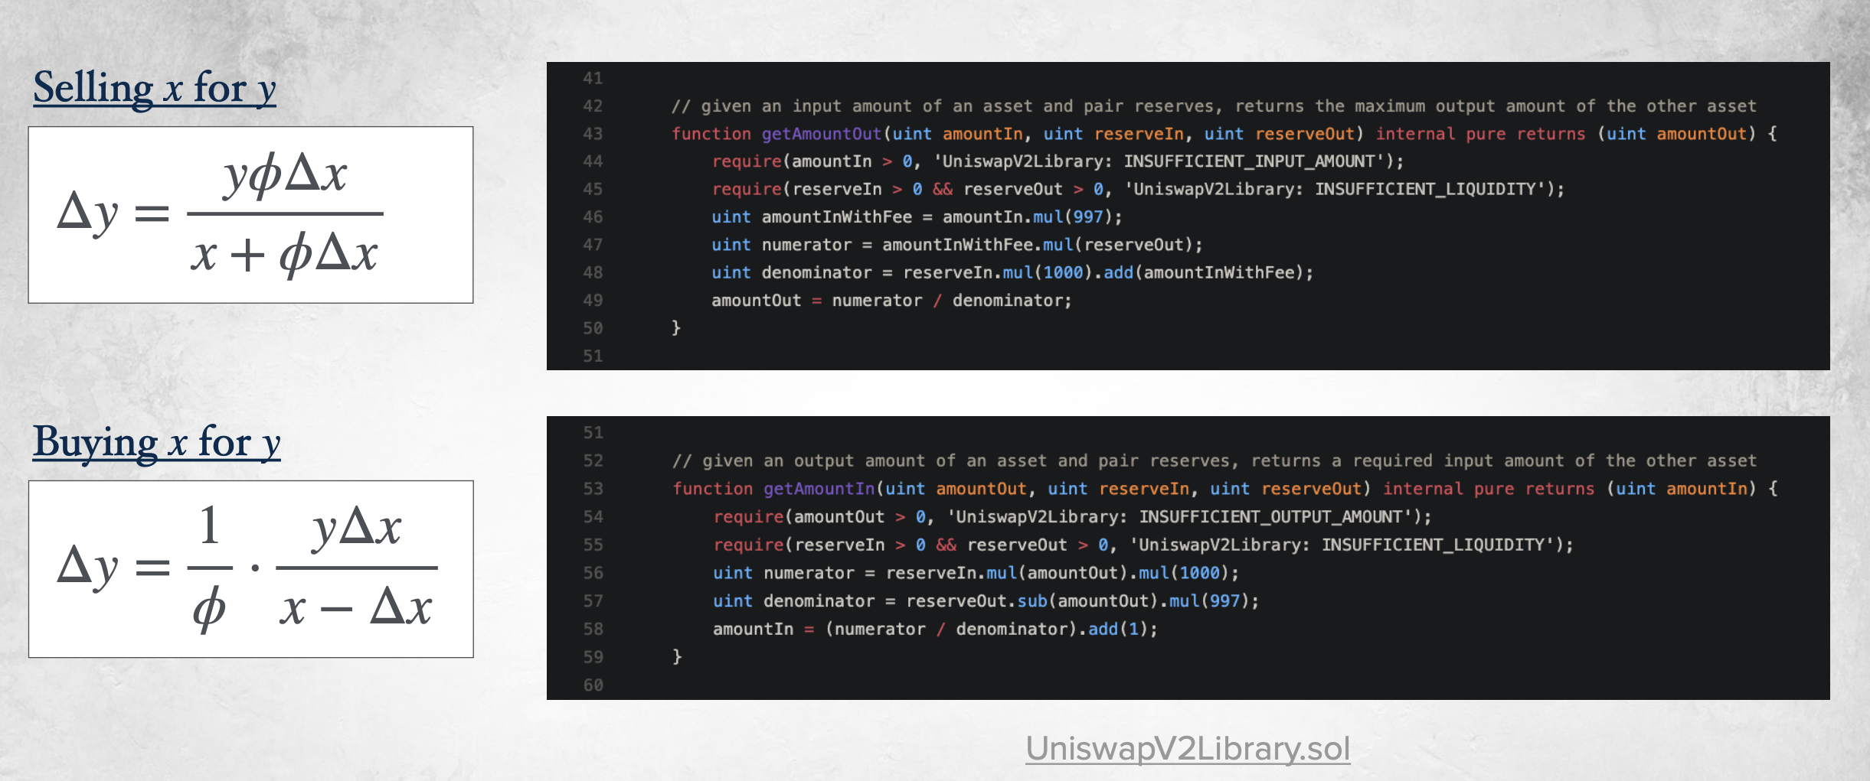


Buy and sell equations
($x⇾x+∆x$)
($x⇾x−∆x$)
gas efficient calculations

Slide 33
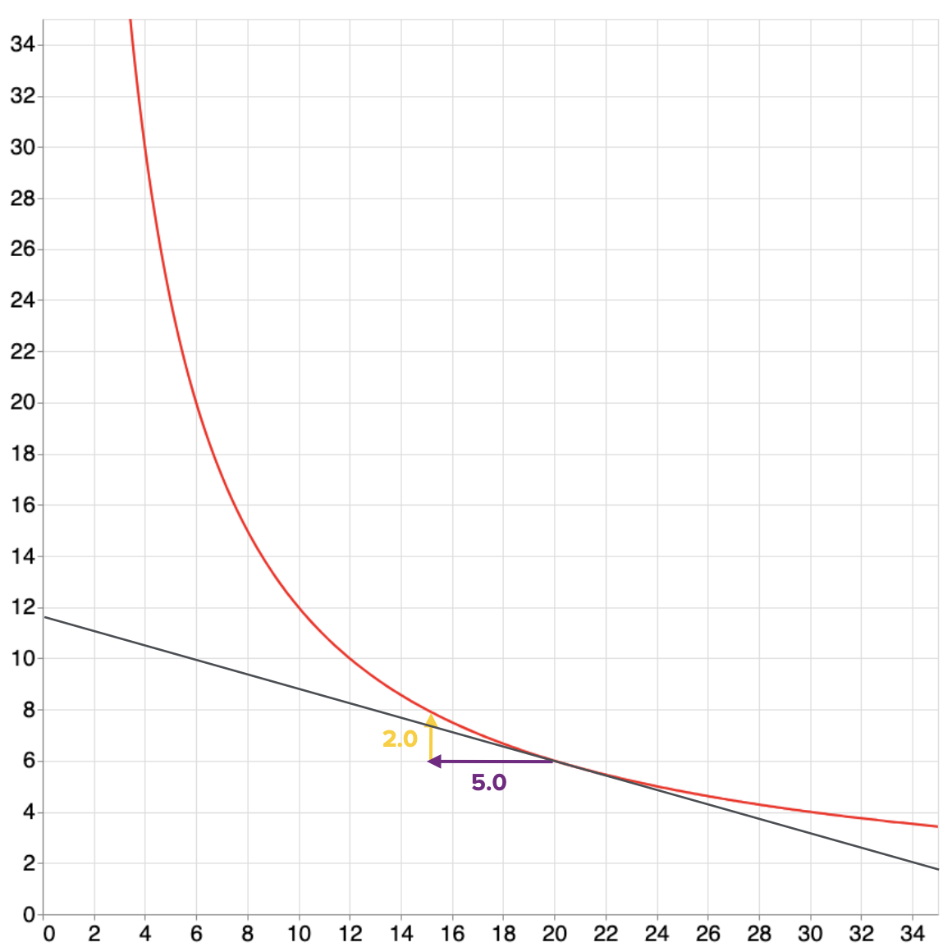
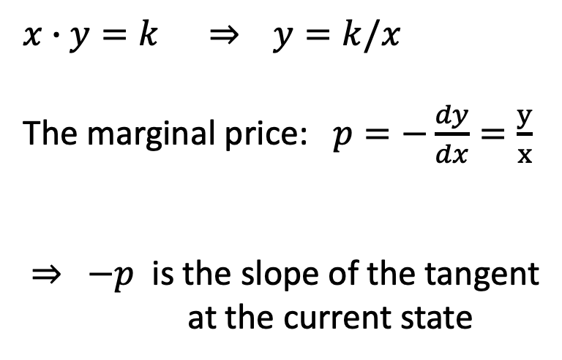
The marginal price as a tangent
$x∙y=k$ ⇒ $y=k/x$
The marginal price: $p=−\frac{dy}{dx}=\frac{y}{x}$
⇒ $−p$ is the slope of the tangent
at the current state
current
state
tangent

Slide 34
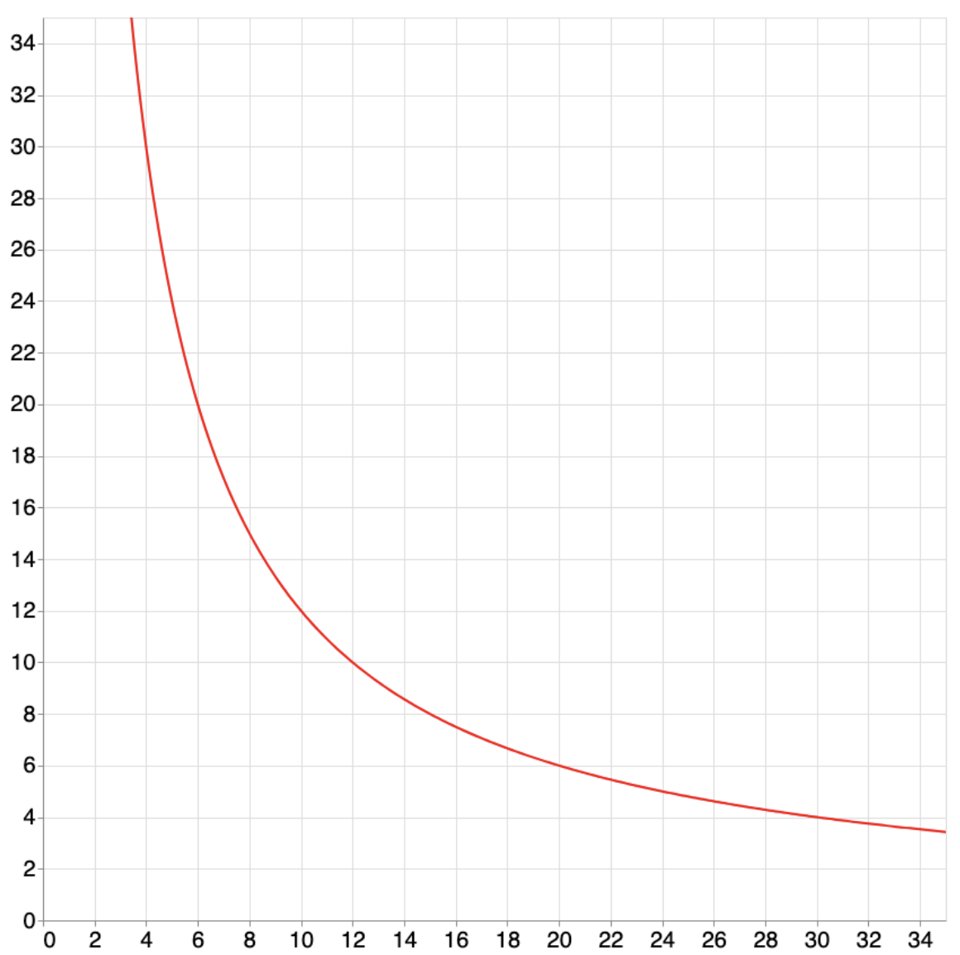


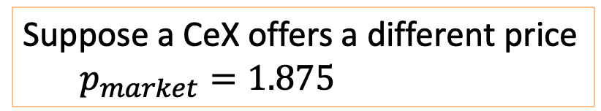
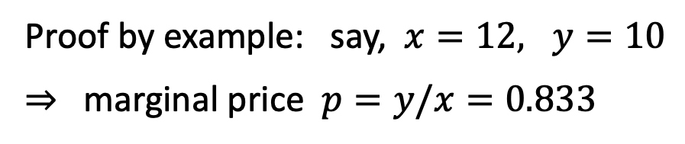
A feature: automatic price discovery (assume $φ$=1)
Thm: the marginal price $y/x$ converges to the market exchange rate
Proof by example: say, $x=12, y=10$
⇒ marginal price $p=y/x=0.833$
This point matches
the CeX price: 15/8=1.875
current
state
Suppose a CeX offers a different price
$p_{market}=1.875$
⇒ arbitrage opportunity!
$$p=y/x=0.833$$

Slide 35
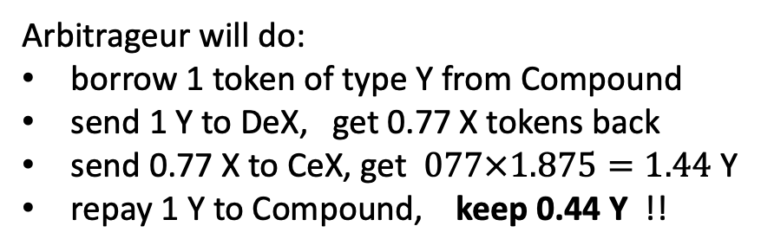
A feature: automatic price discovery (assume $φ$=1)
Thm: the marginal price $y/x$ converges to the market exchange rate
Arbitrageur will do:
borrow 1 token of type Y from Compound
send 1 Y to DeX, get 0.77 X tokens back
send 0.77 X to CeX, get $077×1.875=1.44$ Y
repay 1 Y to Compound, keep 0.44 Y !!
updated DeX state
current
state
Iterate until DeX marginal price = CeX price
⇒ Arb. is providing a service, and making a profit
Where did the 0.44 Y come from? Who lost money?
$$p=y/x=0.833$$
Answer: LP’s lost … we will see why

Slide 36
A feature: automatic price discovery (assume $φ$=1)
Thm: the marginal price $y/x$ converges to the market exchange rate
To summarize:
DeX state is below market rate
⇒ arbitrageurs will move DeX up
DeX state is above market rate
⇒ arbitrageurs will move DeX down
DeX above CeX
CeX price
DeX below CeX
DeX marginal price matches market price,
without ever being told the market price !!
Notes:
This holds for any curve as long as dy/dx is monotonically decreasing from infinity to zero as x goes from 0 to infinity.

Slide 37
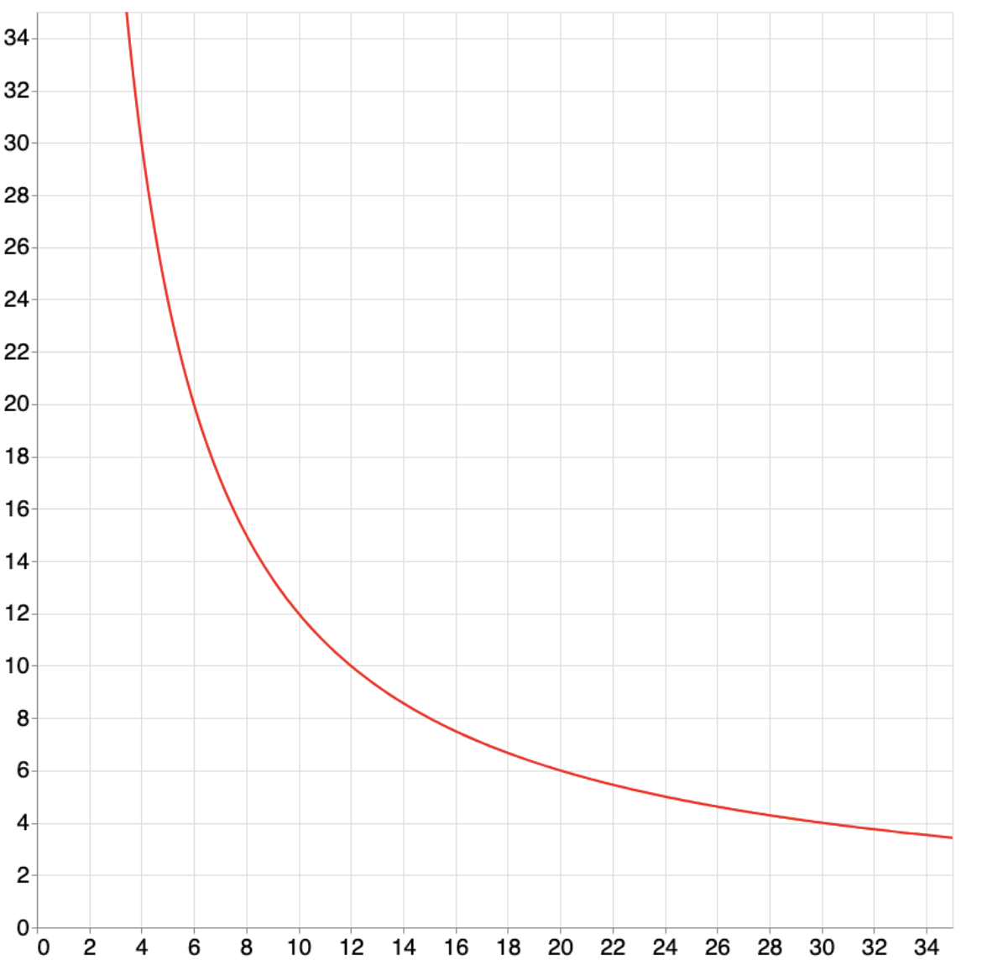
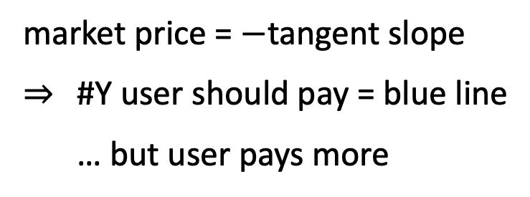
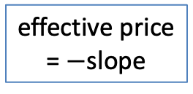
Problem 1: Slippage
Slippage:
the larger the trade,
the worse the exchange rate
is for the user
effective price
= $−$slope
state after
trade
market price = $−$tangent slope
⇒ #Y user should pay = blue line
… but user pays more
current
state
#Y user
pays
market
price
#X user
gets
tangent
(uniswap bounds slippage at 0.5%)
Notes:
Alternatively, the shallower the pool, the greater the slippage. We want deep pools.

Slide 38
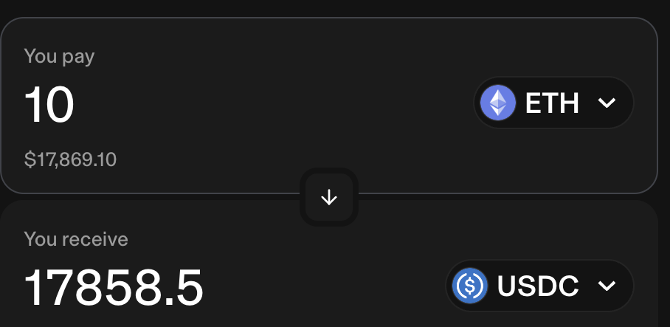
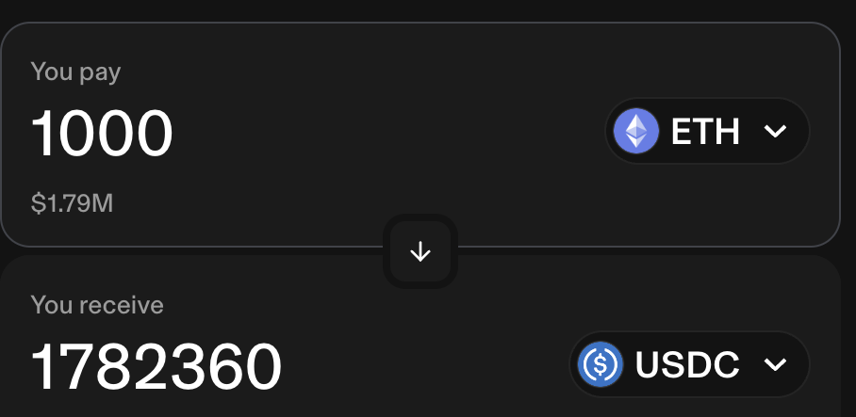

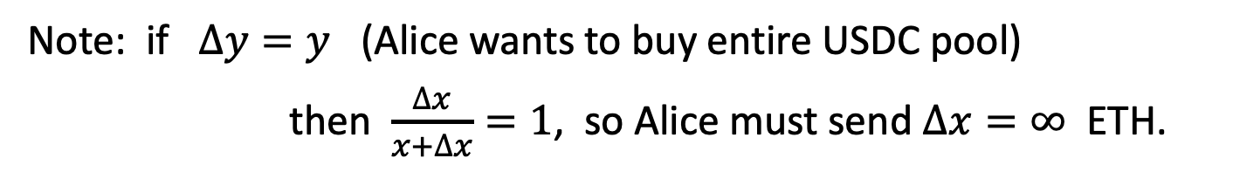
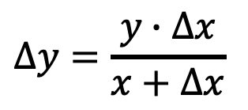
Slippage: an example
$$∆y=\frac{y∙∆x}{x+∆x}$$
1785.5 USDC/ETH
$$>$$
1782.36 USDC/ETH
Note: if $∆y=y$ (Alice wants to buy entire USDC pool)
then $\frac{∆x}{x+∆x}=1$, so Alice must send $∆x=∞$ ETH.
Alice cannot do ⇒ pool will never run out of X or Y tokens.
Notes:
https://app.uniswap.org/swap

Slide 39
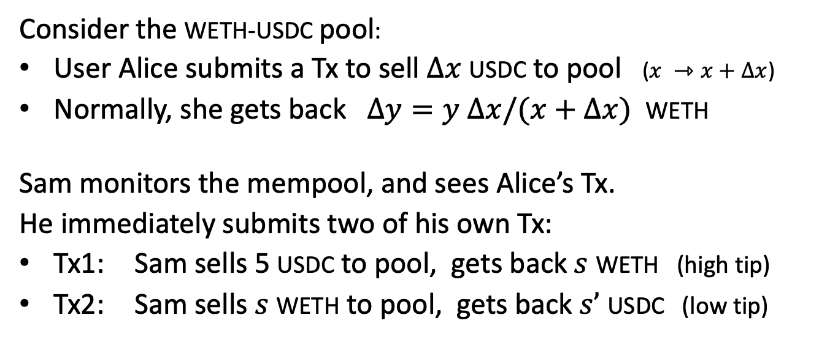
Problem 2: the sandwich attack
Consider the WETH-USDC pool:
User Alice submits a Tx to sell $∆x$ USDC to pool ($x ⇾x+$ $∆x$)
Normally, she gets back $∆y=y ∆x/(x+∆x)$ WETH
Sam monitors the mempool, and sees Alice’s Tx.
He immediately submits two of his own Tx:
Tx1: Sam sells 5 USDC to pool, gets back $s$ WETH (high tip)
Tx2: Sam sells $s$ WETH to pool, gets back $s’$ USDC (low tip)
Sam’s
Tx1
Alice’s
sandwiched Tx
Sam’s
Tx2
time

Slide 40
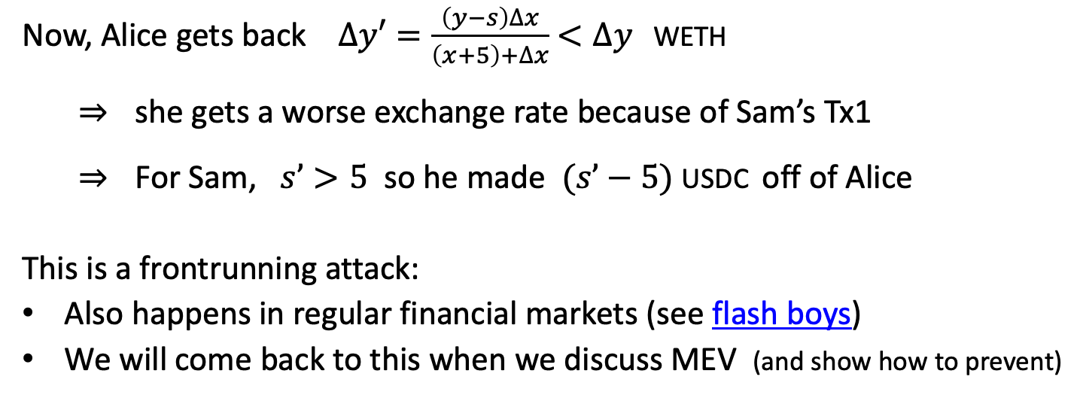
Problem 2: the sandwich attack
Now, Alice gets back $∆y′=\frac{\left(y−s\right)∆x}{\left(x+5\right)+∆x}$ $<∆y$ WETH
⇒ she gets a worse exchange rate because of Sam’s Tx1
⇒ For Sam, $s’>5$ so he made $(s’−5)$ USDC off of Alice
This is a frontrunning attack:
Also happens in regular financial markets (see flash boys)
We will come back to this when we discuss MEV (and show how to prevent)
Sam’s
Tx1
Alice’s
sandwiched Tx
Sam’s
Tx2
time

Slide 41
Incentives for liquidity providers

Slide 42
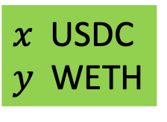
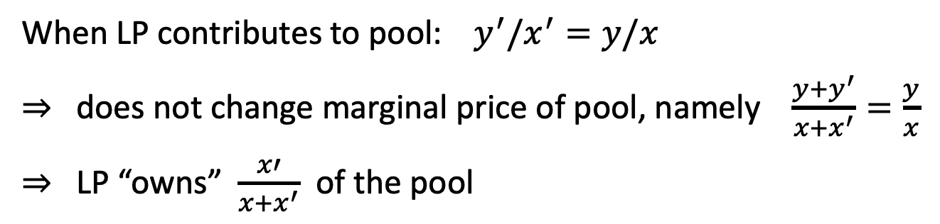
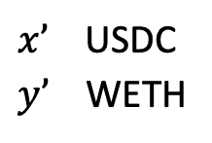
Recall: liquidity providers (LP’s)
When LP contributes to pool: $y^{′}/x^{′}=y/x$
⇒ does not change marginal price of pool, namely $\frac{y+y^{′}}{x+x^{′}}=\frac{y}{x}$
⇒ LP “owns” $\frac{x′}{x+x^{′}}$ of the pool
Uniswap
USDC-WETH pool
(dAPP)
LP
$x’$ USDC
$y’$ WETH
$x$ USDC
$y$ WETH

Slide 43
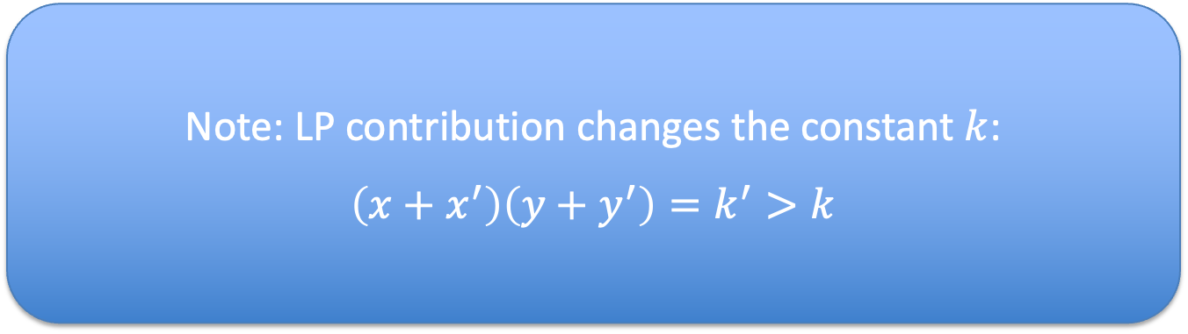
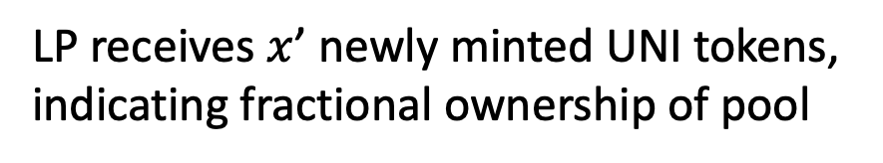
Recall: liquidity providers (LP’s)
When LP contributes to pool: $y^{′}/x^{′}=y/x$
⇒ does not change marginal price of pool, namely $\frac{y+y^{′}}{x+x^{′}}=\frac{y}{x}$
⇒ LP “owns” $\frac{x′}{x+x^{′}}$ of the pool
Note: LP contribution changes the constant $k$:
$\left(x+x^{′}\right)\left(y+y^{′}\right)=k^{′}>k$
Uniswap
USDC-WETH pool
(dAPP)
LP receives $x$’ newly minted UNI tokens,
indicating fractional ownership of pool
LP
$x’$ USDC
$y’$ WETH
$x$ USDC
$y$ WETH

Slide 44
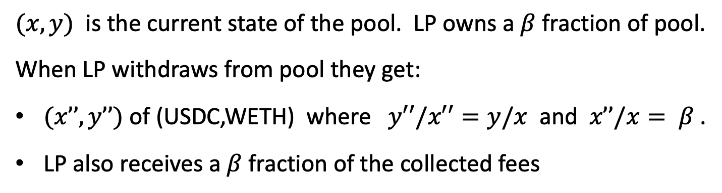
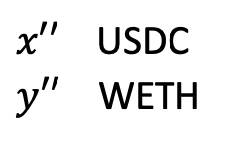
LP withdrawal
$(x,y)$ is the current state of the pool. LP owns a $β$ fraction of pool.
When LP withdraws from pool they get:
$(x’’,y’’)$ of (USDC,WETH) where $y′′/x′′=y/x$ and $x’’/x= β$.
LP also receives a $β$fraction of the collected fees
Uniswap
USDC-WETH pool
(dAPP)
LP
$x′′$ USDC
$y′′$ WETH
$x$ USDC
$y$ WETH

Slide 45
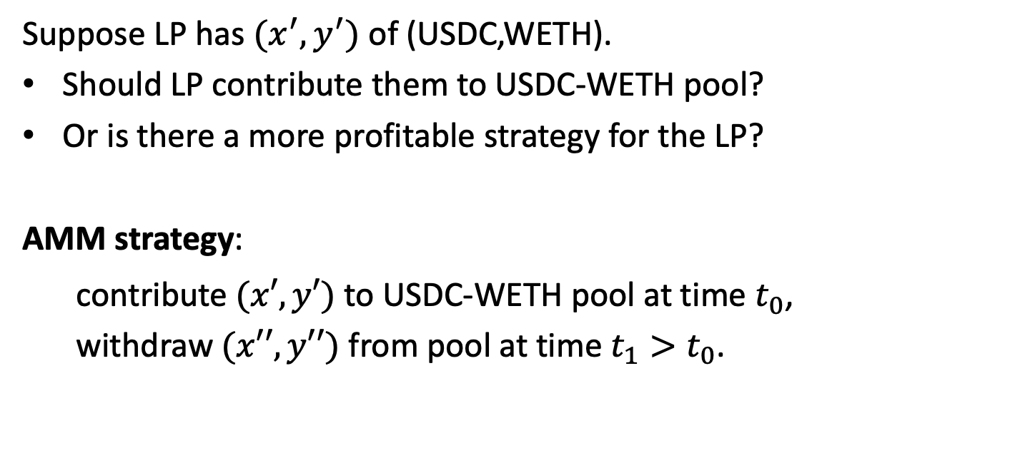
Should LP’s contribute to pool?
Suppose LP has $(x^{′},y^{′})$ of (USDC,WETH).
Should LP contribute them to USDC-WETH pool?
Or is there a more profitable strategy for the LP?
AMM strategy:
contribute $(x′,y′)$ to USDC-WETH pool at time $t_{0}$,
withdraw $(x′′,y′′)$ from pool at time $t_{1}>t_{0}$.

Slide 46
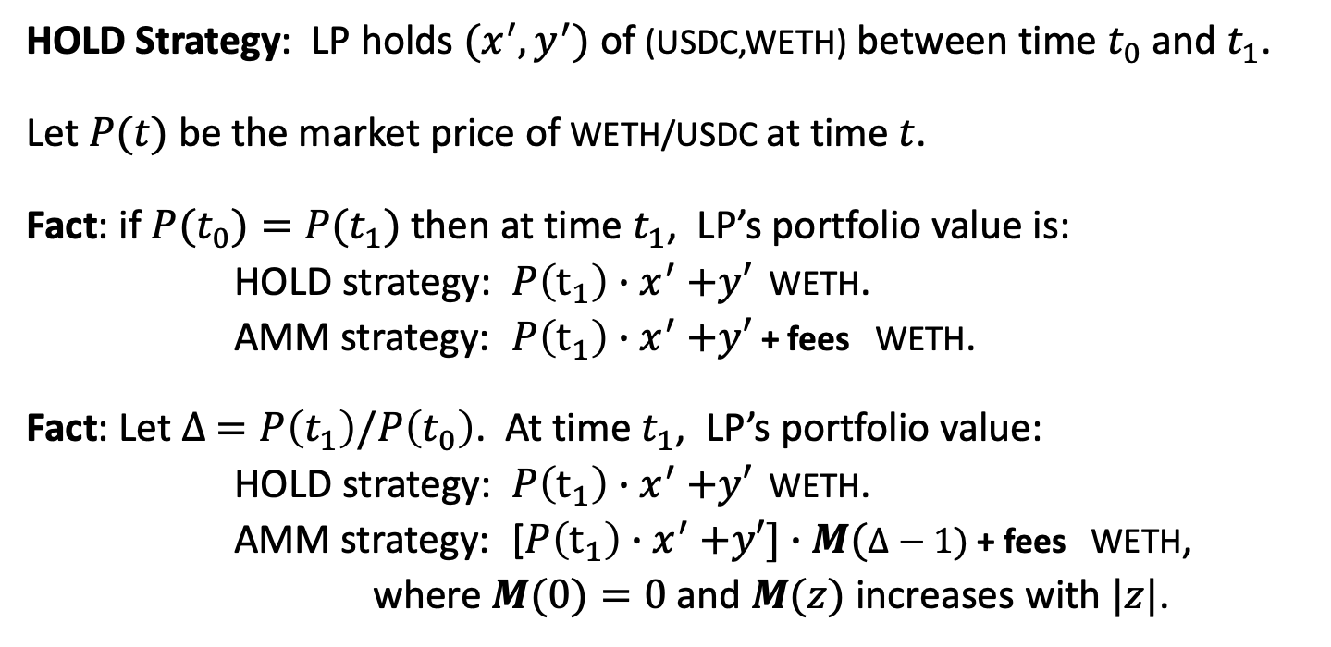
Loss vs. Hold (divergence loss)
HOLD Strategy: LP holds $(x^{′},y^{′})$ of (USDC,WETH) between time $t_{0}$ and $t_{1}$.
Let $P(t)$ be the market price of WETH/USDC at time $t$.
Fact: if $P(t_{0})=P(t_{1})$ then at time $t_{1}$, LP’s portfolio value is:
HOLD strategy: $P\left(t_{1}\right){∙x}^{′}+y′$ WETH.
AMM strategy: $P\left(t_{1}\right){∙x}^{′}+y′$ + fees WETH.
Fact: Let $∆ =P\left(t_{1}\right)/P\left(t_{0}\right)$. At time $t_{1}$, LP’s portfolio value:
HOLD strategy: $P\left(t_{1}\right){∙x}^{′}+y′$ WETH.
AMM strategy: [$P\left(t_{1}\right){∙x}^{′}+y′]∙M(∆−1)$ + fees WETH,
where $M(0)=0$and $M(z)$ increases with $|z|$.
Loss vs. Hold
Notes:
When $∆ =$1, LP gets fees. When |$∆ −$1| is large, LP’s losses are great.

Slide 47
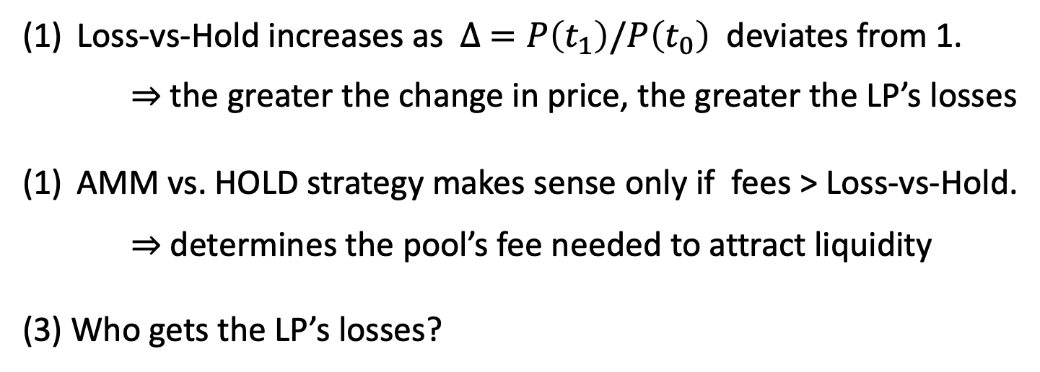
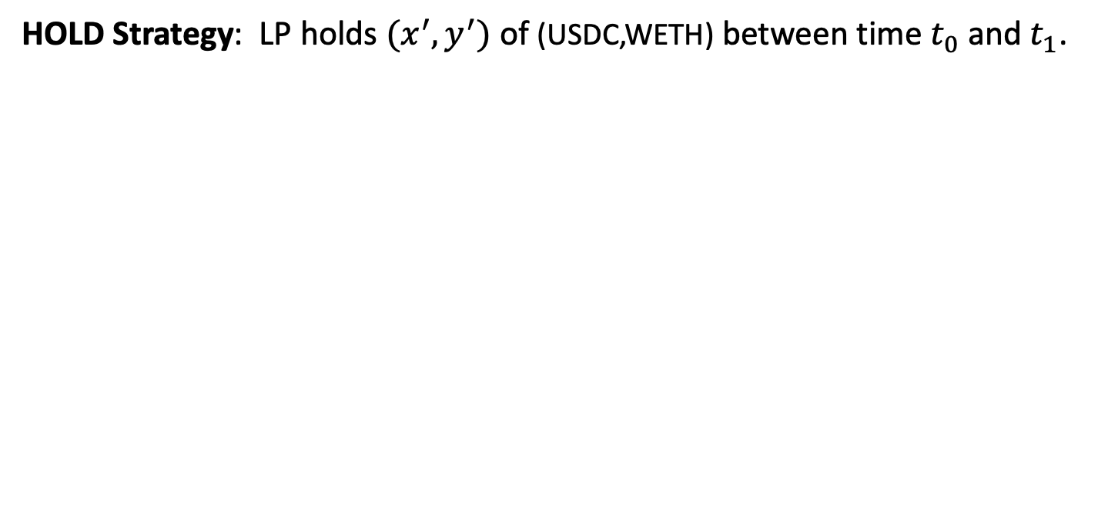
Loss vs. Hold (divergence loss)
HOLD Strategy: LP holds $(x^{′},y^{′})$ of (USDC,WETH) between time $t_{0}$ and $t_{1}$.
Loss-vs-Hold increases as $∆ =P\left(t_{1}\right)/P\left(t_{0}\right)$ deviates from 1.
⇒ the greater the change in price, the greater the LP’s losses
AMM vs. HOLD strategy makes sense only if fees > Loss-vs-Hold.
⇒ determines the pool’s fee needed to attract liquidity
(3) Who gets the LP’s losses?
Arbitrageurs

Slide 48
Loss vs. Rebalancing (LVR)
Rebalancing Strategy:
LP maintains its portfolio outside of the DeX
LP does the same rebalancing on its portfolio as the DeX,
but it does so by trading with a CeX.
A strategy that more accurately predicts LP’s losses
when providing liquidity to DeX
⇒ more accurately determines the fee needed to attract liquidity
https://arxiv.org/pdf/2208.06046.pdf

Slide 49
Loss vs. Rebalancing (LVR)
LVR meta theorem:
At periods of high exchange rate volatility, the rebalancing strategy greatly outperforms the investment in a DeX as an LP,
unless fees are “very” high
⇒ At periods of high volatility, LPs withdraw funds from the pool
(unless the pool charges very high fees)

Slide 50
Other functions

Slide 51
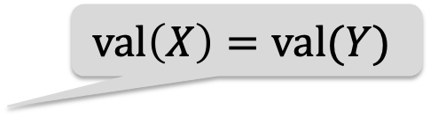
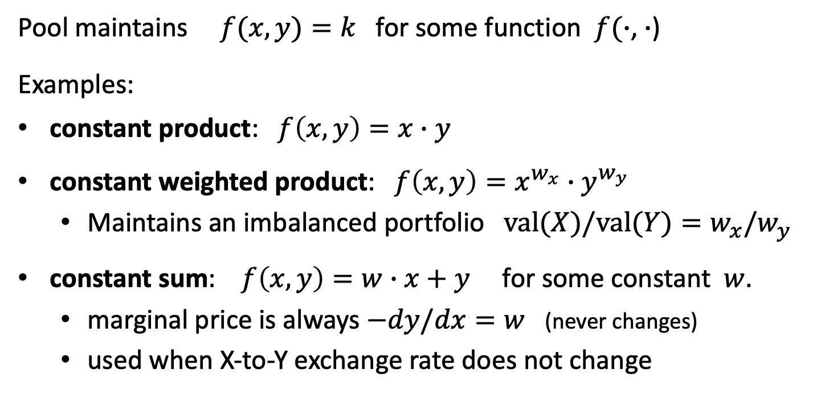
Constant Function Market Maker (CFMM)
Pool maintains $f(x,y)=k$ for some function $f(∙$, $∙$)
Examples:
constant product: $f\left(x,y\right)=x∙y$
constant weighted product: ${f\left(x,y\right)=x}^{w_{x}}∙y^{w_{y}}$
  Maintains an imbalanced portfolio $val(X)/val(Y)=w_{x}/w_{y}$
constant sum: $f\left(x,y\right)=w∙x+y$ for some constant $w$.
  marginal price is always $−dy/dx=w$ (never changes)
  used when X-to-Y exchange rate does not change
$$val\left(X\right)=val(Y)$$

Slide 52
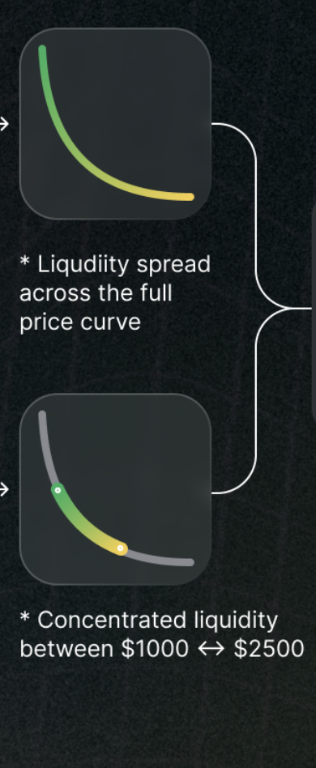
Uniswap v3: concentrated liquidity
In v2, LP’s liquidity is used on the entire price range.
In v3, LP can specify a price range where their liquidity will be used
⇒ protects LP from price swings. Results in a deeper pool when price is in the allowed range.
https://uniswap.org/whitepaper-v3.pdf

Slide 53
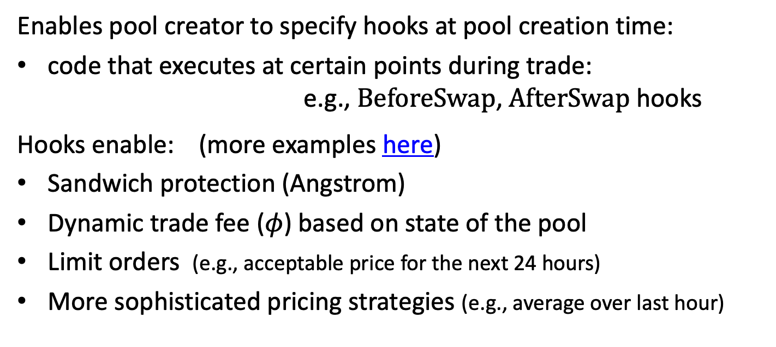
Uniswap v4: hooks
Enables pool creator to specify hooks at pool creation time:
code that executes at certain points during trade:
e.g., BeforeSwap, AfterSwap hooks
Hooks enable: (more examples here)
Sandwich protection (Angstrom)
Dynamic trade fee ($φ$) based on state of the pool
Limit orders (e.g., acceptable price for the next 24 hours)
More sophisticated pricing strategies (e.g., average over last hour)
https://blog.uniswap.org/uniswap-v4

Slide 54
Summary: AMMs
AMM is implemented as a simple smart contract
Automatic price discovery (no off-chain oracles)
No dependence on a central point of control
Fully composable with other dAPPs

Slide 55
END OF LECTURE
Next lecture: MEV

