Slide 1
Solidity
CS251 Fall 2023
(cs251.stanford.edu)
Dan Boneh
https://docs.soliditylang.org/en/latest/

Slide 2
Recap
World state: set of accounts identified by 32-byte address.
Two types of accounts:
  owned accounts (EOA): address = H(PK)
  (2) contracts: address = H(CreatorAddr, CreatorNonce)

Slide 3
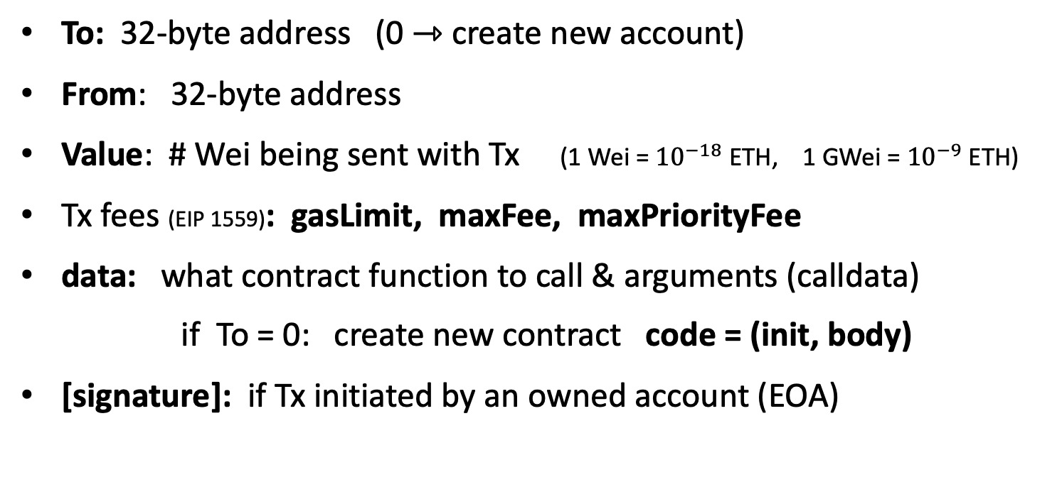
Recap: Transactions
To: 32-byte address (0 ⇾ create new account)
From: 32-byte address
Value: # Wei being sent with Tx (1 Wei = ${10}^{−18}$ ETH, 1 GWei = ${10}^{−9}$ ETH)
Tx fees (EIP 1559): gasLimit, maxFee, maxPriorityFee
data: what contract function to call & arguments (calldata)
if To = 0: create new contract code = (init, body)
[signature]: if Tx initiated by an owned account (EOA)

Slide 4
Recap: Blocks
Validators collect Tx from users:
⇒ run Tx sequentially on current world state
⇒ new block contains updated world state, Tx list, log msgs

Slide 5
The Ethereum blockchain: abstractly
prev hash
prev hash
…
…
accts.
accts.
updated
world
state
Tx
log
messages
updated
world
state
Tx
log
messages

Slide 6
EVM mechanics: execution environment
Write code in Solidity (or another front-end language)
⇒ compile to EVM bytecode
(other projects use WASM or BPF bytecode)
⇒ validators use the EVM to execute contract bytecode
in response to a Tx

Slide 7
The EVM

Slide 8
The EVM
see https://www.evm.codes
Stack machine (like Bitcoin) but with JUMP
contract can create or call another contract ⇒ composability
Two types of zero initialized memory:
Persistent storage (on blockchain): SLOAD, SSTORE (expensive)
Volatile memory (for single Tx): MLOAD, MSTORE (cheap)
LOG0(data): write data to log tree (not readable by EVM)
Tx Calldata (16 gas/byte): readable by EVM in current Tx
(near future: support for cheap 128KB blobs)

Slide 9
Every instruction costs gas
Why charge gas?
Tx fees (gas) prevents submitting Tx that runs for many steps.
During high load: block proposer chooses Tx from mempool
that maximize its income.
if gasUsed ≥ gasLimit: block proposer keeps gas fees (from Tx originator)
calculated by EVM
specified in Tx

Slide 10
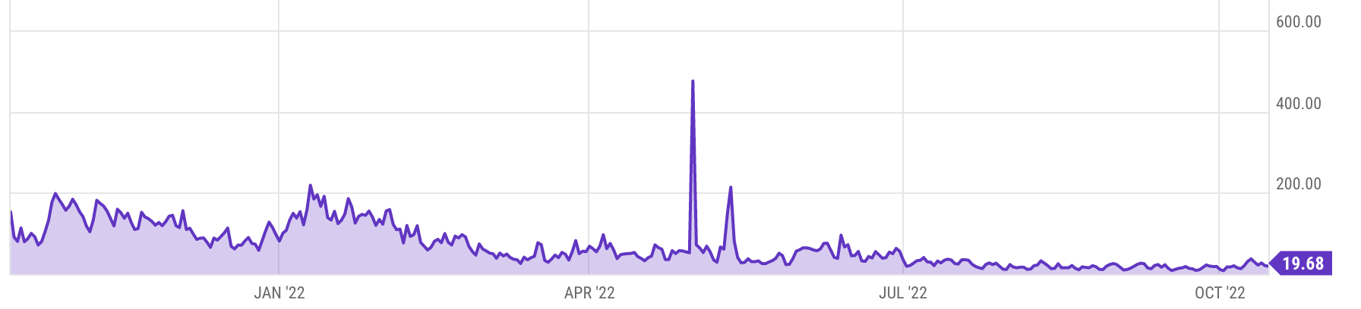
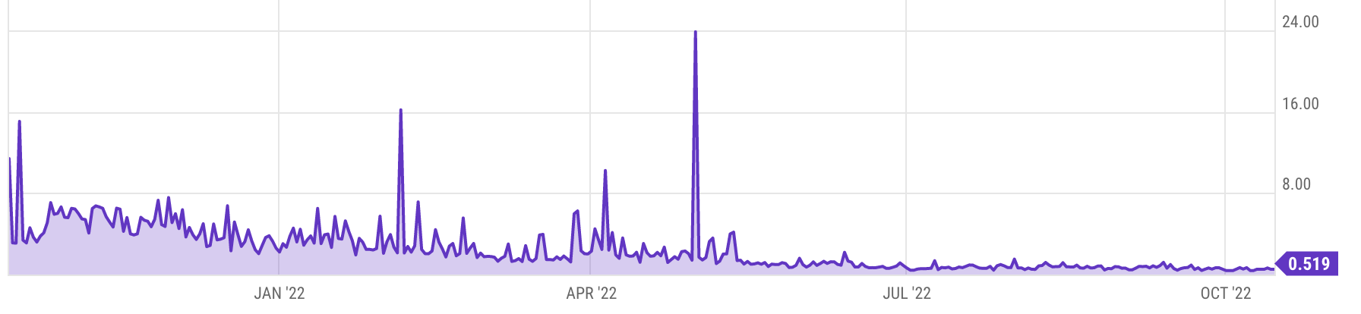
Gas prices spike during congestion
GasPrice in Gwei:
20 Gwei = 20×10⁻⁹ ETH
popular project launch
Average Tx fee in USD
Notes:
https://ycharts.com/indicators/ethereum_average_gas_price
https://ycharts.com/indicators/ethereum_average_transaction_fee

Slide 11
Gas calculation: EIP1559
Every block has a “baseFee”: the minimum gasPrice for Tx in the block
baseFee is computed from total gas in earlier blocks:
earlier blocks at gas limit (30M gas) ⟹ base fee goes up 12.5%
earlier blocks empty ⟹ base fee decreases by 12.5%
If earlier blocks at “target size” (15M gas) ⟹ baseFee does not change
interpolate
in between

Slide 12
Gas calculation
A transaction specifies three parameters:
gasLimit: max total gas allowed for Tx
maxFee: maximum allowed gas price
maxPriorityFee: additional “tip” to be paid to block proposer
bid
Computed gasPrice bid (in Wei = 10⁻¹⁸ ETH):
gasPrice ⇽ min(maxFee, baseFee + maxPriorityFee)
Max Tx fee: gasLimit × gasPrice
Notes:
gas for each instruction defined by a hard coded table.

Slide 13

Gas calculation (informal)
gasUsed ⇽ gas used by Tx
Send gasUsed×(gasPrice – baseFee) to block proposer
BURN gasUsed× baseFee
⇒ total supply of ETH can decrease
Notes:
gas for each instruction defined by a hard coded table.
BURN: deflates the currency

Slide 14
Gas calculation
if gasPrice < baseFee: abort
If gasLimit×gasPrice > msg.sender.balance: abort
deduct gasLimit×gasPrice from msg.sender.balance
set Gas ⇽ gasLimit
execute Tx: deduct gas from Gas for each instruction
if at end (Gas < 0): abort, Tx is invalid (proposer keeps gasLimit×gasPrice)
(6) Refund Gas×gasPrice to msg.sender.balance (leftover change)
(7) gasUsed ⇽ gasLimit – Gas
(7a) BURN gasUsed× baseFee
(7b) Send gasUsed×(gasPrice – baseFee) to block producer
Notes:
gas for each instruction defined by a hard coded table.
BURN: deflates the currency

Slide 15
Example baseFee and effect of burn
block # | gasUsed | baseFee (Gwei) | ETH burned
15763570 | 21,486,058 | 16.92 | 0.363
15763569 | 14,609,185 | 16.97 | 0.248
15763568 | 25,239,720 | 15.64 | 0.394
15763567 | 29,976,215 | 13.90 | 0.416
15763566 | 14,926,172 | 13.91 | 0.207
15763565 | 1,985,580 | 15.60 | 0.031
↓
(<15M)
↓
(>15M)
↓
(<15M)
↓
(<15M)
≈ gasUsed×baseFee
new issuance > burn ⇒ ETH inflates
new issuance < burn ⇒ ETH deflates
Notes:
https://etherscan.io/blocks
When previous block is light (<15M gas), baseFee goes down. When previous block is heavy (>15M gas), baseFee goes up.

Slide 16
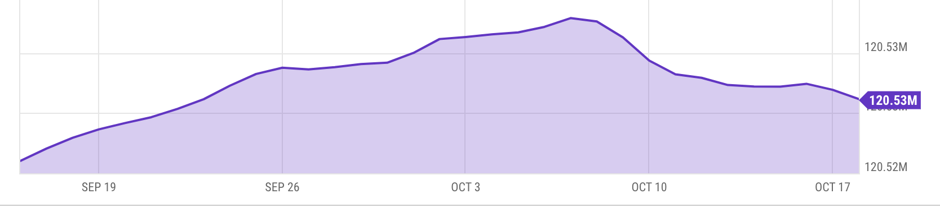
Eth total supply (since merge)
Notes:
https://ycharts.com/indicators/ethereum_supply

Slide 17
Why burn ETH ???
EIP1559 goals (informal):
users incentivized to bid their true utility for posting Tx,
block proposer incentivized to not create fake Tx, and
disincentivize off chain agreements.
Suppose no burn (i.e., baseFee given to block producer):
⟹ in periods of low Tx volume proposer would try to increase volume by offering to refund the baseFee off chain to users.
Notes:
If a second price auction were used: proposers would be incentivized to create fake transactions.
See https://arxiv.org/pdf/2106.01340.pdf for an analysis.

Slide 18
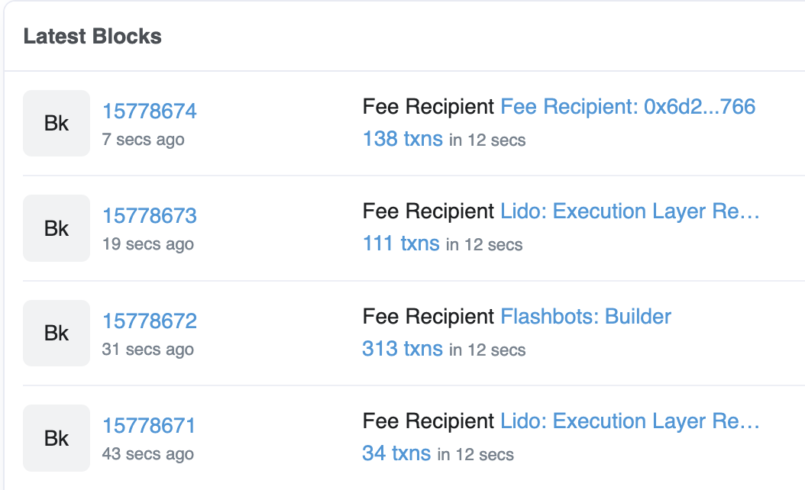
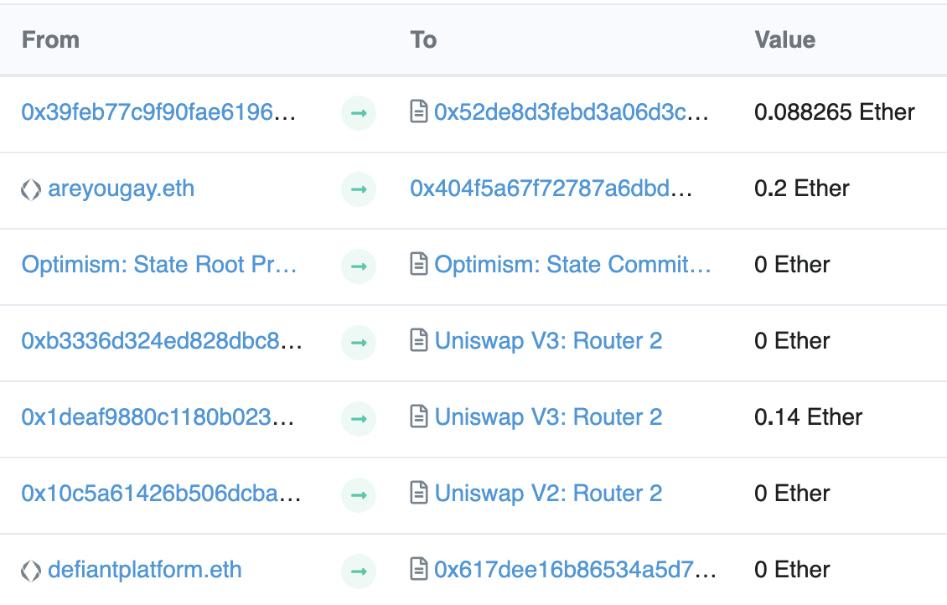
Let’s look at the Ethereum blockchain
etherscan.io:
From/to address
Tx value

Slide 19
Let’s look at a transaction …
Transaction ID: 0x14b1a03534ce3c460b022185b4 …
From: 0x1deaf9880c1180b02307e940c1e8ef936e504b6a
To: Contract 0x68b3465833fb72a70ecdf485e0e4c7bd8665fc45
(Uniswap V3: Router 2)
Value: 0.14 Ether ($182)
Data: Function: multicall() [calls multiple methods in a single call]
Contract generated a call to Contract 0xC02aaA39b22 … (value:0.14)

Slide 20
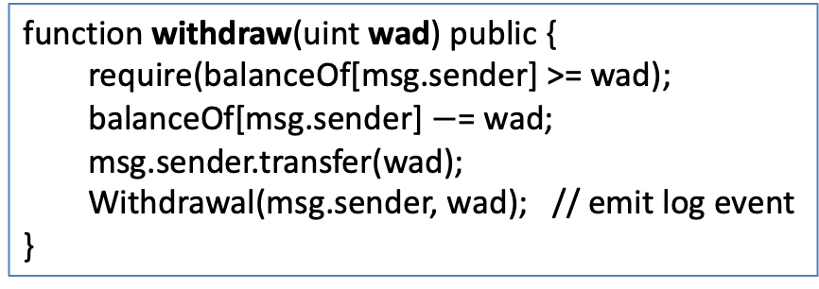
Let’s look at the To contract …
Contract 0xC02aaA39b223FE8D0A0e5C4F27eAD9083C756Cc2
(Wrapped ETH: called from Uniswap V3: Router 2)
Balance: 4,133,236 Ether
Code: 81 lines of solidity
anyone can read
function withdraw(uint wad) public {
require(balanceOf[msg.sender] >= wad);
balanceOf[msg.sender] $−$= wad;
msg.sender.transfer(wad);
Withdrawal(msg.sender, wad); // emit log event
}
code snippet

Slide 21
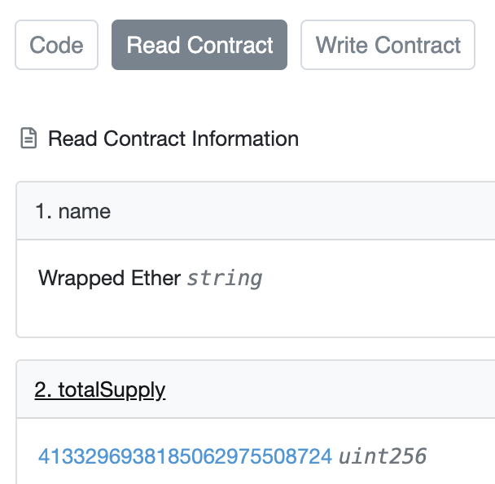
Remember: contracts cannot keep secrets!
Contract 0xC02aaA39b223FE8D0A0e5C4F27eAD9083C756Cc2
(Wrapped ETH)
etherscan.io
(storage)
(see API)
Anyone can read contract
state in storage array
⟹ never store secrets
in contract!
Solidity variables stored in S[] array
Notes:
Code tab shows code.

Slide 22
Solidity
docs: https://docs.soliditylang.org/en/latest/
Several IDE’s available

Slide 23
Contract structure
interface IERC20 {
function transfer(address _to, uint256 _value) external returns (bool);
function totalSupply() external view returns (uint256);
…
}
contract ERC20 is IERC20 { // inheritance
address owner;
constructor() public { owner = msg.sender; }
function transfer(address _to, uint256 _value) external returns (bool) {
… implentation …
} }

Slide 24
Value types
uint256
address (bytes32)
  _address.balance, _address.send(value), _address.transfer(value)
  call: send Tx to another contract
  bool success = _address.call{value: msg.value/2, gas: 1000}(args);
  delegatecall: load code from another contract into current context
bytes32
bool
Notes:
send(): returns false on failure. transfer() raises exception on failure.

Slide 25
Reference types
struct Person {
uint128 age;
uint128 balance;
address addr;
}
Person[10] public people;
structs
arrays
bytes
strings
mappings:
  Declaration: mapping (address => unit256) balances;
  Assignment: balances[addr] = value;

Slide 26
Globally available variables
block: .blockhash, .coinbase, .gaslimit, .number, .timestamp
gasLeft()
msg: .data, .sender, .sig, .value
tx: .gasprice, .origin
abi: encode, encodePacked, encodeWithSelector, encodeWithSignature
Keccak256(), sha256(), sha3()
require, assert e.g.: require(msg.value > 100, “insufficient funds sent”)
A ⇾ B ⇾ C ⇾ D:
at D: msg.sender == C
tx.origin == A
Notes:
block.coinbase: fee recipient address. block.gaslimit: block gas limit. gasleft() returns (uint256): Remaining gas.
require: for checking inputs. assert: for validating internal state (failure means a bug). Either way, triggers reversion (same as throw).

Slide 27
Function visibilities
external: function can only be called from outside contract.
Arguments read from calldata
public: function can be called externally and internally.
if called externally: arguments copied from calldata to memory
private: only visible inside contract
internal: only visible in this contract and contracts deriving from it
view: only read storage (no writes to storage)
pure: does not touch storage
function f(uint a) private pure returns (uint b) { return a + 1; }
Notes:
External is more efficient than public, so use it if you know the function will never be called internally.

Slide 28
Inheritance
contract owned {
address owner;
constructor() { owner = msg.sender; }
modifier onlyOwner {
require( msg.sender == owner); _; } }
Inheritance
  contract Destructable is owned {
  function destroy() public onlyOwner { selfdestruct(owner) };
  }
  code of contract “owned” is compiled into contract Destructable
Libraries: library code is executed in the context of calling contract
  library Search { function IndexOf(); }
  contract A { function B { Search.IndexOf(); } }
Notes:
SafeMath can be declared as a library: Library SafeMath { } (instead of a contract)
Libraries are called using DELEGATECALL

Slide 29
ERC20 tokens
https://github.com/ethereum/EIPs/blob/master/EIPS/eip-20.md
A standard API for fungible tokens that provides basic functionality to transfer tokens or allow the tokens to be spent by a third party.
An ERC20 token is itself a smart contract that maintains all user balances:
mapping(address => uint256) internal balances;
A standard interface allows other contracts to interact with every ERC20 token. No need for special logic for each token.

Slide 30
ERC20 token interface
function transfer(address _to, uint256 _value) external returns (bool);
function transferFrom(address _from, address _to, uint256 _value) external returns (bool);
function approve(address _spender, uint256 _value) external returns (bool);
function totalSupply() external view returns (uint256);
function balanceOf(address _owner) external view returns (uint256);
function allowance(address _owner, address _spender) external view returns (uint256);
Notes:
transfer: transfer from Tx sender.
transferFrom: transfer from some other account. Function will check permissions.
approve: allow _spender to spend _value from Tx sender’s account
totalSupply: total coins in all accounts
allowance: how much can _spender spend from _owner’s acccount?

Slide 31
How are ERC20 tokens transferred?
contract ERC20 is IERC20 {
mapping (address => uint256) internal balances;
function transfer(address _to, uint256 _value) external returns (bool) {
require(balances[msg.sender] >= _value, "ERC20_INSUFFICIENT_BALANCE");
require(balances[_to] + _value >= balances[_to], "UINT256_OVERFLOW” );
balances[msg.sender] −= _value;
balances[_to] += _value;
emit Transfer(msg.sender, _to, _value); // write log message
return true;
}}
Tokens can be minted by a special function mint(address _to, uint256 _value)
Notes:
All coins initially belong to creator, set by constructor.
Admin can call the mint() function to add tokens to someone’s account.

Slide 32
ABI encoding and decoding
Every function has a 4 byte selector that is calculated as the first 4 bytes of the hash of the function signature.
  For `transfer`, this looks like bytes4(keccak256(“transfer(address,uint256)”);
The function arguments are then ABI encoded into a single byte array and concatenated with the function selector.
  This data is then sent to the address of the contract, which is able to decode the arguments and execute the code.
Functions can also be implemented within the fallback function

Slide 33
Calling other contracts
Addresses can be cast to contract types.
      address _token;
      IERC20Token tokenContract = IERC20Token(_token);
      ERC20Token tokenContract = ERC20Token(_token);
When calling a function on an external contract, Solidity will automatically handle ABI encoding, copying to memory, and copying return values.
  tokenContract.transfer(_to, _value);

Slide 34
Stack variables
Stack variables generally cost the least gas
  can be used for any simple types (anything that is <= 32 bytes).
  uint256 a = 123;
All simple types are represented as bytes32 at the EVM level.
Only 16 stack variables can exist within a single scope.

Slide 35
Calldata
Calldata is a read-only byte array.
Every byte of a transaction’s calldata costs gas
(16 gas per non-zero byte, 4 gas per zero byte).
It is cheaper to load variables directly from calldata, rather than copying them to memory.
  This can be accomplished by marking a function as `external`.

Slide 36
Memory (compiled to MSTORE, MLOAD)
Memory is a byte array.
Complex types (anything > 32 bytes such as structs, arrays, and strings) must be stored in memory or in storage.
  string memory name = “Alice”;
Memory is cheap, but the cost of memory grows quadratically.

Slide 37
Storage array (compiled to SSTORE, SLOAD)
Using storage is very expensive and should be used sparingly.
Writing to storage is most expensive.
Reading from storage is cheaper, but still relatively expensive.
mappings and state variables are always in storage.
Some gas is refunded when storage is deleted or set to 0
Trick for saving has: variables < 32 bytes can be packed into 32 byte slots.

Slide 38
Event logs
Event logs are a cheap way of storing data that
does not need to be accessed by any contracts.
Events are stored in transaction receipts, rather than in storage.

Slide 39
Security considerations
Are we checking math calculations for overflows and underflows?
    done by the compiler since Solidity 0.8.
What assertions should be made about function inputs,
return values, and contract state?
Who is allowed to call each function?
Are we making any assumptions about the functionality of external contracts that are being called?

Slide 40
Re-entrency bugs

Slide 41
contract Bank{
mapping(address=>uint) userBalances;
function getUserBalance(address user) constant public returns(uint) {
return userBalances[user]; }
function addToBalance() public payable {
userBalances[msg.sender] = userBalances[msg.sender] + msg.value; }
// user withdraws funds
function withdrawBalance() public {
uint amountToWithdraw = userBalances[msg.sender];
// send funds to caller ... vulnerable!
if (msg.sender.call{value:amountToWithdraw}() == false) { throw; }
userBalances[msg.sender] = 0;
} }

Slide 42
contract Attacker {
uint numIterations;
Bank bank;
function Attacker(address _bankAddress) { // constructor
bank = Bank(_bankAddress);
numIterations = 10;
if (bank{value:75}.addToBalance() == false) { throw; } // Deposit 75 Wei
if (bank.withdrawBalance() == false) { throw; } // Trigger attack
} }
function () { // the fallback function
if (numIterations > 0) {
numIterations --; // make sure Tx does not run out of gas
if (bank.withdrawBalance() == false) { throw; }
} } } }

Slide 43
Why is this an attack?
Attacker ⇾ Bank.addToBalance(75)
Attacker ⇾ Bank.withdrawBalance ⇾
Attacker.fallback ⇾ Bank.withdrawBalance ⇾
Attacker.fallback ⇾ Bank.withdrawBalance ⇾ …
withdraw 75 Wei at each recursive step

Slide 44
How to fix?
function withdrawBalance() public {
uint amountToWithdraw = userBalances[msg.sender];
userBalances[msg.sender] = 0;
if (msg.sender.call{value:amountToWithdraw}() == false) {
userBalances[msg.sender] = amountToWithdraw;
throw;
}
}

Slide 45
END OF LECTURE
Next lecture: DeFi contracts

