Slide 1
Incentives and Accountability in Consensus:
Proof-of-Stake
CS251 Fall 2023
(cs251.stanford.edu)
Ertem Nusret Tas

Slide 2

Recap: Security for SMR
Let ${LOG}_{t}^{i}$ denote the log learned by a client $i$ at time $t$.
Then, a secure SMR protocol satisfies the following guarantees:
Safety (Consistency):
  For any two clients $i$ and $j$, and times $t$ and $s$: either ${LOG}_{t}^{i}≼{LOG}_{s}^{j}$ is true or ${LOG}_{s}^{j}≼{LOG}_{t}^{i}$ is true or both (Logs are consistent).
Liveness:
  If a transaction $tx$ is input to an honest replica at some time $t$, then for all clients $i$, and times $s≥t+T_{conf}$: $tx∈{LOG}_{s}^{i}$.
Similar to agreement!
No double spend
Similar to validity and termination!
No censorship

Slide 3




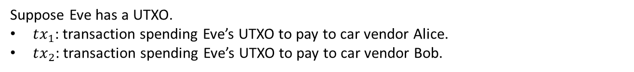
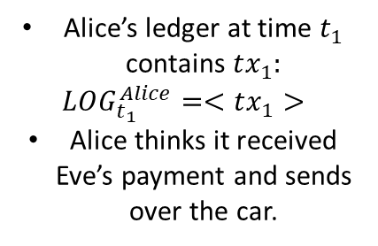
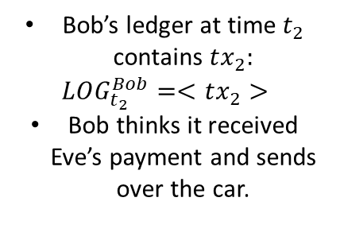



Recap: Why is safety important?
Eve
Suppose Eve has a UTXO.
$tx_{1}$: transaction spending Eve’s UTXO to pay to car vendor Alice.
$tx_{2}$: transaction spending Eve’s UTXO to pay to car vendor Bob.
$$UTXO_{Eve}$$
$$t_{0}=0$$
$$t_{1}$$
$$t_{2}$$
spent to pay Alice
spent to pay Bob
Alice’s ledger at time $t_{1}$ contains $tx_{1}:$
$$LOG_{t_{1}}^{Alice}=<tx_{1}>$$
Alice thinks it received Eve’s payment and sends over the car.
Bob’s ledger at time $t_{2}$ contains $tx_{2}:$
$$LOG_{t_{2}}^{Bob}=<tx_{2}>$$
Bob thinks it received Eve’s payment and sends over the car.
Alice
Bob

Slide 4
Recap: Why is safety important?
Eve
Suppose Eve has a UTXO.
$tx_{1}$: transaction spending Eve’s UTXO to pay to car vendor Alice.
$tx_{2}$: transaction spending Eve’s UTXO to pay to car vendor Bob.
$$UTXO_{Eve}$$
$$t_{0}=0$$
$$t_{1}$$
safety violation
$$t_{2}$$
spent to pay Alice
spent to pay Bob
Alice’s ledger at time $t_{1}$ contains $tx_{1}:$
$$LOG_{t_{1}}^{Alice}=<tx_{1}>$$
Alice thinks it received Eve’s payment and sends over the car.
Bob’s ledger at time $t_{2}$ contains $tx_{2}:$
$$LOG_{t_{2}}^{Bob}=<tx_{2}>$$
Bob thinks it received Eve’s payment and sends over the car.
Alice
Bob
Double-spend $→$ inconsistent ledgers $→$ safety violation!
Safety $→$ no double-spend!

Slide 5
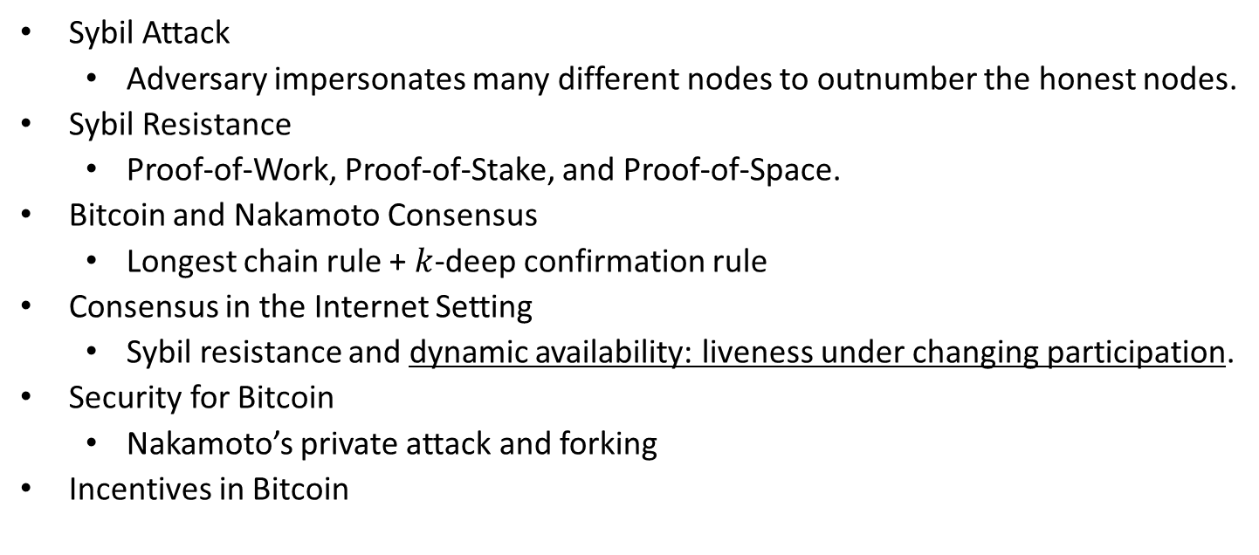
Recap of the Last Lecture
Sybil Attack
  Adversary impersonates many different nodes to outnumber the honest nodes.
Sybil Resistance
  Proof-of-Work, Proof-of-Stake, and Proof-of-Space.
Bitcoin and Nakamoto Consensus
  Longest chain rule + $k$-deep confirmation rule
Consensus in the Internet Setting
  Sybil resistance and dynamic availability: liveness under changing participation.
Security for Bitcoin
  Nakamoto’s private attack and forking
Incentives in Bitcoin

Slide 6
Incentives in Bitcoin
How does Bitcoin incentivize miners to participate in consensus and mine new blocks?
Block rewards – currently 6.25 Bitcoin – halved every 210,000 blocks – halved ~4 years
Transaction fees
How does a miner capture these rewards?
The first transaction in a Bitcoin block is called the coinbase transaction.
The coinbase transaction can be created by the miner.
Miner uses it to collect the block reward and the transaction fees.
Can these incentives guarantee honest participation?
Not necessarily!
Selfish mining attack!
(See the optional slides if interested in the details.)

Slide 7


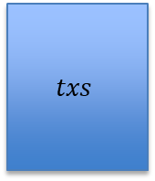
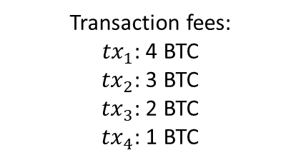
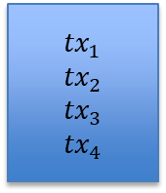

Incentives in Bitcoin
$k+1$-deep
+0 BTC earned
Transaction fees:
${tx}_{1}$: 4 BTC
${tx}_{2}$: 3 BTC
${tx}_{3}$: 2 BTC
${tx}_{4}$: 1 BTC
Miner A
Genesis
$$txs$$
$${tx}_{1}$$
$${tx}_{2}$$
$${tx}_{3}$$
$${tx}_{4}$$
…
>0 BTC earned
Miner B

Slide 8
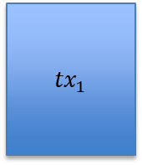
Incentives in Bitcoin
$k+1$-deep
+0 BTC earned
Transaction fees:
${tx}_{1}$: 4 BTC
${tx}_{2}$: 3 BTC
${tx}_{3}$: 2 BTC
${tx}_{4}$: 1 BTC
Miner A
Genesis
$$txs$$
$${tx}_{1}$$
$${tx}_{2}$$
$${tx}_{3}$$
$${tx}_{4}$$
…
>0 BTC earned
$${tx}_{1}$$
Miner B

Slide 9
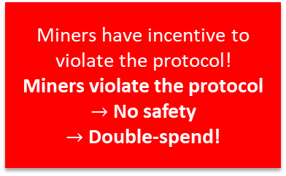

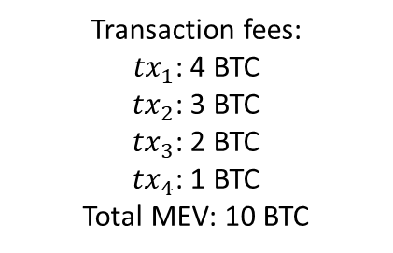

Incentives in Bitcoin
$k+1$-deep
Transaction fees:
${tx}_{1}$: 4 BTC
${tx}_{2}$: 3 BTC
${tx}_{3}$: 2 BTC
${tx}_{4}$: 1 BTC
Total MEV: 10 BTC
Miner A
Miner A’s block got ‘reorged’:
It was part of the longest chain before but not anymore!!
Genesis
$$txs$$
$${tx}_{1}$$
$${tx}_{2}$$
$${tx}_{3}$$
$${tx}_{4}$$
…
Miner (maximal) extractable value (MEV): a measure of miner’s profit via inclusion, exclusion or re-ordering of transactions within its block
$${tx}_{1}$$
$${tx}_{2}$$
Miners have incentive to violate the protocol!
Miners violate the protocol $→$ No safety
$→$ Double-spend!
…
Miner B
Miner C
$k+1$-deep
Need to think about incentives!!

Slide 10
From Bitcoin to Proof-of-Stake
1982
2008
2015
2022
…
Time
The Byzantine Generals Problem
Bitcoin
PoW Ethereum
PoS Ethereum
Consensus in the Internet Setting
Sybil resistance
Dynamic availability
  (Liveness under changing part.)
Block rewards (carrot)
  to incentivize participation!
Consensus in the Internet Setting
  Sybil resistance
  Dynamic availability
Block rewards (carrot)
Finality and accountable safety
Slashing (stick)
  to punish protocol violation!
The Byzantine Generals Problem (1982)
Bitcoin: A Peer-to-Peer Electronic Cash System (2008)
Ethereum: A Next-Generation Smart Contract and Decentralized Application Platform. (2015)
Combining GHOST and Casper (2020)

Slide 11
A few words on Proof-of-Stake (PoS)
In a Proof-of-Stake protocol, nodes lock up (i.e., stake) their coins in the protocol to become eligible to participate in consensus.
The more coins staked by a node…
Higher the probability that the node is elected as a leader.
Larger the weight of that node’s actions.
If a node is caught doing an adversarial action (e.g., sending two values), it can be punished by burning its locked coins (stake)! This is called slashing.
Thus, in a Proof-of-Stake protocol, nodes can be held accountable for their actions (unlike in Bitcoin, where nodes do not lock up coins).

Slide 12










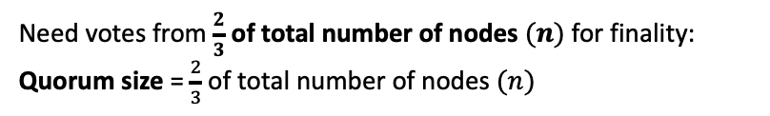


A Simple (PBFT-style) PoS Protocol*
Need votes from $\frac{2}{3}$ of total number of nodes $(n)$ for finality:
Quorum size = $\frac{2}{3}$ of total number of nodes $(n)$
Staked Coins
epochs
e
(9 nodes)
e+1
…
Vote by a node: Signature of the node on the block and the epoch
Alice’s log:
$${txs}_{1}$$
$${txs}_{4}$$
PBFT: Practical Byzantine Fault Tolerance. (1999)

Slide 13


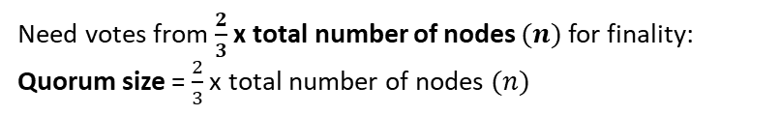


A Simple (PBFT-style) PoS Protocol*
Need votes from $\frac{2}{3}$ x total number of nodes $(n)$for finality:
Quorum size = $\frac{2}{3}$ x total number of nodes $(n)$
Staked Coins
epochs
e
Votes for ${txs}_{4}$
Votes for ${txs}_{5}$
$$≥\frac{2}{3}n$$
$$≥\frac{2}{3}n$$
e+1
…
Vote by a node: Signature of the node on the block and the epoch
Alice’s log:
$${txs}_{1}$$
$${txs}_{4}$$
PBFT: Practical Byzantine Fault Tolerance. (1999)

Slide 14

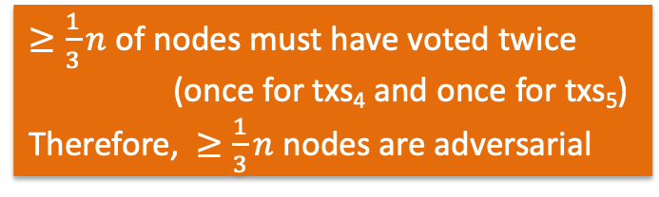

A Simple (PBFT-style) PoS Protocol*
Need votes from $\frac{2}{3}$ x total number of nodes $(n)$for finality:
Quorum size = $\frac{2}{3}$ x total number of nodes $(n)$
Staked Coins
epochs
e
Votes for ${txs}_{4}$
Votes for ${txs}_{5}$
$$≥\frac{2}{3}n$$
$$≥\frac{1}{3}n$$
$$≥\frac{2}{3}n$$
e+1
…
$≥\frac{1}{3}n$ of nodes must have voted twice
(once for txs₄ and once for txs₅)
Therefore, $≥\frac{1}{3}n$ nodes are adversarial
Safety when # adversarial nodes $<\frac{1}{3}$ x total number of nodes
Alice’s log:
$${txs}_{1}$$
$${txs}_{4}$$
PBFT: Practical Byzantine Fault Tolerance. (1999)

Slide 15



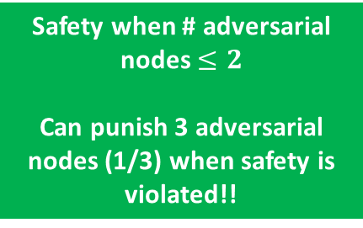
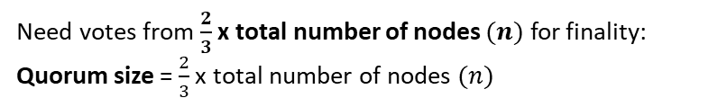
A Simple (PBFT-style) PoS Protocol*
Need votes from $\frac{2}{3}$ x total number of nodes $(n)$ for finality:
Quorum size = $\frac{2}{3}$ x total number of nodes $(n)$
Staked Coins
epochs
e
e+1
…
safety violation!
Alice’s log:
$${txs}_{1}$$
$${txs}_{4}$$
Bob’s log:
$${txs}_{1}$$
$${txs}_{5}$$

Slide 16



A Simple (PBFT-style) PoS Protocol*
Need votes from $\frac{2}{3}$ x total number of nodes $(n)$ for finality:
Quorum size = $\frac{2}{3}$ x total number of nodes $(n)$
Staked Coins
epochs
e
e+1
Safety when # adversarial nodes $<\frac{1}{3}$ x total number of nodes
Can punish $≥\frac{1}{3}$ x total number of nodes when safety is violated!!
…
Protocol violators!
safety violation!
Alice’s log:
$${txs}_{1}$$
$${txs}_{4}$$
Bob’s log:
$${txs}_{1}$$
$${txs}_{5}$$

Slide 17
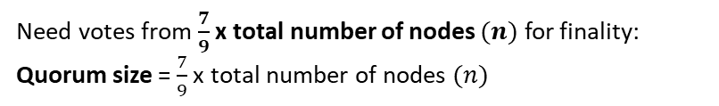
A Simple (PBFT-style) PoS Protocol*
Need votes from $\frac{7}{9}$ x total number of nodes $(n)$ for finality:
Quorum size = $\frac{7}{9}$ x total number of nodes $(n)$
Staked Coins
epochs
e
e+1
…

Slide 18

A Simple (PBFT-style) PoS Protocol*
Need votes from $\frac{7}{9}$ x total number of nodes $(n)$ for finality:
Quorum size = $\frac{7}{9}$ x total number of nodes $(n)$
Staked Coins
epochs
e
e+1
Safety when # adversarial nodes $<\frac{5}{9}$ x total number of nodes
Can punish $≥\frac{5}{9}$ x total number of nodes when safety is violated!!
…
Protocol violators!

Slide 19
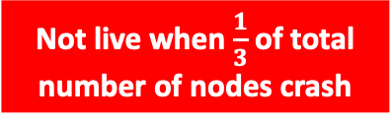
A Simple (PBFT-style) PoS Protocol*
Need votes from $\frac{2}{3}$ x total number of nodes $(n)$ for finality:
Quorum size = $\frac{2}{3}$ x total number of nodes $(n)$
Staked Coins
epochs
e
e+1
…
Not live when $\frac{1}{3}$ of total number of nodes crash
Alice’s log:
$${txs}_{1}$$

Slide 20
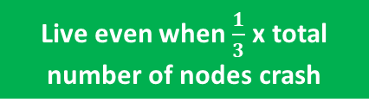
A Simple (PBFT-style) PoS Protocol*
Need votes from $\frac{2}{3}$ x total number of nodes $(n)$ for finality:
Quorum size = $\frac{2}{3}$ x total number of nodes $(n)$
Staked Coins
epochs
e
e+1
…
Live even when $\frac{1}{3}$ x total number of nodes crash
Alice’s log:
$${txs}_{1}$$
$${txs}_{4}$$

Slide 21
A Simple (PBFT-style) PoS Protocol*
Sybil resistance mechanism determines how to select the nodes that are eligible to participate in consensus and propose/vote for transactions/blocks.
Consensus protocol specifies the instructions for honest nodes so that given a set of eligible nodes with sufficiently many being honest, safety and liveness are satisfied.
Sybil resistance mechanism: Consensus protocol (SMR): | Proof-of-Work | Proof-of-Stake
Nakamoto consensus (longest chain) | Bitcoin PoW Ethereum | Ouroboros
PBFT-style (with votes) | ?? | PoS Ethereum* Simple PBFT-style PoS protocol
satisfies dynamic availability
satisfies finality and accountable safety
Ouroboros Genesis: Composable Proof-of-Stake Blockchains with Dynamic Availability. (2019)

Slide 22
Accountable Safety
In a protocol with resilience of n/3:
  The protocol is secure (safe & live) if there are less than n/3 adversarial nodes.
  Example: The simple proof-of-stake protocol.
In a protocol with accountable safety resilience of n/3:
  The protocol is secure if there are less than n/3 adversarial nodes.
  If there is ever a safety violation, all observers of the protocol can provably identify (i.e., catch) at least n/3 adversarial nodes as protocol violators.
  No honest node is ever identified (no false accusation).
  Examples: The simple proof-of-stake protocol , PBFT, Tendermint, HotStuff …
Casper the Friendly Finality Gadget. (2017)
BFT Protocol Forensics (2021)

Slide 23
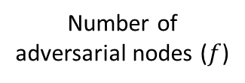




Accountable Safety
Accountable safety is a stronger notion than just security.
Number of adversarial nodes ($f$)
$$0$$
$$n/3$$
$$2n/3$$
$$1$$
Resilience of n/3
Safety & Liveness ☺
No Safety or Liveness ☹
No Safety or Liveness ☹
Accountable safety resilience of n/3
No liveness ☹
If safety is violated, catch and punish adversarial nodes ☺
Safety & Liveness ☺

Slide 24
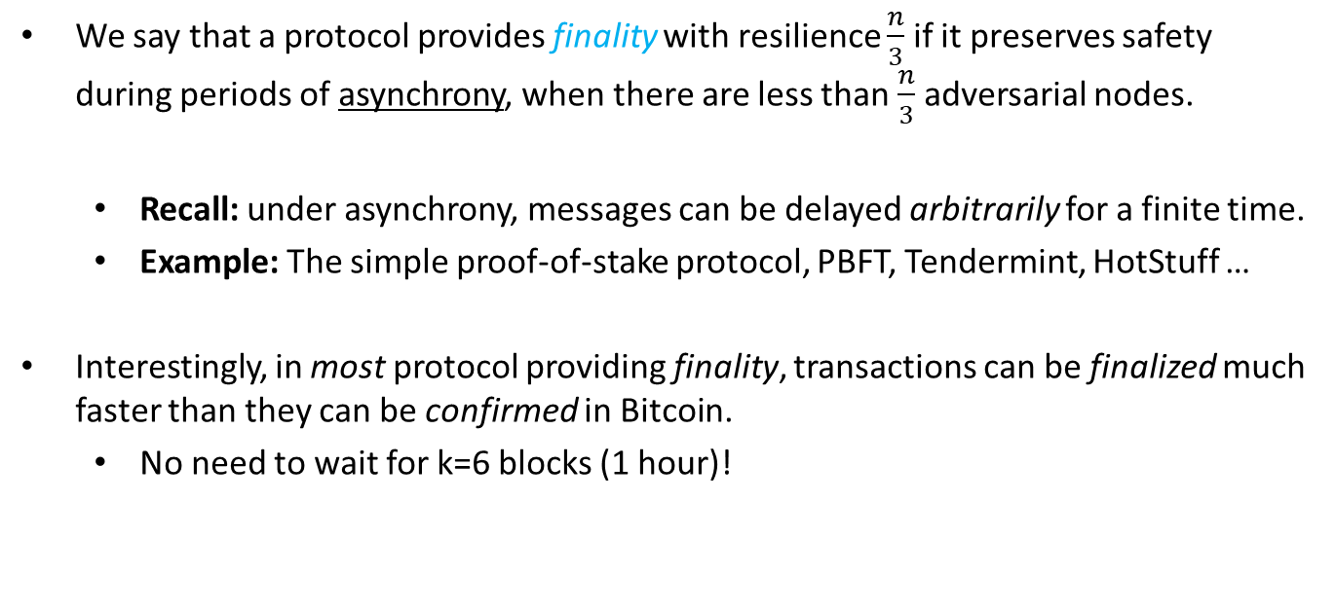
Finality
We say that a protocol provides finality with resilience $\frac{n}{3}$ if it preserves safety during periods of asynchrony, when there are less than $\frac{n}{3}$ adversarial nodes.
  Recall: under asynchrony, messages can be delayed arbitrarily for a finite time.
  Example: The simple proof-of-stake protocol, PBFT, Tendermint, HotStuff …
Interestingly, in most protocol providing finality, transactions can be finalized much faster than they can be confirmed in Bitcoin.
  No need to wait for k=6 blocks (1 hour)!

Slide 25

Accountability implies Finality
Accountability implies Finality:
Accountable safety (with resilience $\frac{n}{3}$) implies finality (with resilience $\frac{n}{3}$).
Accountably safe protocols:
can punish the adversary
Finalizing
protocols: safe under asynchrony
???
HotStuff-null
Simple proof-of-stake protocol, PBFT, HotStuff, …
BFT Protocol Forensics (2021)
Accountable Safety Implies Finality (2023)

Slide 26
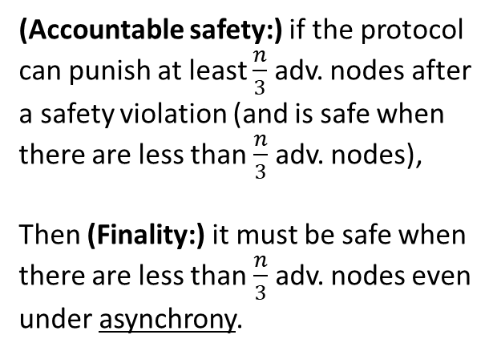
Accountability implies Finality
Accountability implies Finality:
Accountable safety (with resilience $\frac{n}{3}$) implies finality (with resilience $\frac{n}{3}$).
(Accountable safety:) if the protocol can punish at least $\frac{n}{3}$ adv. nodes after a safety violation (and is safe when there are less than $\frac{n}{3}$ adv. nodes),
Then (Finality:) it must be safe when there are less than $\frac{n}{3}$adv. nodes even under asynchrony.
Accountably safe protocols:
can punish the adversary
Finalizing
protocols: safe under asynchrony
HotStuff-null
Simple proof-of-stake protocol, PBFT, HotStuff, …
BFT Protocol Forensics (2021)
Accountable Safety Implies Finality (2023)

Slide 27
Holy Grail of Internet Scale Consensus
We want Sybil resistance: Proof-of-Work or Proof-of-Stake…
We want dynamic availability so that…
  Transactions continue to be confirmed and processed even when there is low participation.
  Satisfied by Nakamoto consensus.
We want finality and accountable safety so that…
  Finality: There cannot be safety violations (double-spends) during asynchrony.
  Accountable safety: Nodes can be held accountable for their actions.
  Satisfied by our simple proof-of-stake protocol, PBFT, HotStuff, …
Let’s focus on having dynamic availability and finality for now…

Slide 28
Holy Grail of Internet Scale Consensus
Is there a SMR protocol that provides both dynamic availability and finality with any resilience?
No: Blockchain CAP Theorem!!
CAP: Consistency, Availability, Partition tolerance
Dynamically available protocols:
live under changing part.
Accountably safe protocols:
can punish the adversary
Finalizing
protocols:
safe under asynchrony
Simple proof-of-stake protocol, PBFT, HotStuff, …
Nakamoto consensus
Resource Pools and the CAP Theorem (2020)

Slide 29





Blockchain CAP Theorem
For contradiction, suppose our SMR protocol has both dynamic availability and finality.
World 1
Log: ${tx}_{1}{tx}_{2}{tx}_{3}$
Nodes/miners
Nodes/miners
Log: ${tx}_{1}{tx}_{2}{tx}_{3}$
Log: ${tx}_{1}{tx}_{2}{tx}_{3}$
“I didn’t hear from the other nodes; they are probably offline.”
Correct log: ${tx}_{1}{tx}_{2}{tx}_{3}$
Dynamic Availability:
Liveness under changing part.
Client: Alice
Log learned by Alice: ${tx}_{1}{tx}_{2}{tx}_{3}$

Slide 30





Blockchain CAP Theorem
For contradiction, suppose our SMR protocol has both dynamic availability and finality.
World 2
Nodes/miners
Log: ${tx}_{3}{tx}_{2}{tx}_{1}$
Nodes/miners
Replicas/miners
Log: ${tx}_{3}{tx}_{2}{tx}_{1}$
Log: ${tx}_{3}{tx}_{2}{tx}_{1}$
Correct log: ${tx}_{3}{tx}_{2}{tx}_{1}$
“I didn’t hear from the other nodes; they are probably offline.”
Dynamic Availability:
Liveness under changing part.
Client: Bob
Log learned by Bob: ${tx}_{3}{tx}_{2}{tx}_{1}$

Slide 31





Blockchain CAP Theorem
For contradiction, suppose our SMR protocol has both dynamic availability and finality.
World 3
Asynchrony:
Network partition
Log: ${tx}_{1}{tx}_{2}{tx}_{3}$
Nodes/miners
Log: ${tx}_{3}{tx}_{2}{tx}_{1}$
Nodes/miners
Replicas/miners
Log: ${tx}_{1}{tx}_{2}{tx}_{3}$
Log: ${tx}_{3}{tx}_{2}{tx}_{1}$
Log: ${tx}_{1}{tx}_{2}{tx}_{3}$
Log: ${tx}_{3}{tx}_{2}{tx}_{1}$
“I didn’t hear from the other nodes; they are probably offline. I am in world 1.”
Correct log: ${tx}_{1}{tx}_{2}{tx}_{3}$
Correct log: ${tx}_{3}{tx}_{2}{tx}_{1}$
“I didn’t hear from the other nodes; they are probably offline. I am in world 2.”
Safety violation!
No safety under asynchrony!
No finality!
Client: Alice
Client: Bob
Log learned by Alice: ${tx}_{1}{tx}_{2}{tx}_{3}$
Log learned by Bob: ${tx}_{3}{tx}_{2}{tx}_{1}$

Slide 32
Resolution: Nested Ledgers/Chains
Impossible!
Due to the CAP Theorem!
Single chain: tx₁, tx₂, tx₃, …
Finality: Safe under asynchrony
Dynamic availability: Live under changing participation
Accountable finalized chain
Available chain
Prefix property: Prefix of the available chain.
Accountably safe under asynchrony.
Live once the network becomes synchronous and if enough nodes are online.
Not live under low participation.
Safe and live under synchrony and changing participation.
Not safe under asynchrony.
Ebb-and-Flow Protocols: A Resolution of the Availability-Finality Dilemma (2020)

Slide 33






Resolution: Nested Ledgers/Chains
Accountable finalized chain
Available chain
Prefix property: Prefix of the available chain.
Accountably safe under asynchrony.
Live once the network becomes synchronous and if enough nodes are online.
Not live under small participation.
Safe and live under synchrony and dynamic participation.
Not safe under asynchrony.
Nakamoto consensus
$$Π_{ava}$$
Safety-favoring client:
trusts acc. finalized chain
Liveness-favoring client:
trusts available chain
$$Π_{fin}$$
PBFT
Client chooses!
Can interact with each other thanks to the prefix property!!
Ebb-and-Flow Protocols: A Resolution of the Availability-Finality Dilemma (2020)

Slide 34
Resolution: Nested Ledgers/Chains
Accountable finalized chain
Available chain
Prefix property: Prefix of the available chain.
Accountably safe under asynchrony.
Live once the network becomes synchronous and if enough nodes are online.
Not live under small participation.
Safe and live under synchrony and dynamic participation.
Not safe under asynchrony.
Nakamoto consensus
$$Π_{ava}$$
Safety-favoring client:
trusts acc. finalized chain
Liveness-favoring client:
trusts available chain
$$Π_{fin}$$
PBFT
Client chooses!
Ledgers can be inconsistent!
No prefix property!
Can interact with each other thanks to the prefix property!!
Ebb-and-Flow Protocols: A Resolution of the Availability-Finality Dilemma (2020)

Slide 35
Resolution: Nested Ledgers/Chains
Safety-favoring client:
trusts acc. finalized chain
Liveness-favoring client:
trusts available chain
Client chooses!
When the participation seems low at the weekend, it can either be that participation is actually low due to nodes taking time off or there is in fact a network partition.
In this case, the boba vendor is willing to follow the available chain and risk a safety violation (and some double spend) due to a partition, since its transactions are of less value. By following the available chain, it can in turn keep selling boba at the weekends. Indeed, most of the time, there will not be a network partition, and participation will be low at the weekends due to nodes taking time off.
However, the car vendor’s transactions have large value, and the car vendor cannot afford even one double spend! Therefore, it will follow the accountable, finalized chain that never has safety violations, but stops when there is low participation, e.g., at the weekends. This is fine since the car vendor has few transactions and can afford to wait the weekend. Indeed, on Monday, the accountable, finalized chain regains its liveness with higher participation.

Slide 36


How to obtain the nested chains?
Latest checkpoint
Checkpointing Protocol
e.g., PBFT-style finality gadgets
Accountable
finalized chain
txs
$$Π_{ava}$$
$$Π_{fin}$$
Proposal to checkpoint
Available chain
Dynamically Available Protocol
e.g., Nakamoto consensus
Combining GHOST and Casper. (2020)

Slide 37




How to obtain the nested chains?
Nested Chains
Orange: available (full) chain
Blue: accountable, final (prefix) chain
Checkpointing Protocol
Propose “txs5”
A
C votes “txs5”
B votes “txs5”
D votes “txs5”
C
Propose “txs6”
A votes “txs6”
B
C votes “txs6”
Always extend the last checkpoint!!
D votes “txs6”
D
Dynamic Availability: Longest chain keeps growing.
Finality: Thanks to votes, checkpoints are safe even under asynchrony.

Slide 38
Ethereum
Latest checkpoint
Casper the Friendly Finality Gadget
Accountable
finalized chain
txs
LMD
GHOST
Casper
FFG
Proposal to checkpoint
Available chain
Latest Message Driven - Greedy Heaviest Observed Subtree
Combining GHOST and Casper. (2020)

Slide 39
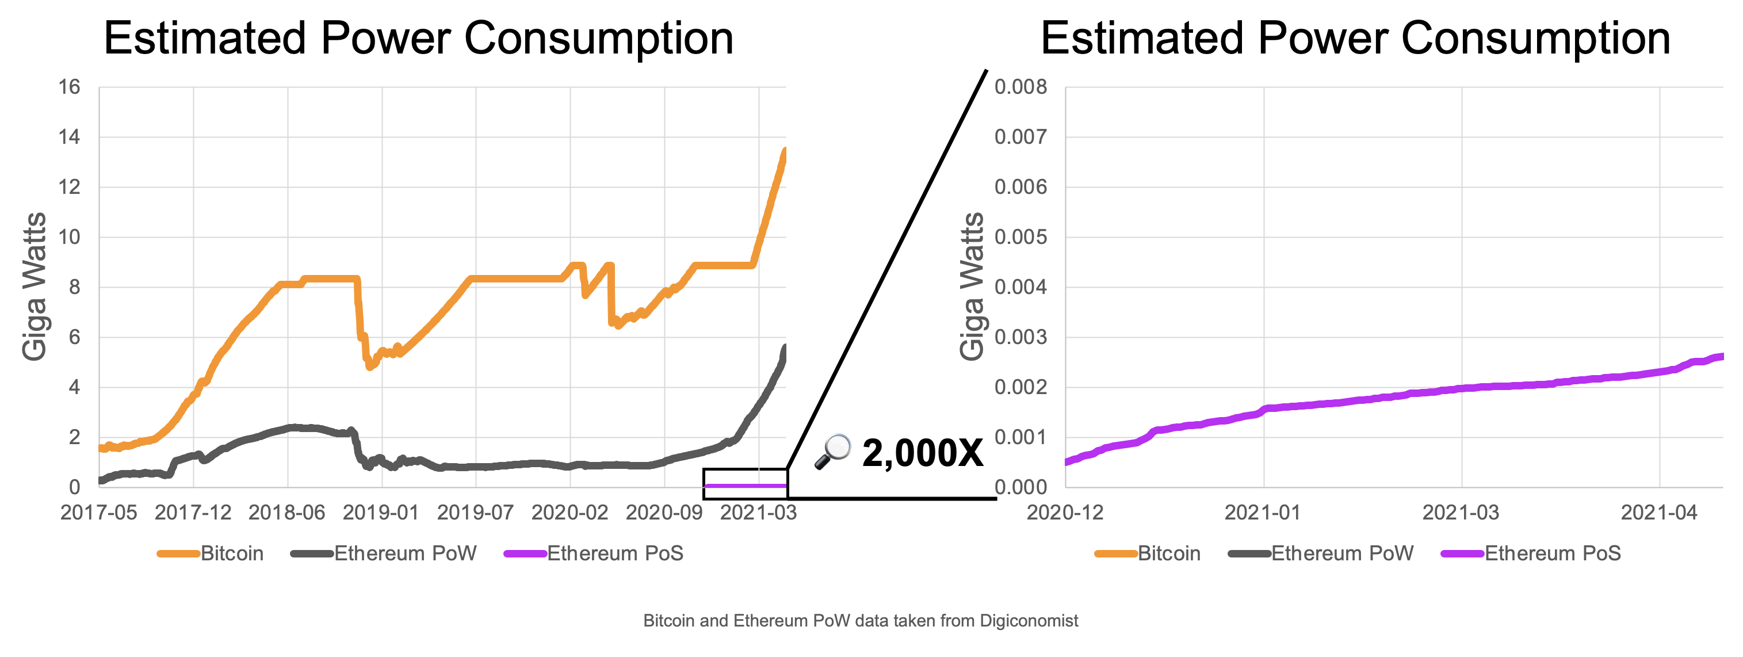
A Greener Future for Blockchains?
Taken from the article “Ethereum's energy usage will soon decrease by ~99.95%” that appeared at the ‘ethereum foundation blog’ on May 18th 2021.

Slide 40
END OF LECTURE
Next lecture: interesting scripts,
wallets, and how to manage crypto assets

Slide 41
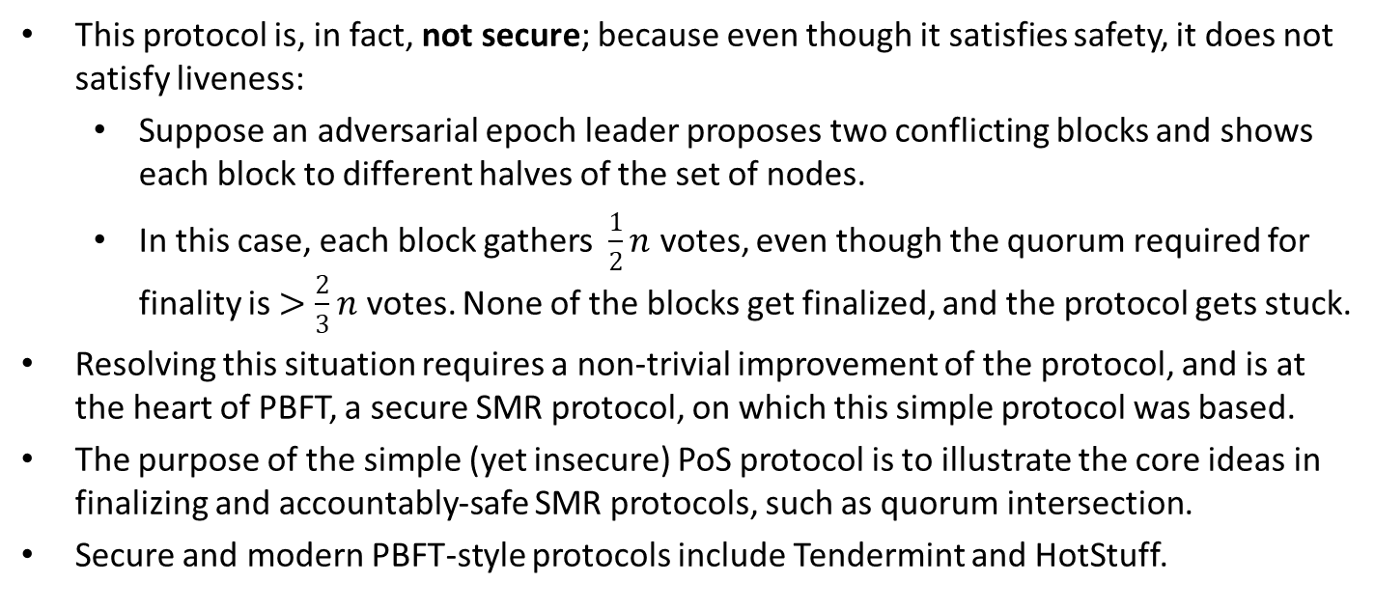
*A Note on the Simple PoS Protocol
This protocol is, in fact, not secure; because even though it satisfies safety, it does not satisfy liveness:
  Suppose an adversarial epoch leader proposes two conflicting blocks and shows each block to different halves of the set of nodes.
  In this case, each block gathers $\frac{1}{2}n$ votes, even though the quorum required for finality is $>\frac{2}{3}n$ votes. None of the blocks get finalized, and the protocol gets stuck.
Resolving this situation requires a non-trivial improvement of the protocol, and is at the heart of PBFT, a secure SMR protocol, on which this simple protocol was based.
The purpose of the simple (yet insecure) PoS protocol is to illustrate the core ideas in finalizing and accountably-safe SMR protocols, such as quorum intersection.
Secure and modern PBFT-style protocols include Tendermint and HotStuff.

Slide 42
Optional Slides
Slides going forward is optional material and investigate the Selfish Mining Attack.

Slide 43
Selfish Mining Attack (Optional)
Attacker keeps its blocks private until sufficiently many honest blocks are mined.
It then publishes the hidden blocks to ‘reorg’ the honest blocks.
Block Reward
Block Reward
Block Reward
Block Reward
Block Reward
Block Reward
Majority is not Enough: Bitcoin Mining is Vulnerable (2013)

Slide 44
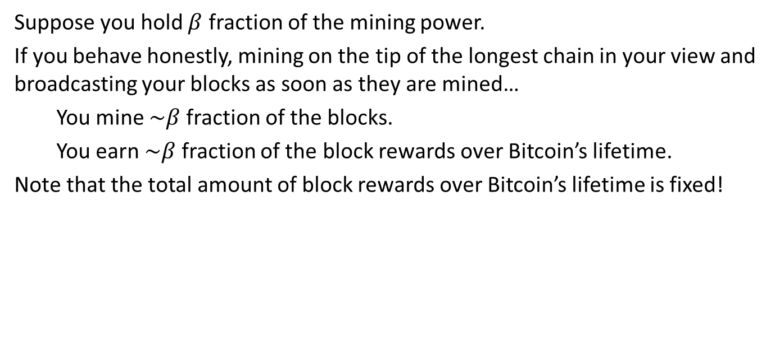
Selfish Mining Attack (Optional)
Suppose you hold $β$ fraction of the mining power.
If you behave honestly, mining on the tip of the longest chain in your view and broadcasting your blocks as soon as they are mined…
You mine $\sim β$ fraction of the blocks.
You earn $\sim β$ fraction of the block rewards over Bitcoin’s lifetime.
Note that the total amount of block rewards over Bitcoin’s lifetime is fixed!

Slide 45


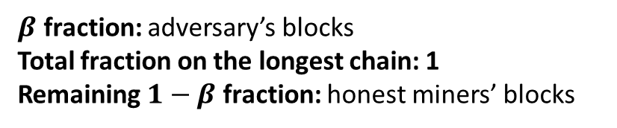
Selfish Mining Attack (Optional)
…
…
…
$β$ fraction: adversary’s blocks
Total fraction on the longest chain: 1
Remaining $1−β$ fraction: honest miners’ blocks

Slide 46
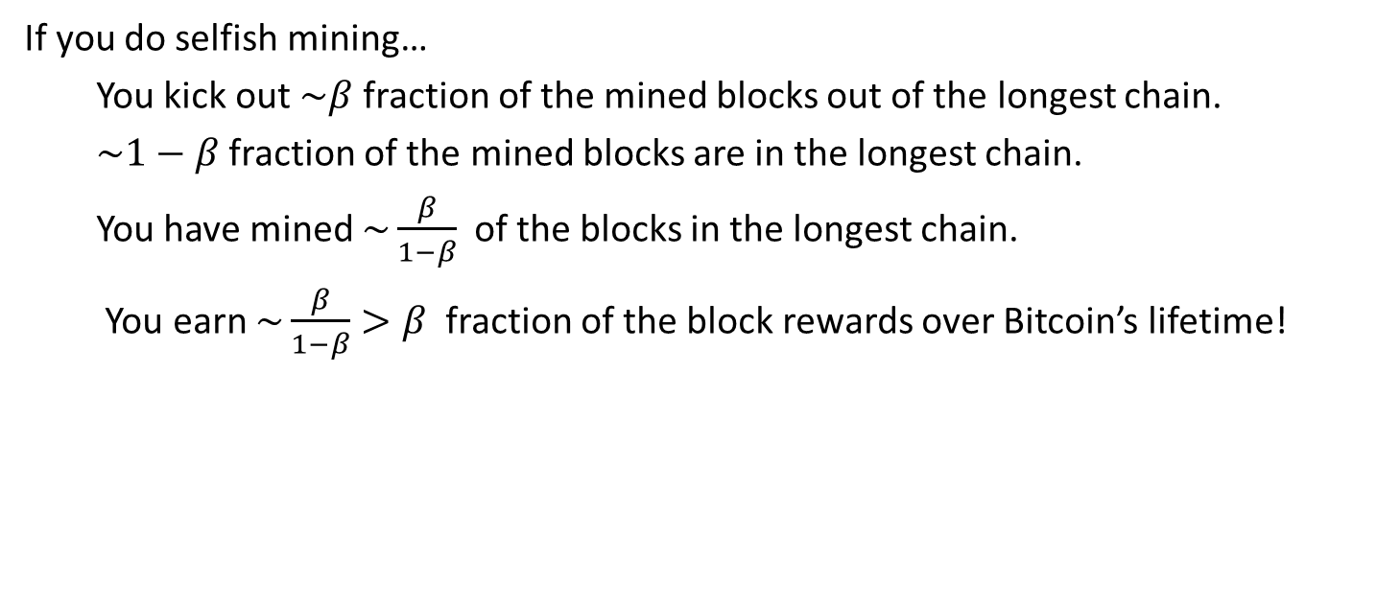
Selfish Mining Attack (Optional)
If you do selfish mining…
You kick out $\sim β$ fraction of the mined blocks out of the longest chain.
$\sim 1−β$ fraction of the mined blocks are in the longest chain.
You have mined $\sim \frac{β}{1−β}$ of the blocks in the longest chain.
You earn $\sim \frac{β}{1−β}>β$ fraction of the block rewards over Bitcoin’s lifetime!

Slide 47
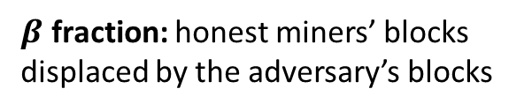
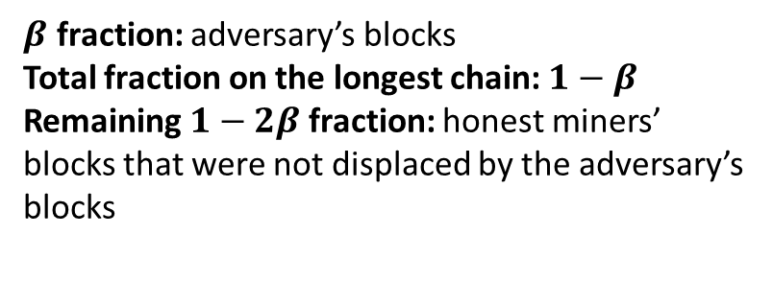
Selfish Mining Attack (Optional)
$β$ fraction: honest miners’ blocks displaced by the adversary’s blocks
…
…
…
…
$β$ fraction: adversary’s blocks
Total fraction on the longest chain: $1−β$
Remaining $1−2β$ fraction: honest miners’ blocks that were not displaced by the adversary’s blocks

Slide 48
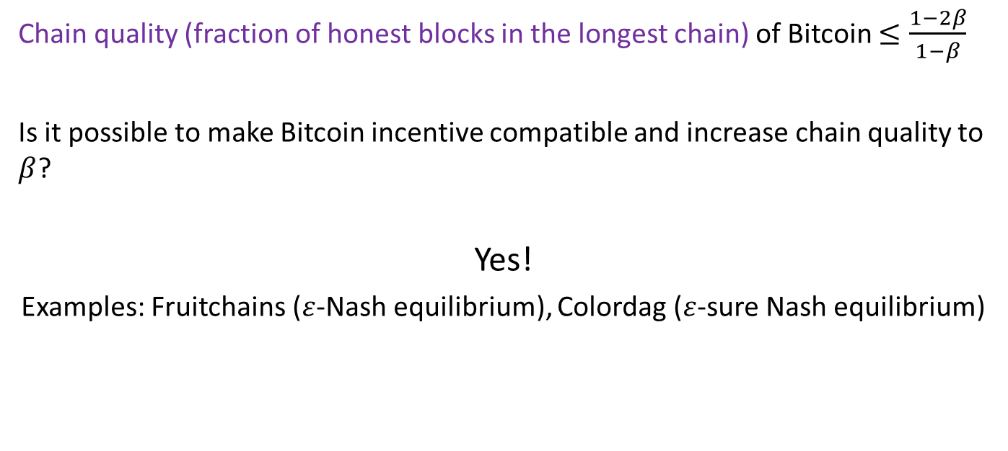
Selfish Mining Attack (Optional)
Chain quality (fraction of honest blocks in the longest chain) of Bitcoin $≤\frac{1−2β}{1−β}$
Is it possible to make Bitcoin incentive compatible and increase chain quality to $β$?
Yes!
Examples: Fruitchains ($ε$-Nash equilibrium), Colordag ($ε$-sure Nash equilibrium)
Fruitchains: A Fair Blockchain (2017)
Colordag: An Incentive-Compatible Blockchain (2022)

