Slide 1
Consensus in the Internet Setting
CS251 Fall 2023
(cs251.stanford.edu)
Ertem Nusret Tas

Slide 2
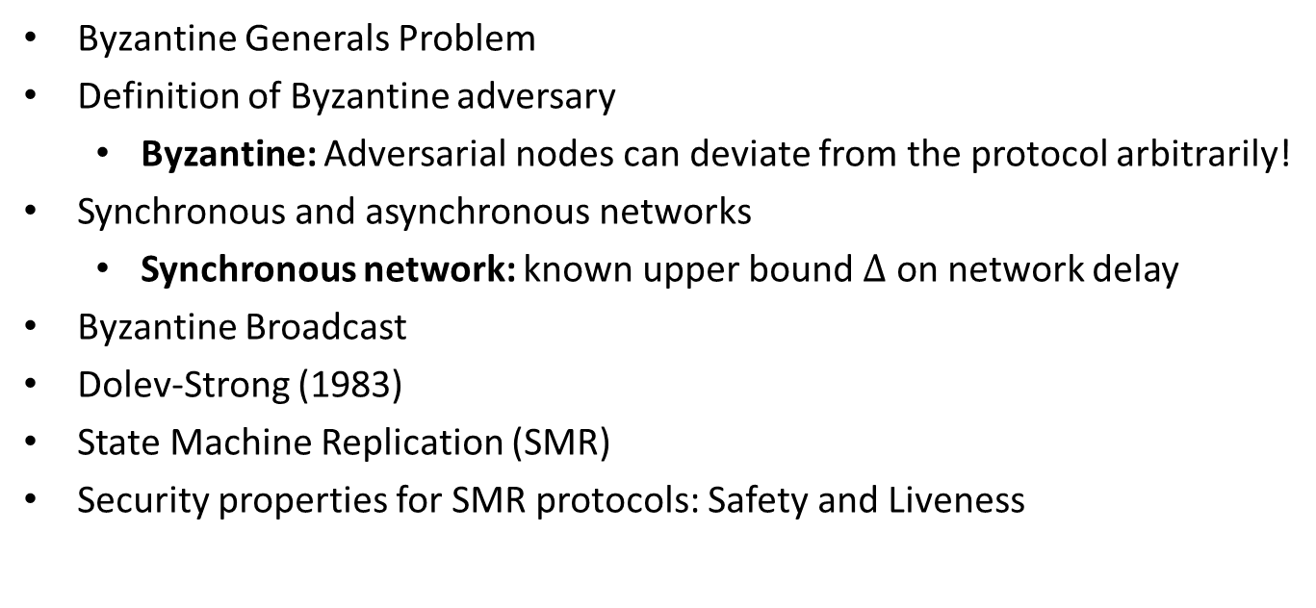
Recap of the Last Lecture
Byzantine Generals Problem
Definition of Byzantine adversary
  Byzantine: Adversarial nodes can deviate from the protocol arbitrarily!
Synchronous and asynchronous networks
  Synchronous network: known upper bound $Δ$ on network delay
Byzantine Broadcast
Dolev-Strong (1983)
State Machine Replication (SMR)
Security properties for SMR protocols: Safety and Liveness

Slide 3

Sybil Attack
How to select the nodes that participate in consensus?
Two variants:
Permissioned: There is a fixed set of nodes (previous lecture).
Permissionless: Anyone is free to join the protocol at any time.
Can we accept any node that has a signing key to participate in consensus?
Sybil Attack!

Slide 4
Sybil Attack
How to select the nodes that participate in consensus?
Two variants:
Permissioned: There is a fixed set of nodes (previous lecture).
Permissionless: Anyone is free to join the protocol at any time.
Can we accept any node that has a signing key to participate in consensus?
In a sybil attack, a single adversary impersonates many different nodes, outnumbering the honest nodes and potentially disrupting consensus.

Slide 5
Sybil Resistance
Consensus protocols with Sybil resistance are typically based on a bounded (scarce) resource:
How does Proof-of-Work prevent Sybil attacks?
We assume that the adversary controls a small fraction of the scarce resource!
Resource gives the power to influence the protocol.
Adversary has less influence than honest nodes.
 | Resource dedicated to the protocol | Some Example Blockchains
Proof-of-Work | Total computational power | Bitcoin, PoW Ethereum…
Proof-of-Stake | Total number of coins | Algorand, Cardano, Cosmos, PoS Ethereum…
Proof-of-Space/Time | Total storage across time | Chia, Filecoin…

Slide 6




Bitcoin: Mining
To mine a new block, a miner must find $nonce$ such that
$H\left(h_{prev},txn root, nonce\right)<Target=\frac{2^{256}}{D}$
Each miner tries different nonces until one of them finds a nonce that satisfies the above equation.
$$B_{0}$$
$$B_{1}$$
Genesis
H($B_{0}$)
nonce
txn root
H
Block headers
coinbase Tx

Slide 7


Bitcoin: Mining
Difficulty: How many nonces on average miners try until finding a block?
To mine a new block, a miner must find $nonce$ such that
$H\left(h_{prev},txn root, nonce\right)<Target=\frac{2^{256}}{D}$
Each miner tries different nonces until one of them finds a nonce that satisfies the above equation.
$$B_{0}$$
$$B_{1}$$
$$B_{2}$$
Genesis
H($B_{0}$)
nonce
txn root
H($B_{1}$)
nonce
txn root
H
New block: random process but app. once in every 10 minutes
Block headers
coinbase Tx
coinbase Tx

Slide 8
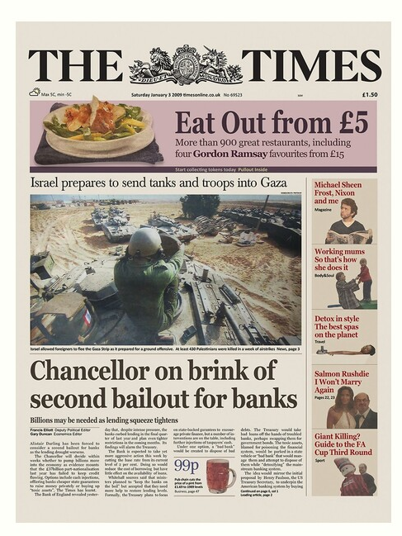
Bitcoin: Mining
genesis
block
B₁
B₂
version (4 bytes)
prev (32 bytes)
time (4 bytes)
bits (4 bytes)
nonce (4 bytes)
tx root (32 bytes)
prev
tx root
H
H
80 bytes
coinbase Tx
coinbase Tx

Slide 9
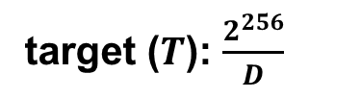
Bitcoin: Mining
genesis
block
B₁
B₂
version (4 bytes)
prev (32 bytes)
time (4 bytes)
bits (4 bytes)
nonce (4 bytes)
tx root (32 bytes)
prev
tx root
H
H
target ($T$): $\frac{2^{256}}{D}$
80 bytes
coinbase Tx
coinbase Tx

Slide 10

Nakamoto Consensus
Bitcoin uses Nakamoto consensus:
Fork-choice / proposal rule: At any given time, each honest miner attempts to extend (i.e., mines on the tip of) the heaviest chain held in its view (Ties broken adversarially).
G
Difficulty values on the blocks
3
5
3
5
1
a
b
b
1
c

Slide 11
Nakamoto Consensus
Chain with the highest difficulty, i.e, largest sum of the difficulty D within blocks!
Bitcoin uses Nakamoto consensus:
Fork-choice / proposal rule: At any given time, each honest miner attempts to extend (i.e., mines on the tip of) the heaviest chain held in its view (Ties broken adversarially).
G
Difficulty values on the blocks
3
5
3
5
1
a
b
b
1
c

Slide 12
Nakamoto Consensus
Chain with the highest difficulty, i.e, largest sum of the difficulty D within blocks!
Bitcoin uses Nakamoto consensus:
Fork-choice / proposal rule: At any given time, each honest miner attempts to extend (i.e., mines on the tip of) the heaviest (longest for us) chain held in its view (Ties broken adversarially).
G
a
b
1
c
c

Slide 13
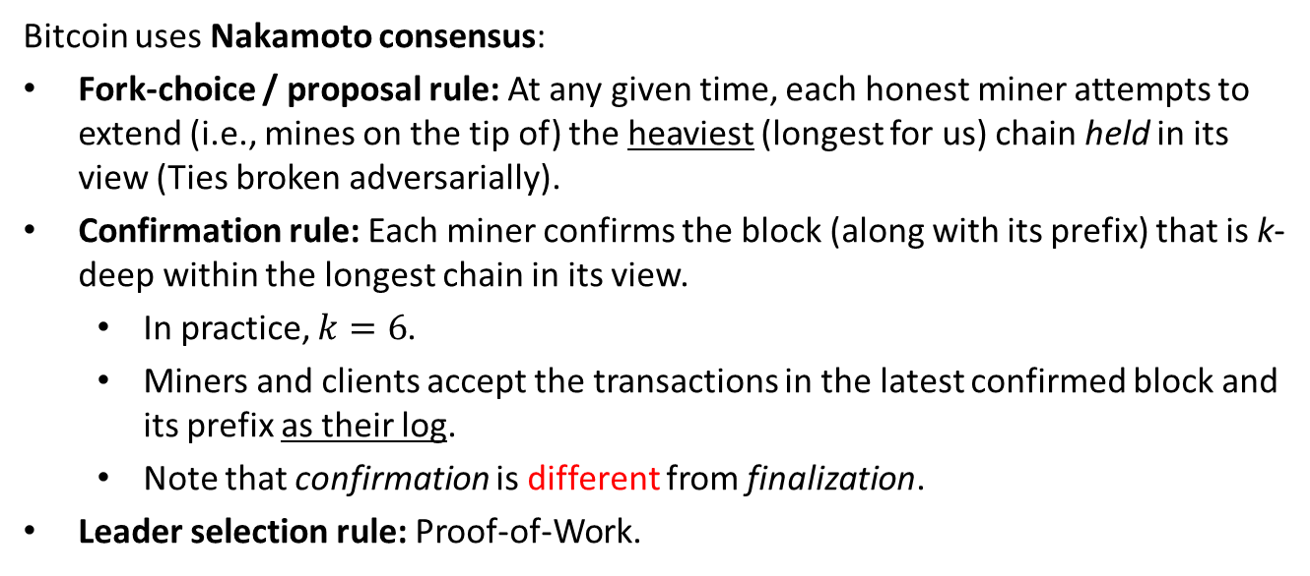
Nakamoto Consensus
Bitcoin uses Nakamoto consensus:
Fork-choice / proposal rule: At any given time, each honest miner attempts to extend (i.e., mines on the tip of) the heaviest (longest for us) chain held in its view (Ties broken adversarially).
Confirmation rule: Each miner confirms the block (along with its prefix) that is k-deep within the longest chain in its view.
  In practice, $k=6$.
  Miners and clients accept the transactions in the latest confirmed block and its prefix as their log.
  Note that confirmation is different from finalization.
Leader selection rule: Proof-of-Work.

Slide 14
Nakamoto Consensus
Chain with the highest difficulty, i.e, largest sum of the difficulty D within blocks!
Bitcoin uses Nakamoto consensus:
Fork-choice / proposal rule: At any given time, each honest miner attempts to extend (i.e., mines on the tip of) the heaviest (longest for us) chain held in its view (Ties broken adversarially).
Confirmation rule: Each miner confirms the block (along with its prefix) that is k-deep within the longest chain in its view.
  In practice, $k=6$.
  Miners and clients accept the transactions in the latest confirmed block and its prefix as their log.
  Note that confirmation is different from finalization.
Leader selection rule: Proof-of-Work.

Slide 15









Nakamoto Consensus
k=2
Available under
dynamic participation
Confirmed
Alice’s log:
$${txs}_{1}$$
$${txs}_{3}$$

Slide 16


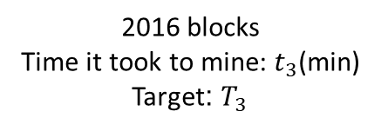
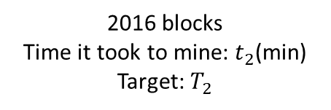
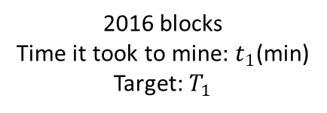
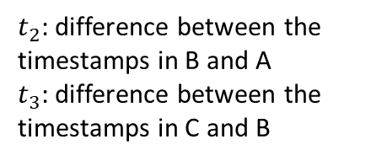
Bitcoin: Difficulty Adjustment
New target: $T_{2}=T_{1}$ $\frac{t_{1}}{2016×10 mins}$
New target: $T_{3}=T_{2}$ $\frac{t_{2}}{2016×10 mins}$
…
A
…
B
…
C
2016 blocks
Time it took to mine: $t_{1}$(min)
Target: $T_{1}$
2016 blocks
Time it took to mine: $t_{2}$(min)
Target: $T_{2}$
2016 blocks
Time it took to mine: $t_{3}$(min)
Target: $T_{3}$
$t_{2}$: difference between the timestamps in B and A
$t_{3}$: difference between the timestamps in C and B
New target is not allowed to be more than 4x old target.
New target is not allowed to be less than ¼ x old target.
The Bitcoin Backbone Protocol with Chains of Variable Difficulty (2016)

Slide 17
Consensus in the Internet Setting
Characterized by open participation.
Challenges:
Adversary can create many Sybil nodes to take over the protocol.
Honest nodes can come and go at will.
Requirements:
Limit adversary’s participation.
  Sybil resistance (e.g., Proof-of-Work)!
Maintain availability (liveness) of the protocol when the honest nodes come and go at will, resulting in changes in the number of nodes.
  Dynamic availability!
Achieved by Bitcoin!

Slide 18

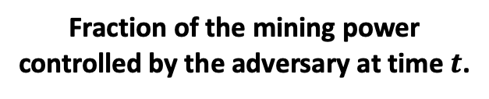
Security?
Can we show that Bitcoin is a secure state machine replication (SMR) protocol (satisfies safety and liveness) under synchrony against a Byzantine adversary?
$β\left(t\right)$ ∈ [0,1] for all t
Fraction of the mining power controlled by the adversary at time $t$.
What is the highest $β\left(t\right)$ for which Bitcoin is secure??

Slide 19

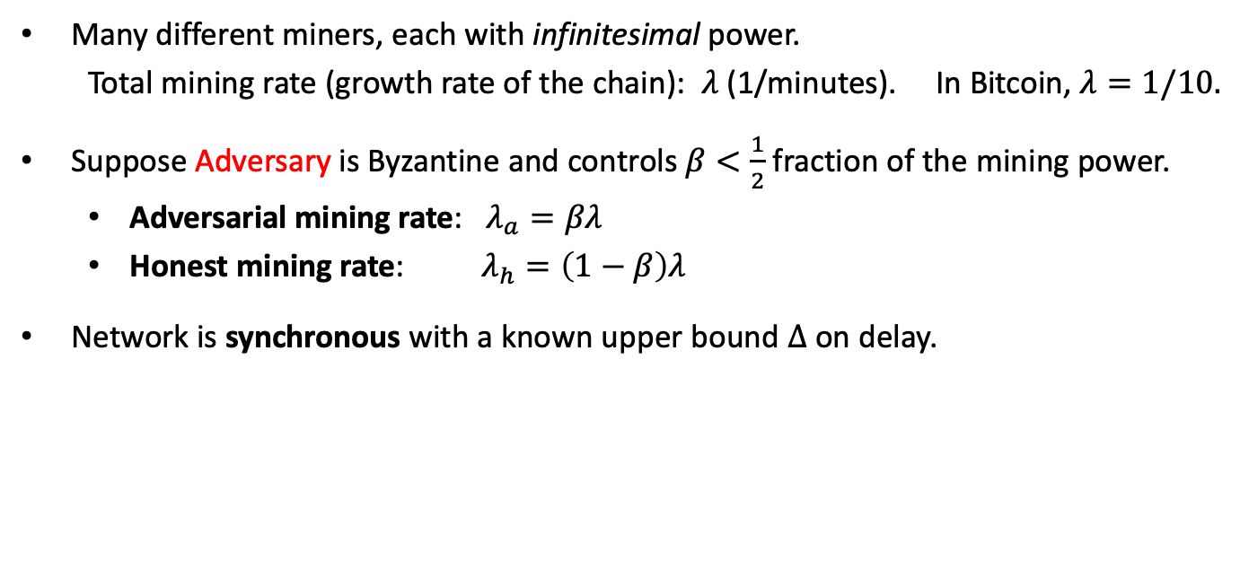





Model for Bitcoin
Many different miners, each with infinitesimal power.
Total mining rate (growth rate of the chain): $λ$ (1/minutes). In Bitcoin, $λ=1/10.$
Suppose Adversary is Byzantine and controls $β<\frac{1}{2}$ fraction of the mining power.
  Adversarial mining rate: $λ_{a}=βλ$
  Honest mining rate: $λ_{h}=\left(1−β\right)λ$
Network is synchronous with a known upper bound $Δ$ on delay.
$$t_{0}=0$$
$$t_{1}$$
$$t_{2}$$
$$t_{3}$$
$$t_{4}$$
$$t_{5}$$

Slide 20



Reminder: Why is safety important?
Eve
Suppose Eve has a UTXO.
$tx_{1}$: transaction spending Eve’s UTXO to pay to car vendor Alice.
$tx_{2}$: transaction spending Eve’s UTXO to pay to car vendor Bob.
$$UTXO_{Eve}$$
$$t_{0}=0$$
$$t_{1}$$
$$t_{2}$$
spent to pay Alice
spent to pay Bob
Alice’s ledger at time $t_{1}$ contains $tx_{1}:$
$$LOG_{t_{1}}^{Alice}=<tx_{1}>$$
Alice thinks it received Eve’s payment and sends over the car.
Bob’s ledger at time $t_{2}$ contains $tx_{2}:$
$$LOG_{t_{2}}^{Bob}=<tx_{2}>$$
Bob thinks it received Eve’s payment and sends over the car.
Alice
Bob

Slide 21
Reminder: Why is safety important?
Eve
Suppose Eve has a UTXO.
$tx_{1}$: transaction spending Eve’s UTXO to pay to car vendor Alice.
$tx_{2}$: transaction spending Eve’s UTXO to pay to car vendor Bob.
$$UTXO_{Eve}$$
$$t_{0}=0$$
$$t_{1}$$
safety violation
$$t_{2}$$
spent to pay Alice
spent to pay Bob
Alice’s ledger at time $t_{1}$ contains $tx_{1}:$
$$LOG_{t_{1}}^{Alice}=<tx_{1}>$$
Alice thinks it received Eve’s payment and sends over the car.
Bob’s ledger at time $t_{2}$ contains $tx_{2}:$
$$LOG_{t_{2}}^{Bob}=<tx_{2}>$$
Bob thinks it received Eve’s payment and sends over the car.
Alice
Bob
When safety is violated, Eve can double-spend!

Slide 22















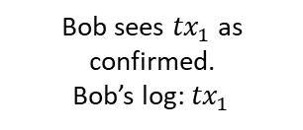




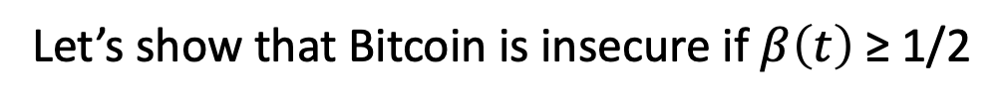
Nakamoto’s Private Attack: $β≥$ 1/2
Bob
comes
$$t_{0}=0$$
$$t_{1}$$
$$t_{2}$$
$$t_{3}$$
$$t_{4}$$
$$t_{5}$$
$$t_{6}$$
$$t_{7}$$
Bob sees ${tx}_{1}$ as confirmed.
Bob’s log: ${tx}_{1}$
k deep confirmation rule
(k=3 in our example)
$${tx}_{1}$$
$${tx}_{5}$$
Hidden
$${tx}_{2}$$
$${tx}_{3}$$
$${tx}_{4}$$
Let’s show that Bitcoin is insecure if $β\left(t\right)$ ≥ 1/2
A Peer-to-Peer Electronic Cash System (2008)

Slide 23

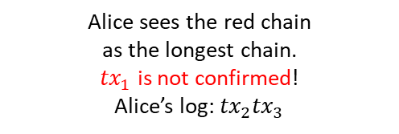

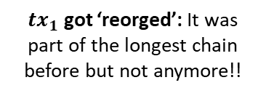
Nakamoto’s Private Attack: $β≥$ 1/2
safety violation!
double spend!
Bob
comes
Adv releases
Alice
comes
$$t_{0}=0$$
$$t_{1}$$
$$t_{2}$$
$$t_{3}$$
$$t_{4}$$
$$t_{5}$$
$$t_{6}$$
$$t_{7}$$
${tx}_{1}$ got ‘reorged’: It was part of the longest chain before but not anymore!!
Bob sees ${tx}_{1}$ as confirmed.
Bob’s log: ${tx}_{1}$
k deep confirmation rule
(k=3 in our example)
$${tx}_{1}$$
$${tx}_{5}$$
$$λ_{h}$$
Honest mining rate
Alice sees the red chain
as the longest chain.
${tx}_{1}$ is not confirmed!
Alice’s log: ${tx}_{2}{tx}_{3}$
$${tx}_{2}$$
$${tx}_{3}$$
$${tx}_{4}$$
$$λ_{a}$$
Private attack succeeds!
Adversarial mining rate
A Peer-to-Peer Electronic Cash System (2008)

Slide 24
Nakamoto’s Private Attack: $β≥$ 1/2
safety violation!
double spend!
Bob
comes
Adv releases
Alice
comes
$$t_{0}=0$$
$$t_{1}$$
$$t_{2}$$
$$t_{3}$$
$$t_{4}$$
$$t_{5}$$
$$t_{6}$$
$$t_{7}$$
${tx}_{1}$ got ‘reorged’: It was part of the longest chain before but not anymore!!
Bob sees ${tx}_{1}$ as confirmed.
Bob’s log: ${tx}_{1}$
k deep confirmation rule
(k=3 in our example)
$${tx}_{1}$$
$${tx}_{5}$$
$$λ_{h}$$
Honest mining rate
Alice sees the red chain
as the longest chain.
${tx}_{1}$ is not confirmed!
Alice’s log: ${tx}_{2}{tx}_{3}$
$${tx}_{2}$$
$${tx}_{3}$$
$${tx}_{4}$$
$$λ_{a}$$
Private attack succeeds!
Adversarial mining rate
Private attack (mostly) succeeds if $λ_{a}≥$ $λ_{h}$, i.e., if $β≥$ $1−β$, i.e., if $β≥\frac{1}{2}$.
Private attack (mostly) fails if $λ_{a}<$ $λ_{h}$, i.e., if $β<$ $1−β$, i.e., if $β<\frac{1}{2}$.
Can another attack succeed?
A Peer-to-Peer Electronic Cash System (2008)

Slide 25












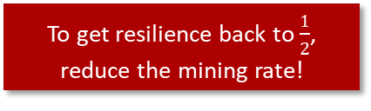
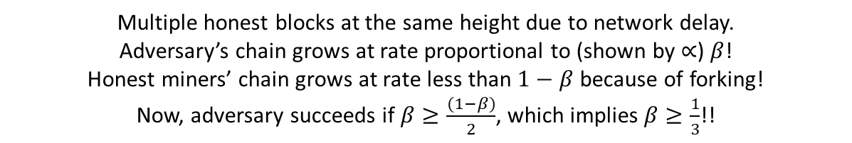



Forking
C
A
B
To get resilience back to $\frac{1}{2}$, reduce the mining rate!
Tx
${ λ}_{h}∝$ e.g., $\frac{(1−β)}{2}$,
Hidden
$λ_{a}$ $∝$ $β$
D
E
$$Δ$$
$$Δ$$
$$Δ$$
$$t_{0}=0$$
$$t_{1}$$
$$t_{2}$$
$$t_{3}$$
$$t_{4}$$
$$t_{5}$$
$$t_{6}$$
$$t_{7}$$
$$t_{8}$$
Multiple honest blocks at the same height due to network delay.
Adversary’s chain grows at rate proportional to (shown by $∝$) $β$!
Honest miners’ chain grows at rate less than $1−β$ because of forking!
Now, adversary succeeds if $β≥\frac{(1−β)}{2}$, which implies $β≥\frac{1}{3}$!!

Slide 26

Reminder for SMR Security
Let’s recall the security definition for state machine replication (SMR) protocols. Let ${ch}_{t}^{i}$ denote the confirmed (i.e., k-deep) of a client $i$ at time $t$.
Safety (Consistency):
  For any two clients $i$ and $j$, and times $t$ and $s$: ${ch}_{t}^{i}≼{ch}_{s}^{j}$ (prefix of) or vice versa, i.e., chains are consistent.
Liveness:
  If a transaction $tx$ is input to an honest miner at some time $t$, then for all clients $i$, and times $s≥t+T_{conf}$: $tx∈{ch}_{s}^{i}$.
No double spend
No censorship

Slide 27


Security Theorem
Theorem: If $β<1/2$, there exists a small enough mining rate $λ\left(Δ,β\right)=λ_{a}+λ_{h}$ such that Bitcoin satisfies safety and liveness except with error probability $ε=e^{−Ω(k)}$ under synchronous network (recall that $k$ is used in the $k$ deep confirmation rule).
$e^{−Ω(k)}$ is the error probability for confirmation.
Latest result for bounding the error probability as a function of $k$:
$$ε≤\left(2+2\sqrt{\frac{1−β}{β}}\right){\left(4β\left(1−β\right)\right)}^{k}$$
We say ‘confirmation’ instead of finalization because when you confirm a block or transaction, you confirm it with an error probability…
…unlike finalizing a block where there is no error probability*.
The Bitcoin Backbone Protocol: Analysis and Applications (2015)
Analysis of the Blockchain Protocol in Asynchronous Networks (2016)
Analysis of Nakamoto Consensus (2019)
Everything is a Race and Nakamoto Always Wins (2022)
Bitcoin’s Latency–Security Analysis Made Simple (2022)

Slide 28

Security Theorem
Theorem: If $β<1/2$, there exists a small enough mining rate $λ\left(Δ,β\right)=λ_{a}+λ_{h}$ such that Bitcoin satisfies safety and liveness except with error probability $ε=e^{−Ω(k)}$ under synchronous network (recall that $k$ is used in the $k$ deep confirmation rule).
$e^{−Ω(k)}$ is the error probability for confirmation.
Latest result for bounding the error probability as a function of $k$:
$$ε≤\left(2+2\sqrt{\frac{1−β}{β}}\right){\left(4β\left(1−β\right)\right)}^{k}$$
We say ‘confirmation’ instead of finalization because when you confirm a block or transaction, you confirm it with an error probability…
…unlike finalizing a block where there is no error probability*.
The Bitcoin Backbone Protocol: Analysis and Applications (2015)
Analysis of the Blockchain Protocol in Asynchronous Networks (2016)
Analysis of Nakamoto Consensus (2019)
Everything is a Race and Nakamoto Always Wins (2022)
Bitcoin’s Latency–Security Analysis Made Simple (2022)
Now, we see why Bitcoin has 1 block every 10 minutes, instead of 1 block every second…

Slide 29
Proof of the Security Theorem
See the optional slides at the end of the deck …

Slide 30


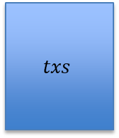

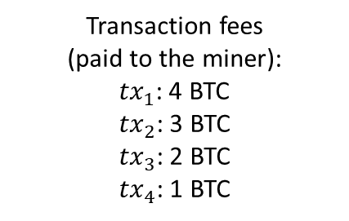
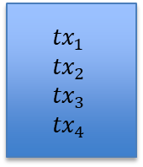
Would $β<1/2$ hold in practice?
+0 BTC earned
Transaction fees
(paid to the miner):
${tx}_{1}$: 4 BTC
${tx}_{2}$: 3 BTC
${tx}_{3}$: 2 BTC
${tx}_{4}$: 1 BTC
A
Genesis
$$txs$$
$${tx}_{1}$$
$${tx}_{2}$$
$${tx}_{3}$$
$${tx}_{4}$$
>0 BTC earned

Slide 31
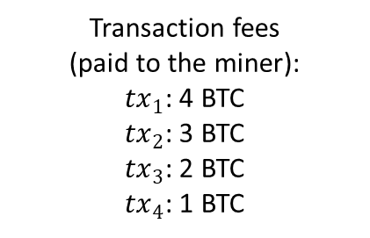
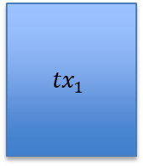
Would $β<1/2$ hold in practice?
+0 BTC earned
Transaction fees
(paid to the miner):
${tx}_{1}$: 4 BTC
${tx}_{2}$: 3 BTC
${tx}_{3}$: 2 BTC
${tx}_{4}$: 1 BTC
A
Genesis
$$txs$$
$${tx}_{1}$$
$${tx}_{2}$$
$${tx}_{3}$$
$${tx}_{4}$$
>0 BTC earned
$${tx}_{1}$$

Slide 32

Would $β<1/2$ hold in practice?
Transaction fees
(paid to the miner):
${tx}_{1}$: 4 BTC
${tx}_{2}$: 3 BTC
${tx}_{3}$: 2 BTC
${tx}_{4}$: 1 BTC
A
Genesis
$$txs$$
$${tx}_{1}$$
$${tx}_{2}$$
$${tx}_{3}$$
$${tx}_{4}$$
$${tx}_{1}$$
$${tx}_{2}$$
…

Slide 33
Would $β<1/2$ hold in practice?
Transaction fees
(paid to the miner):
${tx}_{1}$: 4 BTC
${tx}_{2}$: 3 BTC
${tx}_{3}$: 2 BTC
${tx}_{4}$: 1 BTC
A
Genesis
$$txs$$
$${tx}_{1}$$
$${tx}_{2}$$
$${tx}_{3}$$
$${tx}_{4}$$
Miner (maximal) extractable value (MEV): a measure of miner’s profit via inclusion, exclusion or re-ordering of transactions within its block
$${tx}_{1}$$
$${tx}_{2}$$
- Miners have incentive to violate the protocol!
- Can lead to double spends!
…
Need to think about incentives!!
MEV gives even more incentive to violate the protocol!!

Slide 34
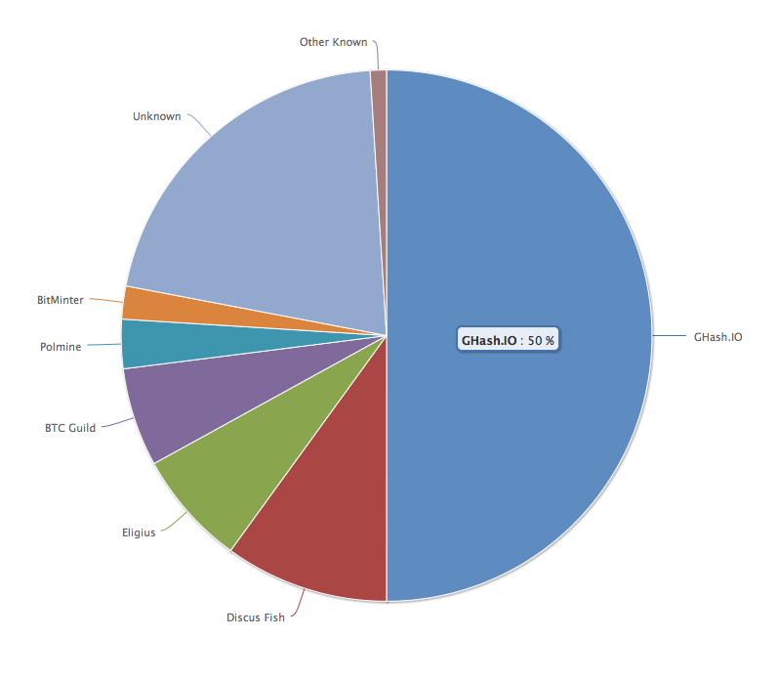
No Attacks on Bitcoin?
Ghash.IO had >50% in 2014
Gave up mining power
Why are visible attacks not more frequent?
Miners care about the Bitcoin price?
Not a valid argument.
They can ‘short’ the chain for profit!
Might not always be rational to attack.
No guarantees for the future!

Slide 35
Is Bitcoin the Endgame?
Bitcoin provides Sybil resistance and dynamic availability.
Is it the Endgame for consensus?
No!
Bitcoin is secure only under synchrony and loses security during periods of asynchrony.
It confirms blocks with an error probability depending on k, i.e., blocks are not finalized.
Energy consumption?
Next lecture: low-energy consensus using proof-of-stake

Slide 36
END OF LECTURE
Next lecture: Incentives and Accountability in Consensus

Slide 37



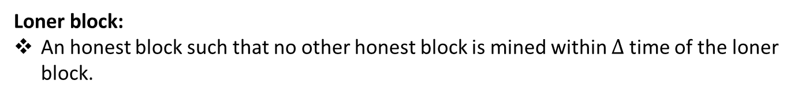






Optional: Security Proof
Loner block:
An honest block such that no other honest block is mined within $∆$ time of the loner block.
$$t_{0}=0$$
$$t_{1}$$
$$t_{2}$$
$$t_{3}$$
$$t_{4}$$
$$t_{5}$$
$$t_{6}$$
$$t_{7}$$
$$t_{8}$$
Analysis of Nakamoto Consensus (2019)
The Sleepy Model of Consensus (2016)

Slide 38




Optional: Security Proof
Loner block:
An honest block such that no other honest block is mined within $∆$ time of the loner block.
Not loners!
Loner!
$$t_{0}=0$$
$$t_{1}$$
$$t_{2}$$
$$t_{3}$$
$$t_{4}$$
$$t_{5}$$
$$t_{6}$$
$$t_{7}$$
$$t_{8}$$
$$∆$$
$$∆$$
$$∆$$
$$∆$$
Length of the shortest chain among the longest chains observed by the clients at time $t$: $L\left(t\right)$
Analysis of Nakamoto Consensus (2019)
The Sleepy Model of Consensus (2016)

Slide 39















Optional: Security Proof
Loner block:
An honest block such that no other honest block is mined within $∆$ time of the loner block.
Loner!
Loner!
Loner!
Loner!
Not loners!
$$t_{0}=0$$
$$t_{1}$$
$$t_{2}$$
$$t_{3}$$
$$t_{4}$$
$$t_{5}$$
$$t_{6}$$
$$t_{7}$$
$$t_{8}$$
Lemma: For any$s>t, L\left(s\right)−L\left(t\right)≥$“number of loners mined in the interval $(t+Δ,s−Δ]"$.
Proof sketch: Each loner increases the length of the longest chains observed by the clients by one block. For instance;
$$t_{8}$$
$$t_{1}$$
$$t_{3}$$
$$t_{4}$$
$$t_{5}$$
$$t_{7}$$
Analysis of Nakamoto Consensus (2019)
The Sleepy Model of Consensus (2016)

Slide 40









Optional: Security Proof
Pivot block:
In any interval covering the mining time of the pivot block, more loner blocks are mined than adversarial blocks.
Pivot block is a loner.
2 loners
0 adversarial
$$t_{0}=0$$
$$t_{1}$$
$$t_{2}$$
$$t_{3}$$
$$t_{4}$$
$$t_{5}$$
$$t_{6}$$
$$t_{7}$$
$$t_{8}$$
pivot

Slide 41
Optional: Security Proof
Pivot block:
In any interval covering the mining time of the pivot block, more loner blocks are mined than adversarial blocks.
Pivot block is a loner.
2 loner
1 adversarial
$$t_{0}=0$$
$$t_{1}$$
$$t_{2}$$
$$t_{3}$$
$$t_{4}$$
$$t_{5}$$
$$t_{6}$$
$$t_{7}$$
$$t_{8}$$
pivot

Slide 42
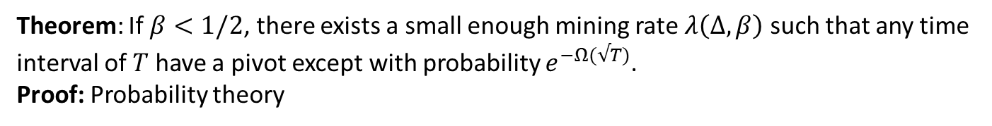
Optional: Security Proof
Pivot block:
In any interval covering the mining time of the pivot block, more loner blocks are mined than adversarial blocks.
Pivot block is a loner.
4 loner
2 adversarial
$$t_{0}=0$$
$$t_{1}$$
$$t_{2}$$
$$t_{3}$$
$$t_{4}$$
$$t_{5}$$
$$t_{6}$$
$$t_{7}$$
$$t_{8}$$
Theorem: If $β<1/2$, there exists a small enough mining rate $λ\left(Δ,β\right)$ such that any time interval of $T$ have a pivot except with probability $e^{−Ω(√T)}$.
Proof: Probability theory

Slide 43




Optional: Security Proof
Theorem: Suppose a block mined at time $t$ is a pivot. Then, the pivot block is on every (longest) chain held by any client at all times $≥t$.
Proof: For contradiction, suppose there exists a minimum time $s≥t$ such that a client Bob holds a chain conflicting with the pivot block.
pivot
G
…
…
tx
…
$$t$$
…
…
…
Bob’s chain
Heights
$h_{0}$=0
time s
time t

Slide 44




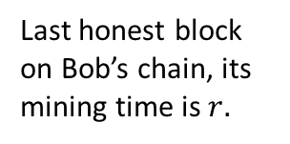



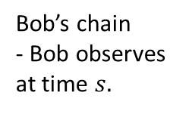
Optional: Security Proof
Theorem: If a client holds a chain containing a pivot block, then no client can hold a chain conflicting with the pivot block after the pivot block is mined.
Proof continued:
pivot
G
…
…
tx
…
$$t$$
…
…
$$r$$
…
Bob’s chain
- Bob observes at time $s.$
$h_{0}$=0
Last honest block on Bob’s chain, its mining time is $r.$
$$h_{1}$$
$$h_{2}$$
$r<s$ by definition.
$r<t$ because otherwise $s$ is not the first time a conflicting chain is held a client or honest miner.

Slide 45
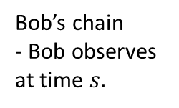
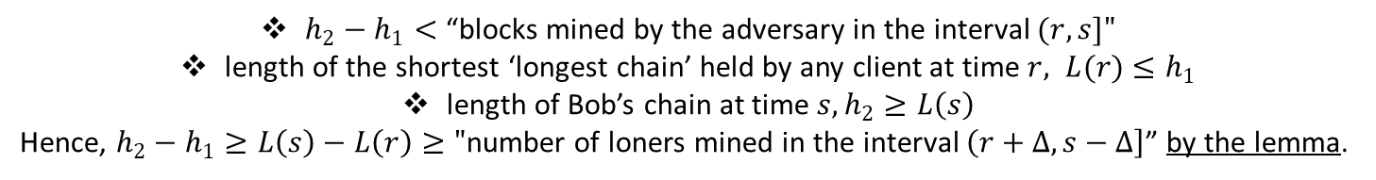





Optional: Security Proof
pivot
Proof continued:
Proof continued:
G
…
…
tx
…
$$t$$
…
…
$$r$$
…
Bob’s chain
- Bob observes at time $s.$
$h_{0}$=0
$$h_{1}$$
$$h_{2}$$
$h_{2}−h_{1}<$ “blocks mined by the adversary in the interval $(r,s]"$
length of the shortest ‘longest chain’ held by any client at time $r, L(r)$ $≤h_{1}$
length of Bob’s chain at time $s, h_{2}≥L\left(s\right)$
Hence, $h_{2}−h_{1}≥L\left(s\right)−L\left(r\right)≥"$number of loners mined in the interval $\left(r+Δ,s−Δ\right]$” by the lemma.

Slide 46
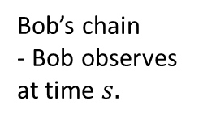
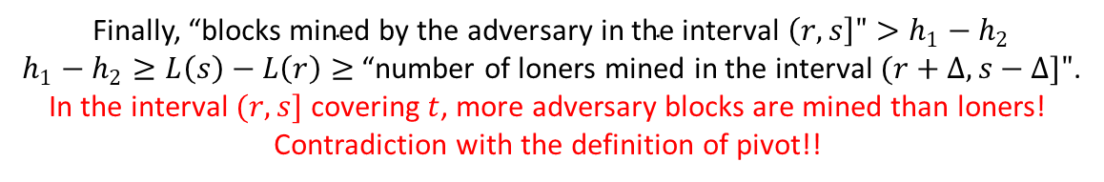





Optional: Security Proof
Proof continued:
Proof continued:
pivot
G
…
…
tx
…
$$t$$
…
…
$$r$$
…
Bob’s chain
- Bob observes at time $s.$
$h_{0}$=0
$$h_{1}$$
$$h_{2}$$
Finally, “${\text{blocks} \text{mined} \text{by} \text{the} \text{adversary} \text{in} \text{the} \text{interval} \left(r,s\right]">h}_{1}−h_{2}$
$h_{1}−h_{2}≥L\left(s\right)−L\left(r\right)≥$“number of loners mined in the interval $(r+Δ,s−Δ]"$.
In the interval $(r,s]$ covering $t$, more adversary blocks are mined than loners!
Contradiction with the definition of pivot!!

Slide 47


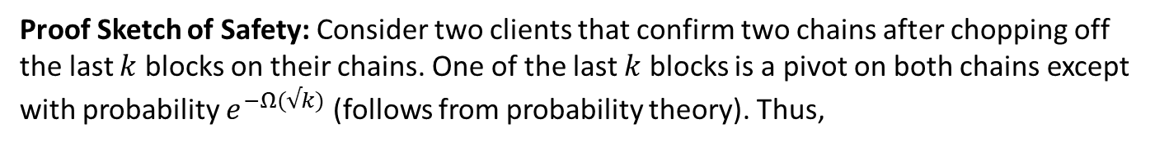


Optional: Security Proof
Proof Sketch of Liveness: The pivot is mined by an honest miner and contains all transactions input to the honest miners. Since it is on all chains held by all clients at all times, liveness is satisfied.
Proof Sketch of Safety: Consider two clients that confirm two chains after chopping off the last $k$ blocks on their chains. One of the last $k$ blocks is a pivot on both chains except with probability $e^{−Ω(√k)}$ (follows from probability theory). Thus,
…
Alice’s chain
G
pivot
pivot
$$k$$
…
Bob’s chain
$$k$$

Slide 48
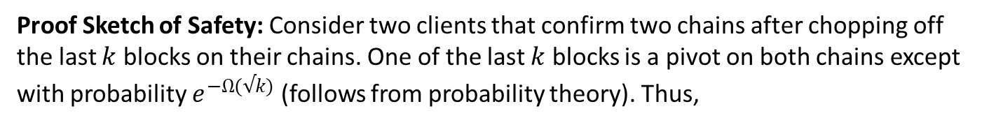
Optional: Security Proof
Proof Sketch of Liveness: The pivot is mined by an honest miner and contains all transactions input to the honest miners. Since it is on all chains held by all clients at all times, liveness is satisfied.
Proof Sketch of Safety: Consider two clients that confirm two chains after chopping off the last $k$ blocks on their chains. One of the last $k$ blocks is a pivot on both chains except with probability $e^{−Ω(√k)}$ (follows from probability theory). Thus,
…
G
$$k$$
Pivots:
The same block appears in Alice’s chain by the Theorem.
Chains are consistent!!
…
$$k$$

