Slide 1
Fundamentals of Consensus
CS251 Fall 2023
(cs251.stanford.edu)
Ertem Nusret Tas

Slide 2
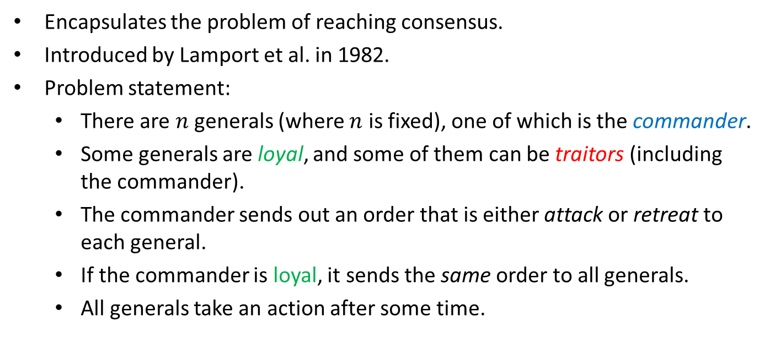
Byzantine Generals Problem
Encapsulates the problem of reaching consensus.
Introduced by Lamport et al. in 1982.
Problem statement:
  There are $n$ generals (where $n$ is fixed), one of which is the commander.
  Some generals are loyal, and some of them can be traitors (including the commander).
  The commander sends out an order that is either attack or retreat to each general.
  If the commander is loyal, it sends the same order to all generals.
  All generals take an action after some time.
The Byzantine Generals Problem (1982)

Slide 3
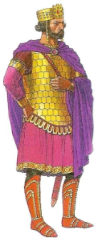
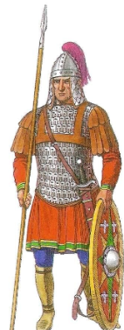

Byzantine Generals Problem
Goal:
Agreement: No two loyal generals take different actions.
Validity: If the commander is loyal, then all loyal generals must take the action suggested by the commander.
Termination: All loyal generals must eventually take some action.
loyal
retreat
retreat
retreat
retreat
loyal
loyal
loyal
traitor
retreat
retreat
retreat
attack

Slide 4
Byzantine Generals Problem
Goal:
Agreement: No two loyal generals take different actions.
Validity: If the commander is loyal, then all loyal generals must take the action suggested by the commander.
Termination: All loyal generals must eventually take some action.
traitor
retreat
retreat
attack
retreat
loyal
loyal
loyal
traitor
retreat
retreat
retreat
attack

Slide 5
Byzantine Generals Problem
Goal:
Agreement: No two loyal generals take different actions.
Validity: If the commander is loyal, then all loyal generals must take the action suggested by the commander.
Termination: All loyal generals must eventually take some action.
traitor
retreat
retreat
attack
retreat
loyal
loyal
loyal
traitor
retreat
retreat
retreat
attack

Slide 6
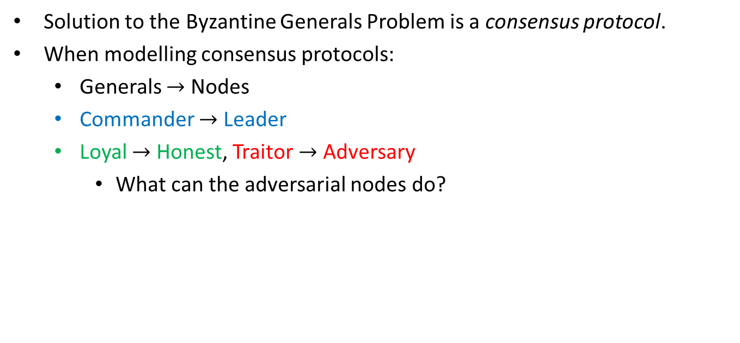
From Generals to Nodes
Solution to the Byzantine Generals Problem is a consensus protocol.
When modelling consensus protocols:
  Generals $→$ Nodes
  Commander $→$ Leader
  Loyal $→$ Honest, Traitor $→$ Adversary
    What can the adversarial nodes do?

Slide 7





Adversary
The adversary can corrupt nodes, after which they are called adversarial.
  Crash faults if the adversarial nodes do not send or receive any messages.
  Omission faults if the adversarial nodes can selectively choose to drop or let through each messages sent or received.
  Byzantine faults (Byzantine adversary) if the adversarial nodes can deviate from the protocol arbitrarily.

Slide 8

Adversary
We typically bound the adversary’s power by assuming an upper bound $(f)$on the number of nodes $(n)$ that can ever be adversarial.
  e.g., $f<n, f<\frac{n}{2}, f<\frac{n}{3}, …$

Slide 9

Communication
Nodes can send messages to each other, authenticated by signatures.
There is a public key infrastructure (PKI) setup.
  Adversary cannot simulate honest nodes!
  There are other ways to prevent such simulation (e.g., proof-of-work).
Consensus protocols typically assume that the adversary cannot forge signatures. Why?

Slide 10
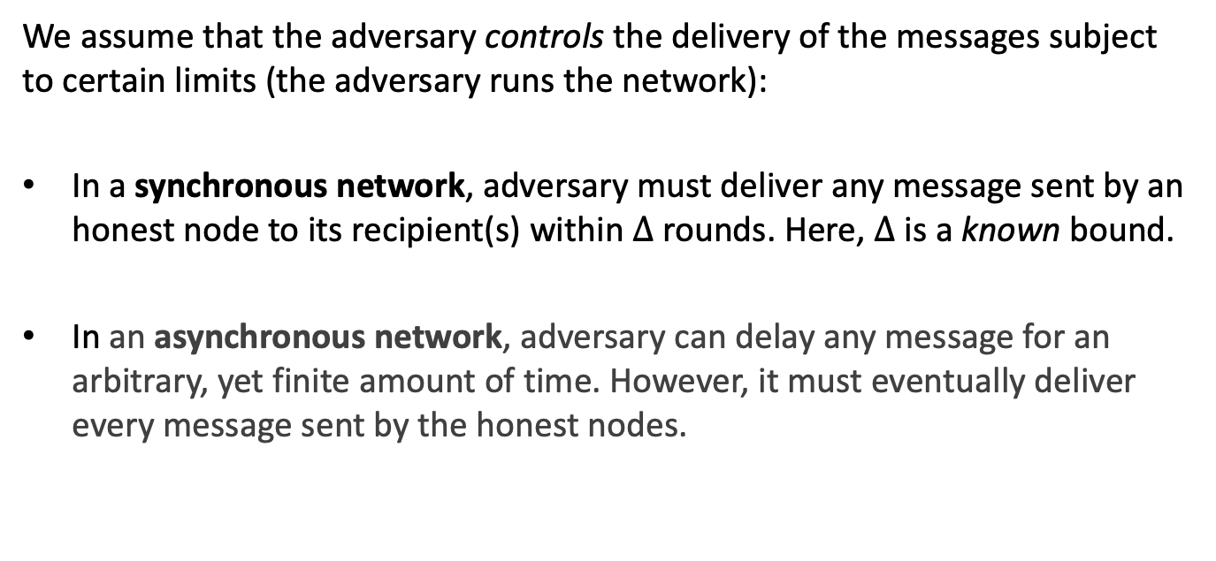
Communication
We assume that the adversary controls the delivery of the messages subject to certain limits (the adversary runs the network):
In a synchronous network, adversary must deliver any message sent by an honest node to its recipient(s) within $∆$ rounds. Here, $∆$ is a known bound.
In an asynchronous network, adversary can delay any message for an arbitrary, yet finite amount of time. However, it must eventually deliver every message sent by the honest nodes.

Slide 11
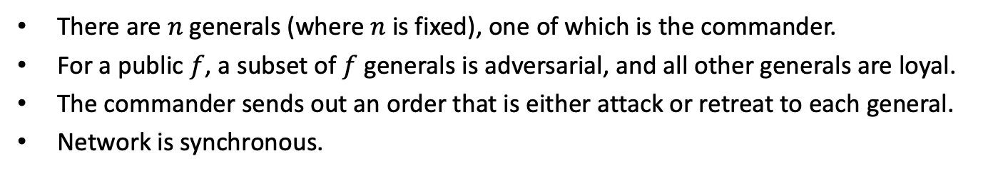
Byzantine Generals Problem
There are $n$ generals (where $n$ is fixed), one of which is the commander.
For a public $f$, a subset of $f$ generals is adversarial, and all other generals are loyal.
The commander sends out an order that is either attack or retreat to each general.
Network is synchronous.
Byzantine Generals Problem:
Agreement: No two loyal generals take different actions.
Validity: If the commander is loyal, then all loyal generals must take the action suggested by the commander.
Termination: All loyal generals must eventually take some action.
Notes:
Motivate Byzantine Broadcast by giving the example of a single transaction, Alice paying Bob $5. Does everyone agree on this, even when the leader is adversarial?

Slide 12
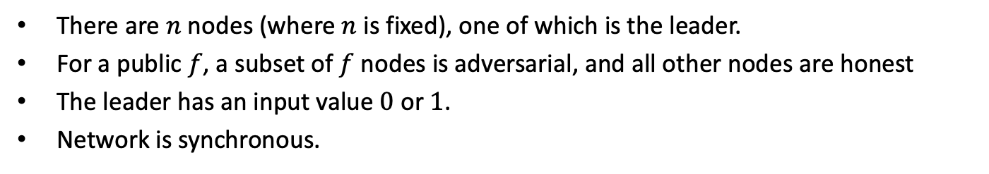
Byzantine Broadcast (BB)
There are $n$ nodes (where $n$ is fixed), one of which is the leader.
For a public $f$, a subset of $f$ nodes is adversarial, and all other nodes are honest
The leader has an input value $0$ or $1$.
Network is synchronous.
Byzantine Broadcast Problem:
Agreement: No two honest nodes output different values.
Validity: Leader is honest ⇒ All honest nodes output the value input to the leader.
Termination: All honest nodes eventually output some value.
Notes:
Motivate Byzantine Broadcast by giving the example of a single transaction, Alice paying Bob $5. Does everyone agree on this, even when the leader is adversarial?

Slide 13
Byzantine Broadcast (BB)
There are $n$ nodes (where $n$ is fixed), one of which is the leader.
For a public $f$, a subset of $f$ nodes is adversarial, and all other nodes are honest
The leader has an input value $0$ or $1$.
Network is synchronous.
Byzantine Broadcast Problem:
Agreement: No two honest nodes output different values.
Validity: Leader is honest ⇒ All honest nodes output the value input to the leader.
Termination: All honest nodes eventually output some value.
even when the leader is adversarial!!
Notes:
Motivate Byzantine Broadcast by giving the example of a single transaction, Alice paying Bob $5. Does everyone agree on this, even when the leader is adversarial?

Slide 14
Byzantine Broadcast (BB)
There are $n$ nodes (where $n$ is fixed), one of which is the leader.
For a public $f$, a subset of $f$ nodes is adversarial, and all other nodes are honest
The leader has an input value $0$ or $1$.
Network is synchronous.
No double spend
Byzantine Broadcast Problem:
Agreement: No two honest nodes output different values.
Validity: Leader is honest ⇒ All honest nodes output the value input to the leader.
Termination: All honest nodes eventually output some value.
even when the leader is adversarial!!
No censorship
Notes:
Motivate Byzantine Broadcast by giving the example of a single transaction, Alice paying Bob $5. Does everyone agree on this, even when the leader is adversarial?

Slide 15





Protocol for BB: Setup
Denote the nodes by the indices $i=0, 1, 2,…, n$.
Node 0 is the leader. Let $v$ denote its value.
Let $V_{i}$ denote the set of values received by node $i$.
Time moves in lock-step.
Let $<v^{′}:i>$ denote the value $v′$ signed by node $i$.
Let $<v^{′}:i,j,…,l,k>$ denote a signature chain signed by $i,j,…,k$:
  Recursive definition: $<v^{′}:i,j,…,l,k> =< <v^{′}:i,j,…,l> : k>$
$$<v^{′}:0>$$
$$<v^{′}:0,1>$$
$$<v^{′}:0,1,2>$$

Slide 16
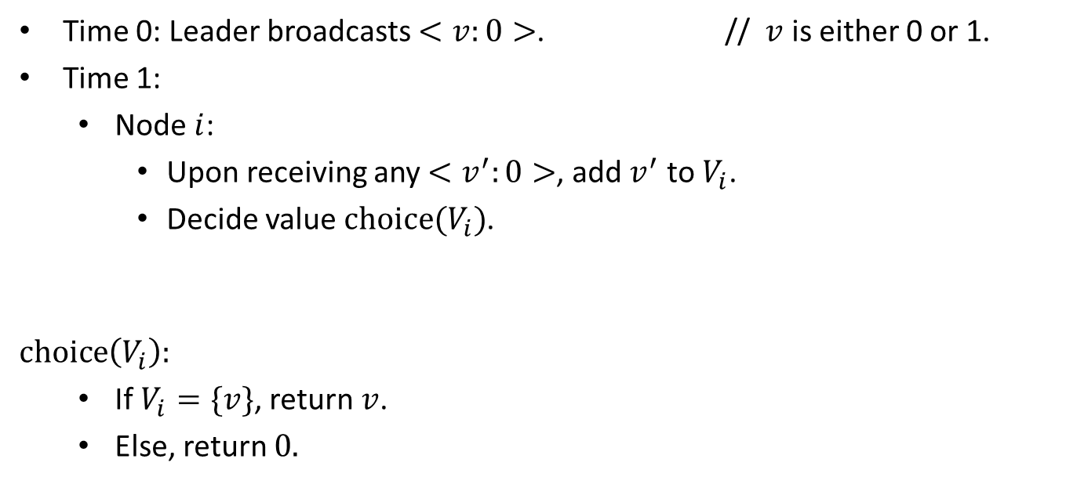
Strawman Protocol I
Time 0: Leader broadcasts $<v:0>$. // $v$ is either 0 or 1.
Time 1:
  Node $i$:
    Upon receiving any $<v^{′}:0>$, add $v^{′}$ to $V_{i}$.
    Decide value $choice(V_{i})$.
$$choice\left(V_{i}\right):$$
  If $V_{i}=\{v\}$, return $v$.
  Else, return $0.$
(the broadcast value)

Slide 17




Strawman Protocol I
0: honest
Input value is 1.
1
1
1: honest
2: honest
$V_{1}$= {}
$V_{2}$= {}
Time 0

Slide 18


Strawman Protocol I
0: honest
Input value is 1.
1
1
1: honest
2: honest
$V_{1}$= {1}
$V_{2}$= {1}
Time 1
1
1
Validity is satisfied!

Slide 19
Strawman Protocol I
Problem: what if the leader is adversarial?
0: adversarial
1
0
1: honest
2: honest
$V_{1}$= {}
$V_{2}$= {}
Time 0

Slide 20

Strawman Protocol I
Problem: what if the leader is adversarial?
0: adversarial
1
0
1: honest
2: honest
$V_{1}$= {1}
$V_{2}$= {0}
Time 1
1
0
Agreement is violated!

Slide 21
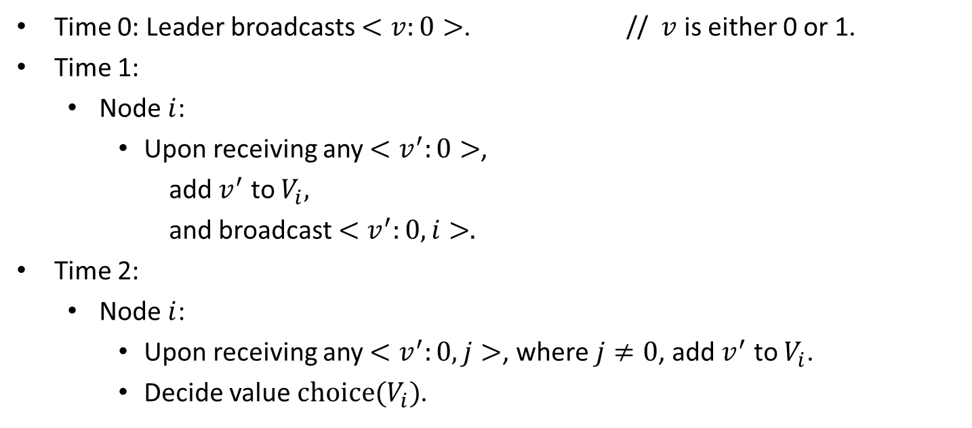
Strawman Protocol II
Time 0: Leader broadcasts $<v:0>$. // $v$ is either 0 or 1.
Time 1:
  Node $i$:
    Upon receiving any $<v^{′}:0>$,
      add $v^{′}$ to $V_{i},$
      and broadcast $<v^{′}:0,i>.$
Time 2:
  Node $i$:
    Upon receiving any $<v^{′}:0,j>$, where $j≠0$, add $v^{′}$ to $V_{i}$.
    Decide value $choice(V_{i})$.
(the broadcast value)

Slide 22


Strawman Protocol II
0: adversarial
1
0
1: honest
2: honest
$V_{1}$= {}
$V_{2}$= {}
Time 0

Slide 23


Strawman Protocol II
0: adversarial
1
0
1: honest
0
1
2: honest
$V_{1}$= {1}
$V_{2}$= {0}
Time 1

Slide 24


Strawman Protocol II
0: adversarial
1
0
1: honest
0
1
2: honest
$V_{1}$= {0,1}
$V_{2}$= {0,1}
Time 2
0
0
Agreement is satisfied!

Slide 25


Strawman Protocol II
Problem: what if one of the nodes is adversarial?
0: honest
Input value is 1.
$$<1:0>$$
$$<1:0>$$
1: honest
2: adversarial
$V_{1}$= {}
Time 0

Slide 26


Strawman Protocol II
Problem: what if one of the nodes is adversarial?
0: honest
Input value is 1.
$$<1:0>$$
$$<1:0>$$
$$<0:2,2>$$
1: honest
2: adversarial
$$<1:0,1>$$
$V_{1}$= {1}
Time 1

Slide 27
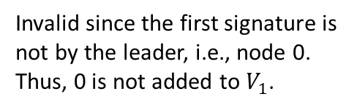

Strawman Protocol II
Problem: what if one of the nodes is adversarial?
0: honest
Input value is 1.
$$<1:0>$$
$$<1:0>$$
$$<0:2,2>$$
1: honest
2: adversarial
$$<1:0,1>$$
$V_{1}$= {1}
Time 1
Invalid since the first signature is not by the leader, i.e., node 0.
Thus, 0 is not added to $V_{1}$.

Slide 28

Strawman Protocol II
Problem: what if one of the nodes is adversarial?
0: honest
Input value is 1.
$$<1:0>$$
$$<1:0>$$
$$<0:2,2>$$
1: honest
2: adversarial
$$<1:0,1>$$
$V_{1}$= {1}
Time 2
1
Validity is satisfied as well!
So are agreement and termination!

Slide 29
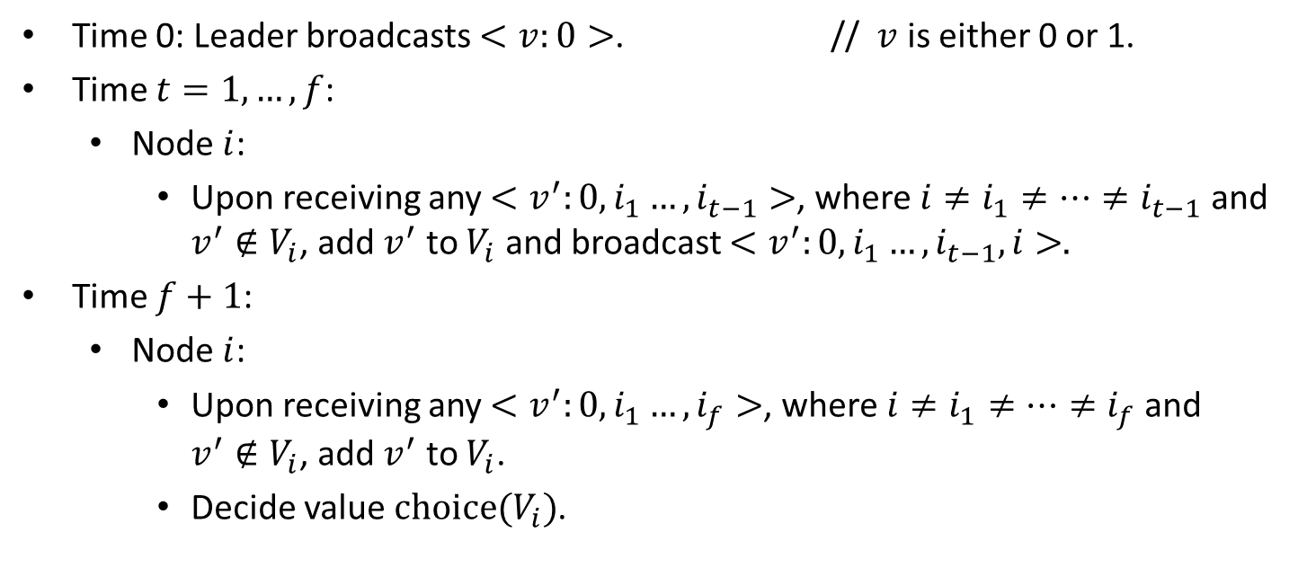
Dolev-Strong (1983)
Time 0: Leader broadcasts $<v:0>$. // $v$ is either 0 or 1.
Time $t=1,…,f$:
  Node $i$:
    Upon receiving any $<v^{′}:0,i_{1}…,i_{t−1}>$, where $i≠i_{1}≠…≠i_{t−1}$ and $v^{′}∉V_{i}$, add $v^{′}$ to $V_{i}$ and broadcast $<v^{′}:0,i_{1}…,i_{t−1},i>.$
Time $f+1$:
  Node $i$:
    Upon receiving any $<v^{′}:0,i_{1}…,i_{f}>$, where $i≠i_{1}≠…≠i_{f}$ and $v^{′}∉V_{i}$, add $v^{′}$ to $V_{i}$.
    Decide value $choice(V_{i})$.
(the broadcast value)
Authenticated Algorithms for Byzantine Agreement (1983)

Slide 30

Security of Dolev-Strong (1983)
Theorem (Dolev-Strong, 1983): For any $f<n$, Dolev-Strong (1983) with $n$ nodes and $f+1$ rounds satisfies agreement, validity and termination in a synchronous network.
Converse Theorem: Any (deterministic) protocol that satisfies agreement, validity and termination for $n$ nodes in a synchronous network with resilience up to $f$ crash (as well as Byzantine) faults must have an execution with at least $f+1$ rounds.
(try to prove yourself … the proof is in the slides at the end of the deck)
Authenticated Algorithms for Byzantine Agreement (1983)
Distributed Algorithms (1996)
A Simple Bivalency Proof that t-Resilient Consensus Requires t + 1 Rounds (1998)

Slide 31








State Machine Replication (SMR)
A Centralized Bank
Blockchain (State Machine Replication)
$${tx}_{i}$$
$$y_{i}$$
$${st}_{i−1}$$
$${st}_{i}$$
Log (Ledger): an ever-growing, linearly-ordered sequence of transactions.
$${tx}_{2}{tx}_{1}{tx}_{4}…$$
$${tx}_{2}{tx}_{1}{tx}_{4}…$$
$${tx}_{2}{tx}_{1}{tx}_{4}…$$
$${tx}_{2}{tx}_{1}{tx}_{4}…$$

Slide 32

















State Machine Replication (SMR)
Two parties of SMR:
Replicas receive transactions, execute the SMR protocol and determine the log.
Clients are the learners: They communicate with the replicas to learn the log.
Goal of SMR is to ensure that the clients learn the same log.
$${tx}_{1}$$
$${tx}_{3}$$
$${tx}_{2}$$
$${tx}_{4}$$
$$R_{a}$$
$$R_{c}$$
$$R_{b}$$
$$R_{d}$$
$$R_{e}$$
$$R_{f}$$
Replicas
(miners)
Execute the SMR protocol
$${tx}_{2}{tx}_{1}{tx}_{4}…$$
$${tx}_{2}{tx}_{1}{tx}_{4}…$$
$${tx}_{2}{tx}_{1}{tx}_{4}…$$
$${tx}_{2}{tx}_{1}{tx}_{4}…$$
$${tx}_{1}{tx}_{2}{tx}_{3}…$$
$${tx}_{2}{tx}_{1}{tx}_{4}…$$

Slide 33


























State Machine Replication (SMR)
$${tx}_{1}$$
$${tx}_{3}$$
$${tx}_{2}$$
$${tx}_{4}$$
Wallet asking for the log + response
$$R_{a}$$
$$R_{c}$$
$$R_{b}$$
$$R_{d}$$
$$R_{e}$$
$$R_{f}$$
Replicas
(miners)
Execute the SMR protocol
$${tx}_{2}{tx}_{1}{tx}_{4}…$$
$${tx}_{2}{tx}_{1}{tx}_{4}…$$
$${tx}_{2}{tx}_{1}{tx}_{4}…$$
$${tx}_{2}{tx}_{1}{tx}_{4}…$$
$${tx}_{1}{tx}_{2}{tx}_{3}…$$
$${tx}_{2}{tx}_{1}{tx}_{4}…$$
$$C_{1}$$
$$C_{2}$$
Wallets are an example of a client.
Wallets ask the replicas what the correct log is.
Wallets do not execute the SMR protocol and do not talk to each other.
$${LOG}_{t}^{1}={tx}_{2}{tx}_{1}{tx}_{4}…$$
$${LOG}_{t}^{2}={tx}_{2}{tx}_{1}{tx}_{4}…$$
Clients (Wallets)
Clients (Wallets)
$$C_{3}$$
$$C_{4}$$
$${LOG}_{t}^{3}={tx}_{2}{tx}_{1}{tx}_{4}…$$
$${LOG}_{t}^{4}={tx}_{2}{tx}_{1}{tx}_{4}…$$

Slide 34










State Machine Replication (SMR)
$${tx}_{1}$$
$${tx}_{3}$$
$${tx}_{2}$$
$${tx}_{4}$$
Wallet asking for the log + response
$$R_{a}$$
$$R_{c}$$
$$R_{b}$$
$$R_{d}$$
$$R_{e}$$
$$R_{f}$$
Replicas
Execute the SMR protocol
$${tx}_{2}{tx}_{1}{tx}_{4}…$$
$${tx}_{2}{tx}_{1}{tx}_{4}…$$
$${tx}_{2}{tx}_{1}{tx}_{4}…$$
$${tx}_{2}{tx}_{1}{tx}_{4}…$$
$${tx}_{1}{tx}_{2}{tx}_{3}…$$
$${tx}_{2}{tx}_{1}{tx}_{4}…$$
$$C_{1}$$
How does a wallet learn the correct log from the replicas?
It asks the replicas what the correct log is.
Wallet then accepts the answer given by majority of the replicas as its log.
Wallet learns the correct log if over half of the replicas are honest!
$$C_{2}$$
$${LOG}_{t}^{1}={tx}_{2}{tx}_{1}{tx}_{4}…$$
$${LOG}_{t}^{2}={tx}_{2}{tx}_{1}{tx}_{4}…$$
Clients (Wallets)
Clients (Wallets)
$$C_{3}$$
$$C_{4}$$
$${LOG}_{t}^{3}={tx}_{2}{tx}_{1}{tx}_{4}…$$
$${LOG}_{t}^{4}={tx}_{2}{tx}_{1}{tx}_{4}…$$

Slide 35
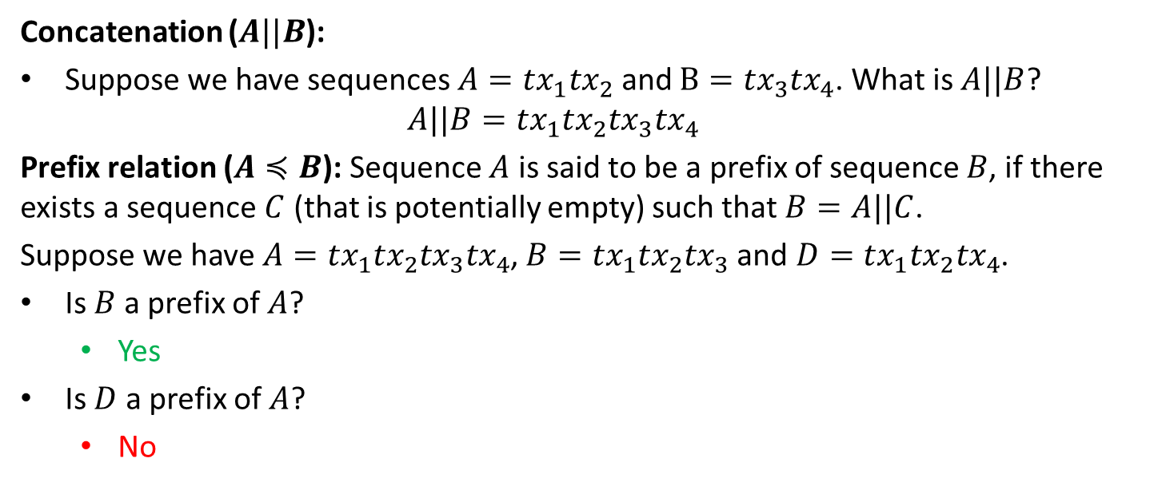
Security for SMR: Definitions
Concatenation ($A||B$):
Suppose we have sequences $A={tx}_{1}{tx}_{2}$ and $B={tx}_{3}{tx}_{4}$. What is $A||B$?
  $$A||B={tx}_{1}{tx}_{2}{tx}_{3}{tx}_{4}$$
Prefix relation ($A≼B$): Sequence $A$ is said to be a prefix of sequence $B$, if there exists a sequence $C$ (that is potentially empty) such that $B=A||C$.
Suppose we have $A={tx}_{1}{tx}_{2}{tx}_{3}{tx}_{4}$, $B={tx}_{1}{tx}_{2}{tx}_{3}$and $D={tx}_{1}{tx}_{2}{tx}_{4}$.
Is $B$ a prefix of $A$?
  Yes
Is $D$ a prefix of $A$?
  No

Slide 36
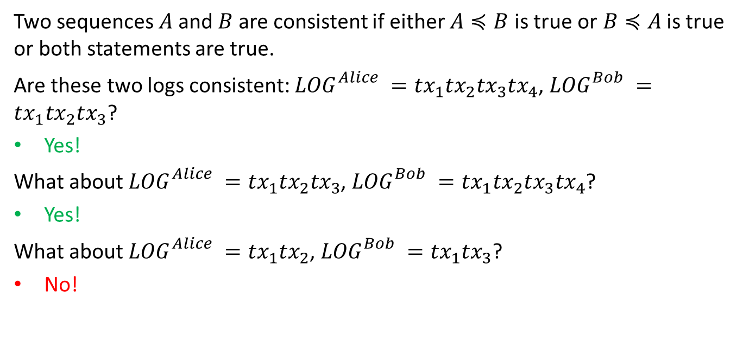
Security for SMR: Definitions
Two sequences $A$and $B$ are consistent if either $A≼B$ is true or$B≼A$ is true or both statements are true.
Are these two logs consistent: ${LOG}_{}^{Alice} ={tx}_{1}{tx}_{2}{tx}_{3}{tx}_{4}$, ${LOG}_{}^{Bob} ={tx}_{1}{tx}_{2}{tx}_{3}$?
Yes!
What about ${LOG}_{}^{Alice} ={tx}_{1}{tx}_{2}{tx}_{3}$, ${LOG}_{}^{Bob} ={tx}_{1}{tx}_{2}{tx}_{3}{tx}_{4}$?
Yes!
What about ${LOG}_{}^{Alice} ={tx}_{1}{tx}_{2}$, ${LOG}_{}^{Bob} ={tx}_{1}{tx}_{3}$?
No!

Slide 37

Security for SMR
Let ${LOG}_{t}^{i}$ denote the log outputted by a client $i$ at time $t$.
Then, a secure SMR protocol satisfies the following guarantees:
Safety (Consistency):
  For any two clients $i$ and $j$, and times $t$ and $s$: either ${LOG}_{t}^{i}≼{LOG}_{s}^{j}$ is true or ${LOG}_{s}^{j}≼{LOG}_{t}^{i}$ is true or both (Logs are consistent).
Liveness:
  If a transaction $tx$ is input to an honest replica at some time $t$, then for all clients $i$, and times $s≥t+T_{conf}$: $tx∈{LOG}_{s}^{i}$.
Similar to agreement!
Similar to validity and termination!

Slide 38
Security for SMR
Let ${LOG}_{t}^{i}$ denote the log outputted by a client $i$ at time $t$.
Then, a secure SMR protocol satisfies the following guarantees:
Safety (Consistency):
  For any two clients $i$ and $j$, and times $t$ and $s$: either ${LOG}_{t}^{i}≼{LOG}_{s}^{j}$ is true or ${LOG}_{s}^{j}≼{LOG}_{t}^{i}$ is true or both (Logs are consistent).
Liveness:
  If a transaction $tx$ is input to an honest replica at some time $t$, then for all clients $i$, and times $s≥t+T_{conf}$: $tx∈{LOG}_{s}^{i}$.
Similar to agreement!
No double spend
Similar to validity and termination!
No censorship

Slide 39




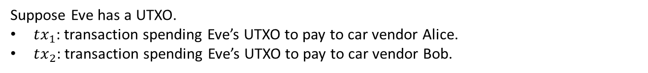
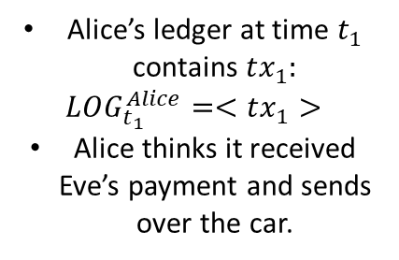
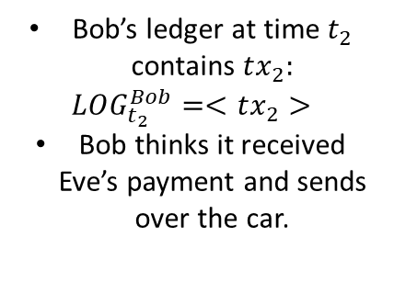



Why is safety important?
Eve
Suppose Eve has a UTXO.
$tx_{1}$: transaction spending Eve’s UTXO to pay to car vendor Alice.
$tx_{2}$: transaction spending Eve’s UTXO to pay to car vendor Bob.
$$UTXO_{Eve}$$
$$t_{0}=0$$
$$t_{1}$$
$$t_{2}$$
spent to pay Alice
spent to pay Bob
Alice’s ledger at time $t_{1}$ contains $tx_{1}:$
$$LOG_{t_{1}}^{Alice}=<tx_{1}>$$
Alice thinks it received Eve’s payment and sends over the car.
Bob’s ledger at time $t_{2}$ contains $tx_{2}:$
$$LOG_{t_{2}}^{Bob}=<tx_{2}>$$
Bob thinks it received Eve’s payment and sends over the car.
Alice
Bob

Slide 40
Why is safety important?
Eve
Suppose Eve has a UTXO.
$tx_{1}$: transaction spending Eve’s UTXO to pay to car vendor Alice.
$tx_{2}$: transaction spending Eve’s UTXO to pay to car vendor Bob.
$$UTXO_{Eve}$$
$$t_{0}=0$$
$$t_{1}$$
safety violation
$$t_{2}$$
spent to pay Alice
spent to pay Bob
Alice’s ledger at time $t_{1}$ contains $tx_{1}:$
$$LOG_{t_{1}}^{Alice}=<tx_{1}>$$
Alice thinks it received Eve’s payment and sends over the car.
Bob’s ledger at time $t_{2}$ contains $tx_{2}:$
$$LOG_{t_{2}}^{Bob}=<tx_{2}>$$
Bob thinks it received Eve’s payment and sends over the car.
Alice
Bob
When safety is violated, Eve can double-spend!

Slide 41
SMR vs. Byzantine Broadcast
Single shot vs. Multi-shot
  Broadcast is single shot consensus. Each node outputs a single value.
  State Machine Replication is multi-shot. Each client continuously outputs a log, which is a sequence of transactions (values).
Who are the learners?
  In Broadcast, the nodes executing the protocol are the same as the nodes that output decision values.
  In State Machine Replication, protocol is executed by the replicas, whereas the goal is for the clients to learn the log.
    Replicas must ensure that the clients learn the same log.

Slide 42
Building an SMR protocol
Next lecture …

Slide 43
END OF LECTURE
Next lecture: Consensus in the Internet Setting
Notes:
Add last slide on comparison to HotStuff

Slide 44
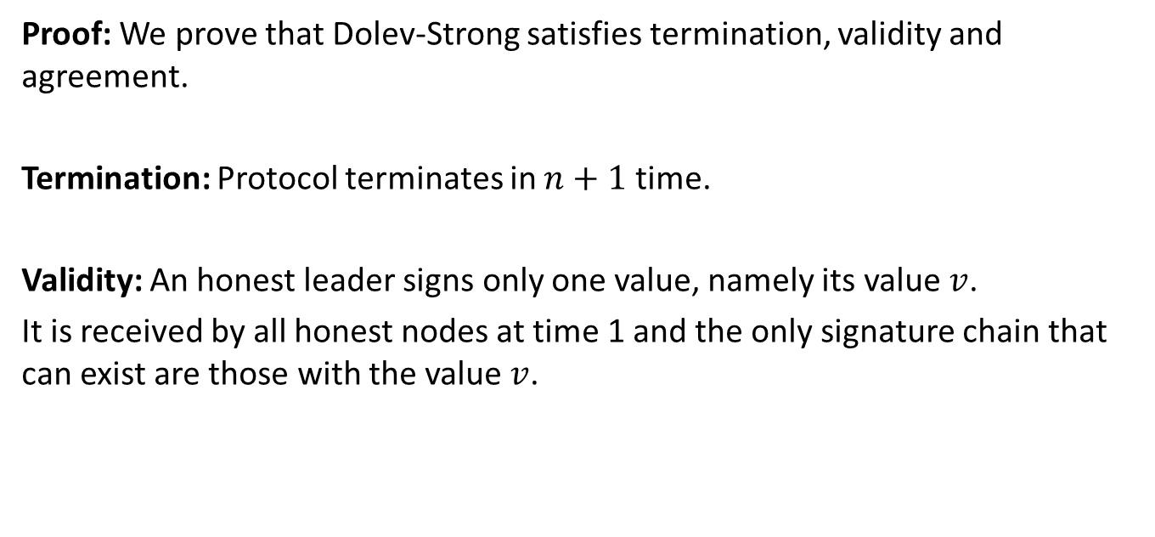
Security Proof for Dolev-Strong (1983)
Proof: We prove that Dolev-Strong satisfies termination, validity and agreement.
Termination: Protocol terminates in $n+1$ time.
Validity: An honest leader signs only one value, namely its value $v$.
It is received by all honest nodes at time 1 and the only signature chain that can exist are those with the value $v$.

Slide 45
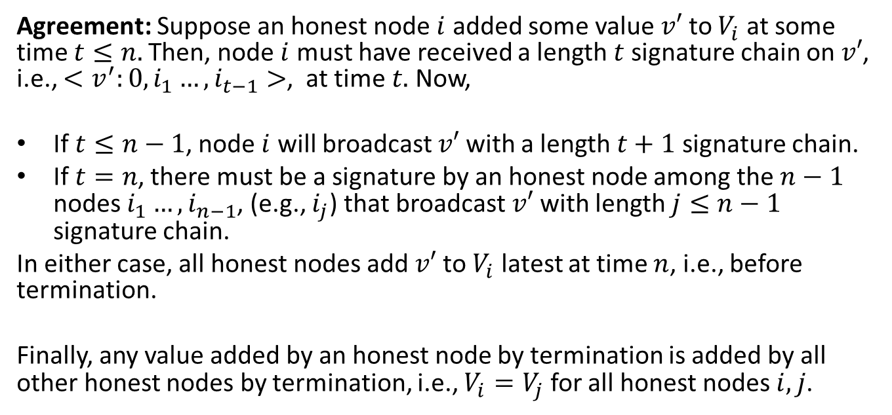
Security Proof for Dolev-Strong (1983)
Agreement: Suppose an honest node $i$ added some value $v′$ to $V_{i}$ at some time $t≤n.$Then, node $i$ must have received a length $t$ signature chain on $v′$, i.e., $<v^{′}:0,i_{1}…,i_{t−1}>$, at time $t.$ Now,
If $t≤n−1$, node $i$ will broadcast $v′$ with a length $t+1$ signature chain.
If $t=n$, there must be a signature by an honest node among the $n−1$ nodes $i_{1}…,i_{n−1}$, (e.g., $i_{j}$) that broadcast $v′$ with length $j≤n−1$ signature chain.
In either case, all honest nodes add $v′$ to $V_{i}$ latest at time $n$, i.e., before termination.
Finally, any value added by an honest node by termination is added by all other honest nodes by termination, i.e., $V_{i}=V_{j}$ for all honest nodes $i,j$.

