Slide 1
Bitcoin Scripts and Wallets
CS251 Fall 2023
(cs251.stanford.edu)
Dan Boneh
Note: HW#1 is posted on the course web site. Due Tue, Oct. 10.

Slide 2
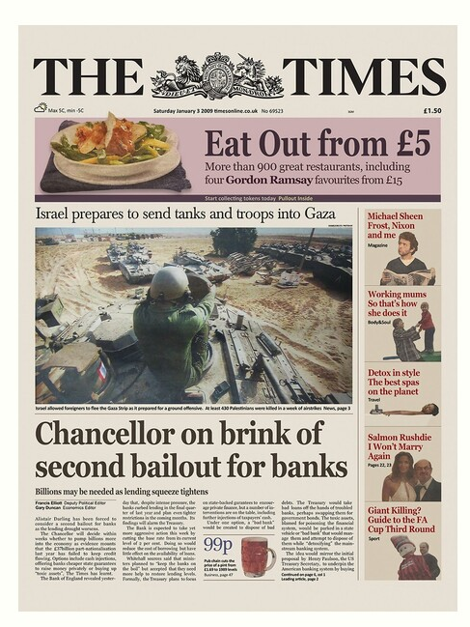
Recap: the Bitcoin blockchain
genesis
block
BH₃
BH₁
BH₂
version (4 bytes)
prev (32 bytes)
time (4 bytes)
bits (4 bytes)
nonce (4 bytes)
Tx root (32 bytes)
prev
Tx root
prev
Tx root
H
H
H
…
80 bytes
coinbase Tx
coinbase Tx
Notes:
Every block header contains the hash of the previous block header.

Slide 3
Tx sequence
View the blockchain as a sequence of Tx (append-only)
…
coinbase Tx
Tx cannot be erased: mistaken Tx ⇒ locked or lost of funds
Notes:
Unlike a canceled check: no such thing as canceling a Tx.

Slide 4
Tx structure (non-coinbase)
input[0]
input[1]
input[2]
output[0]
output[1]
witnesses
(part of input)
locktime
TxID
out-index
ScriptSig
seq
32 byte hash
input:
inputs
4 byte index
program
TxID = H(Tx)
ignore
outputs
(excluding witnesses)
output:
value
ScriptPK
8 bytes
(segwit)
program
(4 bytes)
#BTC = value/10⁸
earliest block # that can include Tx
Notes:
10⁻⁸ BTC = 1 Satoshi ~ 0.01 cent
TxID are unique – two Tx cannot have the same TxID, because inputs are unique. The only exception is the coinbase Tx, which has no inputs, so that two coinbase Tx can have the same TxID. To solve that, every coinbase Tx includes the block height in its ScriptPk (BIP 34).

Slide 5
Example
null locktime
Tx1:
input
2
ScriptPK
5
ScriptPK
0
(funding Tx)
value
value
UTXO₁
UTXO₂
UTXO: unspent Tx output
Tx2:
TxID
1
ScriptSig
output
output
0
(spending Tx)
identifies
a UTXO
UTXO₃
UTXO₄
Notes:
ScriptPK specifies who or how can spend.

Slide 6
Example
☓
null locktime
Tx1:
input
2
ScriptPK
5
ScriptPK
0
(funding Tx)
UTXO₁
UTXO₂
UTXO: unspent Tx output
Tx2:
TxID
1
ScriptSig
output
output
0
(spending Tx)
identifies
a UTXO
UTXO₃
UTXO₄

Slide 7
Validating Tx2
program from funding Tx:
under what conditions
can UTXO be spent
Miners check (for each input):
The program ScriptSig | ScriptPK returns true
TxID | index is in the current UTXO set
sum input values ≥ sum output values
After Tx2 is posted, miners remove UTXO₂ from UTXO set
program from spending Tx:
proof that conditions
are met
Notes:
Spent UTXOs can be forgotten. They are no longer needed for block validation.

Slide 8
Transaction types: (1) P2PKH
pay to public key hash
Alice want to pay Bob 5 BTC:
step 1: Bob generates sig key pair (pk_{B}, sk_{B}) ⇽ Gen()
step 2: Bob computes his Bitcoin address as addr_{B} ⇽ H(pk_{B})
step 3: Bob sends addr_{B} to Alice
step 4: Alice posts Tx:
UTXO_{B} for Bob
UTXO_{A} for Alice (change)
Point to Alice’s UTXO
input
7 BTC
5
ScriptPK_{B}
2
ScriptPK_{A}
0
ScriptPK_{B}:
DUP HASH256 <addr_{B}> EQVERIFY CHECKSIG

Slide 9
Transaction types: (1) P2PKH
pay to public key hash
“input” contains ScriptSig that authorizes spending Alice’s UTXO
example: ScriptSig contains Alice’s signature on Tx
⟹ miners cannot change ScriptPK_{B} (will invalidate Alice’s signature)
UTXO_{B} for Bob
UTXO_{A} for Alice (change)
Point to Alice’s UTXO
input
7 BTC
5
ScriptPK_{B}
2
ScriptPK_{A}
0
ScriptPK_{B}:
DUP HASH256 <addr_{B}> EQVERIFY CHECKSIG

Slide 10
Transaction types: (1) P2PKH
Later, when Bob wants to spend his UTXO: create a Tx_{spend}
Tx_{spend}:
TxID
0
ScriptSig_{B}
output
output
0
points to
UTXO_{B}
<sig> <pk_{B}>
(authorizes spending UTXO_{B})
<sig> = Sign(sk_{B}, Tx) where Tx = (Tx_{spend} excluding all ScriptSigs) (SIGHASH_ALL)
Miners validate that ScriptSig_{B} | ScriptPK_{B} returns true
Notes:
<sig> ensures that miners cannot change the Tx outputs.

Slide 11
P2PKH: comments
Alice specifies recipient’s pk in UTXO_{B}
Recipient’s pk is not revealed until UTXO is spent
(some security against attacks on pk)
Miner cannot change <Addr_{B}> and steal funds:
invalidates Alice’s signature that created UTXO_{B}

Slide 12
Segregated Witness
ECDSA malleability:
Given (m, sig) anyone can create (m, sig’) with sig ≠ sig’
⇒ miner can change sig in Tx and change TxID = SHA256(Tx)
⇒ Tx issuer cannot tell what TxID is, until Tx is posted
⇒ leads to problems and attacks
Segregated witness: signature is moved to witness field in Tx
TxID = Hash(Tx without witnesses)
Notes:
Mt. Gox attack

Slide 13
Transaction types: (2) P2SH: pay to script hash
(pre SegWit in 2017)
Payer specifies a redeem script (instead of just pkhash)
Usage: (1) Bob publishes hash(redeem script) ⟵ Bitcoint addr.
(2) Alice sends funds to that address in funding Tx
(3) Bob can spend UTXO if he can satisfy the script
ScriptPK in UTXO: HASH160 <H(redeem script)> EQUAL
ScriptSig to spend: <sig₁> <sig₂> … <sig_{n}> <redeem script>
payer can specify complex conditions for when UTXO can be spent

Slide 14
P2SH
Miner verifies:
<ScriptSig> ScriptPK = true ⟵ spending Tx gave correct script
(2) ScriptSig = true ⟵ script is satisfied

Slide 15
Example P2SH: multisig
Goal: spending a UTXO requires t-out-of-n signatures
Redeem script for 2-out-of-3: (chosen by payer)
<2> <PK₁> <PK₂> <PK₃> <3> CHECKMULTISIG
threshold
hash gives P2SH address
ScriptSig to spend: (by payee) <0> <sig1> <sig3> <redeem script>
(in the clear)
Notes:
Note: redeem script becomes public when spending Tx. Several tricks make it possible to keep redeem script secret, unless there is a dispute (Taproot)

Slide 16
Abstractly …
Multisig address: addr = H(PK₁, PK₂, PK₃, 2-of-3)
Tx1:
input
5
addr
2
ScriptPK_{A}
0
(funding Tx)
7 BTC
UTXO_{B} for Bob
UTXO_{A} for Alice (change)
Tx2:
input: UTXO, sig₁, sig₃, PK₁, PK₂, PK₃, 2-of-3
output
0
(spending Tx)

Slide 17
Example Bitcoin scripts

Slide 18
Protecting assets with a co-signatory
Alice stores her funds in UTXOs for addr = 2-of-2(PK_{A}, PK_{S})
PK_{A}
spending Tx
PK_{S}
Alice
custody
server
is this Alice
SK_{A}
yep, it’s me
SK_{S}
post Tx with <sig_{A}> <sig_{S}>
<sig_{S}> on Tx
⇒ theft of Alice’s SK_{A} does not compromise BTC
Notes:
Alice’s authentication: out of band (cell phone, pwd, etc.)

Slide 19

Escrow service
Alice wants to buy a backpack for 0.1₿ from merchant Bob
Goal: Alice only pays after backpack arrives, but can’t not pay
addr = 2-of-3(PK_{A}, PK_{B}, PK_{J})
post
payment
of 0.11₿
to addr
(creates
UTXO_{A})
want backpack for 0.1₿
Alice
Bob
Judge
once see Tx on chain
mail backpack
PK_{A}
PK_{B}
PK_{J}
backpack arrives
send <sig_{A}> on Tx:
UTXO_{A}⇾ (PK_{B}:0.1, PK_{A}:0.01)
redeem using
<sig_{A}> <sig_{B}>
on Tx
Notes:
redeem: 2-of-3 is satisfied. 0.01B acts as a deposit that makes Alice send the final signature to Bob.

Slide 20
Escrow service: a dispute
Backpack never arrives: (Bob at fault)
Alice gets her funds back with help of Judge and a Tx:
Tx: ( UTXO_{A} ⇾ PK_{A} , sig_{A}, sig_{Judge} ) [2-out-of-3]
Alice never sends sig_{A}: (Alice at fault)
Bob gets paid with help of Judge and a Tx:
Tx: ( UTXO_{A} ⇾ PK_{B} , sig_{B}, sig_{Judge} ) [2-out-of-3]
(3) Both are at fault: Judge publishes <sig_{Judge}> on Tx:
Tx: ( UTXO_{A} ⇾ PK_{A}: 0.05, PK_{B}: 0.05, PK_{J}: 0.01 )
Now either Alice or Bob can execute this Tx.

Slide 21
Cross Chain Atomic Swap
Alice has 5 BTC, Bob has 2 LTC (LiteCoin). They want to swap.
Want a sequence of Tx on the Bitcoin and Litecoin chains s.t.:
either success: Alice has 2 LTC and Bob has 5 BTX,
or failure: no funds move.
Swap cannot get stuck halfway.
Goal: design a sequence of Tx to do this.
solution: programming proj #1 ex 4.

Slide 22
Managing crypto assets: Wallets

Slide 23
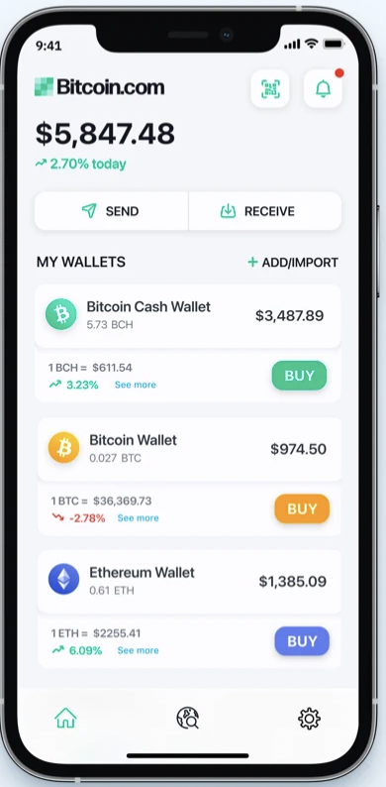
Managing secret keys
Users can have many PK/SK:
one per Bitcoin address, Ethereum address, …
Wallets:
Generates PK/SK, and stores SK,
Post and verify Tx,
Show balances
Notes:
How much Bitcoin do I own?

Slide 24
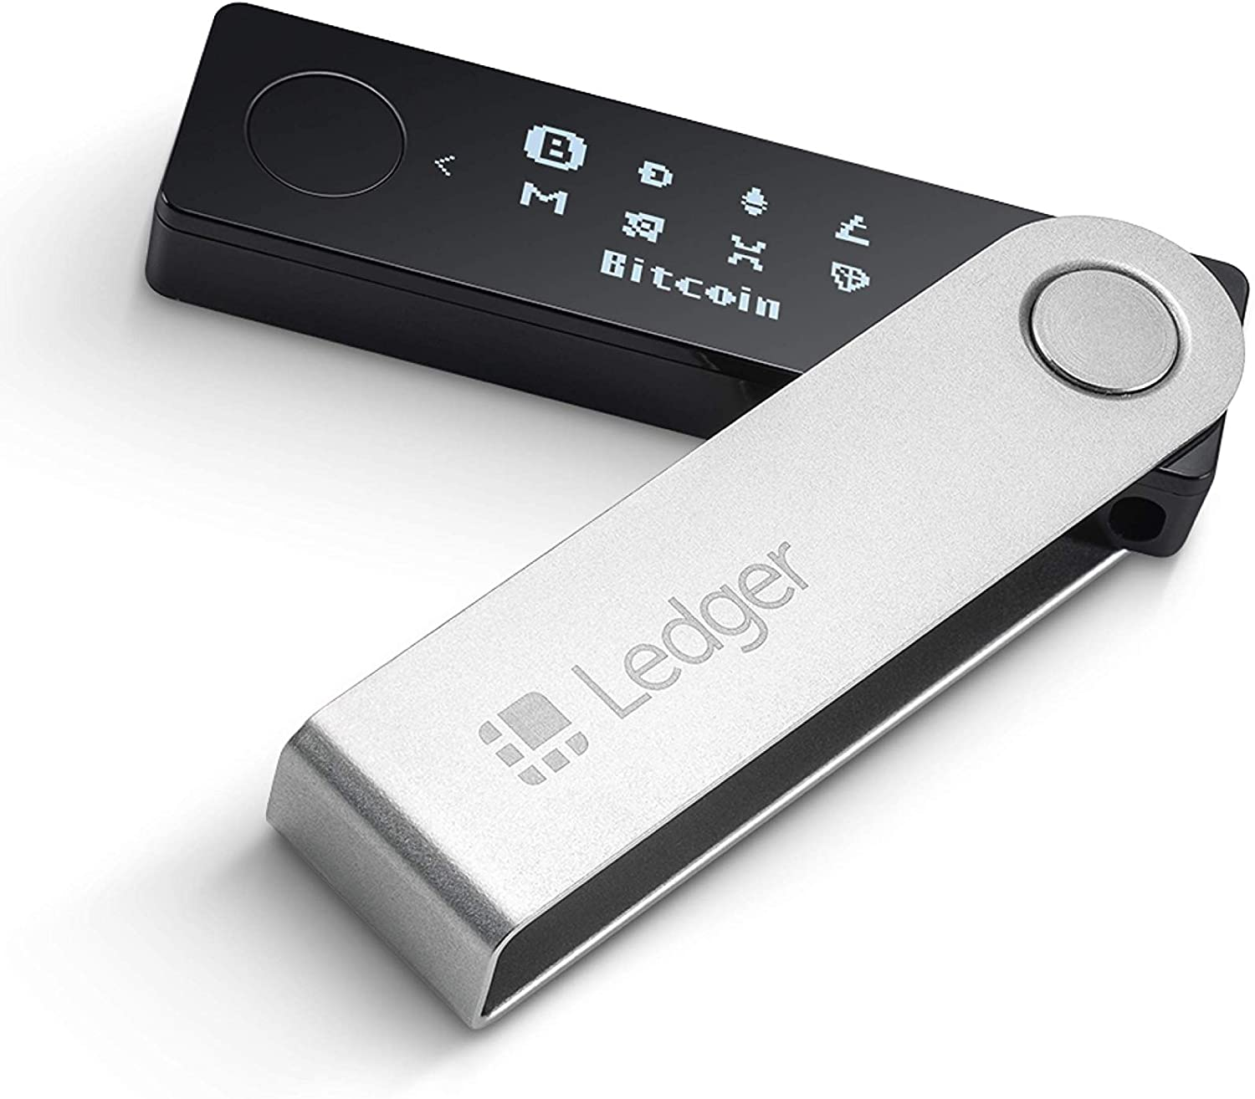
Managing lots of secret keys
Types of wallets:
cloud (e.g., Coinbase): cloud holds secret keys … like a bank.
laptop/phone: Electrum, MetaMask, …
hardware: Trezor, Ledger, Keystone, …
paper: print all sk on paper
brain: memorize sk (bad idea)
Hybrid: non-custodial cloud wallet (using threshold signatures)
client stores
secret keys
Not your keys, not your coins …
but lose key ⇒ lose funds
Notes:
Threshold signatures in section.

Slide 25
Simplified Payment Verification (SPV)
How does a client wallet display Alice’s current balances?
Laptop/phone wallet needs to verify an incoming payment
Goal: do so w/o downloading entire blockchain (366 GB)
SPV: (1) download all block headers (60 MB)
(2) Tx download:
        wallet ⇾ server: list of my wallet addrs (Bloom filter)
        server ⇾ wallet: Tx involving addresses +
        Merkle proof to block header.
Tx root
block header

Slide 26
Simplified Payment Verification (SPV)
Problems:
(1) Security: are BH the ones on the blockchain? Can server omit Tx?
  Electrum: download block headers from ten random servers,
  optionally, also from a trusted full node.
List of servers: electrum.org/#community
(2) Privacy: remote server can test if an addr belongs to wallet
We will see better light client designs later in the course (e.g. Celo)

Slide 27
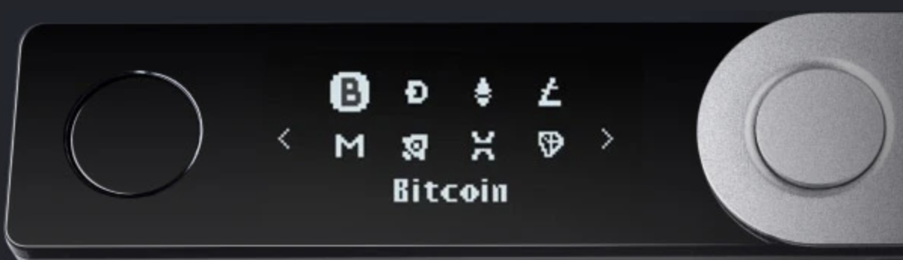
Hardware wallet: Ledger, Trezor, …
End user can have lots of secret keys. How to store them ???
Hardware wallet (e.g., Ledger Nano X)
- connects to laptop or phone wallet using Bluetooth or USB
manages many secret keys
  Bolos OS: each coin type is an app on top of OS
PIN to unlock HW (up to 48 digits)
screen and buttons to verify and confirm Tx

Slide 28
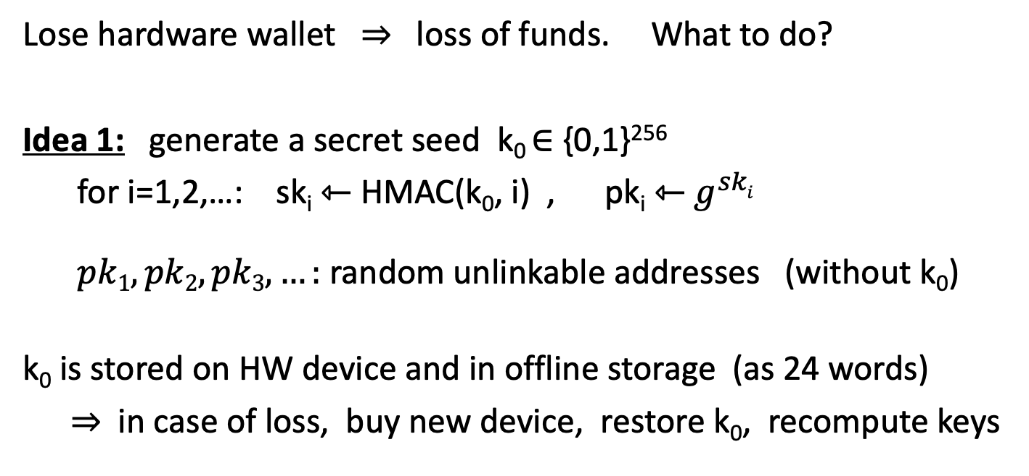
Hardware wallet: backup
Lose hardware wallet ⇒ loss of funds. What to do?
Idea 1: generate a secret seed k₀ ∈ {0,1}²⁵⁶
for i=1,2,…: sk_{i} ⇽ HMAC(k₀, i) , pk_{i} ⇽ $g^{ski}$
$pk1, pk2, pk3, …:$ random unlinkable addresses (without k₀)
k₀ is stored on HW device and in offline storage (as 24 words)
  ⇒ in case of loss, buy new device, restore k₀, recompute keys
ECDSA public key

Slide 29
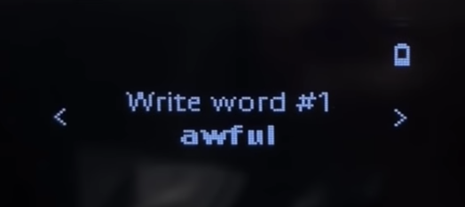
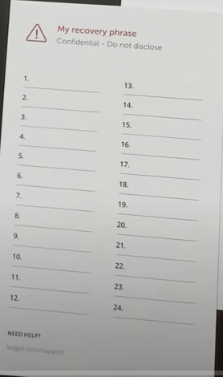
On Ledger
When initializing ledger:
user asked to write down the 24 words
each word encodes 11 bits (24 ×11 = 268 bits)
  list of 2048 words in different languages (BIP 39)
Notes:
pre-initialized wallet purchased on eBay.

Slide 30
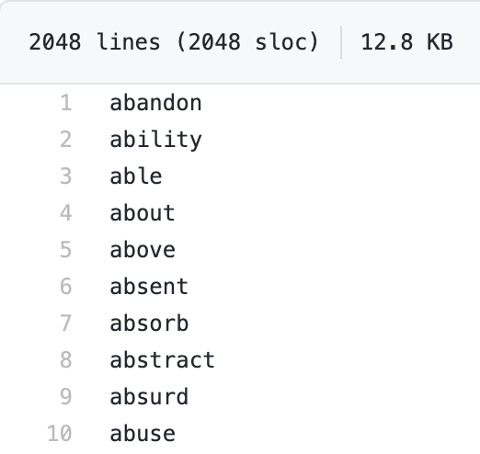
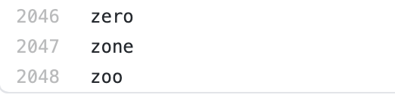
Example: English word list
⋮
save list of
24 words
Notes:
https://github.com/trezor/python-mnemonic/blob/master/mnemonic/wordlist/english.txt

Slide 31
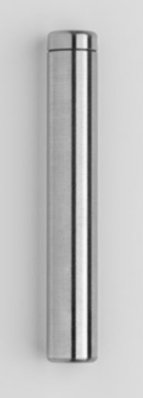
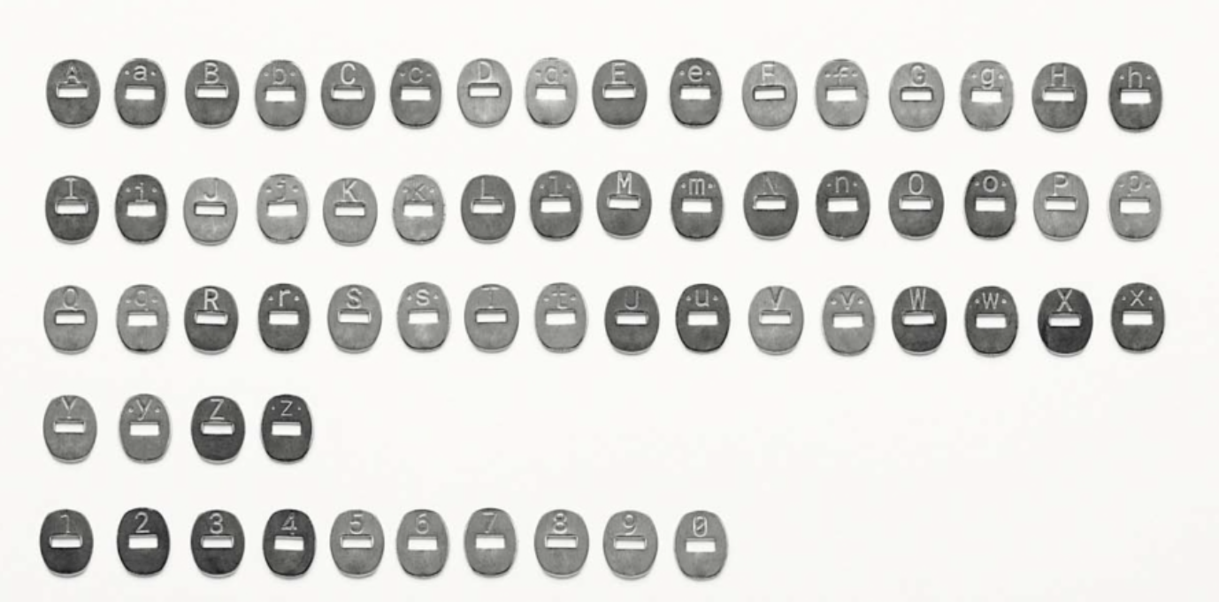
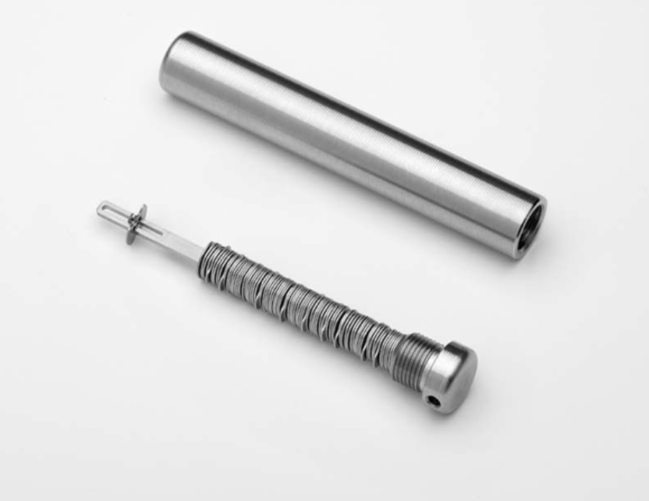
Crypto Steel
Careful with unused letters …

Slide 32
On Ledger
When initializing ledger:
user asked to write down the 24 words
each word encodes 11 bits (24 ×11 = 268 bits)
  list of 2048 words in different languages (BIP 39)
Beware of “pre-initialized HW wallet”
2018: funds transferred to wallet promptly stolen
Notes:
pre-initialized wallet purchased on eBay.

Slide 33
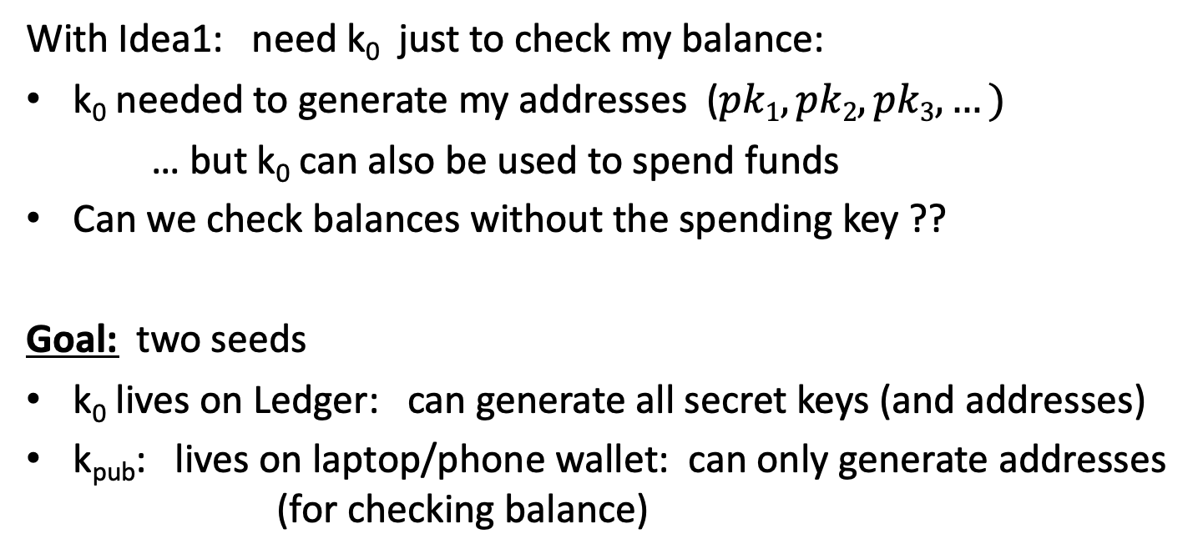
How to securely check balances?
With Idea1: need k₀ just to check my balance:
k₀ needed to generate my addresses ($pk1, pk2, pk3, …)$
… but k₀ can also be used to spend funds
Can we check balances without the spending key ??
Goal: two seeds
k₀ lives on Ledger: can generate all secret keys (and addresses)
k_{pub}: lives on laptop/phone wallet: can only generate addresses
(for checking balance)

Slide 34
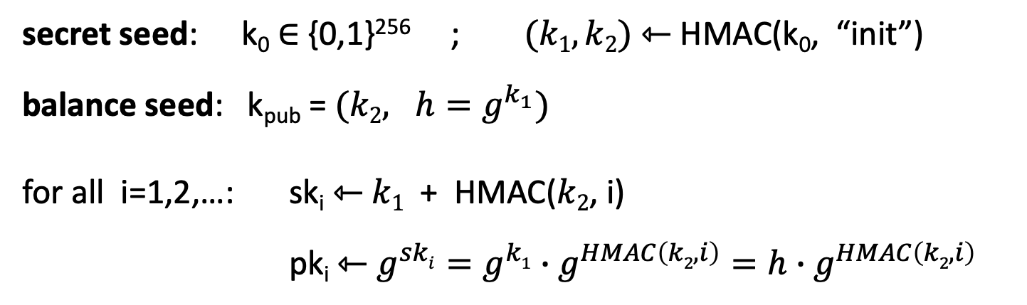
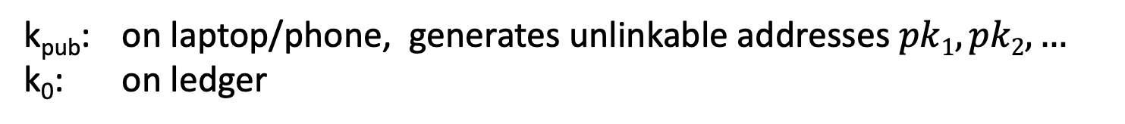
Idea 2: (used in HD wallets)
secret seed: k₀ ∈ {0,1}²⁵⁶ ; $(k1, k2)$ ⇽ HMAC(k₀, “init”)
balance seed: k_{pub} = $(k2, h=g^{k_{1}})$
for all i=1,2,…: sk_{i} ⇽ $k1$ + HMAC($k2$, i)
pk_{i} ⇽ $g^{ski}=g^{k1}∙g^{HMAC\left(k2,i\right)}=h$ $∙$ $g^{HMAC\left(k2,i\right)}$
k_{pub} does not reveal sk₁, sk₂, …
computed from k_{pub}
k_{pub}: on laptop/phone, generates unlinkable addresses $pk1, pk2, …$
k₀: on ledger
Notes:
HD wallet: hierarchical deterministic wallet

Slide 35
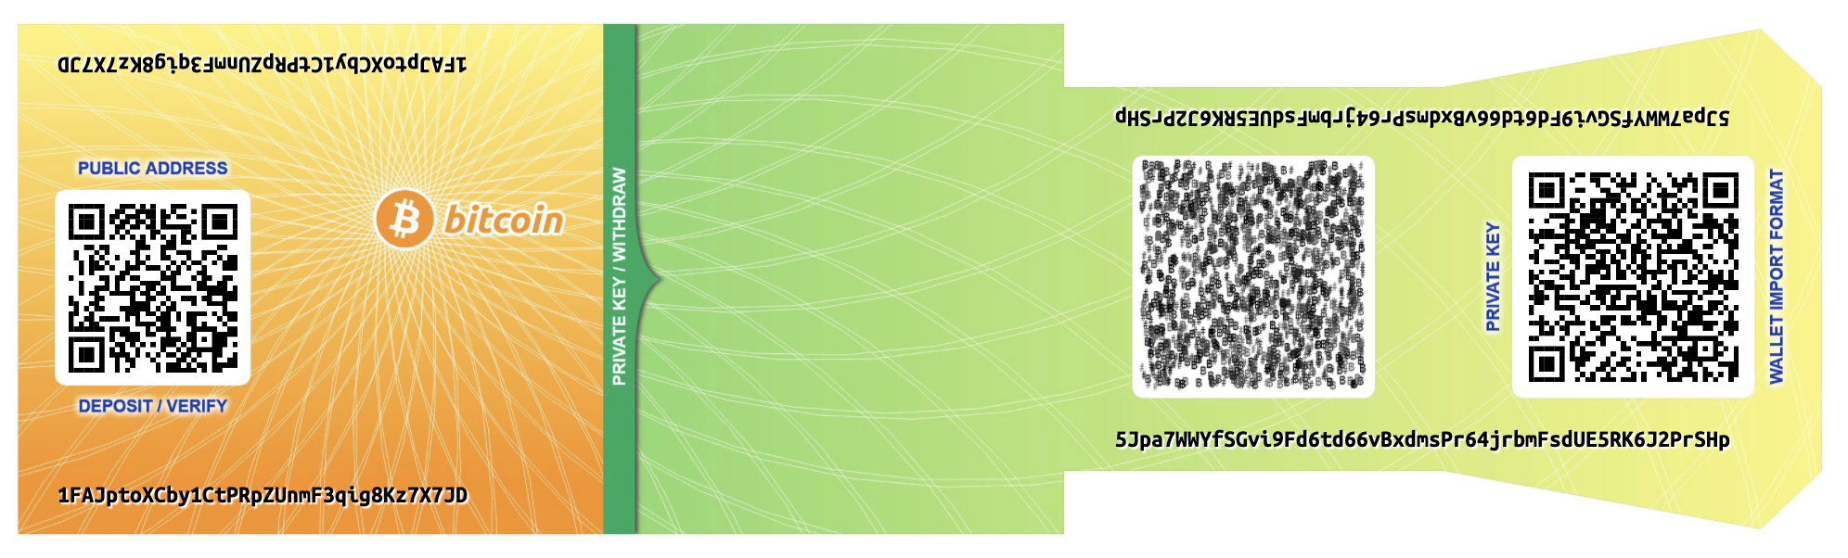
Paper wallet (be careful when generating)
signing key (cleartext)
Bitcoin address = base58(hash(PK))
base58 = a-zA-Z0-9 without {0,O,l,1}
Notes:
base58: 62 – 4 = 58. Javascript that generated secret key can easily steal it.

Slide 36
Managing crypto assets in the cloud
How exchanges store assets

Slide 37
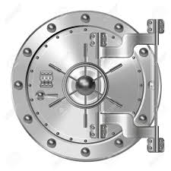
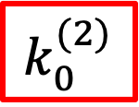
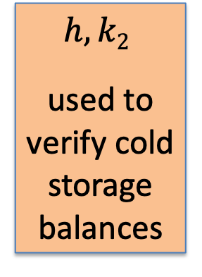
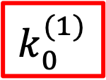
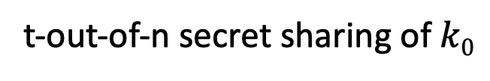

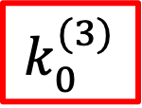
Hot/cold storage
Coinbase: holds customer assets
Design: 98% of assets (SK) are held in cold storage
cold storage (98%)
hot wallet (2%)
$$k_{0}^{(1)}$$
$$h, k2$$
used to verify cold storage balances
SK_{hot}
2% of assets
$$k0$$
customers
$$k_{0}^{(2)}$$
$$k_{0}^{(3)}$$
t-out-of-n secret sharing of $k0$
Notes:
Vault is used when need to reconstruct K0 and move funds out of cold storage. Otherwise, K0 is split into shares all over the world.

Slide 38
Problems
Can’t prove ownership of assets in cold storage,
without accessing cold storage:
To prove ownership (e.g., in audit or in a proof of solvency)
To participate in proof-of-stake consensus
Solutions:
Keep everything in hot wallet (e.g, Anchorage)
Proxy keys: keys that prove ownership of assets,
but cannot spend assets

Slide 39
END OF LECTURE
Next lecture: consensus

