Slide 1
Bitcoin Mechanics
CS251 Fall 2023
(cs251.stanford.edu)
Dan Boneh
Reminder: proj #1 is posted on the course web site. Due Oct. 4

Slide 2
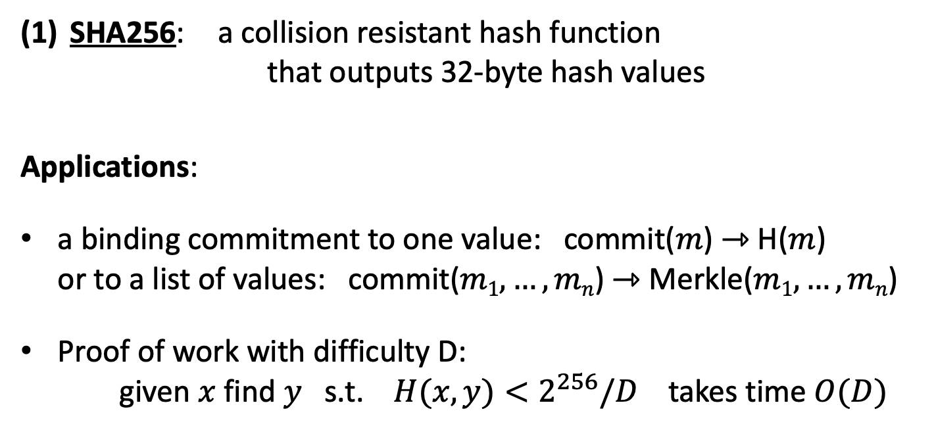
Recap
SHA256: a collision resistant hash function
that outputs 32-byte hash values
Applications:
a binding commitment to one value: commit($m$) ⇾ H($m$)
or to a list of values: commit($m1, …, mn$) ⇾ Merkle($m1,…,mn$)
Proof of work with difficulty D:
given $x$ find $y$ s.t. $H(x,y)<2^{256}/D$ takes time $O(D)$

Slide 3
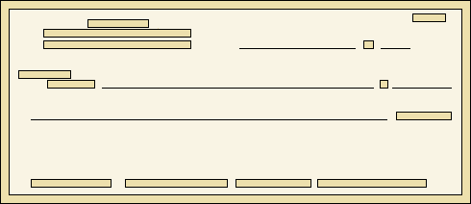

Digital Signatures
Physical signatures: bind transaction to author
Bob agrees to pay Alice 1$
Bob agrees to pay Alice 100$
Problem in the digital world:
anyone can copy Bob’s signature from one doc to another
Notes:
Bad example: will see why on the last slide of this segment.

Slide 4
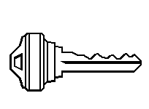
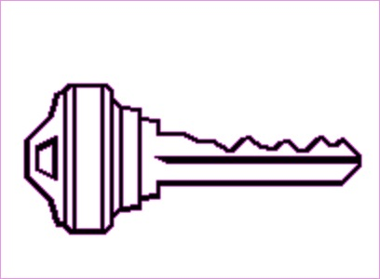
Digital signatures
Solution: make signature depend on document
Signer
Verifier
‘accept’
or
‘reject’
Bob agrees to pay Alice 1$
verifier
signature
signing
algorithm
secret signing
key (sk)
public verification
key (pk)

Slide 5
Digital signatures: syntax
Def: a signature scheme is a triple of algorithms:
  Gen(): outputs a key pair (pk, sk)
  Sign(sk, msg) outputs sig. σ
  Verify(pk, msg, σ) outputs ‘accept’ or ‘reject’
Secure signatures: (informal)
Adversary who sees signatures on many messages of his choice,
cannot forge a signature on a new message.

Slide 6
Families of signature schemes
RSA signatures (old … not used in blockchains):
  long sigs and public keys (≥256 bytes), fast to verify
Discrete-log signatures: Schnorr and ECDSA
  short sigs (48 or 64 bytes) and public key (32 bytes)
BLS signatures: 48 bytes, aggregatable, easy threshold
Post-quantum signatures: long (≥600 bytes)
(Bitcoin, Ethereum)
(Ethereum 2.0, Chia, Dfinity)
details in CS255

Slide 7
Signatures on the blockchain
Signatures are used everywhere:
ensure Tx authorization,
governance votes,
consensus protocol votes.
verifyTx
verifyTx
verify
Tx
sk₁
data
signatures
sk₂
data
signatures

Slide 8
In summary …
Digital signatures: (Gen, Sign, Verify)
Gen() ⇾ (pk, sk),
Sign(sk, m) ⇾ σ, Verify(pk, m, σ) ⇾ accept/reject
signing key
verification key

Slide 9
Bitcoin mechanics

Slide 10
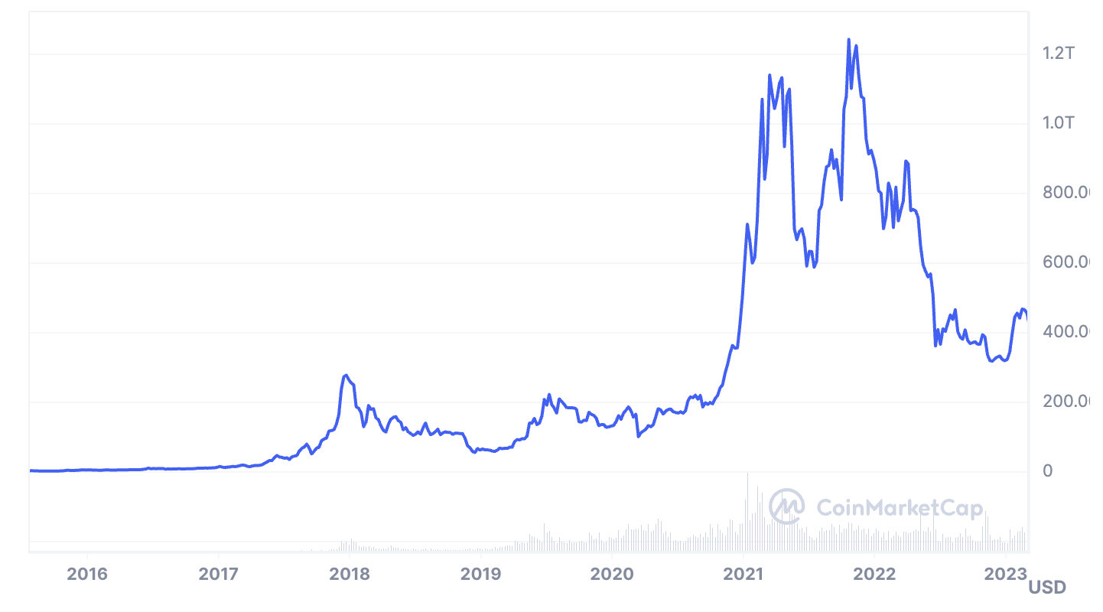
This lecture: Bitcoin mechanics
Oct. 2008: paper by Satoshi Nakamoto
Jan. 2009: Bitcoin network launched
Total market value:
Sep. 2023: $528B
Notes:
https://coinmarketcap.com/currencies/bitcoin/

Slide 11
This lecture: Bitcoin mechanics
user facing tools (cloud servers)
applications (DAPPs, smart contracts)
Execution engine (blockchain computer)
today
Sequencer: orders transactions
Data Availability / Consensus Layer
next week

Slide 12
First: overview of the Bitcoin consensus layer
Bitcoin P2P network
end users
signed Tx
sk_{A}
sk_{B}
sk_{C}
typically, miners are connected to
eight other peers (anyone can join)

Slide 13
First: overview of the Bitcoin consensus layer
mempool
miners broadcast received Tx
to the P2P network
every miner:
validates received Tx and
stores them in its mempool
(unconfirmed Tx)
note: miners see all Tx before they are posted on chain
Bitcoin P2P network
Notes:
Minters may decide to front run a Tx, if it is profitable.

Slide 14
First: overview of the Bitcoin consensus layer
blockchain
I am the leader
Every ≈10 minutes:
Each miner creates a candidate
block from Tx in its mempool
a “random” miner is selected
(how: next week), and broadcasts
its block to P2P network
all miners validate new block
Bitcoin P2P network
Notes:
Tx in new block are removed from the mempool.

Slide 15
First: overview of the Bitcoin consensus layer
blockchain
6.25 BTC
Selected miner is paid 6.25 BTC
in coinbase Tx (first Tx in the block)
only way new BTC is created
block reward halves every four years
⇒ max 21M BTC (currently 19.6M BTC)
note: miner chooses order of Tx in block
Notes:
Miners want to be selected as often as possible: can join multiple times to increase their chances. Need to prevent that.
Next halving: Apr. 2024, 3.125 BTC/block

Slide 16
Properties (very informal)
Next week:
  Safety / Persistence:
  to remove a block, need to convince 51% of mining power *
  Liveness:
  to block a Tx from being posted, need to convince 51% of
  mining power **
  (some sub 50% censorship attacks, such as feather forks)

Slide 17
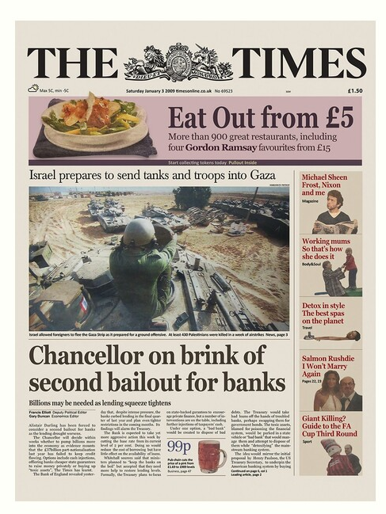
Bitcoin blockchain: a sequence of block headers, 80 bytes each
genesis
block
BH₃
BH₁
BH₂
version (4 bytes)
prev (32 bytes)
time (4 bytes)
bits (4 bytes)
nonce (4 bytes)
Tx root (32 bytes)
prev
Tx root
prev
Tx root
H
H
H
…
80 bytes
coinbase Tx
coinbase Tx
Notes:
The London Times front page from 03/Jan/2009.

Slide 18
Bitcoin blockchain: a sequence of block headers, 80 bytes each
time: time miner assembled the block. Self reported.
(block rejected if too far in past or future)
bits: proof of work difficulty
nonce: proof of work solution
Merkle tree: payer can give a short proof that Tx is in the block
new block every ≈10 minutes.
for choosing a leader (next week)

Slide 19
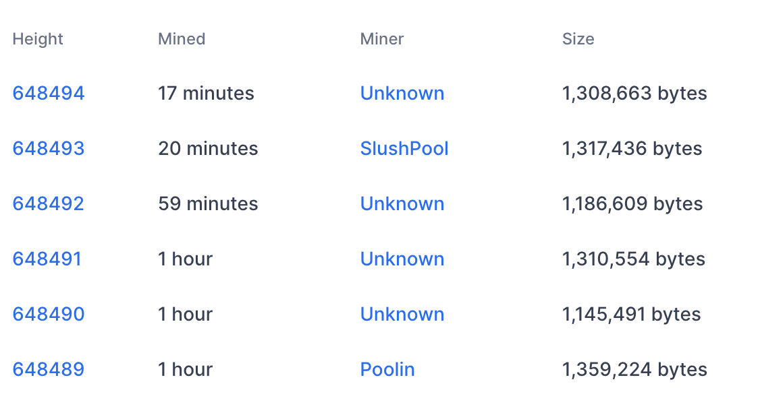
An example
Tx data
#Tx
1855
2826
1128
2774
2075
2622

Slide 20
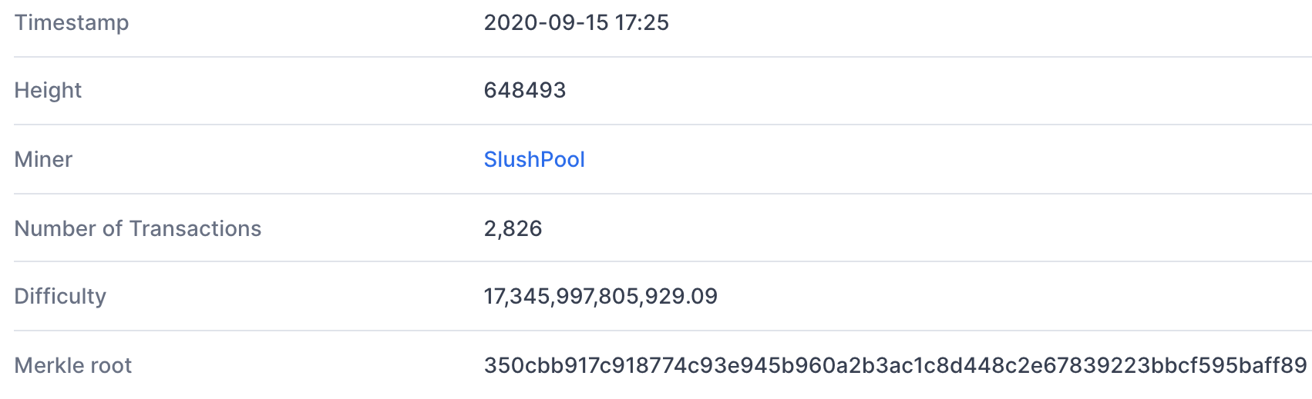
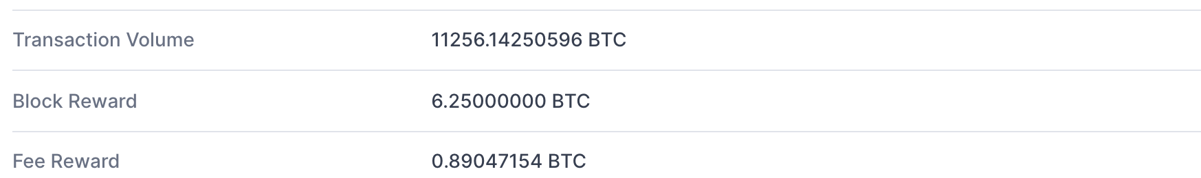
Block 648493
(from coinbase Tx)
(D)
(adjusts every two weeks)
(Tx fees given to miner in coinbase Tx)

Slide 21
This lecture
View the blockchain as a sequence of Tx (append-only)
…
coinbase Tx

Slide 22
Tx structure (non-coinbase)
input[0]
input[1]
input[2]
output[0]
output[1]
witnesses
(part of input)
locktime
TxID
out-index
ScriptSig
seq
32 byte hash
input:
inputs
4 byte index
program
TxID = H(Tx)
ignore
outputs
(excluding witnesses)
output:
value
ScriptPK
8 bytes
(segwit)
program
(4 bytes)
#BTC = value/10⁸
earliest block # that can include Tx
Notes:
10⁻⁸ BTC = 1 Satoshi ~ 0.01 cent
TxID are unique – two Tx cannot have the same TxID, because inputs are unique. The only exception is the coinbase Tx, which has no inputs, so that two coinbase Tx can have the same TxID. To solve that, every coinbase Tx includes the block height in its ScriptPk (BIP 34).

Slide 23
Example
null locktime
TxIn[0]
TxOut[0]
TxOut[1]
Tx1:
input
2
ScriptPK
5
ScriptPK
0
(funding Tx)
value
value
UTXO₁
UTXO₂
UTXO: unspent Tx output
TxIn[0]
TxOut[0]
TxOut[1]
Tx2:
TxID
1
ScriptSig
output
output
0
(spending Tx)
identifies
a UTXO
UTXO₃
UTXO₄
Notes:
ScriptPK specifies who or how can spend.

Slide 24
Example
☓
null locktime
TxIn[0]
TxOut[0]
TxOut[1]
Tx1:
input
2
ScriptPK
5
ScriptPK
0
(funding Tx)
value
value
UTXO₁
UTXO₂
UTXO: unspent Tx output
TxIn[0]
TxOut[0]
TxOut[1]
Tx2:
TxID
1
ScriptSig
output
output
0
(spending Tx)
identifies
a UTXO
UTXO₃
UTXO₄
Notes:
ScriptPK specifies who or how can spend.

Slide 25
Validating Tx2
program from funding Tx:
under what conditions
can UTXO be spent
Miners check (for each input):
The program ScriptSig | ScriptPK returns true
TxID | index is in the current UTXO set
sum input values ≥ sum output values
After Tx2 is posted, miners remove UTXO₂ from UTXO set
Notes:
Spent UTXOs can be forgotten. They are no longer needed for block validation.

Slide 26
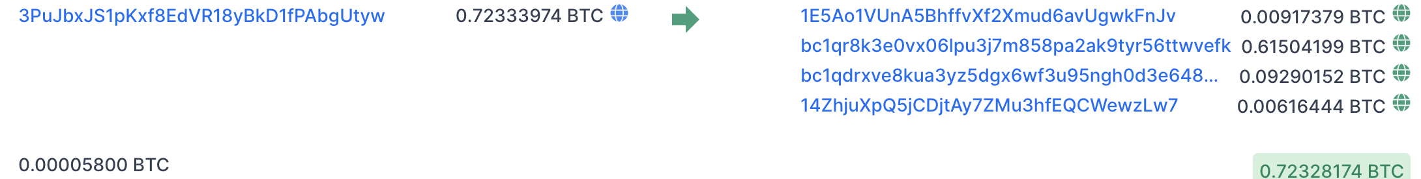
An example (block 648493) [2826 Tx]
Tx0
6.25 + Tx fees =
input
(input UTXO value)
Tx1
outputs
(Tx fee)
Tx2
(Tx fee)
sum of fees in block added to coinbase Tx
Notes:
Fees: Tx1 0.00005 BTC ≈ .5$,
Fees: Tx2 0.002 BTC ≈ 20$.
Low Tx fee in Tx means Tx will remain unconfirmed (sit in mempool).
To frontrun a Tx: submit a Tx with a higher Tx fee.

Slide 27
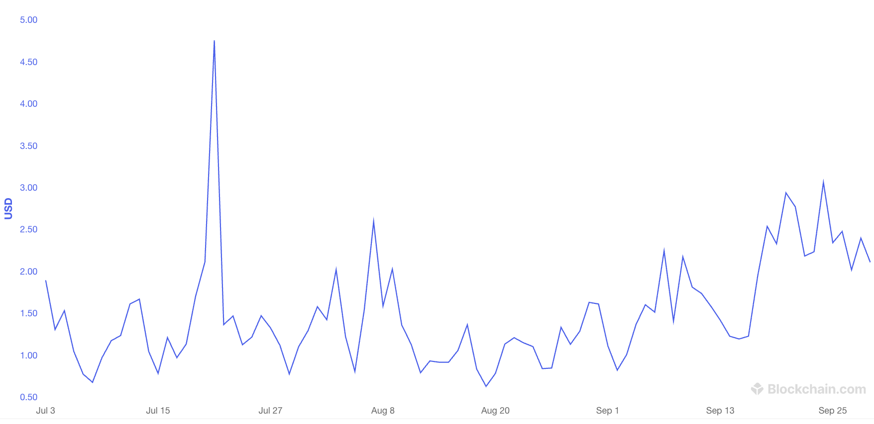
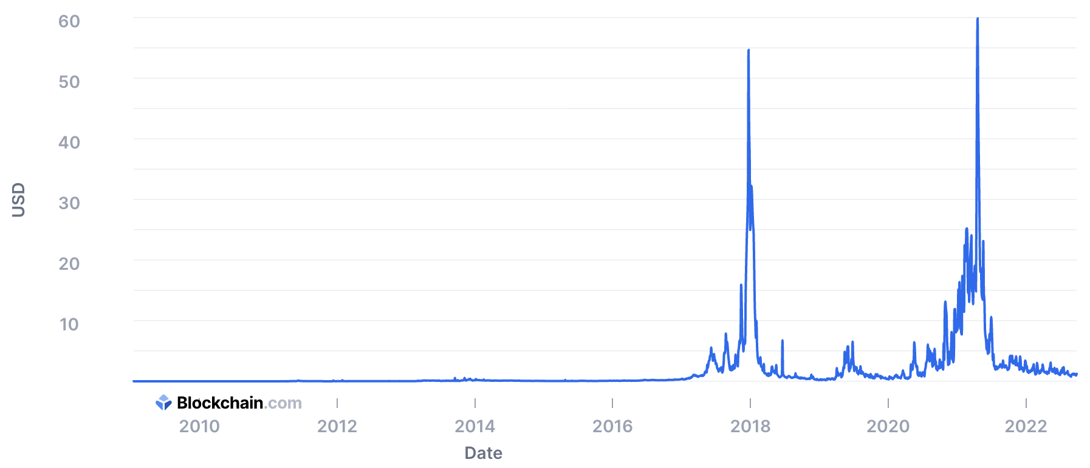
Tx fees
Bitcoin average Tx fees in USD (last 60 days, sep. 2023)
$2.11
Bitcoin average Tx fees in USD (all time)
Notes:
Fee depends on network congestion, price of BTC.
https://www.blockchain.com/charts/fees-usd-per-transaction

Slide 28
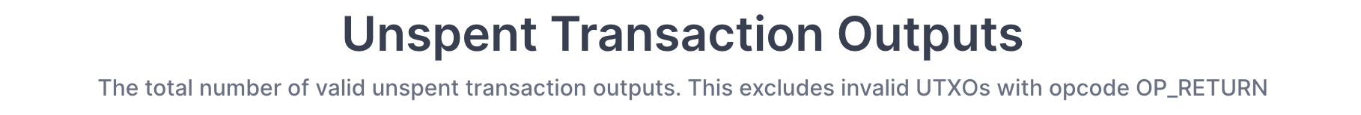
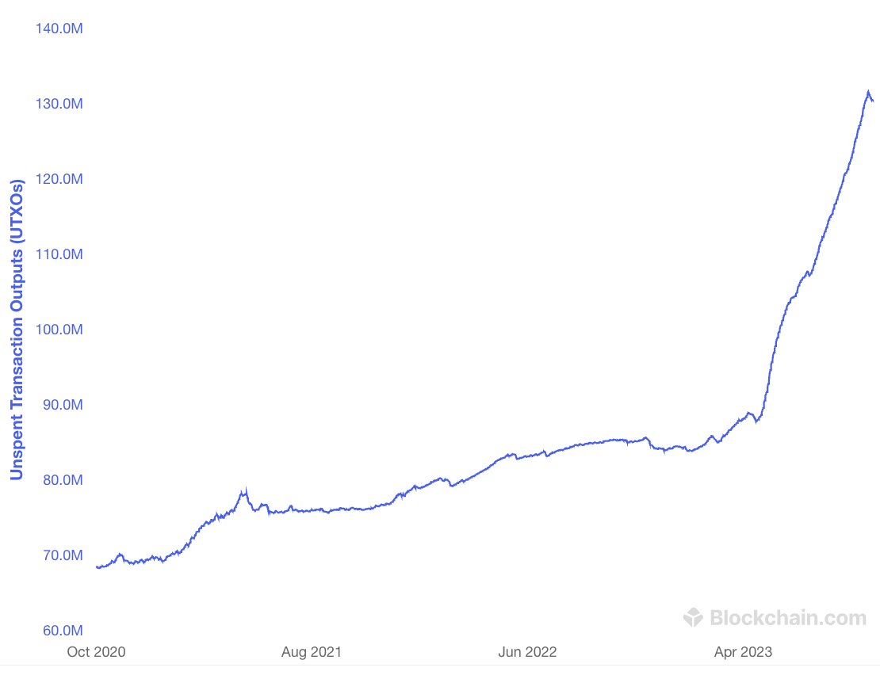
All value in Bitcoin is held in UTXOs
130M
Sep. 2023: miners need to store ≈130M UTXOs in memory
Notes:
How many Bitcoins do I have: need to find all the UTXOs on chain that I can spend. Typically done by wallet software (next lecture).
https://www.blockchain.com/charts/utxo-count

Slide 29
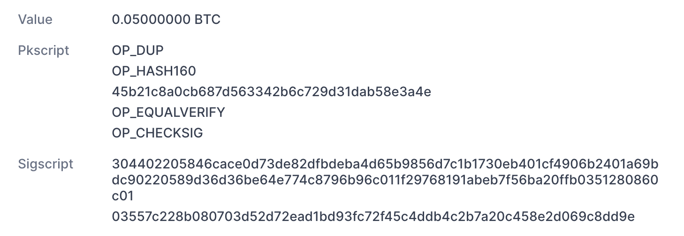
Focusing on Tx2: TxInp[0]
from UTXO
(Bitcoin script)
from TxInp[0]

Slide 30
Bitcoin Script
A stack machine. Not Turing Complete: no loops.
Quick survey of op codes:
1. OP_TRUE (OP_1), OP_2, …, OP_16: push value onto stack
2. OP_DUP: push top of stack onto stack
81
82
96
118

Slide 31
Bitcoin Script
control:
OP_IF <statements> OP_ELSE <statements> OP_ENDIF
OP_VERIFY: abort fail if top = false
OP_RETURN: abort and fail
what is this for? ScriptPK = [OP_RETURN, <data>]
OP_EQVERIFY: pop, pop, abort fail if not equal
99
105
106
136

Slide 32
Bitcoin Script
4. arithmetic:
OP_ADD, OP_SUB, OP_AND, …: pop two items, add, push
5. crypto:
OP_SHA256: pop, hash, push
OP_CHECKSIG: pop pk, pop sig, verify sig. on Tx, push 0 or 1
Time: OP_CheckLockTimeVerify (CLTV):
fail if value at the top of stack > Tx locktime value.
usage: UTXO can specify min-time when it can be spent
Notes:
Tx locktime comes from the spending Tx (current height must be ≥ locktime). Value at top of stack could come from ScriptPK in the UTXO. So, UTXO can only be spent if current-height ≥ value-at-top-of-stack.

Slide 33
Example: a common script
<sig> <pk> DUP HASH256 <pkhash> EQVERIFY CHECKSIG
stack: empty init
<sig> <pk> push values
<sig> <pk> <pk> DUP
<sig> <pk> <hash> HASH256
<sig> <pk> <hash> <pkhash> push value
<sig> <pk> EQVERIFY
1 CHECKSIG
⇒ successful termination
verify(pk, Tx, sig)

Slide 34
Transaction types: (1) P2PKH
pay to public key hash
Alice want to pay Bob 5 BTC:
step 1: Bob generates sig key pair (pk_{B}, sk_{B}) ⇽ Gen()
step 2: Bob computes his Bitcoin address as addr_{B} ⇽ H(pk_{B})
step 3: Bob sends addr_{B} to Alice
step 4: Alice posts Tx:
UTXO_{B} for Bob
UTXO_{A} for Alice (change)
Point to Alice’s UTXO
input
7 BTC
5
ScriptPK_{B}
2
ScriptPK_{A}
0
ScriptPK_{B}:
DUP HASH256 <addr_{B}> EQVERIFY CHECKSIG

Slide 35
Transaction types: (1) P2PKH
pay to public key hash
“input” contains ScriptSig that authorizes spending Alice’s UTXO
example: ScriptSig contains Alice’s signature on Tx
⟹ miners cannot change ScriptPK_{B} (will invalidate Alice’s signature)
UTXO_{B} for Bob
UTXO_{A} for Alice (change)
Point to Alice’s UTXO
input
7 BTC
5
ScriptPK_{B}
2
ScriptPK_{A}
0
ScriptPK_{B}:
DUP HASH256 <addr_{B}> EQVERIFY CHECKSIG

Slide 36
Transaction types: (1) P2PKH
Later, when Bob wants to spend his UTXO: create a Tx_{spend}
Tx_{spend}:
TxID
0
ScriptSig_{B}
output
output
0
points to
UTXO_{B}
<sig> <pk_{B}>
(authorizes spending UTXO_{B})
<sig> = Sign(sk_{B}, Tx) where Tx = (Tx_{spend} excluding all ScriptSigs) (SIGHASH_ALL)
Miners validate that ScriptSig_{B} | ScriptPK_{B} returns true
Notes:
Bob’s <sig> ensures that miners cannot change the Tx outputs.

Slide 37
P2PKH: comments
Alice specifies recipient’s pk in UTXO_{B}
Recipient’s pk is not revealed until UTXO is spent
(some security against attacks on pk)
Miner cannot change <Addr_{B}> and steal funds:
invalidates Alice’s signature that created UTXO_{B}

Slide 38
Segregated Witness
ECDSA malleability:
Given (m, sig) anyone can create (m, sig’) with sig ≠ sig’
⇒ miner can change sig in Tx and change TxID = SHA256(Tx)
⇒ Tx issuer cannot tell what TxID is, until Tx is posted
⇒ leads to problems and attacks
Segregated witness: signature is moved to witness field in Tx
TxID = Hash(Tx without witnesses)
Notes:
Mt. Gox attack

Slide 39
Transaction types: (2) P2SH: pay to script hash
(pre SegWit in 2017)
Let’s payer specify a redeem script (instead of just pkhash)
Usage: payee publishes hash(redeem script) ⟵ Bitcoint addr.
payer sends funds to that address
ScriptPK in UTXO: HASH160 <H(redeem script)> EQUAL
ScriptSig to spend: <sig₁> <sig₂> … <sig_{n}> <redeem script>
payer can specify complex conditions for when UTXO can be spent

Slide 40
P2SH
Miner verifies:
<ScriptSig> ScriptPK = true ⟵ payee gave correct script
(2) ScriptSig = true ⟵ script is satisfied

Slide 41
Example P2SH: multisig
Goal: spending a UTXO requires t-out-of-n signatures
Redeem script for 2-out-of-3: (set by payer)
<2> <PK₁> <PK₂> <PK₃> <3> CHECKMULTISIG
hash gives P2SH address
ScriptSig to spend: (by payee) <0> <sig1> <sig3> <redeem script>
Notes:
Note: redeem script becomes public when spending Tx. Several tricks make it possible to keep redeem script secret, unless there is a dispute (Taproot)

Slide 42
END OF LECTURE
Next lecture: interesting scripts,
wallets, and how to manage crypto assets

