Slide 1
Building a SNARK
CS251 Fall 2023
(cs251.stanford.edu)
Dan Boneh

Slide 2
Recap: zk-SNARK applications
Private Tx on a public blockchain: Zcash, IronFish
Compliance:
  Proving that a private Tx are in compliance with banking laws
  Proving solvency in zero-knowledge
Scalability: privacy in a zk-SNARK Rollup (next week)
Bridging between blockchains: zkBridge

Slide 3
(preprocessing) NARK: Non-interactive ARgument of Knowledge
Public arithmetic circuit: $C( x, w ) ⇾ 𝔽$
public statement in $𝔽_{}^{n}$
secret witness in $𝔽_{}^{m}$
Preprocessing (setup): S($C$) ⇾ public parameters ($pp$, $vp$ )
$pp$, $x,$ $w$
$vp$, $x$
proof $π$ that $C(x,w)=0$
Prover
Verifier
accept or
reject
Notes:
Knowledge is stronger the soundness.

Slide 4


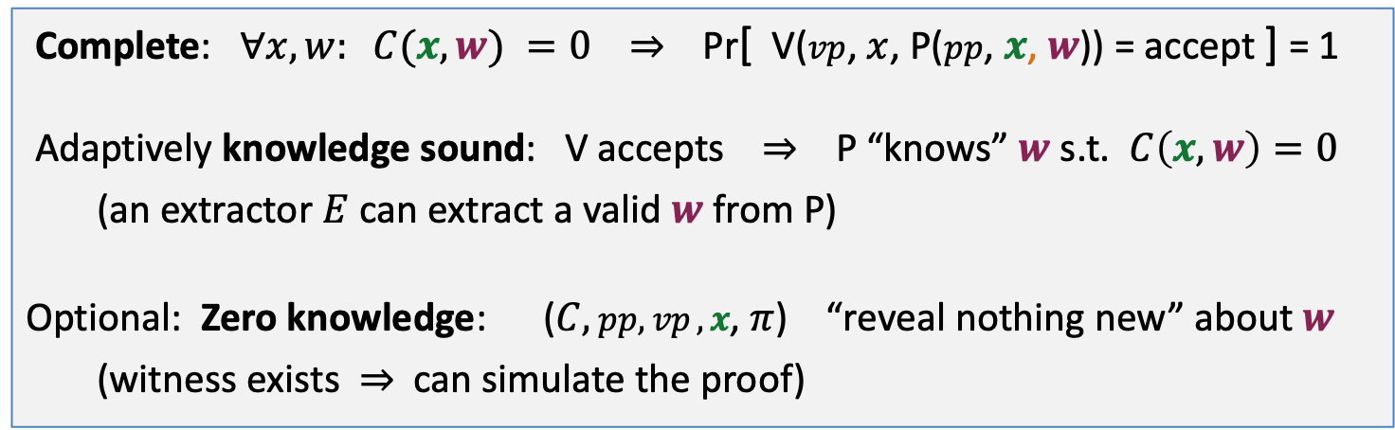

NARK: requirements (informal)
Prover P($pp$, $x, w$)
Verifier V ($vp$, $x$, $π$)
proof $π$
accept or reject
Complete: $∀x, w: C(x, w) =0$ ⇒ Pr[ V($vp$, $x$, P($pp$, $x$, $w$)) = accept ] = 1
Adaptively knowledge sound: V accepts ⇒ P “knows” $w$ s.t. $C\left(x, w\right)=0$
(an extractor $E$ can extract a valid $w$ from P)
Optional: Zero knowledge: ($C,$ $pp,vp ,x$, $π$) “reveal nothing new” about $w$
(witness exists ⇒ can simulate the proof)

Slide 5
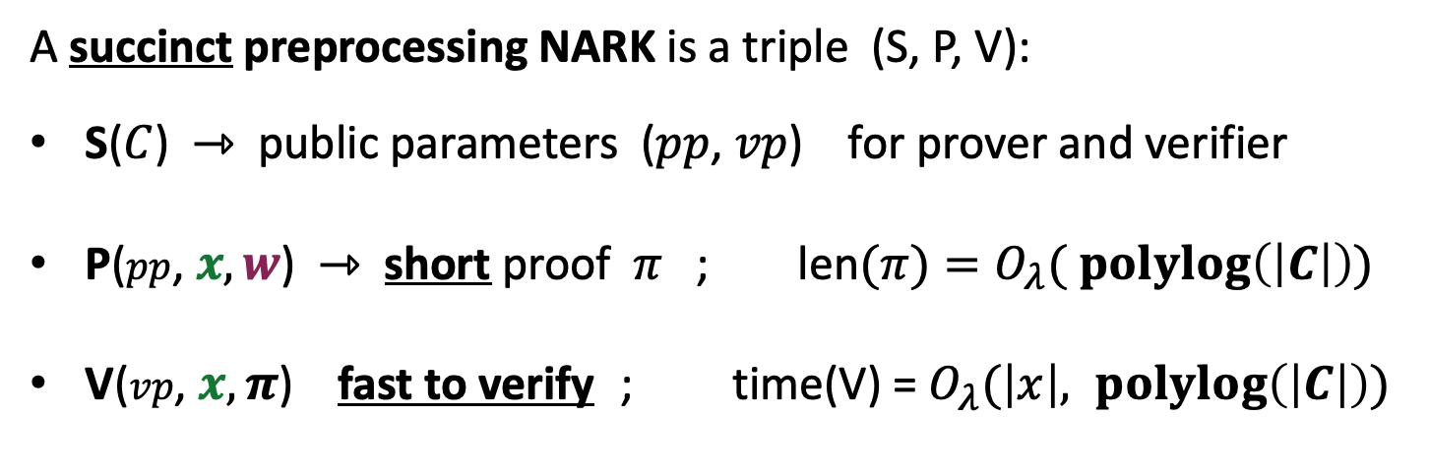
SNARK: a Succinct ARgument of Knowledge
A succinct preprocessing NARK is a triple (S, P, V):
S($C$) ⇾ public parameters ($pp$, $vp$) for prover and verifier
P($pp$, $x, w$) ⇾ short proof $π$ ; len$(π)=O_{λ}( \operatorname{polylog}\left(\left|C\right|\right))$
V($vp$, $x, π$) fast to verify ; time(V) = $O_{λ}(\left|x\right|, \operatorname{polylog}\left(\left|C\right|\right))$
short “summary” of circuit
Notes:
log |C| is bigger than log |w|, so this is not as strict as requiring proof size to be log |w|. In many SNARKs, proof size and verify time is independent of |C| or |w|.

Slide 6
A simple PCP-based SNARK
[Kilian’92, Micali’94]

Slide 7
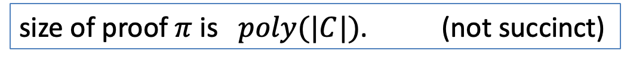
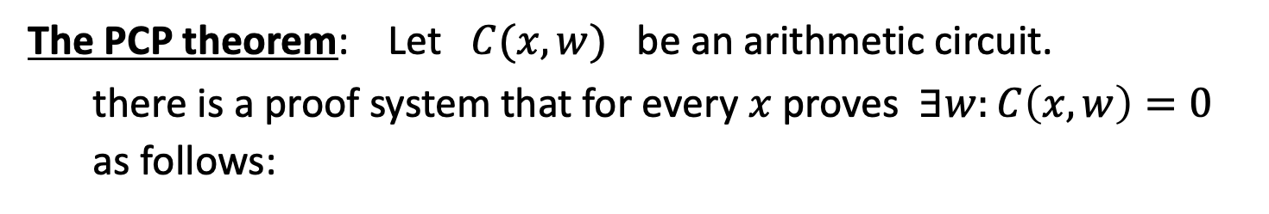
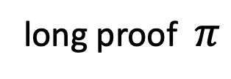
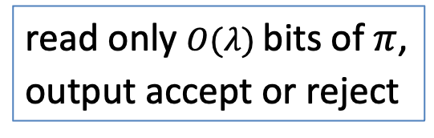
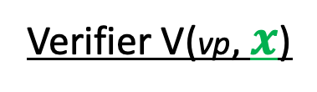
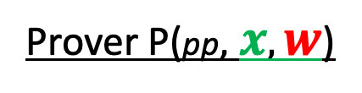
A simple construction: PCP-based SNARK
The PCP theorem: Let $C(x,w)$ be an arithmetic circuit.
there is a proof system that for every $x$ proves $∃w:C\left(x,w\right)=0$
as follows:
Prover P(pp, $x, w$)
Verifier V(vp, $x$)
long proof $π$
read only $O(λ)$bits of $π$,
output accept or reject
V always accepts valid proof. If no $w$, then V rejects with high prob.
size of proof $π$is $poly(|C|)$. (not succinct)
Notes:
V reads RANDOM locations in proof π, and checks look like a*b=c.
Think of $λ$ as $λ$=128.

Slide 8
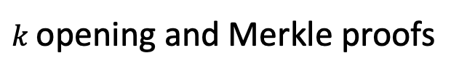

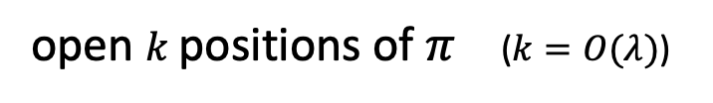
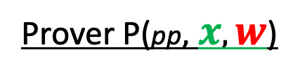


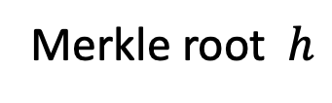


Converting a PCP proof to a SNARK
Prover P(pp, $x, w$)
Verifier V(vp, $x$)
$$h$$
Merkle
$$π$$
Merkle root $h$
1 hash
open $k$positions of $π$ ($k=O(λ)$)
$O(k log |C|)$ hashes
$k$opening and Merkle proofs
output accept or reject
Verifier sees $O(λ log⁡|C|)$data ⇒ succinct proof.
Problem: interactive

Slide 9
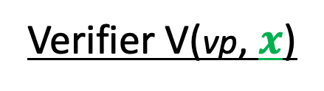
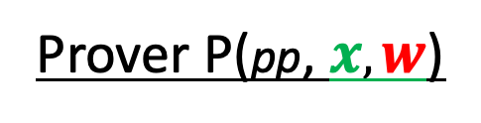
Making the proof non-interactive
The Fiat-Shamir transform:
public-coin interactive protocol ⇒ non-interactive protocol
public coin: all verifier randomness is public (no secrets)
Prover P(pp, $x, w$)
Verifier V(vp, $x$)
msg1
r
choose random bits r
msg2
accept or reject

Slide 10
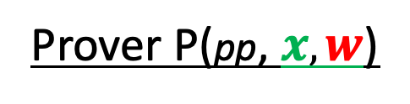
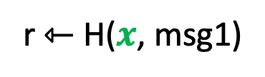
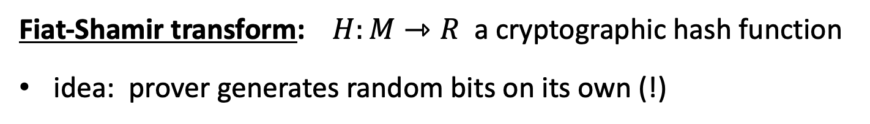
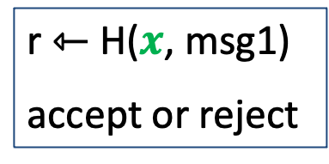

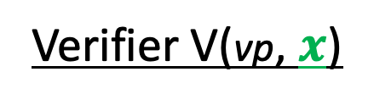
Making the proof non-interactive
Fiat-Shamir transform: $H:M⇾R$ a cryptographic hash function
idea: prover generates random bits on its own (!)
Prover P(pp, $x, w$)
Verifier V(vp, $x$)
generate msg1
r ⇽ H($x$, msg1)
$π$ = (msg1, msg2)
$|π|$ = O($λ log |C|)$
r ⇽ H($x$, msg1)
accept or reject
generate msg2
Fiat-Shamir: certain secure interactive protocols ⟹ non-interactive

Slide 11
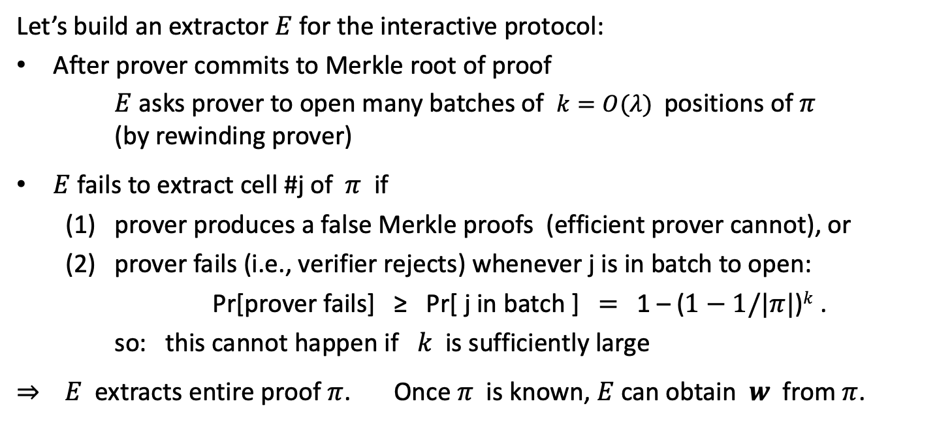
Why is this an argument of knowledge? (can skip)
Let’s build an extractor $E$ for the interactive protocol:
After prover commits to Merkle root of proof
$E$ asks prover to open many batches of $k=O(λ)$positions of $π$
(by rewinding prover)
$E$ fails to extract cell #j of $π$ if
  (1) prover produces a false Merkle proofs (efficient prover cannot), or
  (2) prover fails (i.e., verifier rejects) whenever j is in batch to open:
Pr[prover fails] ≥ Pr[ j in batch ] $=$ 1 – ($1−1/|π|$)$k$ .
so: this cannot happen if $k$ is sufficiently large
⇒ $E$ extracts entire proof $π$. Once $π$ is known, $E$can obtain $w$ from $π$.

Slide 12

Are we done?
Simple transparent SNARK from the PCP theorem
Use Fiat-Shamir transform to make non-interactive
We will apply Fiat-Shamir in many other settings
The bad news: an impractical SNARK --- Prover time too high
Better SNARKs: Goal: Time(Prover) = $\tilde{O}$(|C|)

Slide 13
Building an efficient SNARK

Slide 14

General paradigm: two steps
A polynomial
commitment scheme
(1)
(cryptographic object)
SNARK for
general circuits
A polynomial interactive
oracle proof (Poly-IOP)
(2)
(info. theoretic object)
Let’s explain each concept …

Slide 15
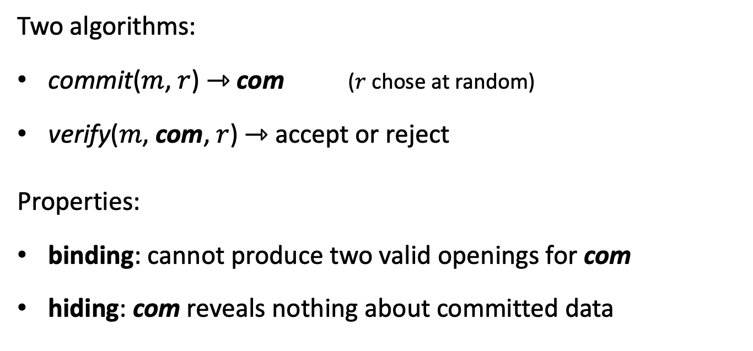
Recall: commitments
Two algorithms:
commit($m$, $r$) ⇾ com ($r$ chose at random)
verify($m$, com, $r$) ⇾ accept or reject
Properties:
binding: cannot produce two valid openings for com
hiding: com reveals nothing about committed data

Slide 16
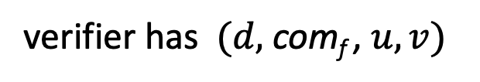
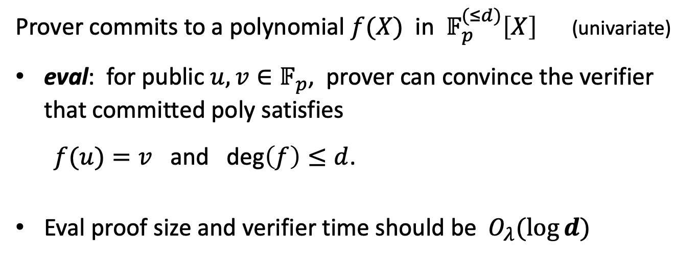

(1) Polynomial commitment scheme (PCS)
Notation: $𝔽_{p}^{(≤d)}\left[X\right]$ is all polynomials in $𝔽_{p}[X]$ of degree ≤ d.
Prover commits to a polynomial $f(X)$ in $𝔽_{p}^{(≤d)}\left[X\right]$ (univariate)
eval: for public $u,v∈𝔽_{p}$, prover can convince the verifier that committed poly satisfies
$f(u)=v$ and deg$\left(f\right)≤d$.
Eval proof size and verifier time should be $O_{λ}(log⁡⁡d)$
verifier has $(d,$ com_{f} , $u, v)$
$$f$$

Slide 17

(1) Polynomial commitment scheme (PCS)
setup($d$) ⇾ pp, public parameters for polynomials of degree ≤ $d$
commit(pp, f, $r$) ⇾ com_{f} commitment to f ∈ $𝔽_{p}^{(≤d)}\left[X\right]$
eval: goal: for a given com_{f} and x, y ∈ $𝔽_{p}$, prove that f(x) = y.
Formally: eval = (S, P, V) is a SNARK for:
statement st = (pp, com_{f} , x, y) with witness = $w$ = (f, $r$)
where $C$(st, $w$) = 0 iff
[ f(x) = y and f ∈ $𝔽_{p}^{(≤d)}\left[X\right]$ and commit(pp, f, $r$) = com_{f} ]

Slide 18
(1) Polynomial commitment scheme (PCS)
Properties:
Binding: cannot produce two valid openings (f_{1,} r₁), (f_{2,} r₂) for com_{f}.
eval is knowledge sound (can extract (f, r) from a successful prover)
optional:
    commitment is hiding
    eval is zero knowledge
Note: poly. commitments have many applications beyond SNARKs

Slide 19
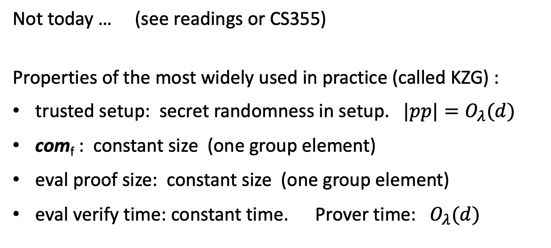
Constructing a PCS
Not today … (see readings or CS355)
Properties of the most widely used in practice (called KZG) :
trusted setup: secret randomness in setup. $|pp|=O_{λ}(d)$
com_{f} : constant size (one group element)
eval proof size: constant size (one group element)
eval verify time: constant time. Prover time: $O_{λ}(d)$

Slide 20
General paradigm: two steps
A polynomial
commitment scheme
(1)
(cryptographic object)
SNARK for
general circuits
A polynomial interactive
oracle proof (Poly-IOP)
(2)
(info. theoretic object)
What is a Poly-IOP?

Slide 21
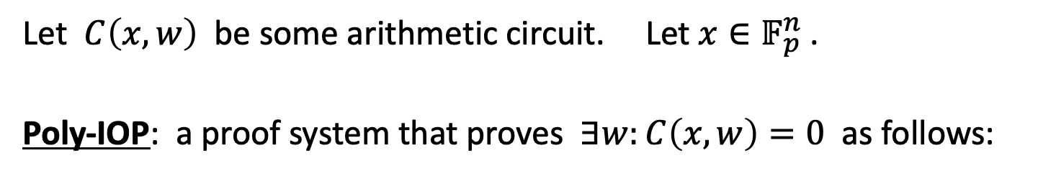
Component 2: Polynomial IOP
Let $C\left(x,w\right)$ be some arithmetic circuit. Let $x∈𝔽_{p}^{n}$ .
Poly-IOP: a proof system that proves $∃w:C\left(x,w\right)=0$ as follows:
Setup($C$) ⇾ public parameters $pp$ and $vp$ = $( { f}_{0} , f_{−1} ,…{, f}_{−s} )$

Slide 22
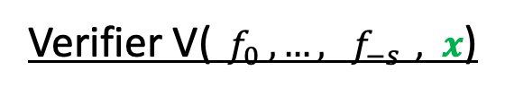


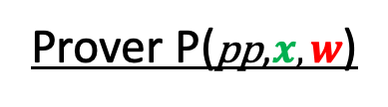





Polynomial IOP
Prover P($\text{p}\text{p}\text{,}x, w$)
Verifier V(${ f}_{0} ,…{, f}_{−s} \text{,} x$)
$r$₁
$$r1⇽𝔽_{p}$$
$f1$ ${∈ 𝔽}_{p}^{(≤d)}\left[X\right]$
commit
⋮
$$r_{t}$$
$$r_{t}⇽𝔽_{p}$$
$ft$ ${∈ 𝔽}_{p}^{(≤d)}\left[X\right]$
commit
query $f_{−s},…, f_{t}$ at a few points
send values (and eval proofs)
⇾ accept/reject

Slide 23
The Plonk poly-IOP
Goal: construct a poly-IOP called Plonk (eprint/2019/953)
[Gabizon – Williamson – Ciobotaru]
Plonk + PCS ⇒ SNARK
(and also a zk-SNARK)
[ PCS = Polynomial Commitment Scheme]

Slide 24
Proving properties of committed polynomials
Goal: succinct proofs

Slide 25

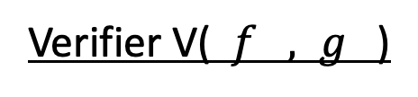

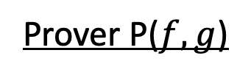



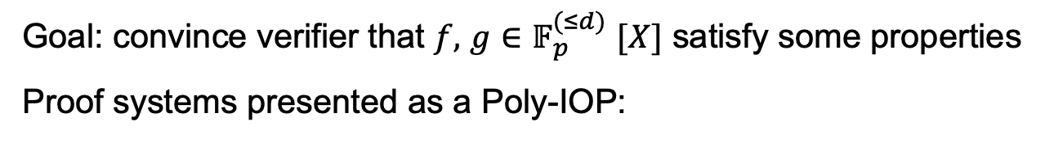
Proving properties of committed polynomials
Prover P($f,g$)
Verifier V( $f , g$)
Goal: convince verifier that $f,$ $g{∈𝔽}_{p}^{(≤d)}[X]$ satisfy some properties
Proof systems presented as a Poly-IOP:
$$r$$
$
$r$ ⇽ $𝔽_{p}$
$$q$$
(a commitment to some poly. $q$)
query $f\left(X\right), g(X), q(X)$ at some points in $𝔽_{p}$
accept or reject

Slide 26
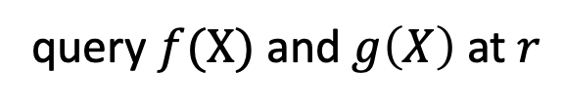



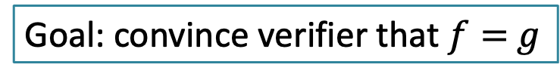
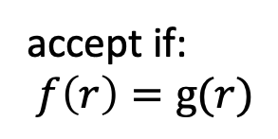
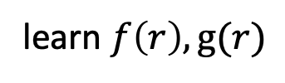
A simple example: polynomial equality testing
Prover
Verifier
Goal: convince verifier that $f=$ $g$
$$f, g$$
$$f$$
$$g$$
$r$ ⇽ $𝔽_{p}$
query $f(X)$ and $g\left(X\right)$ at $r$
$
learn $f\left(r\right), g(r)$
accept if:
$$f\left(r\right)=g(r)$$
Why is this sound?

Slide 27
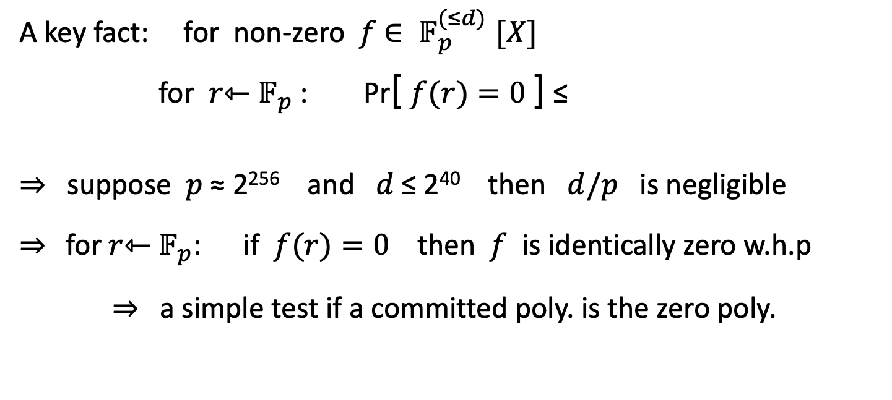

Why is this sound?
A key fact: for non-zero $f$ ${∈ 𝔽}_{p}^{(≤d)}[X]$
for $r$⇽ $𝔽_{p}$: Pr[ $f(r)=0$] ≤
⇒ suppose $p$ ≈ 2²⁵⁶ and $d$ ≤ 2⁴⁰ then $d/p$ is negligible
⇒ for $r$⇽ $𝔽_{p}$: if $f(r)=0$ then $f$ is identically zero w.h.p
⇒ a simple test if a committed poly. is the zero poly.
$$d/p$$
(∗)
SZDL lemma: (∗) also holds for multivariate polynomials (where d is total degree of $f$)
Notes:
This generalizes to multivariates: Schwartz-Zipple-Demilo-Lipton lemma

Slide 28
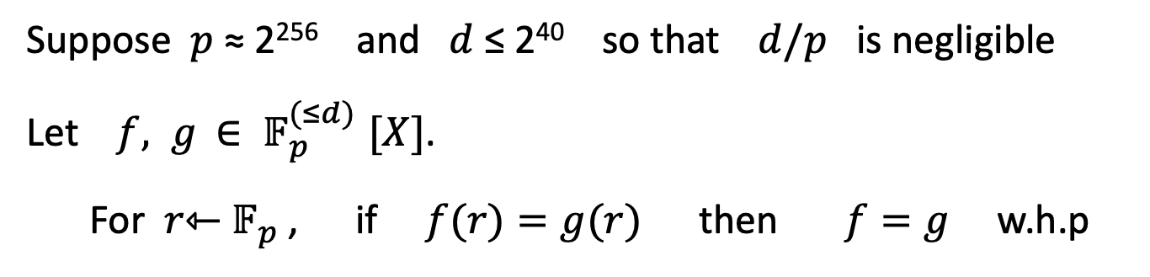
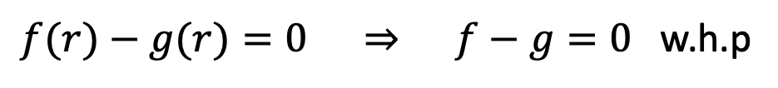
Why is this sound?
Suppose $p$ ≈ 2²⁵⁶ and $d$ ≤ 2⁴⁰ so that $d/p$ is negligible
Let $f, g$ ${∈ 𝔽}_{p}^{(≤d)}[X]$.
For $r$⇽ $𝔽_{p}$ , if $f(r)=g(r)$ then $f=g$ w.h.p
$f(r)−g(r)=0$ ⇒ $f−g=0$ w.h.p
⇒ a simple equality test for two committed polynomials
Notes:
This generalizes to multivariates: Schwartz-Zipple-Demilo-Lipton lemma

Slide 29
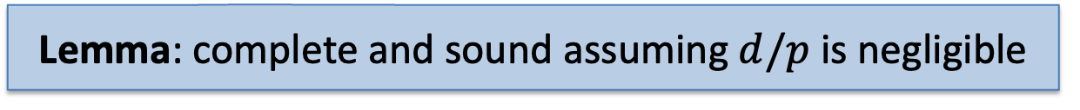
The polynomial equality testing protocol
Prover
Verifier
Goal: convince verifier that $f=$ $g$
$$f, g$$
$$f$$
$$g$$
$r$ ⇽ $𝔽_{p}$
query $f(X)$ and $g\left(X\right)$ at $r$
$
learn $f\left(r\right), g(r)$
accept if:
$$f\left(r\right)=g(r)$$
Lemma: complete and sound assuming $d/p$ is negligible

Slide 30
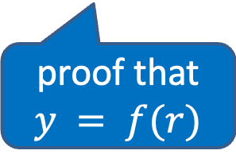




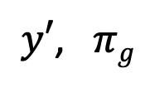
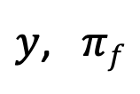
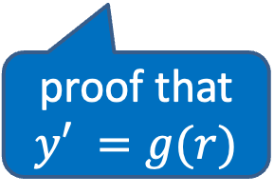
Review: the compiled proof system
Prover
Verifier
Make non-interactive
using Fiat-Shamir
$$f, g$$
$$f$$
$$g$$
$$r$$
$r$ ⇽ $𝔽_{p}$
$
$$y \text{⇽} f(r)$$
$$y^{′}\text{⇽} g(r)$$
$y$, $πf$
$y′$, $πg$
learn $f\left(r\right), g(r)$
accept if:
(i) $y=y′$ and
(ii) $πf$, $πg$
are valid
proof that $y = f(r)$
proof that $y′ =g(r)$

Slide 31
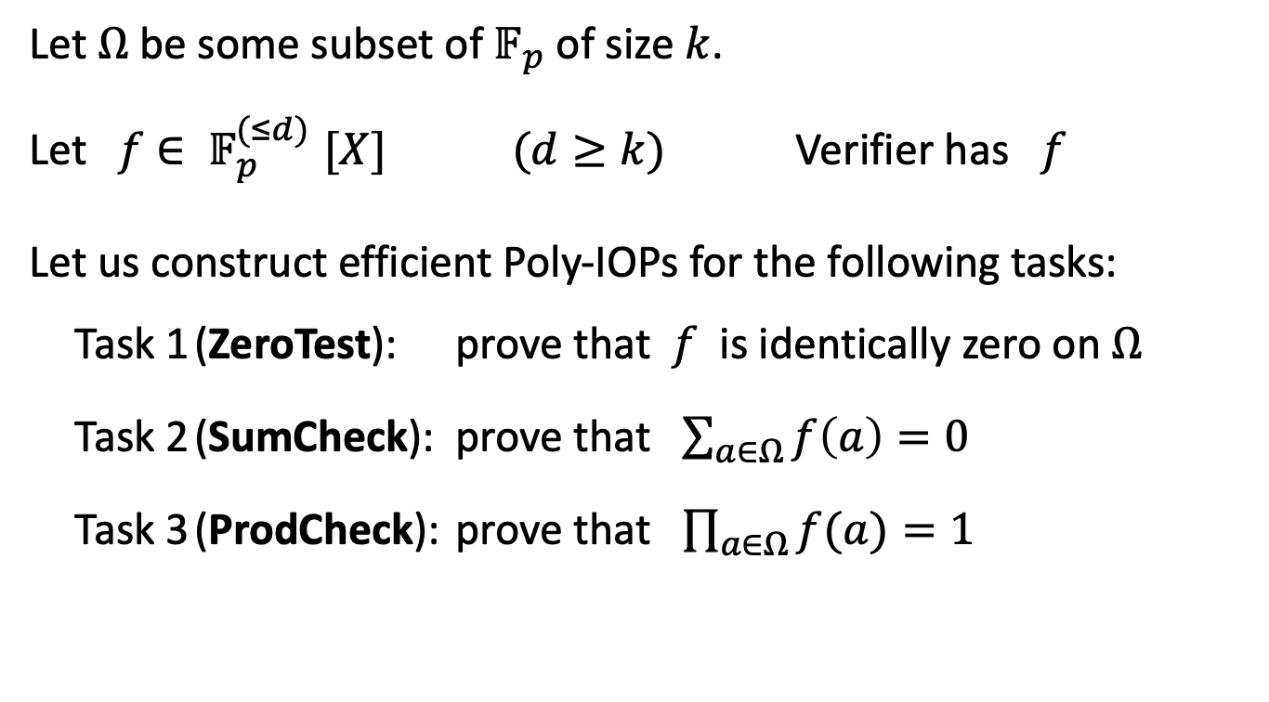
Important proof gadgets for univariates
Let $Ω$ be some subset of $𝔽_{p}$ of size $k$.
Let $f$ ${∈ 𝔽}_{p}^{(≤d)}[X]$ $(d≥k)$ Verifier has $f$
Let us construct efficient Poly-IOPs for the following tasks:
  Task 1 (ZeroTest): prove that $f$ is identically zero on $Ω$
  Task 2 (SumCheck): prove that $\sum_{a∈Ω}{f\left(a\right)=0 }$
  Task 3 (ProdCheck): prove that $\prod_{a∈Ω}{f(a)}=1$

Slide 32
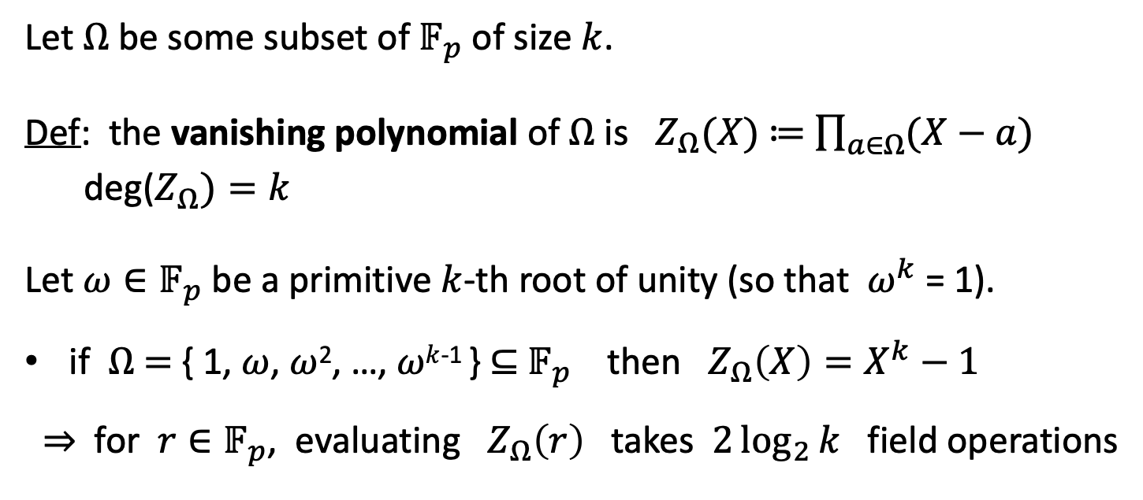
The vanishing polynomial
Let $Ω$ be some subset of $𝔽_{p}$ of size $k$.
Def: the vanishing polynomial of $Ω$ is $Z_{Ω}(X)$ ≔ $\prod_{a∈Ω}{(X−a)}$
deg($Z_{Ω})=k$
Let $ω∈𝔽_{p}$ be a primitive $k$-th root of unity (so that $ω^{k}$ = 1).
if $Ω$ $=$ { 1, $ω$, $ω$², …, $ωk$⁻¹ } ⊆ $𝔽_{p}$ then $Z_{Ω}\left(X\right)=X^{k}−1$
⇒ for $r∈𝔽_{p}$, evaluating $Z_{Ω}\left(r\right)$ takes $2\log_{2}{k}$ field operations
Notes:
This is one reason why we use roots of unity.

Slide 33
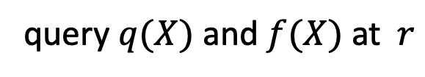


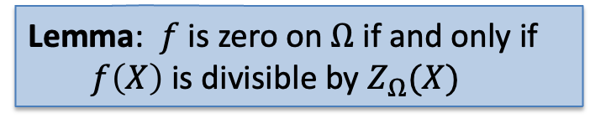







(1) ZeroTest on $Ω$ ($Ω$ = { 1, $ω$, $ω$², …, $ωk$⁻¹ } )
Prover P($f$)
Verifier V( $f$ )
$$q(X)⇽f(X)/Z_{Ω}(X)$$
$q$ ${∈ 𝔽}_{p}^{(≤d)}\left[X\right]$
$$r⇽𝔽_{p}$$
verifier evaluates $Z_{Ω}(r)$by itself
$
query $q(X)$ and $f(X)$ at $r$
learn $q\left(r\right), f(r)$
Lemma: $f$ is zero on $Ω$ if and only if
$f\left(X\right)$ is divisible by $Z_{Ω}(X)$
accept if $f\left(r\right)≟q(r)⋅Z_{Ω}(r)$
(implies that $f(X)=q\left(X\right){∙Z}_{Ω}\left(X\right)$ w.h.p)
Thm: this protocol is complete and sound, assuming $d/p$ is negligible.
Notes:
Prover can only commit to q(X) if it is a polynomial.
proof size: two commitments and two eval proofs (but one eval proof is sufficient by batching, and with KZG this can simply be tested using a pairing)

Slide 34

(1) ZeroTest on $Ω$ ($Ω$ = { 1, $ω$, $ω$², …, $ωk$⁻¹ } )
Prover P($f$)
Verifier V( $f$ )
$$q(X)⇽f(X)/Z_{Ω}(X)$$
$q$ ${∈ 𝔽}_{p}^{(≤d)}\left[X\right]$
$$r⇽𝔽_{p}$$
verifier evaluates $Z_{Ω}(r)$by itself
$
query $q(X)$ and $f(X)$ at $r$
learn $q\left(r\right), f(r)$
Lemma: $f$ is zero on $Ω$ if and only if
$f\left(X\right)$ is divisible by $Z_{Ω}(X)$
accept if $f\left(r\right)≟q(r)⋅Z_{Ω}(r)$
(implies that $f(X)=q\left(X\right){∙Z}_{Ω}\left(X\right)$ w.h.p)
Verifier time: O(log $k$) and two poly queries (but can be batched)
Prover time: dominated by time to compute $q(X)$ and commit to $q(X)$
Notes:
Prover can only commit to q(X) if it is a polynomial.
proof size: two commitments and two eval proofs (but one eval proof is sufficient by batching, and with KZG this can simply be tested using a pairing)

Slide 35



(3) Product check on H: $\prod_{a∈H}{f(a)}=1$
Set $t{∈𝔽}_{p}^{(≤k)}[X]$ to be the degree-$d$ polynomial:
$t(1)=f(1), t(ωs)=\prod_{i=0}^{s}{f(}ωi)$for$s=1, …, k−1$
Then t($ω^{k−1}$) $=$
and $t(ω⋅x)=t(x)⋅f(ω⋅x)$for all $x∈H$ (including $x=ω^{k−1}$ )
Lemma: if (1) t($ω^{k−1}$) $=1$ and
(2) $t\left(ω⋅x\right)−t\left(x\right)⋅f\left(ω⋅x\right)=0$ for all $x∈H$
then $\prod_{a∈H}{f(a)}=1$
$\prod_{a∈H}{f(a)}$

Slide 36










(3) Product check on H (unoptimized)
Prover P($(f,c),⊥$)
Verifier V( $f$)
construct $t\left(X\right)$ ${∈ 𝔽}_{p}^{(≤k)}$ , $t1(X) = t(ω⋅X)−t(X)⋅f(ω⋅X)$
and q$(X)=t1(X){/(X^{k}−1) ∈ 𝔽}_{p}^{(≤k)}$
q$, t$ ${∈ 𝔽}_{p}^{(≤k)}\left[X\right]$
$$r⇽𝔽_{p}$$
eval $t(X)$ at $ω^{k−1} , r, ωr$
learn $t(ω^{k−1}$), t(r), $t(ωr)$, $q(r)$, $f(ωr)$
eval $q\left(X\right)$ at $r$ , and $f(X)$ at $ωr$
accept if $t(ω^{k−1}$) ≟ 1 and
$$t\left(ωr\right)−t(r)f(ωr) ≟q(r)⋅(r^{k}−1)$$
$t1(H) = 0$ :

Slide 37





Same works for rational functions: $\prod_{a∈Ω}{(f/g)(a)}=1$
Prover P($f,g$)
Verifier V( $f , g$ )
Set $t{∈𝔽}_{p}^{(≤k)}[X]$ to be the degree-$k$ polynomial:
$t(1)=f(1)/g(1), t(ωs)=\prod_{i=0}^{s}{f(}ωi)/g(ωi$) for$s=1, …, k−1$
Lemma: if (i) $t$($ω^{k−1}$) $=1$ and
(ii) $t\left(ω⋅x\right)⋅g\left(ω⋅x\right)=t\left(x\right)⋅f\left(ω⋅x\right)$ for all $x∈Ω$
then $\prod_{a∈Ω}{f(a)/g(a)}=1$

Slide 38

(4) Another useful gadget: permutation check
Let $f, g$ polynomials in $𝔽_{p}^{(≤d)}\left[X\right].$ Verifier has $f$ , $g$ .
Prover wants to prove that ($f\left(1\right), f\left(ω\right), f\left(ω^{2}\right), …, f(ω^{k−1}$) ) $∈𝔽_{p}^{k}$
is a permutation of ($g\left(1\right), g\left(ω\right), g\left(ω^{2}\right), …, g(ω^{k−1}$) ) $∈𝔽_{p}^{k}$
⇒ Proves that $g(Ω)$ is the same as $f(Ω)$, just permuted

Slide 39







(4) Another useful gadget: permutation check
Prover P($f,g$)
Verifier V( $f , g$)
Let $\hat{f}\left(X\right)= \prod_{a∈Ω}{(X−f\left(a\right))}$ and $\hat{g}\left(X\right)= \prod_{a∈Ω}{(X−g\left(a\right))}$
Then: $\hat{f}\left(X\right)=$ $\hat{g}\left(X\right) ⟺$ $g(Ω)$ is a permutation of $f(Ω)$
$$r$$
$$r⇽𝔽_{p}$$
$
prove that $\hat{f}\left(r\right)=$ $\hat{g}\left(r\right)$
prod-check:
implies $\hat{f}\left(X\right)=$ $\hat{g}\left(X\right)$w.h.p
accept or reject
[Lipton’s trick, 1989]
Notes:
Lipton, “efficient checking of computations”, 1989. The quantity \hat{f}(r) is called a fingerprint of f.
We are using product check for rational functions.

Slide 40

(5) final gadget: prescribed permutation check
$W:Ω⇾Ω$ is a permutation of $Ω$ if $∀i∈\left[k\right]:$ $W(ω^{i})=$ $ω^{j}$ a bijection
example $(k=3)$: $W\left(ω^{0}\right)=ω^{2} , W\left(ω^{1}\right)=ω^{0} , W(ω^{2})=ω^{1}$
Let $f, g$ polynomials in ${ 𝔽}_{p}^{(≤d)}[X]$ . Verifier has $f$ , $g$ , $W$ .
Goal: prover wants to prove that $f(y)=g(W(y))$ for all $y∈Ω$
⇒ Proves that $g(Ω)$ is the same as $f(Ω)$, permuted by the prescribed $W$

Slide 41

Prescribed permutation check
How? Use a zero-test to prove $f\left(y\right)−g\left(W\left(y\right)\right)=0$ on $Ω$
The problem: the polynomial $f\left(y\right)−g\left(W\left(y\right)\right)$ has degree k²
⇒ prover would need to manipulate polynomials of degree k²
⇒ quadratic time prover !! (goal: linear time prover)
Can reduce this to a prod-check on a poly of degree $2k$ (not $k^{2}$)

Slide 42

Prescribed permutation check
Observation:
if ${\left(W(a),f\left(a\right)\right)}_{a∈Ω}$ is a permutation of ${\left(a,g\left(a\right)\right)}_{a∈Ω}$
then $f(y)=g(W(y))$ for all $y∈Ω$
Proof by example: $W\left(ω^{0}\right)= ω^{2} , W\left(ω^{1}\right)=ω^{0} , W(ω^{2})=ω^{1}$
Right tuple: (ω⁰,g(ω⁰)), (ω¹,g(ω¹)), (ω²,g(ω²))
Left tuple: (ω² ,f(ω⁰)), (ω⁰ ,f(ω¹)), (ω¹,f(ω²))

Slide 43




Prescribed permutation check
Prover P($f,g,W$)
Verifier V( $f , g , W$)
Let $\hat{f}\left(X,Y\right)= \prod_{a∈Ω}{ (X−Y∙W\left(a\right)−f\left(a\right))}$ and
$\hat{g}\left(X,Y\right)= \prod_{a∈Ω}{ (X−Y∙a−g\left(a\right))}$
(bivariate polynomials of total degree $k$)
Lemma: $\hat{f}\left(X,Y\right)=$ $\hat{g}\left(X,Y\right) ⟺ {\left(W(a),f\left(a\right)\right)}_{a∈Ω}$ is a perm. of ${\left(a,g\left(a\right)\right)}_{a∈Ω}$
To prove, use the fact that $𝔽_{p}\left[X,Y\right]$ is a unique factorization domain

Slide 44




The complete protocol
Prover P($f,g,W$)
Verifier V( $f , g , W$)
$$r,s$$
$
$$r, s⇽𝔽_{p}$$
prove that $\hat{f}\left(r,s\right)=$ $\hat{g}\left(r,s\right)$:
by Schwartz-Zippel
ProdCheck:
implies $\hat{f}\left(X,Y\right)=$ $\hat{g}\left(X,Y\right)$w.h.p
accept or reject
Complete and sound, assuming $2d/p$ is negligible.
Notes:
Prover time: O(k log k). Verifier time: O(log k).
Two commits, seven evals.

Slide 45

Summary of proof gadgets
polynomial equality testing
zero test on $Ω$
product check, sum check
permutation check
prescribed permutation check

Slide 46
The PLONK Poly-IOP for general circuits
eprint/2019/953

Slide 47
PLONK: widely used in practice
polynomial commitment scheme
SNARK system
KZG’10
(pairings)
Aztec, JellyFish
The Plonk
Poly-IOP
Bulletproofs
(no pairings)
Halo2
(slow verifier)
(no trusted setup)
FRI
(hashing)
Plonky2, Redshift
(no trusted setup)
Notes:
Mention R1CS

Slide 48


PLONK: a poly-IOP for a general circuit $C(x,w)$
Step 1: compile circuit to a computation trace (gate fan-in = 2)
The computation trace (arithmetization):
$$(x1+x2)(x2+w1)$$
77
inputs: 5, 6, 1
Gate 0: 5 , 6 , 11
Gate 1: 6 , 1 , 7
Gate 2: 11, 7, 77
$$\text{×}$$
(Gate 2)
11
7
(Gate 0)
$$+$$
$$+$$
(Gate 1)
5
6
1
6
$$x1$$
$$x2$$
$$w1$$
5
6
1
example input
left
inputs
right
inputs
outputs
Notes:
Mention R1CS

Slide 49


Encoding the trace as a polynomial
$|C|$ ≔ total # of gates in $C$ , |$I$| ≔ |$Ix$| + |$Iw$| $=$ # inputs to $C$
let $d \text{≔} 3 \left|C\right|+|I|$ (in example, $d=12$) and $Ω$ ≔ { 1, $ω$, $ω$²,…, $ω^{d−1}$ }
The plan:
prover interpolates a poly. $T{∈ 𝔽}_{p}^{(≤d)}$[X]
that encodes the entire trace.
inputs: 5, 6, 1
Gate 0: 5 , 6 , 11
Gate 1: 6 , 1 , 7
Gate 2: 11, 7, 77
Let’s see how …

Slide 50

Encoding the trace as a polynomial
The plan: Prover interpolates $T{∈ 𝔽}_{p}^{(≤d)}$[X] such that
(1) $T$ encodes all inputs: T($ω^{−j})=$ input #$j$ for $j$ = 1, …, $|I|$
(2) $T$ encodes all wires: ∀ $l=0,…,\left|C\right|−1$:
    T($ω3l$): left input to gate #$l$
    T($ω3l$⁺¹): right input to gate #$l$
    T($ω3l$⁺²): output of gate #$l$
inputs: 5, 6, 1
Gate 0: 5 , 6 , 11
Gate 1: 6 , 1 , 7
Gate 2: 11, 7, 77

Slide 51



Encoding the trace as a polynomial
In our example, Prover interpolates $T(X)$ such that:
inputs: T($ω^{−1})=5$, T($ω^{−2})=6$, T($ω^{−3})=1$,
gate 0: T($ω^{0})=5$, T($ω^{1})=6$, T($ω^{2})=11$,
gate 1: T($ω^{3})=6$, T($ω^{4})=1$, T($ω^{5})=7$,
gate 2: T($ω^{6})=11$, T($ω^{7})=7$, T($ω^{8})=77$
degree($T$) = 11
inputs: 5, 6, 1
Gate 0: 5 , 6 , 11
Gate 1: 6 , 1 , 7
Gate 2: 11, 7, 77
Prover can use FFT to compute the coefficients
of T in time $O(d \text{log} d)$

Slide 52


Step 2: proving validity of T
Prover P($Sp,x,w$)
Verifier V($Sv, x$)
build T$(X){∈𝔽}_{p}^{(≤d)}$[X]
$$T$$
Prover needs to prove that T is a correct computation trace:
  T encodes the correct inputs,
  every gate is evaluated correctly,
  the wiring is implemented correctly,
  the output of last gate is 0
(wiring constraints)
inputs: 5 , 6, 1
Gate 0: 5 , 6 , 11
Gate 1: 6 , 1 , 7
Gate 2: 11, 7, 77
Proving (4) is easy: prove $T$($ω^{3\left|C\right|−1})=0$

Slide 53


Proving (1): T encodes the correct inputs
Both prover and verifier interpolate a polynomial $v(X)$ ${∈ 𝔽}_{p}^{(≤|I_{x}|)}$[X]
that encodes the $x$-inputs to the circuit:
for $j=1,...,|I_{x}|: v(ω^{−j})=$input #j
In our example: $v\left(ω^{−1}\right)=5, v\left(ω^{−2}\right)=6$ . ($v$ is linear)
constructing $v(X)$ takes time proportional to the size of input $x$
⇒ verifier has time do this

Slide 54

Proving (1): T encodes the correct inputs
Both prover and verifier interpolate a polynomial $v(X)$ ${∈ 𝔽}_{p}^{(≤|I_{x}|)}$[X]
that encodes the $x$-inputs to the circuit:
for $j=1,...,|I_{x}|: v(ω^{−j})=$input #j
Let $Ω$_{inp} ≔ {${ ω}^{−1},ω^{−2}, …,ω^{−\left|I_{x}\right|} \}$⊆ $Ω$ (points encoding the input)
Prover proves (1) by using a ZeroTest on $Ω$_{inp} to prove that
T(y) $−$ $v$(y) $=$ $0$ ∀ y ∈ $Ω$_{inp}

Slide 55


Proving (2): every gate is evaluated correctly
Idea: encode gate types using a selector polynomial S(X)
define S(X) ${∈ 𝔽}_{p}^{(≤d)}$[X] such that ∀ $l=0,…,\left|C\right|−1$:
S($ω3l$) = 1 if gate #$l$ is an addition gate
S($ω3l$) = 0 if gate #$l$ is a multiplication gate
inputs: 5 , 6, 1 $S(X)$
Gate 0 ($ω0$): 5 , 6 , 11 1
Gate 1 ($ω3$): 6 , 1 , 7 1
Gate 2 ($ω6$): 11, 7, 77 0
$$\text{×}$$
(Gate 2)
(+)
$$+$$
$$+$$
(Gate 1)
(+)
(Gate 0)
(×)
$$x1$$
$$x2$$
$$w1$$

Slide 56


Proving (2): every gate is evaluated correctly
Idea: encode gate types using a selector polynomial S(X)
define S(X) ${∈ 𝔽}_{p}^{(≤d)}$[X] such that ∀ $l=0,…,\left|C\right|−1$:
S($ω3l$) = 1 if gate #$l$ is an addition gate
S($ω3l$) = 0 if gate #$l$ is a multiplication gate
Then ∀ y ∈ $Ω$_{gates} ≔ { 1, $ω3$, $ω6$, $ω9$, …, $ω^{3(\left|C\right|−1)}$ } :
S(y)⋅[T(y) + T($ωy$)] + (1 – S(y))⋅T(y)⋅T($ωy$) $=$
T($ω$²y)
left input
right input
left input
right input
output

Slide 57





Proving (2): every gate is evaluated correctly
Setup($C$) ⇾ $pp\text{≔}$S and $vp$≔ ( S )
Prover P($pp,x,w$)
Verifier V($vp, x$)
$$T$$
build T$(X){∈𝔽}_{p}^{(≤d)}$[X]
Prover uses ZeroTest to prove that for all $∀ y∈Ωgates$ :
S(y)⋅[T(y) + T($ωy$)] + (1 – S(y))⋅T(y)⋅T($ωy$) − T($ω$²y) $=0$

Slide 58



Proving (3): the wiring is correct
example: x₁=5, x₂=6 , $w1$=1
$ω$⁻¹, $ω$⁻², $ω$⁻³: 5, 6, 1
$ω$⁰, $ω$¹, $ω$² : 5, 6, 11
$ω3$, $ω$⁴, $ω$⁵ : 6, 1, 7
$ω6$, $ω$⁷, $ω$⁸ : 11, 7, 77
Step 4: encode the wires of $C$:
T($ω$⁻²) = T($ω$¹) = T($ω$³)
T($ω$⁻¹) = T($ω$⁰)
T$(ω$²) = T($ω$⁶)
T($ω$⁻³) = T($ω$⁴)
0:
1:
2:
Define a polynomial W: $Ω$ ⇾ $Ω$ that implements a rotation:
W($ω$⁻², $ω$¹ , $ω$³) = ($ω1, ω$³, $ω$⁻² ) , W($ω$⁻¹, $ω$⁰) = ($ω$⁰ , $ω$⁻¹) , …
Lemma: ∀ $y$∈$Ω$: T($y$) = T(W($y$)) ⇒ wire constraints are satisfied
Notes:
Also T($ω$⁵) = T($ω$⁷)

Slide 59
Proving (3): the wiring is correct
example: x₁=5, x₂=6 , $w1$=1
$ω$⁻¹, $ω$⁻², $ω$⁻³: 5, 6, 1
$ω$⁰, $ω$¹, $ω$² : 5, 6, 11
$ω3$, $ω$⁴, $ω$⁵ : 6, 1, 7
$ω6$, $ω$⁷, $ω$⁸ : 11, 7, 77
Step 4: encode the wires of $C$:
T($ω$⁻²) = T($ω$¹) = T($ω$³)
T($ω$⁻¹) = T($ω$⁰)
T$(ω$²) = T($ω$⁶)
T($ω$⁻³) = T($ω$⁴)
0:
1:
2:
Proved using a prescribed permutation check
Define a polynomial W: $Ω$ ⇾ $Ω$ that implements a rotation:
W($ω$⁻², $ω$¹ , $ω$³) = ($ω1, ω$³, $ω$⁻² ) , W($ω$⁻¹, $ω$⁰) = ($ω$⁰ , $ω$⁻¹) , …
Lemma: ∀ $y$∈$Ω$: T($y$) = T(W($y$)) ⇒ wire constraints are satisfied

Slide 60







The complete Plonk Poly-IOP (and SNARK)
Setup($C$) ⇾ $pp$≔ ($S$,$W$) and $vp$ ≔ ( $S$ and $W$ ) (untrusted)
Prover P($pp,x,w$)
Verifier V($vp, x$)
build T$(X){∈𝔽}_{p}^{(≤d)}$[X]
$$T$$
build $v(X){∈𝔽}_{p}^{(≤|I_{x}|)}\text{[}\text{X}\text{]}$
Prover proves:
(1) S(y)⋅[T(y) + T($ωy$)] + (1 – S(y))⋅T(y)⋅T($ωy$) $−$ T($ω$²y) $=$ $0$; ∀ y ∈ $Ω$_{gates}
(2) T(y) $−$ $v$(y) $=$ $0$ ∀ y ∈ $Ω$_{inp}
(3) T(y) $−$ T($W$(y)) $=$ $0$ (using prescribed perm. check) ∀ y ∈ $Ω$
(4) T($ω^{3\left|C\right|−1})=0$ (output of last gate = 0)
gates:
inputs:
wires:
output:

Slide 61

The complete Plonk Poly-IOP (and SNARK)
Setup($C$) ⇾ $pp$≔ ($S$,$W$) and $vp$ ≔ ( $S$ and $W$ ) (untrusted)
Prover P($pp,x,w$)
Verifier V($vp, x$)
build T$(X){∈𝔽}_{p}^{(≤d)}$[X]
$$T$$
build $v(X){∈𝔽}_{p}^{(≤|I_{x}|)}\text{[}\text{X}\text{]}$
Thm: The Plonk Poly-IOP is complete and knowledge sound,
assuming $7|C|/p$is negligible
(eprint/2019/953)

Slide 62

Many extensions …
Plonk proof: a short proof (O(1) commitments), fast verifier
The SNARK can be made into a zk-SNARK
Main challenge: reduce prover time
Hyperplonk: replace $Ω$ with ${\left\{0,1\right\}}^{t}$ ( where $t=\log_{2}|Ω|$ )
  The polynomial T is now a multilinear polynomial in $t$ variables
  ZeroTest is replaced by a multilinear SumCheck (linear time)

Slide 63
END OF LECTURE
Next lecture: scaling the blockchain

