Slide 1
Using zk-SNARKs for Privacy on the Blockchain
CS251 Fall 2023
(cs251.stanford.edu)
Dan Boneh

Slide 2
The need for privacy in the financial system
Supply chain privacy:
  A manufacturer does not want to reveal
  how much it pays its supplier for parts.
Payment privacy:
  A company that pays its employees in crypto wants to keep list of employees and salaries private.
  Endusers need privacy for rent, donations, purchases
Business logic privacy: Can the code of a smart contract be private?

Slide 3
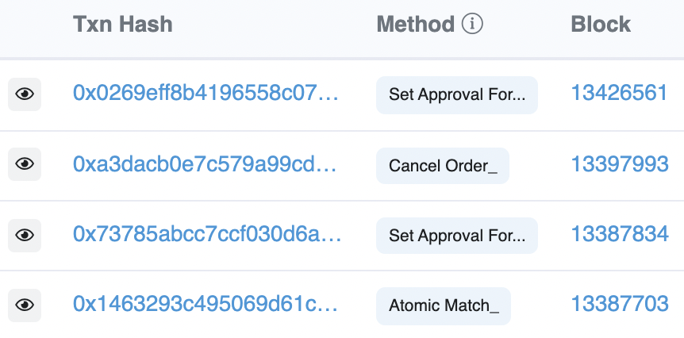
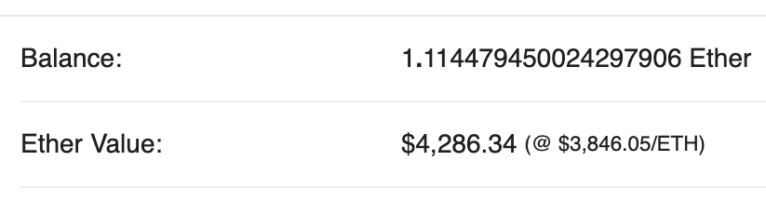
Previous lecture
Neither Bitcoin nor Ethereum are private
etherscan.io:
Address 0x1654b0c3f62902d7A86237…
This lecture: general tools for privacy on the blockchain

Slide 4
What is a zk-SNARK?
Succinct zero knowledge proofs:
an important tool for privacy on the blockchain

Slide 5
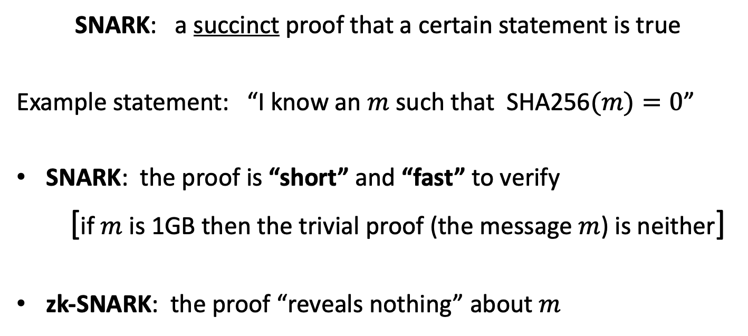
What is a zk-SNARK ? (intuition)
SNARK: a succinct proof that a certain statement is true
Example statement: “I know an $m$ such that SHA256$(m)=0$”
SNARK: the proof is “short” and “fast” to verify
[if $m$ is 1GB then the trivial proof (the message $m$) is neither]
zk-SNARK: the proof “reveals nothing” about $m$

Slide 6









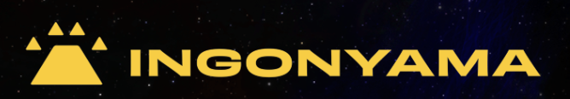
Commercial interest in SNARKs
Many more building applications that use SNARKs

Slide 7
Blockchain Applications I
Outsourcing computation: (no need for zero knowledge)
L1 chain quickly verifies the work of an off-chain service
Examples:
Scalability: proof-based Rollups (zkRollup)
off-chain service processes a batch of Tx;
L1 chain verifies a succinct proof that Tx were processed correctly
Bridging blockchains: proof of consensus (zkBridge)
Chain A produces a succinct proof about its state. Chain B verifies.
To minimize gas: need a short proof, fast to verify
Notes:
Stress non-interactive aspect of proof.

Slide 8
Blockchain Applications II
Some applications require zero knowledge (privacy):
Private Tx on a public blockchain:
  zk proof that a private Tx is valid (Tornado cash, Zcash, IronFish, Aleo)
Compliance:
  Proof that a private Tx is compliant with banking laws (Espresso)
  Proof that an exchange is solvent in zero-knowledge (Proven)
More on these blockchain applications in a minute

Slide 9
Many non-blockchain applications
Blockchains drive the development of SNARKs
… but many non-blockchain applications benefit

Slide 10
Why is all this possible now?
The breakthrough: new fast SNARK provers
Proof generation time is linear (or quasilinear) in computation size
Many beautiful ideas … next lecture
a large bibliography: a16zcrypto.com/zero-knowledge-canon
Notes:
GGPR 2013: Gennaro, Gentry, Parno, Reykova . Quadratic span programs.

Slide 11
What is a SNARK?

Slide 12



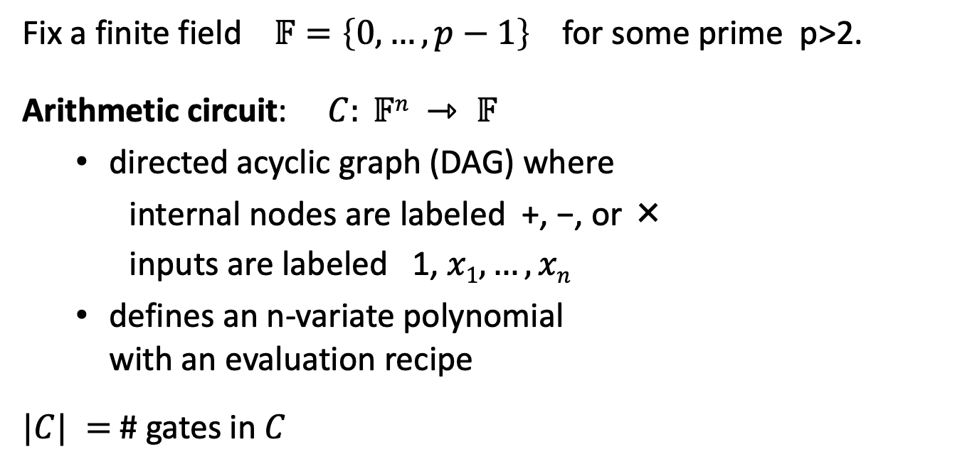




Review: arithmetic circuits
Fix a finite field $𝔽=\left\{0, …, p−1\right\}$ for some prime p>2.
Arithmetic circuit: $C: 𝔽n ⇾ 𝔽$
  directed acyclic graph (DAG) where
    internal nodes are labeled +, −, or ×
    inputs are labeled 1, $x1, …, xn$
  defines an n-variate polynomial
  with an evaluation recipe
$|C| =$ # gates in $C$
$$x1(x1+x2+1)(x2−1)$$
$$\text{×}$$
$$+$$
$$−$$
$$x1$$
$$x2$$
$$1$$

Slide 13




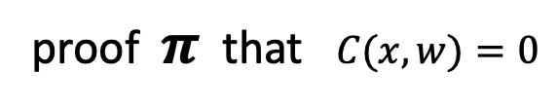
(preprocessing) NARK: Non-interactive ARgument of Knowledge
Public arithmetic circuit: $C( x, w ) ⇾ 𝔽$
public statement in $𝔽_{}^{n}$
secret witness in $𝔽_{}^{m}$
Preprocessing (setup): S($C$) ⇾ public parameters ($pp$, $vp$ )
$pp$, $x,$ $w$
$vp$, $x$
proof $π$ that $C(x,w)=0$
Prover
Verifier
accept or
reject
Notes:
Knowledge is stronger the soundness.

Slide 14
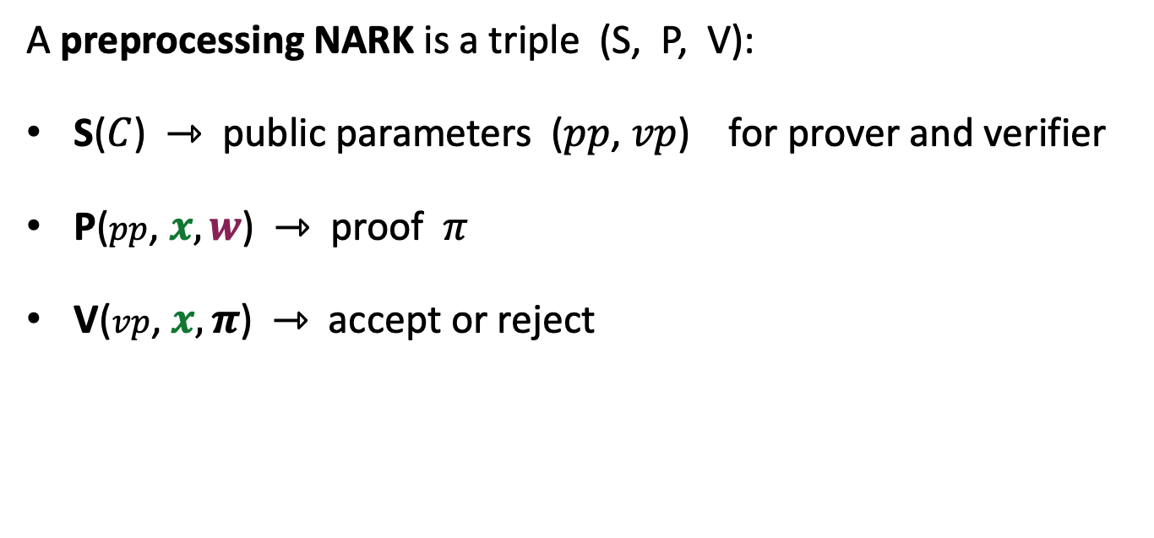
(preprocessing) NARK: Non-interactive ARgument of Knowledge
A preprocessing NARK is a triple (S, P, V):
S($C$) ⇾ public parameters ($pp$, $vp$) for prover and verifier
P($pp$, $x, w$) ⇾ proof $π$
V($vp$, $x, π$) ⇾ accept or reject
all algs. and adversary have
access to a random oracle

Slide 15


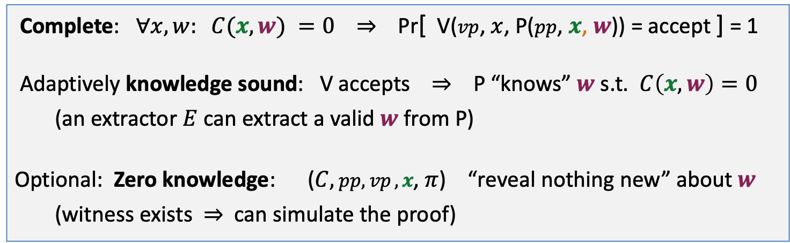

NARK: requirements (informal)
Prover P($pp$, $x, w$)
Verifier V ($vp$, $x$, $π$)
proof $π$
accept or reject
Complete: $∀x, w: C(x, w) =0$ ⇒ Pr[ V($vp$, $x$, P($pp$, $x$, $w$)) = accept ] = 1
Adaptively knowledge sound: V accepts ⇒ P “knows” $w$ s.t. $C\left(x, w\right)=0$
(an extractor $E$ can extract a valid $w$ from P)
Optional: Zero knowledge: ($C,$ $pp,vp ,x$, $π$) “reveal nothing new” about $w$
(witness exists ⇒ can simulate the proof)

Slide 16
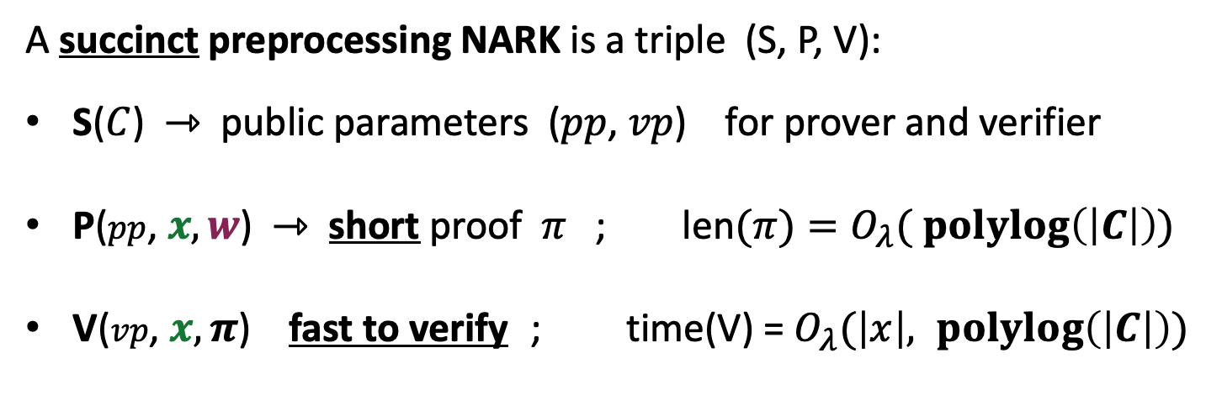
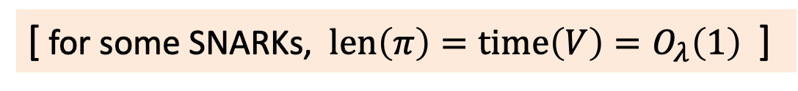

SNARK: a Succinct ARgument of Knowledge
A succinct preprocessing NARK is a triple (S, P, V):
S($C$) ⇾ public parameters ($pp$, $vp$) for prover and verifier
P($pp$, $x, w$) ⇾ short proof $π$ ; len$(π)=O_{λ}( \operatorname{polylog}\left(\left|C\right|\right))$
V($vp$, $x, π$) fast to verify ; time(V) = $O_{λ}(\left|x\right|, \operatorname{polylog}\left(\left|C\right|\right))$
short “summary” of circuit
V has no time to read $C$ !!
[ for some SNARKs, $len\left(π\right)=time\left(V\right)=O_{λ}\left(1\right)$ ]
Notes:
log |C| is bigger than log |w|, so this is not as strict as requiring proof size to be log |w|. In many SNARKs, proof size and verify time is independent of |C| or |w|.

Slide 17
SNARK: a Succinct ARgument of Knowledge
SNARK: a NARC (complete and knowledge sound) that is succinct
zk-SNARK: a SNARK that is also zero knowledge

Slide 18
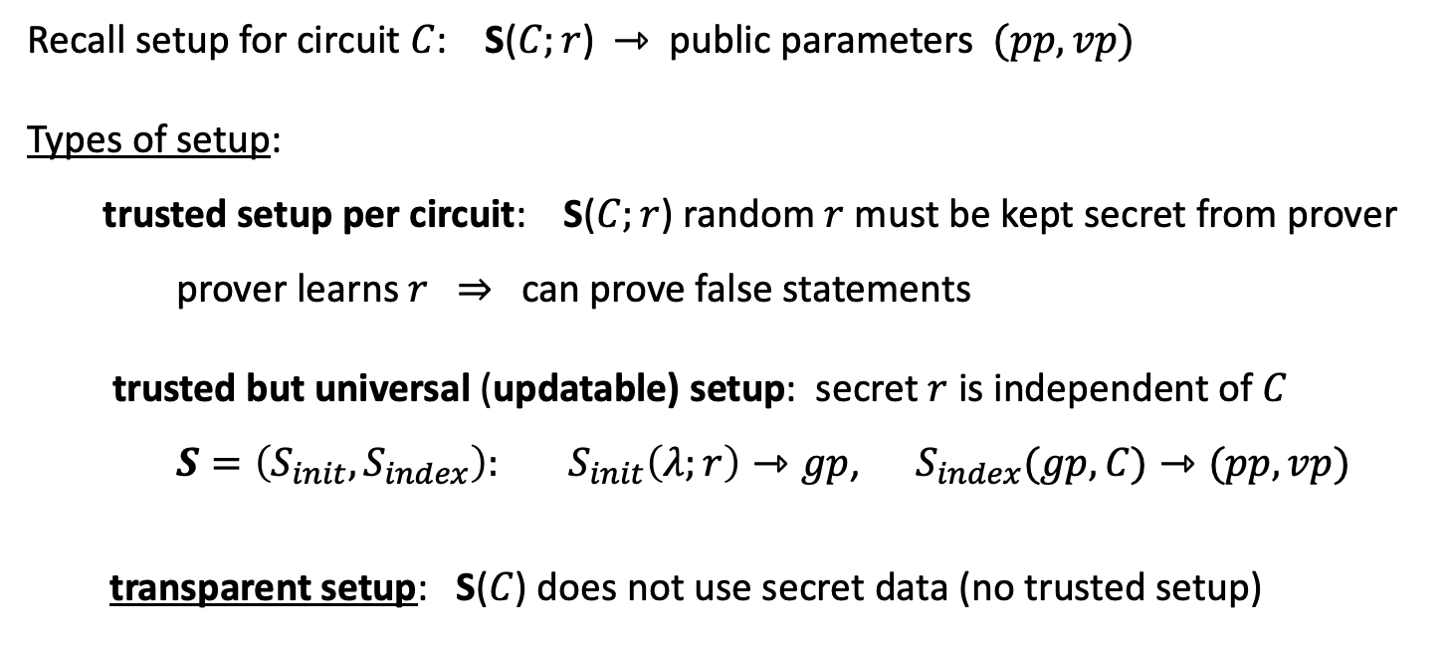
Types of preprocessing Setup
Recall setup for circuit $C$: S($C;r$) ⇾ public parameters $(pp, vp)$
Types of setup:
trusted setup per circuit: S($C;r$) random $r$ must be kept secret from prover
prover learns $r$ ⇒ can prove false statements
trusted but universal (updatable) setup: secret $r$ is independent of $C$
$S=\left(S_{init}, S_{index}\right): S_{init}\left(λ;r\right)⇾gp$, $S_{index}(gp,C)⇾(pp, vp)$
transparent setup: S($C$) does not use secret data (no trusted setup)
random bits
better
one-time
no secret data from prover

Slide 19
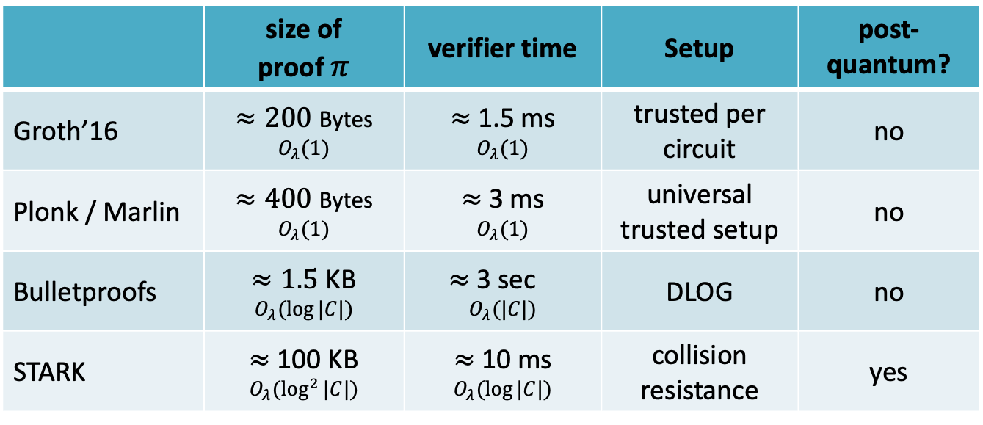
Significant progress in recent years (partial list)
 | size of proof $π$ | verifier time | Setup | post-quantum?
Groth’16 | $≈200$ Bytes $$O_{λ}(1)$$ | $≈$ 1.5 ms $$O_{λ}(1)$$ | trusted per circuit | no
Plonk / Marlin | $≈400$ Bytes $$O_{λ}(1)$$ | $≈$ 3 ms $$O_{λ}(1)$$ | universal trusted setup | no
Bulletproofs | $≈1.5$ KB $$O_{λ}(log⁡|C|)$$ | $≈$ 3 sec⁡ $$O_{λ}(|C|)$$ | DLOG | no
STARK | $≈$ 100 KB $$O_{λ}(\log^{2}⁡|C|)$$ | $≈$ 10 ms $$O_{λ}(log⁡|C|)$$ | collision resistance | yes
(for a circuit with 2²⁰ gates)
Notes:
no trusted setup: log-size proof. but shorter Sp.

Slide 20
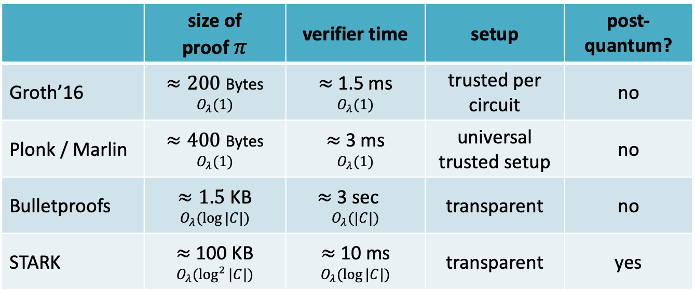
Significant progress in recent years (partial list)
 | size of proof $π$ | verifier time | setup | post-quantum?
Groth’16 | $≈200$ Bytes $$O_{λ}(1)$$ | $≈$ 1.5 ms $$O_{λ}(1)$$ | trusted per circuit | no
Plonk / Marlin | $≈400$ Bytes $$O_{λ}(1)$$ | $≈$ 3 ms $$O_{λ}(1)$$ | universal trusted setup | no
Bulletproofs | $≈1.5$ KB $$O_{λ}(log⁡|C|)$$ | $≈$ 3 sec⁡ $$O_{λ}(|C|)$$ | transparent | no
STARK | $≈$ 100 KB $$O_{λ}(\log^{2}⁡|C|)$$ | $≈$ 10 ms $$O_{λ}(log⁡|C|)$$ | transparent | yes
⋮
⋮
(for a circuit with 2²⁰ gates)
Notes:
no trusted setup: log-size proof. but shorter Sp.

Slide 21
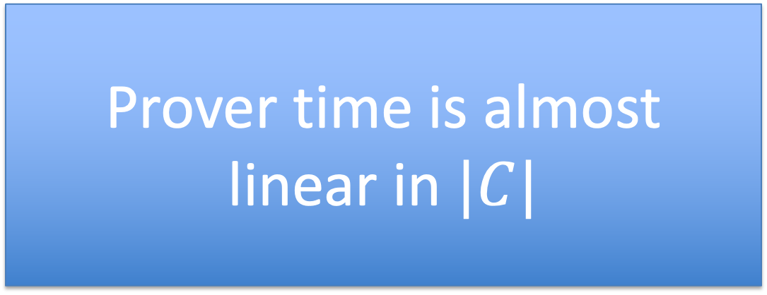
Significant progress in recent years (partial list)
 | size of proof $π$ | verifier time | setup | post-quantum?
Groth’16 | $≈200$ Bytes $$O_{λ}(1)$$ | $≈$ 1.5 ms $$O_{λ}(1)$$ | trusted per circuit | no
Plonk / Marlin | $≈400$ Bytes $$O_{λ}(1)$$ | $≈$ 3 ms $$O_{λ}(1)$$ | universal trusted setup | no
Bulletproofs | $≈1.5$ KB $$O_{λ}(log⁡|C|)$$ | $≈$ 3 sec⁡ $$O_{λ}(|C|)$$ | transparent | no
STARK | $≈$ 100 KB $$O_{λ}(\log^{2}⁡|C|)$$ | $≈$ 10 ms $$O_{λ}(log⁡|C|)$$ | transparent | yes
Prover time is almost
linear in $|C|$
⋮
⋮
(for a circuit with 2²⁰ gates)
Notes:
no trusted setup: log-size proof. but shorter Sp.

Slide 22
How to define “knowledge soundness” and “zero knowledge”?

Slide 23
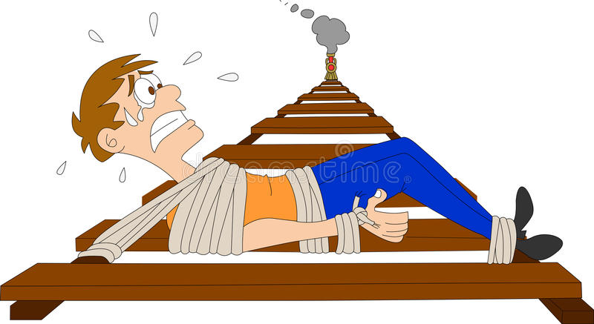
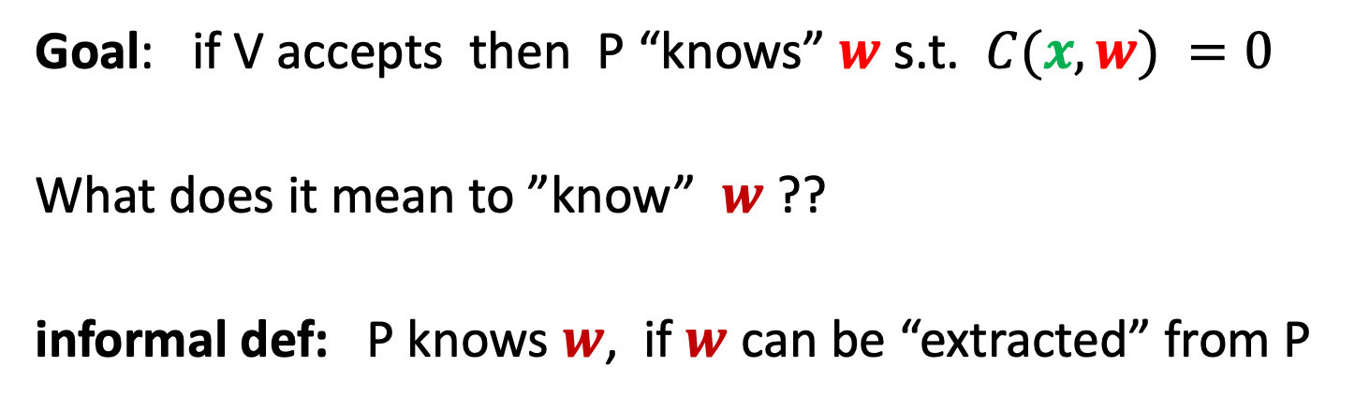
Definitions: (1) knowledge sound
Goal: if V accepts then P “knows” $w$ s.t. $C(x, w) =0$
What does it mean to ”know” $w$ ??
informal def: P knows $w$, if $w$ can be “extracted” from P
P

Slide 24

Definitions: (1) knowledge sound (simplified)
Formally: a universal SNARK (S, P, V) is knowledge sound if
for every poly. time adversary A = (A₀, A₁) there exists
a poly. time extractor $Ext$ (that uses A as a black box) s.t.
if $gp$ ⇽ S_{init}( ), ($C,$ $x$, state) ⇽ A₀($gp$), ($pp$, $vp$) ⇽ S_{index}($gp,C$),
$π$ ⇽ A₁($pp$, $x$, state), $w$ ⇽ $Ext$($gp$, $C$, $x$)
Then
Pr[ V(vp, $x$, $π$) = accept ⇒ $C(x,w)=0$ ] ≥ 1 $− ε$ (for a negl. $ε$)
extracted witness

Slide 25


Definitions: (2) Zero knowledge
Where is
Waldo?

Slide 26

Definitions: (2) Zero knowledge
A story about the lady sipping tea

Slide 27

Definitions: (2) Zero knowledge (simplified)
(S, P, V) is zero knowledge if for every $x∈𝔽_{}^{n}$
proof $π$ “reveals nothing” about $w$, other than its existence
What does it mean to “reveal nothing” ??
Informal def: $π$ “reveals nothing” about $w$ if the verifier can
generate $π$ by itself ⟹ it learned nothing new from $π$
(S, P, V) is zero knowledge if there is an efficient alg. Sim
s.t. ($pp$, $vp$, $π$) ⇽ Sim($C,x$) “look like” the real $pp$,$vp$ and $π$.
Main point: Sim($C$,x) simulates $π$ without knowledge of $w$
Notes:
Honest verifier because we are assuming S is honest (treating S as part o the verifier).
Note: this definition means that (Sp, Sv) are only good for a single proof. The correct definition gives (Sp, Sv) as input to Sim, but then it is not clear what is Sim’s advantage. Sim can program the random oracle, but we are not at a point where we can explain that.

Slide 28
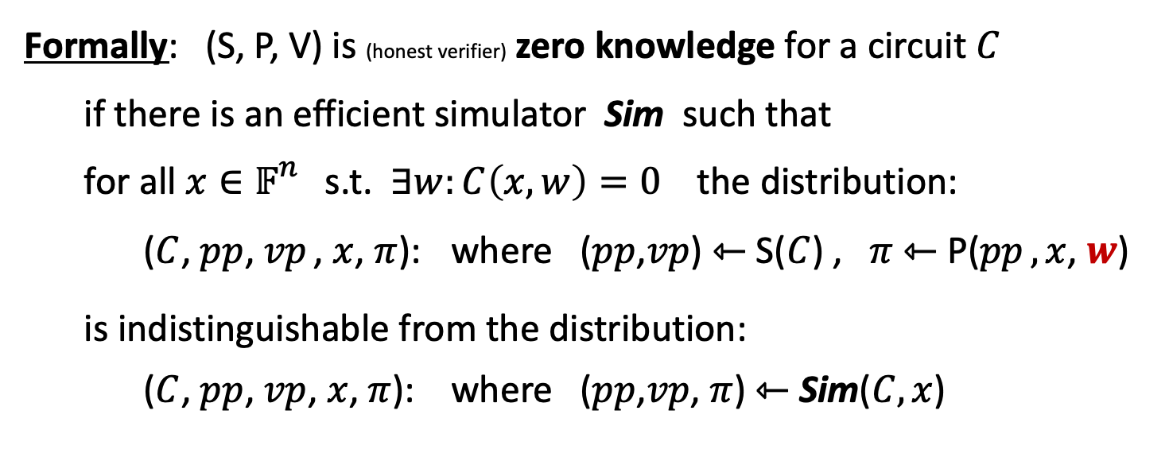
Definitions: (2) Zero knowledge (simplified)
Formally: (S, P, V) is (honest verifier) zero knowledge for a circuit $C$
if there is an efficient simulator Sim such that
for all $x∈𝔽_{}^{n}$ s.t. $∃w:C\left(x,w\right)=0$ the distribution:
($C$, $pp$, $vp$ , $x$, $π$): where ($pp$,$vp$) ⇽ S($C$) , $π$ ⇽ P($pp$ $,x$, $w$)
is indistinguishable from the distribution:
($C$, $pp$, $vp$, $x$, $π$): where ($pp$,$vp$, $π$) ⇽ Sim($C,x$)
Main point: Sim($C$,x) simulates $π$ without knowledge of $w$
Notes:
Honest verifier because we are assuming S is honest (treating S as part o the verifier)

Slide 29
How to build a zk-SNARK?
Recall: prover generates a short proof that is fast to verify
How to build a zk-SNARK ??
Next lecture

Slide 30
Applications of SNARKs:
(1) Tornado cash: a zk-based mixer
Launched on the Ethereum blockchain on May 2020 (v2)

Slide 31
Tornado Cash: a ZK-mixer
A common denomination (1000 DAI) is needed to prevent linking
Alice to her fresh address using the deposit/withdrawal amount
1000 DAI
MIX
NFT
market
???
1000 DAI
1000 DAI
buy NFT
privately
account
fresh
address
(1000 DAI)
1000 DAI
Tornado.cash
contract
Notes:
If Alice deposits and withdraws 1547.3 DAI then that creates a link between the deposit and the withdrawal events.

Slide 32
The tornado cash contract (simplified)
H₁, H₂: R ⇾ {0,1}²⁵⁶
CRHF
100 DAI pool:
each coin = 100 DAI
Treasury: 300 DAI
nf₁
Coins
Merkle
root
coins
Merkle
root
nf₂
(32 bytes)
tree of
height 20
(2²⁰ leaves)
Currently:
three coins in pool
contract has 300 DAI
two nullifiers stored
next = 4
nullifiers
C₁ C₂ C₃ 0 0 … 0
contract state
public list of coins
explicit list:
one entry per spent coin

Slide 33
Tornado cash: deposit (simplified)
H₁, H₂: R ⇾ {0,1}²⁵⁶
100 DAI pool:
each coin = 100 DAI
Treasury: 300 DAI
nf₁
Coins
Merkle
root
coins
Merkle
root
nf₂
Alice deposits 100 DAI:
(32 bytes)
tree of
height 20
(2²⁰ leaves)
100 DAI
C₄ , MerkleProof(4)
next = 4
nullifiers
C₁ C₂ C₃ 0 0 … 0
Build Merkle proof for leaf #4:
MerkleProof(4) (leaf=0)
choose random k, r in R
set C₄ = H₁(k, r)
contract state
public list of coins
explicit list:
one entry per spent coin
Notes:
Note: one Tx per block. Alice needs to know what leaf her coin will occupy.

Slide 34
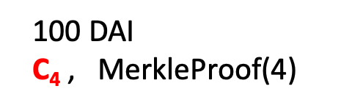
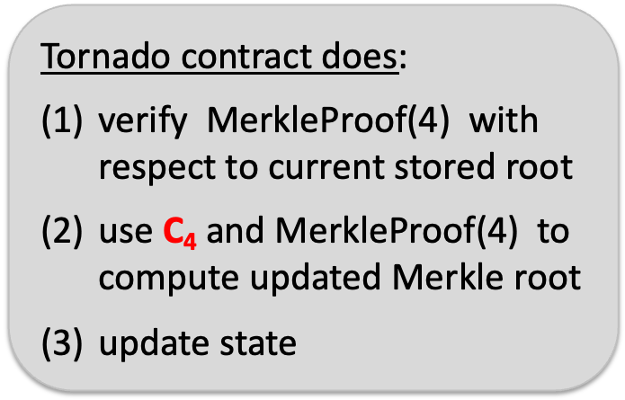
Tornado cash: deposit (simplified)
H₁, H₂: R ⇾ {0,1}²⁵⁶
coins
Merkle
root
100 DAI
C₄ , $\text{MerkleProof}\text{(4)}$
Coins
Merkle
root
(32 bytes)
Tornado contract does:
verify $\text{MerkleProof}\text{(4)}$ with respect to current stored root
use C₄ and MerkleProof(4) to
compute updated Merkle root
update state
tree of
height 20
(2²⁰ leaves)
next = 4
Tornado contract
C₁ C₂ C₃ 0 0 … 0
public list of coins

Slide 35
Tornado cash: deposit (simplified)
H₁, H₂: R ⇾ {0,1}²⁵⁶
coins
Merkle
root
100 DAI
C₄ , $\text{MerkleProof}\text{(4)}$
updated
Merkle
root
(32 bytes)
Tornado contract does:
verify $\text{MerkleProof}\text{(4)}$ with respect to current stored root
use C₄ and MerkleProof(4) to
compute updated Merkle root
update state
tree of
height 20
(2²⁰ leaves)
next = 4
Tornado contract
C₁ C₂ C₃ C₄ 0 … 0
public list of coins

Slide 36
Tornado cash: deposit (simplified)
100 DAI pool:
each coin = 100 DAI
Treasury: 400 DAI
nf₁
updated
Merkle
root
updated
Merkle
root
nf₂
Alice deposits 100 DAI:
(32 bytes)
tree of
height 20
(2²⁰ leaves)
100 DAI
C₄ , MerkleProof(4)
next = 5
nullifiers
C₁ C₂ C₃ C₄ 0 … 0
updated contract state
public list of coins
note: (k, r)
Alice keeps secret
(one note per coin)
Every deposit: new Coin added sequentially to tree
an observer sees who
owns which leaves
Notes:
Observer: Alice owns C4.

Slide 37
Tornado cash: withdrawal (simplified)
H₁, H₂: R ⇾ {0,1}²⁵⁶
100 DAI pool:
each coin = 100 DAI
Treasury: 400 DAI
Merkle
root
coins
Merkle
root
nf₁
nf₂
Withdraw coin #3
to addr A:
tree of
height 20
(2²⁰ leaves)
(32 bytes)
has note= (k’, r’)
next = 5
C₁ C₂ C₃ C₄ 0 … 0
nullifiers
set nf = H₂(k’)
contract state
public list of coins
Bob proves “I have a note for some leaf in the coins tree, and its nullifier is nf”
(without revealing which coin)
Notes:
Bob does not reveal which coin is being spent.

Slide 38
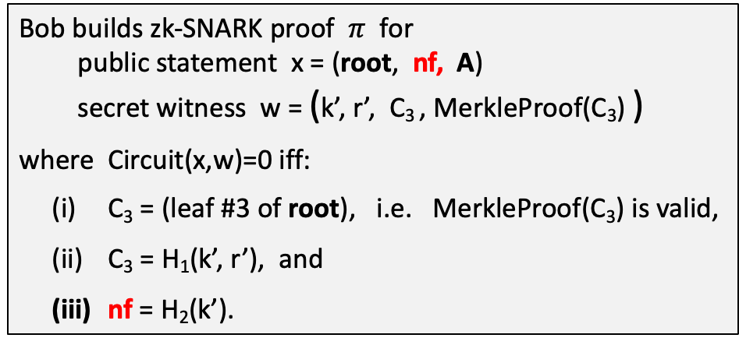
Tornado cash: withdrawal (simplified)
H₁, H₂: R ⇾ {0,1}²⁵⁶
Withdraw coin #3 to addr A:
Merkle
root
has note= (k’, r’)
set nf = H₂(k’)
tree of
height 20
(2²⁰ leaves)
Bob builds zk-SNARK proof $π$ for
public statement x = (root, nf, A)
secret witness w = (k’, r’, C₃ , MerkleProof(C₃) )
where Circuit(x,w)=0 iff:
C₃ = (leaf #3 of root), i.e. MerkleProof(C₃) is valid,
C₃ = H₁(k’, r’), and
nf = H₂(k’).
C₁ C₂ C₃ C₄ 0 … 0
(address A not used in Circuit)
Notes:
Bob proves “I know some leaf in the coins tree whose nullifier is nf”. He does not which coin is being spent, which is why C3 is part of the secret witness.
Tornado uses Groth16. Lava.cash (same thing on Solana) uses zk-STARKs.

Slide 39
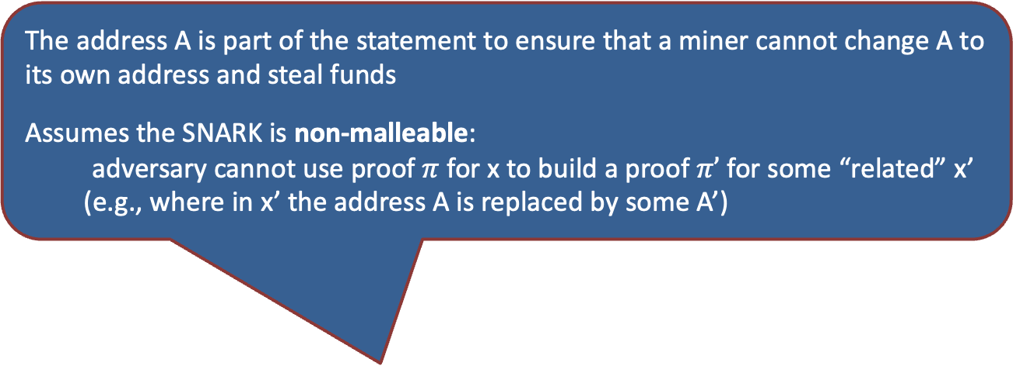
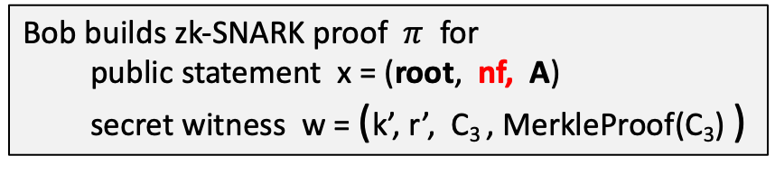
Tornado cash: withdrawal (simplified)
H₁, H₂: R ⇾ {0,1}²⁵⁶
Withdraw coin #3 to addr A:
The address A is part of the statement to ensure that a miner cannot change A to its own address and steal funds
Assumes the SNARK is non-malleable:
adversary cannot use proof $π$ for x to build a proof $π’$ for some “related” x’
(e.g., where in x’ the address A is replaced by some A’)
Merkle
root
has note= (k’, r’)
set nf = H₂(k’)
tree of
height 20
(2²⁰ leaves)
C₁ C₂ C₃ C₄ 0 … 0
Bob builds zk-SNARK proof $π$ for
public statement x = (root, nf, A)
secret witness w = (k’, r’, C₃ , MerkleProof(C₃) )
Notes:
Bob proves “I know some leaf in the coins tree whose nullifier is nf”. He does not which coin is being spent, which is why C3 is part of the secret witness.

Slide 40
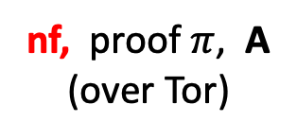
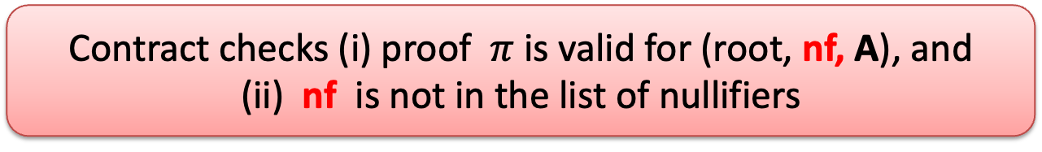
Tornado cash: withdrawal (simplified)
H₁, H₂: R ⇾ {0,1}²⁵⁶
100 DAI pool:
each coin = 100 DAI
Treasury: 400 DAI
Merkle
root
coins
Merkle
root
nf₁
Withdraw coin #3
to addr A:
nf₂
tree of
height 20
(2²⁰ leaves)
nf, proof $π$, A
(over Tor)
(32 bytes)
next = 5
C₁ C₂ C₃ C₄ 0 … 0
Bob’s ID and coin C₃
are not revealed
nullifiers
contract state
public list of coins
Contract checks (i) proof $π$ is valid for (root, nf, A), and
(ii) nf is not in the list of nullifiers
Notes:
Gas can be payed by a relayer, so that Bob’s account is not recorded.

Slide 41
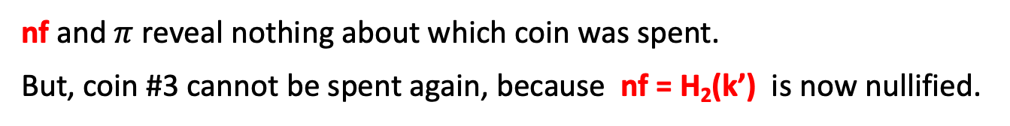
Tornado cash: withdrawal (simplified)
H₁, H₂: R ⇾ {0,1}²⁵⁶
100 DAI pool:
each coin = 100 DAI
Treasury: 300 DAI
Merkle
root
coins
Merkle
root
nf₁
Withdraw coin #3
to addr A:
nf₂
tree of
height 20
(2²⁰ leaves)
(32 bytes)
nf
nf, proof $π$, A
(over Tor)
next = 5
C₁ C₂ C₃ C₄ 0 … 0
100 DAI
nullifiers
to address A
contract state
public list of coins
… but observer does not
know which are spent
nf and $π$ reveal nothing about which coin was spent.
But, coin #3 cannot be spent again, because nf = H₂(k’) is now nullified.
Notes:
Stress that H1 is collision resistant.

Slide 42
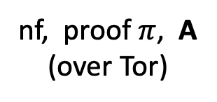
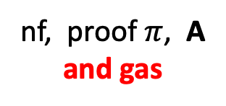
Who pays the withdrawal gas fee?
Problem: how does Bob pay for gas for the withdrawal Tx?
If paid from Bob’s address, then fresh address is linked to Bob
Tornado’s solution: Bob uses a relay
nf, proof $π$, A
and gas
nf, proof $π$, A
(over Tor)
(100-gas) DAI
to address A
gas
relay
tornado
contract
Note: relay and Tornado also charge a fee

Slide 43
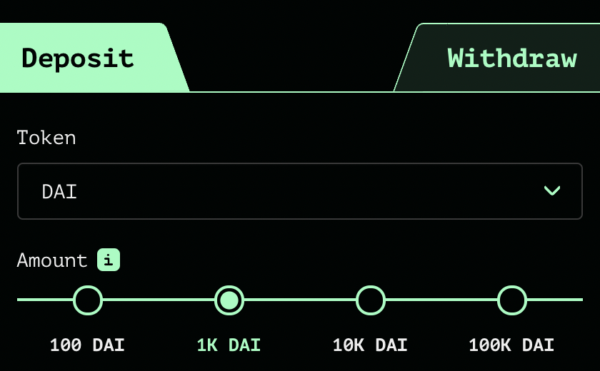
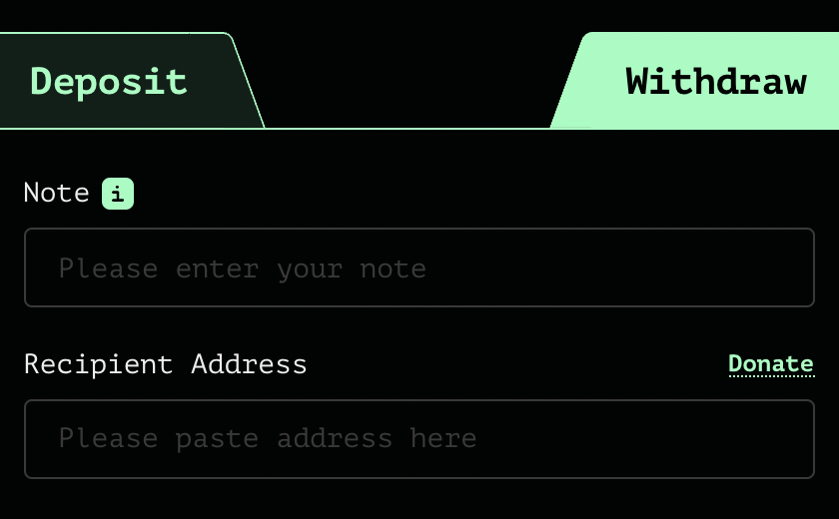
Tornado Cash: the UI
enter note here
address
After deposit: get a note
Later, use note to withdraw
(wait before withdrawing)

Slide 44
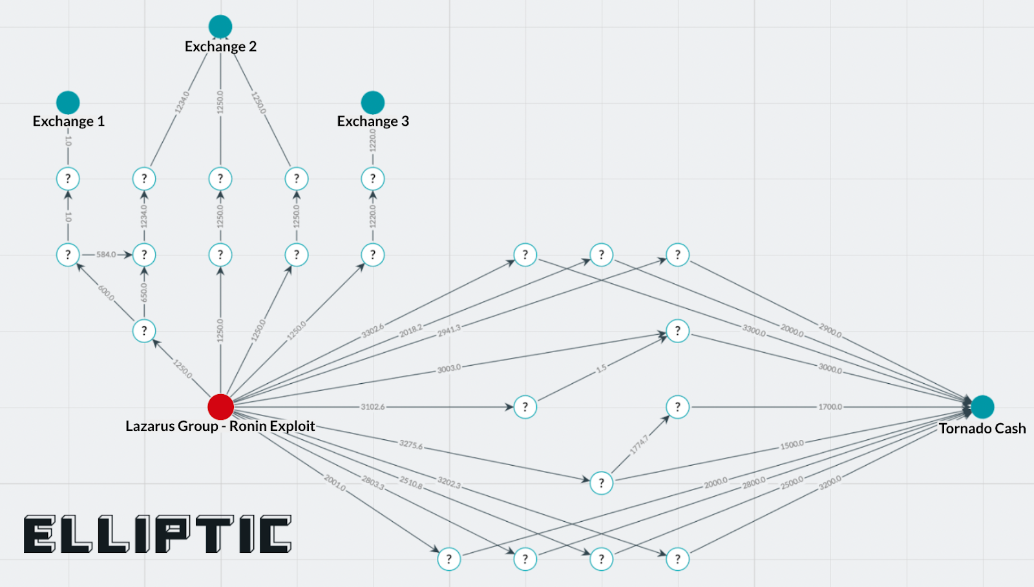
Tornado trouble … U.S. sanctions
The Ronin-bridge hack (2022):
In late March: ≈600M USD stolen … $80M USD sent to Tornado
April: Lazarus Group suspected of hack
August: “U.S. Treasury Sanctions Virtual Currency Mixer Tornado Cash”
  Lots of collateral damage … and two lawsuits
Tornado
The lesson: complete anonymity in the
payment system is problematic

Slide 45
Sanctions
“U.S. persons would not be prohibited by U.S. sanctions regulations from copying the open-source code and making it available online for others to view, as well as discussing, teaching about, or including open-source code in written publications, such as textbooks, absent additional facts”
U.S. Treasury FAQ, Sep. 2022

Slide 46
Designing a compliant Tornado??
deposit filtering: ensure incoming funds are not sanctioned
Chainalysis SanctionsList contract:
function isSanctioned(address addr) public view returns (bool) {
return sanctionedAddresses[addr] == true ;
}
Reject funds coming from a sanctioned address.
Difficulties: (1) centralization, (2) slow updates

Slide 47
Designing a compliant Tornado??
Withdrawal filtering: at withdrawal, require a ZK proof that the source of funds is not currently on sanctioned list.
How?
modify the way Tornado computes Merkle leaves during deposit to include msg.sender.
in our example Alice sets: C₄ = [ H₁(k, r), msg.sender ]
During withdrawal Bob proves in ZK that msg.sender in his leaf is not currently on sanctions list.
Notes:
Discourages bad behavior in Tornado: the funds of sanctioned addressed become trapped inside Tornado.

Slide 48

Designing a compliant Tornado??
(3) Viewing keys: at withdrawal, require nullifier to include an encryption of deposit msg.sender under government public key.
How? Merkle leaf C₄ is computed as on previous slide.
During withdrawal Bob sets nullifier nf = [ H₂(k’), $ct$, $π$ ]
where (i) $ct$ = Enc(pk, msg.sender) and
(ii) $π$ is ZK proof that $ct$ is computed correctly
⇒ As needed, government can trace funds through Tornado
  lots of problems with this design …
Notes:
Which pk to use. How to control access to the secret key sk? What if sk is lost or stolen?

Slide 49
Other private Tx projects
Zcash / IronFISH: private payments
L1 blockchains that extend Bitcoin, similar use of Nullifiers.
Support for any value Tx and in-system transfers.
Aztec / Aleo:
Support for private Tx interacting with a public smart contract.
Aleo: an L1 blockchain. Aztec: runs on top of Ethereum.

Slide 50
END OF LECTURE
Next lecture: how to build a SNARK

Slide 51
Further topics
Privately communicating with the blockchain: Nym
  How to privately compensate proxies for relaying traffic
Next lecture: how to build a SNARK

