Slide 1
Privacy on the Blockchain
CS251 Fall 2023
(cs251.stanford.edu)
Dan Boneh
[project #4 posted]

Slide 2
The need for privacy in the financial system
Supply chain privacy:
  A manufacturer does not want to reveal
  how much it pays its supplier for parts.
Payment privacy:
  A company that pays its employees in crypto wants to keep list of employees and salaries private.
  Endusers need privacy for rent, donations, purchases
Business logic privacy: Can the code of a smart contract be private?

Slide 3
The need for privacy in the financial system
The bottom line:
Blockchains cannot reach their full potential
without some form of private transactions

Slide 4
Types of Privacy
Pseudonymity: (weak privacy)
Every user has a long-term consistent pseudonym (e.g. reddit)
  Pros: reputation
  Cons: link to real-world identity can leak over time
Full anonymity: User’s transactions are unlinkable
No one can tell if two transactions are from the same address
Notes:
Example: User timezone can be inferred. My travel schedule can result in linking.

Slide 5
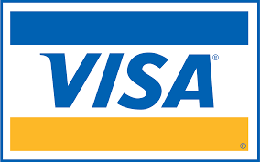
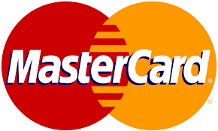

A difficult question: privacy from who?
No privacy:
Everyone can see all transactions
Privacy from the public:
Only a trusted operator can see transactions
Semi-full privacy:
only “local” law enforcement can see transactions
full privacy:
no one can see transactions

Slide 6
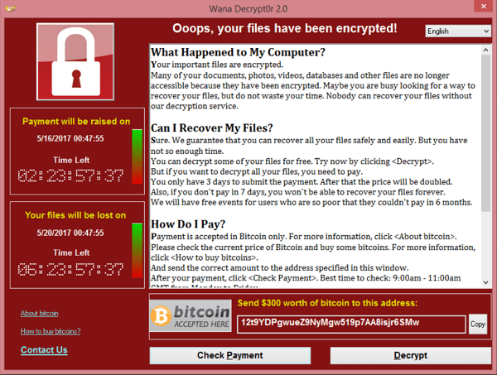
Negative aspects of complete privacy
How to prevent criminal activity?
The challenge:
How to support positive applications of
private payments, but prevent the negative ones?
Can we ensure legal compliance while preserving privacy?
Yes! The key technology: zero knowledge proofs

Slide 7
Are Bitcoin and Ethereum Private?
The base systems are definitely not …

Slide 8
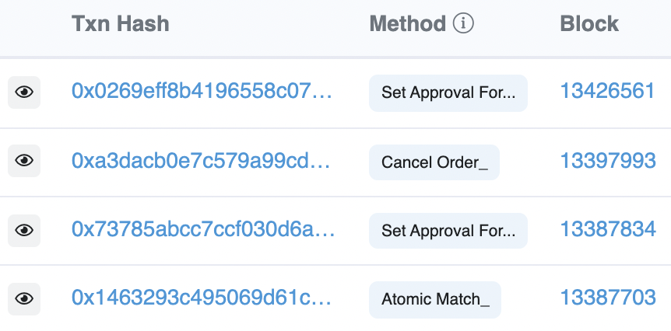
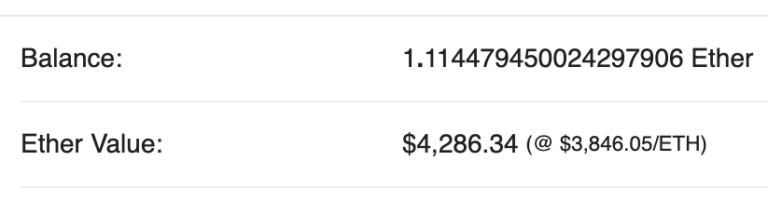
Privacy in Ethereum?
Every account balance is public
For Dapps: code and internal state are public
All account transactions are linked to account
etherscan.io:
Address 0x1654b0c3f62902d7A86237…

Slide 9
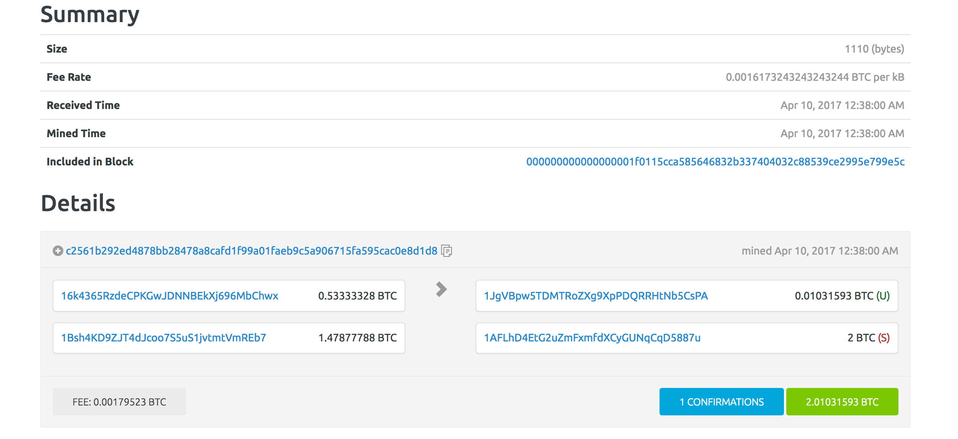
Privacy in Bitcoin?
from addresses amounts
to addresses amounts
Alice can have many addresses (creating address is free)
Transaction data can be used
to link an address to a physical identity
(chainalysis)
Inputs: A1:4, A2: 5 out: B:6, A3:3
Change address
Alice’s addresses
Bob’s address
Notes:
Can build clusters of linked addresses.

Slide 10
Linking an addresses to an identity
inputs: A1: 4, A2: 5 outputs: B: 6, A3: 3
Alice buys a book from a merchant:
Alice learns one of merchant’s address (B)
Merchant links three addresses to Alice (A1, A2, A3)
Alice uses an exchange (ETH ↔︎ USD)
BSA: a US exchange must do KYC (know your customer)
… collect and verify Alice’s ID
Exchange links Alice to her addresses (A1, A2, A3)

Slide 11


At the network layer …
Miners/validators learn Alice’s IP address
end users
sk_{A}
signed Tx
sk_{B}
sk_{C}
P2P network
Solution:

Slide 12
De-anonymization strategy: Idioms of use
A general strategy for de-anonymizing Bitcoin addresses
Heuristic 1:
Two addresses are input to a TX
⇒ both addresses are controlled by same entity

Slide 13
De-anonymization strategy: Idioms of use
Heuristic 2:
Change address is controlled by the same user as input address
Which is the change address?
  Heuristic: a new address that receives less than every input

Slide 14
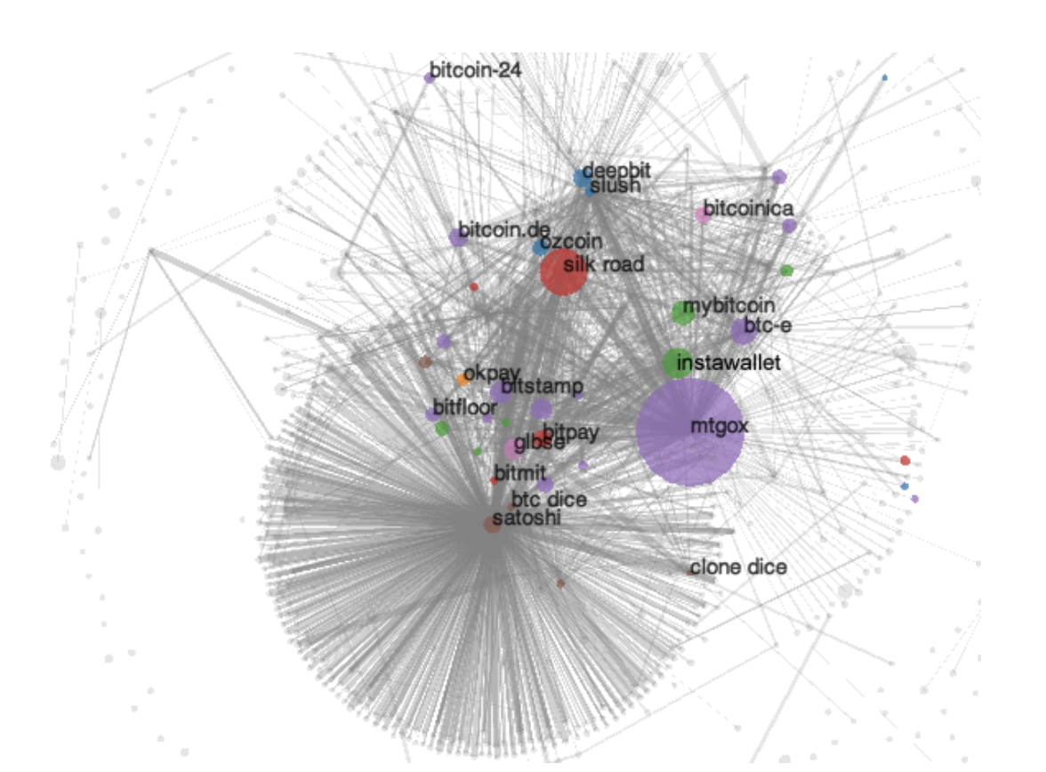
A Bitcoin experiment [Meiklejohn, et al.]
step 1: Heuristic 1 and 2 ⇒ 3.3M clusters
step 2: 1070 addresses identified by interacting with merchants
  Coinbase, Kraken, …
step 3: now 15% of all addresses identified
  Learn total assets for all clusters
Commercial efforts: Chainalysis, Elliptic, …
Notes:
https://arxiv.org/abs/2205.13882

Slide 15
Private coins on a Public Blockchain

Slide 16
Attempt 1: simple mixing
mixer
address: M
1 ETH to M
from Alice
fresh addr X
from Alice
TLS
Send:
1 ETH to X
1 ETH to Y
1 ETH to Z
1 ETH to M
from Bob
fresh addr Y
from Bob
TLS
1 ETH to M
from Carol
fresh addr Z
from Carol
has 3 ETH
blockchain
TLS
Observer knows Y belongs to one of {Alice, Bob, Carol} but does not know which one
⟹ anonymity set of size 3.
Problems: (i) mixer M knows shuffle, (ii) mixer can abscond with 3 ETH !!

Slide 17
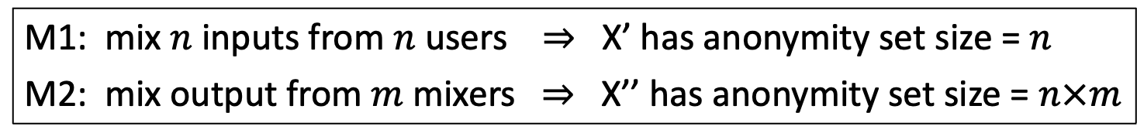
Increasing the anonymity set
Mixer
M1
Mixer
M2
addr X
X’
X’’
M1: mix $n$ inputs from $n$ users ⇒ X’ has anonymity set size = $n$
M2: mix output from $m$ mixers ⇒ X’’ has anonymity set size = $n×m$
Privacy: as long as one of M1 or M2 are honest

Slide 18
Secure mixing without a mixer?
Problem: Mixer can abscond with funds or reveal the shuffle.
Can we securely mix without a trusted mixer? Answer: yes!
on Bitcoin: CoinJoin (used by, e.g., Wasabi wallet)
on Ethereum: Tornado cash, Privacy Pools, …
… a single mixer using ZK proofs – next lecture

Slide 19
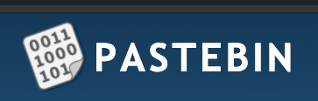
CoinJoin: Bitcoin Mixing without Mixer
The setup: Alice, Bob, and Carol want to mix together.
Alice owns UTXO A1:5, Bob owns UTXO B1:3, Carol owns C1:2
A1: 5, A3 (change addr)
A2 (post mix address over Tor)
A1: 5, A3
B1: 3, B3
C1: 2, C3
B2, A2, C2
B1: 3, B3 (change addr)
mix
addresses
B2 (post mix address over Tor)
(same as Alice and Bob)
public forum
Notes:
Each participants knows which mix address is theirs, but knows nothing about the other mix addresses.

Slide 20
CoinJoin: Bitcoin Mixing without Mixer
CoinJoin TX: all three prepare and sign the following Tx:
inputs (not private): A1: 5, B1: 3, C1: 2
outputs (private): B2: 2, A2: 2, C2: 2
outputs (not private): A3: 3, B3: 1
mix addresses
Mixed UTXOs all have same value = min of inputs (2 in this case)
All three post sigs on Pastebin ⇒ one of them posts Tx on chain.

Slide 21
Coinjoin drawbacks
In practice: each CoinJoin Tx mixes about 40 inputs
Large Tx: 40 inputs, 80 outputs
All participants must sign CoinJoin Tx for it to be valid
⇒ ensures all of them approve the CoinJoin Tx
… but any one of them can disrupt the process

Slide 22
Beyond simple mixing
Private Tx on a public blockchain

Slide 23
Can we have private transactions
on a public blockchain?
Naïve reasoning:
universal verifiability ⇒ transaction data must be public
otherwise, how we can verify Tx ??
crypto magic ⇒ private Tx on a publicly verifiable blockchain
Crypto tools: commitments and zero knowledge proofs

Slide 24

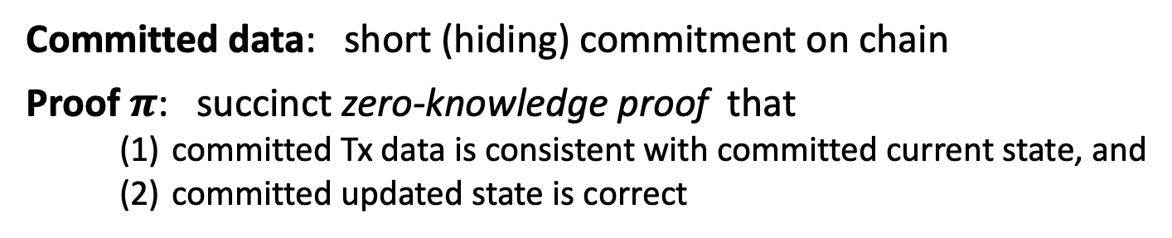
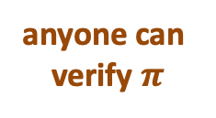
A paradigm for Private Tx
public blockchain
committed state
Tx
$$π$$
updated
committed state
anyone can
verify $π$
committed
Tx data
(reveals nothing about Tx data or state)
Committed data: short (hiding) commitment on chain
Proof $π$: succinct zero-knowledge proof that
    committed Tx data is consistent with committed current state, and
    committed updated state is correct

Slide 25
Review: cryptographic commitments
Cryptographic commitment: emulates an envelope
data
data
Many applications: e.g., a DAPP for a sealed bid auction
Every participant commits to its bid,
Once all bids are in, everyone opens their commitment

Slide 26
Cryptographic Commitments
Syntax: a commitment scheme is two algorithms
commit(msg, r) ⇾ com
verify(msg, com, r) ⇾ accept or reject
anyone can verify that commitment was opened correctly
secret randomness
commitment string

Slide 27
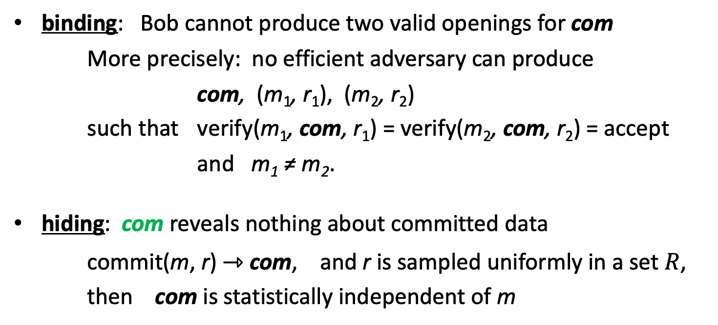
Commitments: security properties
binding: Bob cannot produce two valid openings for com
More precisely: no efficient adversary can produce
com, (m₁, r₁), (m₂, r₂)
such that verify(m₁, com, r₁) = verify(m₂, com, r₂) = accept
and m₁ ≠ m₂.
hiding: com reveals nothing about committed data
commit(m, r) ⇾ com, and r is sampled uniformly in a set $R$,
then com is statistically independent of m

Slide 28
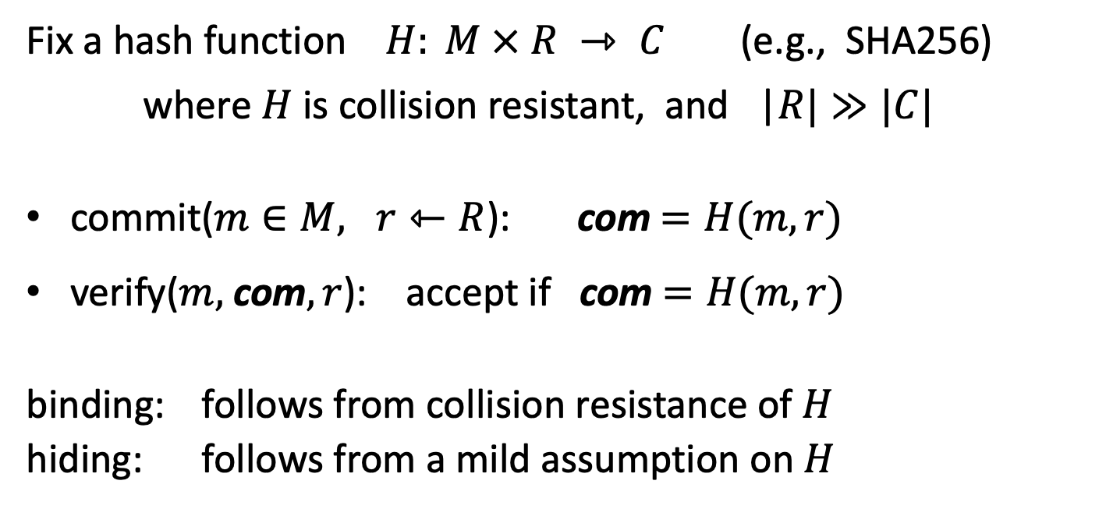
Example: hash-based commitment
Fix a hash function $H: M × R ⇾ C$(e.g., SHA256)
where $H$ is collision resistant, and |$R|≫|C|$
commit($m∈M, r⇽R$): com$=H(m,r)$
verify($m,$com$, r$): accept if com $=H(m,r)$
binding: follows from collision resistance of $H$
hiding: follows from a mild assumption on $H$

Slide 29
What is a zk-SNARK?
Succinct zero knowledge proofs:
an important tool for privacy on the blockchain

Slide 30
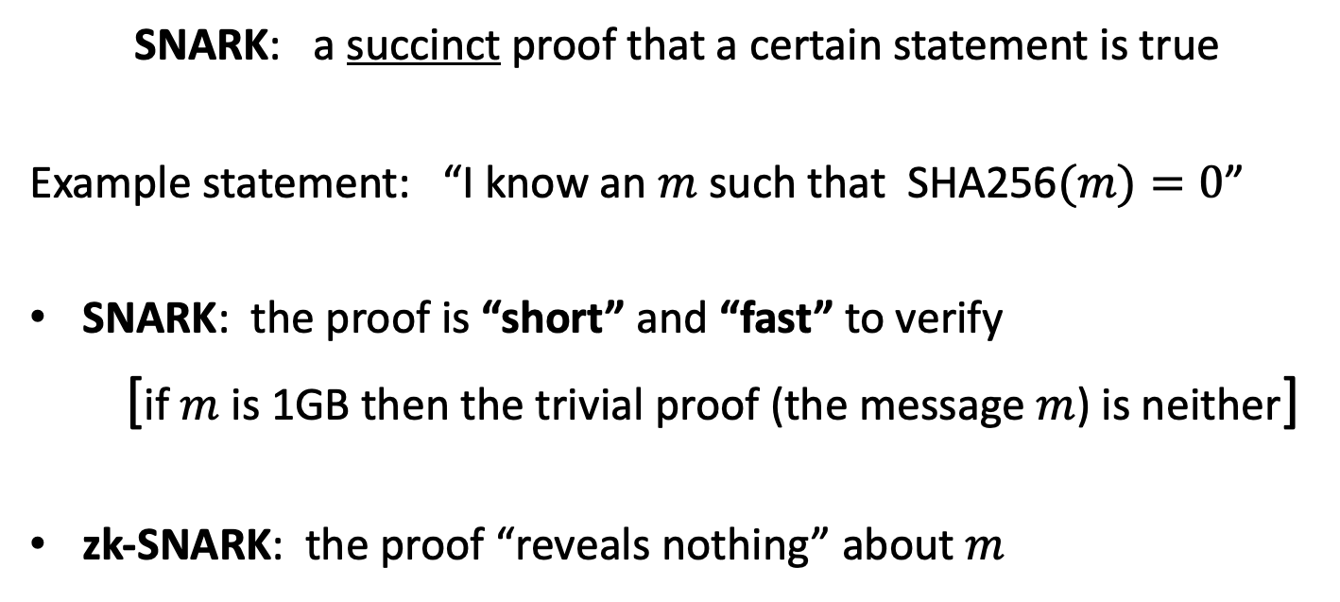
What is a zk-SNARK ? (intuition)
SNARK: a succinct proof that a certain statement is true
Example statement: “I know an $m$ such that SHA256$(m)=0$”
SNARK: the proof is “short” and “fast” to verify
[if $m$ is 1GB then the trivial proof (the message $m$) is neither]
zk-SNARK: the proof “reveals nothing” about $m$

Slide 31









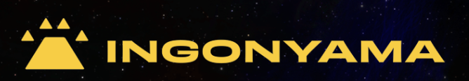
Commercial interest in SNARKs
Many more building applications that use SNARKs

Slide 32
Blockchain Applications I
Outsourcing computation: (no need for zero knowledge)
L1 chain quickly verifies the work of an off-chain service
Examples:
Scalability: proof-based Rollups (zkRollup)
off-chain service processes a batch of Tx;
L1 chain verifies a succinct proof that Tx were processed correctly
Bridging blockchains: proof of consensus (zkBridge)
Chain A produces a succinct proof about its state. Chain B verifies.
To minimize gas: need a short proof, fast to verify
Notes:
Stress non-interactive aspect of proof.

Slide 33
Blockchain Applications II
Some applications require zero knowledge (privacy):
Private Tx on a public blockchain:
  zk proof that a private Tx is valid (Tornado cash, Zcash, IronFish, Aleo)
Compliance:
  Proof that a private Tx is compliant with banking laws (Espresso)
  Proof that an exchange is solvent in zero-knowledge (Raposa)
More on these blockchain applications in a minute

Slide 34
Many non-blockchain applications
Blockchains drive the development of SNARKs
… but many non-blockchain applications benefit

Slide 35



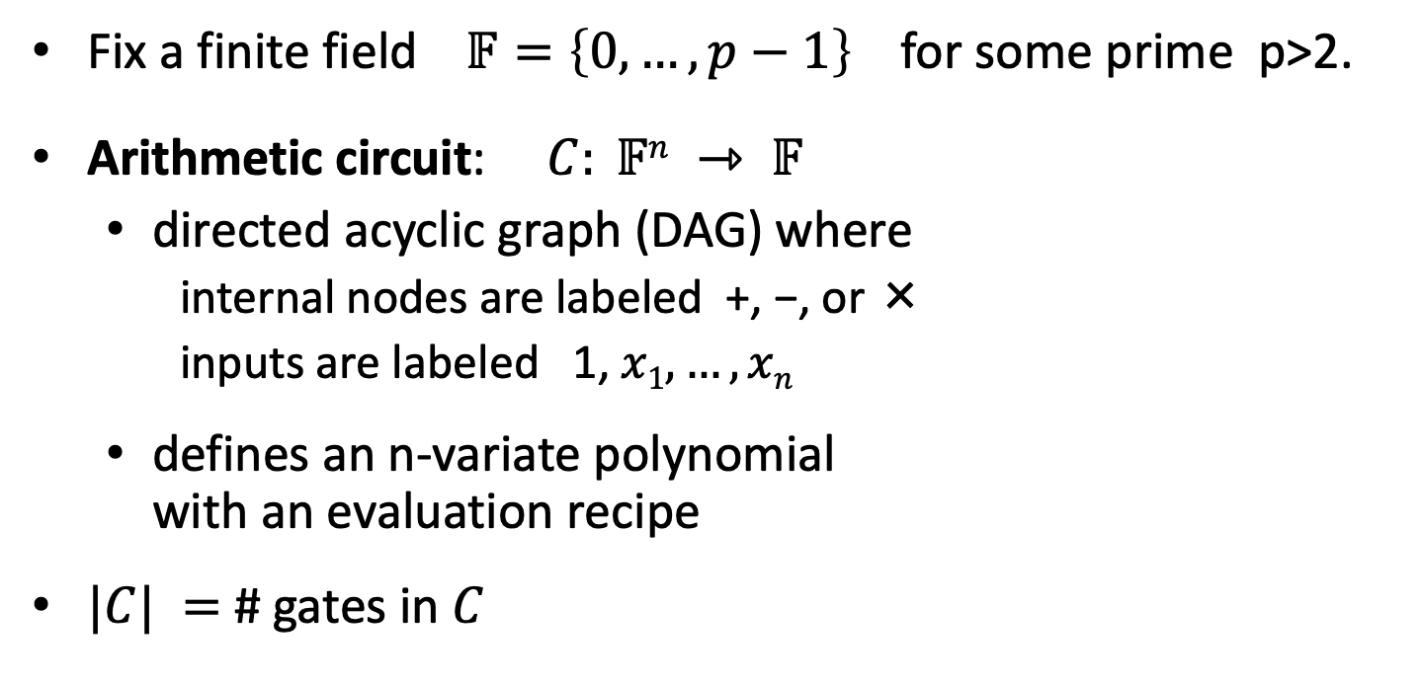




Arithmetic circuits
Fix a finite field $𝔽=\left\{0, …, p−1\right\}$ for some prime p>2.
Arithmetic circuit: $C: 𝔽n ⇾ 𝔽$
  directed acyclic graph (DAG) where
    internal nodes are labeled +, −, or ×
    inputs are labeled 1, $x1, …, xn$
  defines an n-variate polynomial
  with an evaluation recipe
$|C| =$ # gates in $C$
$$x1(x1+x2+1)(x2−1)$$
$$\text{×}$$
$$+$$
$$−$$
$$x1$$
$$x2$$
$$1$$

Slide 36
Interesting arithmetic circuits
Examples:
C_{hash}(h, m): outputs 0 if SHA256(m) = h , and ≠0 otherwise
C_{hash}(h, m) = (h – SHA256(m)) , |C_{hash}| ≈ 20K gates
C_{sig}(pk, m, σ): outputs 0 if σ is a valid ECDSA signature
on m with respect to pk
Notes:
WRITE: and m_i (1– m_i) = 0 for all i=1,…,256

Slide 37
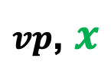
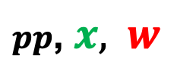



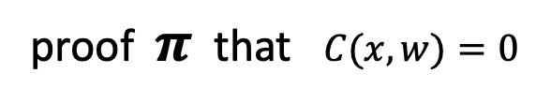
(preprocessing) NARK: Non-interactive ARgument of Knowledge
Public arithmetic circuit: $C( x, w ) ⇾ 𝔽$
public statement in $𝔽_{}^{n}$
secret witness in $𝔽_{}^{m}$
Preprocessing (setup): S($C$) ⇾ public parameters ($pp$, $vp$ )
$pp$, $x,$ $w$
$vp$, $x$
proof $π$ that $C(x,w)=0$
Prover
Verifier
accept or
reject
Notes:
Knowledge is stronger the soundness.

Slide 38
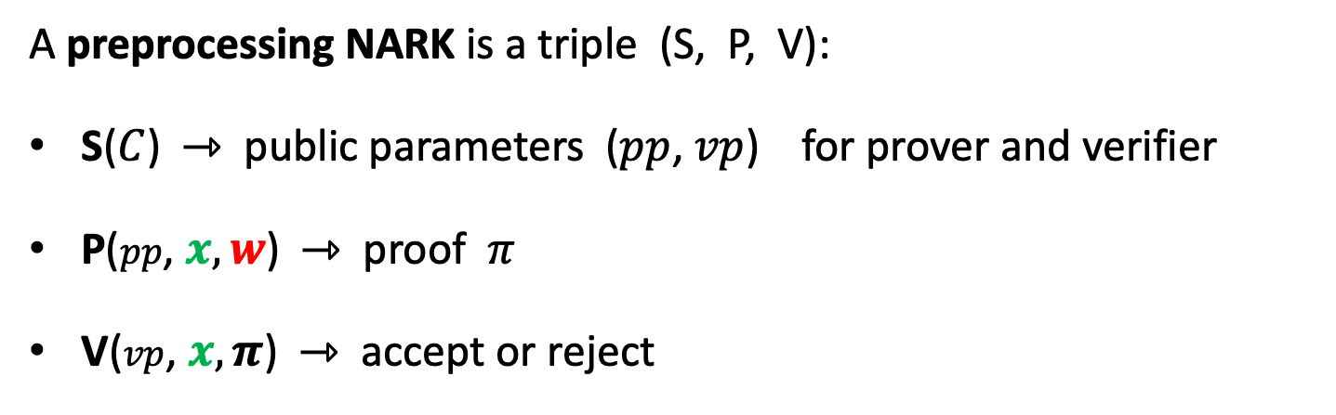
(preprocessing) NARK: Non-interactive ARgument of Knowledge
A preprocessing NARK is a triple (S, P, V):
S($C$) ⇾ public parameters ($pp$, $vp$) for prover and verifier
P($pp$, $x, w$) ⇾ proof $π$
V($vp$, $x, π$) ⇾ accept or reject

Slide 39


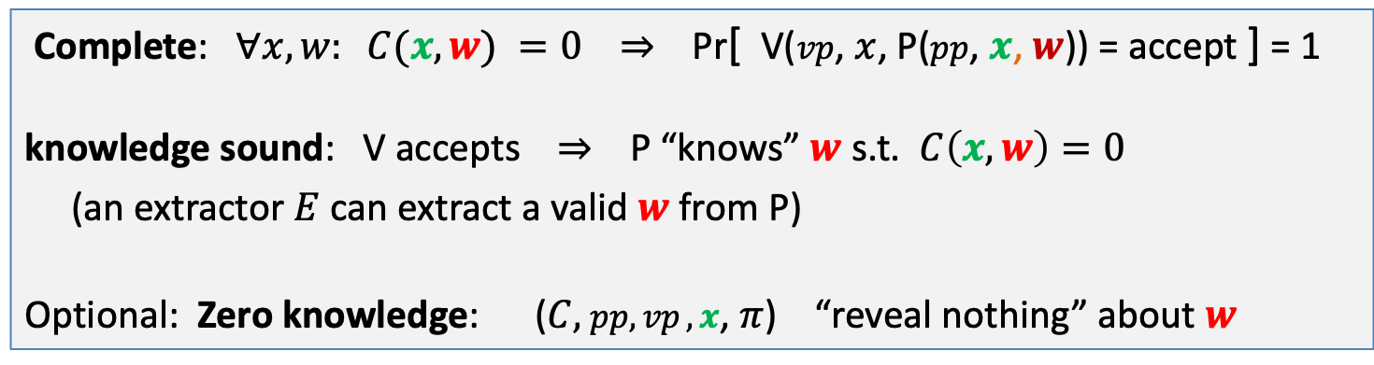

NARK: requirements (informal)
Prover P($pp$, $x, w$)
Verifier V ($vp$, $x$, $π$)
proof $π$
accept or reject
Complete: $∀x, w: C(x, w) =0$ ⇒ Pr[ V($vp$, $x$, P($pp$, $x$, $w$)) = accept ] = 1
knowledge sound: V accepts ⇒ P “knows” $w$ s.t. $C\left(x, w\right)=0$
(an extractor $E$ can extract a valid $w$ from P)
Optional: Zero knowledge: ($C,$ $pp,vp ,x$, $π$) “reveal nothing” about $w$

Slide 40
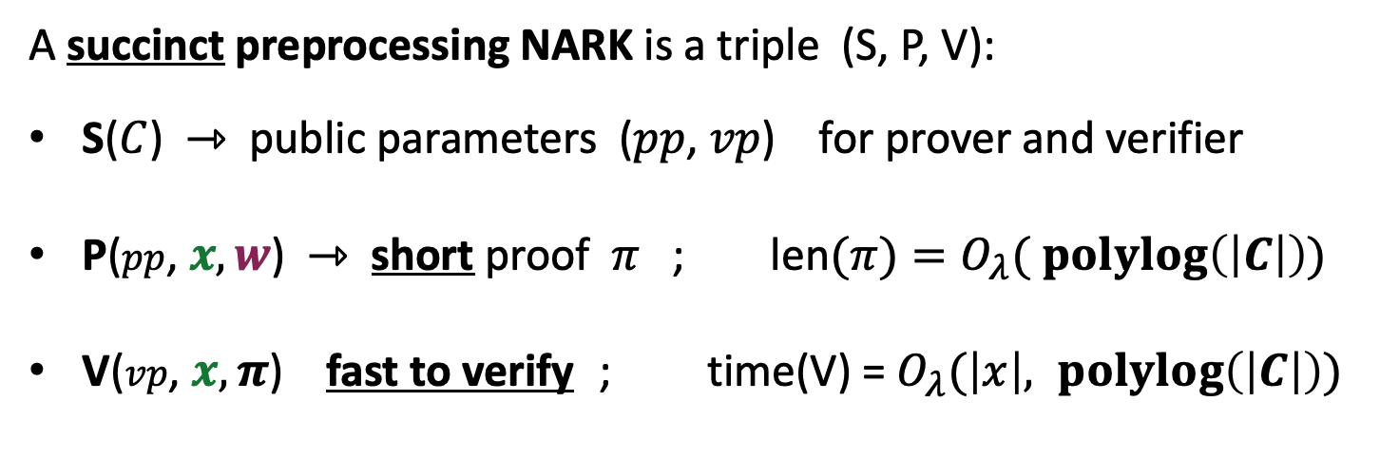
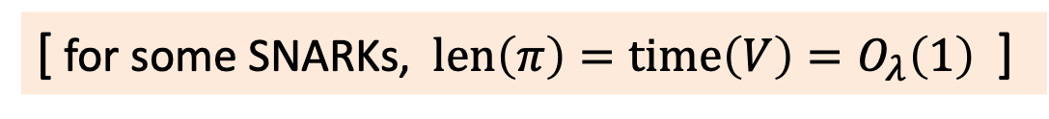

SNARK: a Succinct ARgument of Knowledge
A succinct preprocessing NARK is a triple (S, P, V):
S($C$) ⇾ public parameters ($pp$, $vp$) for prover and verifier
P($pp$, $x, w$) ⇾ short proof $π$ ; len$(π)=O_{λ}( \operatorname{polylog}\left(\left|C\right|\right))$
V($vp$, $x, π$) fast to verify ; time(V) = $O_{λ}(\left|x\right|, \operatorname{polylog}\left(\left|C\right|\right))$
short “summary” of circuit
V has no time to read $C$ !!
[ for some SNARKs, $len\left(π\right)=time\left(V\right)=O_{λ}\left(1\right)$ ]
Notes:
log |C| is bigger than log |w|, so this is not as strict as requiring proof size to be log |w|. In many SNARKs, proof size and verify time is independent of |C| or |w|.

Slide 41
SNARK: a Succinct ARgument of Knowledge
SNARK: a NARC (complete and knowledge sound) that is succinct
zk-SNARK: a SNARK that is also zero knowledge

Slide 42
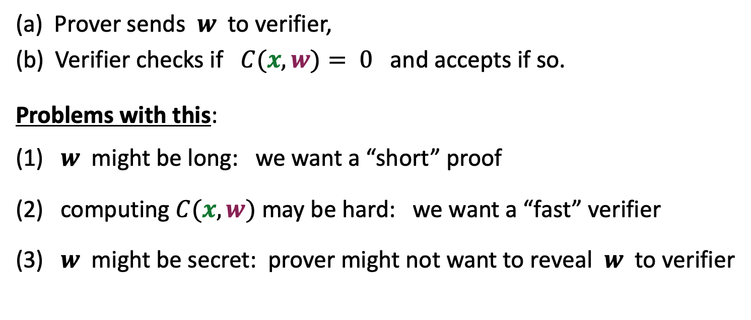
The trivial SNARK is not a SNARK
(a) Prover sends $w$ to verifier,
(b) Verifier checks if $C(x, w)= 0$ and accepts if so.
Problems with this:
(1) $w$ might be long: we want a “short” proof
(2) computing $C(x, w)$may be hard: we want a “fast” verifier
(3) $w$ might be secret: prover might not want to reveal $w$ to verifier

Slide 43

The SNARK zoo … next lecture
STARK
Bulletproofs
Groth16
Gemini
Plonky2
Plonk
DARK
Halo2
Breakdown
Marlin
Hyperplonk
Nova
Orion
Sonic
⋮
Hyrax
Spartan
Open: one SNARK to rule them all

Slide 44
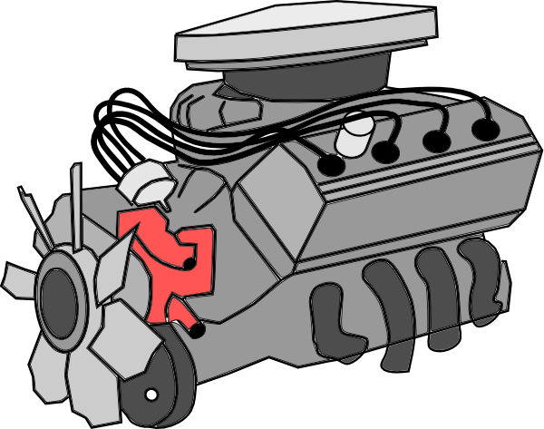
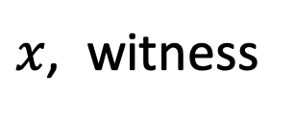

SNARKs in practice
DSL
program
Circom,
ZoKrates,
Leo,
Zinc,
Cairo,
Noir,
…
SNARK
friendly
format
circuit,
R1CS,
AIR,
EVM
byte code
SNARK
backend
prover
heavy
computation
compiler
$$π$$
…
domain specific
language
$x$, witness

Slide 45
END OF LECTURE
Next lecture:
more on zk-SNARKs and their applications

