Slide 1
(1) Maximal Extractable Value,
(2) NFT Marketplaces
CS251 Fall 2023
(cs251.stanford.edu)
Dan Boneh
HW#3 posted

Slide 2
Where we are in the course
How consensus protocols work
Bitcoin: the UTXO model, and the Bitcoin scripting language
Ethereum (the blockchain computer): the EVM and Solidity
Current topic: decentralized finance
on-chain: exchanges, stablecoins, today: MEV
Next: privacy on the blockchain, scaling the blockchain,
and interoperability across blockchains

Slide 3
Decentralized Finance (DeFi)
Permissionless: any financial instrument can be implemented
and deployed with a few lines of Solidity code
(a centralized system could refuse to deploy a competing service)
Transparent: Dapp code and Dapp state are public
  ⟹ Anyone can inspect and verify
Composable: Dapps can call one another
ERC-20 standard enables interoperability (6 functions)
Notes:
Unlike traditional finance where there is very little transparency.

Slide 4
Why DeFi? Failures of the existing financial system
Cross border inefficiency:
    send $10 to south america ⇒ 36% fees
The high cost of being poor in america:
In 2019, 5.4 percent of US households were unbanked
Economies with an unstable fiat currency

Slide 5
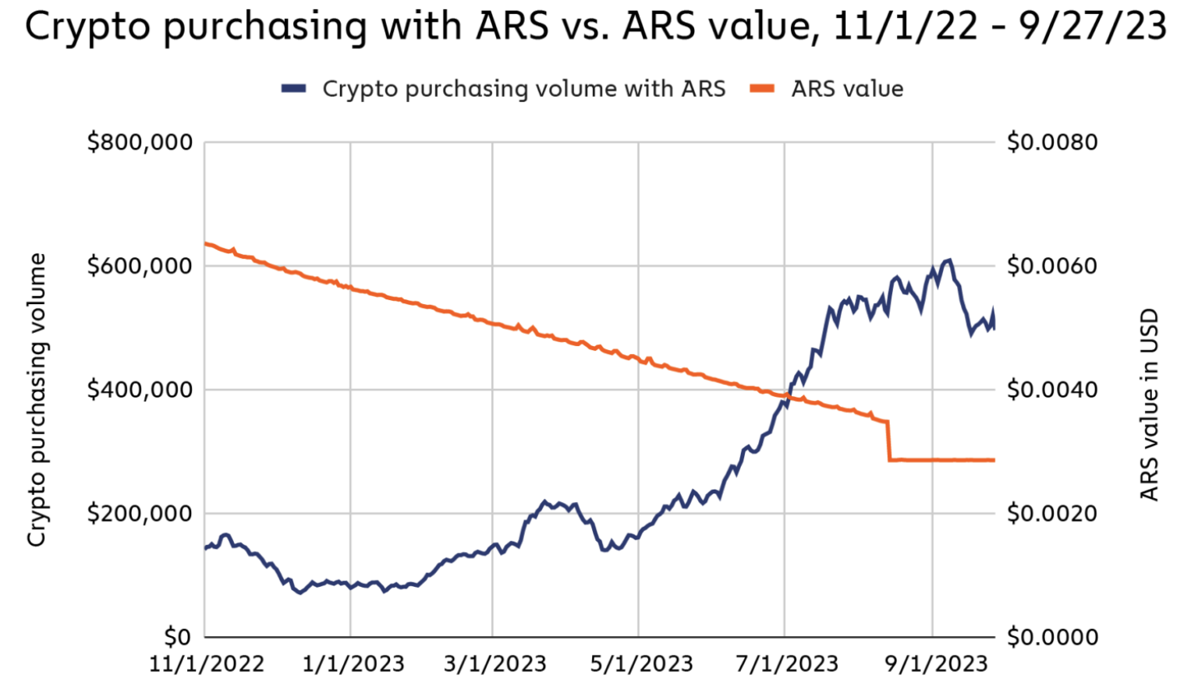
Why DeFi? Failures of the existing financial system
“As crypto adoption has grown,
lots of people [in Argentina] will now
get their paycheck and immediately
put it into USDT or USDC.”
Alfonso Martel Seward, Lemon Cash
USDC/USDT daily purchasing volume
in Argentina during inflation
https://www.chainalysis.com/blog/latin-america-cryptocurrency-adoption/
Notes:
As value of Peso drops, crypto volume increases.

Slide 6
Maximal Extractable Value (MEV)

Slide 7
Searchers
Ethereum gives rise to a new type of business: searchers
Arbitrage: Uniswap DAI/USDC exchange rate is 1.001
whereas at Sushiswap the rate is 1.002
⇒ a searcher posts Tx to equalize the markets and profits
Liquidation: suppose there is a liquidation opportunity on Aave
⇒ a searcher posts a liquidation Tx and profits
Many other examples … often using a sequence of Tx (a bundle)
Notes:
“Searcher” is now a job description.
Arbitrage: take a loan in DAI, exchange DAI for USDC on Uniswap, exchange USDC for DAI on Sushiswap, repay loan.
Another example: searcher discovers a bug in the contract (the dark forest post, https://medium.com/@danrobinson/ethereum-is-a-dark-forest-ecc5f0505dff)

Slide 8
The MEV problem
What happens when a searcher posts a Tx to the mempool?
Validator: create a new Tx’ with itself as beneficiary, and place it before Sam’s Tx in the proposed block
Another searcher: create a new Tx’ with itself as beneficiary, and posts it with a higher maxPrioriyFee
⇒ this action is now mostly automated by copy-paste bots
Tx’
Sam
mempool
Tx: credit Sam
maxPrioriyFee: X
Tx’: credit Alice
maxPrioriyFee: 2X
Notes:
A paper on copy-paste-bots: https://www.usenix.org/system/files/sec23fall-prepub-331-qin.pdf

Slide 9

The MEV problem
Tx’
Sam
mempool
Tx: credit Sam
maxPrioriyFee: X
Tx’: credit Alice
maxPrioriyFee: 2X
Notes:
A paper on copy-paste-bots: https://www.usenix.org/system/files/sec23fall-prepub-331-qin.pdf

Slide 10
The result harms honest users
Price Gas Auctions (PGA): many searchers compete
Repeatedly submit a Tx with higher and higher maxPriorityFee until a validator chooses one … happens within a few seconds
⇒ causes congestion (lots of Tx in mempool) and high gas fees
Tx’
Sam
mempool
Tx: credit Sam
maxPrioriyFee: X
Tx’: credit Alice
maxPrioriyFee: 2X
Notes:
If MEV Tx makes $10K, then gas price can go as high as $7K in practice.

Slide 11
The result harms consensus
Undercutting attack on longest-chain consensus (not Ethereum):
Rational miner: can cause a re-org by taking one MEV Tx for
itself and leave two for other miners
3 MEV Tx
block 1
block 3
Miners incentivized
to build here
miner #1
miner #2
miner #3
The problem: MEV Tx generate extra revenue for miners, higher than block rewards
Notes:
See Flashboys 2.0: https://arxiv.org/abs/1904.05234

Slide 12
The result causes centralization
Validators can steal MEV Tx from searchers
Searchers only send Tx to a validator they trust
(have a business relation with)
These validators do not propagate Tx to the network,
but put them in blocks themselves
In the long run: a few validators will handle the bulk of all Tx
⇒ Private mempools

Slide 13
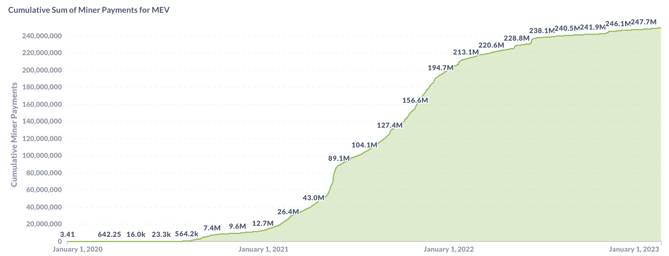
How big are MEV rewards?
Cumulative MEV payments to validators since Nov. 2020: ($247M)
where is this money
coming from?
source: explore.flashbots.net

Slide 14
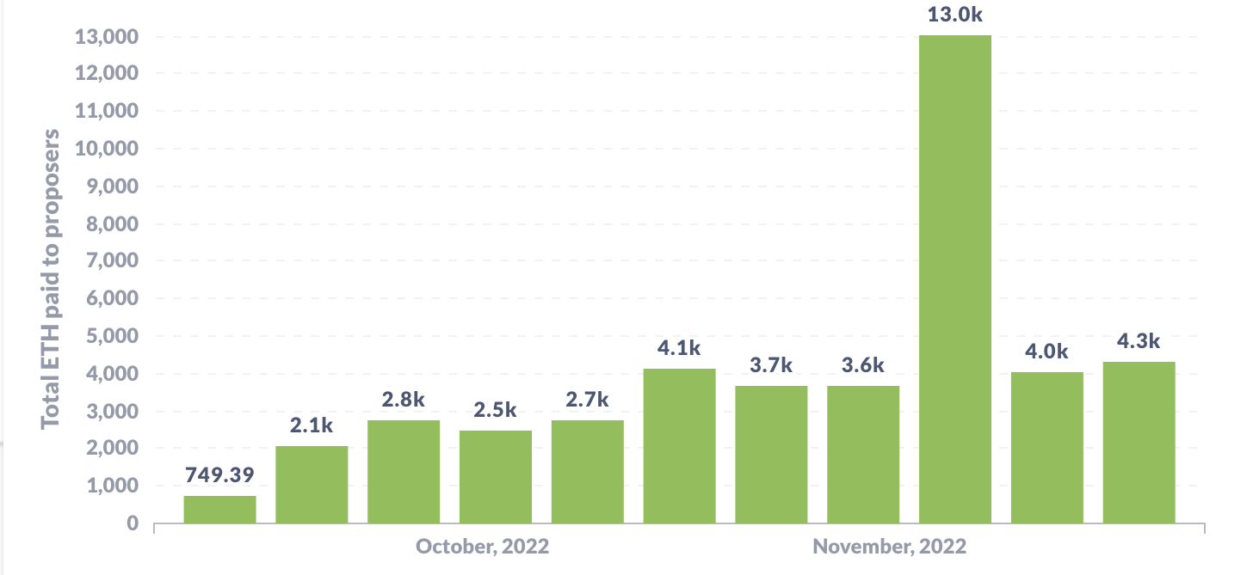
How big are MEV rewards?
Weekly MEV amount paid to validators (in ETH):
source: transparency.flashbots.net

Slide 15
What to do??

Slide 16
Two options
Option 1:
Accept MEV is unavoidable; minimize its harm to the ecosystem
⇒ Flashbots
Option 2:
Try to prevent some MEV, by removing the block proposer’s choice in ordering Tx in a block. (mostly in research papers)

Slide 17
Option 1: Proposer Builder Separation (PBS)
Goals:
Eliminate price gas auctions in the public mempool
  Instead, create an off-chain market for searchers to compete
  on the position of their bundles in a block
Prevent validator concentration: make it possible for every validator to earn MEV payments from searchers
Current PBS implementation: MEV-boost

Slide 18
The participants in PBS (as in MEV-boost)
Users have Tx and searchers have bundles (sequence of Tx)
searcher wants its bundle posted in a block unmodified
build block from
Tx and bundles
choose best block
searchers
bundle
builder A
block
validator
(the current block proposer)
relay 1
blockHdr
bundle
block
bundle
builder B
blockHdr
block
relay 2
signature
Tx
mempool
send block to
eth network
user

Slide 19
MEV-boost
Builder: collects bundles and Tx, builds a block (≈300 bundles/block)
includes a MEV offer to validator (feeRecipient)
Relay: collects blocks, chooses block with max MEV offer
sends block header (and MEV offer) to block proposer
Can’t expose Tx in block to proposer (proposer could steal Tx)
Proposer: chooses best offer and signs header with its staking key
⇒ Then Relay sends block to network, making it public
⇒ Now, proposer cannot steal MEV (would be exposed to slashing)
https://writings.flashbots.net/searching-post-merge
Notes:
Searchers have to win two auctions for their bundle to be included: builder auction and relay auction. Note: this is a first-price auction (unlike gas fee).
Searchers have to work with a builder they trust not steal Tx. Similarly, they need to trust the relay that the builder works with. This is done via business relations. However, Searchers don’t have to trust the proposer – that can by anyone.
Proposer cannot miss slot: if relay does not provide a valid block, validator must build a block locally itself.
Once proposer signs block header, it cannot sign another block header, or it will be slashed by the network (Relay can prove the proposer signed to block headers for that slot)
Future PBS: merge validator and relay into consensus protocol

Slide 20
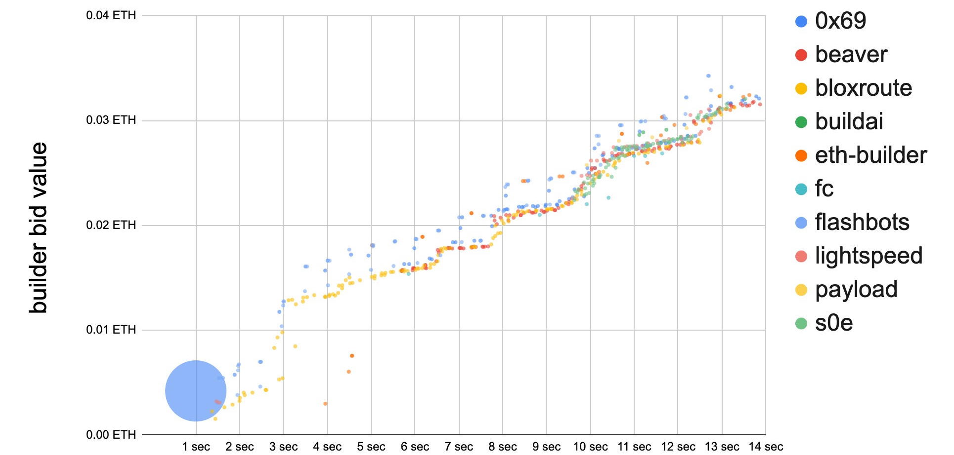
Many block options per slot
A relay might receive 500 blocks per slot from builders
Each builder might send 20 blocks to relay for one slot
Why? The longer builder waits the more MEV opportunities …
slot 5,680,917
builder’s bid goes up
the longer it waits
credit: Justin Drake and Shea Ketsdever

Slide 21
Operating relays
Flashbots: Filters out OFAC sanctioned addresses,
aims to maximize validator payout
(so that many validators will work with it)
BloXroute: no censorship, aims to maximize validator payout
UltraSound: not for profit, non censoring
…
Notes:
https://github.com/eth-educators/ethstaker-guides/blob/main/MEV-relay-list.md

Slide 22
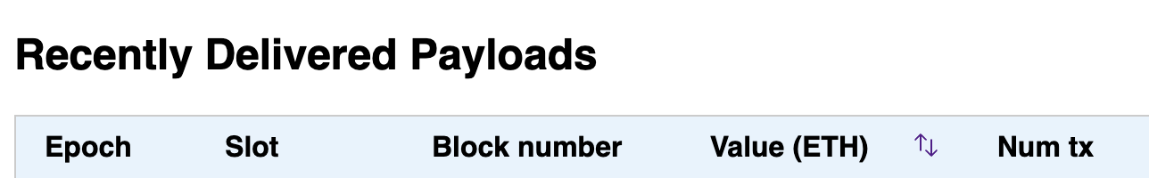
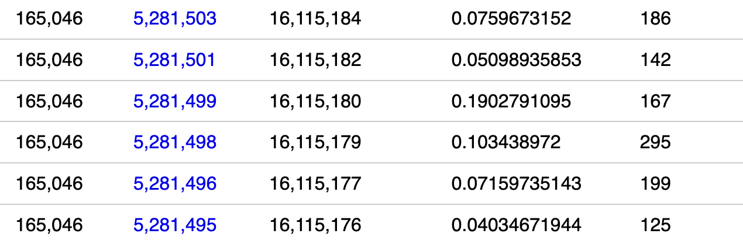
An example: flashbots relay
fee to validator
Notes:
https://boost-relay.flashbots.net/
About 67% of blocks are created by this relay, but not all blocks.

Slide 23
The race problem
The problem
relay 2
blockHdr
validator
(the current block proposer)
signature
send alternate block
with stolen Tx
send block to
eth network
Block proposer will be slashed (why?) ⇒ Lose 1 ETH
… but can gain much more in stolen MEV.

Slide 24
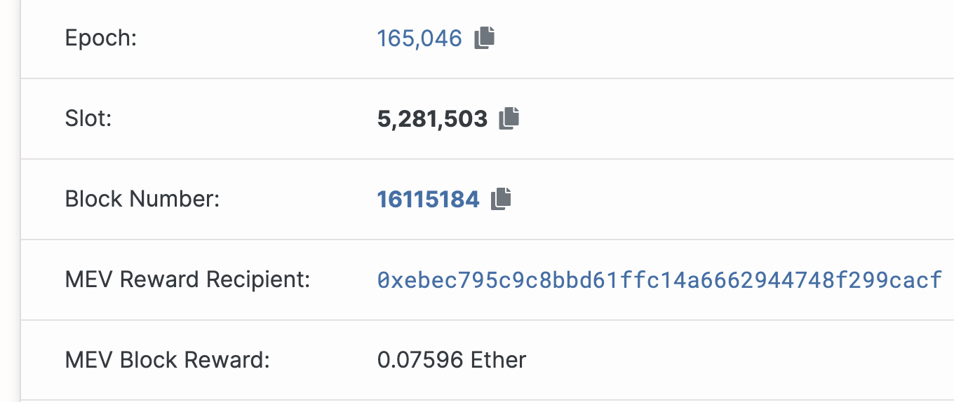
An example: flashbots relay
address of validator who proposed the block

Slide 25
Are we done? Not quite …
Builder concentration: three builders build 75% of all blocks !!
Clear centralization in the builder market
Enables censorship by builders
Proposers hold all the power (first price auction among builders)
⇒ Most MEV profits flow to block proposers
MEV-boost is not designed for cross-chain MEV
For cross-chain arbitrage, no atomicity guarantee for bundle
(builder0x69,beaverbuild,Flashbots)
Notes:
Also mention concentration of relayers

Slide 26
The next step: SUAVE
Goals:
Tx should be private (encrypted) until signed by block proposer
... but should be available to all block builders to build blocks
Seems contradictory! crypto to the rescue:
  ⇒ requires a massive MPC or secure HW enclaves

Slide 27
The SUAVE Multiparty Computation
Sam
Bob
Ideal Functionality
bundle
and prefs
building
strategy
Brooke
Sue
bundle
and prefs
building
strategy
signed
block
searchers
builders
block proposer (signing key)

Slide 28
Option 2:
Fair Ordering of Transactions

Slide 29
Can we reduce MEV?
Randomize transactions before executing
Downside: spamming with identical extracting transaction
Time-Based Order-Fairness
Blind Order-Fairness
Trusted execution environments (TEEs) to order transactions
Downside: hardware assumption
More ideas? Your idea here …
Notes:
TEE-based: Tesseract, SRBV-2021, Automata/XATA, SecretSwap/SecretNetwork

Slide 30
Aequitas: Time-Based Order-Fairness
Basic idea: if most validators received tx1 before tx2,
then tx1 should precede tx2 in the final ordering.
The problem of Condorcet cycles:
  validator #1: [tx1, tx2, tx3]
  validator #2: [tx2, tx3, tx1]
  validator #3: [tx3, tx1, tx2]
Two received (tx1 before tx2) AND
two received (tx2 before tx3) AND
two received (tx3 before tx1)
⇒ No ordering !!
A possible solution: reject entire cycle if Tx in cycle conflict.
[Kelkar-Zhang-Goldfeder-Juels 2020]

Slide 31
Aequitas: Time-Based Order-Fairness
Block-Fair-Ordering protocol:
Miners broadcast their order preferences.
Build a graph of transactions:
  Vertices = transactions present in a large number of orderings,
  Edge(tx1 ⇾ tx2) if tx1 comes before tx2 in most orderings.
Collapse strongly connected components to a single vertex.
Topologically sort vertices.
Final an ordering that respects the sort.
[Kelkar-Zhang-Goldfeder-Juels 2020]
Notes:
Oversimplification

Slide 32
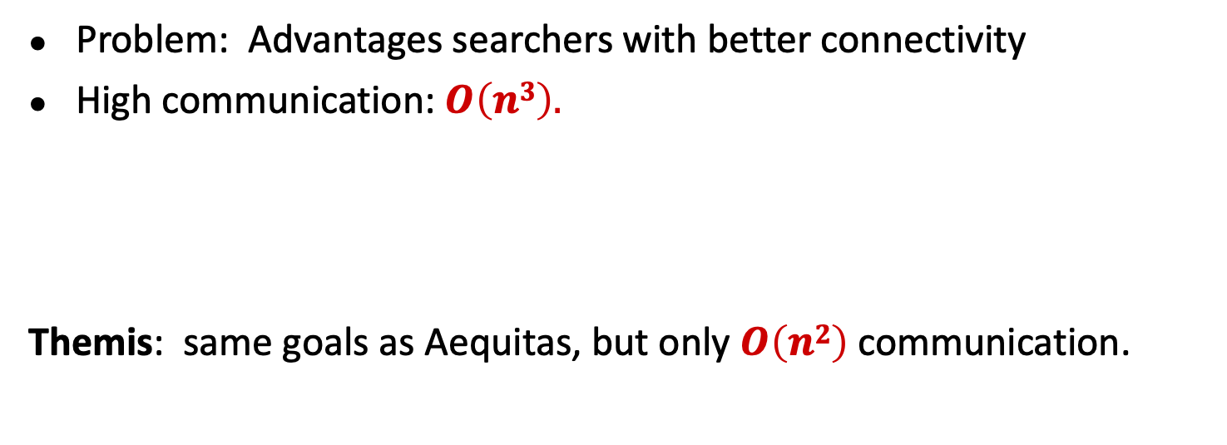
More Time-Based Order-Fairness Protocols
Problem: Advantages searchers with better connectivity
High communication: $O\left(n3\right).$
Themis: same goals as Aequitas, but only $O\left(n2\right)$ communication.
“Themis: Fast, Strong Order-Fairness in Byzantine Consensus” by Kelkar-Deb-Long-Juels-Kannan 2021

Slide 33
A different approach: blind order-fairness
Blind order fairness: three phases:
Commit transactions:
users send commitments to their transactions
(Tx data remains hidden from block proposer)
Order commitments:
block proposer orders commitments into a block.
Reveal transactions:
once block is finalized commitments are revealed
(by validators or “automatically”). Too late to steal MEV.
Notes:
Front-running is still possible by spamming.

Slide 34
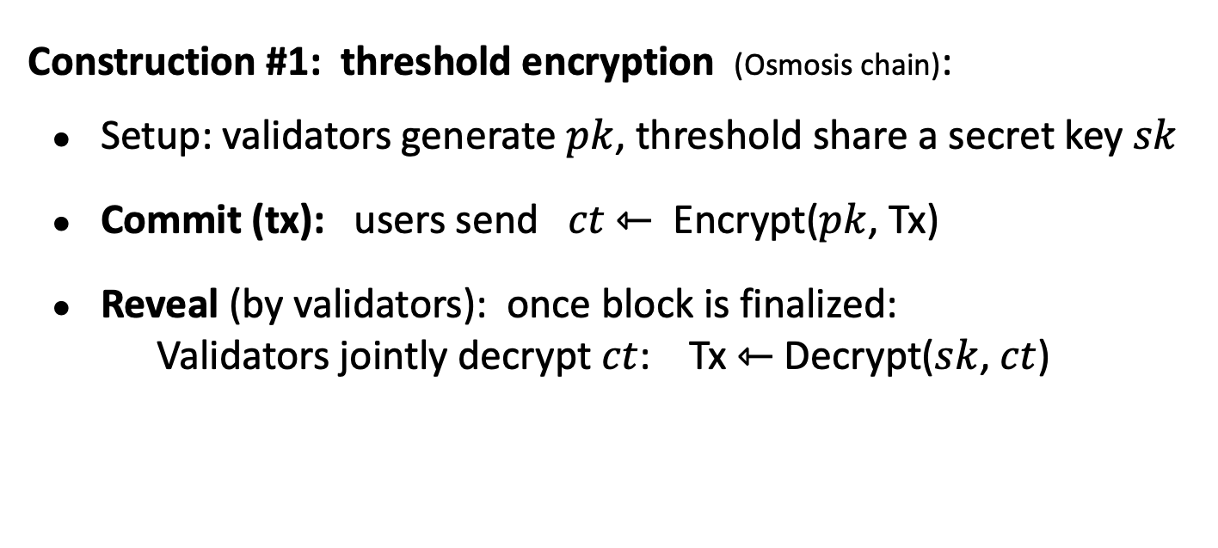
Blind Order-Fairness
Construction #1: threshold encryption (Osmosis chain):
Setup: validators generate $pk$, threshold share a secret key $sk$
Commit (tx): users send $ct$ ⇽ Encrypt($pk$, Tx)
Reveal (by validators): once block is finalized:
Validators jointly decrypt $ct$: Tx ⇽ Decrypt($sk$, $ct$)
Reiter-Birman, 1994
Cachin-Kursawe-Petzold-Shoup, 2001

Slide 35
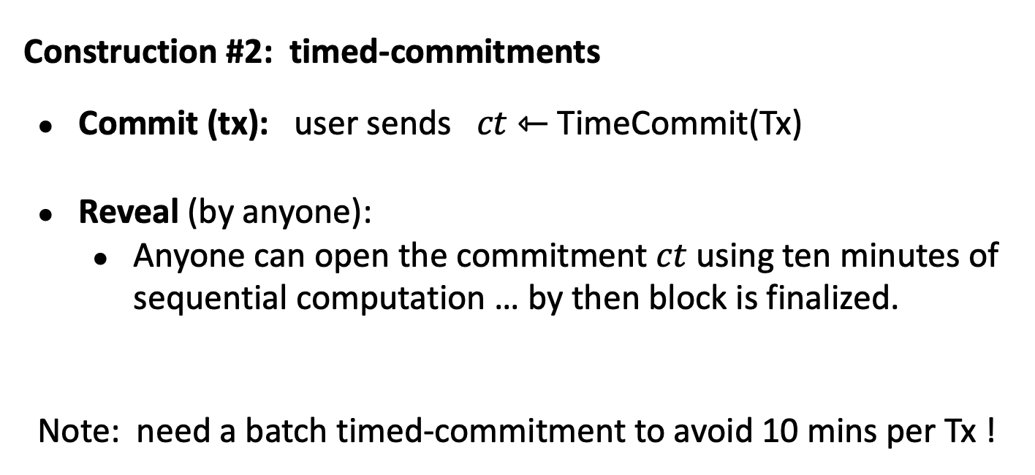
Blind Order-Fairness
Construction #2: timed-commitments
Commit (tx): user sends $ct$ ⇽ TimeCommit(Tx)
Reveal (by anyone):
  Anyone can open the commitment $ct$using ten minutes of sequential computation … by then block is finalized.
Note: need a batch timed-commitment to avoid 10 mins per Tx !

Slide 36
More ideas needed!
An active area of research

Slide 37
New topic: the World of NFTs

Slide 38
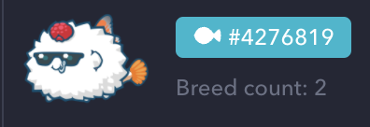


Digital assets (NFTs)
Example digital assets: (ERC-721)
  Gaming assets: axies, DFK Heroes, …
  Memberships: Proof collective (access to events)
  Domain names: ENS
  Sports collectible: NBA top shots
  Virtual worlds: plots in a virtual land
  Art
NBA top shots
Notes:
DFK: DeFi Kingdoms, a role playing game.

Slide 39
Digital assets (NFTs)
No two NFTs are the same: they are not mutually exchangeable
NFTs are defined by their: history, utility, appearance, etc.
Why not manage in a central DB?
Blockchain ensures long-term ownership, until sale.
Provides a trusted record of provenance (forgeries are evident)

Slide 40
The ERC-721 standard
ERC721 contract
ERC721 contract
ERC721 contract
owner addr,
tokenURI,
⋯
owner addr,
tokenURI,
⋯
owner addr,
tokenURI,
⋯
id1
id1
id1
owner addr,
tokenURI,
⋯
owner addr,
tokenURI,
⋯
owner addr,
tokenURI,
⋯
id2
id2
id2
⋮
⋮
⋮
NFT collection
Another NFT collection
NFT collection

Slide 41
The ERC-721 standard (subset)
mapping (uint256 => address) internal idToOwner;
function safeTransferFrom(
address _from, address _to, uint256 _tokenId, bytes data)
function approve(address _approved, uint256 _tokenId)
function setApprovalForAll(address _operator, bool _approved)
function ownerOf(uint256 _tokenId) returns (address);
Notes:
idToOwner: maps token ID to owner address
safeTransferFrom: transfers tokenId from one owner address to another, and records bytes
Approve: allow address to manage tokenId
setApprovalForAll: allow operator to manage all of msg.sender’s tokens (_approved=false to revoke)
ownerOf: who is the owner of tokenId

Slide 42

Example: CryptoPunks (2017, predates ERC-721)
10,000 total CryptoPunks. Managed by contract at
Ethereum address 0xb47e3cd8DF8… (250 lines of solidity)
on-chain marketplace:
visa
#7610
buy offer
sold!
sell offer
https://www.larvalabs.com/cryptopunks/details/7610
Notes:
24x24 picture. Not ERC-721, generated in 2017.
Snapshot of offers and sales.

Slide 43
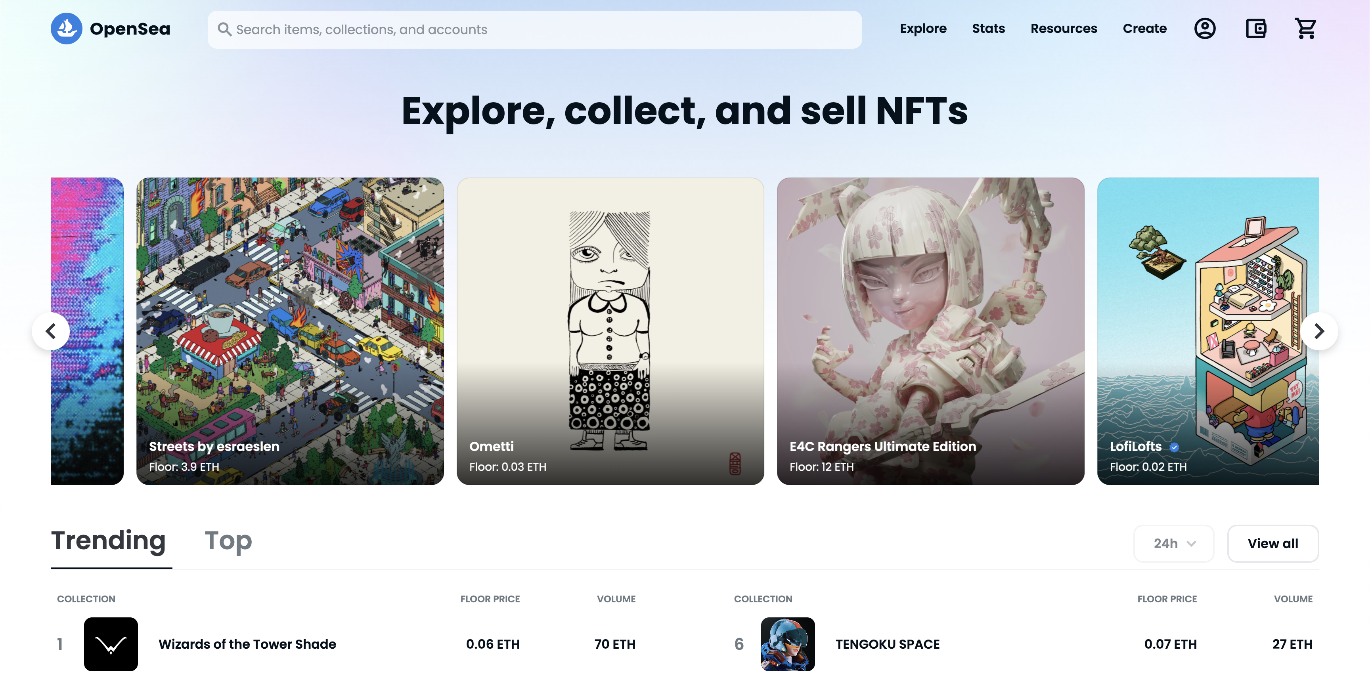
NFT Marketplaces
NFT marketplaces built as a collection of smart contracts
OpenSea, Rarible, Blur, etc.
Why smart contract marketplace?
Trustless: Don't need to give 3rd party custody of your asset
Permissionless: Anyone with wallet can purchase or list
Atomic: Payment for asset and delivery of asset done in one Tx

Slide 44
The NFT ecosystem
Fractional ownership: buy a fraction of an NFT with a large group
  such as an expensive gaming asset (a spaceship)
  control it with the group (governance, collaborative work)
Lending/borrowing an NFT: (enabled by extensions to ERC-721)
  Lend a gaming NFT or a domain name for someone to use
  Try-before-you-buy experience
Use an NFT as collateral for a loan (need continuous price estimates)
NFT derivatives markets, NFT pricing services

Slide 45
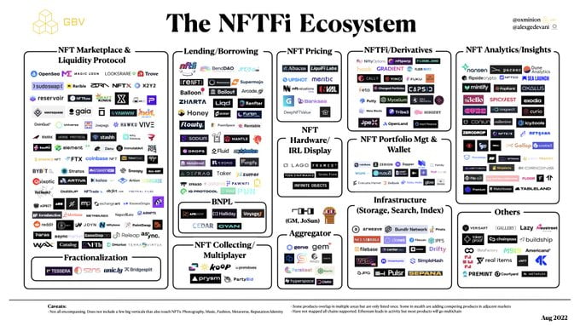

Slide 46
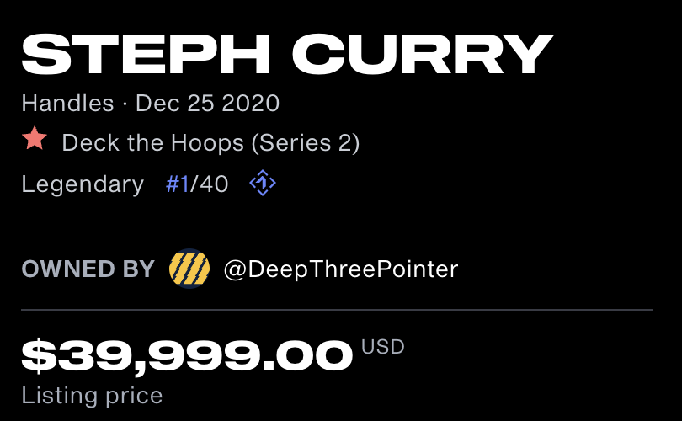
Royalties
With ERC-721 it is quite easy to code up any royalty plan:
example: on every sale of asset, send 1% royalty to creator.
(think: NBA Top Shots)
Problem: not hard to bypass this policy.
Custodial marketplace owns the asset
⇒ shows on its web site that asset belongs to Bob
When Bob sells asset to Carol, marketplace updates its web site.
No on-chain Tx ⇒ no royalty payment to creator

Slide 47

Gaming Guilds
Inter-game financial institutions (Yield Guild Games)
What is it:
Source capital from LPs (by issuing a token)
⇒ Buy up swathes of virtual land and in-game items,
⇒ Generate revenue by leasing assets to players,
⇒ Pay LPs dividends,
⇒ Accrue capital gains on the underlying assets.

Slide 48
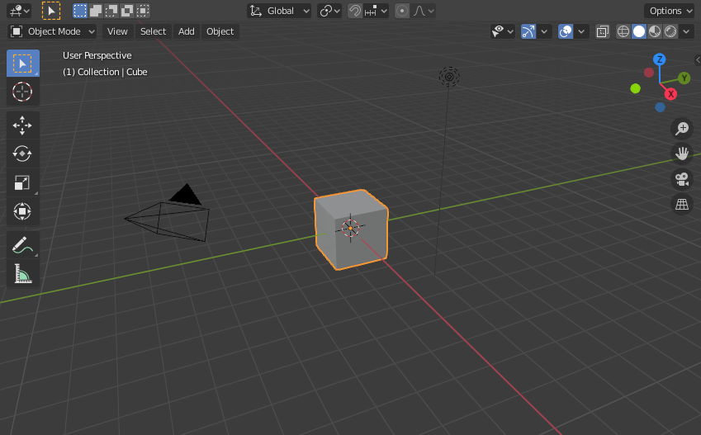

Develop Virtual Land?
Successful platforms leverage the creativity of their users (UGC)
NFTs let creators own, maintain, and control their creations
Challenge for everyone: turn a cube into a digital city.
=>
Notes:
UGC: user generated content

Slide 49
END OF LECTURE
Next lecture: The regulatory landscape

