Slide 1
Decentralized Exchanges
CS251 Fall 2023
(cs251.stanford.edu)
Dan Boneh

Slide 2
… but first, flash loans

Slide 3
What is a flash loan?
A flash loan is taken and repaid in a single transaction
⟹ zero risk for lender ⟹ borrower needs no collateral
Initiating
contract
borrow $1M
Flash
Loan
Provider
do stuff
with funds
return funds
(Tx is valid only if funds are returned in same Tx)
“Attacking the DeFi Ecosystem with Flash Loans for Fun and Profit”

Slide 4
Use cases
Risk free arbitrage
Collateral swap
DeFi attacks: price oracle manipulation
⋮

Slide 5
Risk free arbitrage
Alice finds a USDC/DAI price difference in two pools
Aave (flash loan provider)
Flash loan 1M USDC
Repay 1M USDC loan
Uniswap
USDC⇾DAI
1M USDC
1.002M DAI
Curve
DAI⇾USDC
1.002M DAI
1.001M USDC
1USDC = 1.002DAI
1USDC = 1.001DAI
keep 0.001M USDC
All in a single transaction

Slide 6
Collateral swap
start:
end goal:
Alice @Compound
Alice @Compound
-1000 DAI
+1 cETH
Take 1000 DAI flash loan
Repay 1000 DAI debt (@Compund)
Redeem 1 cETH (from Compound)
Swap 1 cETH for 1500 cUSDC
Deposit 1500 cUSDC as collateral
Borrow 1000 DAI
Repay 1000 DAI flash loan
-1000 DAI
+1500 cUSDC
borrowed DAI using
ETH as collateral
borrowed DAI using
USDC as collateral
(a single Ethereum transaction)
Notes:
Alice is worried ETH value will fall and she will be liquidated. Wants to swap ETH collateral for equivalent USDC.

Slide 7
Aave v1 implementation
function flashLoan(address _receiver, uint256 _amount) {
…
// transfer funds to the receiver
core.transferToUser(_reserve, userPayable, _amount);
// execute action of the receiver
receiver.executeOperation(_reserve, _amount, amountFee, _params);
…
// abort if loan is not repaid
require( availableLiquidityAfter == availableLiquidityBefore.add(amountFee),
"balance inconsistent");
}
Notes:
The fee was paid to the pool, so LiquidityAfter is bigger than LiquidityBefore.
https://github.com/aave/aave-protocol/blob/master/contracts/lendingpool/LendingPool.sol#L835%23L902

Slide 8
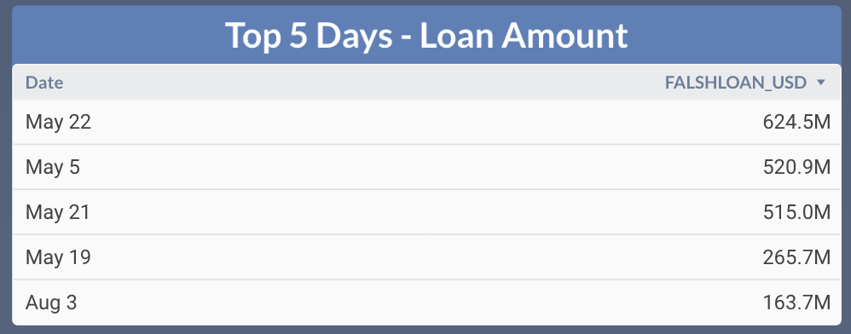
Flash loans amounts on Aave (in 2021)

Slide 9
Decentralized Exchanges
(Dex)

Slide 10
What is an exchange?
Many types of ERC-20 tokens on Ethereum:
WETH: ETH wrapped as an ERC-20, stETH: staked ETH
USDC, USDT, DAI: USD stablecoins
Governance tokens (e.g., GTC for Gitcoin),
Gaming tokens
…
An exchange: used to convert one token to another (e.g., USDC ⇾ GTC)
What is the exchange rate?
How to connect sellers and buyers?

Slide 11
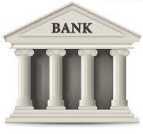
First approach: a centralized exchange (CeX)
I want to exchange 2 ETH for USDC
The exchange rate: 1600 USDC/ETH
Ok. Sends 2 ETH to exchange
CeX
Sends 3200 USDC to Bob
1000: ETH
5 ETH
10000: USDC
Treasury
10: GTC

Slide 12
First approach: a centralized exchange (CeX)
I want to exchange 2 ETH for USDC
The exchange rate: 1600 USDC/ETH
Ok. Sends 2 ETH to exchange
CeX
Sends 3200 USDC to Bob
1002: ETH
3: ETH
1600: USDC
6800: USDC
Treasury
10: GTC

Slide 13
First approach: a centralized exchange (CeX)
Many order types
Example: Limit order:
I am willing to buy
1 ETH for up to 1700 USDC
[for the next 24 hours]
CeX
The exchange either ”fills” the order, or not.
A list of such buy/sell orders is called an order book

Slide 14
Some issues …
How is exchange rate determined?
  By supply and demand at the exchange (not transparent)
  Competition with other exchanges (bad user experience)
Security: What if exch. takes Bob’s 2 ETH, but never sends USDC?
Censorship: What if exchange refuses to do business with Bob?

Slide 15
A more trusted solution: DeX
What is a DEX?
a marketplace where transactions occur directly between participants, without a trusted intermediary
Properties:
Programmable: can be used as a service by other contracts
Transparent: code is available for everyone to see
Permissionless: anyone can use
Non-Custodial

Slide 16
How to build a DeX?
First idea: on-chain order book
Liquidity providers place buy/sell orders on chain
Users fill them on chain
Problem: gas inefficient.
Orders cost gas: when placed, when filled, when canceled.
Matching buy orders to sell orders takes lots of gas (but see here)
Feasible on chains with cheap gas
Notes:
Market maker: a large bank.

Slide 17
How to build a DeX?
Next idea: off-chain order book
Liquidity providers sign buy/sell orders off chain
    Post orders on a centralized web site
User signs an order it wants to fill and submits it on chain.
Examples: 0x Protocol, OpenSea
Problem: order book is not accessible to contracts (dAPPs)

Slide 18
How to build a DeX?
A very elegant idea: Automated Market Maker (AMM)
Liquidity providers deposit assets into an on-chain pool
Users trade with the on-chain pool
    exchange rate is determined algorithmically
Examples: Uniswap, Balancer, Bancor, …
Benefits: Gas-efficient, accessible to contracts, easy to bootstrap
Over 90% of DeX volume on Ethereum

Slide 19
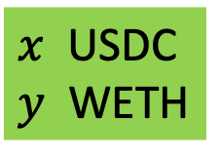
Automated Market Maker
Goal: People want to exchange USDC ⟺ WETH
stable
volitile
Uniswap
USDC-WETH pool
(dAPP)
Liquidity
providers
USDC, WETH
$x$ USDC
$y$ WETH
USDC, WETH
(earn interest)
Notes:
This means that the UNI and USDC ERC-20 contracts transfer coins from LP’s address to pool’s address.

Slide 20
Automated Market Maker
Goal: People want to exchange USDC ⟺ WETH
Calculate exchange rate
Uniswap
USDC-WETH pool
(dAPP)
user
want to sell
12 WETH for USDC
say, 1 WETH = 1.5 USDC
$x$ USDC
$y$ WETH
18 USDC

Slide 21
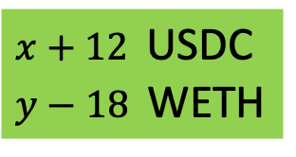
Automated Market Maker
Goal: People want to exchange USDC ⟺ WETH
Calculate exchange rate
Uniswap
USDC-WETH pool
(dAPP)
user
want to sell
12 WETH for USDC
say, 1 WETH = 1.5 USDC
$x+12$ USDC
$y−18$ WETH
18 USDC
updated pool state

Slide 22
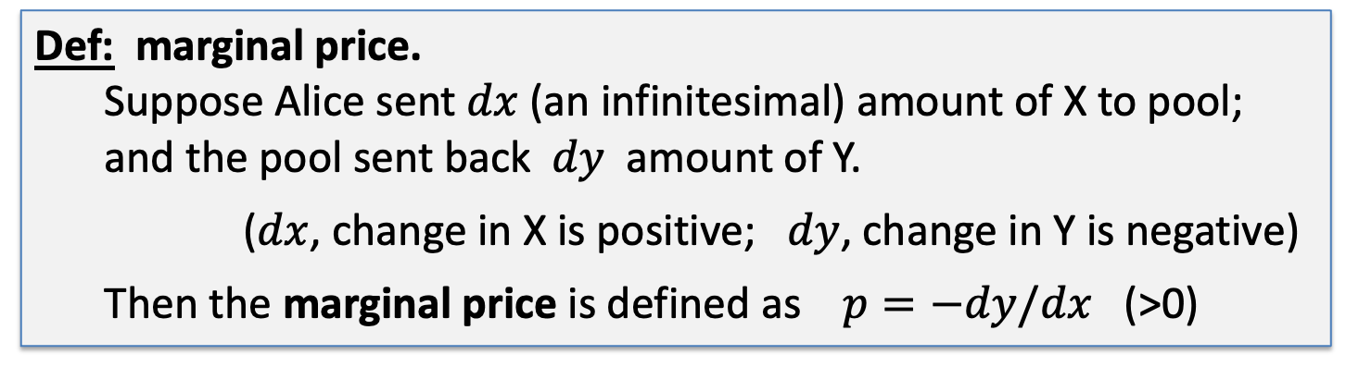
How to determine exchange rate?
Pool has (x units of X) and (y units of Y)
Def: marginal price.
Suppose Alice sent $dx$(an infinitesimal) amount of X to pool;
and the pool sent back $dy$ amount of Y.
($dx$, change in X is positive; $dy$, change in Y is negative)
Then the marginal price is defined as $p=−dy/dx$ (>0)
The price of a small amount Y in units of X
Notes:
$dx$>0, $dy<0$, so p>0.

Slide 23
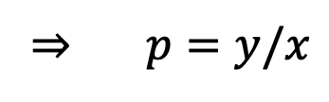
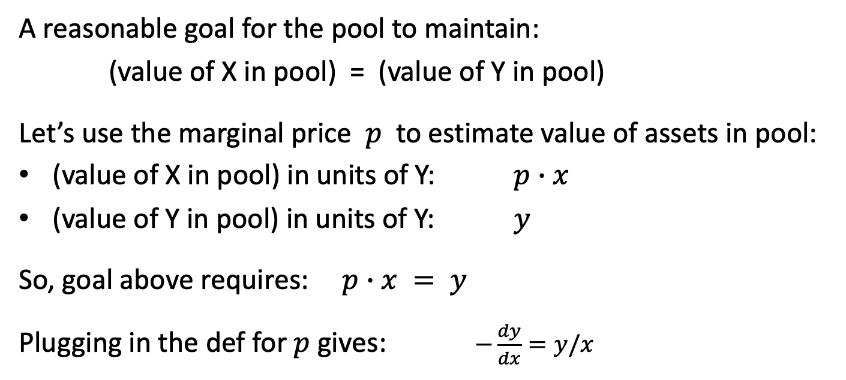
How to determine exchange rate?
A reasonable goal for the pool to maintain:
(value of X in pool) = (value of Y in pool)
Let’s use the marginal price $p$ to estimate value of assets in pool:
(value of X in pool) in units of Y: $p∙x$
(value of Y in pool) in units of Y: $y$
So, goal above requires: $p∙x = y$
Plugging in the def for $p$ gives: $−\frac{dy}{dx}=y/x$
⇒ $p=y/x$

Slide 24
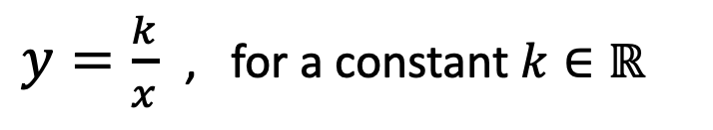

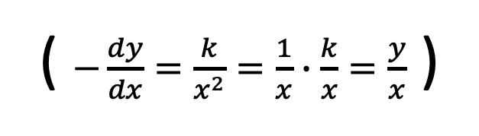
How to determine exchange rate?
$$−\frac{dy}{dx}=y/x$$
The diff. eq.
has a unique solution:
indeed:
$y=\frac{k}{x}$ , for a constant $k∈ℝ$
( $−\frac{dy}{dx}=\frac{k}{x^{2}}=\frac{1}{x}∙\frac{k}{x}=\frac{y}{x}$ )
or equivalently, the pool must maintain: $x∙y=k$
… the famous constant product formula

Slide 25
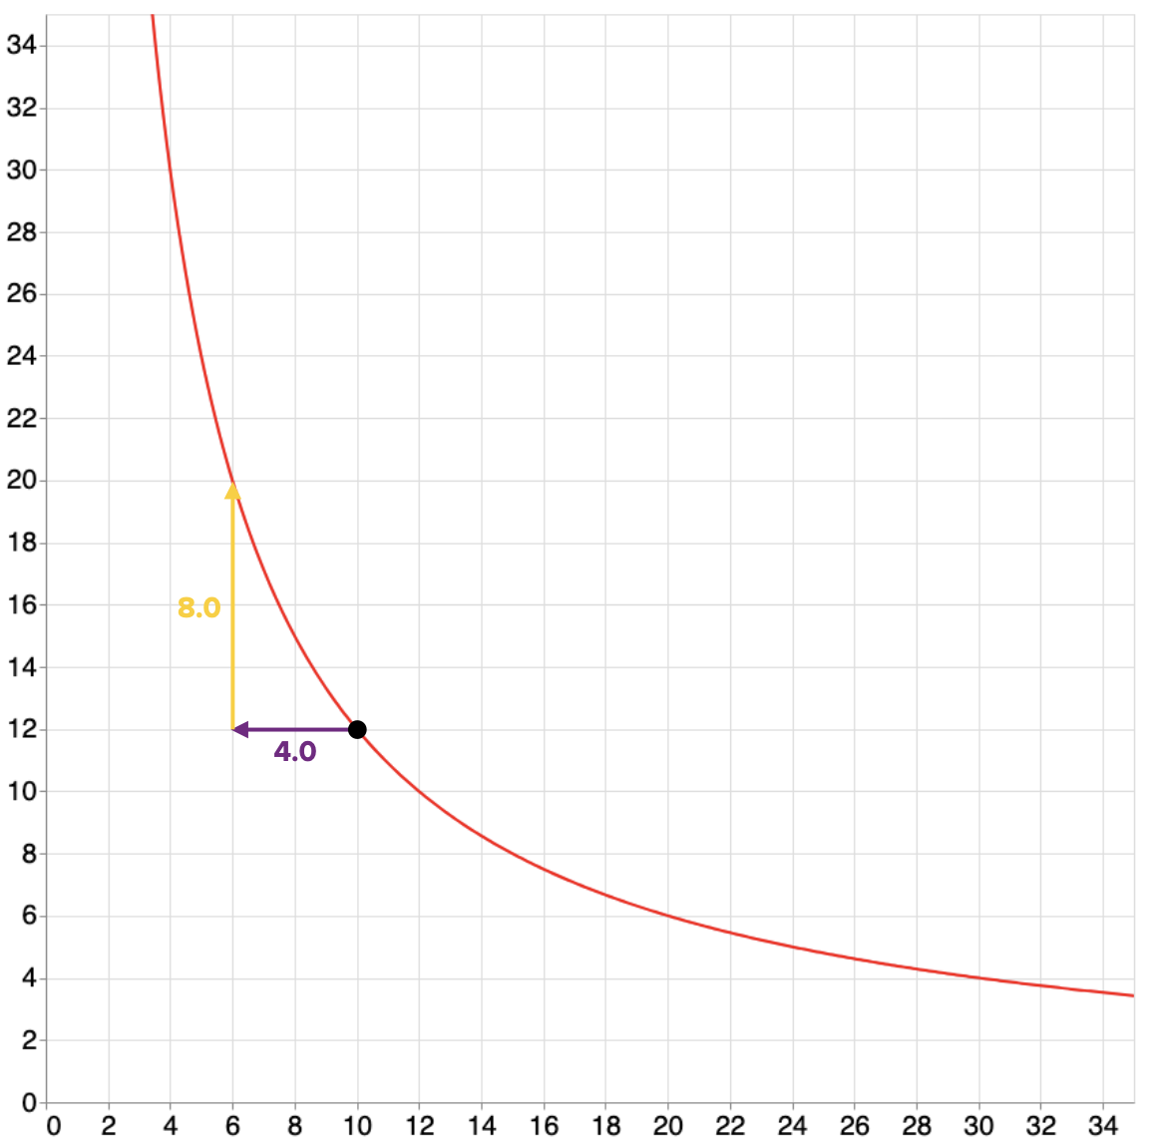
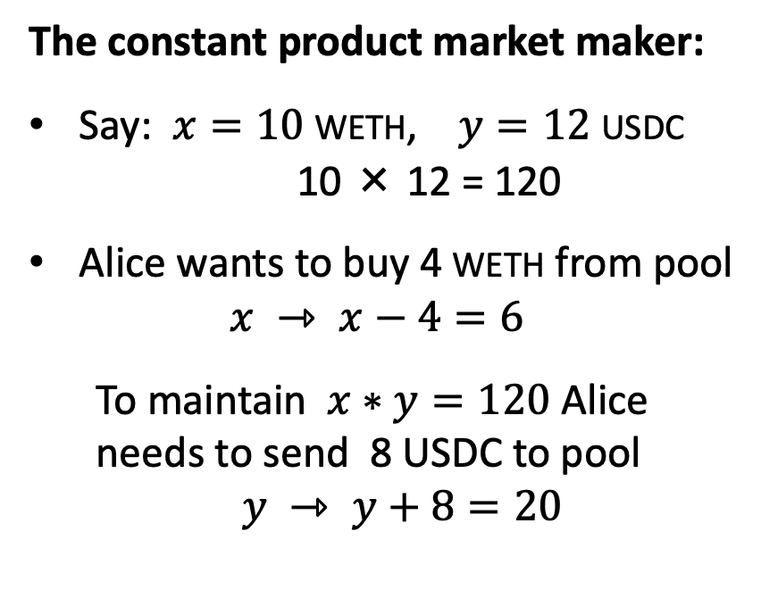


So what does $x∙y=k$ mean ??
$$x∙y=120$$
The constant product market maker:
Say: $x=10$WETH, $y=12$USDC
10 × 12 = 120
Alice wants to buy 4 WETH from pool
$x ⇾ x−4=6$
To maintain $x∗y=120$ Alice
needs to send 8 USDC to pool
$y ⇾ y+8=20$
new
state
USDC
current
state of pool
WETH

Slide 26
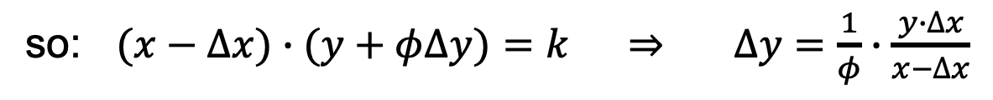
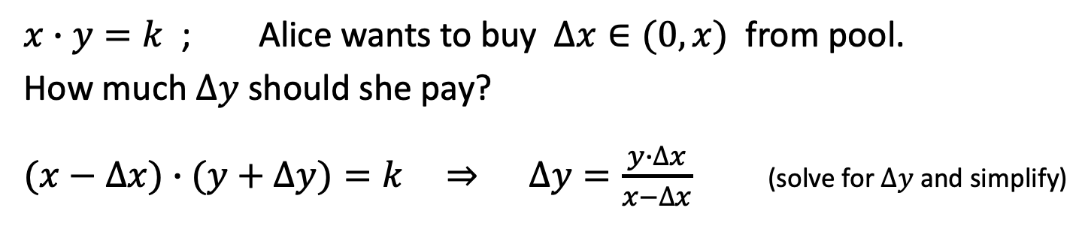
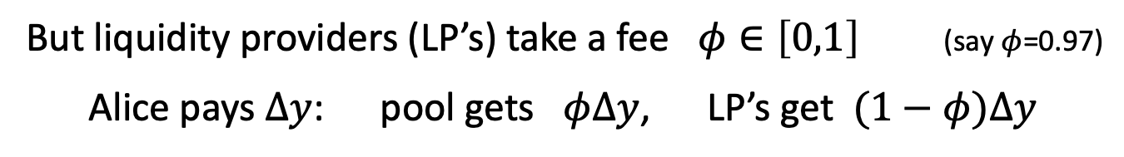
More generally: Uniswap v2
$x∙y=k$ ; Alice wants to buy $∆x∈(0,x)$ from pool.
How much $∆y$ should she pay?
$(x−∆x)∙(y+∆y)=k$ ⇒ $∆y=\frac{y∙∆x}{x−∆x}$ (solve for $∆y$and simplify)
But liquidity providers (LP’s) take a fee $φ∈\left[0,1\right]$ (say $φ$=0.97)
Alice pays $∆y$: pool gets $φ∆y$, LP’s get $(1−φ)∆y$
so: $(x−∆x)∙(y+φ∆y)=k$ ⇒ $∆y=\frac{1}{φ}∙\frac{y∙∆x}{x−∆x}$

Slide 27
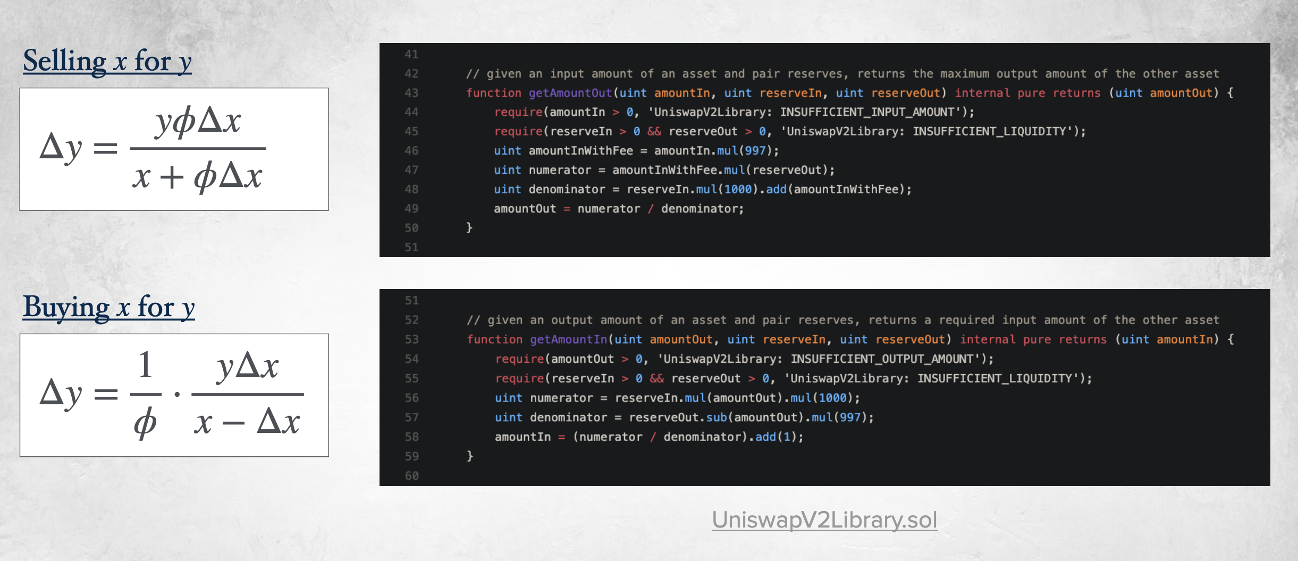


Buy and sell equations
($x⇾x−∆x$)
($x⇾x+∆x$)
gas efficient calculations

Slide 28
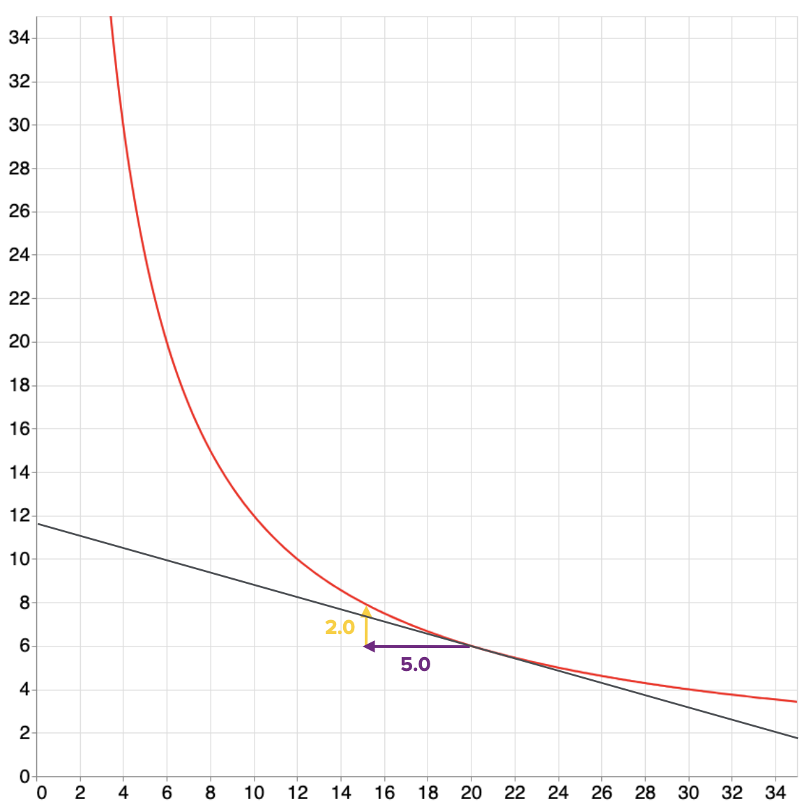
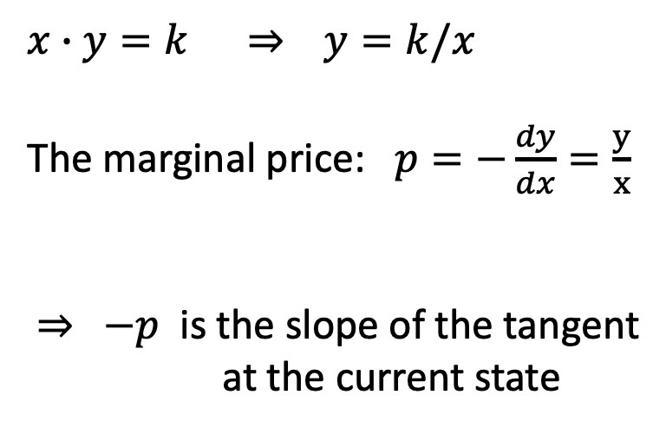
The marginal price as a tangent
$x∙y=k$ ⇒ $y=k/x$
The marginal price: $p=−\frac{dy}{dx}=\frac{y}{x}$
⇒ $−p$ is the slope of the tangent
at the current state
current
state
tangent

Slide 29
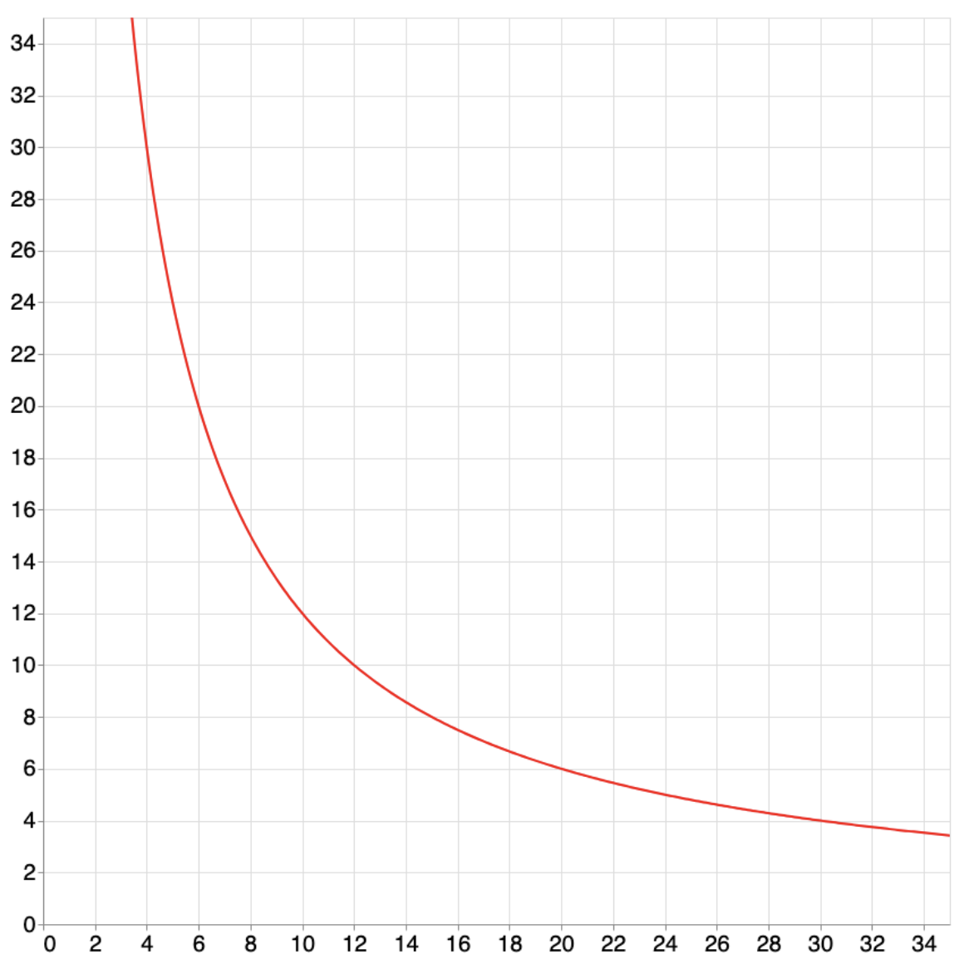


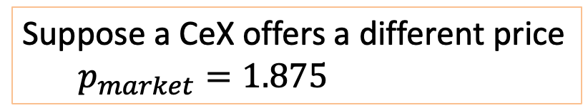
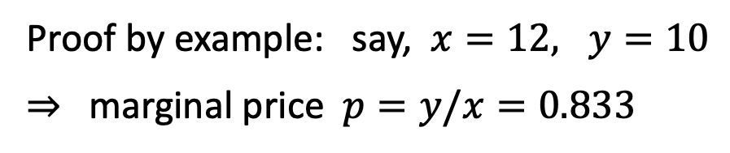
A feature: automatic price discovery (assume $φ$=1)
Thm: the marginal price $y/x$ converges to the market exchange rate
Proof by example: say, $x=12, y=10$
⇒ marginal price $p=y/x=0.833$
This point matches
the CeX price: 15/8=1.875
current
state
Suppose a CeX offers a different price
$p_{market}=1.875$
⇒ arbitrage opportunity!
$$p=y/x=0.833$$

Slide 30
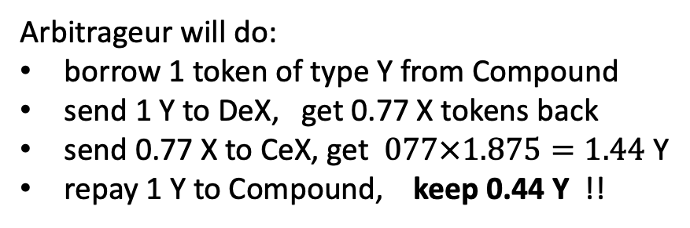
A feature: automatic price discovery (assume $φ$=1)
Thm: the marginal price $y/x$ converges to the market exchange rate
Arbitrageur will do:
borrow 1 token of type Y from Compound
send 1 Y to DeX, get 0.77 X tokens back
send 0.77 X to CeX, get $077×1.875=1.44$ Y
repay 1 Y to Compound, keep 0.44 Y !!
updated DeX state
current
state
Iterate until DeX marginal price = CeX price
⇒ Arb. is providing a service, and making a profit
Where did the 0.44 Y come from? Who lost money?
$$p=y/x=0.833$$
Answer: LP’s lost … we will see why

Slide 31
A feature: automatic price discovery (assume $φ$=1)
Thm: the marginal price $y/x$ converges to the market exchange rate
To summarize:
DeX state is below market rate
⇒ arbitrageurs will move DeX up
DeX state is above market rate
⇒ arbitrageurs will move DeX down
DeX above CeX
CeX price
DeX below CeX
DeX marginal price matches market price,
without ever being told the market price !!
Notes:
This holds for any curve as long as dy/dx is monotonically decreasing from infinity to zero as x goes from 0 to infinity.

Slide 32
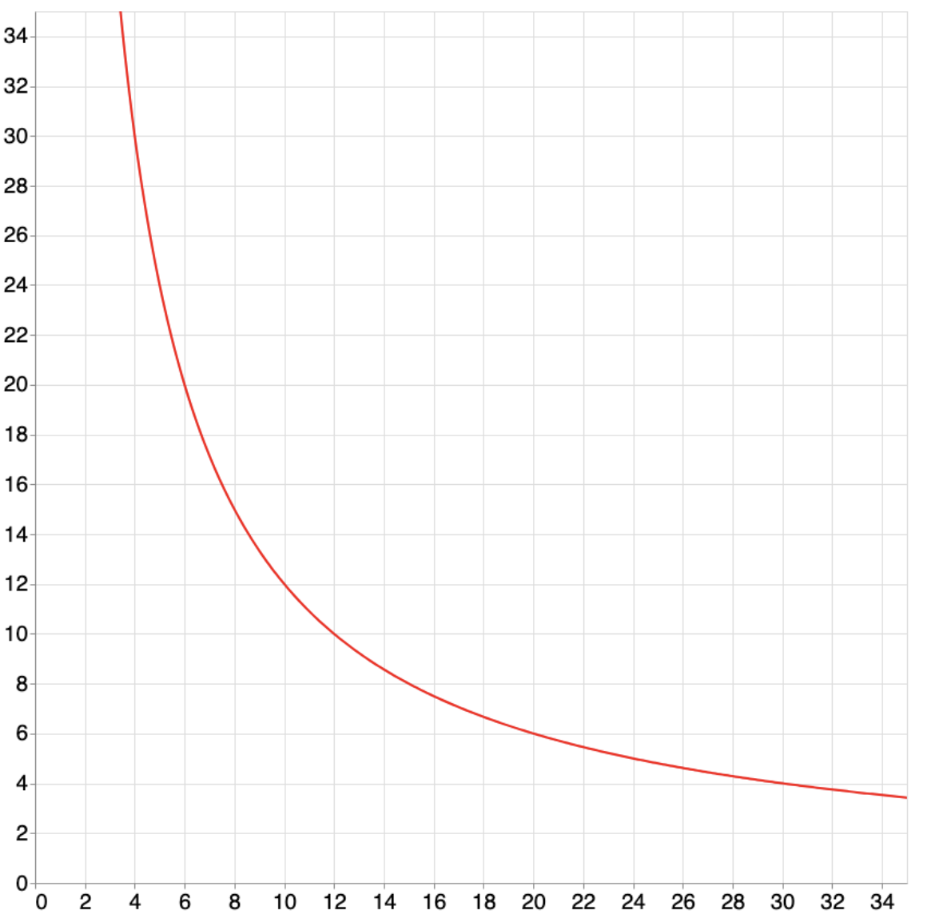
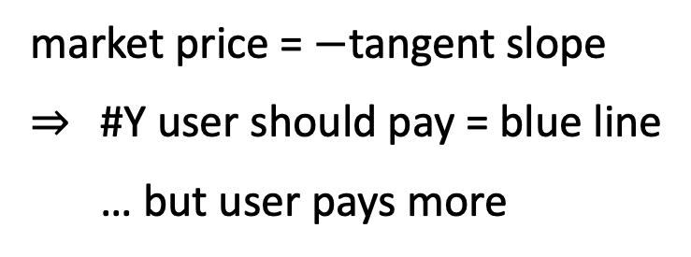
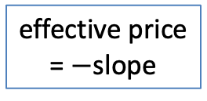
Problem 1: Slippage
Slippage:
the larger the trade,
the worse the exchange rate
is for the user
effective price
= $−$slope
state after
trade
market price = $−$tangent slope
⇒ #Y user should pay = blue line
… but user pays more
current
state
#Y user
pays
market
price
#X user
gets
tangent
(uniswap bounds slippage at 0.5%)
Notes:
Alternatively, the shallower the pool, the greater the slippage. We want deep pools.

Slide 33
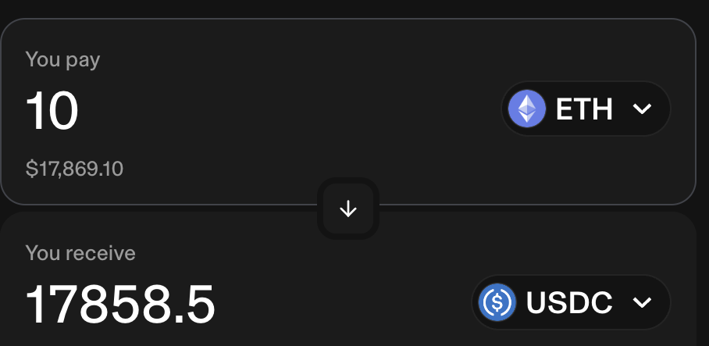
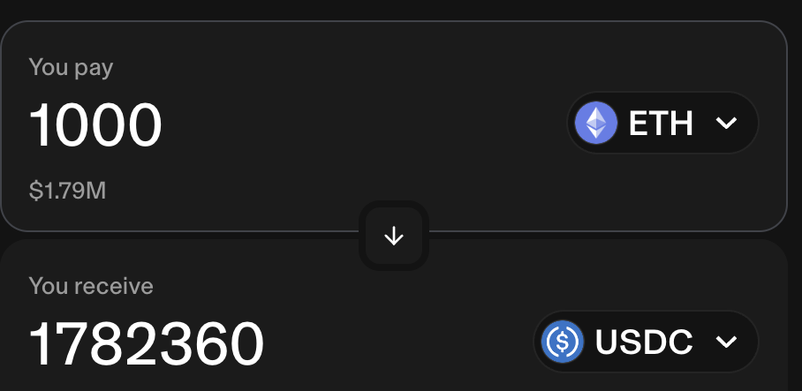

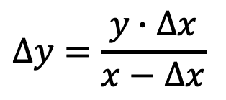
Slippage: an example
$$∆y=\frac{y∙∆x}{x−∆x}$$
1785.5 USDC/ETH
$$>$$
1782.36 USDC/ETH
Note: if $∆x=x$ (Alice wants to buy entire pool) then price is $∞$
⇒ Pool will never run out of X or Y tokens.
https://app.uniswap.org/swap

Slide 34
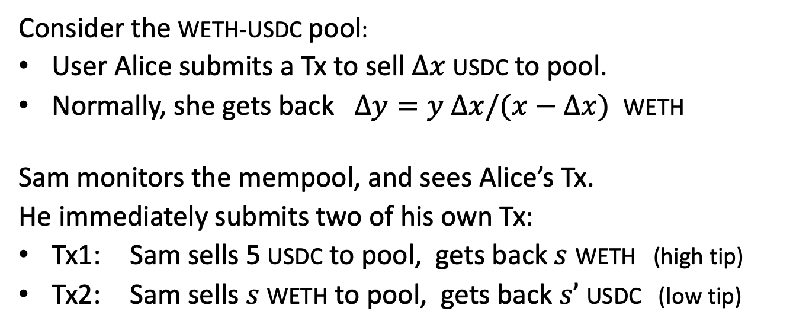
Problem 2: the sandwich attack
Consider the WETH-USDC pool:
User Alice submits a Tx to sell $∆x$ USDC to pool.
Normally, she gets back $∆y=y ∆x/(x−∆x)$ WETH
Sam monitors the mempool, and sees Alice’s Tx.
He immediately submits two of his own Tx:
Tx1: Sam sells 5 USDC to pool, gets back $s$ WETH (high tip)
Tx2: Sam sells $s$ WETH to pool, gets back $s’$ USDC (low tip)
Sam’s
Tx1
Alice’s
sandwiched Tx
Sam’s
Tx2
time

Slide 35
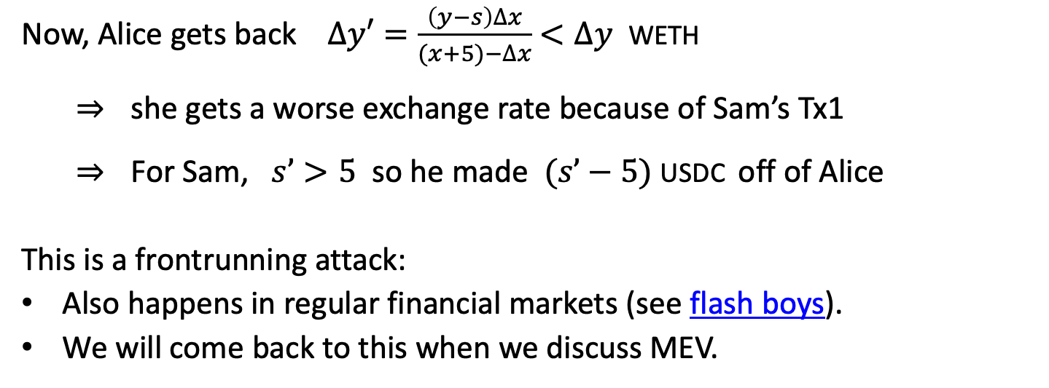
Problem 2: the sandwich attack
Now, Alice gets back $∆y′=\frac{\left(y−s\right)∆x}{(x+5)−∆x}$ $<∆y$ WETH
⇒ she gets a worse exchange rate because of Sam’s Tx1
⇒ For Sam, $s’>5$ so he made $(s’−5)$ USDC off of Alice
This is a frontrunning attack:
Also happens in regular financial markets (see flash boys).
We will come back to this when we discuss MEV.
Sam’s
Tx1
Alice’s
sandwiched Tx
Sam’s
Tx2
time

Slide 36
Incentives for liquidity providers

Slide 37
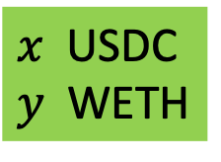
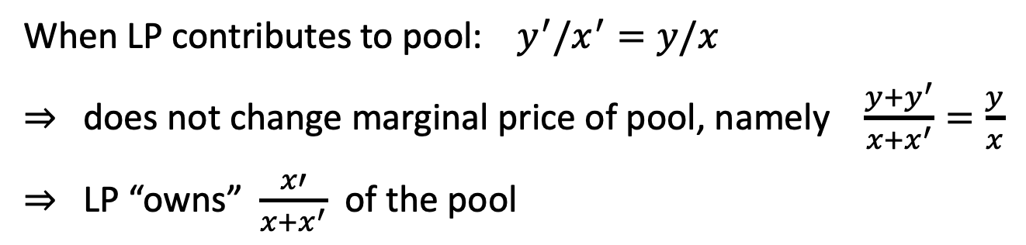

Recall: liquidity providers (LP’s)
When LP contributes to pool: $y^{′}/x^{′}=y/x$
⇒ does not change marginal price of pool, namely $\frac{y+y^{′}}{x+x^{′}}=\frac{y}{x}$
⇒ LP “owns” $\frac{x′}{x+x^{′}}$ of the pool
Uniswap
USDC-WETH pool
(dAPP)
LP
$x’$ USDC
$y’$ WETH
$x$ USDC
$y$ WETH

Slide 38
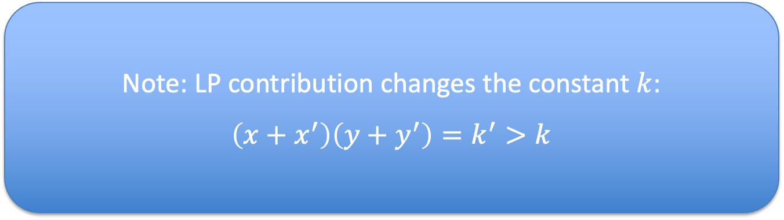
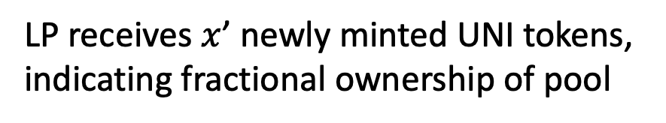
Recall: liquidity providers (LP’s)
When LP contributes to pool: $y^{′}/x^{′}=y/x$
⇒ does not change marginal price of pool, namely $\frac{y+y^{′}}{x+x^{′}}=\frac{y}{x}$
⇒ LP “owns” $\frac{x′}{x+x^{′}}$ of the pool
Note: LP contribution changes the constant $k$:
$\left(x+x^{′}\right)\left(y+y^{′}\right)=k^{′}>k$
Uniswap
USDC-WETH pool
(dAPP)
LP receives $x$’ newly minted UNI tokens,
indicating fractional ownership of pool
LP
$x’$ USDC
$y’$ WETH
$x$ USDC
$y$ WETH

Slide 39
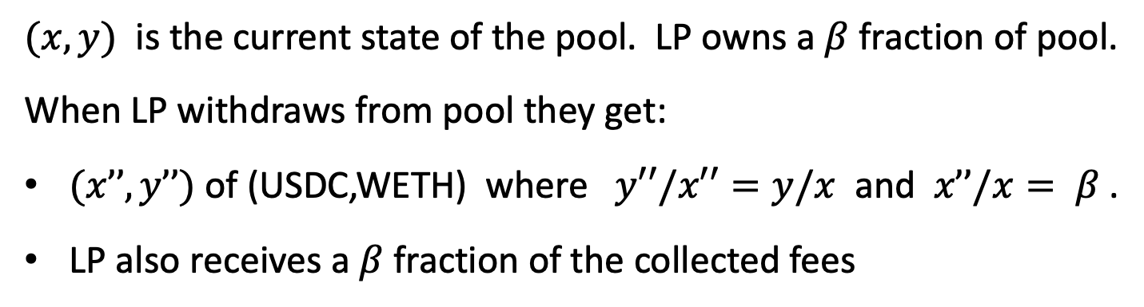

LP withdrawal
$(x,y)$ is the current state of the pool. LP owns a $β$ fraction of pool.
When LP withdraws from pool they get:
$(x’’,y’’)$ of (USDC,WETH) where $y′′/x′′=y/x$ and $x’’/x= β$.
LP also receives a $β$fraction of the collected fees
Uniswap
USDC-WETH pool
(dAPP)
LP
$x′′$ USDC
$y′′$ WETH
$x$ USDC
$y$ WETH

Slide 40
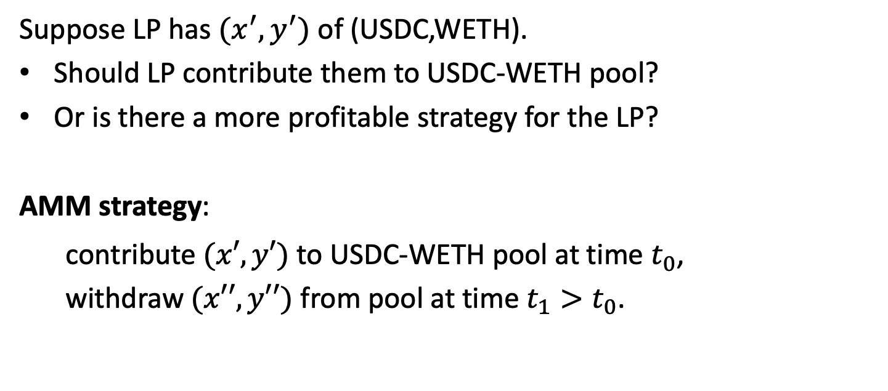
Should LP’s contribute to pool?
Suppose LP has $(x^{′},y^{′})$ of (USDC,WETH).
Should LP contribute them to USDC-WETH pool?
Or is there a more profitable strategy for the LP?
AMM strategy:
contribute $(x′,y′)$ to USDC-WETH pool at time $t_{0}$,
withdraw $(x′′,y′′)$ from pool at time $t_{1}>t_{0}$.

Slide 41
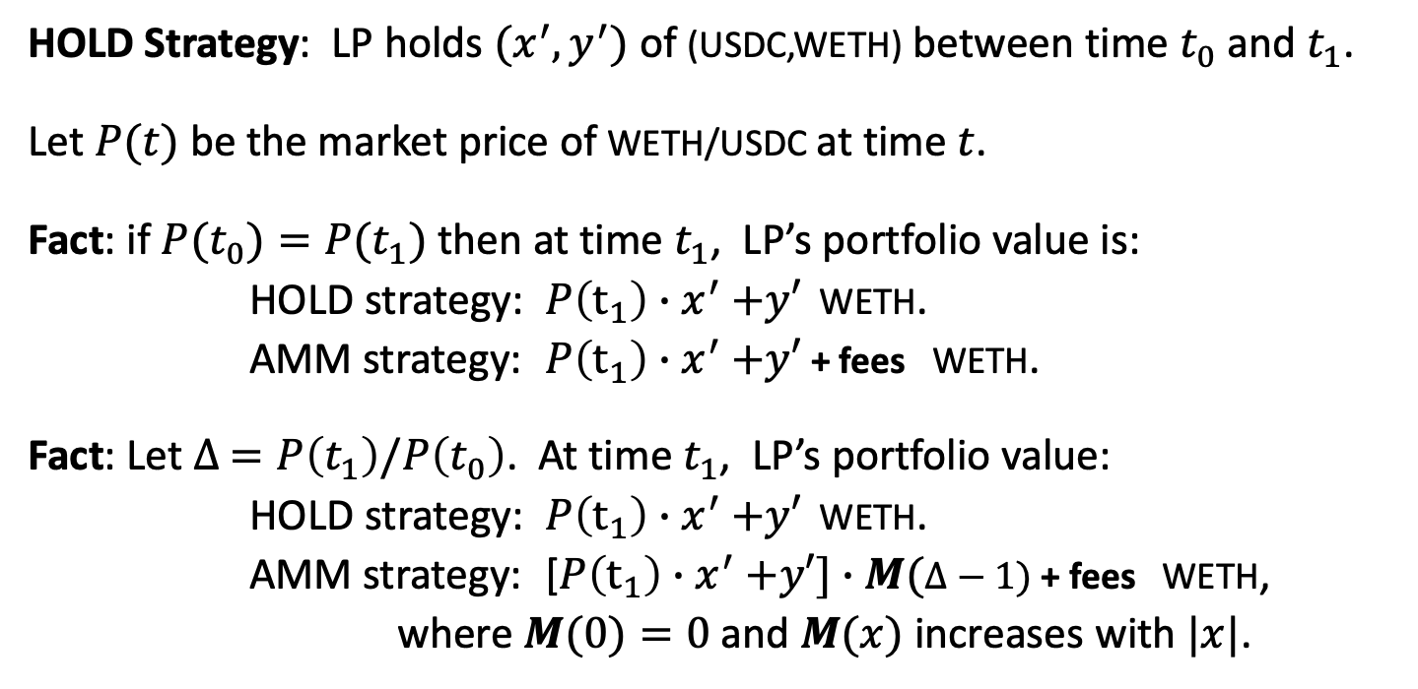
Loss vs. Hold (divergence loss)
HOLD Strategy: LP holds $(x^{′},y^{′})$ of (USDC,WETH) between time $t_{0}$ and $t_{1}$.
Let $P(t)$ be the market price of WETH/USDC at time $t$.
Fact: if $P(t_{0})=P(t_{1})$ then at time $t_{1}$, LP’s portfolio value is:
HOLD strategy: $P\left(t_{1}\right){∙x}^{′}+y′$ WETH.
AMM strategy: $P\left(t_{1}\right){∙x}^{′}+y′$ + fees WETH.
Fact: Let $∆ =P\left(t_{1}\right)/P\left(t_{0}\right)$. At time $t_{1}$, LP’s portfolio value:
HOLD strategy: $P\left(t_{1}\right){∙x}^{′}+y′$ WETH.
AMM strategy: [$P\left(t_{1}\right){∙x}^{′}+y′]∙M(∆−1)$ + fees WETH,
where $M(0)=0$and $M(x)$ increases with $|x|$.
Loss vs. Hold
Notes:
When $∆ =$1, LP gets fees. When |$∆ −$1| is large, LP’s losses are great.

Slide 42
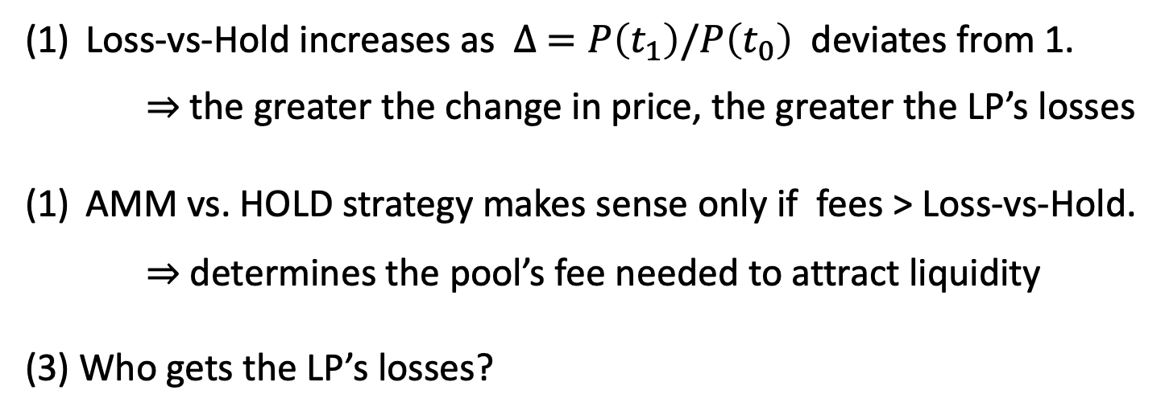

Loss vs. Hold (divergence loss)
HOLD Strategy: LP holds $(x^{′},y^{′})$ of (USDC,WETH) between time $t_{0}$ and $t_{1}$.
Loss-vs-Hold increases as $∆ =P\left(t_{1}\right)/P\left(t_{0}\right)$ deviates from 1.
⇒ the greater the change in price, the greater the LP’s losses
AMM vs. HOLD strategy makes sense only if fees > Loss-vs-Hold.
⇒ determines the pool’s fee needed to attract liquidity
(3) Who gets the LP’s losses?
Arbitrageurs

Slide 43
Loss vs. Rebalancing (LVR)
Rebalancing Strategy:
LP maintains its portfolio outside of the DeX
LP does the same rebalancing on its portfolio as the DeX,
but it does so by trading with a CeX.
A strategy that more accurately predicts LP’s losses
when providing liquidity to DeX
⇒ more accurately determines the fee needed to attract liquidity
https://arxiv.org/pdf/2208.06046.pdf

Slide 44
Loss vs. Rebalancing (LVR)
LVR meta theorem:
At periods of high exchange rate volatility, the rebalancing strategy greatly outperforms the investment in a DeX as an LP,
unless fees are “very” high
⇒ At periods of high volatility, LPs withdraw funds from the pool
(unless the pool charges very high fees)

Slide 45
Other functions

Slide 46
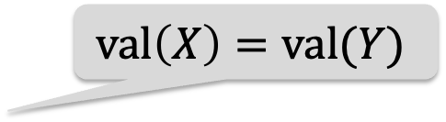
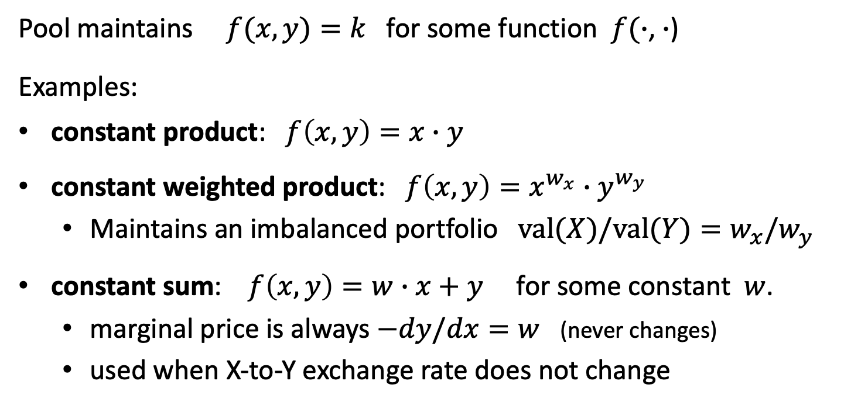
Constant Function Market Maker (CFMM)
Pool maintains $f(x,y)=k$ for some function $f(∙$, $∙$)
Examples:
constant product: $f\left(x,y\right)=x∙y$
constant weighted product: ${f\left(x,y\right)=x}^{w_{x}}∙y^{w_{y}}$
  Maintains an imbalanced portfolio $val(X)/val(Y)=w_{x}/w_{y}$
constant sum: $f\left(x,y\right)=w∙x+y$ for some constant $w$.
  marginal price is always $−dy/dx=w$ (never changes)
  used when X-to-Y exchange rate does not change
$$val\left(X\right)=val(Y)$$

Slide 47
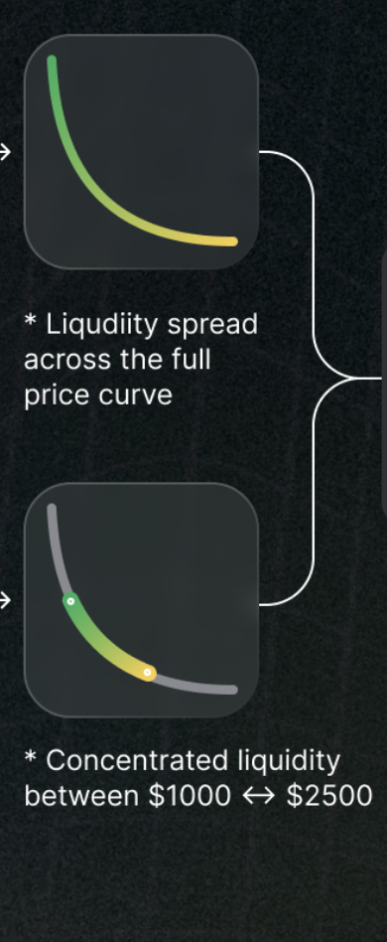
Uniswap v3: concentrated liquidity
In v2, LP’s liquidity is used on the entire price range.
In v3, LP can specify a price range where their liquidity will be used
⇒ protects LP from price swings. Results in a deeper pool when price is in the allowed range.
https://uniswap.org/whitepaper-v3.pdf

Slide 48
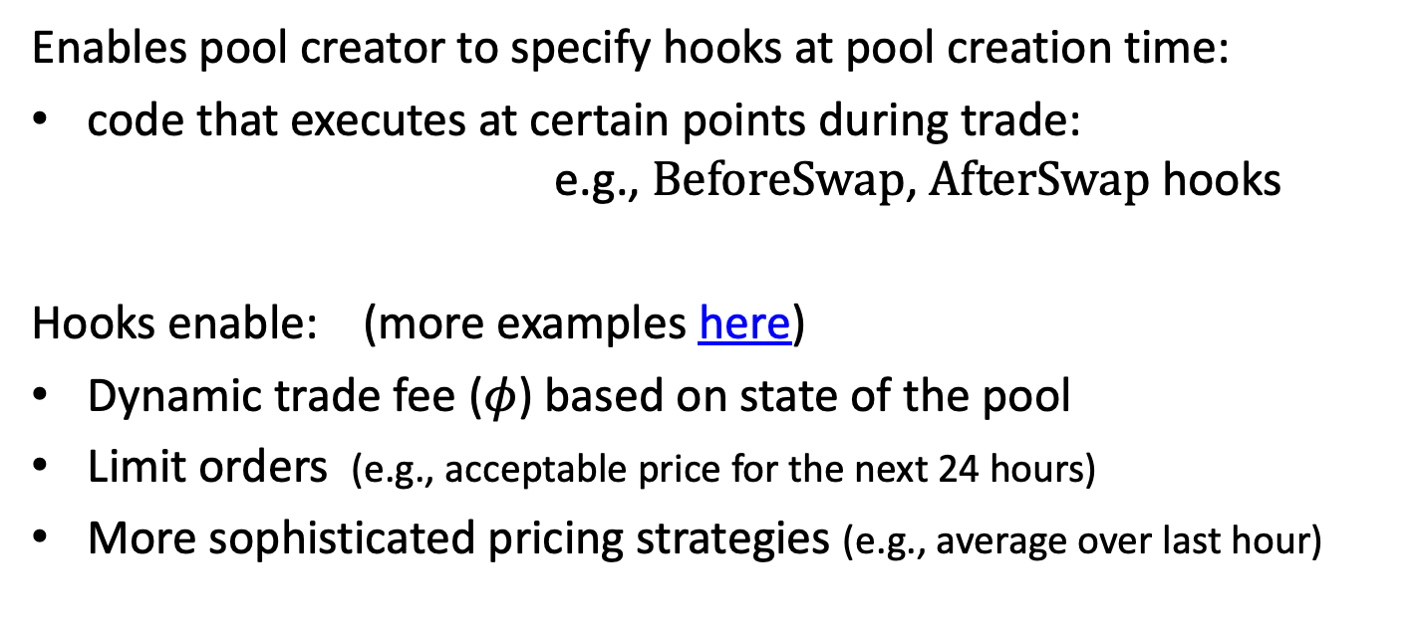
Uniswap v4: hooks
Enables pool creator to specify hooks at pool creation time:
code that executes at certain points during trade:
e.g., BeforeSwap, AfterSwap hooks
Hooks enable: (more examples here)
Dynamic trade fee ($φ$) based on state of the pool
Limit orders (e.g., acceptable price for the next 24 hours)
More sophisticated pricing strategies (e.g., average over last hour)
https://blog.uniswap.org/uniswap-v4

Slide 49
Summary: AMMs
AMM is implemented as a simple smart contract (proj #4)
Automatic price discovery (no off-chain oracles)
No dependence on a central point of control
Fully composable with other dAPPs

Slide 50
END OF LECTURE
Next lecture: MEV

