Slide 1
Cryptocurrencies and
Blockchain Technologies
CS251 Fall 2023
https://cs251.stanford.edu
Dan Boneh
Stanford University
[course videos on canvas, discussions on edstem, homework on gradescope]
[first project – Merkle trees – is out on the course web site]

Slide 2
What is a blockchain for?
Abstract answer: a blockchain provides
  coordination between many parties,
  when there is no single trusted party
if trusted party exists ⇒ no need for a blockchain
Notes:
but blockchains also used in other areas, like digital asset management, e.g., as in online games.

Slide 3
What is a blockchain?
Abstract answer: a blockchain provides
  coordination between many parties,
  when there is no single trusted party
if trusted party exists ⇒ no need for a blockchain
[financial systems: often no trusted party]
Notes:
but blockchains also used in other areas, like digital asset management, e.g., as in online games.

Slide 4
Blockchains: what is the new idea?
2009
Bitcoin
Several innovations:
A practical public append-only data structure,
secured by replication and incentives
A fixed supply asset (BTC). Digital payments, and more.

Slide 5
Blockchains: what is the new idea?
2009
2015
Bitcoin
Ethereum
Several innovations:
Blockchain computer: a fully programmable environment
⟹ public programs that manage digital and financial assets
Composability: applications running on chain can call each other

Slide 6
Blockchains: what is the new idea?
2009
2015
2017
2022
Bitcoin
Ethereum
growth of
DeFi, NFTs, DAOs

Slide 7
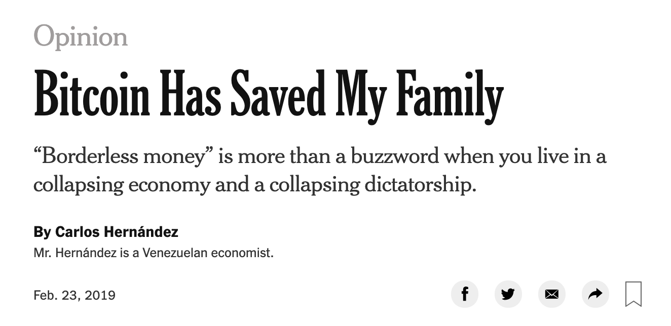

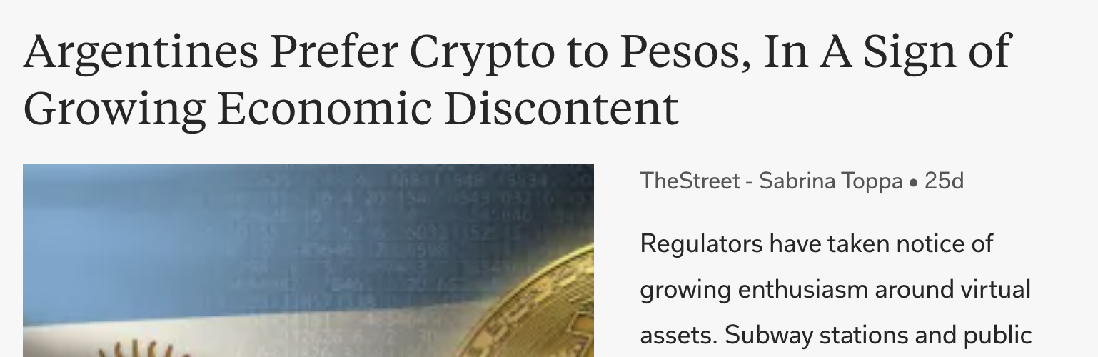
So what is this good for?
(1) Basic application: a digital currency (stored value)
Current largest: Bitcoin (2009), Ethereum (2015)
Global: accessible to anyone with an Internet connection

Slide 8
What else is it good for?
(2) Decentralized applications (DAPPs)
DeFi: financial instruments managed by public programs
  examples: stablecoins, lending, exchanges, ….
Asset management (NFTs): art, game assets, domain names.
Decentralized organizations (DAOs): (decentralized governance)
    DAOs for investment, for donations, for collecting art, etc.
(3) New programming model: writing decentralized programs

Slide 9
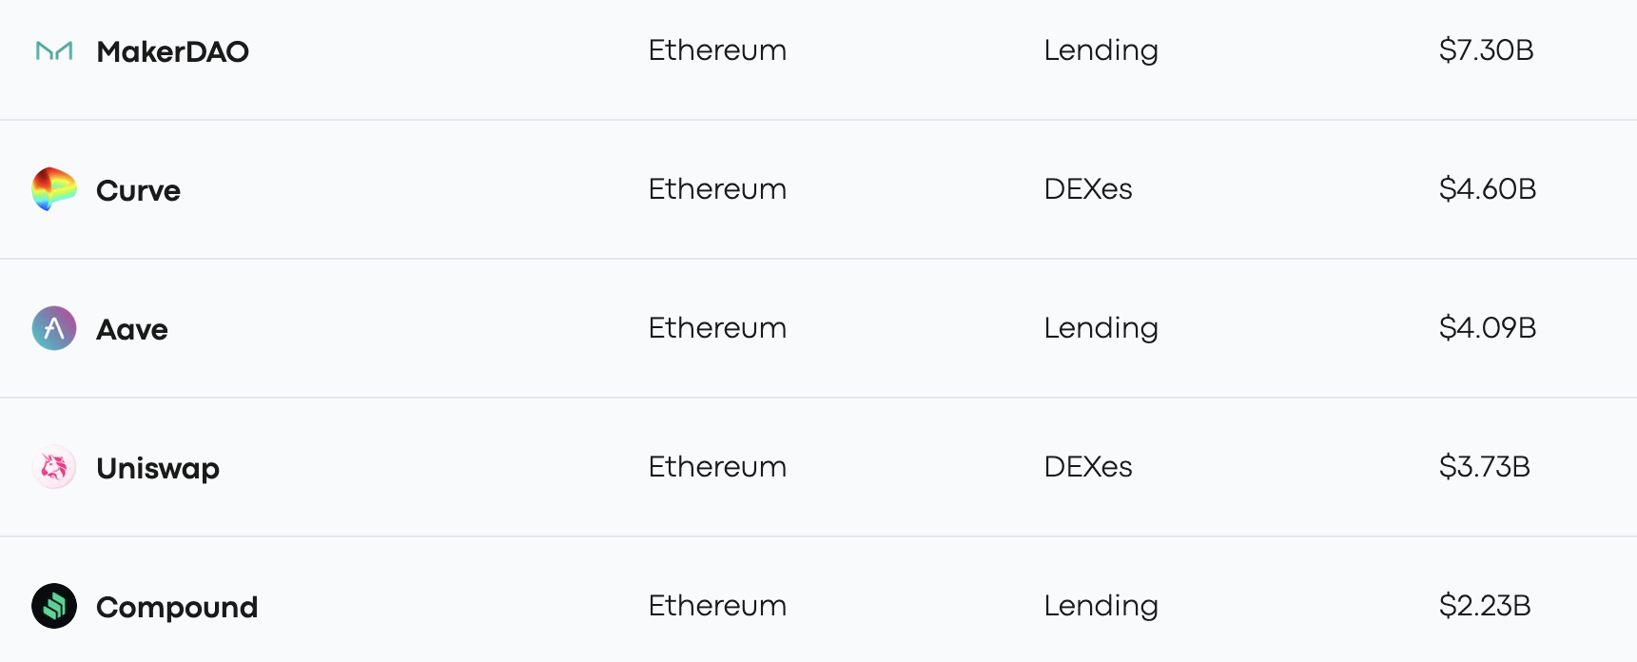
Assets managed by DAPPs
StableCoin
$4.5B
Exchange
$2.2B
V3
Lending
$2.3B
V3
Exchange
$3.1B
Lending
$1.8B
Sep. 2023

Slide 10
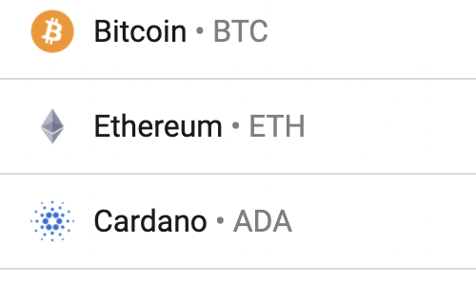
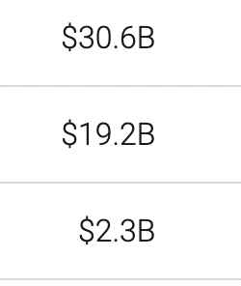

Transaction volume
24h volume Sep. 2023
$9.9B
$3.4B
$2.7B

Slide 11
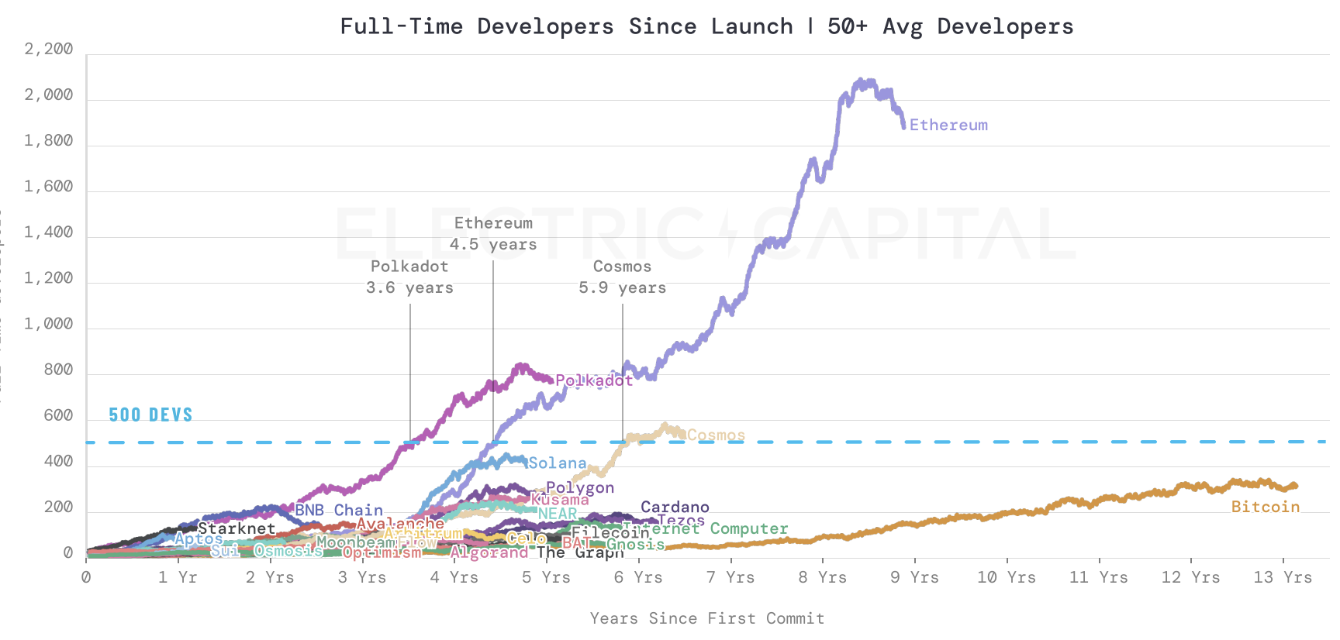
# Active developers since launch (as of 12/31/2022)
source: electric capital
Notes:
https://github.com/electric-capital/developer-reports/blob/master/dev_report_2022.pdf

Slide 12
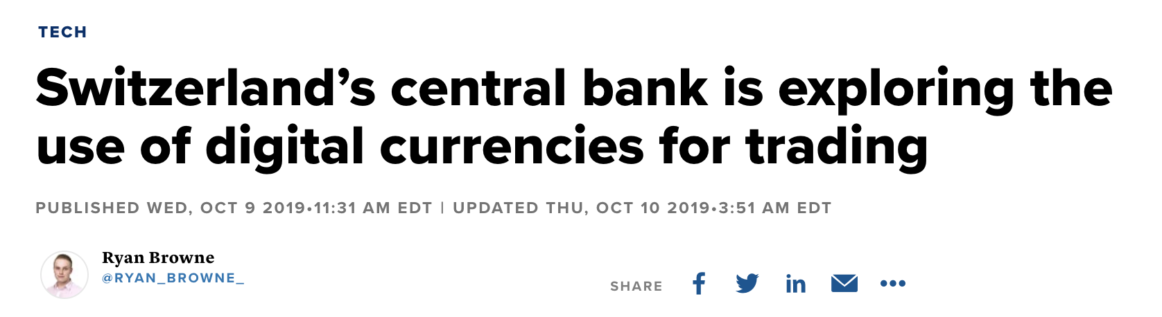
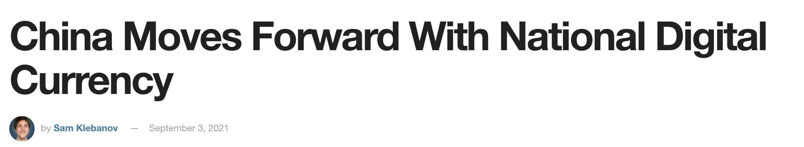
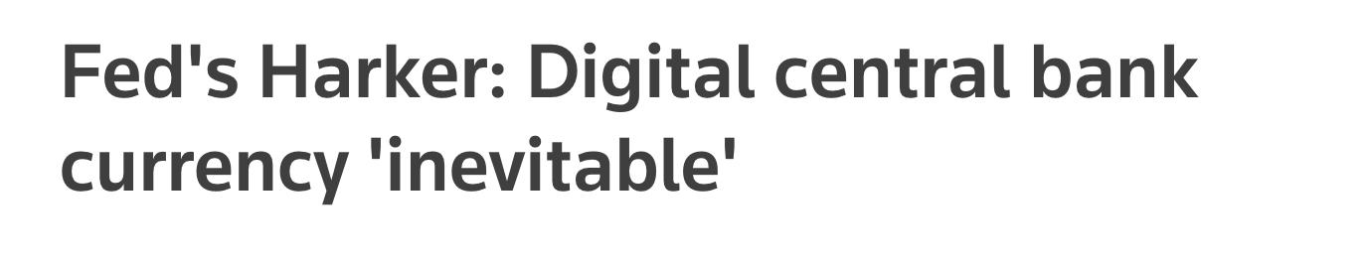
Central Bank Digital Currency (CBDC)
30 central banks actively working on retail CBDC
[BIS survey Jan. 2019]
Notes:
NSD: Russian National Settlement Depository.

Slide 13
What is a blockchain?
user facing tools (cloud servers)
applications (DAPPs, smart contracts)
Execution engine (blockchain computer)
Sequencer: orders transactions
Data Availability / Consensus Layer

Slide 14
Consensus layer (informal)
achieved by replication
A public append-only data structure:
Persistence: once added, data can never be removed*
Safety: all honest participants have the same data**
Liveness: honest participants can add new transactions
Open(?): anyone can add data (no authentication)
Data Availability / Consensus layer
Notes:
[Pass, Seeman, Shelat, 2016]
Blockchain data needs to be public: private blockchains are not part of this course.

Slide 15
How are blocks added to chain?
blockchain
signed
I am the leader
6.25 BTC
sk_{A}
verify
block
verify
block
sk_{B}
sk_{C}

Slide 16
How are blocks added to chain?
blockchain
…
6.25 BTC
I am the leader
sk_{A}
sk_{B}
6.25 BTC
sk_{C}
Notes:
Like a cloud service paid for by inflation.

Slide 17
Why is consensus a hard problem?
Tx1, Tx2, Tx3, Tx4
Tx1, Tx2, Tx3, Tx4
Tx1
Tx3
The good case:
copies are consistent
Tx2
Tx4
Tx1, Tx2, Tx3, Tx4
Tx1, Tx2, Tx3, Tx4

Slide 18
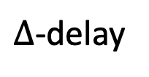
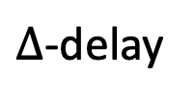
Why is consensus a hard problem?
Tx1, Tx2, Tx3, Tx4
Tx3, Tx4, Tx1, Tx2
Tx1
$∆$-delay
Tx3
Problems:
Network delays
can affect Tx order
Tx2
Tx4
$∆$-delay
Tx1, Tx2, Tx4, Tx3
Tx4, Tx3, Tx1, Tx2
Notes:
In case of network partition: can stop accepting transactions (Paxos), or can accept transactions and resolve fork once partition heals (Bitcoin).

Slide 19

Why is consensus a hard problem?
Tx1, Tx2
Tx3, Tx4
Tx1
Tx3
Problems:
Network delays
Network partition
network
partition
Tx2
Tx4
Tx1, Tx2
Tx3, Tx4
Notes:
In case of network partition: can stop accepting transactions (Paxos), or can accept transactions and resolve fork once partition heals (Bitcoin).

Slide 20
Why is consensus a hard problem?
Tx1, Tx2, Tx4
crashed
Tx1
Tx3??
Problems:
crash
Tx2
Tx4
Tx1, Tx2, Tx4
Tx1, Tx2, Tx4
Notes:
Goal: security when 51% of nodes are honest.

Slide 21

Why is consensus a hard problem?
???
Tx1
Problems:
crash
malice
Consensus protocols:
next week
Tx2
Tx4
???
???
Notes:
Goal: security when 51% of nodes are honest.

Slide 22
Next layer: the blockchain computer
Decentralized applications (DAPPs):
Run on blockchain: code and state are written on chain
Accept Tx from users ⇒ state transitions are recorded on chain
blockchain computer
DAPP
DAPP
DAPP
on-chain
state
Data availability / Consensus layer

Slide 23
Next layer: the blockchain computer
Top layer: user facing servers
end user
blockchain computer
DAPP
DAPP
DAPP
on-chain
state
Data availability / Consensus layer

Slide 24
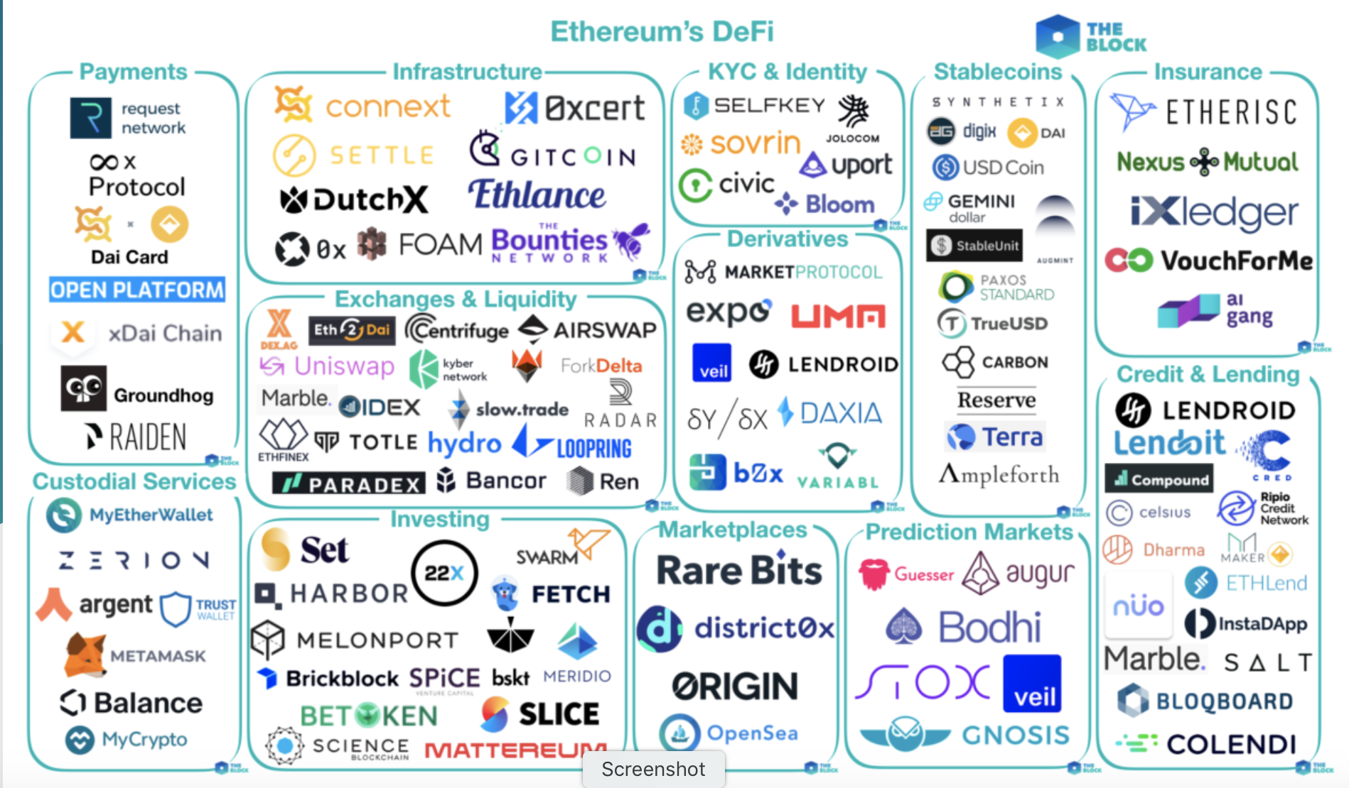
Lots of experiments:
[source: the Block Genesis]
Notes:
By the end of the course: you will know how to write your own DAPP.

Slide 25

This course
Cryptography
Distributed systems
Economics

Slide 26
Course organization
The starting point: Bitcoin mechanics
Consensus protocols
Ethereum and decentralized applications
DeFi: decentralized applications in finance
Private transactions on a public blockchain
(SNARKs and zero knowledge proofs)
Scaling the blockchain: getting to 10K Tx/sec
Interoperability among chains: bridges and wrapped coins

Slide 27
Course organization
cs251.stanford.edu
Homework problems, projects, final exam
Optional weekly sections on Friday
Please tell us how we can improve …
Don’t wait until the end of the quarter

Slide 28
Let’s get started …

Slide 29

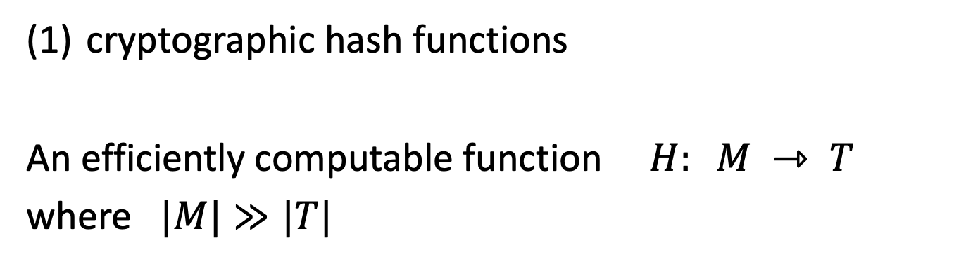
Cryptography Background
cryptographic hash functions
An efficiently computable function $H: M ⇾ T$
where $|M|≫|T|$
32 bytes
megabytes
hash value
$$T = {\left\{0,1\right\}}^{256}$$

Slide 30
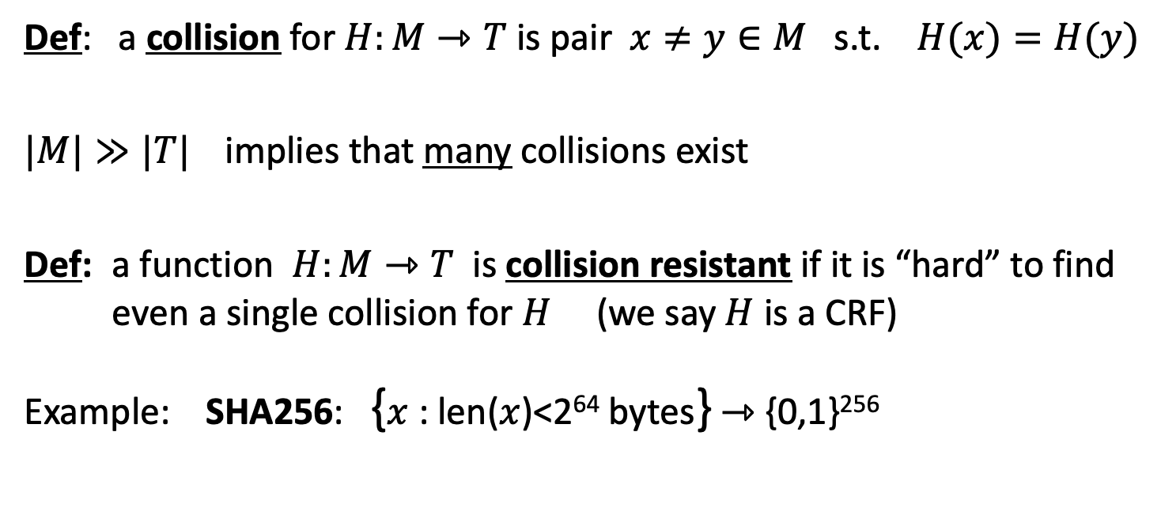
Collision resistance
Def: a collision for $H:M⇾T$ is pair $x≠y∈M$ s.t. $H(x)=H(y)$
$|M|≫|T|$implies that many collisions exist
Def: a function $H:M⇾T$ is collision resistant if it is “hard” to find even a single collision for $H$ (we say $H$ is a CRF)
Example: SHA256: {$x$ : len($x$)<2⁶⁴ bytes} ⇾ {0,1}²⁵⁶
(output is 32 bytes)
details in CS255

Slide 31
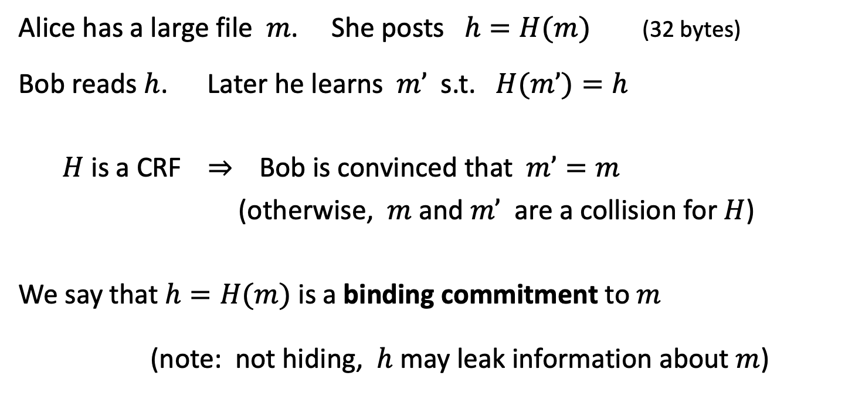
Application: committing to data on a blockchain
Alice has a large file $m$. She posts $h=H(m)$(32 bytes)
Bob reads $h$. Later he learns $m’$ s.t. $H(m’)=h$
$H$ is a CRF ⇒ Bob is convinced that $m’=m$
(otherwise, $m$ and $m’$ are a collision for $H$)
We say that $h=H(m)$ is a binding commitment to $m$
(note: not hiding, $h$ may leak information about $m$)
Notes:
Alice posts hash h on the blockchain.

Slide 32

Committing to a list (of transactions)
32 bytes
Alice has $S=(m1,m2, …,mn)$
Goal:
- Alice posts a short binding commitment to $S$, $h=commit(S)$
Bob reads $h$. Given $\left(mi, proof πi\right)$ can check that $S[i]=m_{i}$
Bob runs $verify\left(h, i, mi, πi\right)$ ⇾ accept/reject
security: adv. cannot find $(S, i, m, π)$s.t. $m≠S[i]$ and
$verify(h,i,m,π)=accept$where $h=commit(S)$

Slide 33





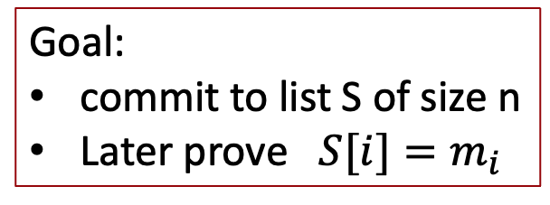




Merkle tree (Merkle 1989)
commitment
$$h$$
Goal:
commit to list S of size n
Later prove $S[i]=m_{i}$
Merkle tree
commitment
$$m1$$
$$m2$$
$$m3$$
$$m_{4}$$
$$m_{5}$$
$$m_{6}$$
$$m_{7}$$
$$m_{8}$$
list of values S

Slide 34



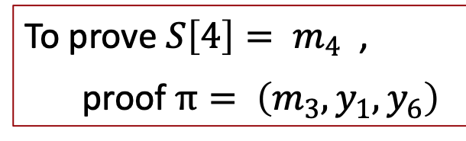




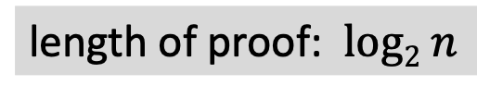


Merkle tree (Merkle 1989) [simplified]
commitment
$$h$$
Goal:
commit to list S of size n
Later prove $S[i]=m_{i}$
$$y_{5}$$
H
$$y_{6}$$
H
H
$$y1$$
$$y_{2}$$
$$y_{3}$$
$$y_{4}$$
To prove ${S\left[4\right]= m}_{4}$ ,
proof $π= \left(m_{3}, y_{1}, y_{6}\right)$
H
H
H
H
$$m1$$
$$m_{2}$$
$$m_{3}$$
$$m_{4}$$
$$m_{5}$$
$$m_{6}$$
$$m_{7}$$
$$m_{8}$$
length of proof: $log2 n$
list of values S

Slide 35

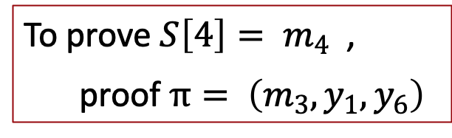
Merkle tree (Merkle 1989) [simplified]
commitment
$$h$$
To prove ${S\left[4\right]= m}_{4}$ ,
proof $π= \left(m_{3}, y_{1}, y_{6}\right)$
$$y_{5}$$
H
$$y_{6}$$
H
H
Bob does:
$y2 ⇽ H(m3,m4)$
$$y5 ⇽ H(y1, y2)$$
$$h’ ⇽ H(y5, y6)$$
accept if $h=h’$
$$y1$$
$$y_{2}$$
$$y_{3}$$
$$y_{4}$$
H
H
H
H
$$m1$$
$$m_{2}$$
$$m_{3}$$
$$m_{4}$$
$$m_{5}$$
$$m_{6}$$
$$m_{7}$$
$$m_{8}$$
list of values S

Slide 36
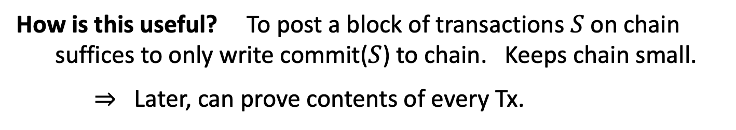
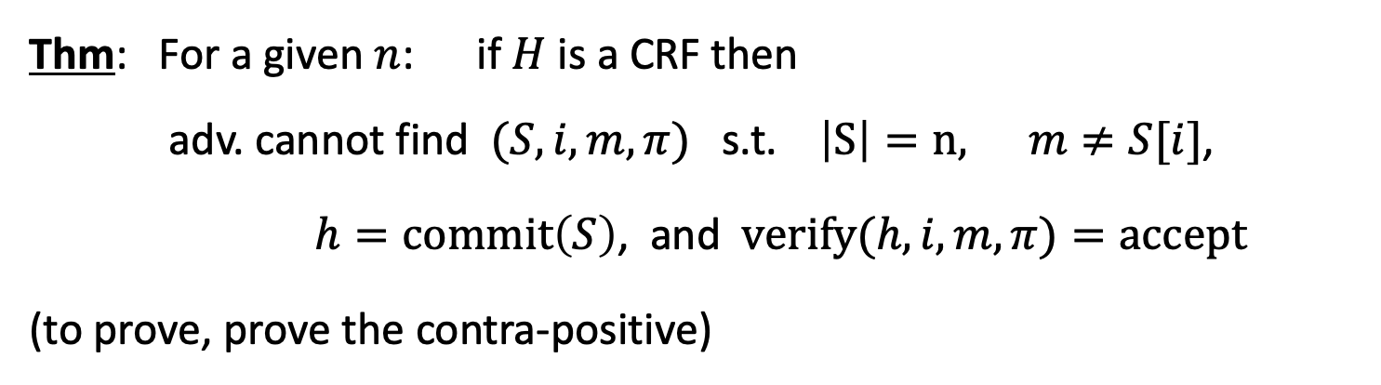
Merkle tree (Merkle 1989)
Thm: For a given $n$: if $H$ is a CRF then
adv. cannot find $(S, i, m, π)$s.t. $\left|S\right|=n,$ $m≠S[i]$,
$h=commit\left(S\right)$, and $verify(h,i,m,π)=accept$
(to prove, prove the contra-positive)
How is this useful? To post a block of transactions $S$ on chain
suffices to only write commit($S$) to chain. Keeps chain small.
⇒ Later, can prove contents of every Tx.

Slide 37
Abstract block chain
blockchain
block header
block header
block header
⊥
Merkle
root
other
data
hash
Merkle
root
other
data
hash
Merkle
root
other
data
Merkle
tree
Merkle
tree
Merkle
tree
Tx₁ Tx₂ … Tx_{n}
Tx₁ Tx₂ … Tx_{n}
Tx₁ Tx₂ … Tx_{n}
Merkle proofs are used to prove that a Tx is “on the block chain”

Slide 38
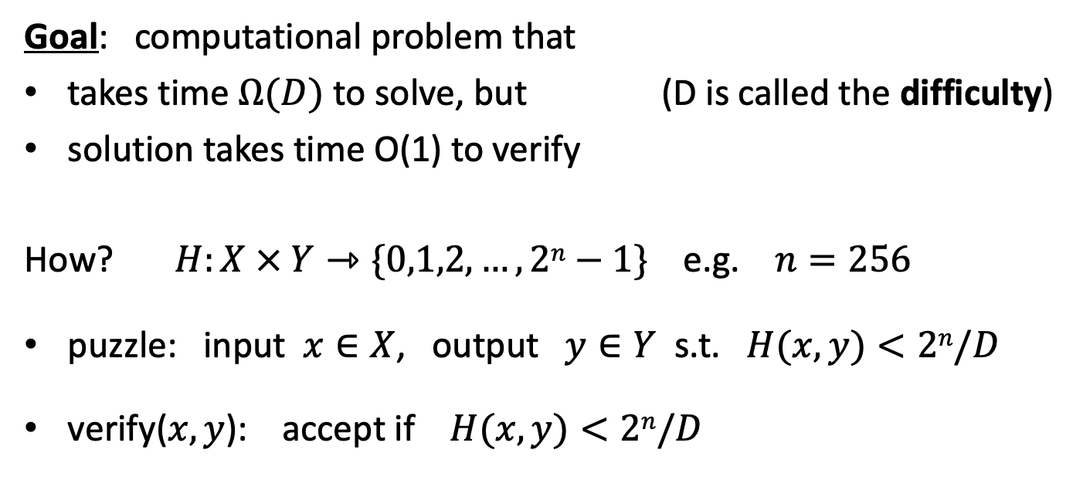
Another application: proof of work
Goal: computational problem that
takes time $Ω(D)$ to solve, but (D is called the difficulty)
solution takes time O(1) to verify
How? $H:X × Y⇾\{0,1,2,…,2n−1\}$ e.g. $n=256$
puzzle: input $x∈X$, output $y∈Y$ s.t. $H(x,y)<2n/D$
verify($x,y$): accept if $H(x,y)<2n/D$

Slide 39
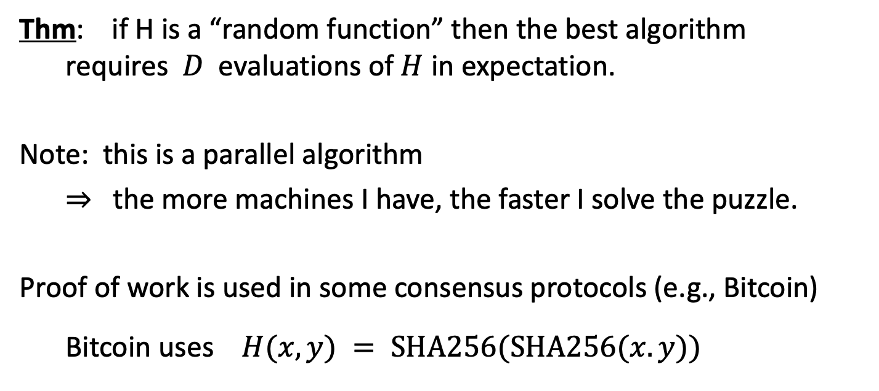
Another application: proof of work
Thm: if H is a “random function” then the best algorithm
requires $D$ evaluations of $H$ in expectation.
Note: this is a parallel algorithm
⇒ the more machines I have, the faster I solve the puzzle.
Proof of work is used in some consensus protocols (e.g., Bitcoin)
Bitcoin uses $H(x,y) = SHA256(SHA256(x.y))$

Slide 40
Cryptography background:
Digital Signatures
How to authorize a transaction

Slide 41
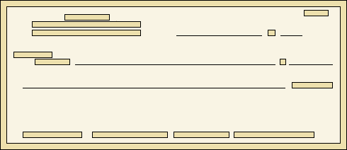

Signatures
Physical signatures: bind transaction to author
Bob agrees to pay Alice 1$
Bob agrees to pay Alice 100$
Problem in the digital world:
anyone can copy Bob’s signature from one doc to another
Notes:
Bad example: will see why on the last slide of this segment.

Slide 42
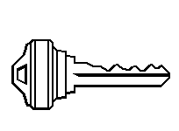

Digital signatures
Solution: make signature depend on document
Signer
Verifier
‘accept’
or
‘reject’
Bob agrees to pay Alice 1$
verifier
signature
signing
algorithm
secret signing
key (sk)
public verification
key (pk)

Slide 43
Digital signatures: syntax
Def: a signature scheme is a triple of algorithms:
  Gen(): outputs a key pair (pk, sk)
  Sign(sk, msg) outputs sig. σ
  Verify(pk, msg, σ) outputs ‘accept’ or ‘reject’
Secure signatures: (informal)
Adversary who sees signatures on many messages of his choice,
cannot forge a signature on a new message.

Slide 44
Families of signature schemes
RSA signatures (old … not used in blockchains):
  long sigs and public keys (≥256 bytes), fast to verify
Discrete-log signatures: Schnorr and ECDSA
  short sigs (48 or 64 bytes) and public key (32 bytes)
BLS signatures: 48 bytes, aggregatable, easy threshold
Post-quantum signatures: long (≥600 bytes)
(Bitcoin, Ethereum)
(Ethereum 2.0, Chia, Dfinity)
details in CS255

Slide 45
Signatures on the blockchain
Signatures are used everywhere:
ensure Tx authorization,
governance votes,
consensus protocol votes.
verifyTx
verifyTx
verify
Tx
sk₁
data
signatures
sk₂
data
signatures

Slide 46
END OF LECTURE
Next lecture: the Bitcoin blockchain

