Slide 1
Consensus in the Internet Setting
CS251 Fall 2022
(cs251.stanford.edu)
Ertem Nusret Tas

Slide 2
Recap of the Last Lecture
Byzantine Generals Problem
Definition of Byzantine adversary
Synchronous, asynchronous and partially synchronous networks
State Machine Replication (SMR)
Security properties for SMR protocols: Safety and Liveness
A secure SMR protocol: Streamlet

Slide 3
Sybil Attack
How to select the nodes that participate in consensus?
Two variants:
Permissioned: There is a fixed set of nodes (previous lecture).
Permissionless: Anyone satisfying certain criteria can participate.
Can we accept any node that has a signing key to participate in consensus?
Sybil Attack!

Slide 4
Sybil Resistance
Consensus protocols with Sybil resistance are typically based on a bounded (scarce) resource:
How does Proof-of-Work prevent Sybil attacks?
We assume that the adversary controls a small fraction of the scarce resource!
 | Resource dedicated to the protocol | Some Example Blockchains
Proof-of-Work | Total computational power | Bitcoin, PoW Ethereum…
Proof-of-Stake | Total number of coins | Algorand, Cardano, Cosmos, PoS Ethereum…
Proof-of-Space/Time | Total storage across time | Chia, Filecoin…

Slide 5
Bitcoin: Mining
Difficulty: How many nonces on average miners try until finding a block?
To mine a new block, a miner must find $nonce$ such that
$H\left(h_{prev},txn root, nonce\right)<Target=\frac{2^{256}}{D}$
Each miner tries different nonces until one of them finds a nonce that satisfies the above equation.
$$B_{0}$$
$$B_{1}$$
$$B_{2}$$
Genesis
H($B_{0}$)
nonce
txn root
H($B_{1}$)
nonce
txn root
H
New block: random process but approximately once in every 10 minutes
coinbase Tx
coinbase Tx

Slide 6
Bitcoin: Block Headers
genesis block
BH₁
BH₂
version (4 bytes)
prev (32 bytes)
time (4 bytes)
bits (4 bytes)
nonce (4 bytes)
Tx root (32 bytes)
prev
Tx root
H
H
target ($T$): $\frac{2^{256}}{D}$
80 bytes
coinbase Tx
coinbase Tx

Slide 7
Bitcoin: Difficulty Adjustment
New target: $T_{2}=T_{1}$ $\frac{t_{1}}{2016×10 mins}$
New target: $T_{3}=T_{2}$ $\frac{t_{2}}{2016×10 mins}$
…
A
…
B
…
C
2016 blocks
Time it took to mine: $t_{1}$(min)
Target: $T_{1}$
2016 blocks
Time it took to mine: $t_{2}$(min)
Target: $T_{2}$
2016 blocks
Time it took to mine: $t_{3}$(min)
Target: $T_{3}$
New target is not allowed to be more than 4x old target.
New target is not allowed to be less than ¼ x old target.
The Bitcoin Backbone Protocol with Chains of Variable Difficulty (2016)

Slide 8
Nakamoto Consensus
Chain with the highest difficulty!
Bitcoin uses Nakamoto consensus:
Fork-choice / proposal rule: At any given time, each honest miner attempts to extend (i.e., mines on the tip of) the heaviest (longest for us) chain in its view (Ties broken adversarially).
Confirmation rule: Each miner confirms the block (along with its prefix) that is k-deep within the longest chain in its view.
In practice, $k=6$.
Miners and clients accept the transactions in the latest confirmed block and its prefix as their log.
Note that confirmation is different from finalization.
Leader selection rule: Proof-of-Work.

Slide 9
Nakamoto Consensus
Confirmed
Dynamic Availability
k=2

Slide 10
Bitcoin vs. Streamlet
 | Bitcoin | Streamlet
Fork-choice rule | Heaviest (Longest in our case) Chain | Longest Notarized Chain
Confirmation/finalization rule | k-deep prefix of the longest (heaviest) chain | Three adjacent blocks in a notarized chain from consecutive epochs
Leader selection rule | Determined by the difficulty D | With the help of a hash function
Streamlet is not dynamically available: It loses liveness if n/3 or more nodes go offline!
Bitcoin is dynamically available: It continues to confirm transactions even if the majority of the mining power goes offline.

Slide 11
Consensus in the Internet Setting
Characterized by open participation:
Adversary can create many Sybil nodes to take over the protocol.
Honest participants can come and go at will.
Goals:
Limit adversary’s participation.
Sybil resistance (e.g., Proof-of-Work)!
Maintain availability (liveness) of the protocol against changing participation by the honest nodes.
Dynamic availability!

Slide 12
Security
Can we show that Bitcoin is secure under synchrony against a Byzantine adversary?
What would be the best possible resilience?
$β<1/2$?
Fraction of the mining power controlled by the adversary.

Slide 13
Nakamoto’s Private Attack: $β≥$ 1/2
Bob
comes
Adv releases
Alice
comes
$$t_{0}=0$$
$$t_{1}$$
$$t_{2}$$
$$t_{3}$$
$$t_{4}$$
$$t_{5}$$
$$t_{6}$$
$$t_{7}$$
${tx}_{1}$ got ‘reorged’: It was part of the longest chain before but not anymore!!
Bob sees ${tx}_{1}$ as confirmed.
Bob’s log: ${tx}_{1}$
k deep confirmation rule
(k=3 in our example)
$${tx}_{1}$$
$${tx}_{5}$$
$$λ_{h}$$
Now, Alice comes, in her view:
The red chain is the longest chain.
${tx}_{1}$ is not confirmed!
Alice’s log: ${tx}_{2}{tx}_{3}$
Hidden
$${tx}_{2}$$
$${tx}_{3}$$
$${tx}_{4}$$
$$λ_{a}$$
Private attack succeeds!
Private attack (mostly) succeeds if $λ_{a}≥$ $λ_{h}$, i.e., if $β≥$ $1−β$, i.e., if $β≥\frac{1}{2}$.
Private attack (mostly) fails if $λ_{a}<$ $λ_{h}$, i.e., if $β<$ $1−β$, i.e., if $β<\frac{1}{2}$.
Can another attack succeed?
A Peer-to-Peer Electronic Cash System (2008)

Slide 14
Forking
A
B
Tx
${ λ}_{h}∝$ e.g., $\frac{(1−β)}{2}$,
$λ_{a}$ $∝$ $β$
D
E
$$Δ$$
$$Δ$$
$$Δ$$
$$t_{0}=0$$
$$t_{1}$$
$$t_{2}$$
$$t_{3}$$
$$t_{4}$$
$$t_{5}$$
$$t_{6}$$
$$t_{7}$$
$$t_{8}$$
Multiple honest blocks at the same height due to network delay.
Adversary’s chain grows at rate proportional to (shown by $∝$) $β$!
Honest miners’ chain grows at rate less than $1−β$ because of forking!
Now, adversary succeeds if $β≥\frac{(1−β)}{2}$, which implies $β≥\frac{1}{3}$!!

Slide 15
Security
Theorem: If $β<1/2$, there exists a small enough mining rate $λ\left(Δ,β\right)=λ_{a}+λ_{h}$ (by changing difficulty) such that Bitcoin satisfies security (safety and liveness) except with error probability $e^{−Ω(k)}$ under synchronous network.
This is the error probability for confirmation.
We say ‘confirmation’ instead of finalization because when you confirm a block or transaction, you confirm it with an error probability…
…unlike finalizing a block where there is no error probability*.
Now, we see why Bitcoin has 1 block every 10 minutes, instead of 1 block every second…
The Bitcoin Backbone Protocol: Analysis and Applications (2015)
Analysis of the Blockchain Protocol in Asynchronous Networks (2016)
Analysis of Nakamoto Consensus (2019)
Everything is a Race and Nakamoto Always Wins (2022)

Slide 16
Is Bitcoin the Endgame?
Bitcoin provides Sybil resistance and dynamic availability.
It can be made secure for any $β<\frac{1}{2}.$
Is it the Endgame for consensus?
No!
Bitcoin is secure only under synchrony unlike Streamlet that is secure under partial synchrony.
It confirms blocks with an error probability as a function of k, unlike Streamlet that finalizes blocks.
Energy?

Slide 17
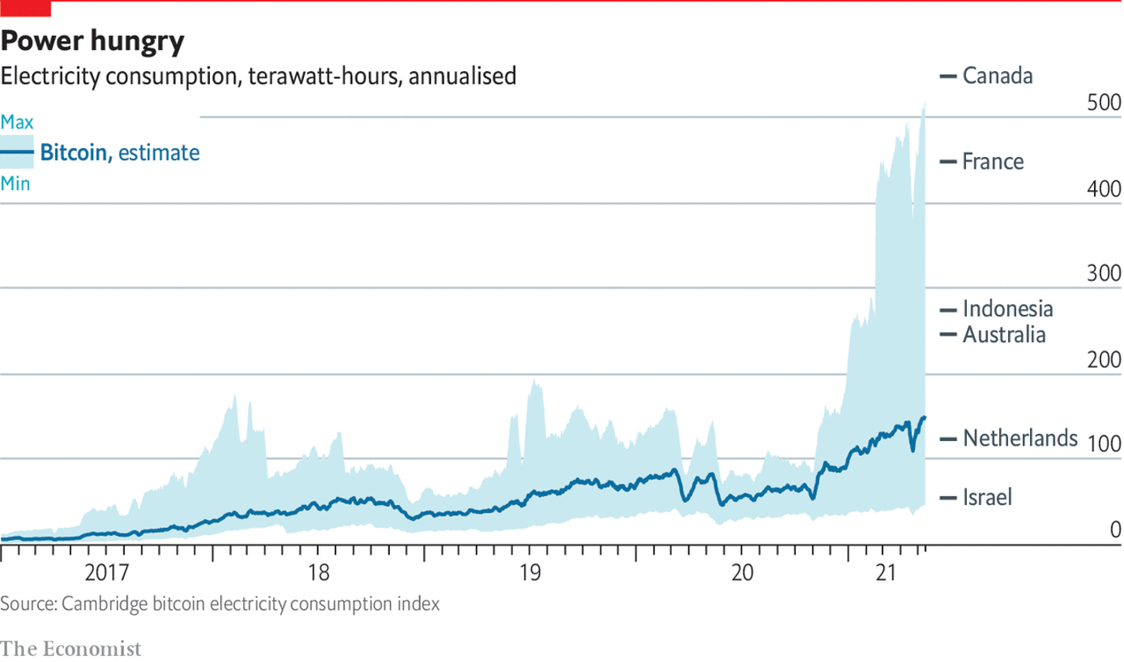
Dark Side of Bitcoin: Energy
Photo taken from the article “As the price of bitcoin has climbed, so has its environmental cost” that appeared at The Economist on May 14th 2021.

Slide 18
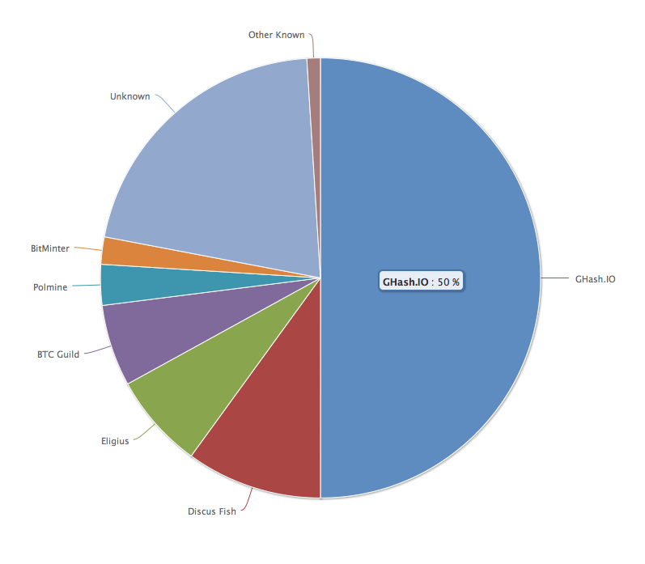
No Attacks on Bitcoin?
Ghash.IO had >50% in 2014
Gave up mining power
No Selfish mining attacks?
Why are visible attacks not more frequent?
Miners care about the Bitcoin price.
Might not be rational to attack.
No guarantees for the future.

Slide 19
END OF LECTURE
Next lecture: Incentives and Accountability in Consensus

Slide 20
Optional Slides
Slides going forward is optional material and present a simplified security proof for Nakamoto consensus.

Slide 21
Reminder for Security (Optional)
Let’s recall the definition of security for SMR protocols. Let ${ch}_{t}^{i}$ denote the confirmed (i.e., k-deep) chain accepted by a client $i$ at time $t$.
Safety (Consistency):
For any two clients $i$ and $j$, and times $t$ and $s$: ${ch}_{t}^{i}≼{ch}_{s}^{j}$ (prefix of) or vice versa, i.e., chains are consistent.
Liveness:
If a transaction $tx$ is input to an honest replica at some time $t$, then for all clients $i$, and times $s≥t+T_{conf}$: $tx∈{ch}_{s}^{i}$.
No double spend
No censorship

Slide 22
Modelling Bitcoin (Optional)
Many different miners, each with infinitesimal power.
Total mining rate: $λ$ (1/minutes). In Bitcoin, $λ=1/10.$
Adversary is Byzantine and controls $β<\frac{1}{2}$ fraction of the mining power.
Adversarial mining rate: $λ_{a}=βλ$
Honest mining rate: $λ_{h}=(1−β)λ$
Each mined block is adversarial with probability $β$ independent of other blocks.
Network is synchronous with a known upper bound $Δ$ on delay.
$$t_{0}=0$$
$$t_{1}$$
$$t$$
$$t_{2}$$
$$t_{3}$$
$$t_{4}$$
$$t_{5}$$
$$s$$
$$H_{(t,s]}=1, A_{(t,s]}=1$$

Slide 23
Security Proof: Safety (Optional)
Suppose there is at most one honest block at every height.
This is the case if the network delay $∆ =0.$
GR (2022): If any attack succeeds in violating a target transaction tx’s safety, then the private attack with premining also succeeds in violating the target transaction’s safety.
Private attack is the best attack!!
Bitcoin’s Latency Security Analysis Made Simple (2022)

Slide 24
Security Proof: Safety (Optional)
We will show that if any attack succeeds in violating safety of a target transaction tx within the first honestly mined block, then the private attack also succeeds in violating the target transaction’s safety.
For the full proof, see “Bitcoin’s Latency Security Analysis Made Simple”.
Bitcoin’s Latency Security Analysis Made Simple (2022)

Slide 25
Security Proof: Safety (Optional)
Suppose a transaction $tx$ is confirmed within the first block b mined by the honest miners in an honest view.
Let’s observe a ‘reorg’ of block b by some attack.
We will show that the private attack will also succeed in ‘reorging’ b!

Slide 26
Security Proof: Safety (Optional)
$$≥k$$
b
c
G
…
tx
…
$$tx$$
d
…
…
…
Heights
$h_{a}$=0
$$h_{b}$$
$$h_{c}$$
$$h_{d}$$
Block b contains the transaction $tx$ that is ‘reorged’.
Consider the first time that t block b is reorged.
Right before t, block c is seen at the tip of the longest chain by an honest node.
Right after t, block d is seen at the tip of the longest chain by another (potentially the same) honest node.

Slide 27
Security Proof: Safety (Optional)
$$≥k$$
b
c
G
…
tx
…
d
…
…
…
$$h_{b}$$
$$h_{c}$$
$$h_{d}$$
Fact 1: At each height until $h_{c}$, there is at least one adversary block.
Why?
Because there can be at most one honest block at any height.

Slide 28
Security Proof: Safety (Optional)
$$≥k$$
b
c
G
…
tx
…
d
…
…
…
$$h_{b}$$
$$h_{c}$$
$$h_{d}$$
Fact 2: Every block after $h_{c}$ thru $h_{d}$ are adversarial (one block per height).
Why?
Otherwise, we contradict with the definition of blocks c and d.
$$A≥h_{d}$$

Slide 29
Security Proof: Safety (Optional)
$$≥k$$
b
c
G
…
tx
…
d
…
…
…
$$h_{b}$$
$$h_{c}$$
$$h_{d}$$
Fact 3: There are at most $h_{c}$ honest blocks.
$$H≤h_{c}$$

Slide 30
Security Proof: Safety (Optional)
Combining everything…
$H≤h_{c}$
$A≥h_{d}$
$h_{d}≥h_{c}≥k$
This implies $A≥H$and $A≥k$.
Private attack also succeeds!
Why?

Slide 31
Security Proof: Safety (Optional)
$A≥H$and $A≥k:$
Private attack also succeeds!
$$H≤A$$
b
G
tx
…
…
…
…
$$A≥k$$

Slide 32
Security Proof: Safety (Optional)
tx
gap: 1 block
$$t_{0}=0$$
$$t_{1}$$
$$t_{2}$$
$$t_{3}$$
$$t_{4}$$
$$t_{5}$$
$$t_{6}$$
$$t_{7}$$
$$t_{8}$$
If every honest block is at a separate height…
Best attack to reorg a transaction is the private attack with premining!
Probability that a private attack with premining succeeds $≤e^{−Ω(k)}$; if $λ_{a}<λ_{h}$, i.e., $β<1/2$!
Safety!

Slide 33
Security Proof: Safety (Optional)
tx
gap: 2 blocks
$$Δ$$
$$Δ$$
$$t_{0}=0$$
$$t_{1}$$
$$t_{2}$$
$$t_{3}$$
$$t_{4}$$
$$t_{5}$$
$$t_{6}$$
$$t_{7}$$
$$t_{8}$$
Multiple honest blocks at the same height due to network delay.
Forking!
Probability that a block is an honest block at a unique height: $e^{−λΔ}(1−β)$

Slide 34
Security Proof: Safety (Optional)
Trick: We give honest blocks that fall into the same height as previous honest blocks to the adversary.
Mining rate of ‘honest’ blocks with new definition = $e^{−λΔ}(1−β)$
tx
$$Δ$$
$$Δ$$
$$t_{0}=0$$
$$t_{1}$$
$$t_{2}$$
$$t_{3}$$
$$t_{4}$$
$$t_{5}$$
$$t_{6}$$
$$t_{7}$$
$$t_{8}$$

Slide 35
Security Proof: Safety (Optional)
tx
$$Δ$$
$$Δ$$
$$t_{0}=0$$
$$t_{1}$$
$$t_{2}$$
$$t_{3}$$
$$t_{4}$$
$$t_{5}$$
$$t_{6}$$
$$t_{7}$$
$$t_{8}$$
Every honest block is again at a separate height!
Best attack to reorg a transaction is the private attack with premining.
Probability that a private attack with premining succeeds $≤e^{−Ω(k)}$; if $\frac{1}{2}<e^{−λΔ}(1−β).$
Safety!

Slide 36
Security Proof: Liveness (Optional)
Growth rate of the blockchain $≥e^{−λΔ}\left(1−β\right)λ.$
Arrival rate of adversary blocks: $βλ$
If $\frac{1}{2}<e^{−λΔ}(1−β)$, then $e^{−λΔ}\left(1−β\right)λ>$ $βλ$.
Thus, over a sufficiently large time interval (call this $u$), the k-deep prefix of the longest chain in the view of each honest node must contain new honest blocks except with probability $e^{−Ω(u)}$.
Liveness!

