Slide 1
Final Topics: Bridging and MEV
CS251 Fall 2022
(cs251.stanford.edu)
Dan Boneh
Invited talk final lecture. Final exam next Wednesday.

Slide 2
… but first, final thoughts on ZK

Slide 3
Commercial interest in SNARKs
Many more building applications on top …

Slide 4
Why so much commercial interest?
Babai-Fortnow-Levin-Szegedy 1991:
In this setup, a single reliable PC can monitor the operation of a herd of supercomputers working with unreliable software.
an L1 blockchain
coordinators
“Checking Computations in Polylogarithmic Time”
Notes:
NP has PCPs

Slide 5
We are going to the moon …
Blockchains drive the development of SNARKs:
zkRollup, zkBridge, zkCreditScore, zkProofOfSolvency, …
… but many non-blockchain applications

Slide 6
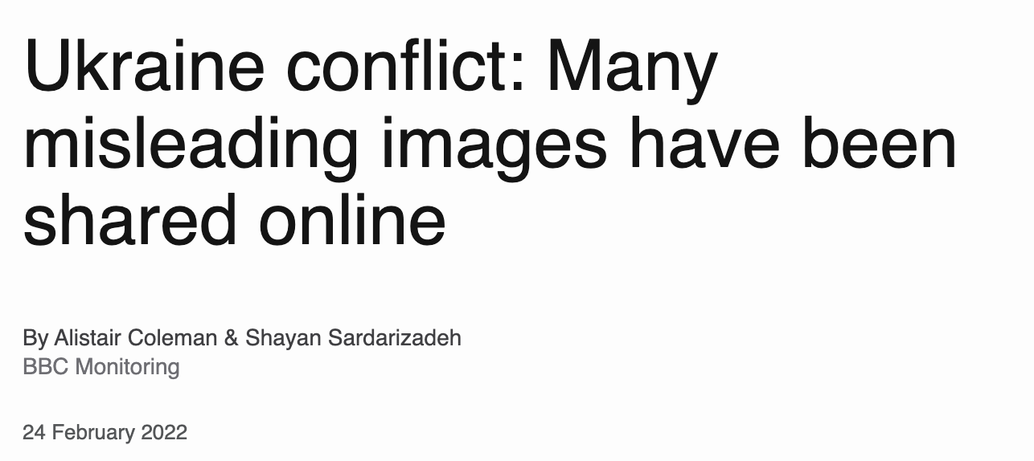
Using ZK to fight disinformation

Slide 7
C2PA: a standard for content provenance
location
timestamp
embedded certified signing key sk
signature
verify metadata
by checking sig
C2PA

Slide 8
A problem: post-processing
Newspapers often process the photos before publishing:
Resize (1500×1000), Crop, Grayscale (AP lists allowed ops)
The problem: laptop cannot verify signature on processed photo
C2PA “solution”:
editing software will sign processed photo to certify edits
???

Slide 9
A solution using ZK proofs (SNARKs)
(with T. Datta)
Editing software attaches a proof $π$ to (processed) photo that:
I know a triple (Orig, Ops, Sig) such that
Sig is a valid C2PA signature on Orig
photo is the result of applying Ops to Orig
metadata(photo) = metadata(Orig)
processed photo
location
timestamp
⇒ Laptop verifies $π$ and shows metadata to user
proof π

Slide 10
Performance
Proof size: 200-400 bytes. Verification time: 2 ms.
Proof generation time by newspaper:
Resize (3000×3000 ⇾ 1500×1500): 84 sec.
Crop (3000×3000 ⇾ 1500×1500): 60 sec.
Grayscale (2.25M pixels): 25 sec.
(in browser)
What about video??
See also: PhotoProof by Naveh & Tromer (2016)

Slide 11
The future: a market for ZK provers
Anyone with a GPU will be paid to create ZK proofs
prover 1
tx1
market
$$π_{1}$$
prover 3
tx2
$$π$$
tx3
$$π_{2}$$
selects provers and distributes rewards
tx4
prover 2

Slide 12
ZK: final thoughts
Lots more to work on:
Better provers: faster, lower memory footprint, shorter proofs, quantum resistant, no trusted setup, distributed witness.
More applications for SNARKs and zk-SNARKs
(e.g., proof of solvency)

Slide 13
Many more topics …

Slide 14
Many more topics to cover …
Maximal extractable value (MEV)
Blockchain interoperability (bridging)
(3) Project governance: (see our Spring course on DAOs)
How to decide on updates to Uniswap, Compound, … ???
(4) Insurance: against bugs in Dapp code and other hacks
(5) Many more cryptography techniques (see slides at end)

Slide 15
More topics …
Where can I learn more?
CS255 and CS355: Cryptography (Winter and Spring)
EE374: Scaling blockchains with fast consensus (Winter)
Stanford blockchain conference (SBC): Aug. 28-30, 2023.
Stanford blockchain club
A career in blockchains? Where to start? [link]

Slide 16
Maximal Extractable Value (MEV)

Slide 17
Searchers
Ethereum gives rise to a new type of business: searchers
Arbitrage: Uniswap DAI/USDC exchange rate is 1.001 whereas at Sushiswap the rate is 1.002
⇒ a searcher posts Tx to equalize the markets and profits
Liquidation: suppose there is a liquidation opportunity on Aave
⇒ a searcher posts a liquidation Tx and profits
Many other examples … often using a sequence of Tx (a bundle)
Notes:
“Searcher” is now a job description.
Arbitrage: take a loan in DAI, exchange DAI for USDC on Uniswap, exchange USDC for DAI on Sushiswap, repay loan.
Another example: searcher discovers a bug in the contract (the dark forest post, https://medium.com/@danrobinson/ethereum-is-a-dark-forest-ecc5f0505dff)

Slide 18
The MEV problem
What happens when a searcher posts a Tx to the mempool?
Validator: create a new Tx’ with itself as beneficiary, and place it before Sam’s Tx in the proposed block
Another searcher: create a new Tx’ with itself as beneficiary, and posts it with a higher maxPrioriyFee
⇒ this action is now mostly automated by bots
Tx’
Sam
mempool
Tx: credit Sam
maxPrioriyFee: X
Tx’: credit Alice
maxPrioriyFee: 2X

Slide 19
The result harms honest users
Price Gas Auctions (PGA): two or more searchers compete
Repeatedly submit a Tx with higher and higher maxPriorityFee until a validator chooses one … happens within a few seconds
⇒ causes congestion (lots of Tx in mempool) and high gas fees
Tx’
Sam
mempool
Tx: credit Sam
maxPrioriyFee: X
Tx’: credit Alice
maxPrioriyFee: 2X
Notes:
If MEV Tx makes $10K, then gas price can go as high as $7K in practice.

Slide 20
The result harms consensus
Undercutting attack on longest-chain consensus:
Rational miner: can cause a re-org by taking one MEV Tx for itself and leave two for other miners
3 MEV Tx
block 1
block 3
Miners incentivized to build here
miner #1
miner #2
miner #3
The problem: MEV Tx generate extra revenue for miners, higher than block rewards
Notes:
See Flashboys 2.0: https://arxiv.org/abs/1904.05234

Slide 21
The result causes centralization
Validators can steal MEV Tx from searchers
Searchers only send Tx to a validator they trust
(have a business relation with)
These validators do not propagate Tx to the network,
but put them in blocks themselves
In the long run: a few validators will handle the bulk of all Tx
⇒ Private mempools

Slide 22
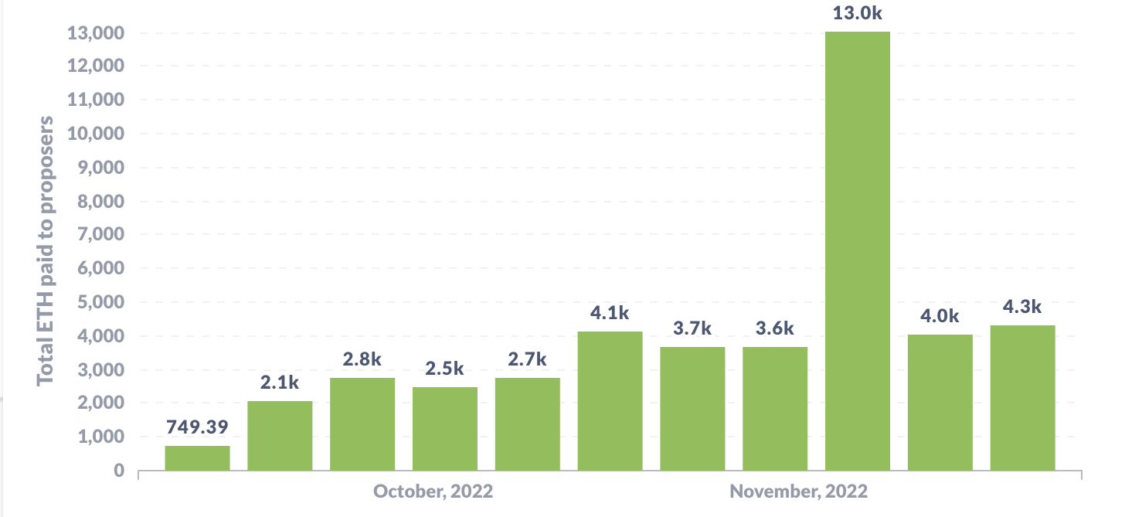
How big are MEV rewards?
Weekly MEV amount paid to validators (in ETH):
source: transparency.flashbots.net

Slide 23
What to do??

Slide 24
Proposer Builder Separation (PBS)
Goals:
Eliminate price gas auctions in the public mempool
Instead, create an open market for searchers to compete on the position of their bundles in a block
Prevent validator concentration: make it possible for every validator to earn MEV payments from searchers
Current PBS implementation: MEV-boost

Slide 25
The participants in PBS (as in MEV-boost)
Users have Tx and searchers have bundles (sequence of Tx)
searcher wants its bundle posted in a block unmodified
build block from Tx and bundles
choose best block
searchers
bundle
builder A
block
blockHdr
validator (the current block proposer)
relay 1
bundle
signature
block
signed block
bundle
builder B
block
relay 2
blockHdr
Tx
mempool
send block to eth network
user

Slide 26
MEV-boost
Builder: collects bundles and Tx and builds a block
includes a MEV offer to validator (feeRecipient)
Relay: collects blocks, chooses block with max MEV offer
sends block header (and MEV offer) to block proposer
Can’t expose Tx in block to proposer (or proposer could steal Tx)
Proposer: chooses best offer and signs header with its staking key
⇒ Then Relay reveals block contents; proposer sends to network
(if bad block, proposer can build a block locally from mempool)
https://writings.flashbots.net/searching-post-merge
Notes:
Searchers have to win two auctions for their bundle to be included: builder auction and relay auction
Searchers have to work with a builder they trust not steal Tx. Similarly, they need to trust the relay that the builder works with. This is done via business relations. However, Searchers don’t have to trust the proposer – that can by anyone.
Proposer cannot miss slot: if relay does not provide a valid block, validator must build a block locally itself.
Once proposer signs block header, it cannot sign another block header, or it will be slashed by the network (Relay can prove the proposer signed to block headers for that slot)
Future PBS: merge validator and relay into consensus protocol

Slide 27
Operating relays
Flashbots: Filters out OFAC sanctioned addresses, aims to maximize validator payout (so that many validators will work with it)
BloXroute: no censorship
aims to maximize validator payout
…
Notes:
https://github.com/eth-educators/ethstaker-guides/blob/main/MEV-relay-list.md

Slide 28
An example: flashbots relay
fee to validator
Notes:
https://boost-relay.flashbots.net/
About 67% of blocks are created by this relay, but not all blocks.

Slide 29
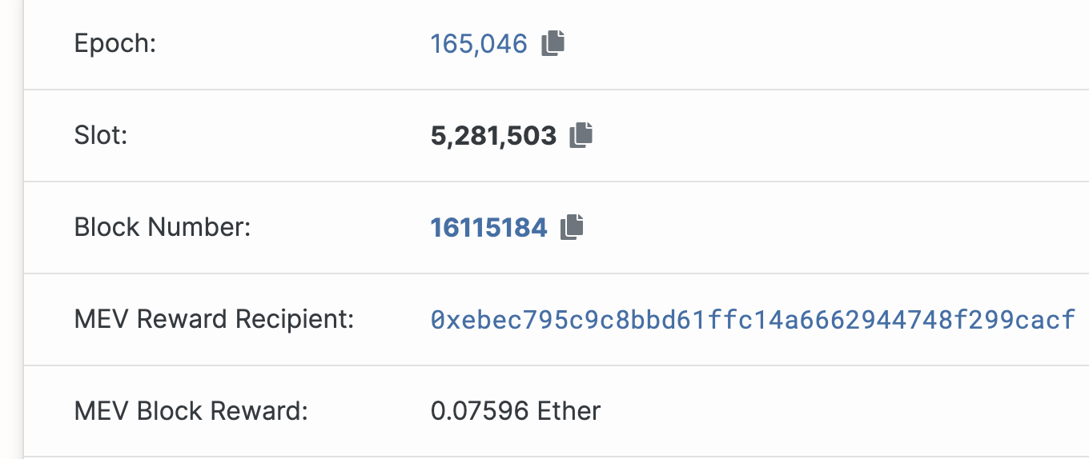
An example: flashbots relay
address of validator who proposed the block

Slide 30
Are we done? Not quite …
Over the last 30 days: five block builders built 80% of all blocks !!
Clear centralization in the builder market
Enables censorship by builders
MEV-boost is not designed for cross-chain MEV
For cross-chain arbitrage, no atomicity guarantee for bundle
A solution: SUAVE (not yet deployed)

Slide 31
SUAVE
Goals:
Users should have pre-confirmation privacy.
Transactions should be private, but available to all block builders
seems like contradictory goals, but possible with with fancy tech (enclaves or MPC)
To support cross-domain MEV: block builders across chains have to integrate with each other.

Slide 32
Encrypted mempool: a complementary approach
Suppose all Tx in the mempool are encrypted
Decrypted only once they are posted in a block
Prevents one party from stealing the MEV Tx of another
… but no support for searchers to complete with each other
Implemented in the Osmosis DEX

Slide 33
Interoperability between blockchain
How to bridge chains

Slide 34
Many L1 blockchains
Bitcoin: Bitcoin scripting language (with Taproot)
Ethereum: EVM. Currently: high Tx fees (better with Rollups)
EVM compatible blockchains: Celo, Avalanche, BSC, …
Higher Tx rate ⟹ lower Tx fees
EVM compatibility ⟹ easy project migration and user support
Other fast non-EVM blockchains: Solana, Flow, Algorand, …
Higher Tx rate ⟹ lower Tx fees
Notes:
User support on EVM-compatible chains: just use metamask by telling it to use a different network.

Slide 35
The problem: siloes
Flow
Cosmos
Ethereum
Osmosis DEX
Can I use Osmosis??
Bitcoin
Polkadot
How???
20 DOT
Notes:
Much like networking before the Internet

Slide 36
Interoperability
Interoperability:
User owns funds or assets (NFTs) on one blockchain system Goal: enable user to move assets to another chain
Composability:
Enable a DAPP on one chain to call a DAPP on another
Both are easy if the entire world used Ethereum
In reality: many blockchain systems that need to interoperate
The solution: bridges

Slide 37
A first example: BTC in Ethereum
How to move BTC to Ethereum ?? Goal: enable BTC in DeFi.
⟹ need new ERC20 on Ethereum pegged to BTC
(e.g., use it for providing liquidity in DeFi projects)
The solution: wrapped coins
Asset X on one chain appear as wrapped-X on another chain
For BTC: several solutions (e.g., wBTC, tBTC, …)

Slide 38
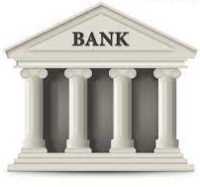
wBTC and tBTC: a lock-and-mint bridge
Let’s start with wBTC: moving 1 BTC to Ethereum
Alice on
Ethereum
Alice
1₿ verified
(signed)
1 ₿
mint 1 wBTC
credit Alice’s address
ERC20
1 ₿
1 ₿
custodian’s BTC address
bridge contract
1 wBTC
(lock 1 BTC)
to use in DeFi
(watch for deposits)
custodian

Slide 39
Alice wants her 1 BTC back
Moving 1 wBTC back to the Bitcoin network:
deduct 1 wBTC from Alice
Alice on
Ethereum
Alice
Bitcoin Tx
(signed)
1 ₿
burn my 1 wBTC
(signed)
1 ₿
1 ₿
custodian’s BTC address
bridge contract
(1 BTC unlocked)
(watch for burns)
custodian

Slide 40
wBTC
Example BTC ⇾ Ethereum:
(Bitcoin Tx: ≈4,000 BTC)
(Ethereum Tx: )
Why two hours?
… make sure no Bitcoin re-org
The problem: trusted custodian
Can we do better?
Notes:
Custodian can run away with BTC, or require high redemption fees.

Slide 41
tBTC: no single point of trust
Alice requests to mint tBTC:
random three registered custodians are selected and they generate P2PKH Bitcoin address for Alice
signing key is 3-out-of-3 secret shared among three
(all three must cooperate to sign a Tx)
Alice sends BTC to P2PKH address, and received tBTC.
Custodians must lock 1.5x ETH stake for the BTC they manage
If locked BTC is lost, Alice can claim staked ETH on Ethereum.
Notes:
P2PKH: pay to public key hash.
3-out-of-3 threshold ECDSA: ensures no single party can steal UTXO deposit.
Not capital efficient.

Slide 42
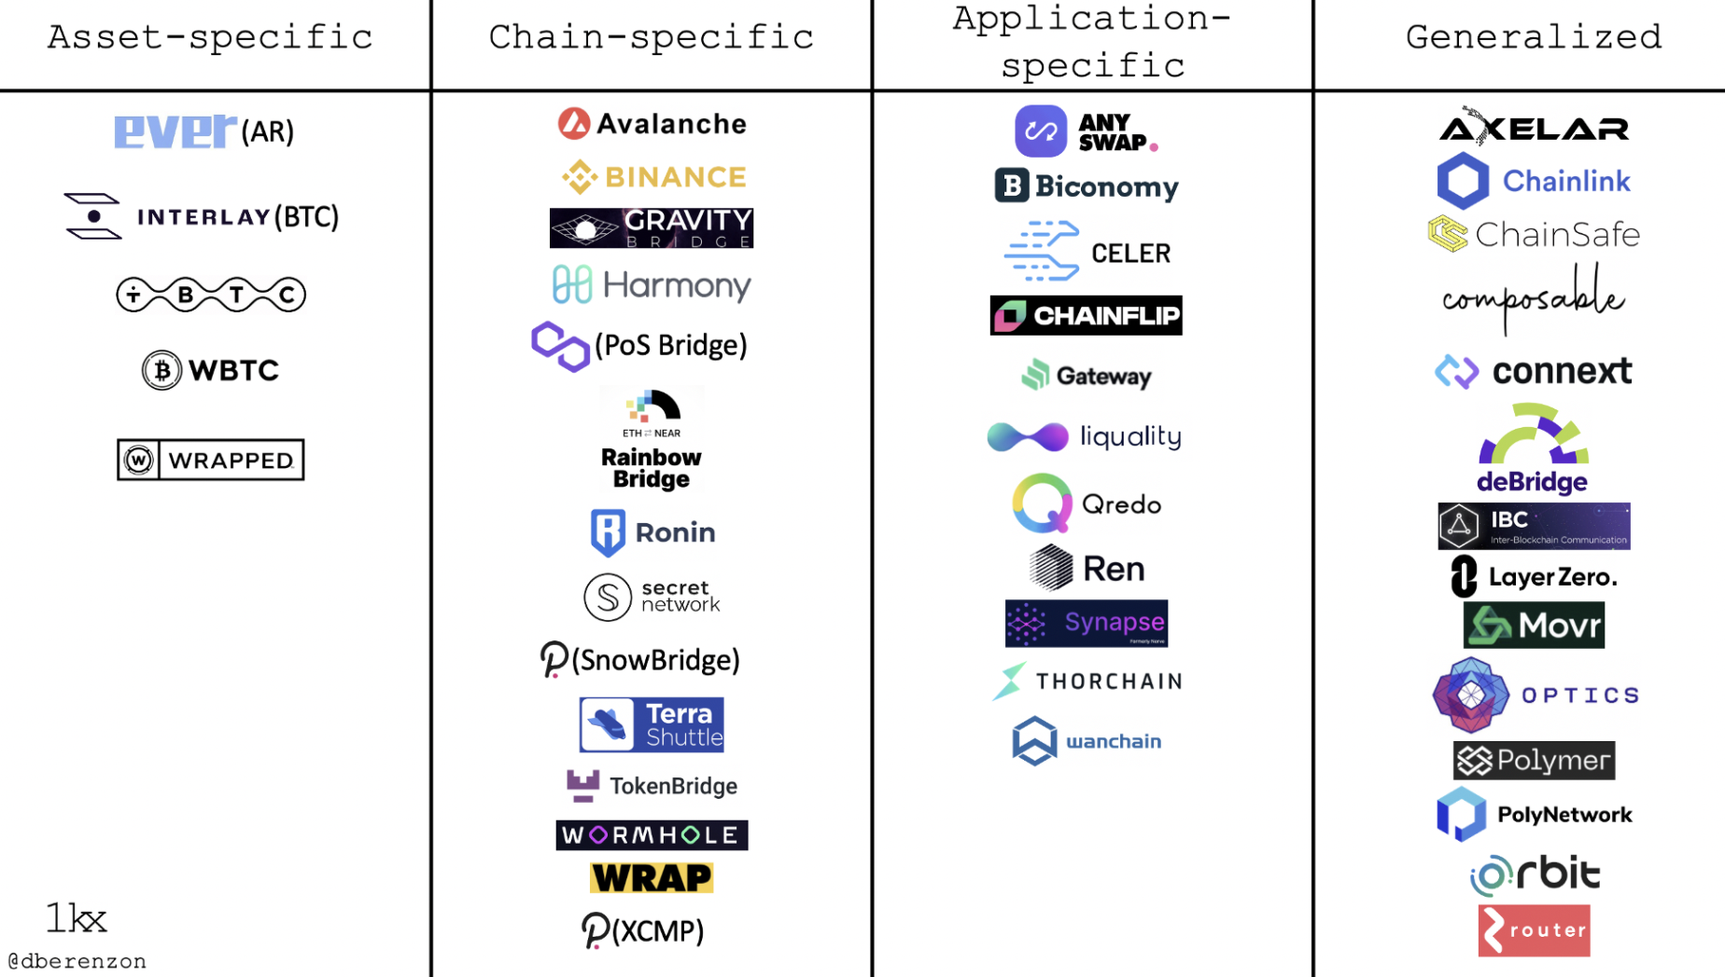
Bridging smart chains (with Dapp support)
A very active area:
Many super interesting ideas
https://medium.com/1kxnetwork/blockchain-bridges-5db6afac44f8

Slide 43
Two types of bridges
Type 1: a lock-and-mint bridge
SRC ⇾ DEST: user locks funds on SRC side, wrapped tokens are minted on the DEST side
DEST ⇾ SRC: funds are burned on the DEST side, and released from lock on the SRC Side
Type 2: a liquidity pool bridge
Liquidity providers provide liquidity on both sides
SRC ⇾ DEST: user sends funds on SRC side, equivalent amount released from pool on DEST side

Slide 44
Bridging smart chains (with Dapp support)
Step 1 (hard): a secure cross-chain messaging system
message to Y
on chain T: data
Source Chain S
DAPP-X
relayer
(contract)
I believe it
message from X
on chain S: data
Target Chain T
DAPP-Y
relayer
(contract)
Step 2 (easier): build a bridge using messaging system

Slide 45
Bridging smart chains (with Dapp support)
Step 1 (hard): a secure cross-chain messaging system
Source Chain S
Target Chain T
DAPP-X
DAPP-Y
Step 2 (easier): build a bridge using messaging system
DAPP-X ⇾ DAPP-Y: “I received 3 CELO, ok to mint 3 wCELO”
DAPP-Y ⇾ DAPP-X: “I burned 3 wCELO, ok to release 3 CELO”
If messaging system is secure, no one can steal locked funds at S
Notes:
… or “I received CryptoPunk#6587, ok to let Alice use it as collateral on chain T”

Slide 46
Primarily two types of messaging systems
(1) Externally verified: external parties verify message on chain S
verify sig and dispatch to recipients
collect msgs D[]
Relayer on S received messages D[] (signed)
Source Chain S
Target Chain T
relayerS
relayerT
Trustees (watch relayerS)
RelayerT dispatches only if all trustees signed
⟹ if DAPP-Y trusts trustees, it knows DAPP-X sent message
Notes:
This is a simplified version of Celo Optics. Same with Wormhole: 2/3 of guardians need to sign.

Slide 47
Primarily two types of messaging systems
(1) Externally verified: external parties verify message on chain S
verify sig and dispatch to recipients
collect msgs D[]
Relayer on S received messages D[] (signed)
Source Chain S
Target Chain T
relayerS
relayerT
Trustees (watch relayerS)
What if trustees sign and post a fake message to relayerT?
off-chain party can send trustee’s signature to relayerS ⟹ trustee slashed
Notes:
What about replay attacks? Can also handle trustees that double-post a message to relayerT.

Slide 48
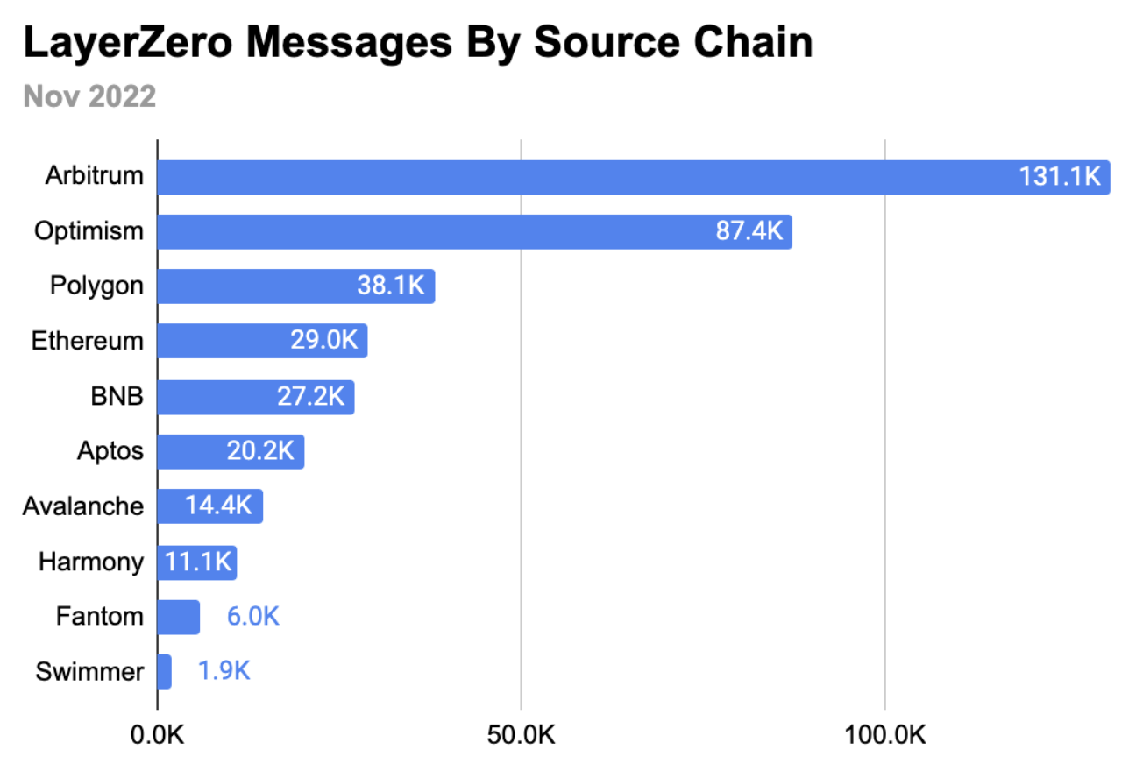
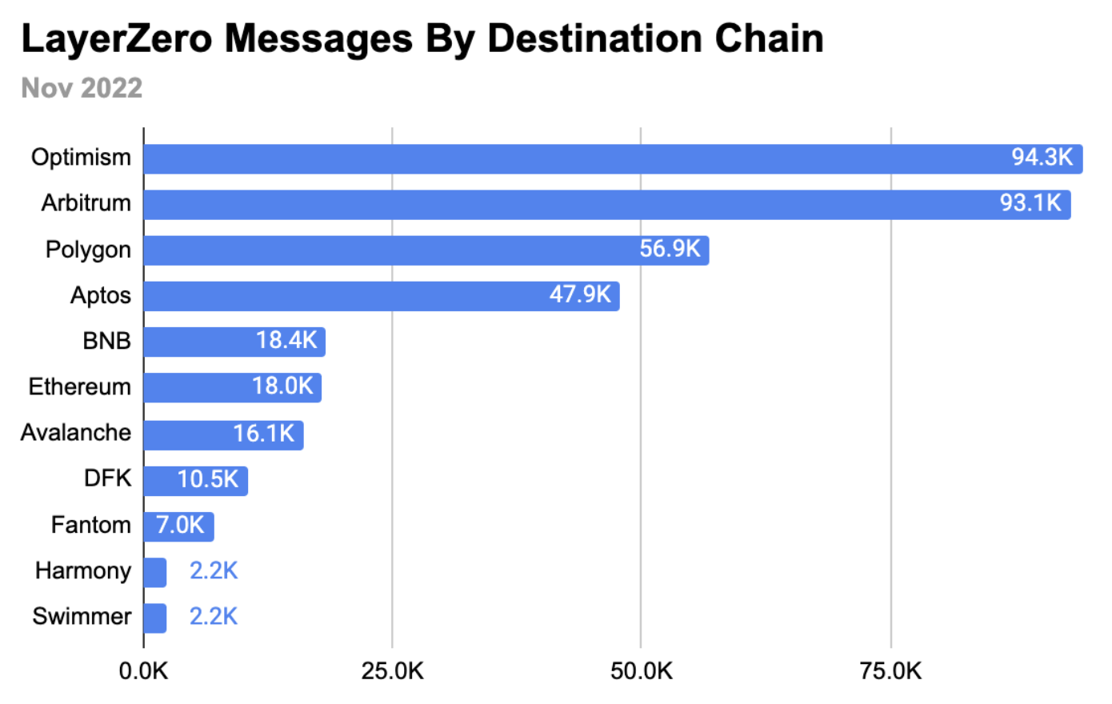
Activity

Slide 49
Primarily two types of messaging systems
(2) On-chain verified: chain T verifies block header of chain S
send messages D[] to relayerT,
along with finalized block header on chain S,
and consensus data
verify and dispatch
receive msgs
Source Chain S
Target Chain T
relayerS
relayerT
oracle
no trustees
relayerT runs a (light) client for chain S to verify that relayerS received messages D[]
assumes security of light client
Notes:
Oracle is not really trusted because it is only relaying *finalized* blocks.

Slide 50
Primarily two types of messaging systems
SNARK prover
(proof of state on chain S)
verify SNARK proof and dispatch
msgs D[]
receive msgs
D[], BH, proof
Source Chain S
Target Chain T
relayerS
relayerT
chain S block header (BH) and consensus data
oracle
Problem: high gas costs on chain T to verify state of source chain S.
Solution: zkBridge: use SNARK to reduce work for relayerT
Notes:
Oracle is not really trusted because it is only relaying *finalized* blocks.

Slide 51
Primarily two types of messaging systems
SNARK prover
(proof of state on chain S)
verify SNARK proof and dispatch
msgs D[]
receive msgs
D[], BH, proof
Source Chain S
Target Chain T
relayerS
relayerT
chain S block header (BH) and consensus data
oracle
… being built by Succinct Labs
Notes:
Third type of messaging system: optimistic bridges (using fraud proofs) as implemented by Nomad.

Slide 52
Bridging: the future vision
User can hold assets on any chain
Assets move cheaply and quickly from chain to chain
A project’s liquidity is available on all chains
Users and projects choose the chain that is best suited for their application and asset type
We are not there yet …

Slide 53
END OF LECTURE
Next lecture: super cool final guest lecture
Notes:
Olaf

Slide 54
Fun crypto tricks

Slide 55
BLS signatures
one Bitcoin block
inputs
outputs
Signatures make up most of Tx data.
Can we compress signatures?
Yes: aggregation!
not possible for ECDSA
Tx1:
sig
sig
sig
Tx2:
sig
sig
sig
sig
Tx3:
sig
sig
Tx4:
sig
sig
sig

Slide 56
BLS Signatures
Used in modern blockchains: Ehtereum 2.0, Dfinity, Chia, etc.
The setup:
G = {1, g, …, g^{q-1}} a cyclic group of prime order q
H: M × G ⇾ G a hash function (e.g., based on SHA256)

Slide 57
BLS Signatures
KeyGen(): choose random $α$ in $\{1, …, q\}$
output sk = $α$ , pk = $g^{α}$ ∈ G
Sign(sk, $m$): output sig = ${H(m,pk)}^{α}$ ∈ G
Verify(pk, $m$, sig): output accept if log_{g}(pk) = log_{H(m,pk)}(sig)
Note: signature on $m$ is unique! (no malleability)

Slide 58
How does verify work?
A pairing: an efficiently computable function e:G×G ⇾ G’
such that e($g^{α},g^{β})={e(g,g)}^{αβ}$ for all $α,β∈\{1,…q\}$
and is not degenerate: $e(g, g)≠1$
Observe: log_{g}(pk) = log_{H(m,pk)}(sig)
if and only if e(g, sig) = e(pk, H(m,pk))
verify test
=
=
e(g, H(m,pk)$α$) = e(g$α$, H(m,pk))

Slide 59
Properties: signature aggregation [BGLS’03]
Anyone can compress n signatures into one
Verify( pk , m , σ* ) = “accept”
convinces verifier that for i=1,…,n: user i signed msg m_{i}
pk₁ , m₁ ⟶ σ₁
⋮
aggregate
⟶ σ*
pk_{n} , m_{n} ⟶ σ_{n}
single short signature

Slide 60
Aggregation: how
user 1: pk₁ = g^{α1} , m₁ ⟶ σ₁=H(m₁,pk₁)^{α1}
σ ⟵ σ₁⋯ σ_{n}
user n: pk_{n} = g^{αn} , m_{n} ⟶ σ_{n}=H(m_{n},pk_{n})^{αn}
Verifying an aggregate signature: (incomplete)
$\prod_{i=1}^{n}{\text{e}\text{(}\text{H}\text{(}\text{mi}\text{,}\text{pki}\text{), }\text{g}\text{α}\text{i}\text{)}}$ ≟ e(σ, g)
=
=
Π_{i=1} e(H(m_{i},pk_{i})^{αi}, g) = e(Π_{i=1}H(m_{i},pk_{i})^{αi}, g)

Slide 61
Compressing the blockchain with BLS
one Bitcoin block
if needed:
compress all signatures in a block into a single aggregate signatures
⇒ shrink block
or: aggregate in smaller batches
inputs
outputs
sig*
Tx1:
sig
sig
sig
Tx2:
sig
sig
sig
sig
Tx3:
sig
sig
Tx4:
sig
sig
sig

Slide 62
Reducing Miner State

Slide 63
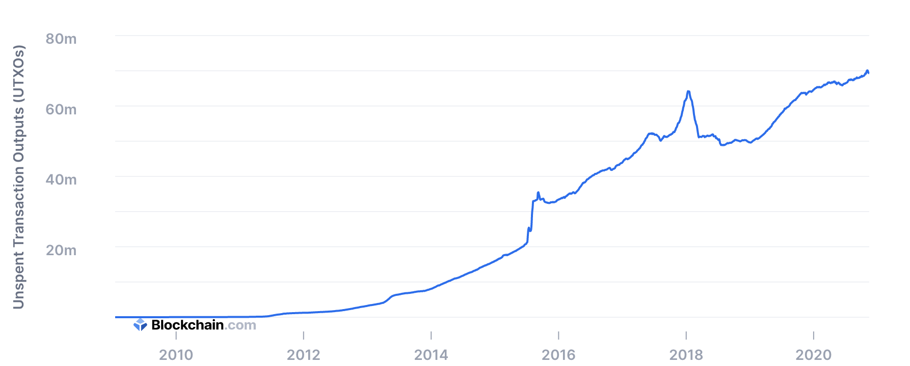
UTXO set size
≈70M UTXOs
Miners need to keep all UTXOs in memory to validate Txs
Can we do better?

Slide 64
Recall: polynomial commitments
commit(pp, f, r) ⇾ com_{f} commitment to f ∈ $𝔽_{p}^{(≤d)}\left[X\right]$
eval: goal: for a given com_{f} and x, y ∈ $𝔽_{p}$,
construct a SNARK to prove that f(x) = y.

Slide 65
Homomorphic polynomial commitment
A polynomial commitment is homomorphic if
there are efficient algorithms such that:
commit(pp, f₁, r₁) ⇾ com_{f1} commit(pp, f₂, r₂) ⇾ com_{f2}
Then:
(i) for all $a, b∈𝔽_{p}^{}$ : com_{f1} , com_{f2} ⇾ com_{a*f1+b*f2}
(ii) com_{f1} ⇾ com_{X*f1}

Slide 66
Committing to a set (of UTXOs)
(accumulator)
Let $S=\{U1, … , Un\}$ ∈ $𝔽_{p}$ be a set of UTXOs
Define: $f\left(X\right)=(X−U1) ⋯(X−Un)$ ∈ $𝔽_{p}^{(≤n)}\left[X\right]$
Set: com_{f} = commit($pp, f, r$) ⇽ short commitment to $S$
For $U$ ∈ $𝔽_{p}$ : $U$ ∈ $S$ if and only if $f(U)=0$
To add U to S: com_{f} ⇾ com_{X*f−U*f} ⇽ short commitment to $S∪\{U\}$

Slide 67
How does this help?
Miners maintain two commitments:
(i) commitment to set T of all UTXOs
(ii) commitment to set S of spent TXOs
≤ 1KB
com_{T}, com_{S}
Tx format:
every input $U$ includes a proof ($U∈T$ && $U∉S$)
Two eval proofs: $T(U)=0$ && $S(U)≠0$ (short)
Tx processing: miners check eval proofs, and if valid,
add inputs to set S and outputs to set T. That’s it!

Slide 68
Does this work ??
Problem: how does a user prove that her UTXO $U$ satisfies
$T(U)=0$ && $S(U)≠0$ ???
This requires knowledge of the entire blockchain
⇒ user needs large memory and compute time
⇒ … can be outsourced to an untrusted 3rd party
UTXO $U$ , fee
polynomials
S and T
proof $π$
spend $U$
The proof factory

Slide 69
Is this practical?
Not quite …
Problem: the factory’s work per proof is linear in the number of UTXOs ever created
Many variations on this design:
can reduce factory’s work to log₂(# current UTXOs) per proof
Factory’s memory is linear in (# current UTXOs)
End result: outsource memory requirements to a small number of 3rd party service providers
Notes:
factory work is logarithmic by using 2-3 trees.

Slide 70
Taproot: semi-private scripts in Bitcoin

Slide 71
Taproot is here …

Slide 72
Script privacy
Currently: Bitcoin scripts must be fully revealed in spending Tx
Can we keep the script secret?
Answer: Yes, easily! when all goes well …

Slide 73
How?
ECDSA and Schnorr public keys:
KeyGen(): sk = $α$ , pk = $g^{α}$ ∈ G for $α$ in $\{1, …, q\}$
Suppose sk_{A} = $α$ , sk_{B} = $β$.
Alice and Bob can sign with respect to pk $={pk}_{A}∙{pk}_{B}=g^{α+β}$
⇒ an interactive protocol between Alice and Bob
(note: much simpler with BLS)
⇒ Alice & Bob can imply consent to Tx by signing with pk = $g^{α+β}$

Slide 74
How?
S: Bitcoin script that must be satisfied to spend a UTXO $U$
S involves only Alice and Bob. Let ${pk}_{AB}={pk}_{A}∙{pk}_{B}$
Goal: keep S secret when possible.
How: modify S so that a signature with respect to
pk =${pk}_{AB}∙$ $g^{H({pk}_{AB} , S)}$
is sufficient to spend UTXO, without revealing S !!

Slide 75
The main point
If parties agree to spend UTXO,
⇒ sign with respect to ${pk}_{AB}$ and spend while keeping S secret
If disagreement, Alice can reveal S and spend UTXO by proving that she can satisfy S.
Taproot pk compactly supports both ways to spend the UTXO

