Slide 1
Using zk-SNARKs for Privacy on the Blockchain
CS251 Fall 2021
(cs251.stanford.edu)
Dan Boneh

Slide 2
Can we have private transactions on a public blockchain?
Naïve reasoning:
universal verifiability ⇒ transaction data must be public.
otherwise, how we can the public verify Tx ??
Goal for this lecture:
crypto magic ⇒ private Tx on a publicly verifiable blockchain
Crypto tools: commitments and zero knowledge proofs

Slide 3
The need for privacy in the financial system
Supply chain privacy:
A car company does not want to reveal how much it pays its supplier for tires, wipers, etc.
Payment privacy:
A company that pays its employees in crypto needs to keep list of employees and their salaries private.
Privacy for rent, donations, purchases
Business logic privacy: Can the code of a smart contract be private?

Slide 4
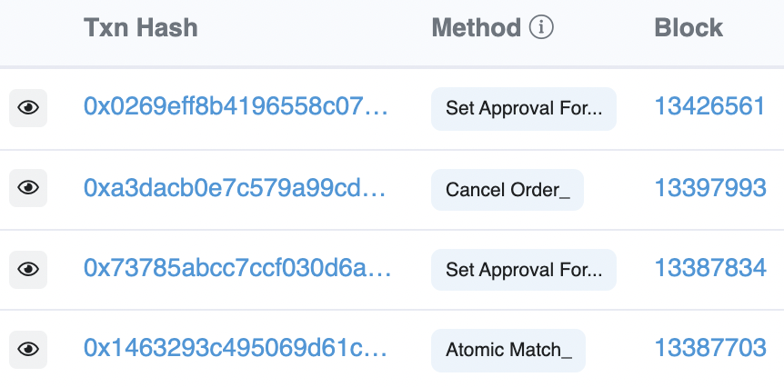
Last lecture
Neither Bitcoin nor Ethereum are private
etherscan.io:
Address 0x1654b0c3f62902d7A86237…

Slide 5
Simple blockchain anonymity via mixing
mixer
address: M
1 ETH to M
from Alice
fresh addr X
from Alice
TLS
Send:
1 ETH to X
1 ETH to Y
1 ETH to Z
1 ETH to M
from Bob
fresh addr Y
from Bob
TLS
1 ETH to M
from Carol
fresh addr Z
from Carol
has 3 ETH
blockchain
TLS
Observer knows Y belongs to one of {Alice, Bob, Carol} but does not know which one
⟹ anonymity set of size 3.
⟹ Bob can mix again with different parties to increase anonymity set.
Problems: (i) mixer knows all, (ii) mixer can abscond with 3 ETH !!
Mixing without a mixer? on Bitcoin: CoinJoin (e.g., Wasabi), on Ethereum: Tornado cash

Slide 6
What is a zk-SNARK?
An central tool for privacy on the blockchain

Slide 7
zk-SNARK: Blockchain Applications
Private Tx on a public blockchain:
Confidential transactions
Tornado cash, Zcash, IronFish
Private Dapps: Aleo
Compliance:
Proving solvency in zero-knowledge
Zero-knowledge taxes
Scalability: privacy in zk-SNARK Rollup (next week)

Slide 8
(1) arithmetic circuits
Fix a finite field $𝔽=\left\{0, …, p−1\right\}$ for some prime p>2.
Arithmetic circuit: $C: 𝔽n ⇾ 𝔽$
directed acyclic graph (DAG) where
internal nodes are labeled +, −, or ×
inputs are labeled 1, $x1, …, xn$
defines an n-variate polynomial with an evaluation recipe
$|C| =$ # gates in $C$
$$x1(x1+x2+1)(x2−1)$$
$$\text{×}$$
$$+$$
$$−$$
$$x1$$
$$x2$$
$$1$$

Slide 9
Interesting arithmetic circuits
Examples:
C_{hash}(h, m): outputs 0 if SHA256(m) = h , and ≠0 otherwise
C_{hash}(h, m) = (h – SHA256(m)) , |C_{hash}| ≈ 20K gates
C_{sig}(pk, m, σ): outputs 0 if σ is a valid ECDSA signature on m with respect to pk
Notes:
WRITE: and m_i (1– m_i) = 0 for all i=1,…,256

Slide 10
(2) Argument systems (for NP)
Public arithmetic circuit: $C( x, w ) ⇾ 𝔽$
public statement in $𝔽_{}^{n}$
secret witness in $𝔽_{}^{m}$
$x,$ $w$
$$x$$
P’s goal: “convince” V that $∃w$ s.t. $C(x, w) =0$
Prover
Verifier
accept or reject
Notes:
Knowledge is stronger the soundness.

Slide 11
(non-interactive) Preprocessing argument systems
Public arithmetic circuit: $C( x, w ) ⇾ 𝔽$
public statement in $𝔽_{}^{n}$
secret witness in $𝔽_{}^{m}$
Preprocessing (setup): S($C$) ⇾ public parameters ( $S_{p}$, $S_{v}$ )
$S_{p}$, $x,$ $w$
$S_{v}$, $x$
proof $π$
Prover
Verifier
accept or reject
Notes:
Knowledge is stronger the soundness.

Slide 12
Preprocessing argument System
A preprocessing argument system is a triple (S, P, V):
S($C$) ⇾ public parameters ($Sp$, $Sv$) for prover and verifier
P($Sp$, $x, w$) ⇾ proof $π$
V($Sv$, $x, π$) ⇾ accept or reject

Slide 13
Argument system: requirements (informal)
Prover P($Sp$, $x, w$)
Verifier V ($Sv$, $x$, $π$)
proof $π$
accept or reject
Complete: $∀x, w: C(x, w) =0$ ⇒ Pr[ V(S_{v}, $x$, P(S_{p}, $x$, $w$)) = accept ] = 1
Knowledge sound: V accepts ⇒ P “knows” $w$ s.t. $C\left(x, w\right)=0$
P* does not “know” $w$ ⇒ Pr[ V(S_{v}, $x$, $π$) = accept ] < negligible
Optional: Zero knowledge: ($Sv ,x$, $π$) “reveals nothing” about $w$

Slide 14
SNARK: a Succinct ARgument of Knowledge
A succinct preprocessing argument system is a triple (S, P, V):
S($C$) ⇾ public parameters ($Sp$, $Sv$) for prover and verifier
P($Sp$, $x, w$) ⇾ short proof $π$ ; $|π|=O( \log\left(\left|C\right|\right), λ)$
V($Sv$, $x, π$) fast to verify ; time(V) = $O(\left|x\right|, \log\left(\left|C\right|\right), λ)$
short “summary” of circuit
Why preprocess $C$??

Slide 15
SNARK: a Succinct ARgument of Knowledge
A succinct preprocessing argument system is a triple (S, P, V):
S($C$) ⇾ public parameters ($Sp$, $Sv$) for prover and verifier
P($Sp$, $x, w$) ⇾ short proof $π$ ; $|π|=O( \log\left(\left|C\right|\right), λ)$
V($Sv$, $x, π$) fast to verify ; time(V) = $O(\left|x\right|, \log\left(\left|C\right|\right), λ)$
SNARK: (S, P, V) is complete, knowledge sound, and succinct
zk-SNARK: (S, P, V) is a SNARK and is zero knowledge

Slide 16
The trivial argument system
(a) Prover sends $w$ to verifier,
(b) Verifier checks if $C(x, w)= 0$ and accepts if so.
Problems with this:
(1) $w$ might be secret: prover does not want to reveal $w$ to verifier
(2) $w$ might be long: we want a “short” proof
(3) computing $C(x, w)$may be hard: we want a “fast” verifier

Slide 17
An example
Prover: I know $(x1, …, x_{n})∈X$ such that $H(x1,…, xn) = y$
SNARK: $size(π)$ and $VerifyTime(π)$ is $O(log n)$ !!
statement: $y$ witness: $x1, …, x_{n}$
statement: $y$
Proof $π$
accept or reject
Prover
Verifier
Notes:
The size of circuit is O(log n) .

Slide 18
An example
How is this possible ???
SNARK: $size(π)$ and $VerifyTime(π)$ is $O(log n)$ !!
statement: $y$ witness: $x1, …, x_{n}$
statement: $y$
Proof $π$
accept or reject
Prover
Verifier

Slide 19
Types of preprocessing Setup
Recall setup for circuit $C$: S($C;r$) ⇾ public parameters $(Sp, Sv)$
Types of setup:
trusted setup per circuit: S($C;r$) random $r$ must be kept secret from prover
prover learns $r$ ⇒ can prove false statements
trusted but universal (updatable) setup: secret $r$ is independent of $C$
$S=\left(S_{init}, S_{index}\right): S_{init}\left(λ;r\right)⇾pp$, $S_{index}(pp,C)⇾(S_{p}, S_{v})$
transparent setup: S($C$) does not use secret data (no trusted setup)
random bits
better
one-time
no secret data from prover

Slide 20
Significant progress in recent years
Kilian’92, Micali’94: succinct transparent arguments from PCP
impractical prover time
GGPR’13, Groth’16, …: linear prover time, constant size proof ($O_{λ}(1)$)
trusted setup per circuit (setup alg. uses secret randomness)
compromised setup ⇒ proofs of false statements
Sonic’19, Marlin’19, Plonk’19, … : universal trusted setup
DARK’19, Halo’19, STARK, … : no trusted setup (transparent)
Notes:
Gennaro, Gentry, Parno, Reykova

Slide 21
Types of SNARKs (partial list)
 | size of proof $π$ | size of S_{p} (beyond $C$) | verifier time | trusted setup?
Groth’16 | O(1) | O(|$C$|) | O(1) | yes/per circuit
Plonk/Marlin | O(1) | O(|$C$|) | O(1) | yes/universal
Bulletproofs | O(log|$C$|) | O(1) | O(|$C$|) | no
STARK | O(log|$C$|) | O(1) | O(log|$C$|) | no
DARK | O(log|$C$|) | O(1) | O(log|$C$|) | no
⋮
⋮
⋮
Notes:
no trusted setup: log-size proof. but shorter Sp.

Slide 22
A SNARK software system
CPU heavy
SNARK backend
DSL program
Circom,
ZoKrates,
Leo,
Zinc,
Cairo,
Snarky,
…
SNARK
friendly
format
R1CS,
AIR,
Plonk-CG
Proof $π$
compiler
x, witness
verifier
accept/ reject
x
(S_{p}, S_{v})
setup
Notes:
SNARK programs: setup, compile, prove, verify. Plonk-CG: plonk with custom gates

Slide 23
How to define “knowledge soundness” and “zero knowledge”?

Slide 24
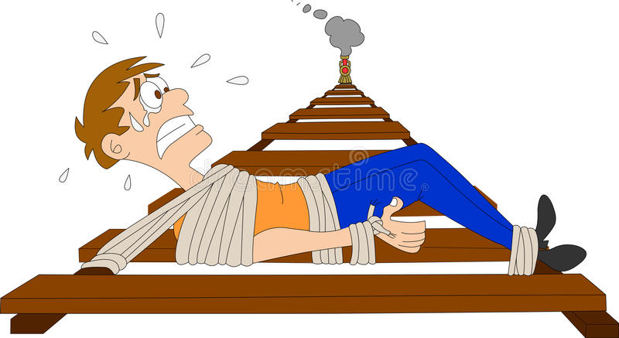
Definitions: (1) knowledge sound
Goal: if V accepts then P “knows” $w$ s.t. $C(x, w) =0$
What does it mean to ”know” $w$ ??
informal def: P knows $w$, if $w$ can be “extracted” from P
P

Slide 25
Definitions: (1) knowledge sound
Formally: (S, P, V) is knowledge sound for a circuit $C$ if
for every poly. time adversary A = (A₀, A₁) such that
S($C$) ⇾ (S_{p}, S_{v}), ($x$, st) ⇽ A₀(S_{p}), $π$ ⇽ A₁(S_{p}, $x$, st):
Pr[V(S_{v}, $x$, $π$) = accept] > 1/10⁶ (non-negligible)
there is an efficient extractor $E$ (that uses A₁ as a black box) s.t.
S($C$) ⇾ (S_{p}, S_{v}), ($x$, st) ⇽ A₀(S_{p}), $w$ ⇽ $E$^{A1(Sp,}$x$^{,st)} (S_{p}, $x$):
Pr[C($x$, $w$) = 0] > 1/10⁶ $− ε$ (for a negligible $ε$)

Slide 26
Definitions: (2) Zero knowledge
A story about the lady sipping tea

Slide 27
Definitions: (2) Zero knowledge (against an honest verifier)
(S, P, V) is zero knowledge if for every $x∈𝔽_{}^{n}$
proof $π$ “reveals nothing” about $w$, other than its existence
What does it mean to “reveal nothing” ??
Informal def: $π$ “reveals nothing” about $w$ if the verifier can generate $π$ by itself ⟹ it learned nothing new from $π$
(S, P, V) is zero knowledge if there is an efficient alg. Sim s.t. (S_{p}, S_{v}, $π$) ⇽ Sim($C,x$) “look like” the real S_{p}, S_{v} and $π$.
Main point: Sim($C$,x) simulates $π$ without knowledge of $w$ (but also outputs S_{p}, S_{v})
Notes:
Honest verifier because we are assuming S is honest (treating S as part o the verifier)

Slide 28
Definitions: (2) Zero knowledge (against an honest verifier)
Formally: (S, P, V) is (honest verifier) zero knowledge for a circuit $C$ if there is an efficient simulator Sim such that for all $x∈𝔽_{}^{n}$ s.t. $∃w:C\left(x,w\right)=0$ the distribution:
(S_{p}, S_{v}, $x$, $π$): where (S_{p}, S_{v}) ⇽ S($C$) , $π$ ⇽ P(S_{p} $,x$, $w$)
is indistinguishable from the distribution:
(S_{p}, S_{v}, $x$, $π$): where (S_{p}, S_{v}, $π$) ⇽ Sim($C,x$)
Notes:
Honest verifier because we are assuming S is honest (treating S as part o the verifier)

Slide 29
How to build a zk-SNARK?
Recall: A zero knowledge preprocessing argument system.
Prover generates a short proof that is fast to verify
How to build a zk-SNARK ??
Next lecture

Slide 30
Tornado cash: a zk-based mixer
Launched on the Ethereum blockchain on May 2020 (v2)

Slide 31
Tornado Cash: a ZK-mixer
A common denomination (1000 DAI) is needed to prevent linking Alice to her fresh address using the deposit/withdrawal amount
1000 DAI
MIX
NFT
market
???
1000 DAI
1000 DAI
buy NFT
privately
account
fresh
address
(1000 DAI)
1000 DAI
Tornado.cash
contract
Notes:
If Alice deposits and withdraws 1547.3 DAI then that creates a link between the deposit and the withdrawal events.

Slide 32
The tornado cash contract (simplified)
H₁, H₂: R ⇾ {0,1}²⁵⁶
CRHF
100 DAI pool:
each coin = 100 DAI
Treasury: 300 DAI
nf₁
Coins Merkle root
coins
Merkle
root
nf₂
(32 bytes)
tree of
height 20
(2²⁰ leaves)
Currently:
three coins in pool
contract has 300 DAI
two nullifiers stored
next = 4
nullifiers
C₁ C₂ C₃ 0 0 … 0
contract state
public list of coins
explicit list:
one entry per spent coin

Slide 33
Tornado cash: deposit (simplified)
H₁, H₂: R ⇾ {0,1}²⁵⁶
100 DAI pool:
each coin = 100 DAI
Treasury: 300 DAI
nf₁
Coins Merkle root
coins
Merkle
root
nf₂
Alice deposits 100 DAI:
(32 bytes)
tree of
height 20
(2²⁰ leaves)
100 DAI
C₄ , MerkleProof(4)
next = 4
nullifiers
C₁ C₂ C₃ 0 0 … 0
Build Merkle proof for leaf #4:
MerkleProof(4) (leaf=0)
choose random k, r in R
set C₄ = H₁(k, r)
contract state
public list of coins
explicit list:
one entry per spent coin
Notes:
Note: one Tx per block. Alice needs to know what leaf her coin will occupy.

Slide 34
Tornado cash: deposit (simplified)
H₁, H₂: R ⇾ {0,1}²⁵⁶
coins
Merkle
root
100 DAI
C₄ , $\text{MerkleProof}\text{(4)}$
Coins Merkle root
(32 bytes)
Tornado contract does:
verify $\text{MerkleProof}\text{(4)}$ with respect to current stored root
use C₄ and MerkleProof(4) to compute updated Merkle root
update state
tree of
height 20
(2²⁰ leaves)
next = 4
Tornado contract
C₁ C₂ C₃ 0 0 … 0
public list of coins

Slide 35
Tornado cash: deposit (simplified)
H₁, H₂: R ⇾ {0,1}²⁵⁶
coins
Merkle
root
100 DAI
C₄ , $\text{MerkleProof}\text{(4)}$
updated Merkle root
(32 bytes)
Tornado contract does:
verify $\text{MerkleProof}\text{(4)}$ with respect to current stored root
use C₄ and MerkleProof(4) to compute updated Merkle root
update state
tree of
height 20
(2²⁰ leaves)
next = 4
Tornado contract
C₁ C₂ C₃ C₄ 0 … 0
public list of coins

Slide 36
Tornado cash: deposit (simplified)
100 DAI pool:
each coin = 100 DAI
Treasury: 400 DAI
nf₁
updated Merkle root
updated
Merkle
root
nf₂
Alice deposits 100 DAI:
(32 bytes)
tree of
height 20
(2²⁰ leaves)
100 DAI
C₄ , MerkleProof(4)
next = 5
nullifiers
C₁ C₂ C₃ C₄ 0 … 0
updated contract state
public list of coins
note: (k, r)
Alice keeps secret (one note per coin)
Every deposit: new Coin added sequentially to tree
an observer sees who owns which coins
Notes:
Observer: Alice owns C4.

Slide 37
Tornado cash: withdrawal (simplified)
H₁, H₂: R ⇾ {0,1}²⁵⁶
100 DAI pool:
each coin = 100 DAI
Treasury: 400 DAI
Merkle root
coins
Merkle
root
nf₁
nf₂
Withdraw coin #3 to addr A:
tree of
height 20
(2²⁰ leaves)
(32 bytes)
has note= (k’, r’)
next = 5
C₁ C₂ C₃ C₄ 0 … 0
nullifiers
set nf = H₂(k’)
contract state
public list of coins
Bob proves “I have a note for some leaf in the coins tree, and its nullifier is nf”
(without revealing which coin)
Notes:
Bob does not reveal which coin is being spent.

Slide 38
Tornado cash: withdrawal (simplified)
H₁, H₂: R ⇾ {0,1}²⁵⁶
Withdraw coin #3 to addr A:
Merkle root
has note= (k’, r’)
set nf = H₂(k’)
tree of
height 20
(2²⁰ leaves)
Bob builds zk-SNARK proof $π$ for
public statement x = (root, nf, A)
secret witness w = (k’, r’, C₃ , MerkleProof(C₃) )
where Circuit(x,w)=0 iff:
C₃ = (leaf #3 of root), i.e. MerkleProof(C₃) is valid,
C₃ = H₁(k’, r’), and
nf = H₂(k’).
C₁ C₂ C₃ C₄ 0 … 0
(address A not used in Circuit)
Notes:
Bob proves “I know some leaf in the coins tree whose nullifier is nf”. He does not which coin is being spent, which is why C3 is part of the secret witness.
Tornado uses Groth16. Lava.cash (same thing on Solana) uses zk-STARKs.

Slide 39
Tornado cash: withdrawal (simplified)
H₁, H₂: R ⇾ {0,1}²⁵⁶
Withdraw coin #3 to addr A:
The address A is part of the statement to ensure that a miner cannot change A to its own address and steal funds
Assumes the SNARK is non-malleable: adversary cannot use proof $π$ for x to build a proof $π’$ for some “related” x’ (e.g., where in x’ the address A is replaced by some A’)
Merkle root
has note= (k’, r’)
set nf = H₂(k’)
tree of
height 20
(2²⁰ leaves)
C₁ C₂ C₃ C₄ 0 … 0
Bob builds zk-SNARK proof $π$ for
public statement x = (root, nf, A)
secret witness w = (k’, r’, C₃ , MerkleProof(C₃) )
Notes:
Bob proves “I know some leaf in the coins tree whose nullifier is nf”. He does not which coin is being spent, which is why C3 is part of the secret witness.

Slide 40
Tornado cash: withdrawal (simplified)
H₁, H₂: R ⇾ {0,1}²⁵⁶
100 DAI pool:
each coin = 100 DAI
Treasury: 400 DAI
Merkle root
coins
Merkle
root
nf₁
Withdraw coin #3 to addr A:
nf₂
tree of
height 20
(2²⁰ leaves)
nf, proof $π$, A
(over Tor)
(32 bytes)
next = 5
C₁ C₂ C₃ C₄ 0 … 0
Bob’s ID and coin C₃ are not revealed
nullifiers
contract state
public list of coins
Contract checks (i) proof $π$ is valid for (root, nf, A), and
(ii) nf is not in the list of nullifiers
Notes:
Gas can be payed by a relayer, so that Bob’s account is not recorded.

Slide 41
Tornado cash: withdrawal (simplified)
H₁, H₂: R ⇾ {0,1}²⁵⁶
100 DAI pool:
each coin = 100 DAI
Treasury: 300 DAI
Merkle root
coins
Merkle
root
nf₁
Withdraw coin #3 to addr A:
nf₂
tree of
height 20
(2²⁰ leaves)
(32 bytes)
nf
nf, proof $π$, A
(over Tor)
next = 5
C₁ C₂ C₃ C₄ 0 … 0
100 DAI
nullifiers
to address A
contract state
public list of coins
… but observer does not know which are spent
nf and $π$ reveal nothing about which coin was spent.
But, coin #3 cannot be spent again, because nf = H₂(k’) is now nullified.
Notes:
Stress that H1 is collision resistant.

Slide 42
Who pays the withdrawal gas fee?
Problem: how does Bob pay for gas for the withdrawal Tx?
If paid from Bob’s address, then fresh address is linkable to Bob
Tornado’s solution: Bob uses a relay
nf, proof $π$, A
and gas
nf, proof $π$, A
(over Tor)
(100-gas) DAI
to address A
gas
relay
tornado
contract
Note: relay and Tornado also charge a fee

Slide 43
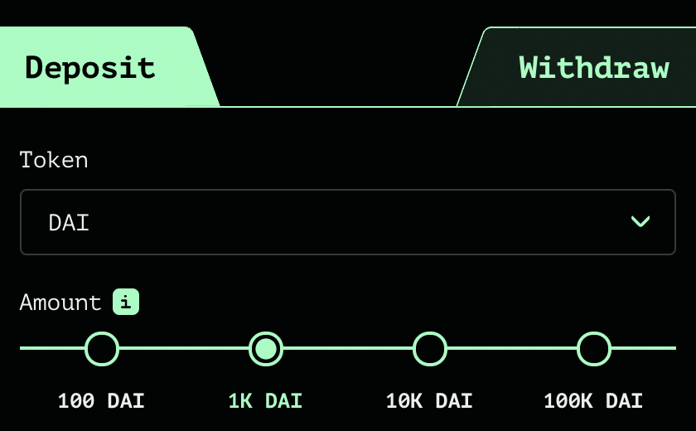
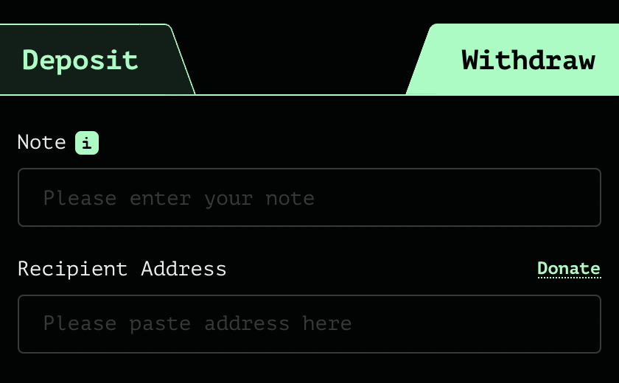
Tornado Cash: the UI
enter note here
address
After deposit: get a note
Later, use note to withdraw
(wait before withdrawing)

Slide 44
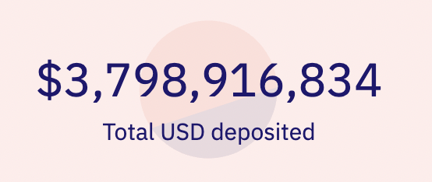
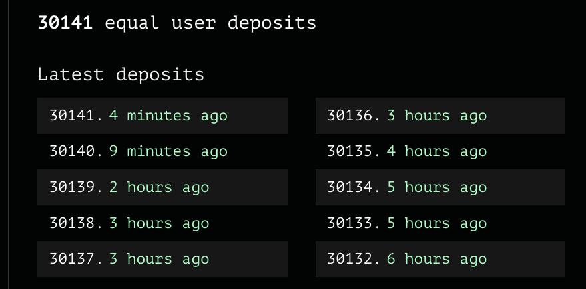
Anonymity set
# leaves occupied
over all pools
1 ETH pool
Oct. 2021

Slide 45
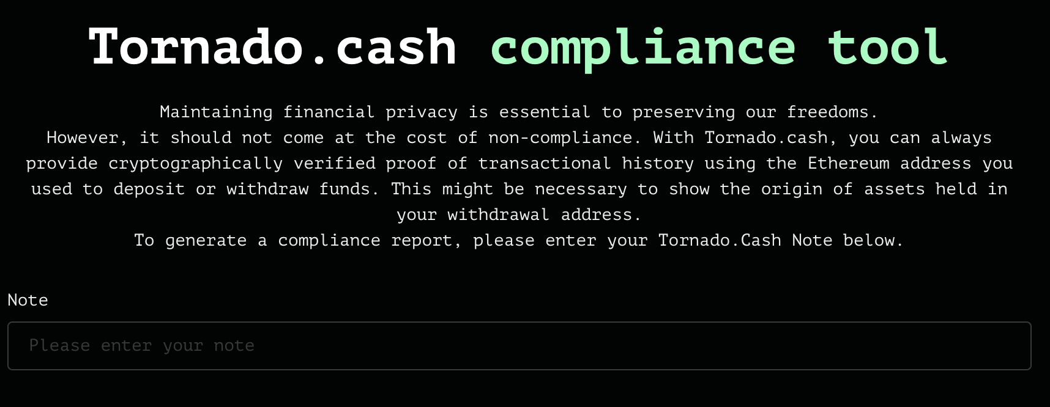
Compliance tool
enter note here

Slide 46
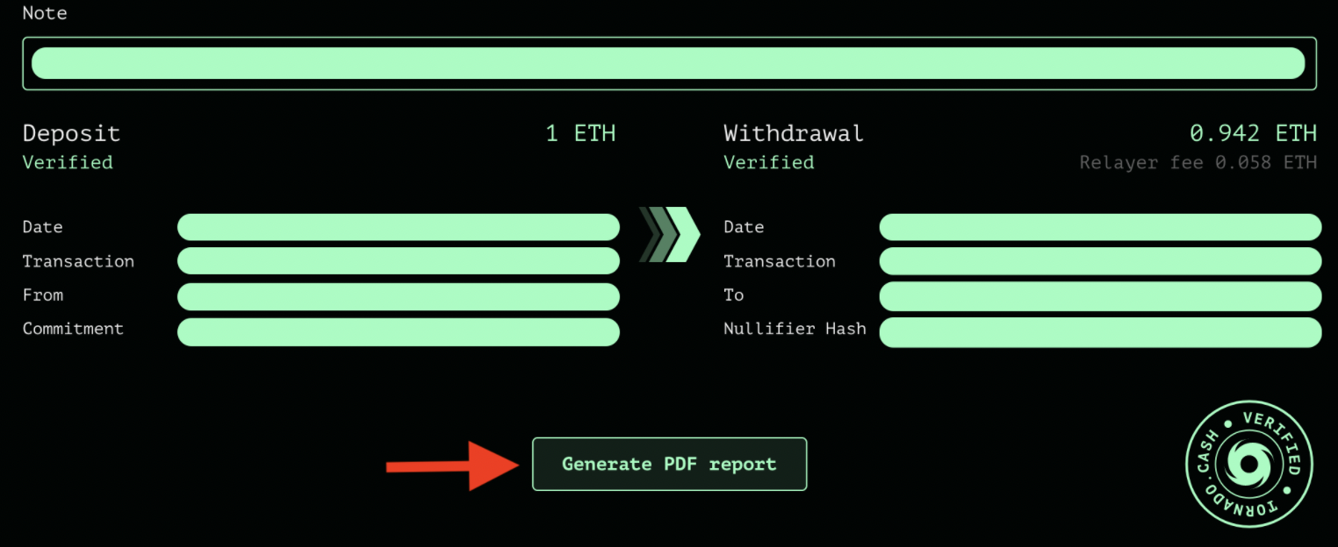
Compliance tool
Reveals source address and destination address of funds

Slide 47
Zcash / IronFISH
Two L1 blockchains that extend Bitcoin.
Sapling (Zcash v2) launched in Aug. 2018.
Similar use of Nullifiers, support for any value Tx.

Slide 48
Quick review
A zk-SNARK for a circuit $C$:
For a public statement $x$, prover outputs a proof that “convinces” verifier that prover knows $w$ s.t. $C(x,w)=0$.
Proof is short and fast to verify
What is it good for?
Private payments and private Dapp business logic (Aleo)
Private compliance and L2 scalability with privacy
More to think about:
private DAO participation? private governance?

Slide 49
Further topics
Privately communicating with the blockchain: Nym
How to privately compensate proxies for relaying traffic
Next lecture: how to build a SNARK

Slide 50
END OF LECTURE

Slide 51
Two types of argument systems: interactive vs. non-interactive
Interactive: proof takes multiple P↔︎V rounds of interaction
Useful when there is a single verifier, e.g. a compliance auditor
Example: zero-knowledge proof of taxes to tax authority
Non-interactive: prover sends a single message (proof) to verifier
Used when many verifiers need to verify proof
SNARK: short proof that is fast to verify

