Slide 1
Privacy, Mixers and Monero
CS251 Fall 2021
(cs251.stanford.edu)
Benedikt Bünz

Slide 2
Privacy for Cryptocurrencies
What information might a user want to hide?
Identity (anonymity):
Who they are
Who they pay
Who pays them
Amounts:
How much they are paying
How much are they receiving
E.g. salary
Metadata:
Script Sig, e.g multisig threshold
Smart contract

Slide 3
Anonymity
Weak Anonymity (Pseudonymity):
One consistent Pseudonym (e.g. reddit)
Pros: Reputation
Cons: Linkable posts, one post linked to you-> all posts linked to you
Writing style, topics of interest may link you
Strong Anonymity:
Cons: No Reputation

Slide 4
Who needs privacy for payments
Companies:
Ford does not want to reveal cost of tires
Salaries of employees
Investment funds want to keep strategies private
Notes:
Split into 4 slides

Slide 5
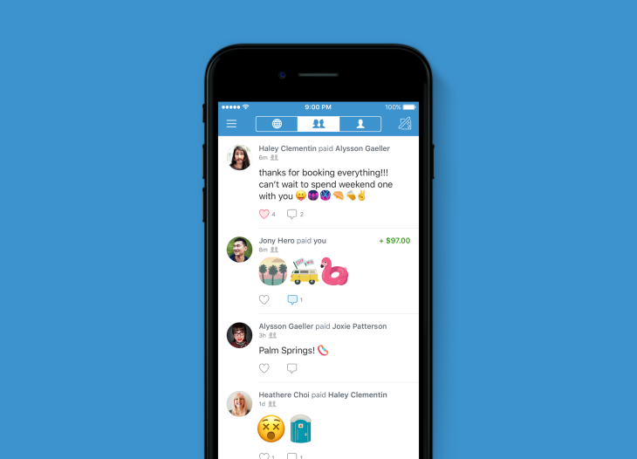
Who needs privacy for payments
Consumers
Salary, Rent, Purchasing things online, Donations
Notes:
Split into 4 slides

Slide 6
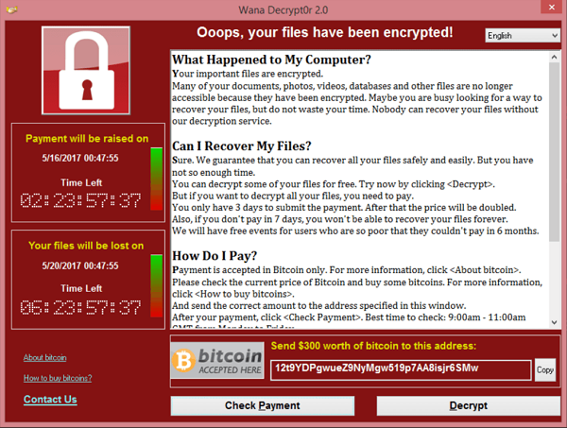
Who needs privacy for payments
Criminals:
Stolen funds (WannaCry), buying/selling drugs, tax evasion
Notes:
Split into 4 slides

Slide 7
Who needs privacy for payments
Applications:
Privacy can prevent frontrunning
Exchanges may want to keep orderbook private
Sealed bid auction
Notes:
Split into 4 slides

Slide 8
Privacy of Digital Payments
Payments publicly visible/linkable
Payments only visible to bank/venmo. Optionally sender/receiver public
Unlinkable private payments
Less private
More private

Slide 9
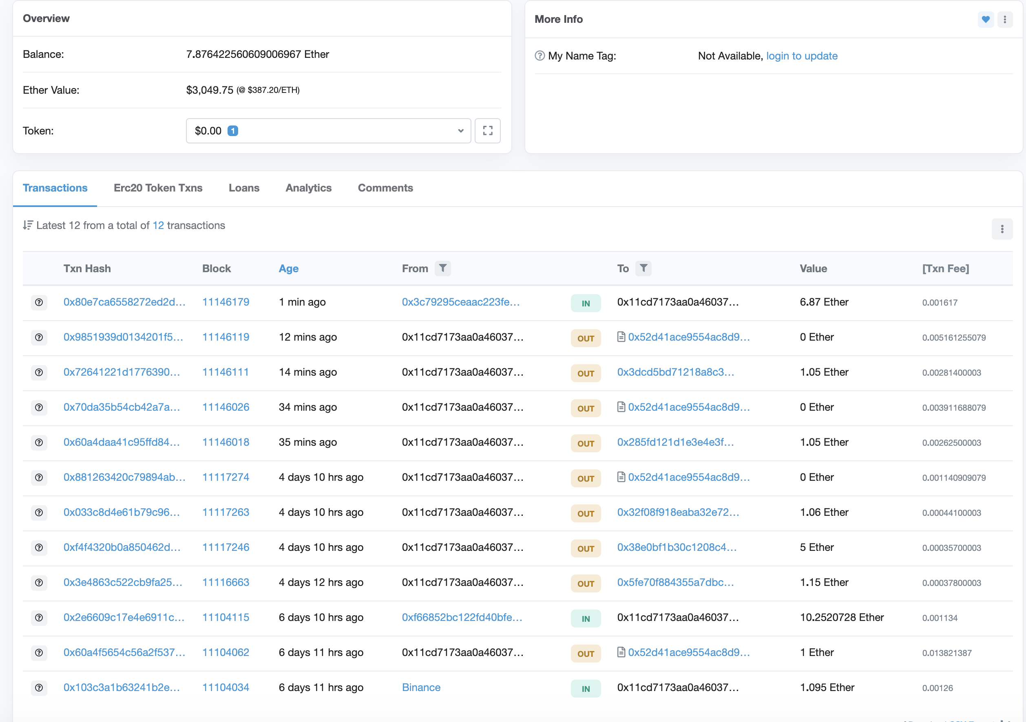
Privacy in Ethereum
Weak Pseudonymity:
Account public
Values public
Mostly one account per user
Some accounts known (Binance)

Slide 10
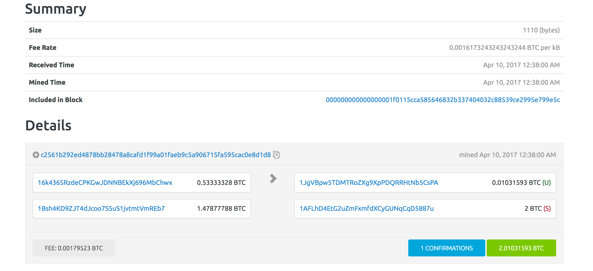
Privacy in Bitcoin

Slide 11
Privacy in Bitcoin
Alice can have many addresses (creating address is free)
Ins: A1: 4 A2: 5 out: B: 6, A3: 3
Change address
Alice’s addresses
Bob’s address

Slide 12
Linking Addresses to Identities
Ins: A1: 4 A2: 5 out: B: 6, A3: 3
Buying book from merchant
Alice learns one of merchant’s addresses (B)
Merchant learns three of Alice’s addresses
Alice uses an exchange
KYC (Know your customer)
Money serving business collect and verify IDs
BTC ←→ $

Slide 13
Linking Addresses to Identities
Ins: A1: 4 A2: 5 out: B: 6, A3: 3
Buying book from merchant
Alice learns one of merchant’s addresses (B)
Merchant learns three of Alice’s addresses
Alice uses an exchange
KYC (Know your customer)
Money serving business collect and verify IDs
Exchange learns real ID
BTC ←→ $

Slide 14
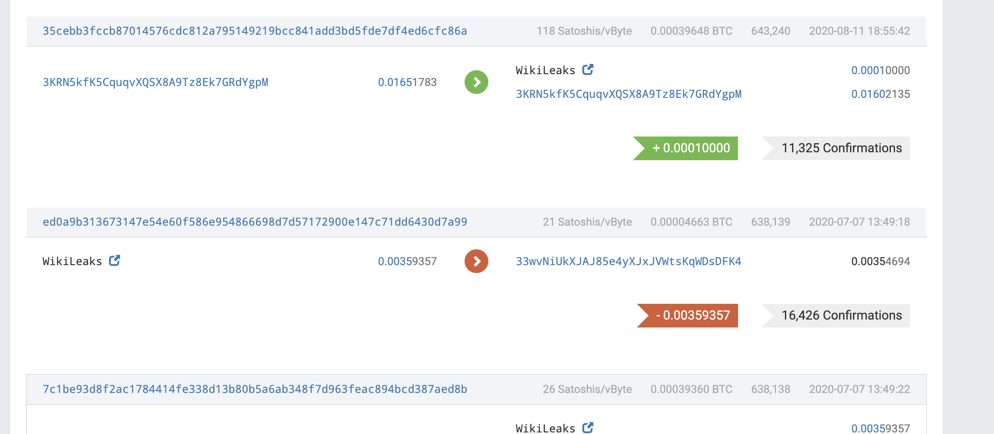
Donating to Wikileaks
Wikileaks had one address -> Easy to see who donates

Slide 15
Is Bitcoin Anonymous?
Now commercialized:
No!
It is possible to:
Link all addresses of a single entity:
Determine total assets
Given two TX A->B, C->D, Are B&C the same
If D knows C, can unmask B
Trace stolen funds, find tax evasion
Oppressive governments (Venezuela, North Korea)
Test if Alice ever paid Bob (Wikileaks)
Often answer is yes for all 3. How?

Slide 16
Network Anonymity
Bitcoin P2P network
end users
signed Tx
sk_{A}
sk_{B}
sk_{C}
Can learn Alice’s IP address
Solution:

Slide 17
Light client network anonymity
SPV client
Full node
All addresses and transactions
Fully linkable!

Slide 18
Idioms of use
Heuristic 1:
Two addresses are input to same TX (and not multisig script)
-> both addresses are controlled by same entity

Slide 19
Idioms of use
Heuristic 2:
Change address is controlled by same user as input address
Which is change address: Used to be first address
Heuristic: Only new address, Non round, Less than inputs

Slide 20
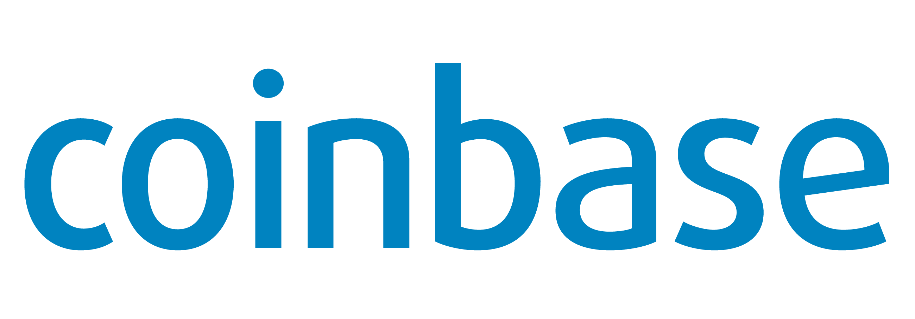
Example tracing
output
transaction
chg
chg.
chg.
chg.
Coinbase knows entity!

Slide 21
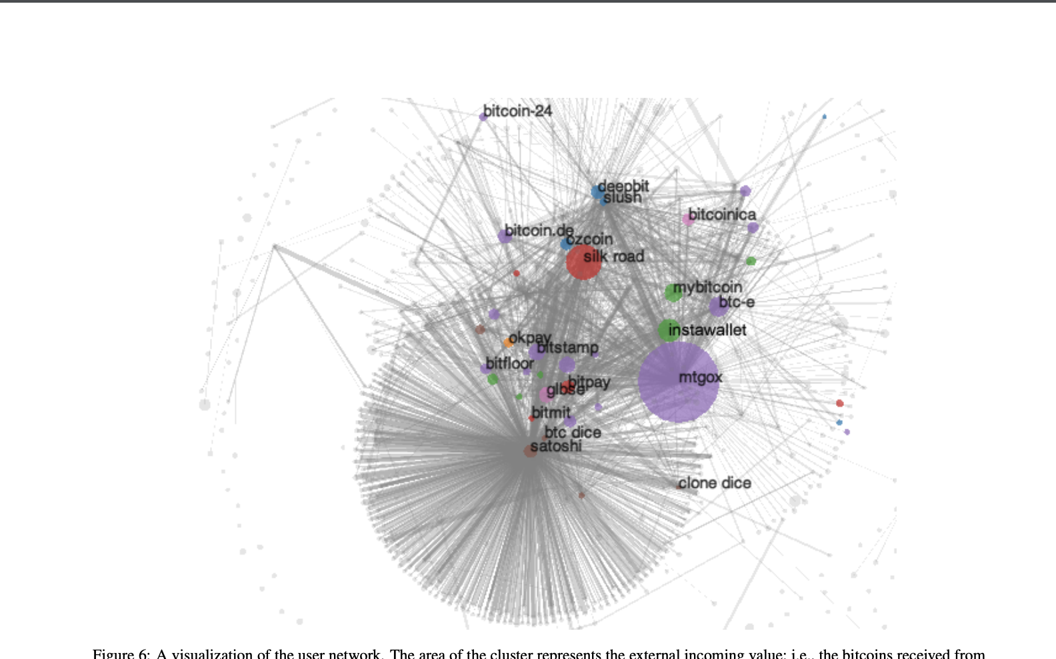
Experiment (2013)
Use Heuristic 1 and 2 -> 3.3M clusters
ID 1070 addreses by interacting with merchants
Coinbase, Bitpay, …
Learn ID of 2200 clusters
1.8M address
15% of total value
Track multiple thefts
Learn total assets for each cluster

Slide 22
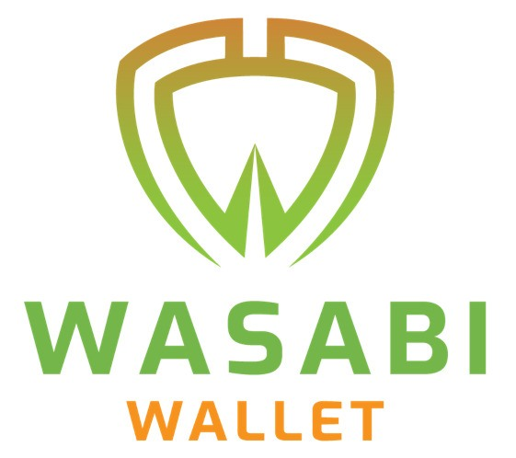
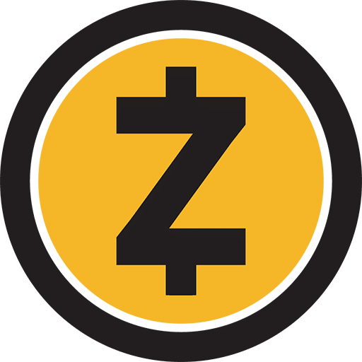
Making Cryptocurrencies anonymous
Mixing
Anonymous cryptocurrencies

Slide 23
Another example
Ins: A1: 1. out: EC1 1
Ins: EC1: 1 out: S: 0.8, EC2: 0.2
Alice and Subcontractor learn EC’s profit margin.
How can we prevent this?

Slide 24
Another example
Ins: A1: 1. out: EC1 1
Ins: EC1: 1 out: S: 0.8, EC2: 0.2
EC has many customers. Mix payments -> use some to pay sub

Slide 25
Mixing
A1 -> M: 1
A2
Mixer
B1 -> M: 1
B2
C2
C1 -> M: 1
TLS
Ins: M: 3 Outs: B2: 1, A2: 1, C2: 1

Slide 26
Mixing Analysis
Outside observer who is A2?
A2 $∈\{Alice, Bob, Carol\}$
For Bob
A2 $∈\{Alice, Bob, Carol\}$
The more the better mixing

Slide 27
Mixer Problems
Mixer can deanonymize
All outputs MUST have same value
If not you can match inputs and outputs
Mixer takes transaction fees
Mixer can steal funds
ScriptPK for all outputs must be the same
Otherwise linkable on spend

Slide 28
CoinJoin (Mixing without Mixer)
CoinJoin TX
Ins: :A1: 5, B1: 3, C1: 2
Outs: B2: 2, A2: 2, C2: 2
Change (not private): A3: 3, B3: 1
Signed: Multisig A1, B1, C1
Out value = min of inputs
Usually ~40 inputs

Slide 29
CoinJoin
Online Forum
A1: 5, A3 (change)
A2 (over Tor)
A1: 5, A3
B1: 3, B3
C1: 2, C3
B2,A2,C2
Add Signatures
Publish Transaction
What if A1 is spent?

Slide 30
Coinjoin drawbacks
Coinjoin still has drawbacks:
Interaction required
Any party can disrupt the process
Anonymity set determined by who is using the service
Transaction amounts public

Slide 31
Cryptonote (Monero)
Cryptonote protocol, proposed in 2012
Enables non interactive coinjoin
Sender can choose anonymity set
Hides amounts
Basis of Monero, Mobile coin, others

Slide 32
Recap Signatures
Def: a signature scheme is a triple of algorithms:
Gen(): outputs a key pair (pk, sk)
Sign(sk, msg) outputs sig. σ
Verify(pk, msg, σ) outputs ‘accept’ or ‘reject’
Secure signatures: (informal)
Adversary who sees signatures on many messages of his choice, cannot forge a signature on a new message.

Slide 33
Linkable Ring Signatures
Def: a signature scheme is a triple of algorithms:
Gen(): outputs a key pair (pk, sk)
RingSign(sk,PKs, msg) outputs sig. σ
Verify(pk, PKs, msg, σ) outputs ‘accept’ or ‘reject’
Link(PKs, msg, σ, PKs’, msg’, σ’) outputs 0 or 1
Secure signatures: (informal)
Unforgeability: Adversary who sees signatures on many messages of his choice, cannot forge a signature on a new message.
Anonymity: Sign(sk_{i},PKs, msg) $≈$ Sign(sk_{j},PKs, msg) for $pk_{i},pk_{j}∈PKs$
Linkability: If a secret key signs two messages, then the signatures can be linked
PKs=$\{pk_{1},pk_{2},…,pk_{n}\}$
pk$∈$PKs

Slide 34
CryptoNote
All UTXOs
Additional Pieces:
Generate PK_{S} without interaction
Make amounts private (next lecture)
PKs subset of UTXOs
Fresh PK_{R}
TX: Inputs PKs , Output: PK_{R}, Signature: Sign(sk, PKs ,TX)

Slide 35
CryptoNote analysis
Sender picks anonymity set
Ring signature provides anonymity in set
The larger the set the better
Still not perfect (e.g. if I know all other PKs in set)
Linkability of ring signatures prevents double spends
Keys can only be used once
Hides amounts (unlike coinjoin)
Fully non interactive

Slide 36
END OF LECTURE
Next lecture:
Zero-knowledge SNARKs

