Slide 1
Recursive SNARKs
CS251 Fall 2020
(cs251.stanford.edu)
Benedikt Bünz

Slide 2

Hitchhikers guide to the galaxy
What if we want to verify that computation?
Input
Output (42)
Long Computation

Slide 3
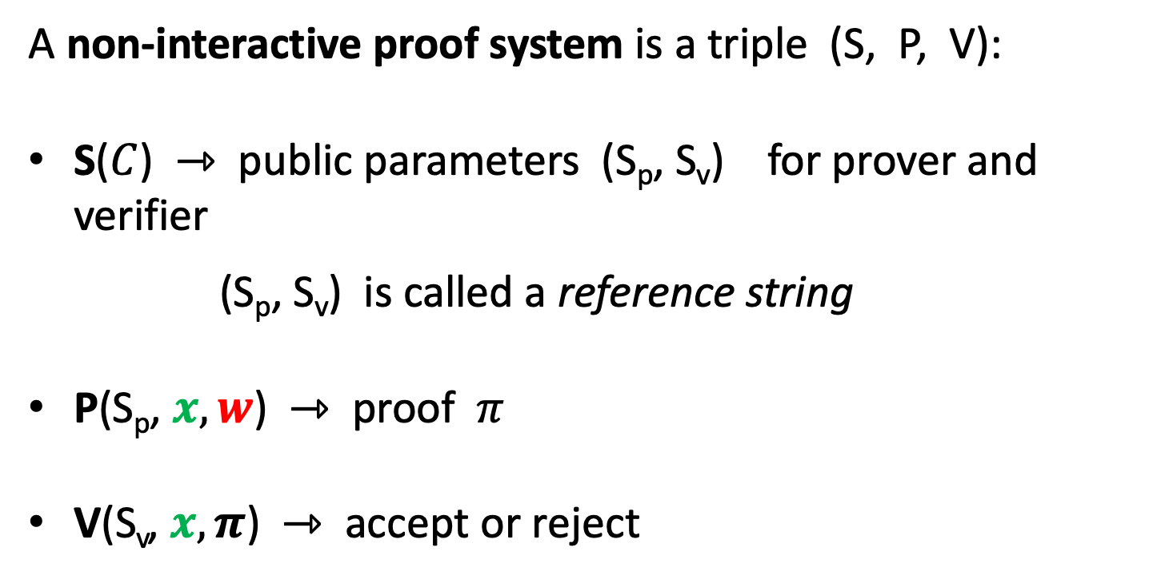
Recap: Non-interactive Proof Systems
A non-interactive proof system is a triple (S, P, V):
S($C$) ⇾ public parameters (S_{p}, S_{v}) for prover and verifier
(S_{p}, S_{v}) is called a reference string
P(S_{p}, $x, w$) ⇾ proof $π$
V(S_{v}, $x, π$) ⇾ accept or reject

Slide 4
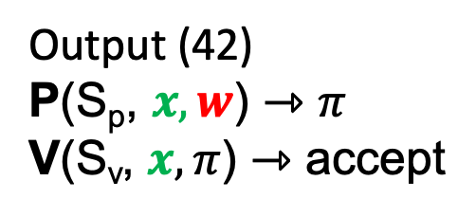
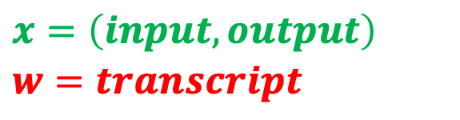
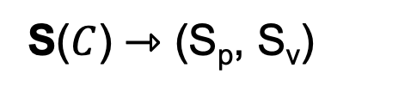
SNARKs for long computations
Issues:
-P takes very long
-Starts after proving after computation finished
-Can’t hand off computation
-S also runs at least linear in |C|
(ok if many proofs)
C – Circuit for long computation
S($C$) ⇾ (S_{p}, S_{v})
$$x=\left(input,output\right)$$
$$w=transcript$$
Input
Output (42)
P(S_{p}, $x,w$) ⇾ $π$
V(S_{v}, $x,π$) ⇾ accept
Long Computation, Transcript

Slide 5
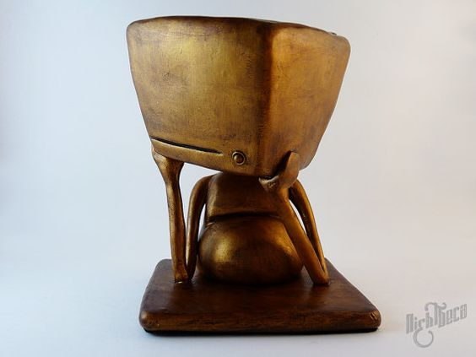
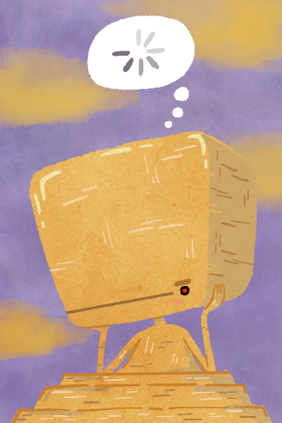
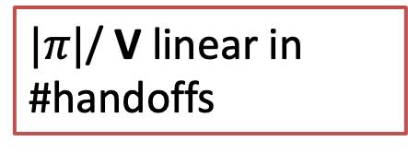
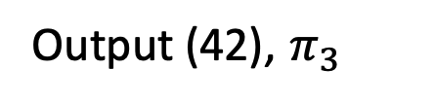

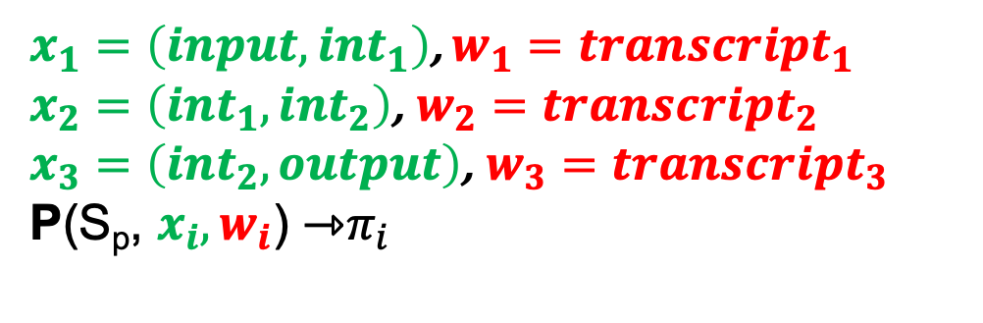
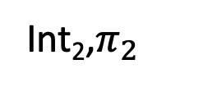
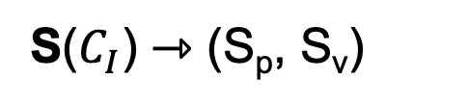
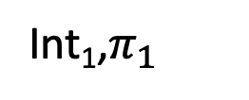
Handing off computation
$C_{I}$– Circuit for long intermediate computation
$x_{1}=\left(input,int_{1}\right)$, $w_{1}=transcript_{1}$
$x_{2}=\left(int_{1},int_{2}\right)$, $w_{2}=transcript_{2}$
$x_{3}=\left(int_{2},output\right)$, $w_{3}=transcript_{3}$
P(S_{p}, $x_{i},w_{i}$) ⇾$π_{i}$
S($C_{I}$) ⇾ (S_{p}, S_{v})
V(S_{v}, $x_{1}, π_{1}$)
V(S_{v}, $x_{2}, π_{2}$)
V(S_{v}, $x_{3}, π_{3}$)
$|π|$/ V linear in #handoffs
Input
Int₁,$π_{1}$
Int₂,$π_{2}$
Output (42), $π_{3}$
transcript₁
transcript₂
transcript₃

Slide 6
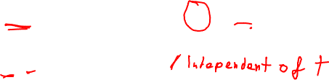
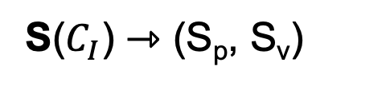
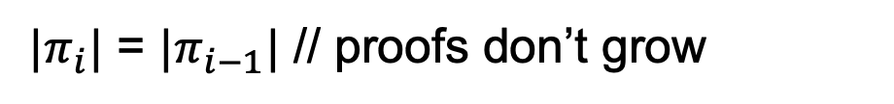
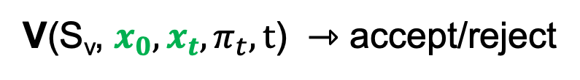
Incremental Proofs
We need updatable/incremental proofs
$C_{I}$– Circuit per computation step, $t$ number of steps/handoffs
S($C_{I}$) ⇾ (S_{p}, S_{v})
P(S_{p}, $x_{i}, w_{i},π_{i−1}$) ⇾ updated proof $π_{i}$ // $π_{0}=⊥$
V(S_{v}, $x_{0},x_{t},π_{t},t$) ⇾ accept/reject
$|π_{i}|$ = $|π_{i−1}|$ // proofs don’t grow

Slide 7
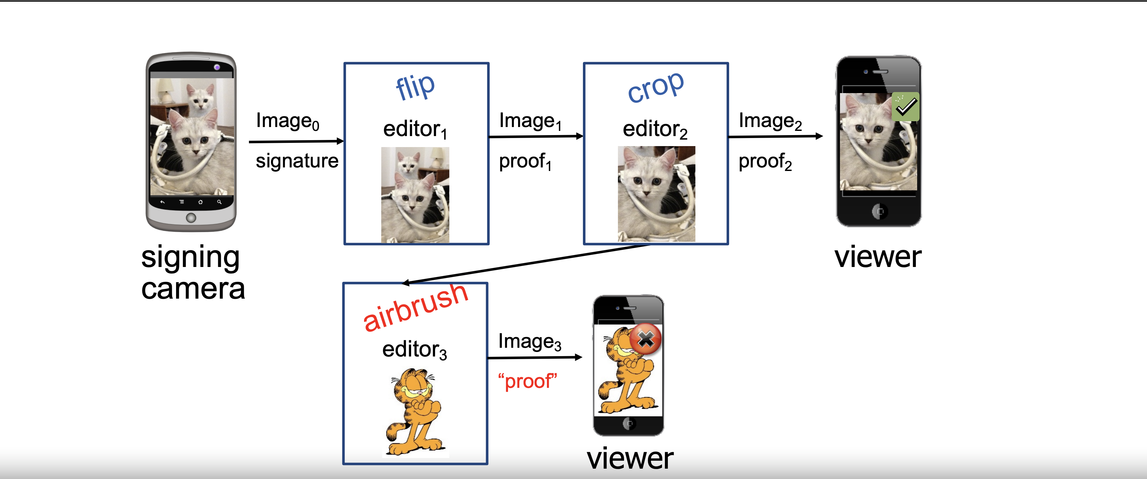
PhotoProof
Viewer can still verify authenticity
Allow valid updates of photo and provide proof

Slide 8
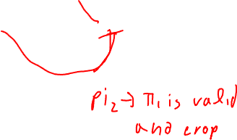
PhotoProof
Proof allows valid edits only, Incrementally updated

Slide 9
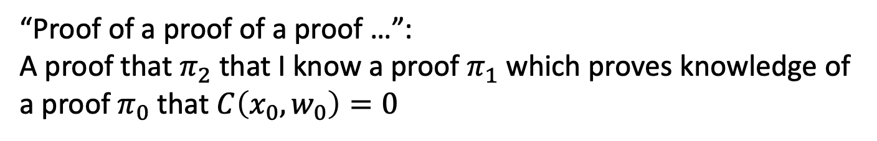
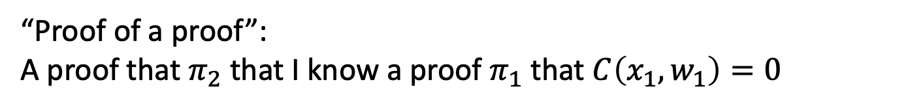
Recursive Proofs
How can we build incremental proofs?
“Proof of a proof”:
A proof that $π_{2}$ that I know a proof $π_{1}$ that $C\left(x_{1},w_{1}\right)=0$
“Proof of a proof of a proof …”:
A proof that $π_{2}$ that I know a proof $π_{1}$ which proves knowledge of a proof $π_{0}$ that $C\left(x_{0},w_{0}\right)=0$

Slide 10
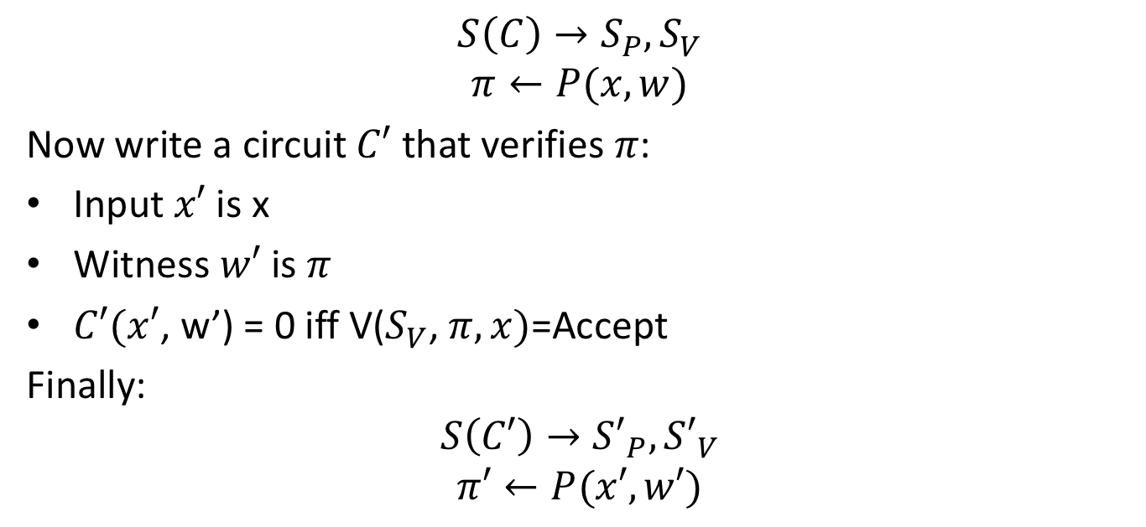
SNARK of SNARK
$$S\left(C\right)→S_{P}, S_{V}$$
$$π←P(x, w)$$
Now write a circuit $C′$ that verifies $π$:
Input $x′$ is x
Witness $w′$ is $π$
$C′(x′$, w’) = 0 iff V($S_{V}$, $π, x)$=Accept
Finally:
$$S\left(C′\right)→{S′}_{P}, {S′}_{V}$$
$$π′←P(x′, w′)$$

Slide 11





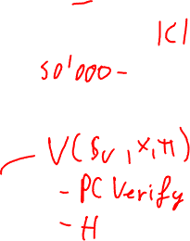


SNARK of SNARK…
Note that C’ depends only on V and S_{v}
We can express V as a circuit:
$$0=“Accept”$$
$$\text{×}$$
$$+$$
$$−$$
$$S_{v}$$
$$x$$
$$π$$

Slide 12


SNARK of SNARK…
We can also make $C′$ more complex…
    Input $x′$ is $x_{0}$, $x_{1}$
    Witness $w^{′}$is $π, w_{1}$
    $C^{′}\left(x^{′},w^{′}\right)=0$ iff $V\left(S_{V}, π, x_{0}\right)=Accept$ AND $C\left(x_{1}, w_{1}\right)=0$

Slide 13
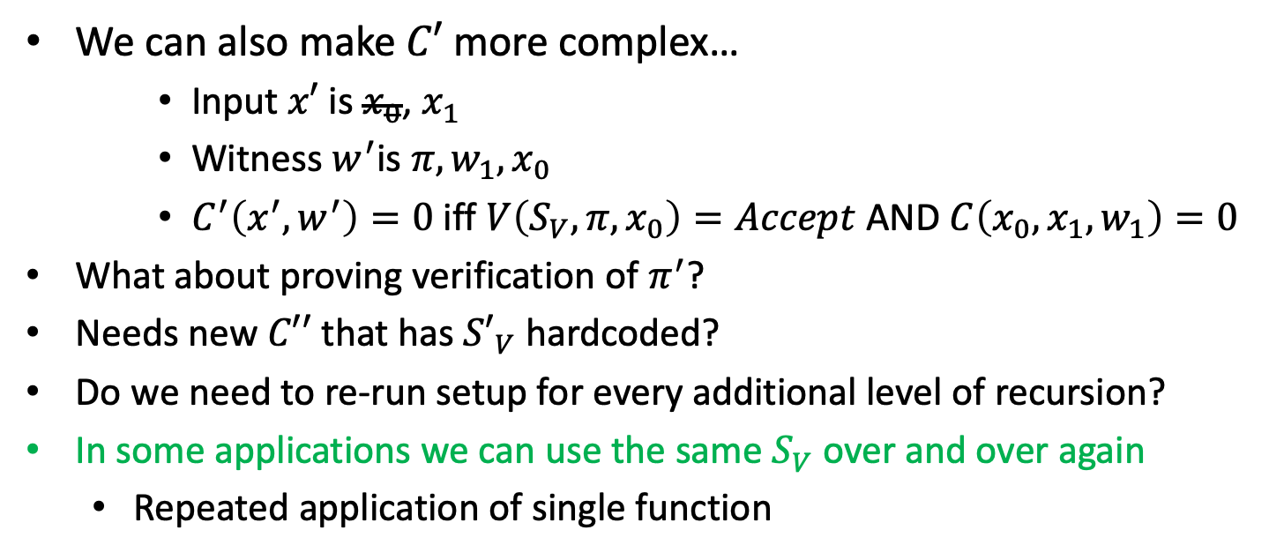
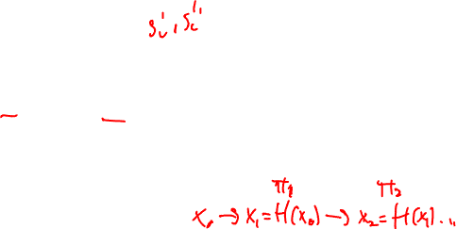
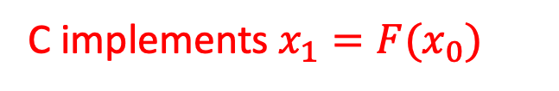
SNARK of SNARK…
We can also make $C′$ more complex…
    Input $x′$ is $x_{0}$, $x_{1}$
    Witness $w^{′}$is $π, w_{1},x_{0}$
    $C^{′}\left(x^{′},w^{′}\right)=0$ iff $V\left(S_{V}, π, x_{0}\right)=Accept$ AND $C\left(x_{0},x_{1}, w_{1}\right)=0$
What about proving verification of $π^{′}$?
Needs new $C′′$ that has ${S′}_{V}$ hardcoded?
Do we need to re-run setup for every additional level of recursion?
In some applications we can use the same $S_{V}$ over and over again
  Repeated application of single function
C implements $x_{1}=F(x_{0})$

Slide 14
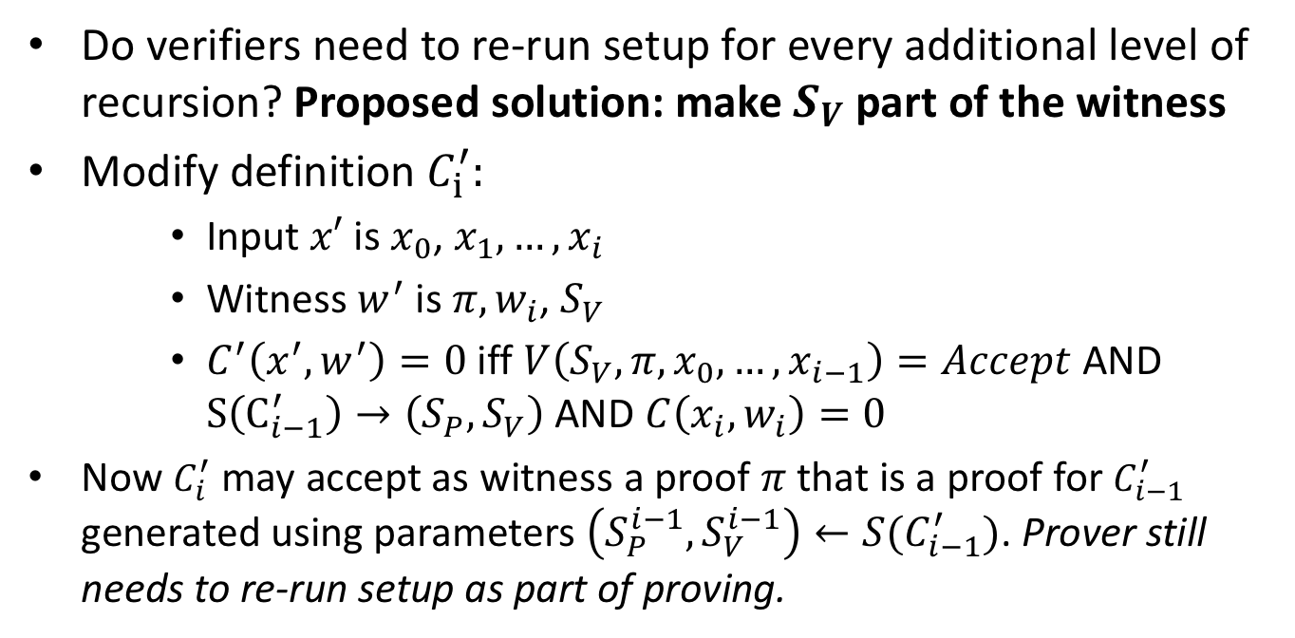

SNARK of SNARK…
Do verifiers need to re-run setup for every additional level of recursion? Proposed solution: make $S_{V}$ part of the witness
Modify definition $C_{i}^{′}:$
    Input $x′$ is $x_{0}$, $x_{1},…,x_{i}$
    Witness $w^{′}$ is $π, w_{i}$, $S_{V}$
    $C^{′}\left(x^{′},w^{′}\right)=0$ iff $V\left(S_{V}, π, x_{0},…,x_{i−1}\right)=Accept$ AND $S\left(C_{i−1}^{′}\right)→\left(S_{P},S_{V}\right) \text{AND} C\left(x_{i}, w_{i}\right)=0$
Now $C_{i}^{′}$ may accept as witness a proof $π$that is a proof for $C_{i−1}^{′}$ generated using parameters $\left(S_{P}^{i−1}, S_{V}^{i−1}\right)←S(C_{i−1}^{′})$. Prover still needs to re-run setup as part of proving.

Slide 15
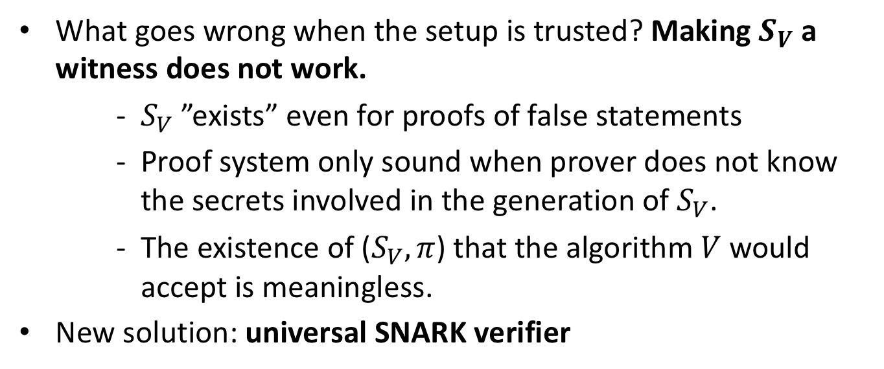
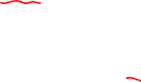
Universal SNARK Verifier
What goes wrong when the setup is trusted? Making $S_{V}$ a witness does not work.
    $S_{V}$ ”exists” even for proofs of false statements
    Proof system only sound when prover does not know the secrets involved in the generation of $S_{V}$.
    The existence of ($S_{V}, π$) that the algorithm $V$ would accept is meaningless.
New solution: universal SNARK verifier

Slide 16
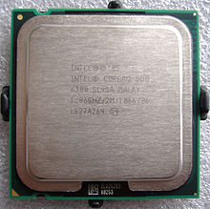
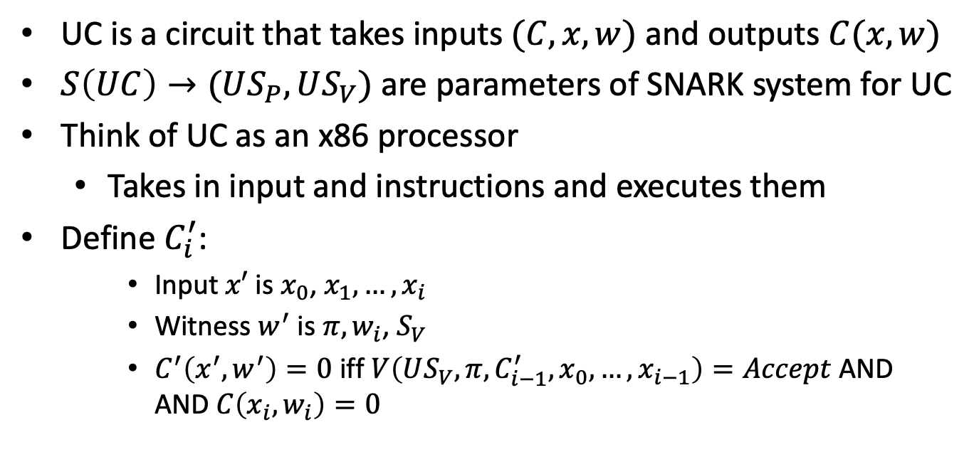
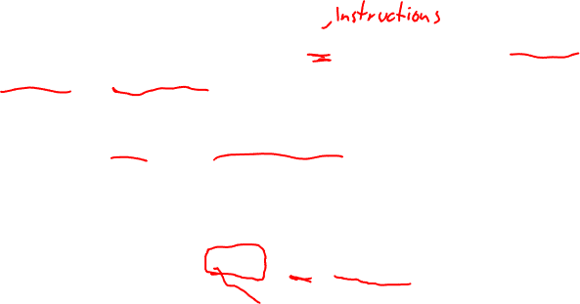
Universal SNARK verifier
UC is a circuit that takes inputs $(C, x, w)$ and outputs $C(x, w)$
$S\left(UC\right)→(US_{P}, US_{V})$are parameters of SNARK system for UC
Think of UC as an x86 processor
  Takes in input and instructions and executes them
Define $C_{i}^{′}$:
    Input $x′$ is $x_{0}$, $x_{1},…,x_{i}$
    Witness $w^{′}$ is $π, w_{i}$, $S_{V}$
    $C^{′}\left(x^{′},w^{′}\right)=0$ iff $V\left(US_{V}, π, {C_{i−1}^{′},x}_{0},…,x_{i−1}\right)=Accept$ AND $\text{AND} C\left(x_{i}, w_{i}\right)=0$

Slide 17
Recap: SNARKRollup
Today: every miner must verify every posted Tx
verify
π
verify
all Tx
verify all Tx
⇒ short proof π
verify
all Tx
verify
π
verify
all Tx
summary, π
Coordinator
verifying proof is much easier than verifying 10K Tx

Slide 18
Recap: Rollup
Today: every miner must verify every posted Tx
verify
π
verify
all Tx
verify all Tx
⇒ short proof π
verify
all Tx
verify
π
verify
all Tx
summary, π
Coordinator
verifying proof is much easier than verifying 10K Tx

Slide 19
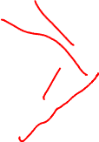
Rollup with many coordinators
verify
π
summary1, π₂
verify
π
verify
π
Coordinator 2
summary, π
summary2, π₁
Coordinator 1

Slide 20
SNARK²-Rollup
Multiple coordinators/servers
Each responsible for subset of users (no overlaps)
Super coordinator (can be one of the coordinators)
Super coordinator combines summaries (balance table) and creates one proof that

Slide 21
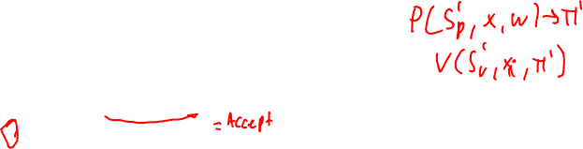

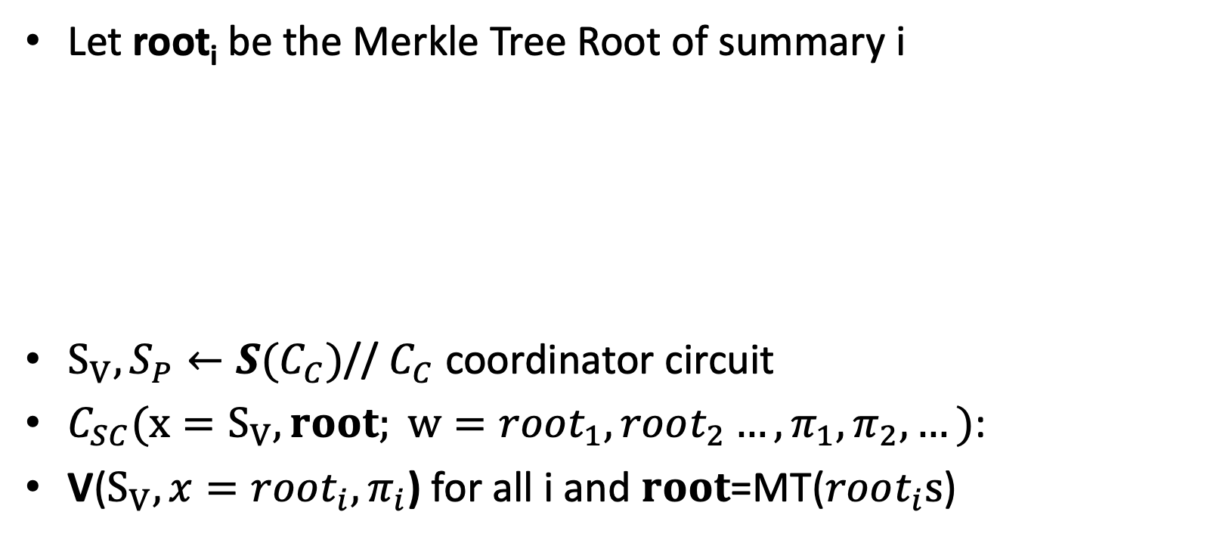



SNARK²-Rollup
Let root_{i} be the Merkle Tree Root of summary i
$S_{V},S_{P}←S(C_{C})$// $C_{C}$ coordinator circuit
$C_{SC}(x=S_{V},root; w=root_{1},root_{2}…, π_{1},π_{2},…)$:
V($S_{V},x=root_{i},π_{i}$) for all i and $root$=MT($root_{i}s$)
root
Merkle tree
Build one root from summaries
$$root1$$
$$root2$$
$$root3$$
$${root}_{4}$$

Slide 22
SNARK²-Rollup
Let root_{i} be the Merkle Tree Root of summary i
$S_{V},S_{P}←S(C_{C})$// $C_{C}$ coordinator circuit
$C_{SC}(x=S_{V},root; w=root_{1},root_{2}…, π_{1},π_{2},…)$:
V($S_{V},x=root_{i},π_{i}$) for all i and $root$=MT($root_{i}s$)
root
Merkle tree
Build one root from summaries
$$root1$$
$$root2$$
$$root3$$
$${root}_{4}$$

Slide 23





SNARK³-Rollup
verify
π
$$π_{tx}$$
summary1, π₂
verify
π
verify
π
$$π_{tx}$$
Coordinator 2
summary, π
$$π_{tx}$$
summary2, π₁
$$π_{tx}$$
Coordinator 1

Slide 24

Enhancing transactions with SNARKs
We’ve seen that private transactions require zero-knowledge proofs
Add ZK-SNARKs to every transaction
Level 1 coordinators verify transaction by verifying transaction ZK-SNARKs
Additionally we can have more complicated transactions (Smart Contracts)
  Transaction verification is constant time regardless of proof complexity

Slide 25
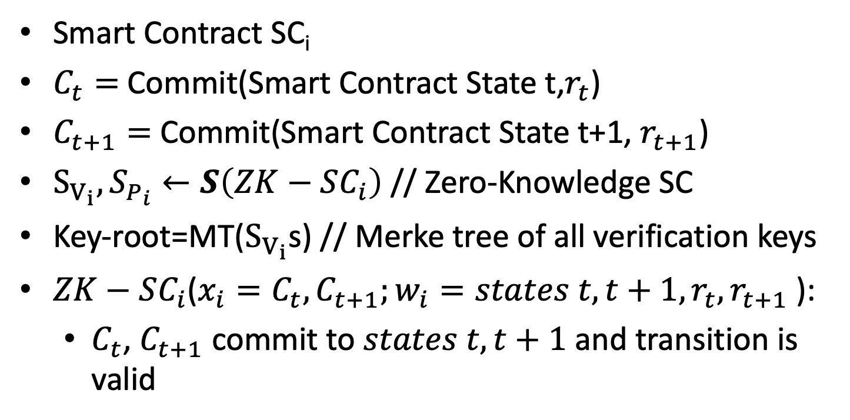
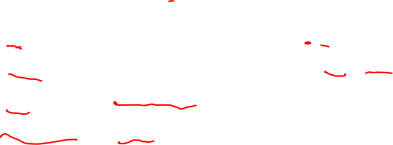
SNARK³-Rollup
Smart Contract SC_{i}
$C_{t}=$ Commit(Smart Contract State t,$r_{t}$)
$C_{t+1}=$ Commit(Smart Contract State t+1, $r_{t+1}$)
$S_{V_{i}},S_{P_{i}}←S\left(ZK−SC_{i}\right)$ // Zero-Knowledge SC
Key-root=MT($S_{V_{i}}$s) // Merke tree of all verification keys
$ZK−SC_{i}$($x_{i}=C_{t},C_{t+1};w_{i}=states t, t+1,r_{t},r_{t+1}$):
  $C_{t}$, $C_{t+1}$ commit to $states t, t+1$ and transition is valid

Slide 26
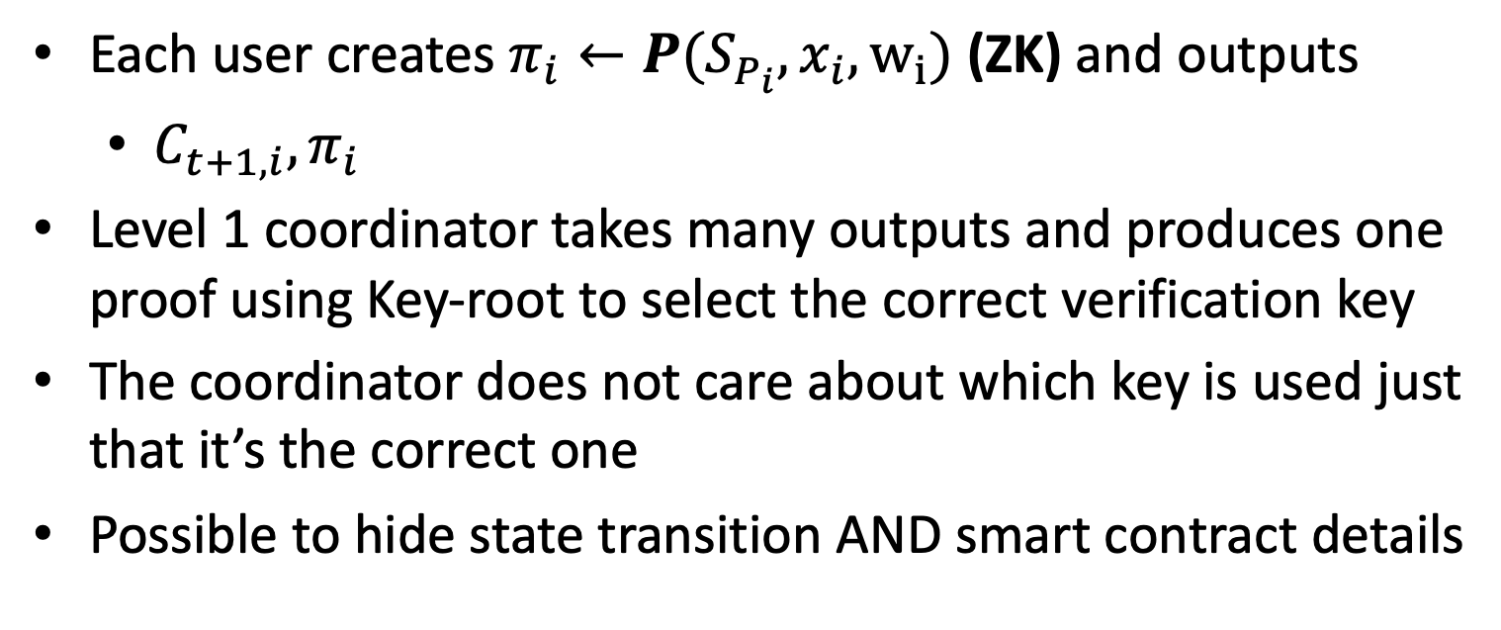
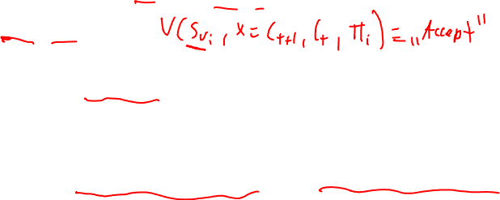
SNARK³-Rollup
Each user creates $π_{i}←P(S_{P_{i}},x_{i},w_{i})$ (ZK) and outputs
  $C_{t+1,i},π_{i}$
Level 1 coordinator takes many outputs and produces one proof using Key-root to select the correct verification key
The coordinator does not care about which key is used just that it’s the correct one
Possible to hide state transition AND smart contract details

Slide 27
Constant size blockchains
Rollup reduces the verification cost
Still linear in the number of state updates
When a node joins the network they need to verify one rollup proof per block!
In general starting a full node requires verification of all blocks
  Can take days!

Slide 28
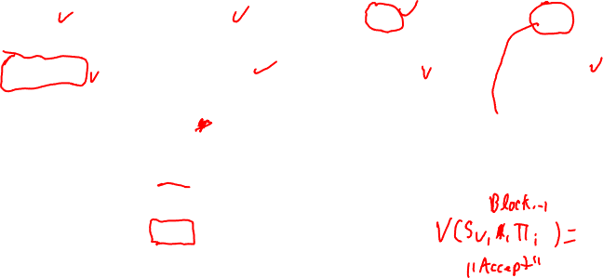
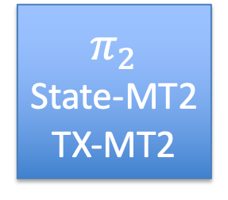
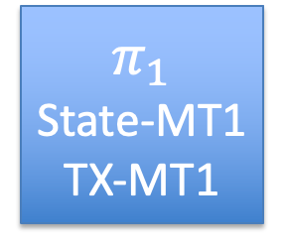
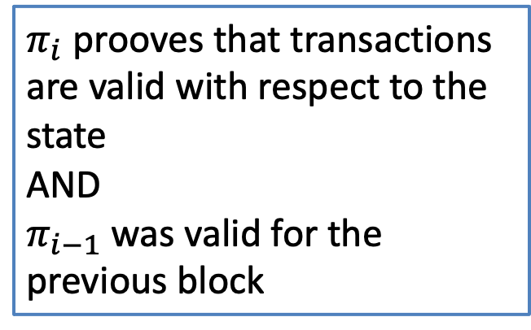
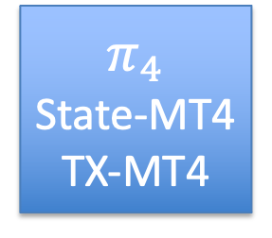
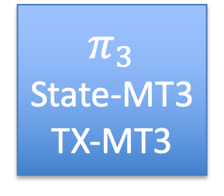
Constant size Blockchain
$$π_{1}$$
State-MT1
TX-MT1
$$π_{2}$$
State-MT2
TX-MT2
$$π_{3}$$
State-MT3
TX-MT3
$$π_{4}$$
State-MT4
TX-MT4
Merkle tree
$π_{i}$ prooves that transactions are valid with respect to the state
AND
$π_{i−1}$ was valid for the previous block
Transactions

Slide 29
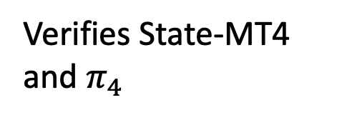
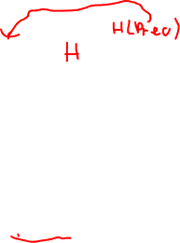
Constant size Blockchain
$$π_{1}$$
State-MT1
TX-MT1
$$π_{2}$$
State-MT2
TX-MT2
$$π_{3}$$
State-MT3
TX-MT3
$$π_{4}$$
State-MT4
TX-MT4
Merkle tree
Old miner
Head and State 4
Transactions
New miner
Verifies State-MT4 and $π_{4}$

Slide 30
Constant size Blockchain
Light clients can verify every block!
  Low memory, low computation
  Independent of length of chain or #transactions
Relies on data serving nodes for synching
Practical today!

Slide 31
END OF LECTURE
Next lecture: Crypto tricks and open discussion
Please attend last two lectures if you can

